Slide 1
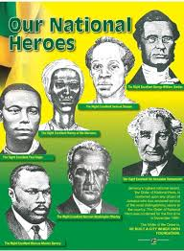
“LOCAL ECONOMIC DEVELOPMENT: AN UNKNOWN EXISTENCE”
Our National Heroes as personifications of LED

Slide 2
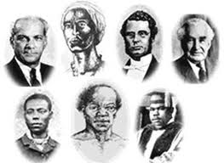
WHAT IS LOCAL ECONOMIC DEVELOPMENT (LED) ?
Sector partners working collectively to create better conditions for economic growth and employment generation.
Local people, making local decisions about local issues.
Participatory – inclusive involving participation of a range of stakeholder interests.
Focuses on birth, growth, development of micro and small businesses.

Slide 3
LED: HOW DID WE GET HERE?
Local Economic Development has always been happening around us; however, LED activities/practices were not sustainable
Has proven to be beneficial to economies around the world (particularly cases in Canada). So those acted as best practices for the Caribbean.
LED became Structured within the context of the National Development Plan (Vision 2030) and a priority of Ministry of Local Government
Local Authorities have been mandated to facilitate the process

Slide 4
CHARACTERISTICS OF LED AS SEEN IN OUR NATIONAL HEROES (see slides 5-11)

Slide 5
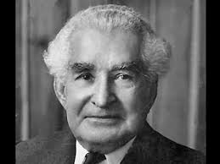
ALEXANDER BUSTAMANTE
Provided leadership (political; social)
Mobilised his immediate and surrounding communities
Worked in partnerships (Trade Unions; other leaders)

Slide 6
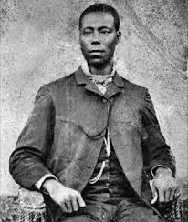
PAUL BOGLE
Mobiliser
Entrepreneur (small/medium land owner)
Formed partnerships (with George William Gordon)

Slide 7
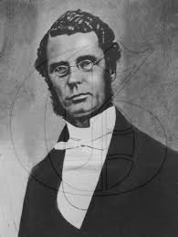
GEORGE WILLIAM GORDON
Provided political leadership; advocate
Entrepreneurial spirit (land owner, shop keeper, produce dealer)

Slide 8
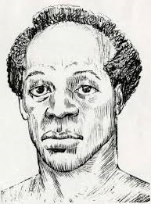
SAM SHARPE
Part of an organisational structure; an organ of a whole system
Also a mobiliser (led uprising)

Slide 9
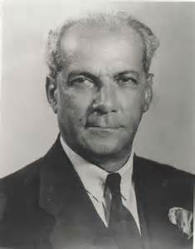
Norman Manley
Mobiliser
Championed the cause for self-sufficiency
Entrepreneur

Slide 10
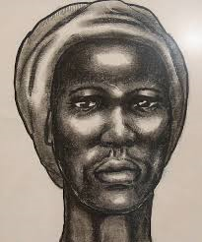
NANNY OF THE MAROONS
Negotiator
Ability to mobilise the efforts of stakeholders at various levels

Slide 11
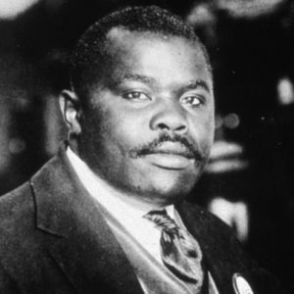
MARCUS GARVEY
Provided political leadership at the local level (KSAC)
Several small businesses
Entrepreneurial spirit (provided employment for many of his disciples)
Established communities of causes (UNIA, etc)
Championed the need to establish enterprises

Slide 12

OUR ROLE AT THE COUNCIL
Creating an ecosystem for the sustainable development of micro and small businesses at the local level (Kingston and St. Andrew)
Planning and Vision of LED (we have to believe that it will happen)
Mobilise and give support to communities (encourage entrepreneurial spirit)

Slide 13

LED REQUIRES THE EFFORTS OF ALL...LET’S MAKE THE COUNCIL AND COUNTRY AN ENABLING ECONOMIC ENVIRONMENT FOR ALL!

