Slide 1
The Latino Donor: Cultural Influences & Research Findings
Victoria Salgado Diggs

Slide 2
WHY IS IT
IMPORTANT?

Slide 3

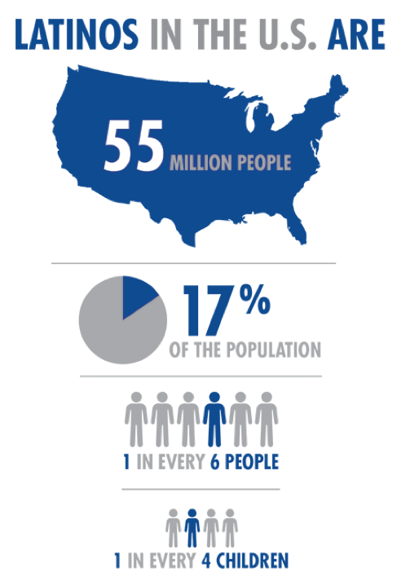
Notes:
- Latinos are the largest and youngest minority group in the United States.
- Only Mexico has a larger Hispanic population than the United States.

Slide 4
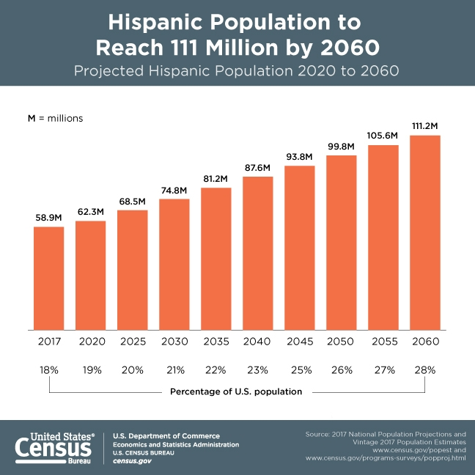
Notes:
- 1 in every 4 people and 1 in every 3 children by 2050.
- As people of color become majorities in communities across America, successful nonprofits will need to have a diverse donor base to sustain and grow.

Slide 5
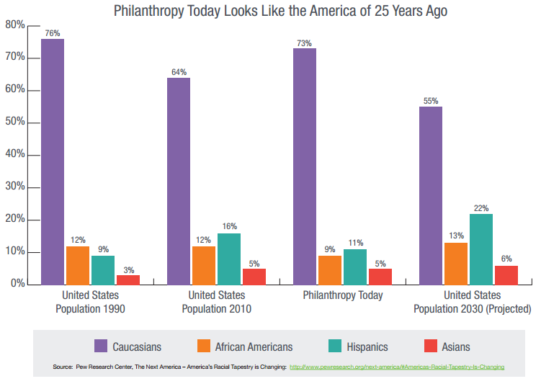
Notes:
Unfortunately in paper it appears that Latinos contributions are lagging as represented by the 2015 Blackbaud: Diversity in Giving report. We will review some of the findings of the Latino donor at the end of my presentation. This Blackbaud study suggests that many nonprofits implement old fundraising tactics, a one size fits all approach that does not take in consideration the unique culture of our diverse immigrant community. Fundraising in the 21st century requires a different approach, one tailored to the interest, values and traditions of many rather than on the interest, values, and traditions of white Americans. Unfortunately, our donor makeup today looks more like the racial and ethnic makeup of America in 1990 with nearly ¾ of donors being Caucasian. How can fundraiser do a better job in engaging the Latino community?

Slide 6
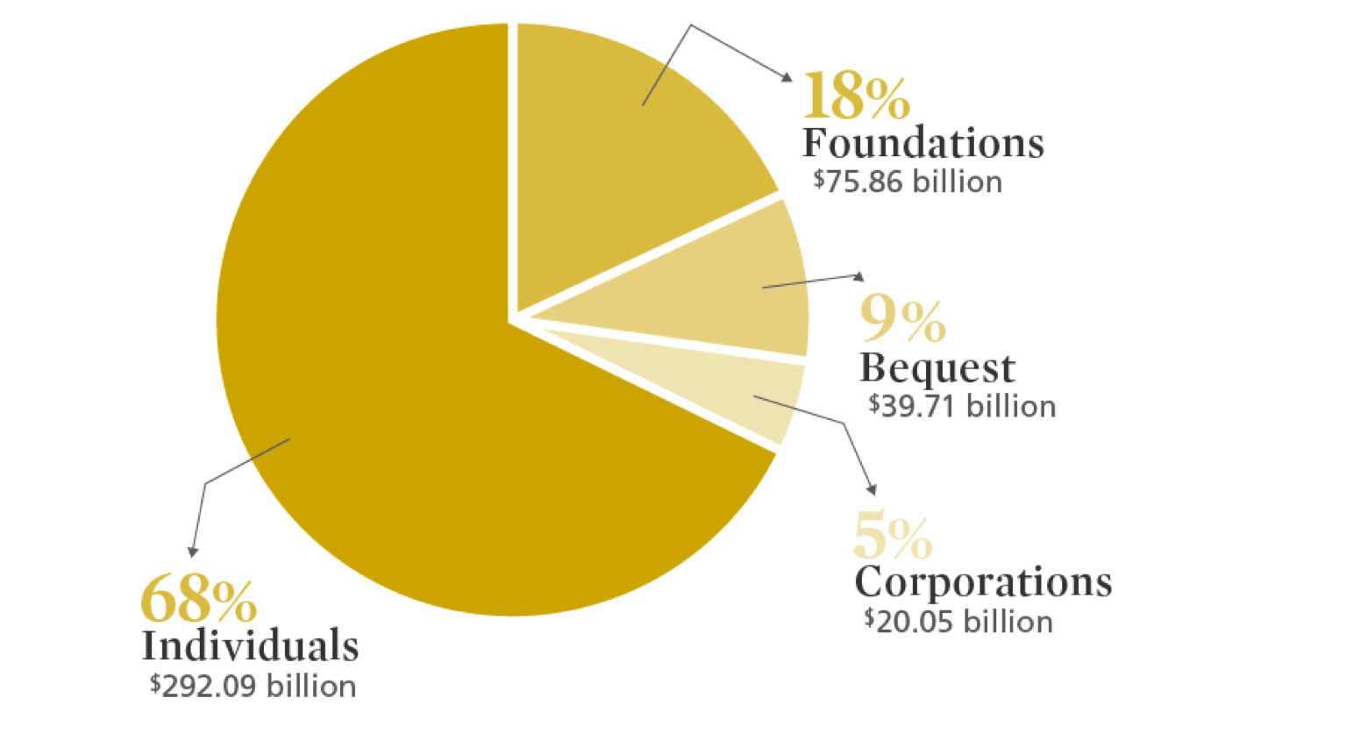
Notes:
According to Giving USA 2019: The Annual Report on Philanthropy, charitable giving in the United States reached $427.71 billion in 2018 and giving by individuals made up 68 percent of total giving.

Slide 7
THOUGHT-PROVOKING FACTS

Slide 8
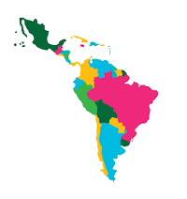
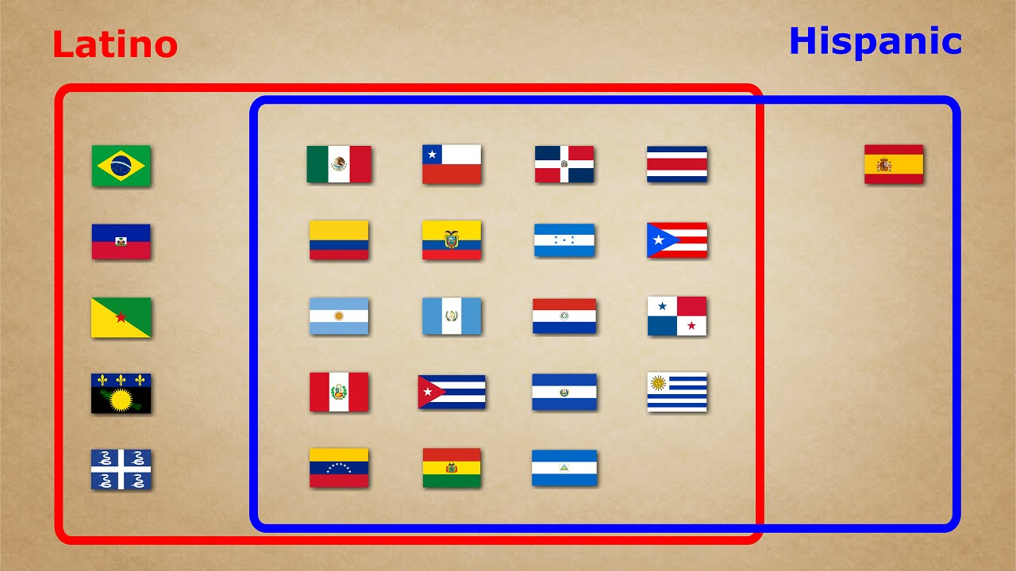
Identity
Brazil
Spain
Haiti
French Guiana
Guadeloupe
Martinique
Hispanic: Term used by the U.S. Bureau of the Census to describe persons in the U.S. who were born in a Spanish-speaking country or who can trace their ancestry to these countries.
Latino: refers to people of Latin America (Central and South America, and the Caribbean Islands).
Latin America: the part of the American continents south of the United States in which Spanish, Portuguese, or French is officially spoken.

Slide 9
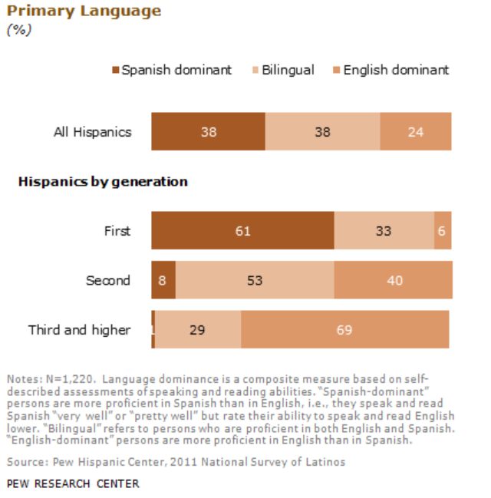
Primary language
Notes:
Dualism of U.S. Latinos straddling two cultures, and many are bilingual.

Slide 10
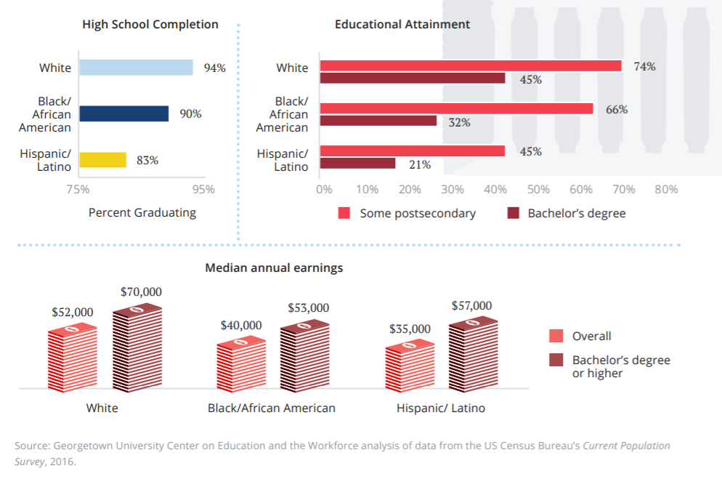
Education & Economic landscape
Notes:
Education, economic status (income) and acculturation are some of the factors influencing Latino’s motivations in giving. The more accultured, higher level of education, and higher socioeconomic status the more likely Latinos are to engage in formal philanthropy.

Slide 11
Entrepreneurs
4.4 Million
Latino owned businesses
Latinos businesses are growing 2.5 times faster than all U.S. businesses.
Latinos account for 1 out of every 5 new entrepreneurs in the U.S.
$700 Billion
Contribution to U.S. economy
Notes:
Another interesting fact is the rate of Latino businesses that are being started each year. According to the Stanford Latino Entrepreneurship initiative in the past 15 years the growth of Latino businesses has doubled, and in some years, tripled the national average. The Latino business community represents billions of dollars in income despite the many constraints and barriers experienced by the Latino community.

Slide 12
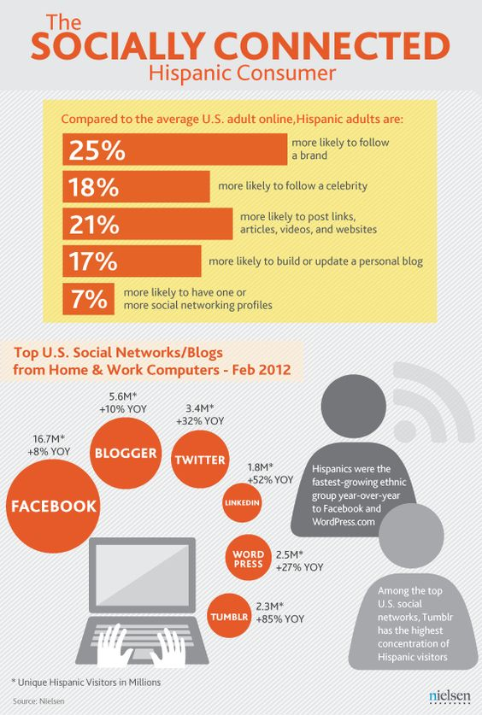




Communication Preferences
Notes:
Direct person-to-person contact is the best way to communicate with Latino Families.
Latinos, especially the younger generation, is increasingly reliant on social media.
Most Latino households still rely primary on traditional media, with preference to TV and radio for information and entertainment.

Slide 13
CULTURAL & HISTORICAL
INFLUENCE

Slide 14
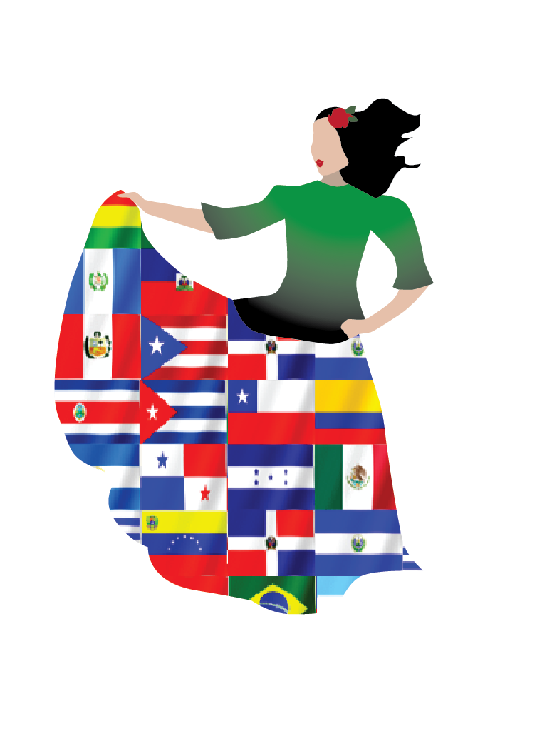
Philanthropy defined
Philanthropy: Goodwill to fellow members of the human race (Merriam Webster).
Formal philanthropy: An organization distributing or supported by funds set aside for humanitarian purposes. Voluntary actions for the public good within the nonprofit sector.
Informal philanthropy: An act or gift done or made for humanitarian purposes. In the Latino culture this is characterized by donations of time, talent and treasure to family, friends and the church.
Notes:
Latino are not “takers” but rather “givers”

Slide 15
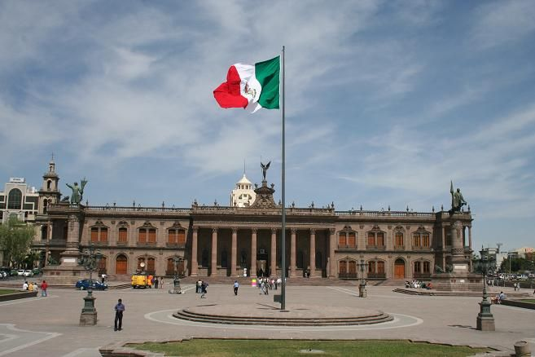
GOVERNMENT
Notes:
Historically in Latino/Hispanic countries the government and the Catholic Church have had a big role in providing social services. This has caused the nonprofit communities in these countries to be weak. A weak non profit sector and many funded by developed nations. Formal charitable giving, like we think of it in the U.S., is an emerging topic among Latino communities.
During the late 18th and throughout the 19th century, many Latino communities emerged in in the U.S. Key factors contributed to the immigration to include: The annexation of Mexican territory and the Mexican revolution. The lack of stable, non-religious traditions and institution in Latin America has meant that many Latinos arrived in the U.S. without the background in organized community-based philanthropy. Nevertheless, three key areas of giving emerged during this time: giving to the Catholic Church, remittances to families back home and mutual aids societies.

Slide 16
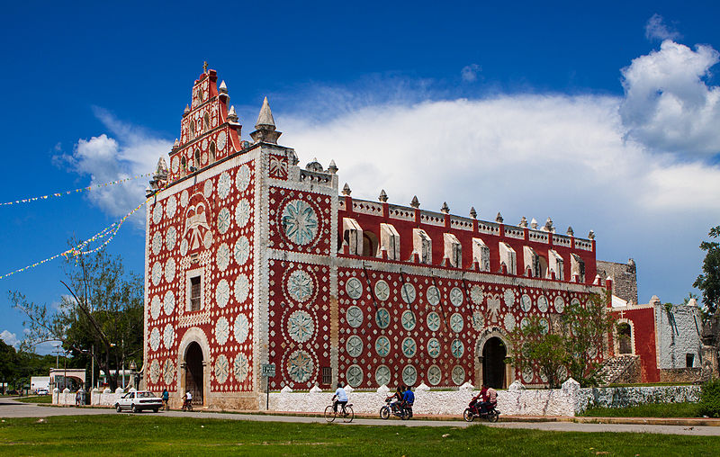
Church
45%
Notes:
GIVING TO THE CATHOLIC CHURCH: Among Latinos that give to charity, 45% give to the church. Giving to the church occupies a special and prominent place for Latinos. The church’s role as a social provider made it the principal vehicle through which individual Latin Americans engaged in charity. Given that Latinos are often portrayed as reluctant donors, the rate of religious giving is indicative of Latino generosity. But then again, the church has a well developed system in place for the “ask”.

Slide 17

Family driven
Notes:
Many argue, and I am one of them, that Latinos give at the same rate as others, however, much of their giving goes not only to their local church but to donations made to family and friends. Charity begins at home, taking care of family, taking care of your own. Its goes without saying that Latinos value family (children, youth and the elderly). Use my mom as an example.

Slide 18
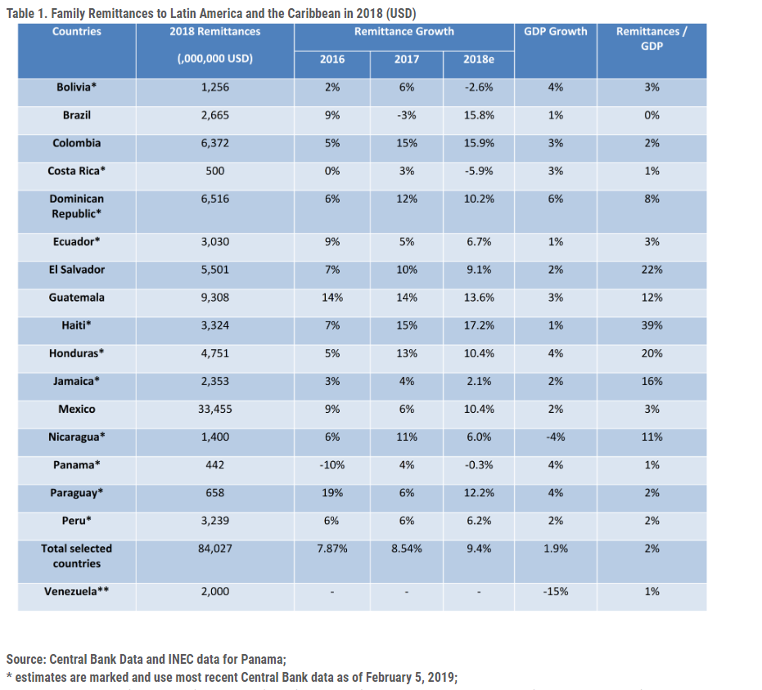




Family driven
Notes:
The amount of remittances sent from the U.S. to Latino America is proof of how much Latinos give to family and friends, to the tune of $86 Billion in 2018. Latinos give to family, friends and church before giving to nonprofits. A network of personal relationships plays in important role in Latino culture. We are not motivated by tax incentives but rather by the cause and the individual who is asking and who has the need.

Slide 19
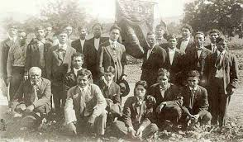
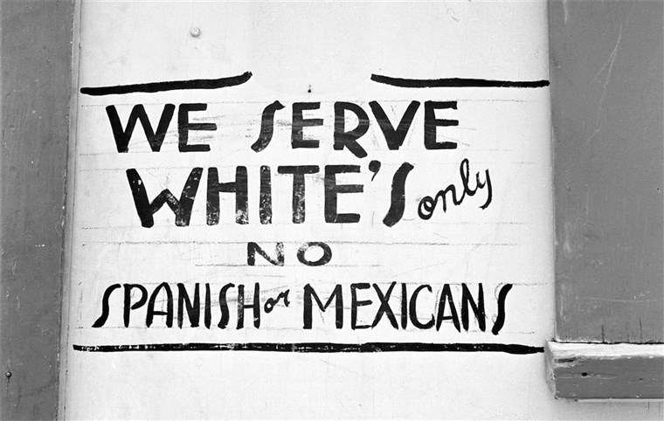
Mutual aid societies
Late 1800’s
Many factors contributed to immigration of Latinos in Texas to include: the annexation of Mexican territory and the Mexican revolution of 1910.
Mutual Aids Societies formed initially to address concerns associated with settling, but they eventually focused on anti-discrimination.

Slide 20
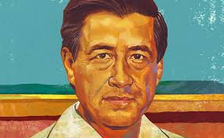
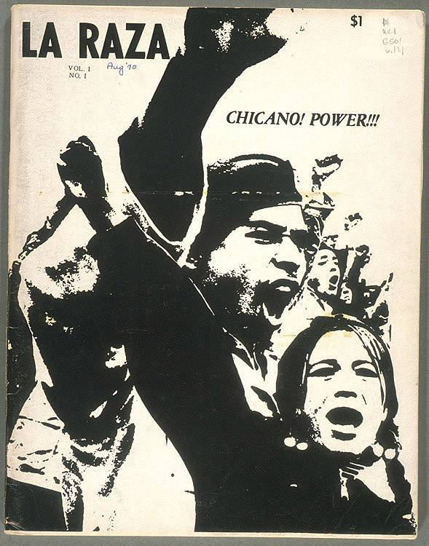


Civil Rights MOVEMENT
1960’s – 1970’s
Notes:
The Civil Rights movement and political mobilization. Cesar Chavez, the National Farm Workers, The Chicano Movement. Hundreds of organizations formed during this period to address a myriad of migrant issues. Many funded by Latinos and government grants.

Slide 21


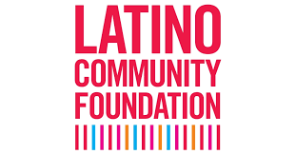

Latino funds
1980’s – Present
Notes:
1981 – President Reagan reduced government spending for social services – Many Latino nonprofits that relied in government grants responded by seeking non-governmental grants or reducing their own budgets. A by-product of the decrease of government support was the creation of Latino-driven funds. The emergence of American style philanthropy in the Latino community. The Hispanic Development Fund of greater Kansas was the first is arguably the most successful. HIP was the first bilingual Latino crowdfunding site focused solely on advancing Latino social impact projects and promoting philanthropy across the Americas. 500 Latin-American Grantmakers and nonprofit leaders committed to increasing philanthropic support of Latino communities and promoting greater participation by Latinos in organized philanthropy. The # of Latino fund has increased dramatically.

Slide 22
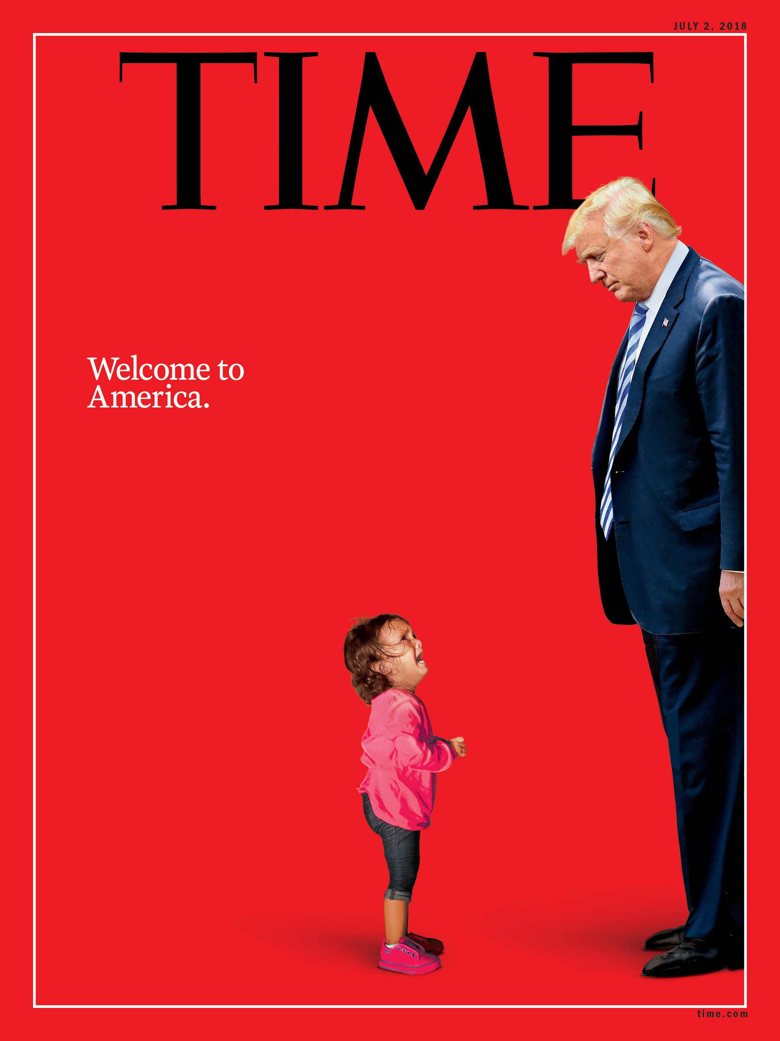

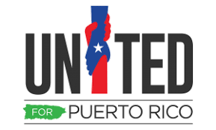


Impulse, TRUST & Identification
Family Separations
Disaster Relief
$20 Million
$38.8 Million
Notes:
Impulse, trust and identification. Latinos give to causes related to children. Latinos give in response to emergency needs in Latin America, Latinos give based on their cultural heritage and personal connections.

Slide 23
RESEARCH FINDINGS

Slide 24
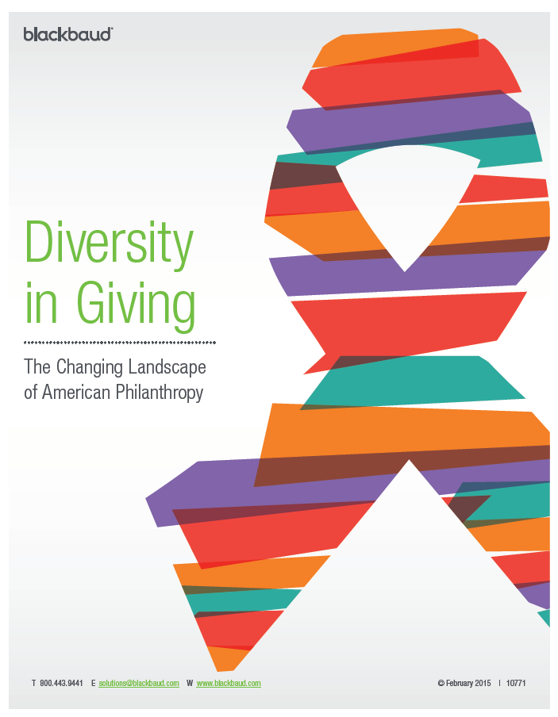
BLACKBAUD STUDY FINDINGS
Notes:
Blackbaud conducted research in 2014 with over 1,096 donors , representative of the U.S. population and the report came out in 2015 named Diversity in Giving, The changing landscape of American Philanthropy.

Slide 25
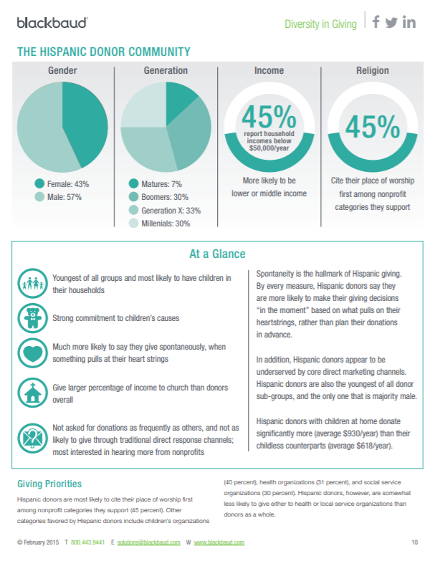
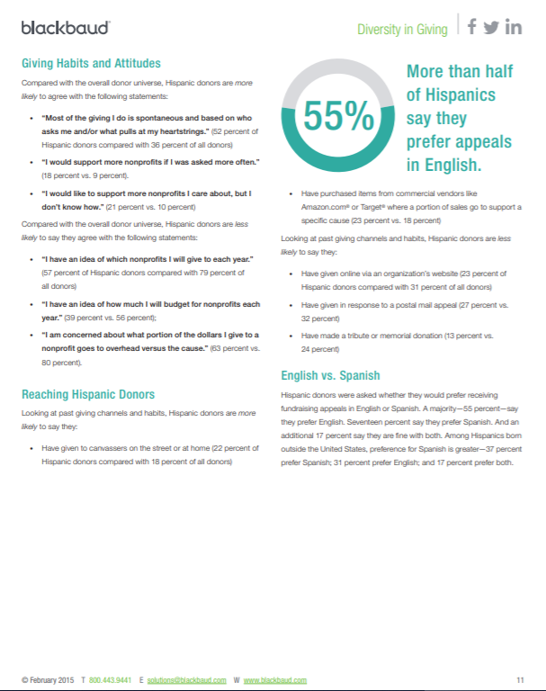
BLACKBAUD STUDY FINDINGS
Notes:
Asians, African Americans and Latinos – 3 pages for Latinos.

Slide 26
BLACKBAUD STUDY FINDINGS
THE LATINO DONOR COMMUNITY
Giving Priorities:
Place of Worship
Children Organizations
Health Organizations
Social Service Organizations
Notes:
The report found that Latino households give primary to places of worship, children’s charities and health. Yet the largest source of Latino philanthropy is informal to individuals, family and Friends, rather than organized philanthropy.

Slide 27
BLACKBAUD STUDY FINDINGS
THE LATINO DONOR COMMUNITY
At a Glance:
Youngest of all donor groups
Strong commitment to children’s causes
Give larger percentage of income to church
Spontaneous givers
Majority male
More likely to be from lower or middle income households
Not asked for donations as frequently as others

Slide 28
BLACKBAUD STUDY FINDINGS
THE LATINO DONOR COMMUNITY
Planned Giving:
Less likely to make a tribute or memorial donation
English vs. Spanish:
Latinos born in the US prefer English appeals, those born abroad prefer Spanish appeals

Slide 29
BLACKBAUD STUDY FINDINGS
ALL DONORS
Overarching Findings:
Despite race or ethnicity the impulse to give is universal
Religion and faith are drivers and indicators of giving
Wealthier individuals donate more in absolute terms than those with mid-level or lower incomes
Notes:
Also, personal relationship are key to giving!

Slide 30
GETTING
STARTED

Slide 31
Recommendations
To Reach and Engage with Latino Donors:
Know your audience: take time to understand the cultural backgrounds and preferences of Latinos in your community
Partner with well-respected community leaders, civic leaders, successful business owners and, if able, partner with a local celebrity
Recruit and train emerging Latino philanthropists to your board and consider starting a young professional board
Hire and develop a diverse internal staff, including your fundraising staff

Slide 32
Recommendations
To Reach and Engage with Latino Donors:
Organize small events and ask Latinos in your community to give
Join well established professional Latino affinity groups
Go bilingual and build on the Latinos value of family
Demystify formal giving, highlight monthly giving plans and take the time to educate the Latino community about the benefits philanthropy could have on their community
Maintain a strong online presence
Feature your organization in TV and Radio.
Notes:
We need to take the time to educate the Latino community about the benefits philanthropy can have in their communities.

Slide 33


