Slide 1
ID Serology Update
Tom Alexander, PhD., D(ABMLI)
Immunology Consultant
Summit Pathology
Summa Health
alexandt@summahealth.org

Slide 2
Yes, The reservation is in the name of Dr. Alexander. May I ask, is that an actual medical degree, or merely a Ph.D.?
Adapted from The New Yorker, 1987

Slide 3
Talk Outline
Serology Principles
COVID Serology
Lyme Serology
Syphilis Serology
CMV Serology
EBV Serology
TB Exposure Testing
Hepatitis Serology
HIV Serology

Slide 4
General ID Testing Guidelines
Serology is an adjunct to organism identification
Serology is useful where culture is slow or has poor yield or when molecular testing isn’t feasible
IgM normally indicates current infection
Mycoplasma IgM or Toxo IgM may last a year or more
Many tests are combination IgG/IgM to increase sensitivity.
Some COVID serology tests
Lyme Disease
HIV

Slide 5
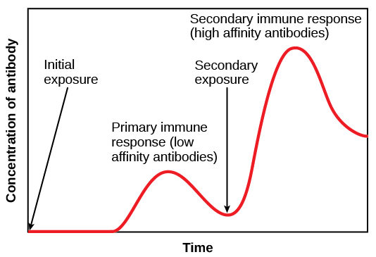

Slide 6
General Guidelines, 2
Acute and convalescent specimens are best for serological diagnosis
Rare in clinical labs
At least 2 weeks between the specimens, 4 is better

Slide 7
Assay Performance Characteristics
Sensitivity- Positive in disease
Specificity- Negative in absence of disease
Positive predictive value- Odds that a positive represents a true positive
Negative predictive value- Odds that a negative represents a true negative
So what is a true positive and a true negative?

Slide 8

Ideal Situation
Negative
Positive
Pos/Neg Cutoff

Slide 9
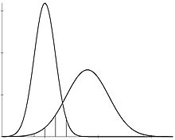
Real Life Where to Place the Cutoff?
True Negatives
Negative
True Positives
Positive
High Sensitivity Cutoff
High Specificity Cutoff

Slide 10
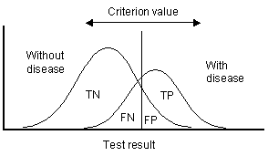

Slide 11
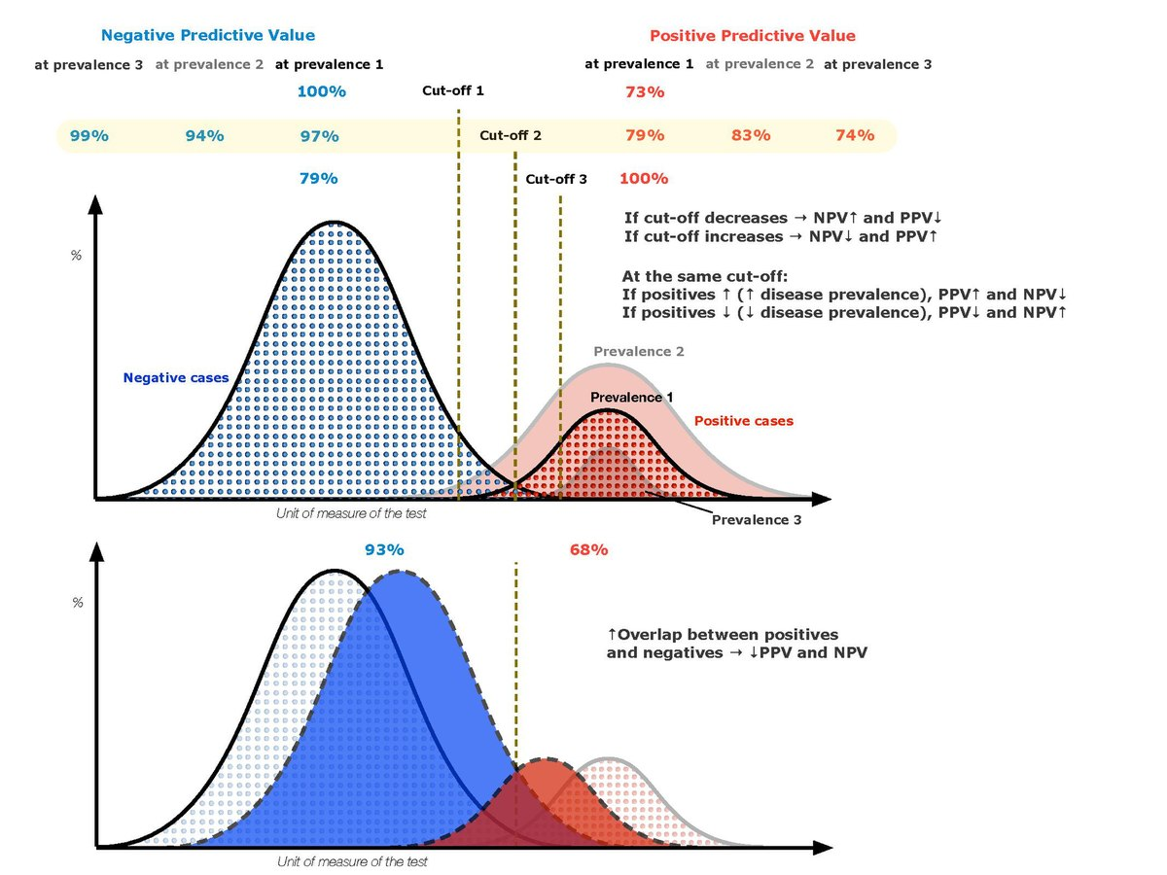

Slide 12
Screening vs Confirmatory
Screening assays
High Sensitivity
High Negative Predictive Value
Rapid, cost is a concern
Confirmatory Assays
High Specificity
High Positive Predictive Value
Time and cost less of a concern

Slide 13
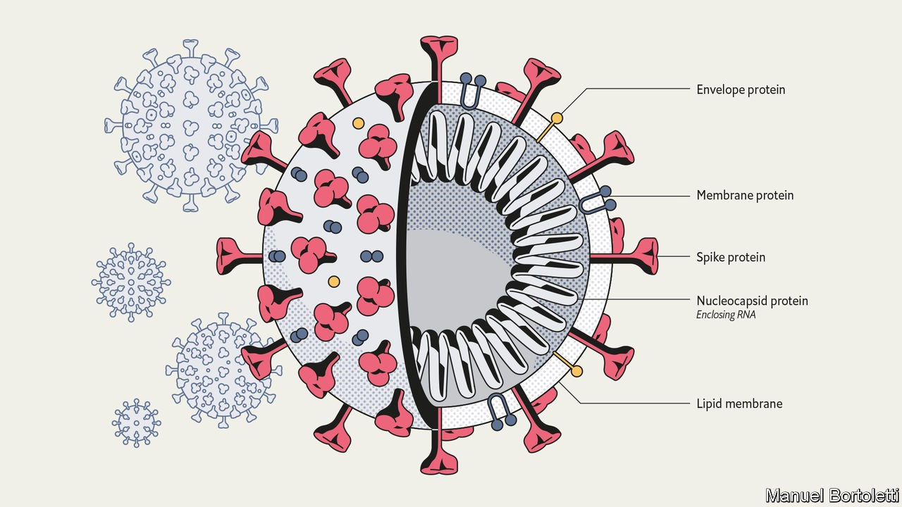

Slide 14
Actual Question brought to me
A patient had two doses of the Pfizer Vaccine
3 weeks after the second dose she was tested for anti- COVID antibody
The result was negative; no antibody detected
Does she need another shot?

Slide 15
Laboratory Testing to Monitor COVID Vaccine Effectiveness
Two types of Antibody tests are available
Anti Spike Protein
Anti Receptor Binding Domain (RBD)
Anti Nucleocapsid Protein
Vaccines induce Anti Spike Protein antibody
Thus to monitor vaccine response one needs to ensure that the test used measures the Anti Spike (RBD) Protein antibody, not the Anti Nucleocapsid Antibody

Slide 16
Case Resolution
The patient had been tested with an anti nucleocapsid antibody test.
The patient was retested with an anti-spike antibody test and was positive.
Thus she had mounted an appropriate antibody response to the vaccine

Slide 17
Lyme Disease
Tick-borne multisystem inflammatory disorder
Can occur at any age or sex
First described in 1910 in Europe by Arvid Afezelius with the Ixodes reduvius tick
Most common vector borne illness in US – >35,000 cases in 2019

Slide 18
Causitive agent
Borrelia burgdorferi
B. burgdorferi sensu stricto – world wide
B. garinii – Eurasian
B. afzelli – Eurasia
Spirochete
PCR demonstrates existence in NA for 100 years

Slide 19
Ohio 2019 Lyme Cases
Confirmed- 388
Probable- 73
Incidence/100,000- 3.3

Slide 20
Lyme Disease Testing
Screen- BioPlex
IgG/M Combination
Positive weeks to months after infection
Sensitivity- 20-30% early, >80% after 4 weeks
CSF Testing- much lower sensitivity
Not recommended unless serum evidence
Western Blot
Confirmatory for Reactive ELISA
5 IgG bands, or 2 IgM bands are required for a positive interpretation
Tick identification- Microbiology

Slide 21
False Positives
Other spirochetes
Rheumatoid arthritis
Systemic Lupus Erythematosus
Spondyloarthritides

Slide 22
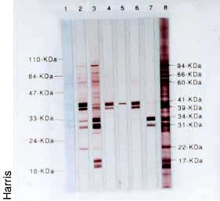
Lyme Disease Western Blot

Slide 23
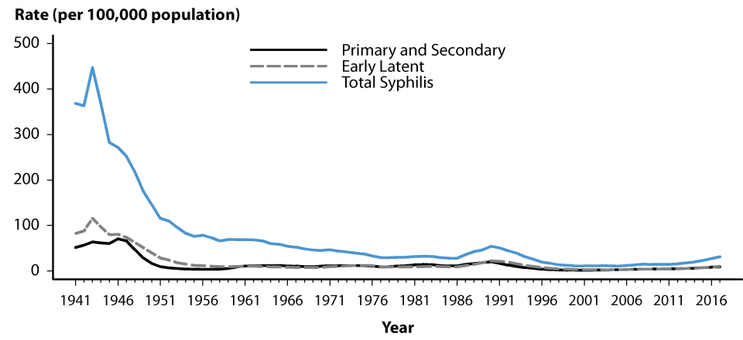
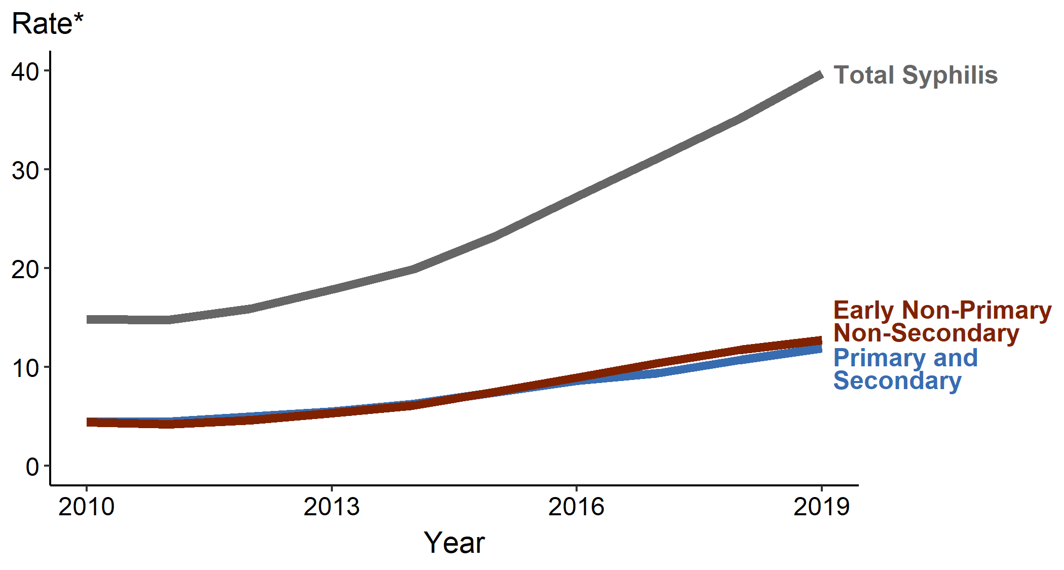
Syphilis Incidence

Slide 24
Syphilis Serology
RPR- Rapid Plasma Reagin
Anti phospholipid (cardiolipin) antibody
Screening test; reactives are titered
May become negative in late stage disease
Will decline (slowly) with successful treatment
Macroscopic test
VDRL- Venereal Disease Research Laboratory Test
Similar to RPR
Flocculation, test with freshly prepared liposomes of cardiolipin, lecithin and cholesterol
Microscopic test

Slide 25
Syphils, confirming tests
FTA-ABS
Immunofluorescent procedure using a non syphilitic strain of t. pallidum to absorb out non specific treponemal antibodies
Non titered
Remains positive in >85% of individuals throughout life
False positives with rheumatic diseases and pregnancy
MHA-TP (TPA, TP-PA)
Hemagglutination or latex agglutination assay with Treponema antigens coupled to red blood cells
May be more specific than FTA; fewer false positives, esp in pregnant women

Slide 26
False Positives Reported with Treponemal Assays
Acute illnesses – hepatitis or other viral infection
Pregnancy
Chronic connective tissue diseases
Malaria
Drug Addiction
Mycoplasma infection
HIV
Lyme disease

Slide 27
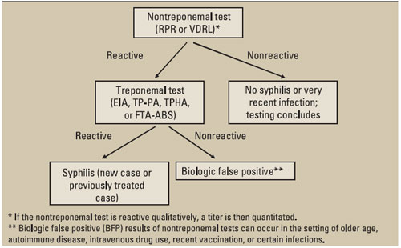
Classic Syphilis Testing Algorithm

Slide 28
ELISA/Chemiluminescent Assays
Treponemal specific antigens
Automated/Semi Automated platforms
High volume testing
Objective interpretation
Screening test
Blood Supply
Reverse Sequence Algorithm

Slide 29
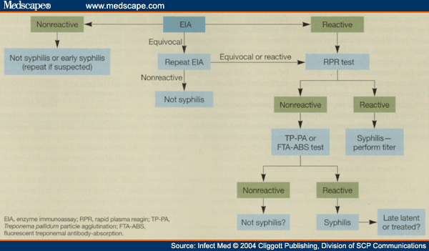
Reverse Sequence Syphilis Algorithm

Slide 30
CDC Recommendations
Traditional screening algorithm is recommended
Reverse sequence may be used
Discordant specimens should be tested using the TP-PA assay

Slide 31
Summa Syphilis Serology
BiopPlex multiplex assay
Both non treponemal; (RPR) and Treponemal results obtained.
Treponemal result only reported for RPR positive specimens

Slide 32
CMV serology
IgG and IgM assays available
IgM may not appear in a reactivation
PCR is available on blood and urine

Slide 33
EBV Serology
Heterophile Antibody
Acute infection
Reacts against SRBC, Horse RBC, Beef Antigens
“Monospot- trade name
Rapid Mono- more appropriate

Slide 34
EBV Panel
IgM Anti Viral Capsid Ag (VCA)
Acute or recent infection
IgG anti VCA- Recent or past infection
IgG anti Early Ag (EA)
Current-past infection
Not overly useful
IgG anti EB Nuclear Ag (EBNA)
Appears app 1-2 months post infection.
Correlates with recovery

Slide 35
TB Testing
PPD Skin test
Single injection
Measure induration only, 48-72 hours later
Positive interpretation depends upon risk factors
>5 X 5 mm- Immunodeficient individual
>10 X 10 mm- Suspect low function
>15 X 15 mm- Normal individuals
“Two Step”
Initial test
If negative at 48-72 hours, repeat the test a week later
Looks for booster effect, increases sensitivity for past exposure

Slide 36
TB- Interferon Gamma Release Assays (Quantiferon)
Stimulate blood with TB antigens
More specific than PPD
Patient only needs to appear once, for blood draw
Assay must be set up within 16 hours of blood collection

Slide 37
TB- Interferon Gamma Release Assays, Methods
Quantiferon in tube plus
Whole blood assay
Differentiates CD4 and CD8 responses
Performed at Summa
T-spot assay
Mononuclear cell separation, supposedly better for immune deficient patients
Our evaluation did not support that claim
No local provider

Slide 38
Hepatitis Testing
Acute Hepatitis Panel (CLIA Approved)
Hepatitis A IgM
Hepatitis B Surface Ag
Hepatitis B Core IgM
Hepatitis C Ab

Slide 39
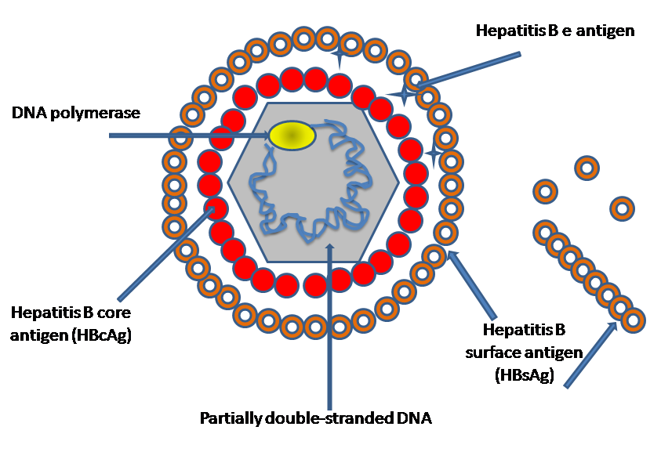
Hepatitis B

Slide 40
Acute Hepatitis B Virus Infection with Recovery
Symptoms
HBeAg
anti-HBe
Titer
Total anti-HBc
HBsAg
IgM anti-HBc
anti-HBs
0
4
8
12
16
20
24
28
32
36
52
100
Weeks after exposure
Notes:
30

Slide 41
Hepatitis Delta
δ antigen
HBsAg
Coinfection
severe acute disease
low risk of chronic infection
Superinfection
usually develop chronic HDV infection
high risk of severe chronic liver disease
RNA
Notes:
19
19
19

Slide 42
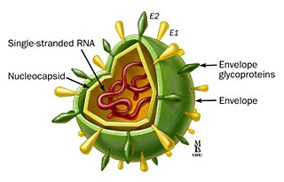
Hepatitis C

Slide 43

Acute HCV Infection with Recovery Serologic Pattern
anti-HCV
Symptoms +/-
HCV RNA
Titer
ALT
Normal
0
1
2
3
4
5
6
1
2
3
4
Months
Years
Time after Exposure

Slide 44
HCV Molecular
HCV Quantitation
Quantitative PCR assay now approved for diagnosis
Assays available with Linear detection limit of 15 IU/ml
Sustained viral response, as measured by viral load, is used to assess treatment efficacy.
HCV Genotyping
Six major genotypes; subtypes of each are known
Genotype 1 is most common in US
1a and 1b subtypes respond differently to some medications
Other Genotypes, e.g. 2, 3, have different responses to different therapies

Slide 45
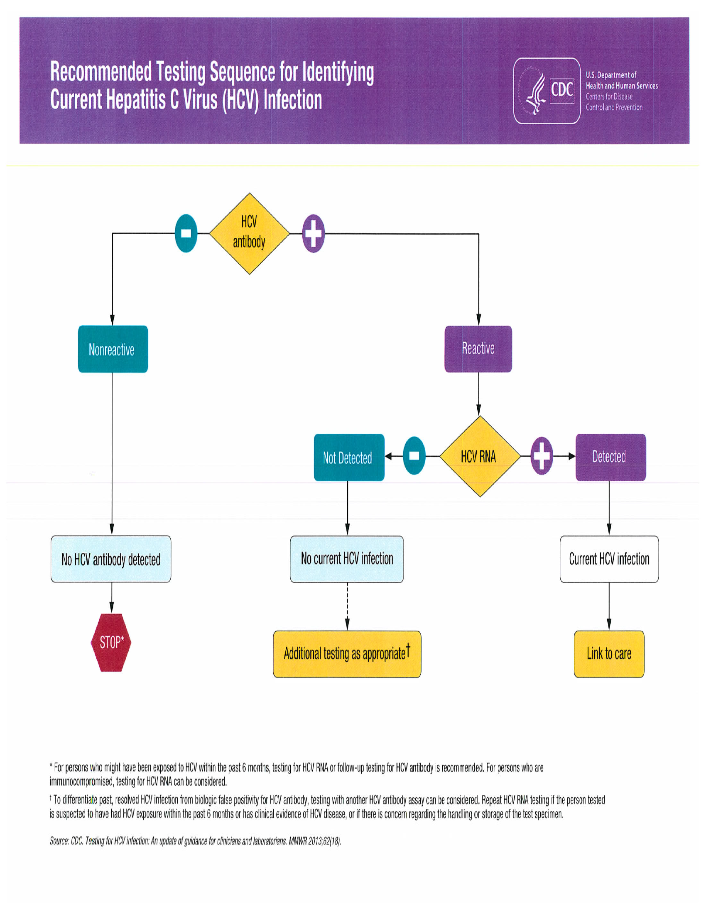

Slide 46
HIV particles

Slide 47
HIV Diagnosis- Antibody Testing
Screening and confirmatory tests
Historically Principle screening method- ELISA
Chemiluminescent and rapid tests methods available
Historically Principle confirmatory method- Western Blot
Newer algorithm deletes western blot- discussed later
Tests available for serum and oral fluid
Combination of screening and confirming assays yields accuracy over 99%
Not useful for neonatal testing as not IgM specific

Slide 48
Detection of HIV by Diagnostic Tests
Symptoms
p24 Antigen
HIV RNA
HIV EIA*
Western blot
0 1 2 3 4 5 6 7 8 9 10
Weeks Since Infection
*3rd generation, IgM-sensitive EIA
*2nd generation EIA
*viral lysate EIA
After Fiebig et al, AIDS 2003; 17(13):1871-9
Notes:
The presence of HIV can be detected using tests that detect HIV directly in the blood, as early as 1-2 weeks after infection. Antibody tests take one to five weeks longer.
The big question is: do people show up for HIV tests during the first few weeks after infection? If not, the question of when different tests detect HIV would be moot. BUT IF THEY DO, we could be missing a lot of HIV infections depending on which test is used.
Although Western blot is considered by many to be the “standard” confirmatory test, it turns positive considerably later than many of the accurate screening tests.

Slide 49
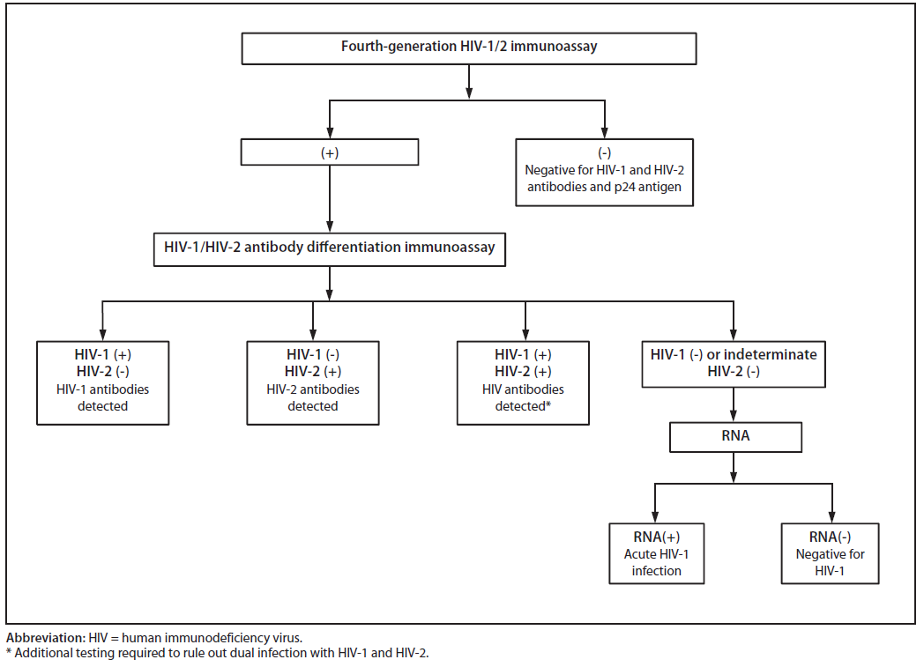
2014 HIV Testing Algorithm
Detection of Acute HIV Infection in Two Evaluations of a New HIV Diagnostic Testing Algorithm — United States, 2011–2013. Morbidity and Mortality Weekly Report. June 2013. Vol. 62 / No. 24. 389-494.
Notes:
These tests are performed on serum or plasma
Nucleic acid test: amplifies viral RNA

Slide 50
HIV 1,2 Differentiation Assay (Geenius)
Rapid HIV 1-2 differentiation; replacing the Multispot
Malloch, et sl., JCV 58 (suppl1), 2013. pp 85-91, Canadian study
N= 289 [181positive (128 HIV-1, 53 HIV-2), 108 negative]
Sensitivity= 100%
Specificity= 96.3%
HIV-1 differentiation= 99.2%
HIV-2 differentiation= 98.1%

Slide 51
If the Geenius is Negative..
Detection of Acute HIV Infection in Two Evaluations of a New HIV Diagnostic Testing Algorithm — United States, 2011–2013. Morbidity and Mortality Weekly Report. June 2013. Vol. 62 / No. 24. 389-494.
Notes:
These tests are performed on serum or plasma
Nucleic acid test: amplifies viral RNA

Slide 52
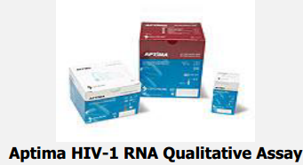
Aptima HIV-1 RNA Qualitative Assay
Detects HIV-1 RNA in plasma/serum
98.5% detection at >/= 30 RNA copies/ml
~100% sensitivity
~99.8% specificity
Notes:
HIV-1 groups M (subtypes A, B, C, D, E, F, G), N, and O are detected

Slide 53

HIV Assay Diagnostic Testing Evolution
Indirect ELISA (HIV-1,2)
Sandwich ELISA
HIV1,2 IgG & IgM
Sandwich ELISA
HIV1,2 IgG & IgM + p24 Ag
Signal
Assay
progression
Y
Ab- conjugate
Y
Y
Ag-conjugate
Patient IgM
Y
Y
Y
Y
Y
Y
Patient IgG
Y
Y
Y
Y
Y
Y
Y
p24
HIV-1
lysate
HIV-2
lysate
HIV
peptide
Y
Y
Year
1985
1987
1991
1997
2015
Generation | 1st | 2nd | 3rd | 4th | 5th
Antigen (Ag) Source | Virus infected cell lysate | Lysate & Recombinant | Recombinant& Synthetic peptides | Recombinant & Synthetic peptides | Recombinant & Synthetic peptides
Specificity | 95-98% | ˃99% | ˃99.5% | 99.5% | 99.5%
Sensitivity | 99% | ˃99.5% | ˃99.5% | ˃99.8% | 100%
Negative window | 8-10 weeks | 4-6 weeks | 2-3 weeks | 2 weeks | 2 weeks
Detects | IgG Anti HIV-1 | IgG Anti HIV-1 and IgG anti HIV-2 | IgG and IgM Anti HIV-1, HIV-2 and Group O | IgG and IgM anti HIV-1, HIV-2 and Group O. Also detects HIV-1 p24 Ag | IgG and IgM anti HIV-1, HIV-2 and Group O. Also detects HIV-1 p24 Ag
Results | Single result | Single result | Single result | Single result; does not differentiate antibody from antigen positivity | Separate HIV-1 and HIV 2 antibody and antigen results
Confirming Tests | HIV-1 western blot (WB) or immunofluorescence (IFA) | HIV-1 WB or IFA, HIV-2 ELISA and WB if HIV-1 confirm is negative | HIV-1 WB or IFA, HIV-2 ELISA and WB if HIV-1 confirm is negative | HIV-1.2 Differentiation Assay followed by qualitative HIV-1 RNA PCR if Differentiation assay is negative | Not Determined at the time of this writing
From: Alexander TS. 2016. Human immunodeficiency virus diagnostic testing: 30 years of evolution. Clin Vaccine Immunol 23:249 –253.

Slide 54
HIV Testing at Summa
Rapid- 4th generation
Standard- 5th generation
Positive are called with the positive result(antigen and/or antibody)
Positives referred for confirmatory Geenius (antibody) or PCR (antigen) testing

Slide 55
Professor, May I please be excused? My brain is full!
Adapted from The Far Side,
Gary Larson, 1985

