Slide 1
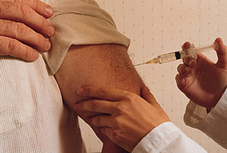
Preventing Infections: Adult Vaccines
Thomas M File, Jr MD MSc MACP FIDSA FCCP
Chair, Infectious Disease Division
Summa Health, Akron, OH;
Professor, Internal Medicine,
Chair, Infectious Disease Section
Northeast Ohio Medical University
Rootstown, OH

Slide 2
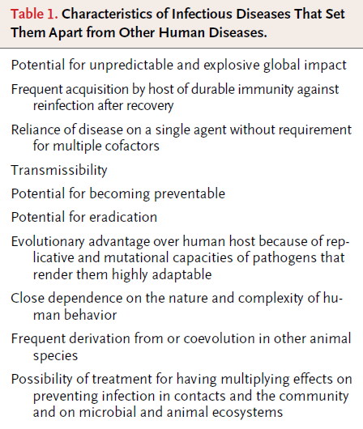
6
NEJM Feb 1, 2012; 366: 454-61

Slide 3
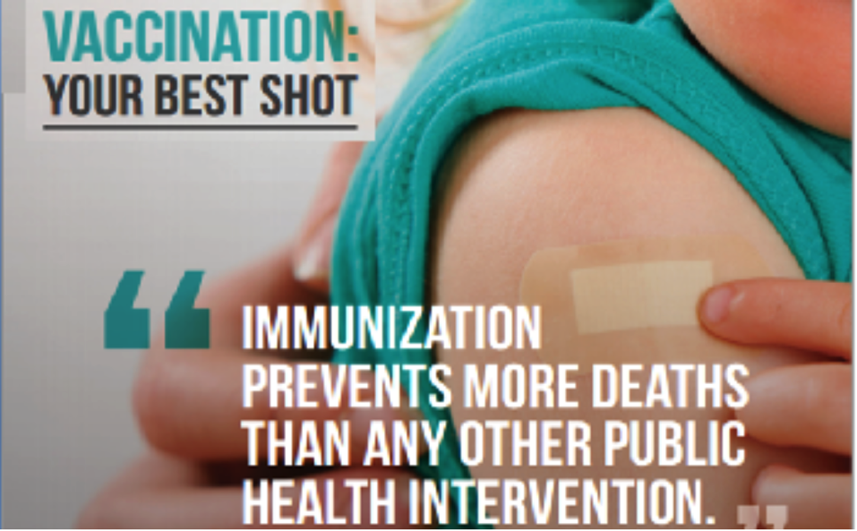
Vaccine evaluation center 2015

Slide 4
Which of the following vaccine -preventable infections causes the most deaths in adults in US?
Pneumococcus
Influenza
Hepatitis B
Papillomavirus
Herpes Zoster

Slide 5
Burden of Vaccine-Adult Preventable Disease in the US
Disease | Annual Burden of Disease, United States
Influenza | 200,000 hospitalizations; 36,000 deaths (> 90% in older adults)
Invasive pneumococcal disease | 44,000 cases, 4500 deaths (higher rates of both in older adults and persons with comorbidities)
Hepatitis B | 51,000 infections (95% adults); 2000-3000 deaths; 1.25 million with chronic HBV infection
Human papillomavirus | 6.2 million new infections (>4000 women die in US annually; ? Male deaths)
Pertussis | 10,454 cases reported in 2007 (3152 adults) Severe illness in infants; often transmitted by older child or adult
Zoster | 1 million cases; risk for shingles and postherpetic neuralgia increases with age
Notes:
Despite the availability of vaccines for adults in the United States, vaccine-preventable diseases still exist and cause a tremendous burden. Older adults are particularly affected by influenza and invasive pneumococcal disease.

Slide 6
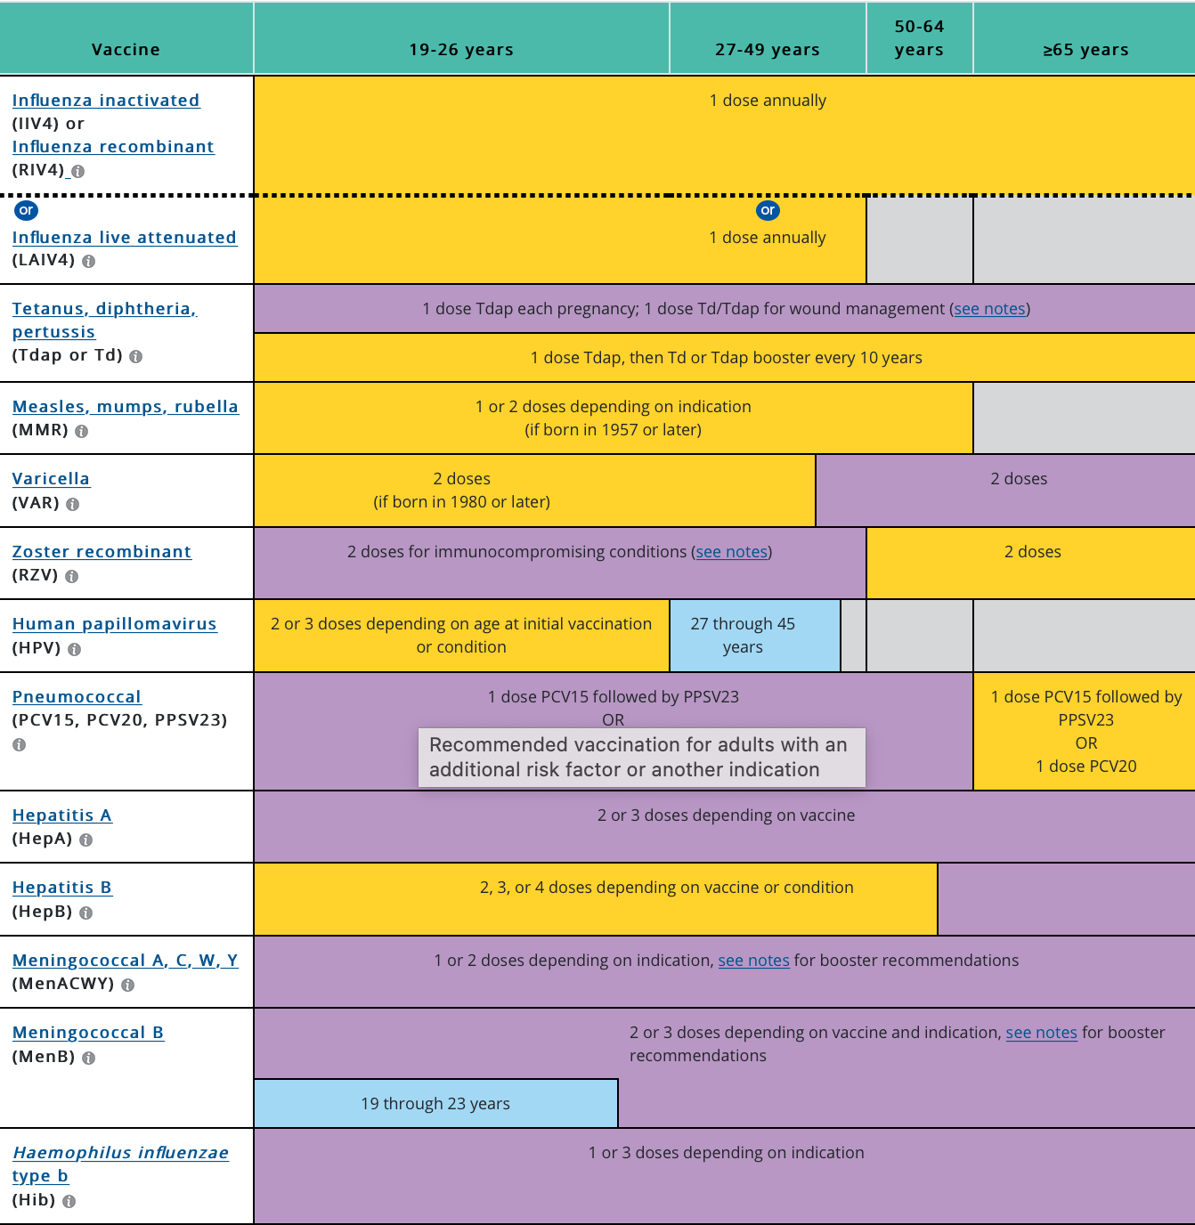
Adult Immunization Schedule: 2022-23

Slide 7
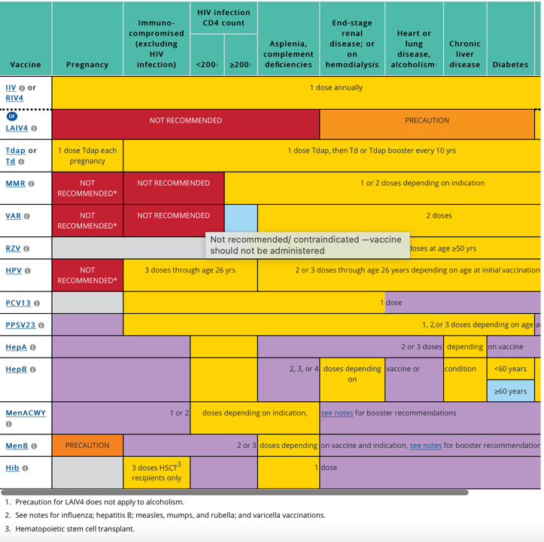

Slide 8
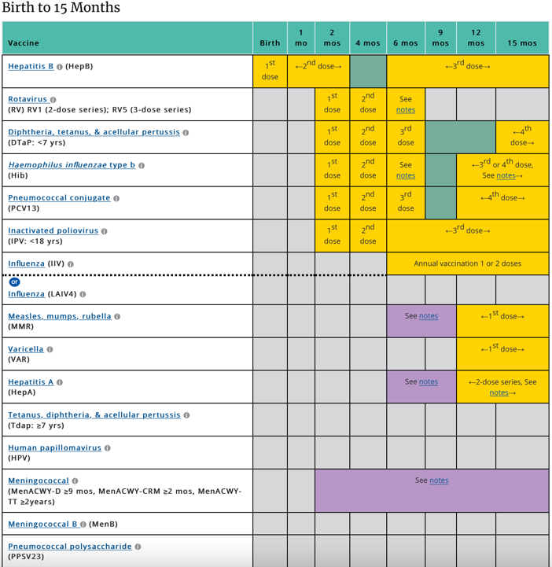
Vaccination Schedule: Birth – 15 months

Slide 9
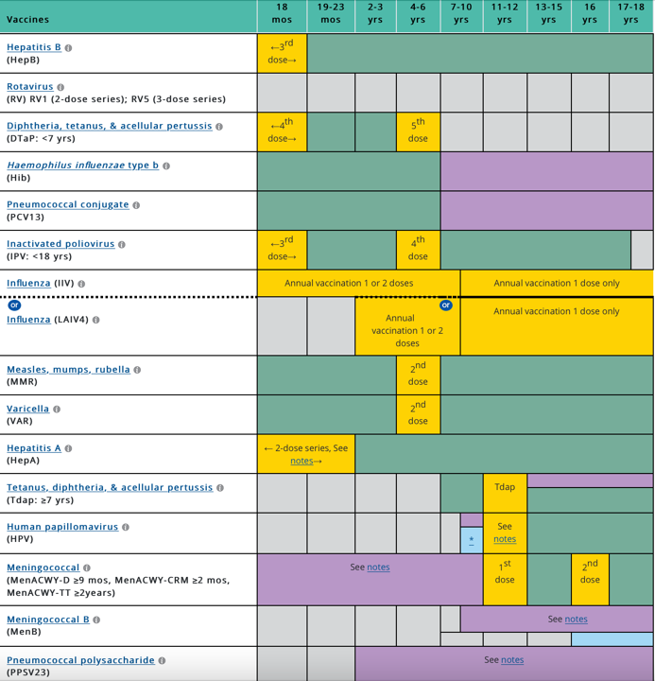
Vaccination Schedule: 16 months-age 18

Slide 10
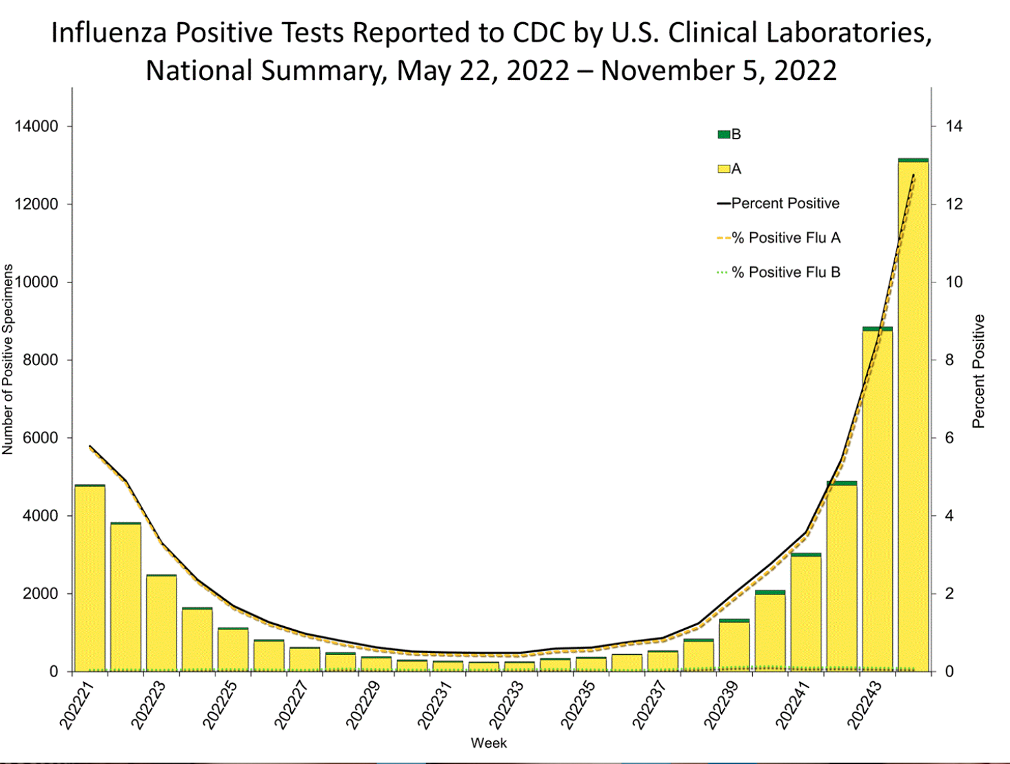
CDC estimates that, so far this season, there have been at least 2.8 million illnesses, 23,000 hospitalizations, and 1,300 deaths from flu.
The cumulative hospitalization rate in the FluSurv-NET system is higher than the rate observed in week 44 during every previous season since 2010-2011.

Slide 11
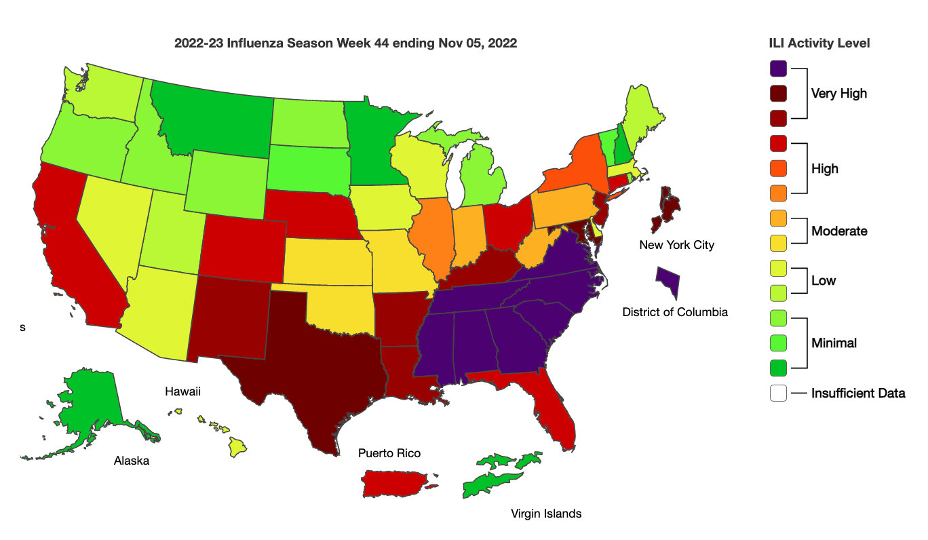

Slide 12
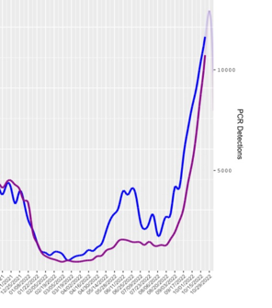
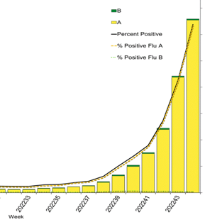
‘”Tripledemic”
RSV INFLUENZA
I
SARS-CoV-2
RSV
FLU

Slide 13
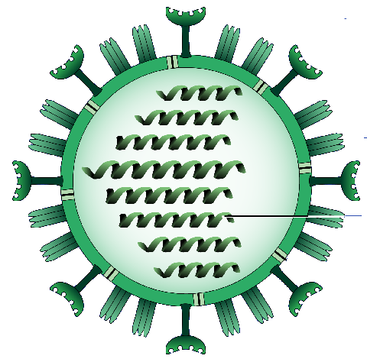
Influenza Surface Proteins
Influenza A genome encodes 2 major surface glycoproteins
16 HA subtypes
9 NA subtypes
All may be found in avian population
Three primarily(H1, H2, H3) in humans
Often change
Drift
Shift
Neuraminidase
Hemagglutinin

Slide 14
INFLUENZA VACCINE-Importance
Influenza may lead to many complications in adults
secondary pneumonia
exacerbation of underlying disease(i.e., chronic lung or heart disease)
High Risk patients: > 65; Chronic Conditions: Pulmonary (including asthma), CV (except hypertension), Renal, Liver, Hematologic, Neurologic, smokers; Immunosuppression (including HIV); Residents of chronic care facilities; Pregnancy; Children < 19 on aspirin; Obesity
Influenza virus changes antigens over time; patients may therefore, not be immune because of prior exposure
Efficacy
Depends on: 1. Immunogenicity; 2. Serotype match
Recently varied 20-60% pending patient type
Can be given at SAME time as pneumococcal vaccine

Slide 15
The Influenza Vaccine for 2022-2023 contains the same Influenza A and B strains as the 2021-2022 vaccine
A Yes
B NO

Slide 16
_{2022/23 U.S. Influenza Vaccine} _{Composition}
Egg-based vaccine composition recommendations:
an A/Victoria/2570/2019 (H1N1) pdm09-like virus*;
an A/Cambodia/e0826360/2020 (H3N2)-like virus*;
a B/Washington/02/2019- like virus (B/Victoria lineage);
a B/Phuket/3073/2013-like virus (B/Yamagata lineage)
Cell- or recombinant-based vaccine composition recommendations:
an A/Wisconsin/588/2019 (H1N1) pdm09-like virus*;
an A/Cambodia/e0826360/2020 (H3N2)-like virus*;
a B/Washington/02/2019- like virus (B/Victoria lineage);
a B/Phuket/3073/2013-like virus (B/Yamagata lineage).
* Change from last year

Slide 17
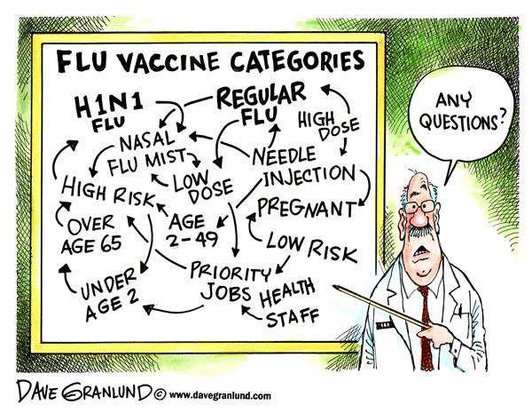

Slide 18
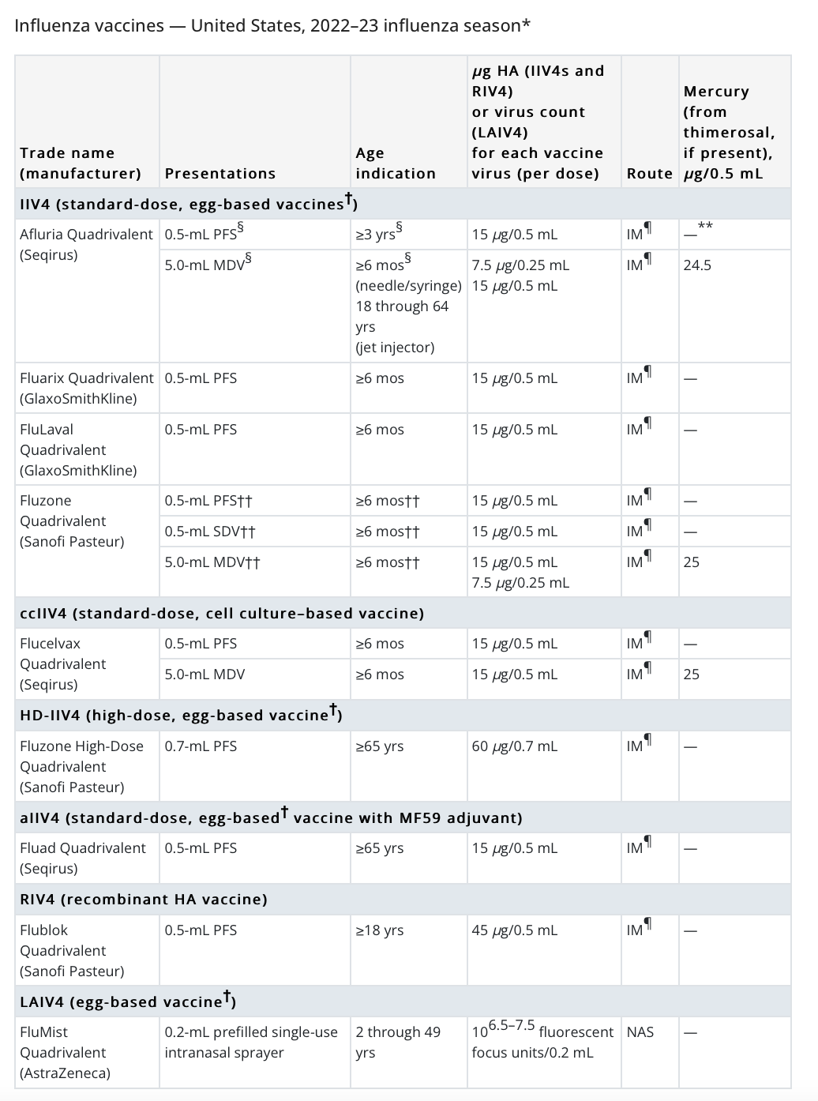
Source: CDC

Slide 19
Influenza Vaccine: Specific Uses
Age ≥ 65—High dose or with Adjuvant-associated with better protection for older population than standard dose vaccine
Hives with eggs-OK to use egg-based since very low egg exposure and evidence indicates OK to use, but CDC suggests observe for short time
Severe Egg allergy (anaphylaxis)-Recombinant (has no egg protein); Not necessarily the cell culture-based vaccine which used a reference strain obtained from virus originally grown in eggs

Slide 20
Case Exercise 1 Which vaccine for:
A 67-year-old man with type 2 diabetes mellitus and no history of egg allergy?
IIV4, standard
IIV4 high-dose (Fluzone High-Dose)
IIV4 (Flublok; recombinant)
Nasal LAIV4 (Flumist)

Slide 21
Influenza Vaccine High Dose
IIV3, high-dose (Fluzone® High-Dose)
Contains 60 mcg each of the 3 influenza antigens (compared to 15 mcg each for regular IIV3)
Slightly higher rate of MILD reactions
Indications: Patients ≥65 years.
Clinical trial had shown high-dose vaccine was 24.2% more effective in preventing influenza in adults ≥65 than the standard vaccine.
ANOTHER STUDY (CDC March 2017): High Dose associated with 38% reduction in mortality
Fluzone High-Dose (Influenza Vaccine) Prescribing Information. Sanofi Pasteur Inc. Swiftwater, PA. June 2016.
1. DiazGranados CA, et al. N Engl J Med. 2014;371:635-45.; 2.

Slide 22
Influenza Vaccine Adjuvanted Vaccine
aIIV4, adjuvanted vaccine (Fluad™)
Trivalent inactivated influenza vaccine plus a proprietary adjuvant that recruits immune cells at the site of injection and enhances antigen uptake
Results in greater immunogenic response in elderly patients
Indication: Patients ≥65 years.
Clinical trials show higher antibody titers and reduced illness than with standard dose vaccine
Fluad™ (influenza vaccine, adjuvanted) Prescribing Information. Sequiris, Inc., Holly Springs, NC. March 2016.

Slide 23
Case Exercise 2 Which vaccine for:
A 19-year-old with history of severe allergic reaction (i.e., respiratory distress) to eggs?
IIV4, standard
aIIV4 (Fluad)
RIV4 (Flublok)
No vaccine/refer to specialist

Slide 24
Influenza Vaccine in Egg Allergies Cell-Cultured and Recombinant Vaccines
ccIIV4 (Flucelvax® Quadrivalent)
In place of chicken eggs, uses animal cells (Canine Kidney) as host (reference strain obtained from virus originally grown in eggs); quadrivalent
Approved for ages ≥4 years
RIV4 (Flublok®)
Recombinant vaccine— egg-free hemagglutinin influenza vaccine produced by recombinant DNA technology using a baculovirus (a virus that infects insects) that produces virus-like particles, hemagglutinin (vaccine of choice for true egg allergy)
Approved for ages >18; only 16-week shelf-life; trivalent
Adverse events similar to other inactive vaccines
Flucelvax® Quadrivalent (influenza vaccine) Prescribing Information. Sequiris, Inc., Holly Springs, NC. April 2016.
Flublok® (influenza vaccine) Prescribing Information. Protein Sciences Corp., Meriden, CT. September 2016.

Slide 25
You are evaluating a healthy 40 y/o male in October and recommend influenza vaccine. He is hesitant to receive the vaccine. The best way to address his hesitancy is:
His hesitancy is best reversed by influence of information from social media
The optimal way to reverse his hesitancy is to ask “do you want to receive the vaccine?”
A helpful way to counter his hesitancy is to explain the consequences of the disease to be prevented (e.g. pneumonia, death)
Emphasize to him there are no side effects
Provide scientific evidence refuting vaccination myths which has been proven to be the best way to counter his hesitancy

Slide 26
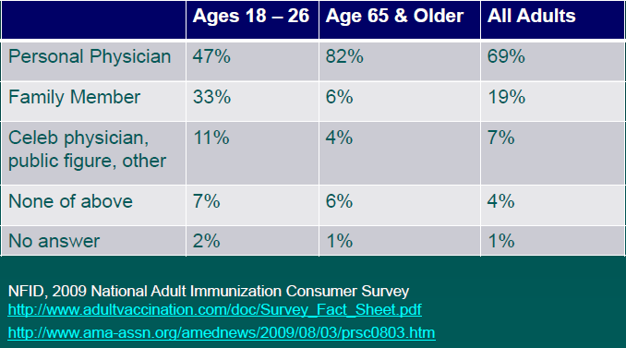
Who influences adults decisions to get immunized?
Social Media is often a negative influence on patients
Personal Physicians can overcome negative attitudes of patients!!

Slide 27
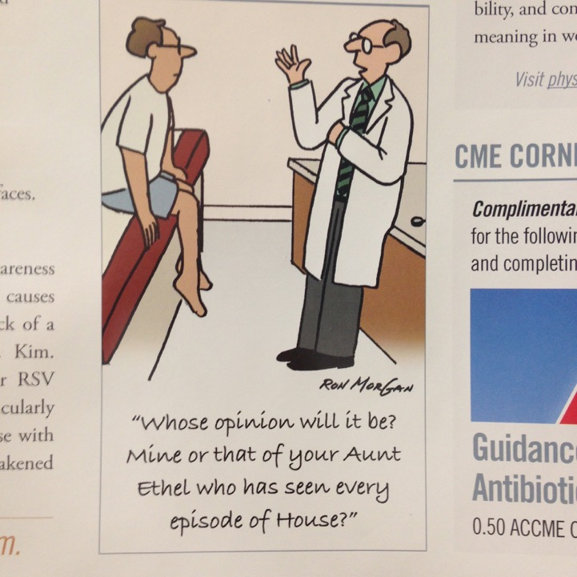

Slide 28
The Communications Breakdown
“You need to get this vaccine.”
OR
“I want you to get this vaccine.”
Vaccine-Motivated Patient
Recommendation
“Do you want this vaccine?”
OR
“Think about getting the vaccine.”
Vaccine-Ambivalent Patient
Not a Recommendation
Notes:
We believe this communications breakdown is attributable to the language used.
“You need to get this vaccine” or “I want you to get this vaccine” is a recommendation.
“Do you want this vaccine?” or “Think about getting the pneumococcal vaccine” is not a recommendation from the patient’s perspective.

Slide 29

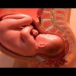
Influenza and Pregnancy
Pregnant woman at high risk for severe complications and death
Cellular immune response diminished
Maternal influenza associated with increased (Zaman et al. NEJM 2008)
Maternal hospitalization
Fetal malformation
Other illnesses
Prevention is best approach
Newborns are at high risk for severe complications
Several reports of 2nd MRSA infection
No approved vaccine for infants < 6 months of age
All care givers need to be free from possible transmission to this vulnerable population

Slide 30
INFLUENZA VACCINE Reduction in Hospitalizations for Cardiac disease and Strokes (Nichols et a. NEJM 348, April 3, 2003)
Observational studies of large cohorts (140,000; 146,000), ’98-’99 AND ’99-’00, 3 HMOs, ≥ age 65
Vaccination against influenza associated with reduction in hospitalization for :
Cardiac disease (19% both seasons)
Cerebrovascular disease (16%; 23%)
Pneumonia and Influenza (32%; 29%)
All cause Death (48%; 50%)
Possible mechanisms: infection cause alterations in clotting factors, platelet aggregation, amount of inflammatory- response cytokines which enhance thrombosis
Lower risk of Cardiovascular complications (JAMA. 2013;310(16):1711-1720)

Slide 31
Influenza ‘Nuts and Bolts’¹
Vaccination season: Soon as available to ~April
Influenza season unpredictable-can start Oct
Immunity will last for almost all patients (no concern for waning immunity for most))
Late season vaccination important and underutilized
LAIV can be safely used in MOST healthcare settings as alternative to TIV²
Egg allergy NO LONGER contraindication³
Anaphylaxis is EXCEEDINGLY rare [<10 documented cases]
Flublok™ if concern
OK to give egg-based if not history of severe anaphylaxis
If vaccinated, should be observed ~30 minutes in office
Centers for Disease Control and Prevention. Inactivated Influenza Vaccine 2011-12. Available at: http://www.cdc.gov/vaccines/pubs/vis/downloads/vis-flu.pdf
Talbot TR, et al. Infect Control Hosp Epidemiol. 2010;31:987-995.
Kelso JM, Wang J. UpToDate. 2011. Available at: http://www.uptodate.com/contents/influenza-vaccination-in-individuals-with-egg-allergy.

Slide 32
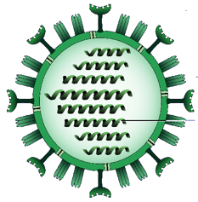
Universal Flu Vaccine
NIH Study
Seasonal flu vaccines fight infection by inducing antibodies that target the HA head. This region varies season to season, which is why flu vaccines must be updated each year. However, scientists discovered the stem typically remains unchanged, making it an ideal target for antibodies induced by a universal flu vaccine
Neuraminidase
Hemagglutinin

Slide 33
Case Exercise 3
A 66-year-old man with COPD who has not received any immunization in the past 15 years. What do you recommend today?
Influenza vaccine
Pneumococcal vaccine
Zoster vaccine
A and B only
A, B, and C

Slide 34
Adult Immunization Schedule: 2022-23

Slide 35
Which of the following causes the most deaths annually in US?
Prostate Cancer
Breast Cancer
Pneumococcal infection

Slide 36
Centers for Disease Control and Prevention. 2010. Active Bacterial Core Surveillance Report, Emerging Infections Program Network, Streptococcus pneumoniae, 2009. http://www.cdc.gov/abcs/reports-findings/survreports/spneu09.pdf. Accessed February 3, 2011.
Pneumococcal Diseases causes more deaths per year in US than Breast Cancer or Prostate Cancer
Xu. Et al. Deaths: Prelimanary data for 2007. Natl Vital Stat Rep. 2009; 58: 1-51

Slide 37
Pneumococcal Vaccines-adults
90+ known serotypes of S. pneumoniae
Pneumococcal polysaccharide vaccine (PPSV23)
Inactive vaccine; contains 23 serotypes which account for approx. 50-60% of clinical disease.
Approved for use in adults of any age; ? Efficacy for pneumonia
Pneumococcal conjugate vaccine
PCV13; PCV 15; PCV20
stimulates mucosal antibody, it greatly suppresses nasal carriage
Notes:
Pneumococcal vaccination offers the best protection against the worst outcomes of the disease.
Vaccination is recommended by CDC and professional societies, including the American Heart Association, for people with cardiovascular disease or stroke. It’s also recommended for people with other health conditions like diabetes, asthma and compromised immune systems, and for everyone 65 and older regardless of their health status.
The vaccine is particularly important for people with heart disease because of their increased risk of complications.
As you might know, the FDA approved the13-valent pneumococcal conjugate vaccine for use in adults 50 and older last December.
The CDC’s Advisory Committee on Immunization Practices hasn’t yet provided guidance for use of PCV13 in adults with cardiovascular disease.
If needed: ACIP is a group of experts that develops recommendations on the use of vaccines.
For the purposes of this program, when we talk about pneumococcal vaccination recommendations for adults with cardiovascular disease we are referring to the polysaccharide vaccine.

Slide 38
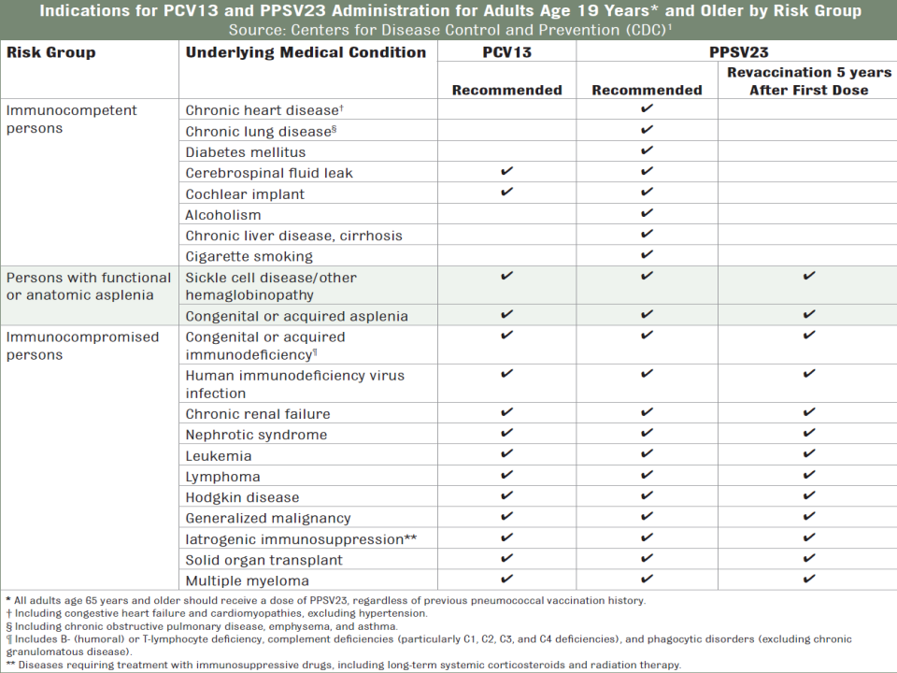

Slide 39
Strategies for sequential use of Conjugate and Polysaccharide vaccine use in adults
Conjugate vaccine more immunogenicity (higher antibody levels) and can have booster effect
13 serogroups (accounts for approx 50% of invasive cases of pneumococcal disease
Polysaccharide vaccine less immunogenecity and NO booster effect (may have hyporesponsiveness)
But has 23 serogroups (accounts for approx 89% of invasive cases)
Give Conjugate first followed by polysaccharide for optimal effect
If polysaccharide given initially wait one year to administer the conjugate vaccine (reduce ? Hyporesponsiveness)

Slide 40
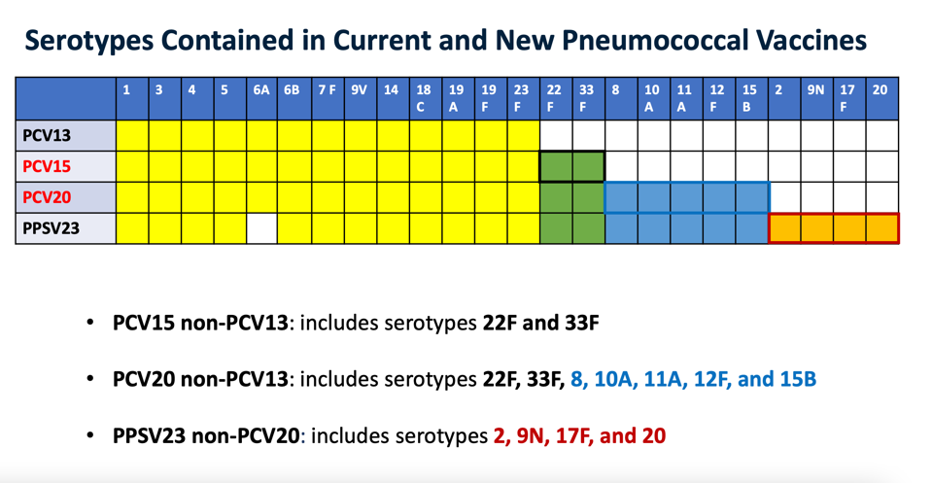
New Pneumococcal Vaccines:
Prevnar 20; Vaxneuvance (15)

Slide 41
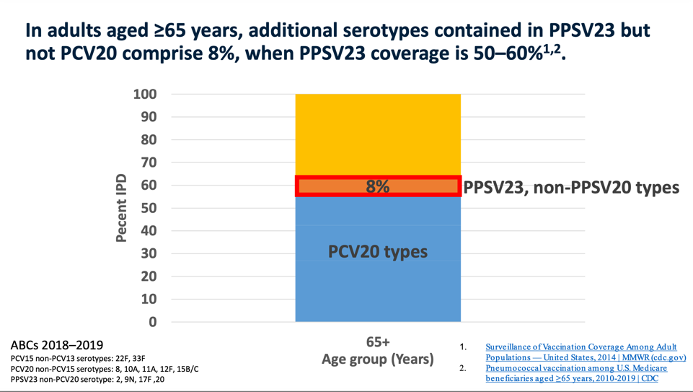

Slide 42
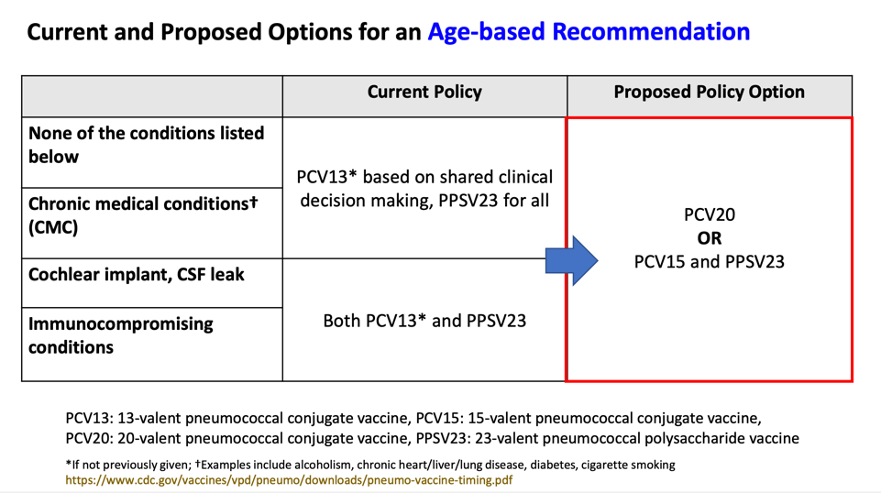

AGE $≥65$

Slide 43
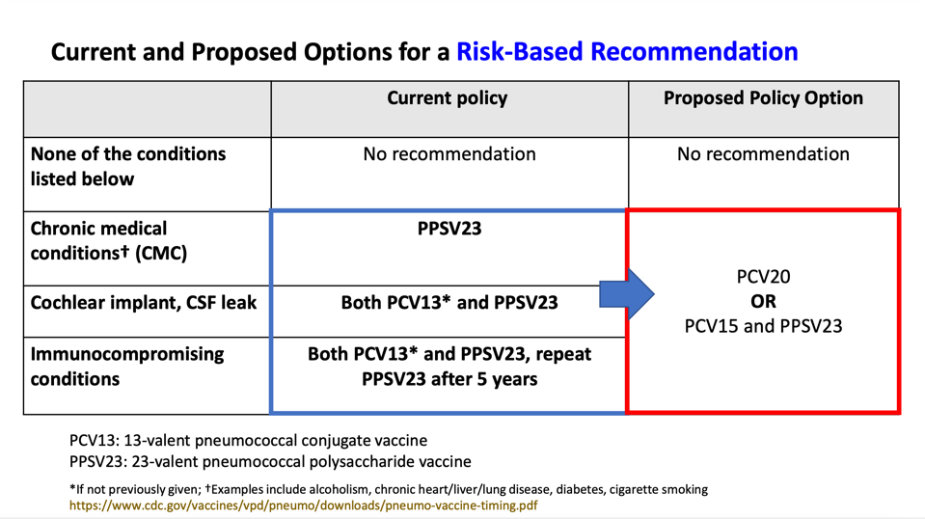
19-64

Slide 44
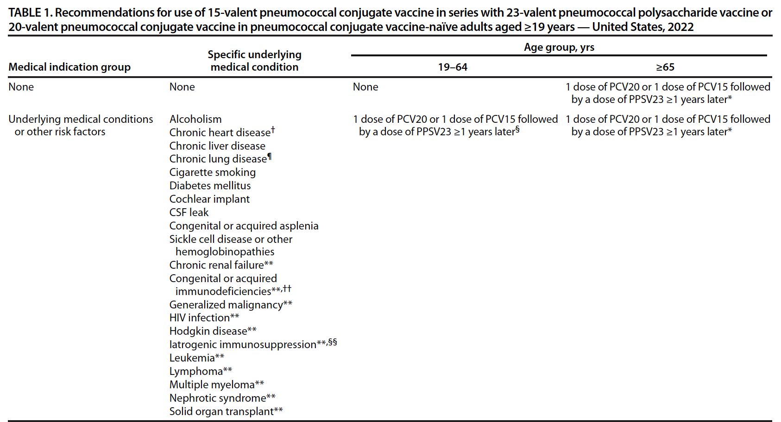
Source: CDC, MMWR Jan 28, 2022

Slide 45
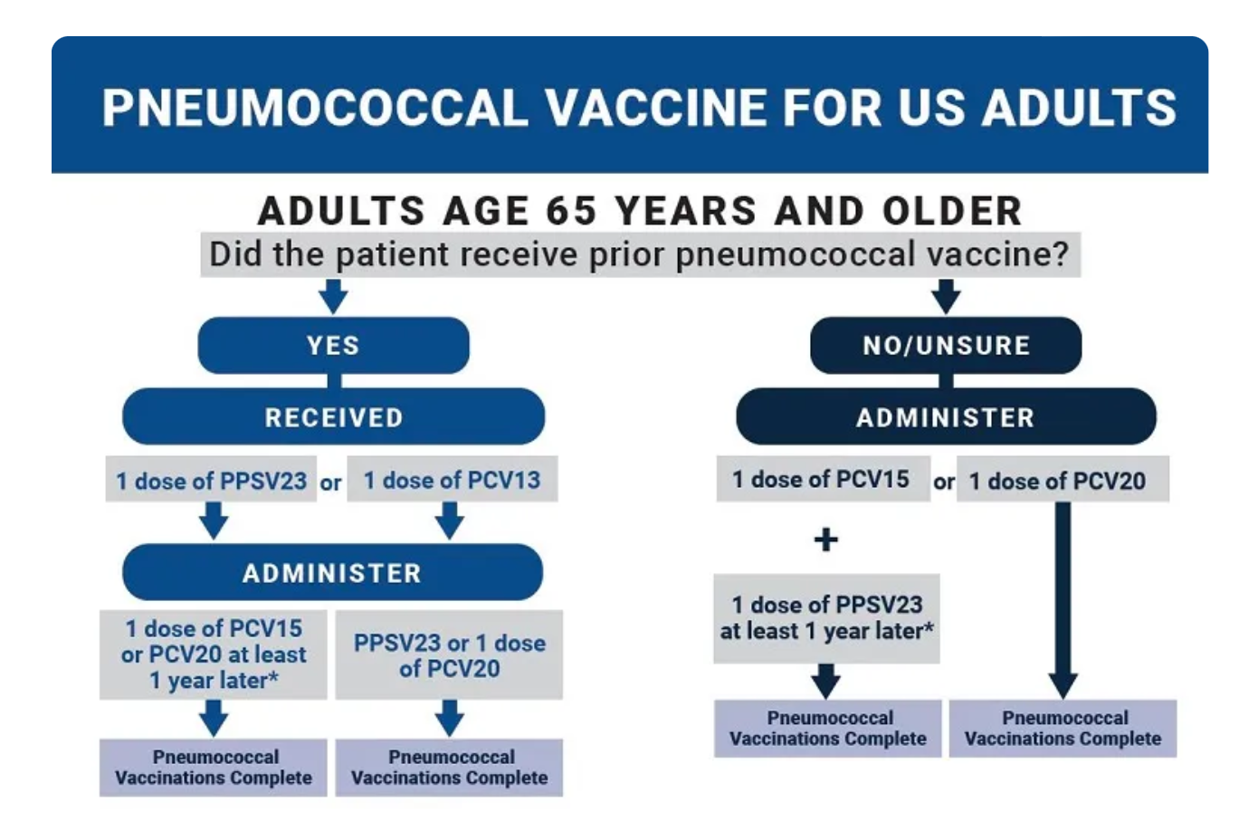

Slide 46
Which Vaccine(s)
34 year with asthma has not previously received any pneumococcal vaccine
A. PPSV23 now; PCV 13 age 65 followed by PPSV 12 months later
B. PCV 20; followed by PPSV23 one year later
C. PCV 20

Slide 47
Which Vaccine(s)
34 year with renal transplant has not previously received any pneumococcal vaccine
A. PCV 13 followed by PPSV 23 in 8 weeks; followed by PPSV 23 5 years later; followed by PPSV 23 age 65
B. PCV 20 followed by PPSV in 5 years.
C. PCV 20

Slide 48
Patient Scenarios
65 year old healthy female; no prior pneumococcal vaccine
a. one dose PPSV 23
b. PCV 13 followed by PPSV 23 one year later
c. PCV 20 or [PCV 15 + PPSV 23]

Slide 49
Patient Scenarios
68 year old male received PPSV23 age 55
A. One dose PCV13 now followed by PPSV 23 in one year
B. PCV 20 or [PCV 15 followed by PPSV 23]

Slide 50
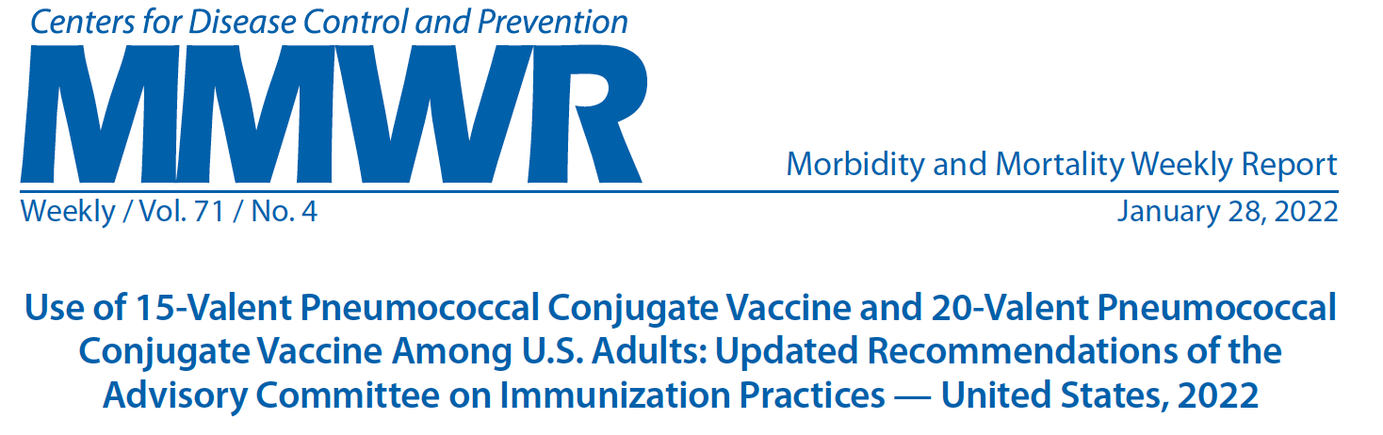
The approach to individuals who have already received pneumococcal vaccination depends on the specific vaccine they received:
● Adults who have already received both a PCV and PPSV23 vaccine require no further vaccination.
● Adults who have only received the PCV13 should receive the PPSV23 vaccine at least one year after receipt of PCV13 (unless a shorter time interval of ≥8 weeks is indicated).
● Adults who have only received the PPSV23 vaccine should receive PCV15 or PCV20 at least a year after PPSV23.
The ACIP does not recommend revaccination with these vaccines.

Slide 51
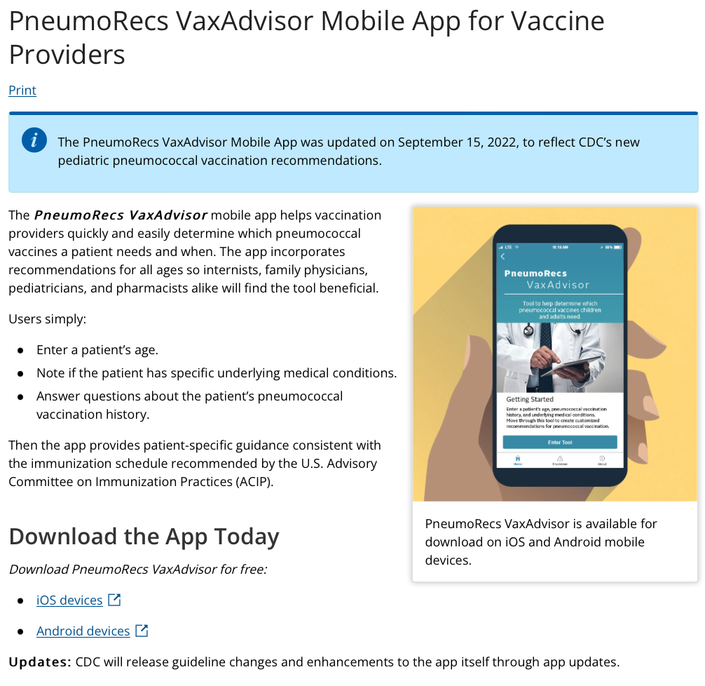

Slide 52
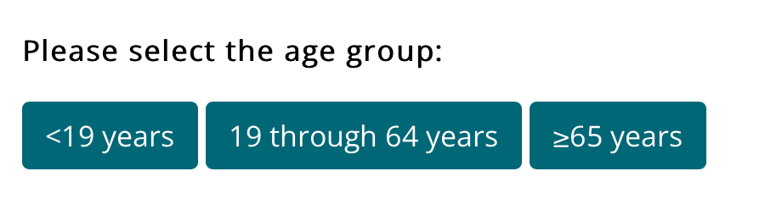
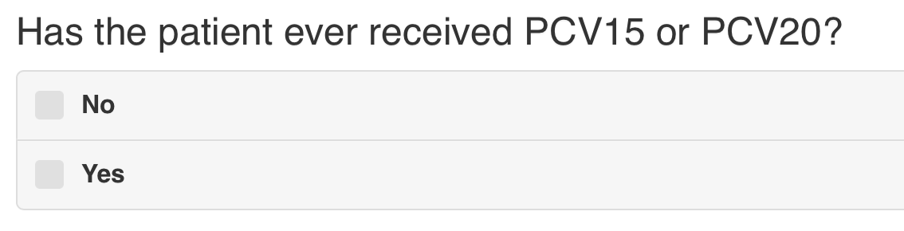
46 y/o with DM

Slide 53
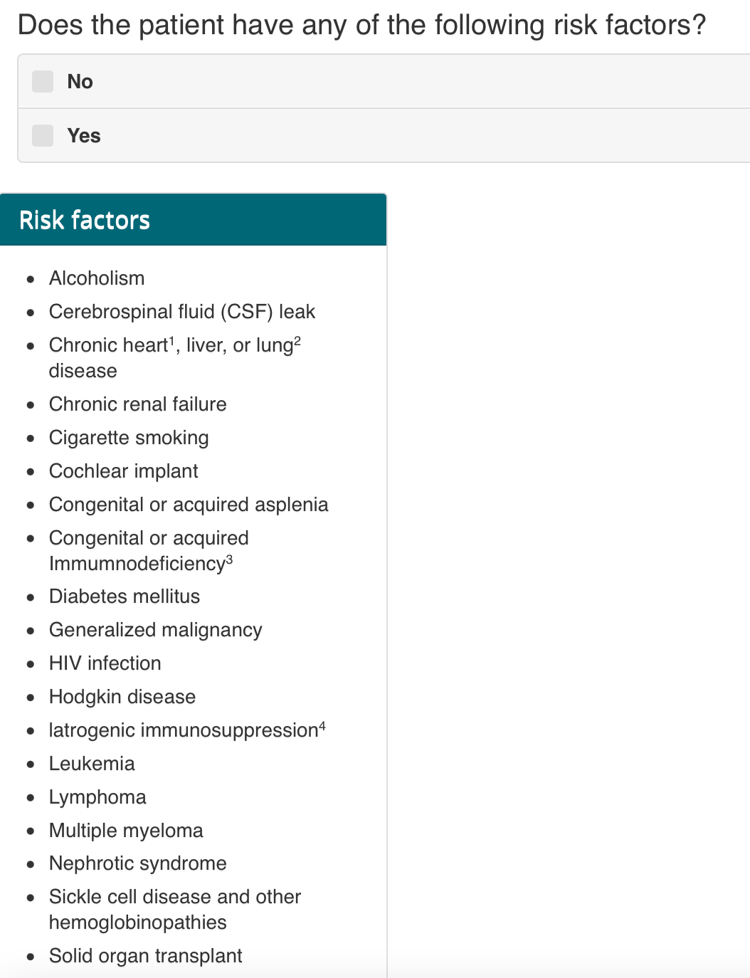

Slide 54
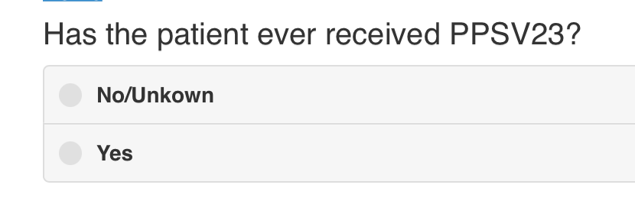
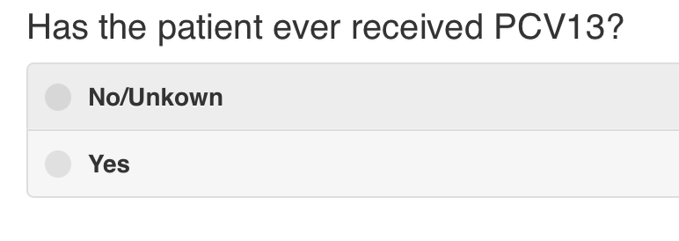

Slide 55
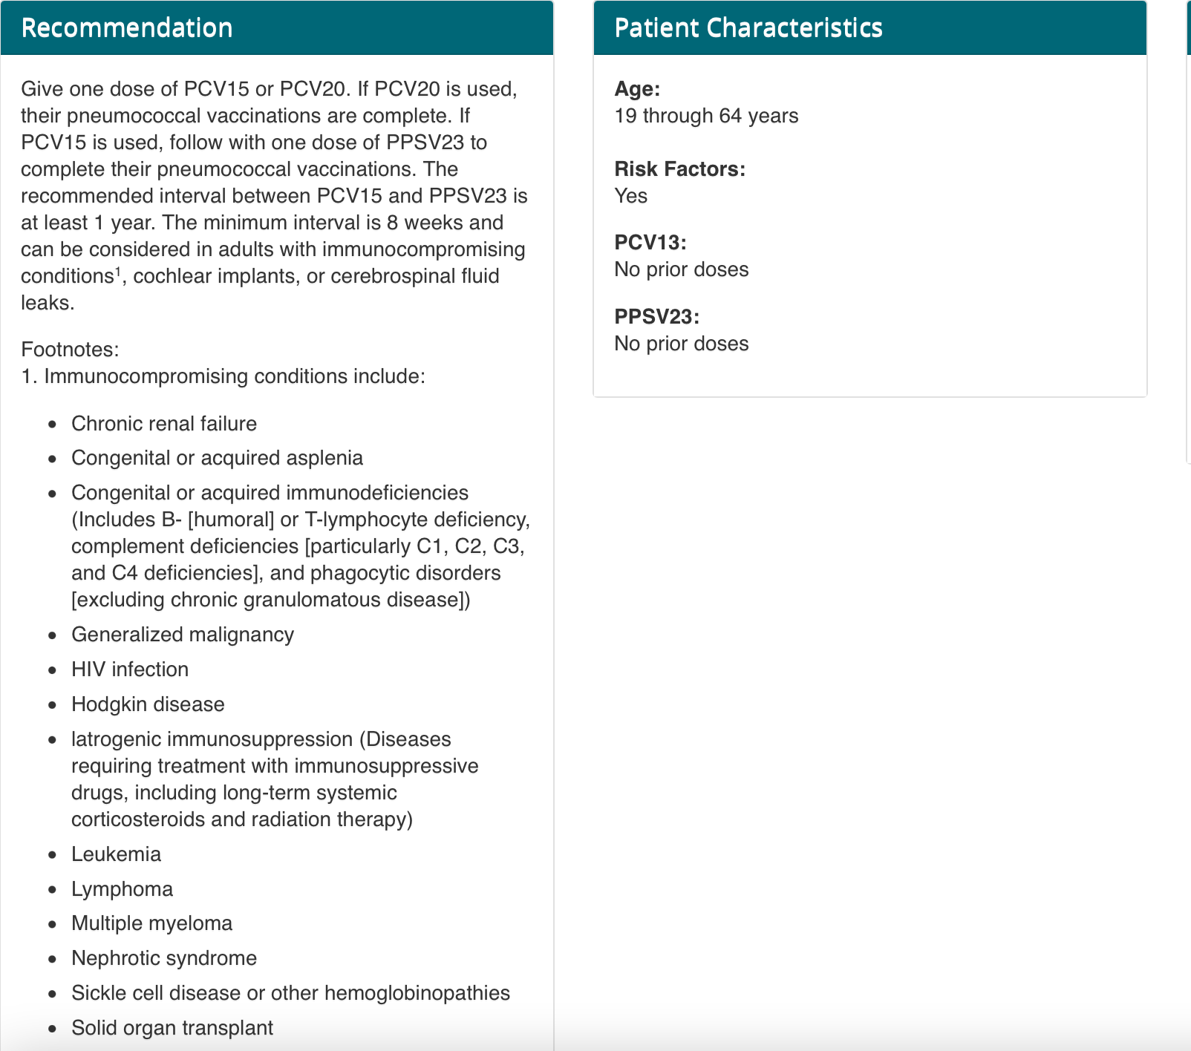

Slide 56
TDAP 28 y/o pregnant women, 3rd trimester. She delivered healthy baby 2 years ago during which time she received Tdap. Which is appropriate?
No repeat Tdap necessary
Administer additional Tdap after delivery
Administer additional Tdap now

Slide 57
ACIP Tdap Recommendations
Specific Priority Groups
Pregnant women at 27-36 weeks' gestation
AT EACH PREGNANCY!
Repeated doses safe (JAMA 2015; 314:1581-87 )
Adults, regardless of age, who are in close contact with infants younger than age 12 months (e.g., parents, grandparents, or child-care providers)
Healthcare Providers

Slide 58
Zoster vaccine (Shingrix™): subunit recombinant, adjuvant
Old Live vaccine (Zostavax™) no longer recommended
VZV glycoprotein E (target of both humoral and cellular immune responses) with novel adjuvant
High and sustained efficacy in clinical trials
ZOE-50: associated with a risk of herpes zoster that was 97.2% lower than that associated with placebo in age 50 and older.¹
2nd trial (ZOE-70) for 70 + demonstrated 89% efficacy and reduced PHN.²
Pooled analysis: 91% efficacy against zoster; 89% against PHN
2 doses (2-6 months apart); AEs comparable.
Recommended unanimously by ACIP advisory committee for age 50 or older (approved by CDC 10/20/2017)
More reactagenic: (fever, chills, aches, pain; resolved after few days)
NEW Recommendations: Nov 2021: Adults age 19 or older who are or will be immunodeficient due to disease or therapy
1. Lal H, et al. N Engl J Med. 2015;372:2087-2096.
2. Cunningham AL, et al. N Engl J Med. 2016;375:1019-1032.Mar 12, 2015)

Slide 59
HPV Vaccine
HPV 9-valent vaccine (Gardasil 9, Merck)
Now approved for men and women up to age 45
Girls and Women 9-26: 98.2% efficacy for Cervical/Vulvar neoplasia*
Girls and Women 27-45: 87.7% efficacy for genital warts, Vulvar, vaginal CA, Cervical Dysplasia*
Boys and Men: Efficacy inferred
2018 CDC recommended reducing to 2 doses for age < 15
No apparent adverse effect if inadvertently given in pregnancy (Quad; Scheller et al. NEJM 2017; 376:1223)
*Gardasil Package INsert

Slide 60
Meningococcal Serogroup B Vaccines
Group B not in the Quadrivalent (A,C,Y,W)
High-risk individuals
Complement deficiencies,
anatomic or functional asplenia,
microbiologists routinely exposed to N. meningitidis isolates
serogroup B meningococcal disease outbreak
2 Vaccines:
Trumenba™
3 doses for high-risk; 2 doses* (6 months apart) healthy
Bexsero™:
2 doses series
* ACIP Oct 2016

Slide 61
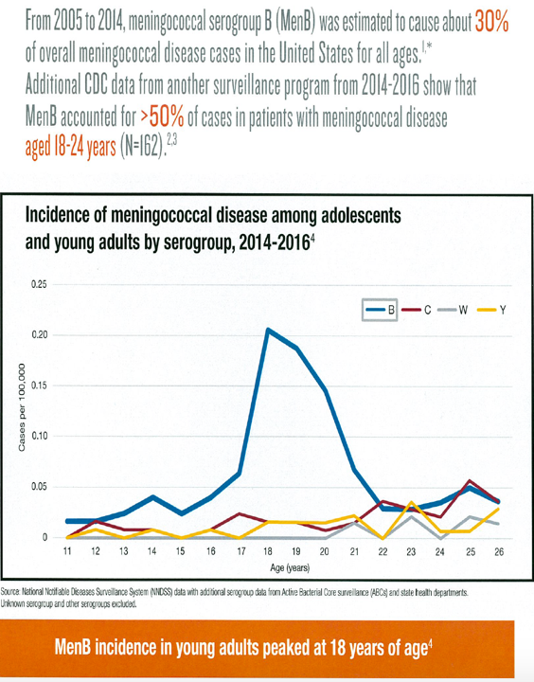

Slide 62
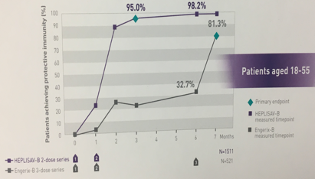
New Hepatitis Vaccine Recommendations
Hepatitis B
New REC: April 2022: Universal age 19-59;
> 60 yes if risk factors (include DM); ‘May’ otherwise
HEPLISAV-B Recombinant vaccine for 2 IM doses one month apart
Higher efficacy than present HBV vaccines
Approved for adults ≥18
Hepatitis A
Anyone to reduce risk
Homeless
Post-exposure
Unvaccinated exposed to HAV within 2 weeks for aged 1-40 yrs.
Immunoglobulin for those outside age range

Slide 63
28 y/o male had splenectomy after MVA. Which vaccines should be administered after the splenectomy?
Pneumococcal
Hemophilus influenzae B
Meningococcal quadrivalent
Meningococcal B
All above

Slide 65
28 y/o male had splenectomy after MVA. Which vaccines should be administered after the splenectomy?
Pneumococcal
PCV13; then PPSV23 > 8 weeks; PPSV23 in 5 years and at age 65 (NEW: PCV 20 or PCV 15 + PPSV 23]
Hemophilus influenzae type B (Hib)
If not previously received
Meningococcal quadrivalent (ACWY)
Menveo™ or Menactra™ (2 doses each, 2 months apart)
Meningococcal B
All above

