Slide 1
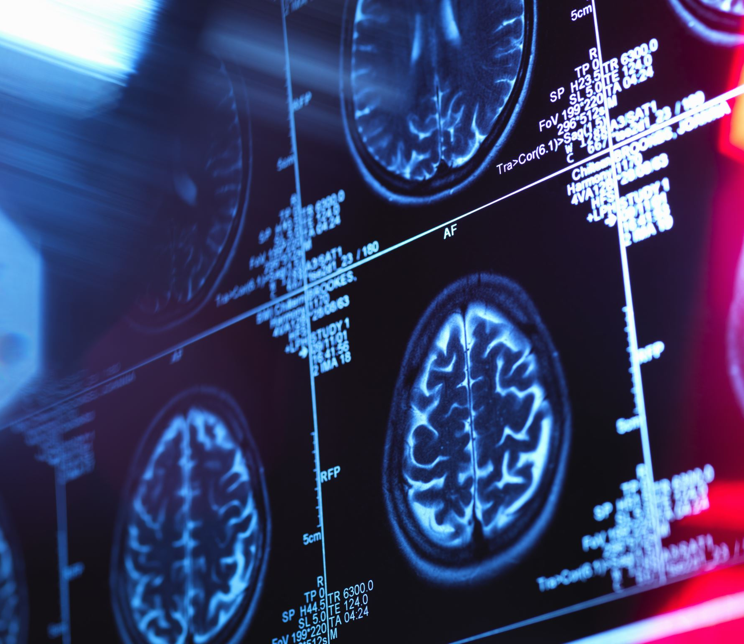
Headache disorders
Dr. Harinoor Mann, MD
Department of Neurology
Summa Health

Slide 2
Primary headaches
Migraines
Tension type headache
Trigeminal Autonomic Cephalgias
Other benign headache syndromes
Headache in pregnancy
Secondary headaches

Slide 3
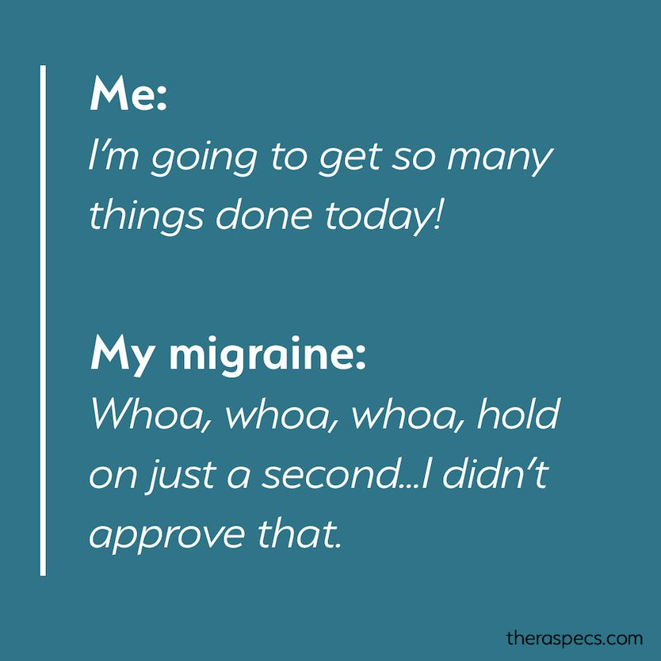
Migraine
1 billion people suffer from migraines
31% of people with migraines have missed at least one day of work or school within a three-month period
Fourth leading cause of ER visits
The prevalence of migraine in boys and girls is similar until menarche but after menarche, there is a subsequent increase in migraines in women related to fluctuations in estrogen
Prevalence of migraine can be as high as 27% in women between the ages of 30-39 years of age

Slide 4
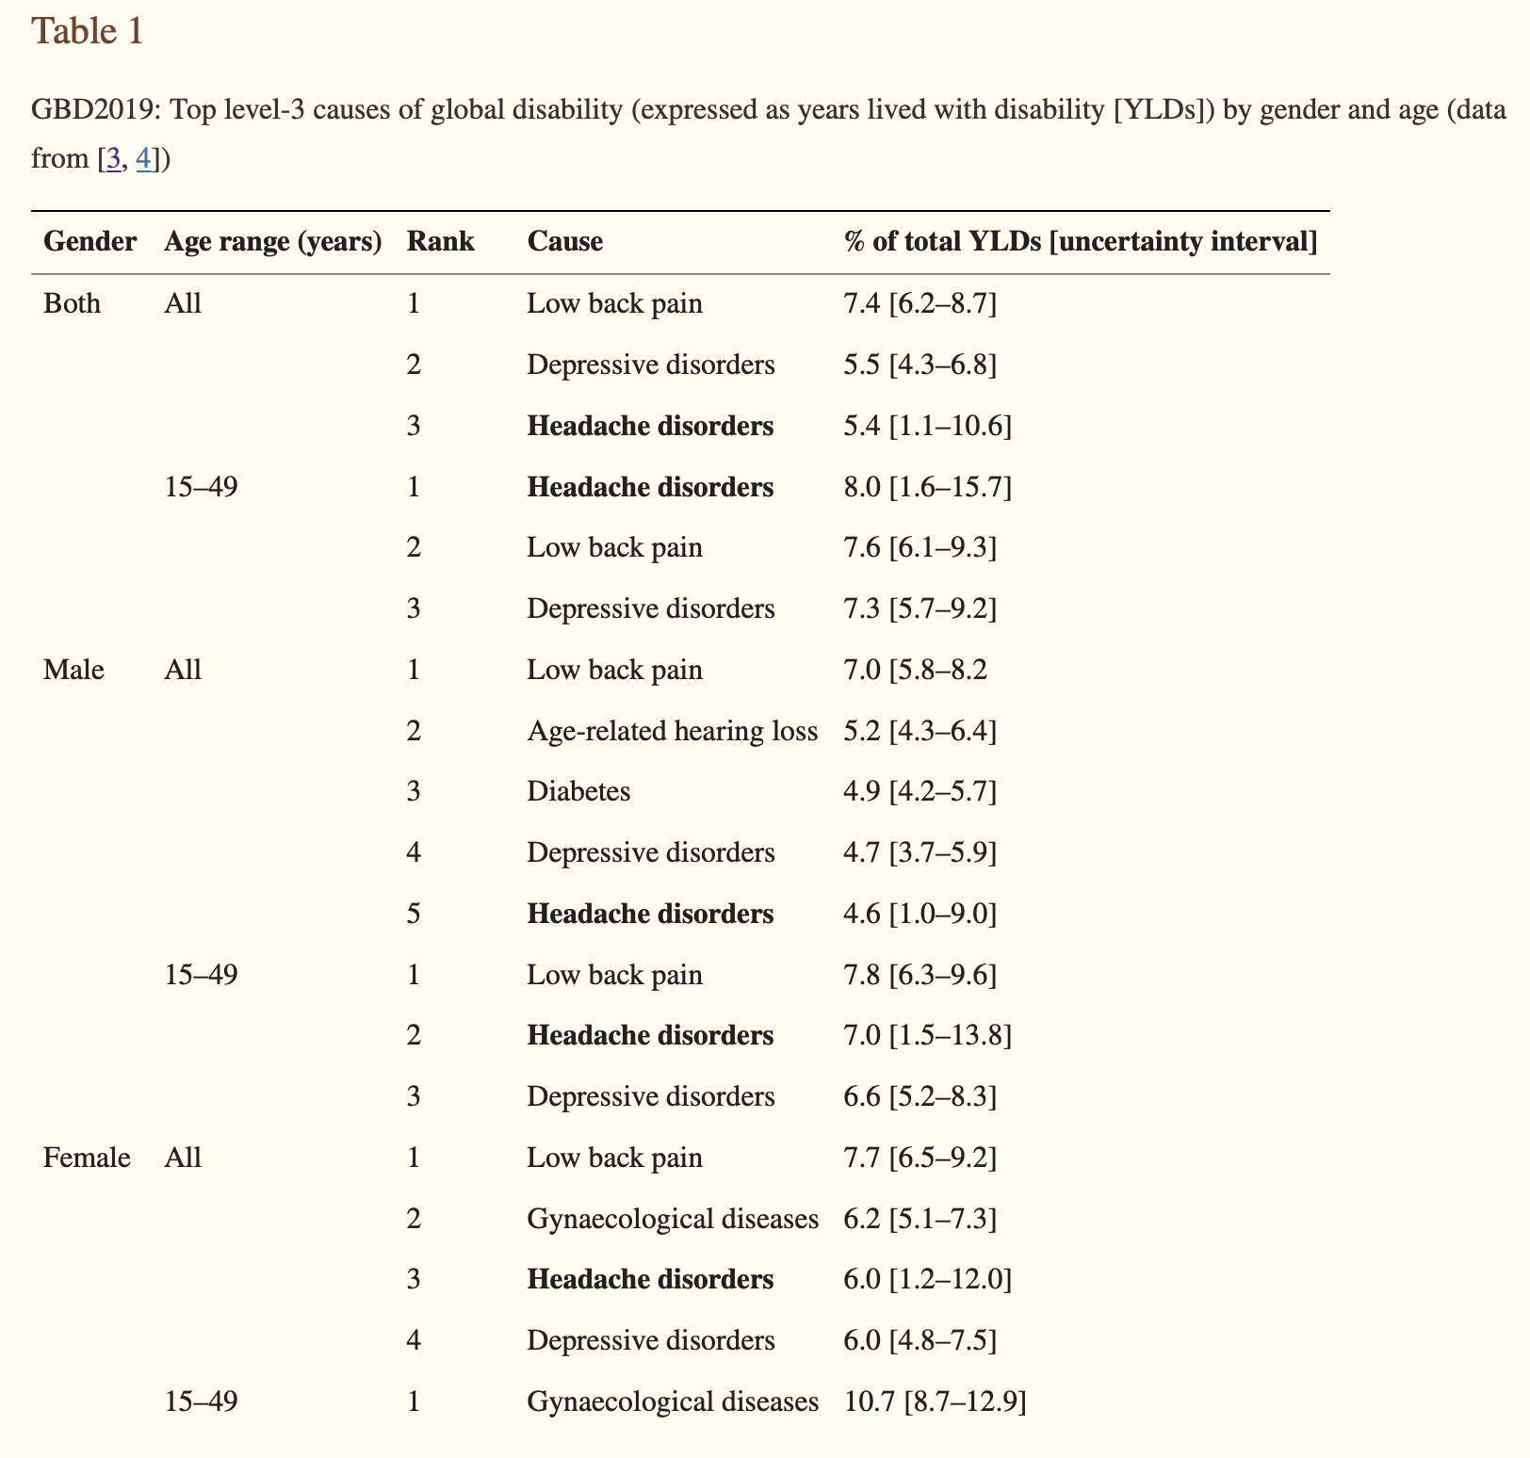
Steiner TJ, Stovner LJ, Jensen R, Uluduz D, Katsarava Z; Lifting The Burden: the Global Campaign against Headache. Migraine remains second among the world's causes of disability, and first among young women: findings from GBD2019. J Headache Pain. 2020 Dec 2;21(1):137. doi: 10.1186/s10194-020-01208-0. PMID: 33267788; PMCID: PMC7708887.

Slide 5
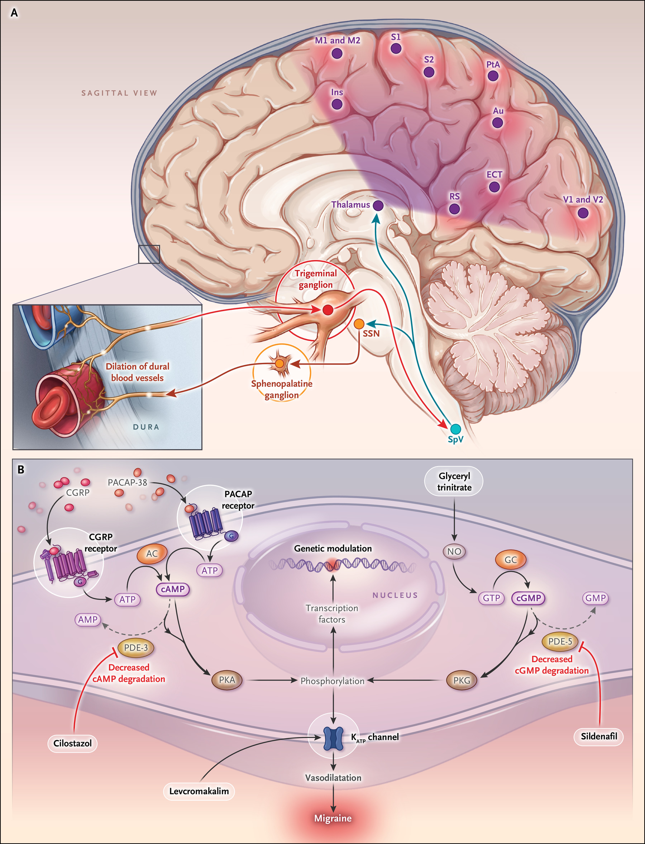
The trigeminovascular system (Panel A) is the anatomical and physiological substrate of migraine. Nociceptive transmission originates from activation and sensitization of first-order trigeminovascular neurons. Their cell bodies are in the trigeminal ganglion, and their afferent fibers innervate the meninges and its vessels.
Ascending nociceptive transmission from the trigeminal ganglion is projected to the brain stem, activating and sensitizing second-order trigeminovascular neurons, including those in the spinal trigeminal nucleus.
This, in turn, activates and sensitizes third-order trigeminovascular neurons in the thalamus, which subsequently relay the nociceptive transmission to the somatosensory cortex and other cortical areas, ultimately resulting in the perception of migraine pain.

Slide 6
Migraine
Migraine without aura:
A: at least 5 attacks fulfilling criteria B-D
B: 4-72 hours ( untreated or unsuccessfully treated)
C: at least 2 of the following 4 characteristics
Unilateral, pulsating, moderate to severe pain intensity, aggravated by or causing avoidance of routine physical activity
D: during headache at least 1 of the following
nausea and/or vomiting
photophobia and phonophobia
E: not better accounted by another diagnosis

Slide 7
Migraine with aura
A: at least 2 attacks fulfilling criteria B and C
B: 1 or more of the following fully reversible aura symptoms: visual, sensory, speech, motor, brainstem, retinal
C: at least 3 of the following 6 characteristics
at least 1 aura symptoms spreads gradually over >=5 minutes
2 or more aura symptoms occur in succession
each individual aura symptoms lasts 5-60 minutes
at least 1 aura symptoms is unilateral
at least 1 aura symptoms is positive
the aura is accompanied by or followed within 60 minutes by headache
Does not better accounted for another diagnosis

Slide 8
Chronic migraine
A: headache on >= 15 days per month for more than 3 months and fulfilling criteria B and C
B: at least 5 attacks fulfilling criteria B-d for migraine without aura and/or criteria B and C for migraine with aura
On >= a days per month for more than 3 months fulfilling:
criteria C and D for migraine without aura
criteria B and C for migraine with aura
believed by the patient to be migraine at onset and relieved by a Triptan

Slide 9
Acute migraine management
Acetaminophen: 1000 mg oral has proven efficacy over placebo with 2 hour pain Freedom in 22.4% treated patients
NSAIDs: aspirin 900 mg, diclofenac 50 mg & 100 mg, ibuprofen 200 mg & 400 mg, naproxen 500 mg all have level A evidence. They do have increased risk of cardiovascular events and when used more than 15 days a month can have medication overuse headache.
Opioids and Fioricet: should not be used as first-line

Slide 10
Triptans
Selective 5HT1B/D agonist
Sumatriptan: oral tablet ( 25, 50, 100 mg with a maximum 200 mg in 24 hours: can repeat in 2 hours), nasal spray ( 10 mg in 1 nostril and repeat in 2 hours with maximum of 30 mg in 1 day), subcutaneous injection ( 6 mg, can repeat in 2 hours with maximum 12 mg in 1 day)
Rizatriptan (Maxalt): 5, 10 mg oral tablet ( repeat in 2 hours, maximum 30 mg). Also available as ODT
Zolmitriptan (Zomig): oral tablet ( 1.25 and 2.5 mg tablet, can take up to 5 mg and 1 dose with maximum 10 mg in 24 hours with repeat dose after 2 hours). Also available as a nasal spray ( 2.5 mg with maximum 5 mg) and ODT
Frovatriptan: 2.5 mg oral tablet ( repeat in 2 hours with a maximum daily 7.5 mg). Can be used for prevention due to long lasting half life 6-26 hours
Naratriptan: long lasting. 1 to 2.5 mg, can repeat in 4 hours with a maximum daily of 5 mg. ( catamenial: 1 mg b.i.d. for total 6 days)
Eletriptan: 20, 40 mg oral tablet ( repeat in 2 hours with a maximum daily dose of 80 mg)
Almotriptan: 6.25- 12.5 mg tablets ( repeat in 2 hours, max daily 25 mg)

Slide 11
On meta-analysis it was concluded that a standard dose Triptan provide 2 hr Pain Relief for 42-76% of patients. Subcutaneous sumatriptan, rizatriptan ODT , Zolmitriptan ODT and Eletriptan had most favorable outcomes. Combining triptans with aspirin or acetaminophen or nsaids may produce better outcomes.
Common side effects include nausea, dizziness, somnolence, paresthesias, dyspepsia, chest tightness, flushing.
Contraindicated in cardio or cerebrovascular disease, uncontrolled hypertension, peripheral vascular disease, cardiac arrhythmias, ischemic bowel disease and Hemiplegic migraine

Slide 12
DITANS
Selective 5HT-1F agonist. They act on the trigeminal system but do not cause vasoconstriction because of their low affinity for 5HT-1B receptor. Lasmiditan had a 2 hour pain Freedom between 28-39% at doses of 50 mg, 100 mg and 200 mg. It is a once in 24 hour pill. Significant side effects with dizziness and sedation ( 8 are driving restriction). Some potential for abuse. Concerns for serotonin syndrome. It can also cause medication overuse headache.

Slide 13
Gepants: CGRP blocking molecules
Ubrogepant (Ubrelvy): 50 mg and 100 mg tablets. About 20% 2 hour pain Freedom. No medication overuse
Rimegepant (Nurtec): 20% 2 hour pain Freedom. Side effects include nausea and hypersensitivity reaction. No medication overuse. Lasts for 48 hours. 75 mg ODT.

Slide 14
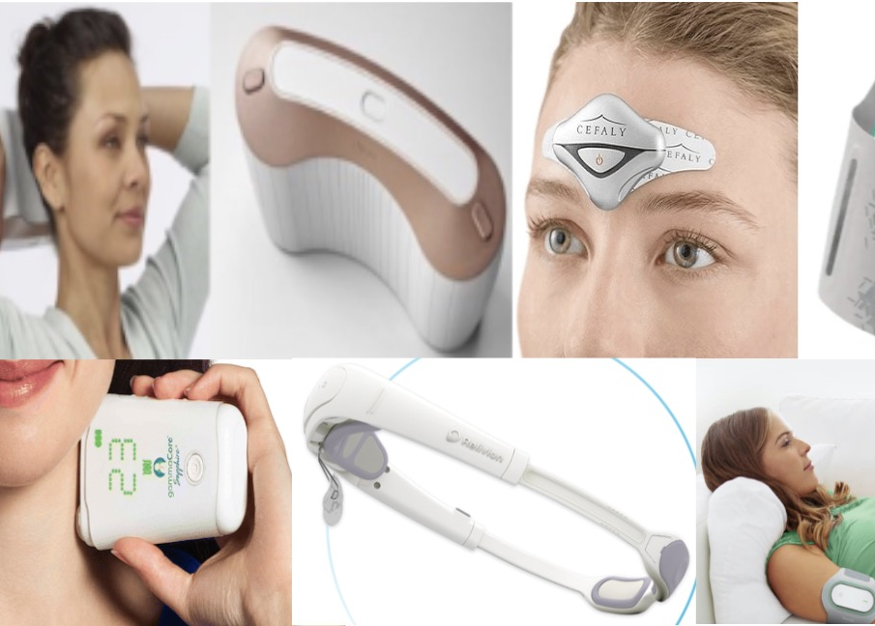
Neuro modulation
External trigeminal nerve stimulation (Relivion): decrease in amount of pain but not pain Freedom. Used as an abortive when used for 1 hr during migraine attack.
Single pulse transcranial magnetic stimulation (Cefaly): 39% patients with 2 hour pain Freedom. 3 pulses up to 3 times per attack
Noninvasive vagus nerve stimulation (gammacore): did not meet primary endpoint (pain Freedom). Bilateral 2 minute stimulation ( within 20 minutes of attack onset)
Remote electrical neuro modulation (Nerivio): to upper arm for 45 minutes within 1 hour of onset. Pain Freedom in 37.4%

Slide 15
Migraine prevention: Antidepressants
Amitriptyline: level B evidence. 25-50 mg.
Nortriptyline: no evidence but commonly used due to lower anticholinergic profile. 50 mg once daily
Venlafaxine: 75 to 225 mg extended release once a day. Level B evidence but can cause significant withdrawal symptoms hence Cymbalta ( duloxetine) 60 mg once a day is used in its place with no evidence to support the use.

Slide 16
Antihypertensive medications
Metoprolol: cardio selective and unlikely to worsen asthma. Level A evidence. 50 mg b.i.d.
Propranolol: nonselective BB (CI in asthma patients). 60 mg once daily or b.i.d. Also has level A evidence
Verapamil: no evidence but frequently used due to benign side effect profile. 120- 240 mg once a day. Has shown benefit in migraine with aura particularly prolonged or brainstem aura and hemiplegic migraine patients
Lisinopril and Candesartan: Level C evidence

Slide 17
Antiseizure medications
Topiramate: level A evidence. 100 mg daily. Side effects include cognitive slowing memory deficits, transient numbness. Contraindications are glaucoma and nephrolithiasis
Valproic acid: level A evidence but significant side effects with hepatic toxicity and thrombocytopenia with weight gain and hair loss. Also highly teratogenic. 500 mg to 1000 mg daily.
Gabapentin: Unclear evidence. Helpful in patients with medication overuse and also acute and preventive effects. No clear target dose
Zonisamide: use in patients who could not tolerate Topamax due to side effects
Keppra: recent evidence suggests possible benefits. 500-1000 mg b.i.d.

Slide 18
CGRP Antagonists
Eptinezumab, Galcanezumab, Fremanezumab, Erenumab
Atogepant: First oral CGRP receptor antagonist
Monthly injections other than Eptizenumab which is infusion every 3 months
Constipation with Erenumab
Watch for hypertension

Slide 19
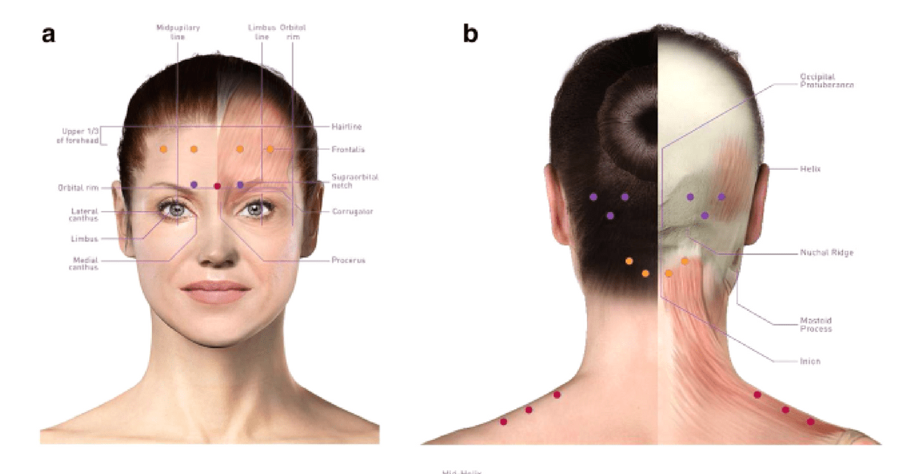
Botox
Approved for chronic migraines

Slide 20
Tension type headaches
Most common headache in population
Steady nature, bilateral, modest intensity and paucity of associated symptoms
Osteopathic and chiropractic manipulation found to be helpful
If pharmacotherapy is required, there is level A evidence for the use of amitriptyline and level B evidence for mirtazapine and venlafaxine in the prevention of TTH. NSAIDs are first line for acute treatment of TTH with caffeine and combination analgesics recommended as second-line agents. Triptans, muscle relaxants, Botox, and opioids have no role in the treatment of TTH

Slide 21
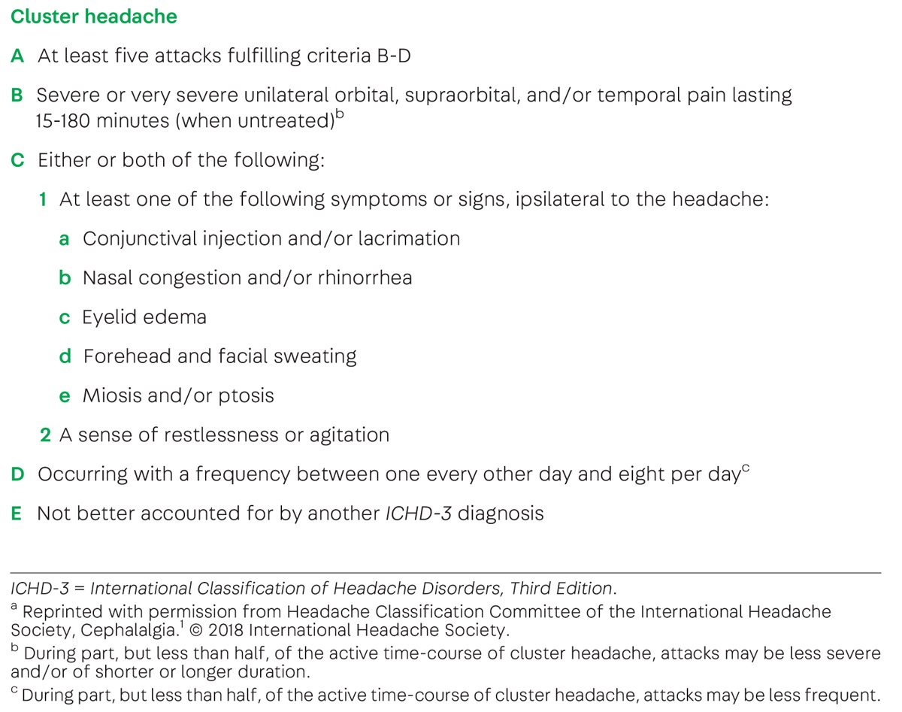
Trigeminal autonomic cephalgias
Cluster headache:
Stabbing in quality
Lasting for 15 minutes to 3 hours
Severe agitation; also called suicide headaches
4:1 male predominance

Slide 22
Abortive: First line includes subcutaneous Sumatriptan with over all greater efficacy than Intranasal sumatriptan and Intranasal Zolmitriptan, High flow oxygen (12 L/min for 15 minutes via non-rebreather), Oral Sumatriptan or Zolmitriptan
Second line: Intranasal Lidocine
Prevention: Depends on if Cluster headaches are chronic vs episodic. For Episodic: Steroid taper (starting 80 mg for 5 days and then 10 mg every day), Emgality (300 mg at start and then monthly till the end of cluster), Lithium. Verapamil is approved for chronic cluster

Slide 23
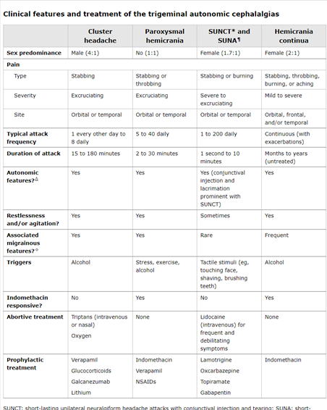
Other TCA include: Paroxysmal hemicrania, SUNCT (Shortlasting unilateral Neuralgiaform headache with conjectival injection and tearing), SUNA ( Shortlasting unilateral Neuralgiaform headache with cranial autonomic symptoms) and hemicrania continua

Slide 24
Medication overuse headache
Result in the development of a new headache type or a marked worsening of the pre-existing condition
Use must exceed 10 to 15 days per month over a period of three months or more
Common culprits include Fioricet, NSAIDS, Tylenol and Opiates
Bridge therapy includes: Tizanidine/ Naproxen/ Prednisone

Slide 25
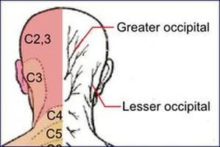
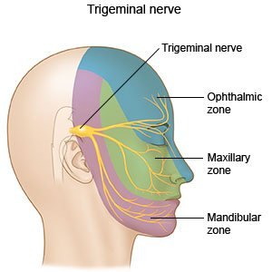
Painful cranial Neuropathies
Most common cause: Trigeminal Neuralgia
  brief unilateral episodes of lancinating, shock-like pain
  Maxillary V2 and Mandibular distribution V3
  innocuous stimuli, including brushing the teeth or hair, eating, speaking, or a breeze on the face
  Distinguish from TCA with absence of autonomic symptoms
  vascular compression of cranial nerve V by a redundant vascular loop; MS
  Carbamazepine, Oxcarbazepine, Lamictal, Gabapentin
  Surgical decompression.
Other causes include Occipital Neuralgia (C2 and C3 distribution) and Glossopharyngeal Neuralgia (unilateral and located in the pharynx, base of the tongue, or ear with painful paroxysms induced by speaking, swallowing, yawning, or coughing)

Slide 26
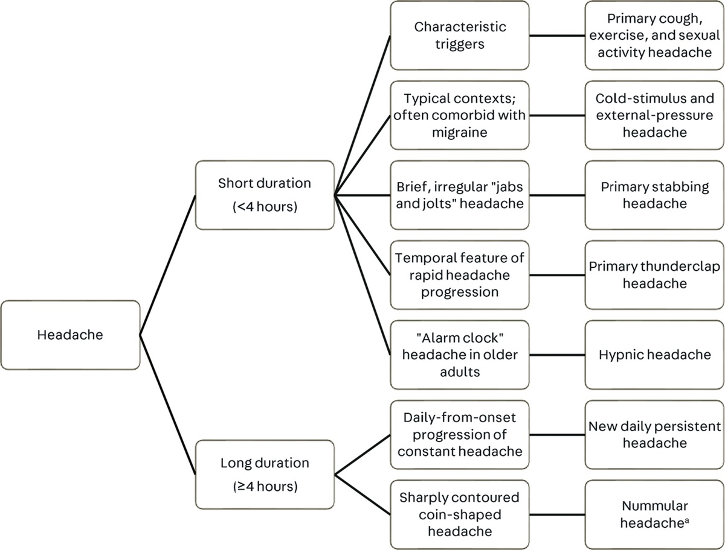
Other Primary headache types:

Slide 27
Headaches in pregnancy
Tension type headache is the most common headache type
About 45% percent of pregnancies are unplanned
20% of patients avoid pregnancy because of the diagnosis of migraine
Migraine associated with increased prevalence ratio of pregnancy related hypertensive disorders (1.5), preeclampsia and a slight increased risk of miscarriage, low birth weight, preterm birth and cesarean delivery
Incidence of dangerous secondary cause of headache is high in the later stages of pregnancy; preeclampsia does not occur till after 20 weeks of gestation and the risk of developing a dural venous sinus thrombosis and dissection are highest in the third trimester and postpartum
Other classes include PRES (posterior reversible encephalopathy syndrome), RCVS (reversible cerebral vasoconstriction syndrome), pituitary apoplexy and post dural puncture headaches
A lack of headache history was associated with nearly fivefold risk of secondary headache and elevated blood pressure was sitting with 17-fold risk of secondary headache

Slide 28
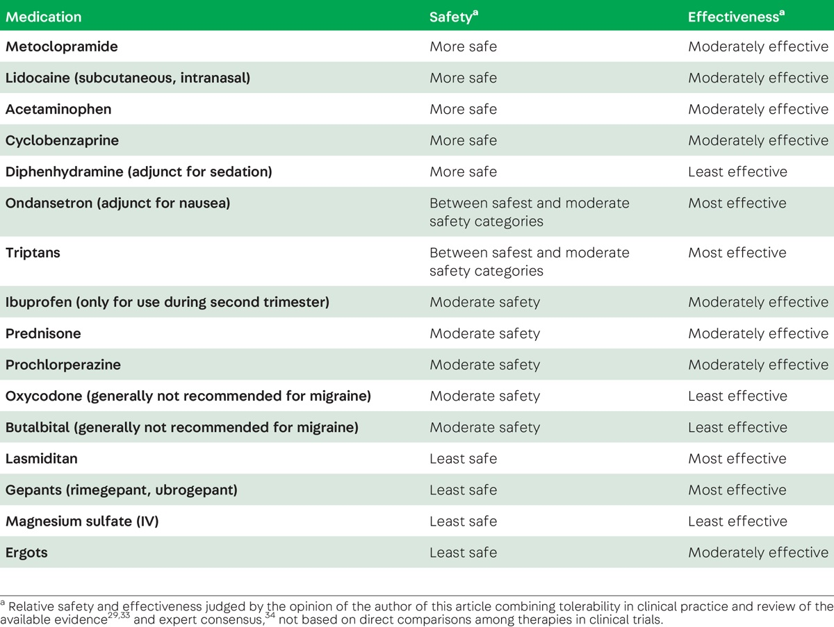
Abortive medications in pregnancy

Slide 29
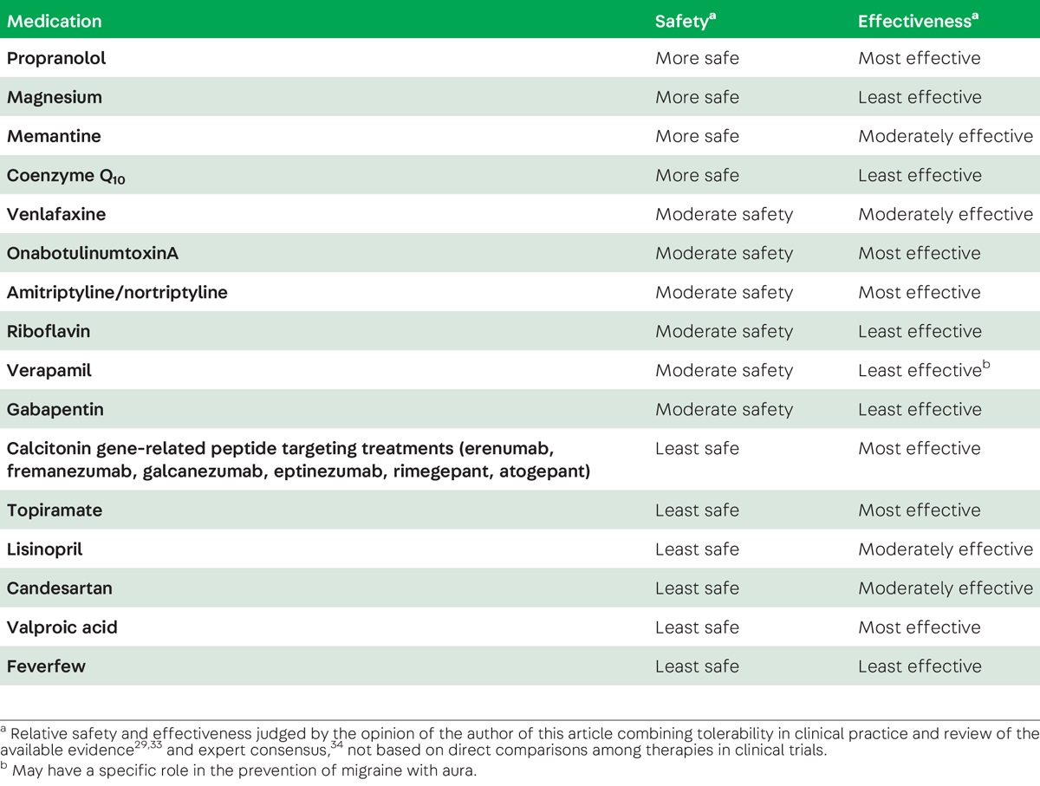
Preventative medications in pregnancy
Headache in Pregnancy and Lactation:Melissa Rayhill, MD, FAHSNeurology of Pregnancy p. 72-92February 2022, Vol.28, No.1

Slide 30
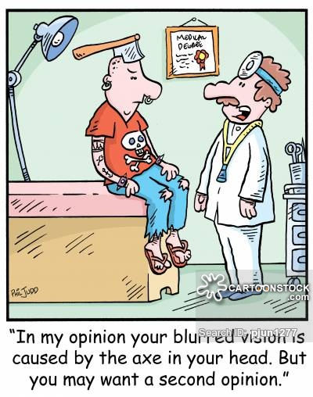
Secondary headache
S: systemic features including fever, chills, night sweats, myalgias, weight loss, jaw claudication
N: local or global neurological symptoms including changes in behavior, personality, vision loss, pulsatile tinnitus
O: onset: sudden (less than 1 minute to peak)
O: onset, age (>65 years)
P: Pattern change, Precipitated by Valsalva, postural aggravation
P: Papilledema
P: Pregnancy
P: Phenotype of rare headache: Trigeminal autonomic cephalalgias, hypnic headache, exercise, related to sex/orgasm

Slide 31
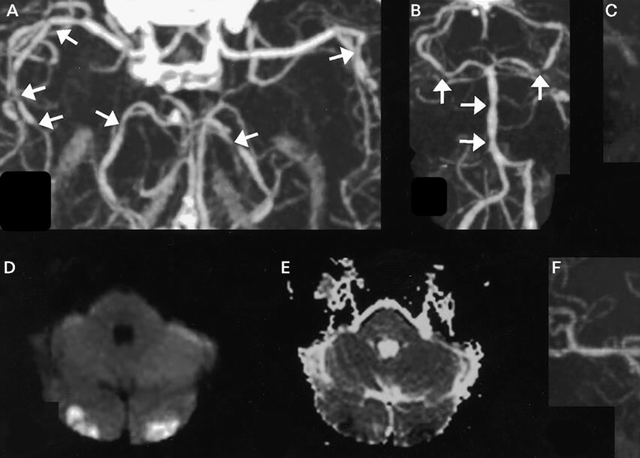
Thunderclap headaches
Abrupt onset, reaching maximal intensity within 1 minute.
Most common etiologies are subarachnoid hemorrhage and reversible cerebral vasoconstriction syndrome (RCVS).
Non-contrast CT of the head: 95% sensitive in the identification of subarachnoid hemorrhage. CT angiogram for RCVS
Lumbar puncture should be performed to evaluate for xanthochromia

Slide 32
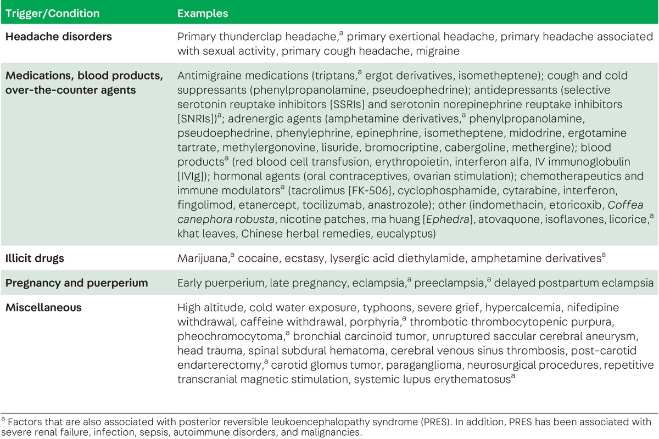

Slide 33
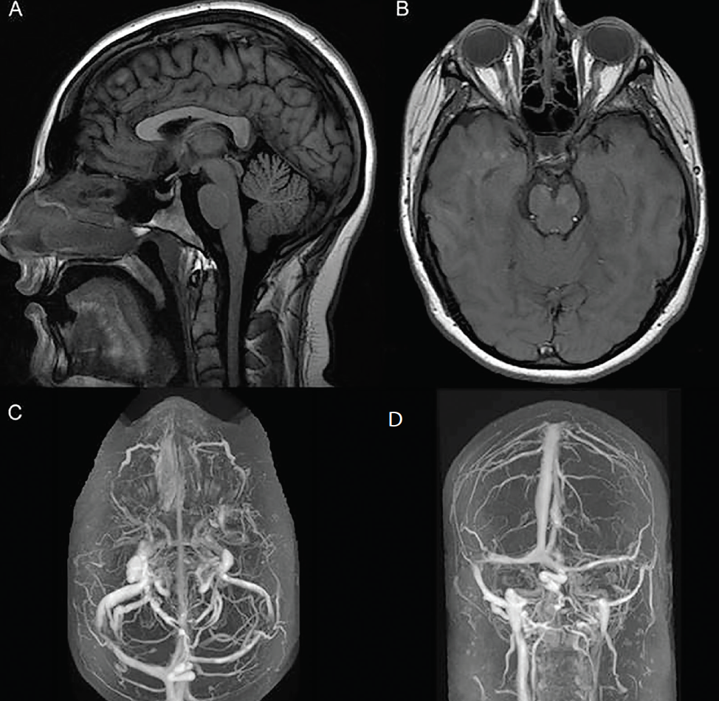
Idiopathic Intracranial Hypertension
A/w young obese women,
CSF opening pressure must be at least 25 cm H2O in the left lateral decubitus position
Papilledema
Other supporting features: pulsatile tinnitus, transient or progressive visual obscurations, and cranial nerve palsies (CN-6: false-localizing sign).
MRI and MR venography of the head: MRI features including an empty sella turcica, flattening of the posterior sclerae, enhancement and/or protrusion of the optic nerve heads, and tortuous orbital vessels.
Treatment: carbonic anhydrase inhibitor: Acetazolamide, topiramate
Serial lumbar punctures, ventriculoperitoneal shunting, optic nerve sheath fenestration, and bariatric surgery

Slide 34
