Slide 1
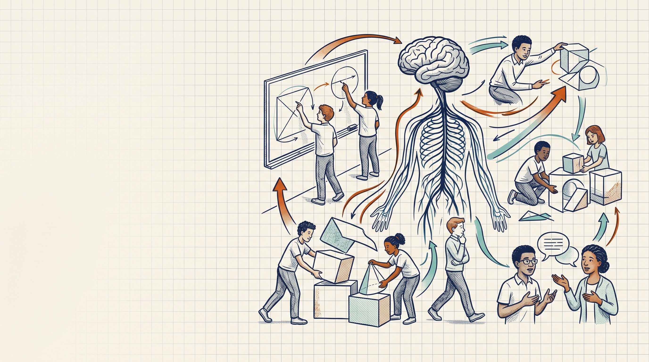
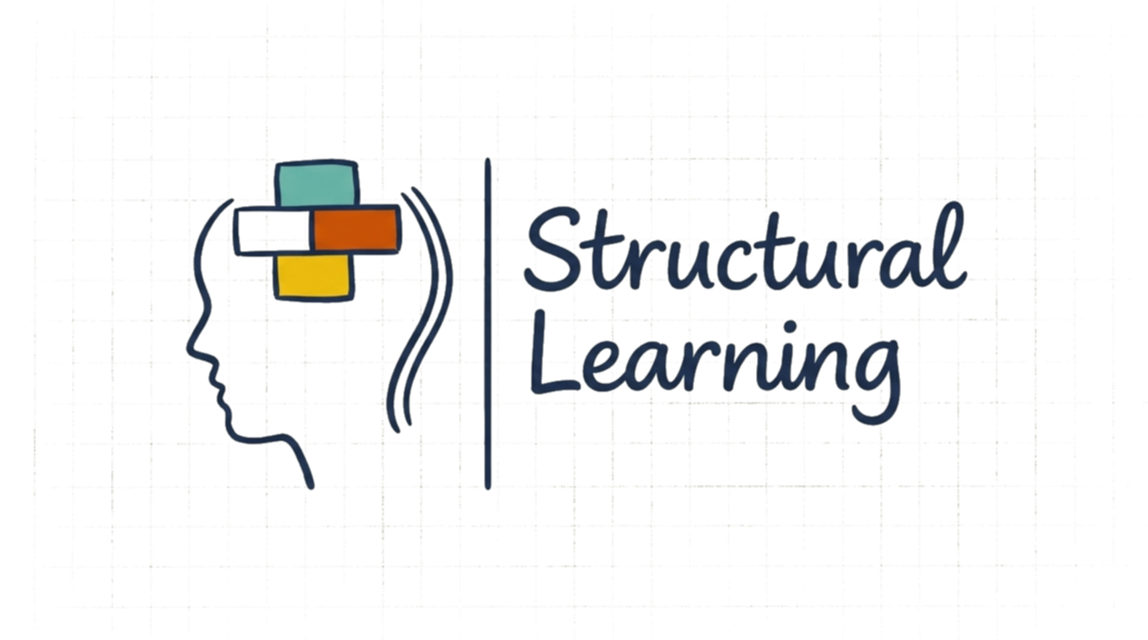
Embodied Cognition: Why Movement Helps Pupils Learn
A teacher's briefing

Slide 2
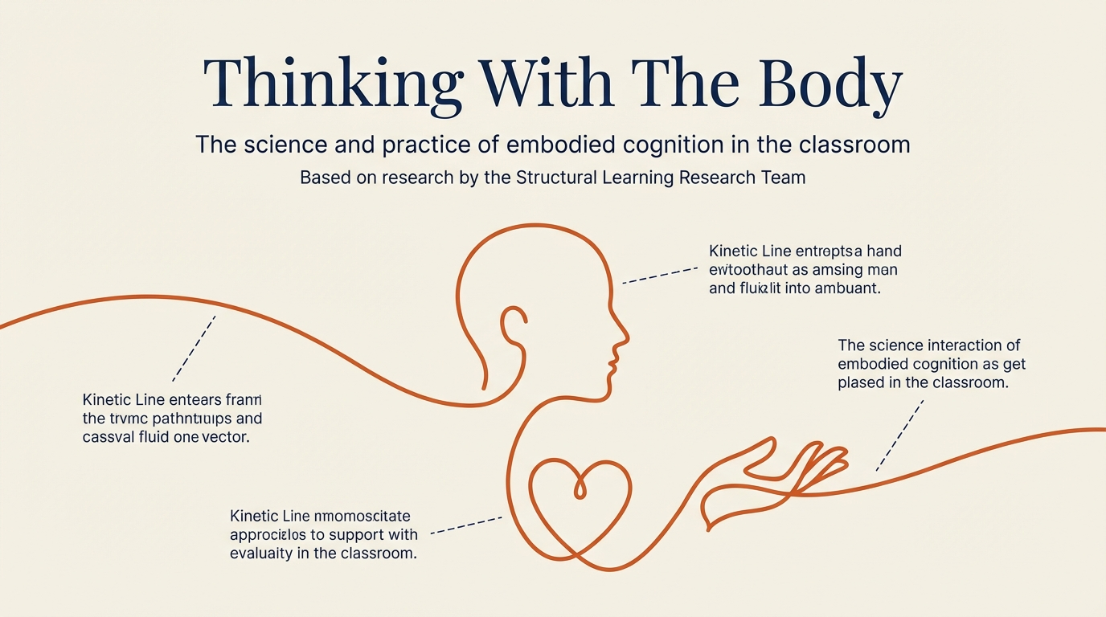
Structural Learning

Slide 3
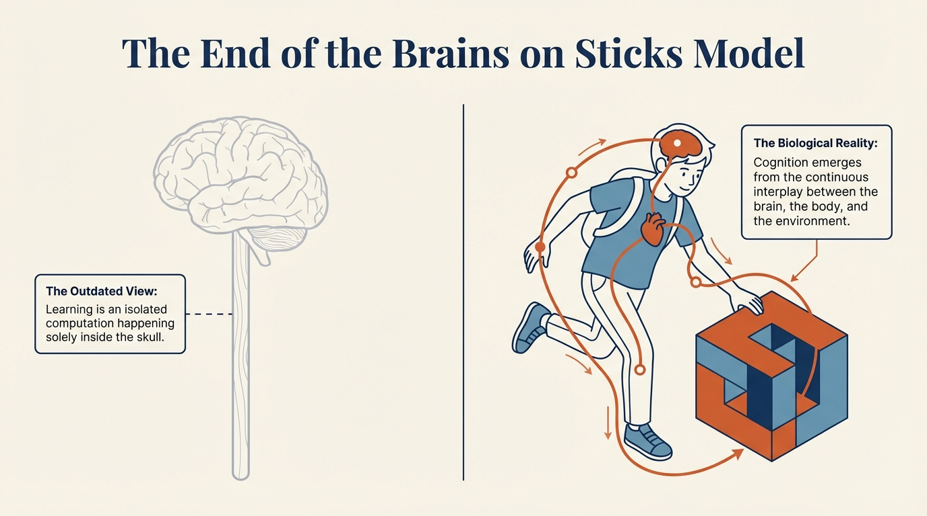
Structural Learning

Slide 4
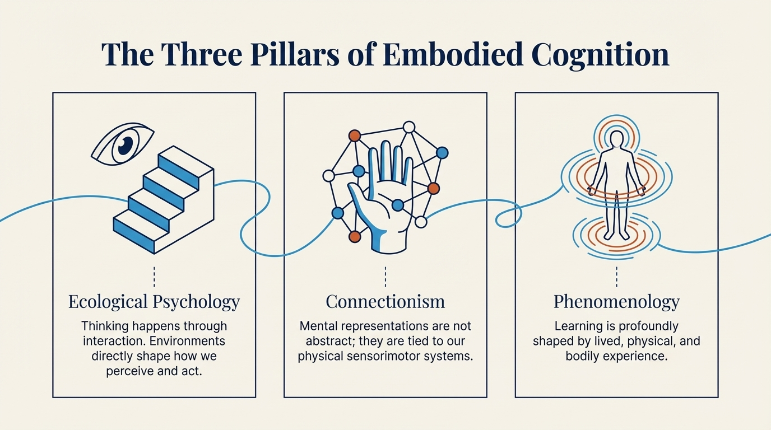
Structural Learning

Slide 5
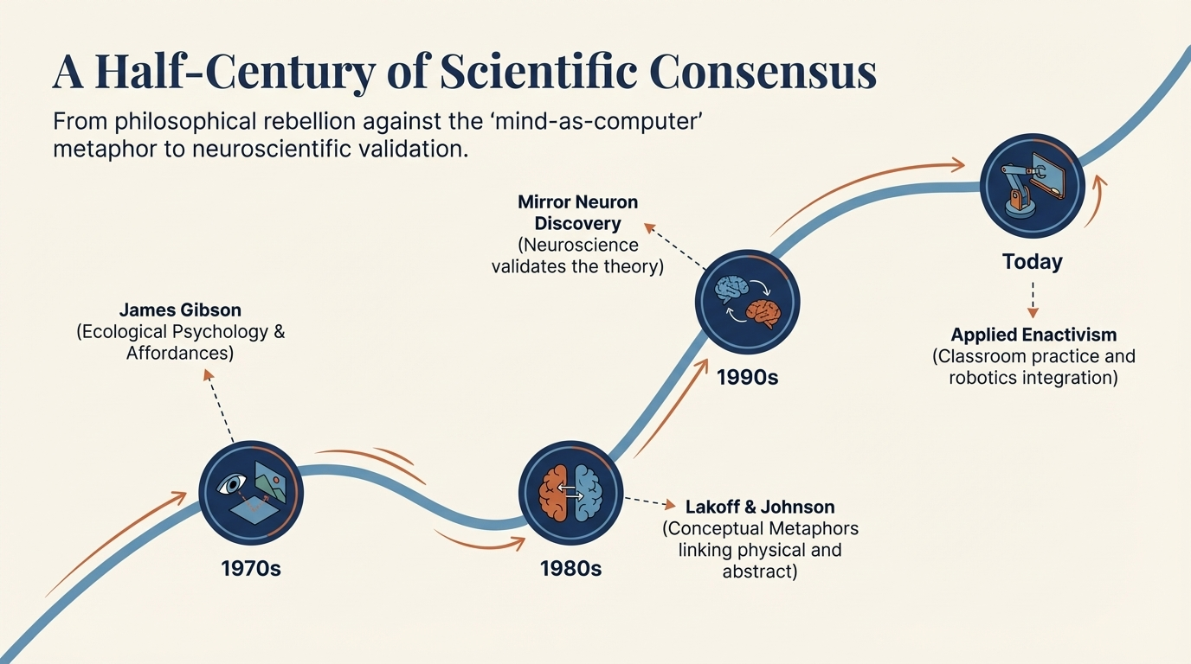
Structural Learning

Slide 6
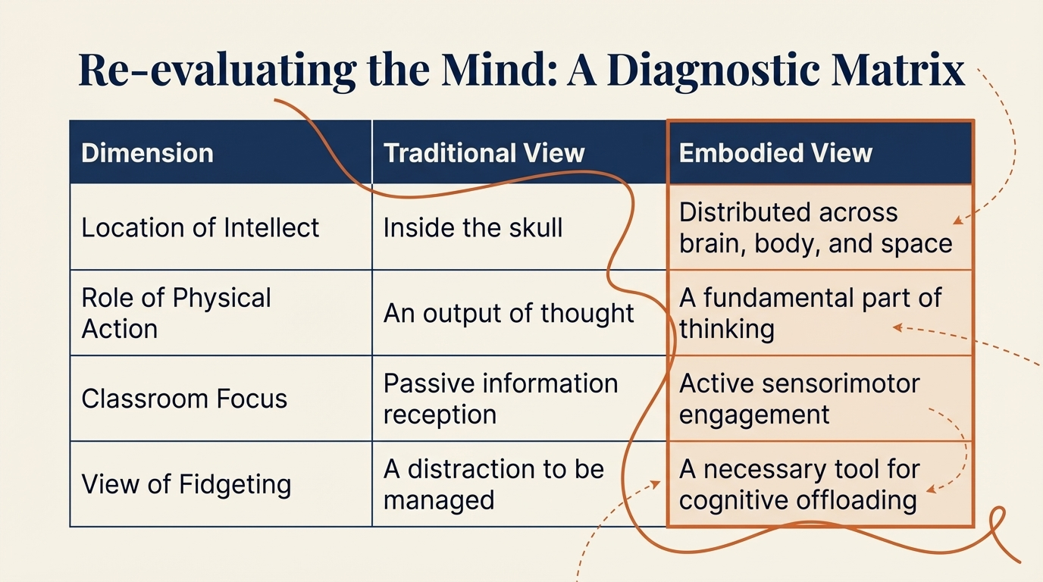
Structural Learning

Slide 7
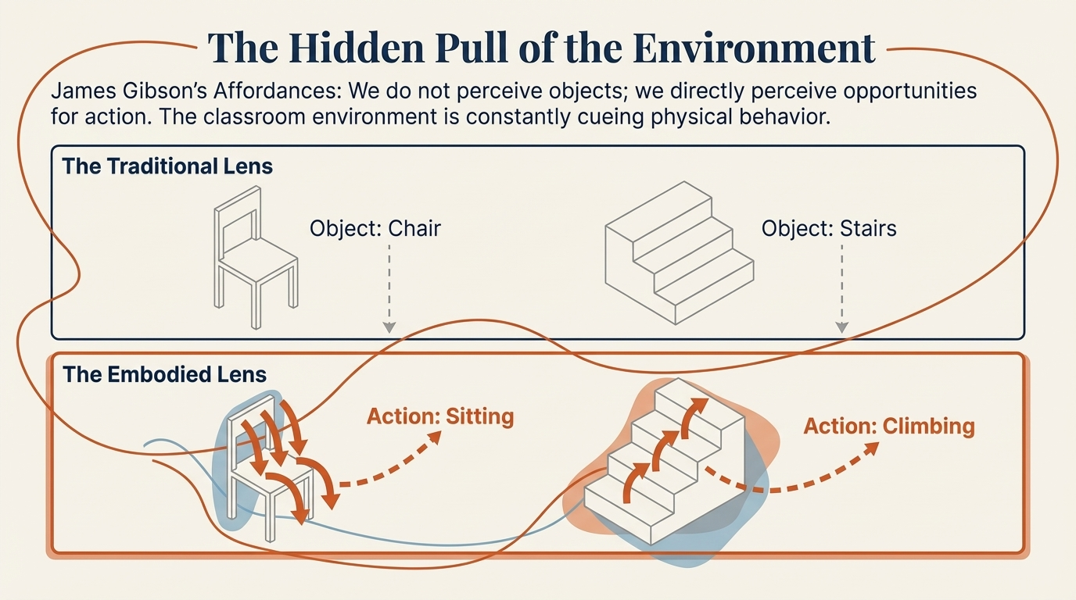
Structural Learning

Slide 8
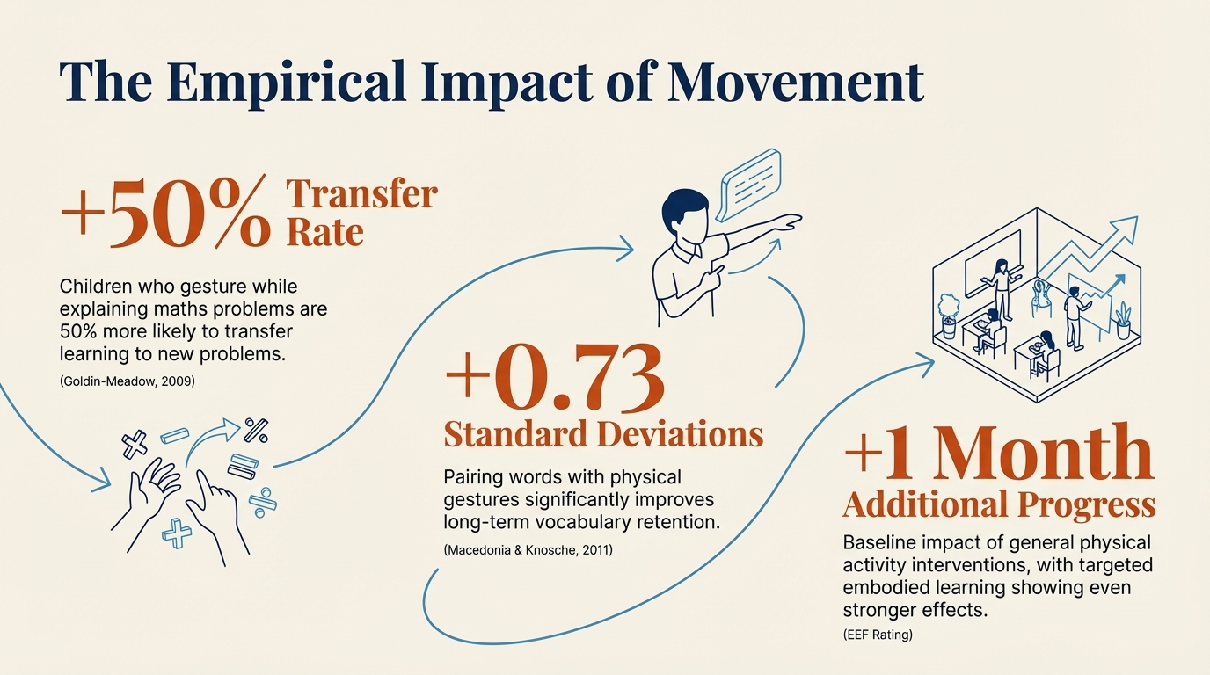
Structural Learning

Slide 9
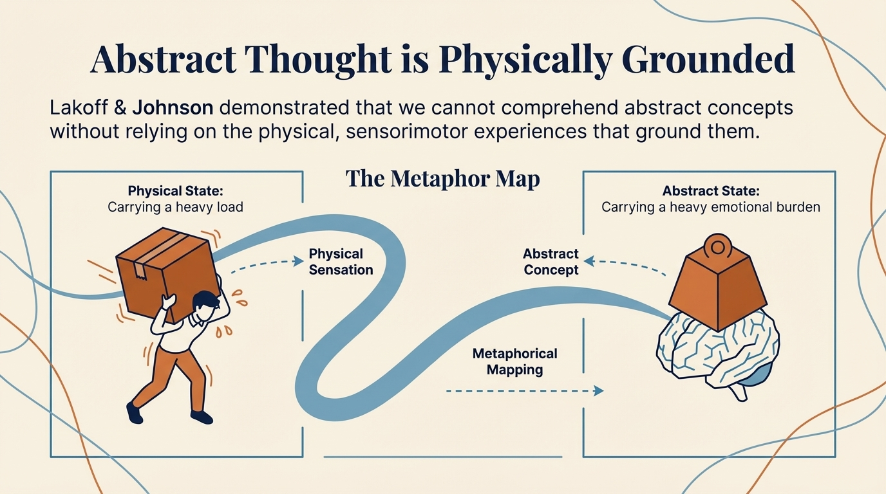
Structural Learning

Slide 10
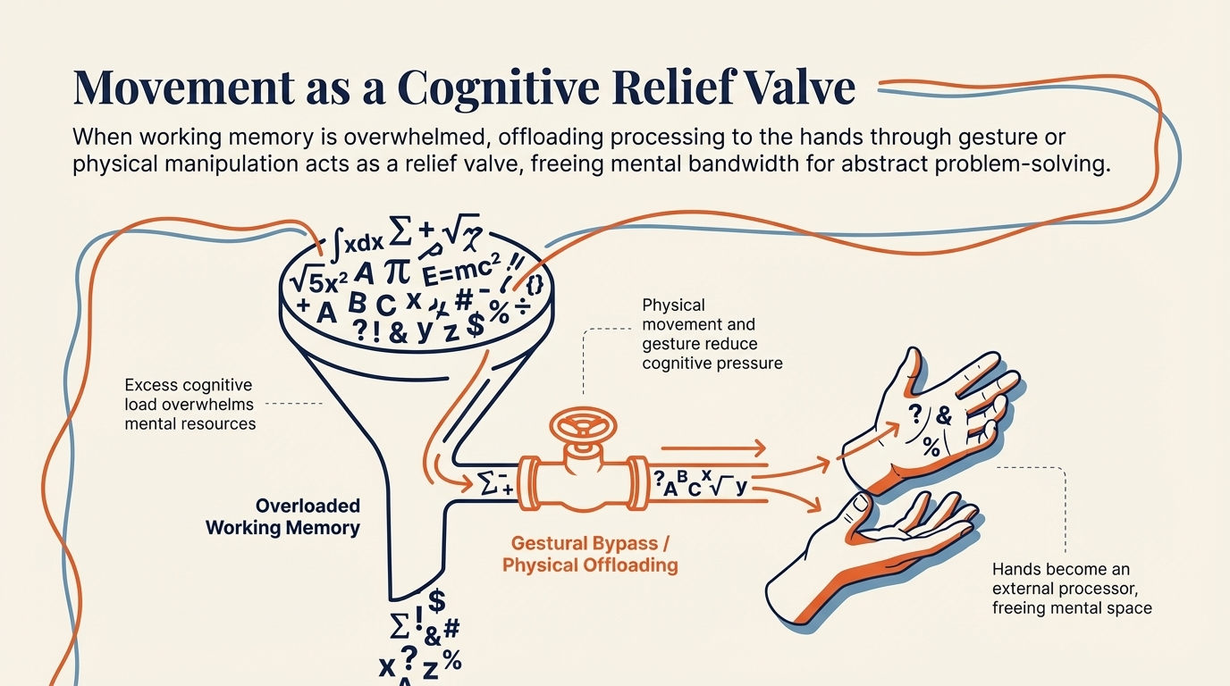
Structural Learning

Slide 11
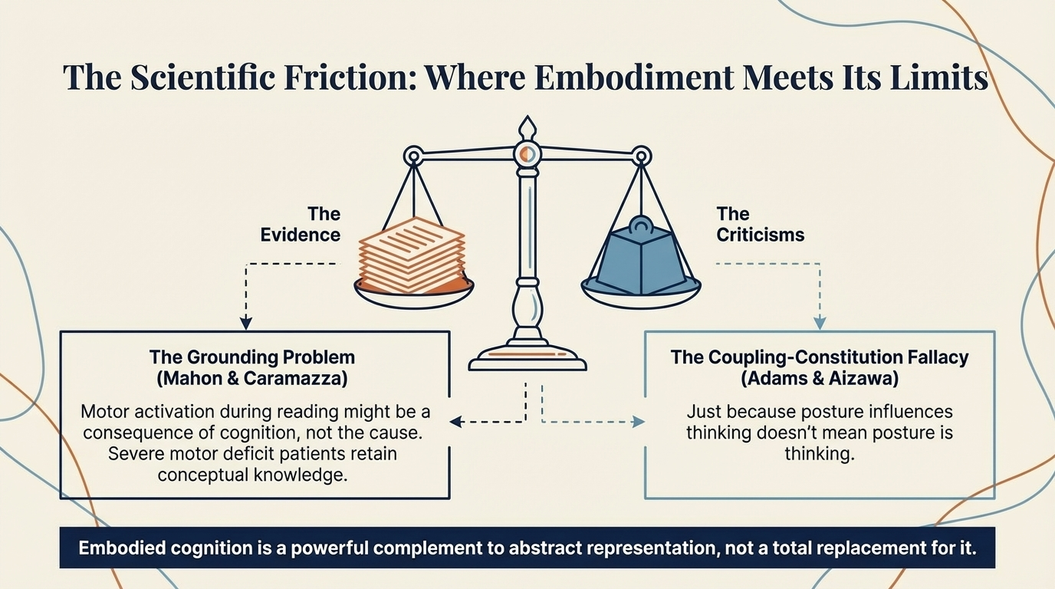
Structural Learning

Slide 12
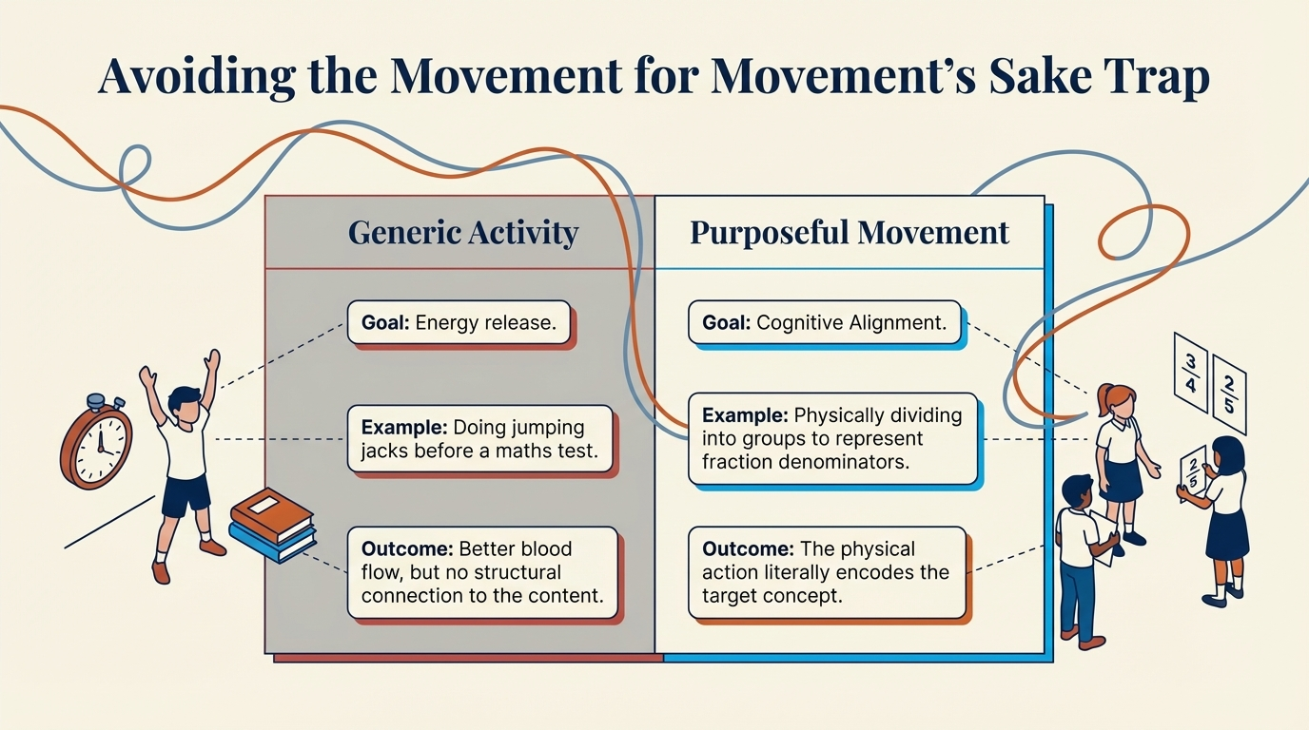
Structural Learning

Slide 13
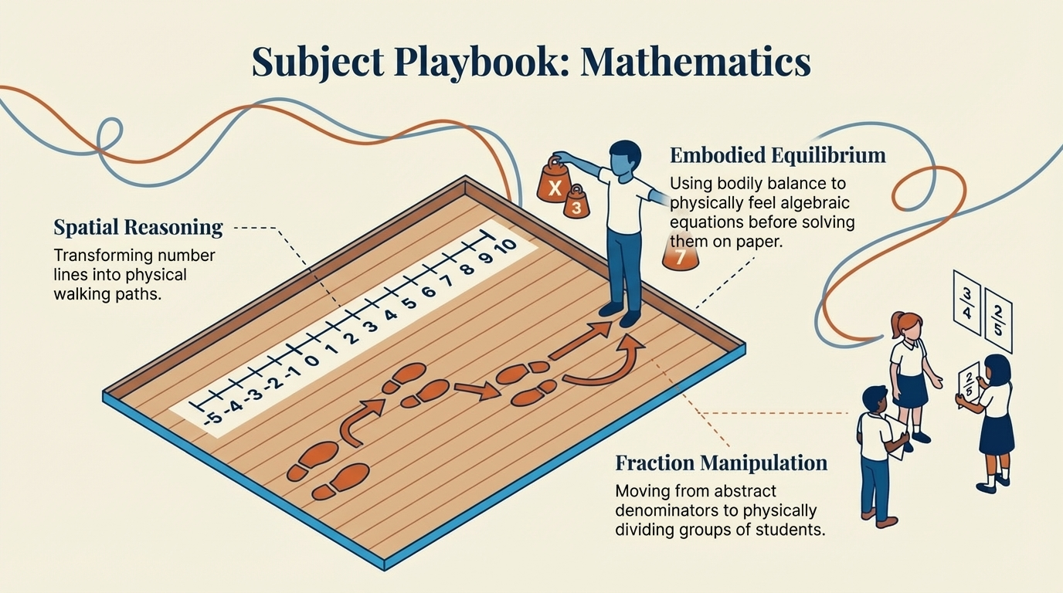
Structural Learning

Slide 14
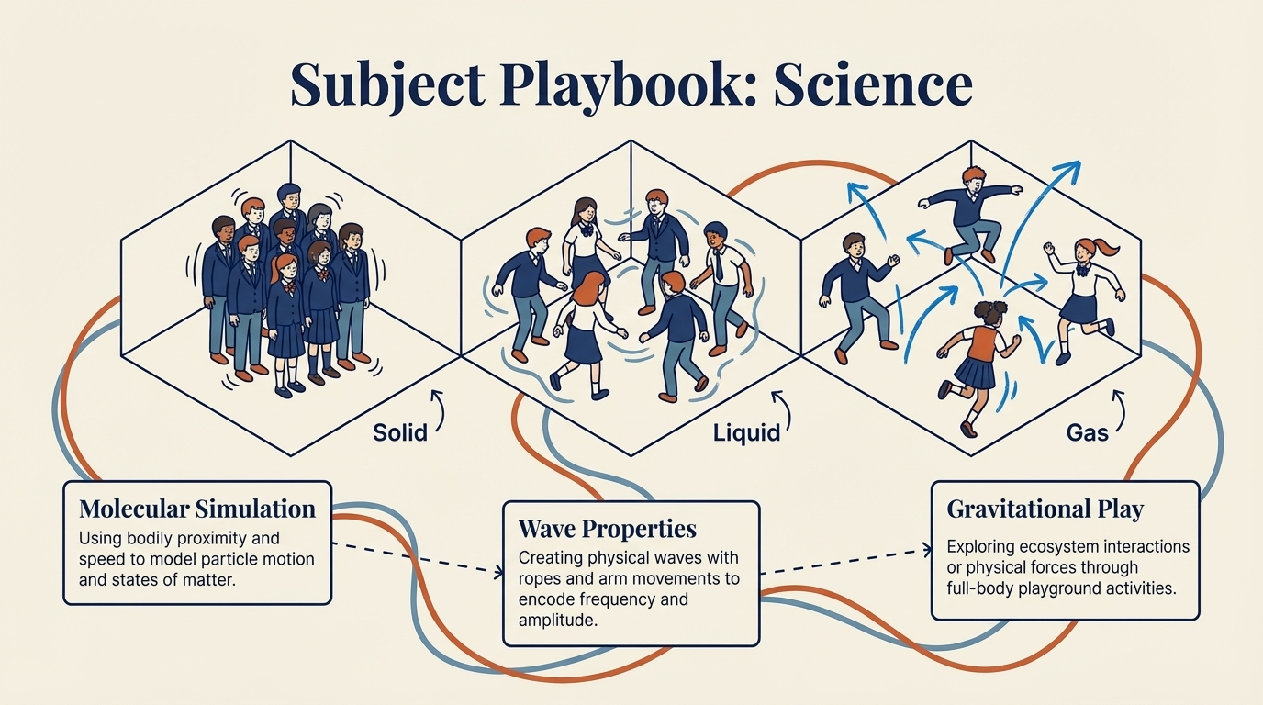
Structural Learning

Slide 15
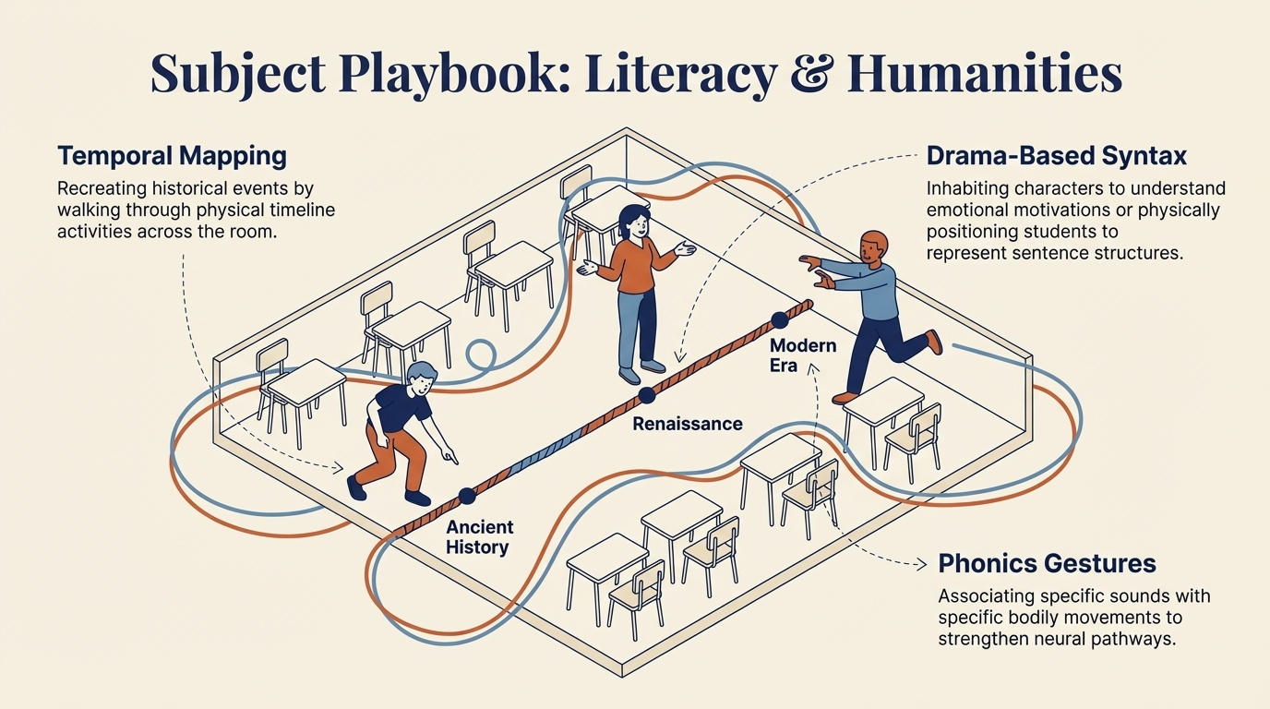
Structural Learning

Slide 16
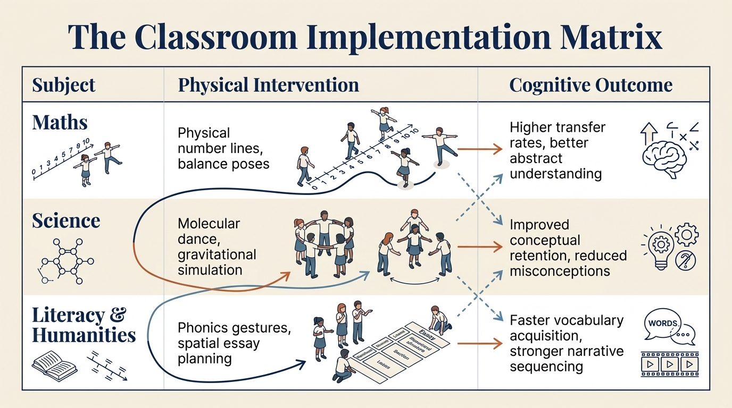
Structural Learning

Slide 17
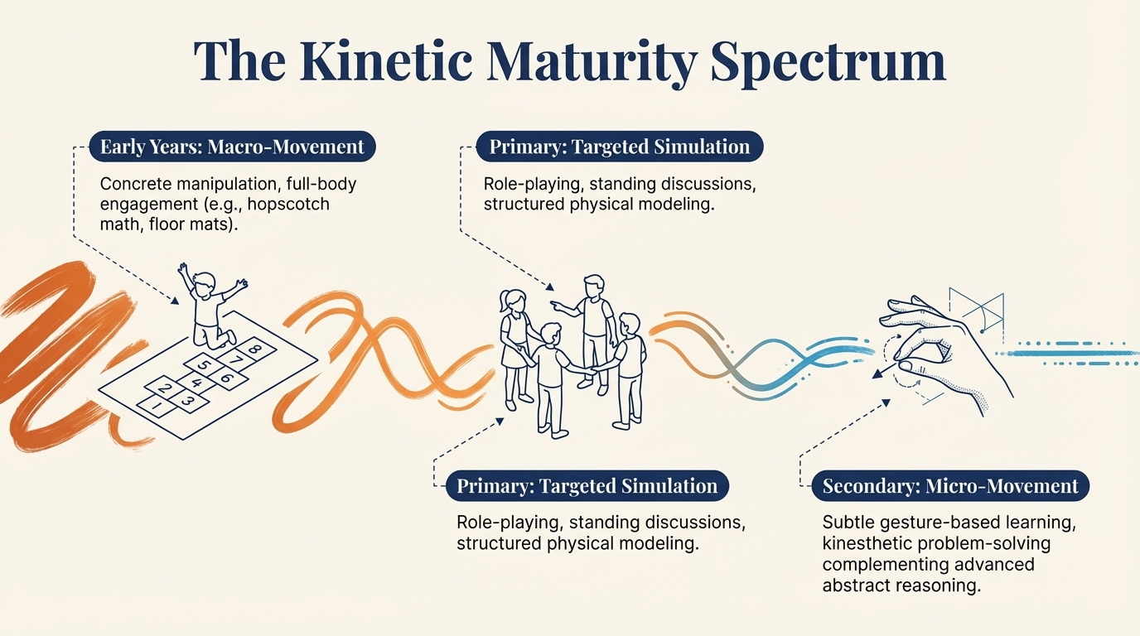
Structural Learning

Slide 18
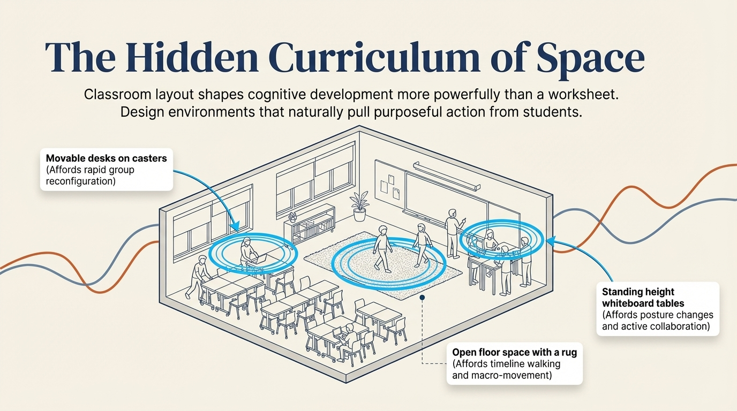
Structural Learning

Slide 19
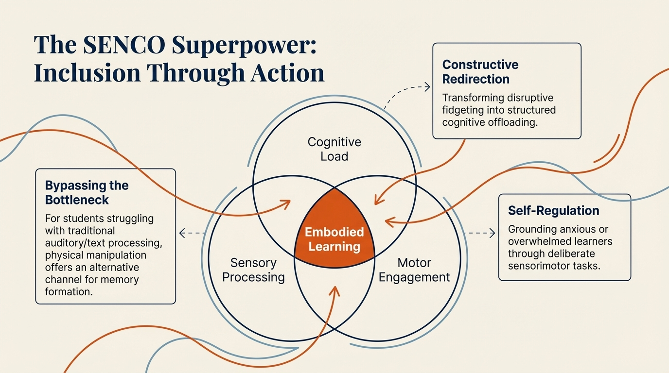
Structural Learning

Slide 20
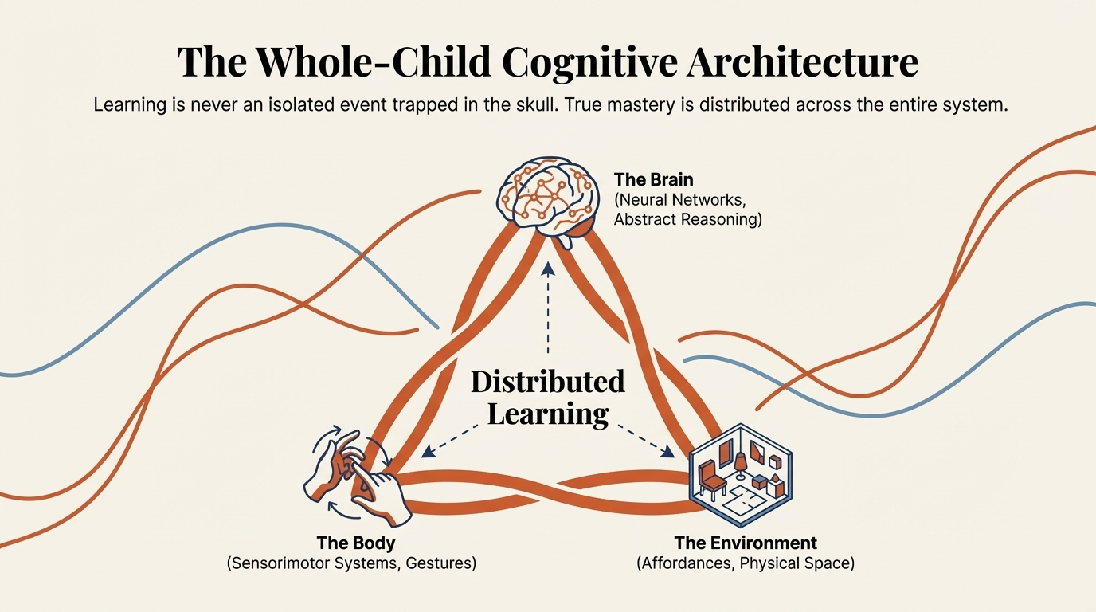
Structural Learning

Slide 21
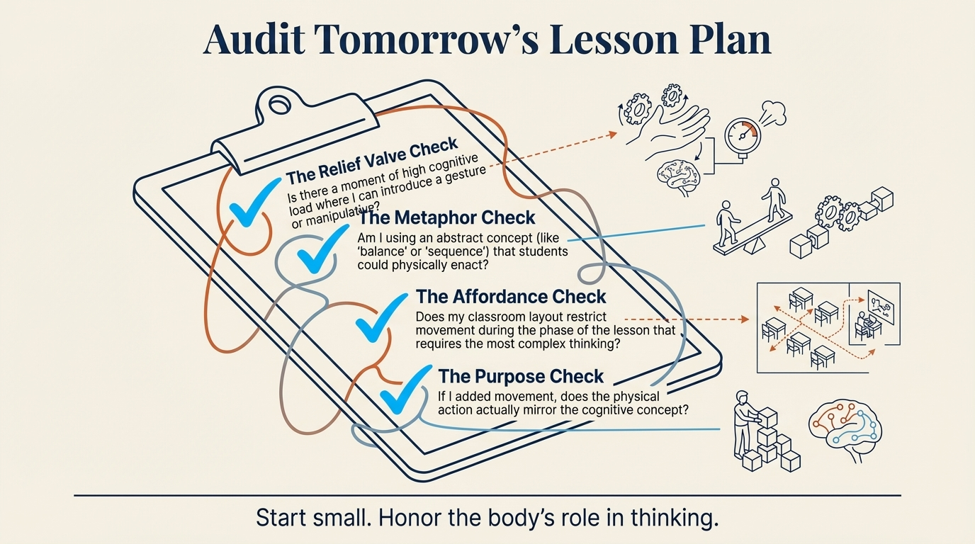
Structural Learning

Slide 22

Read the full guide
structural-learning.com/post/embodied-cognition

