Slide 1
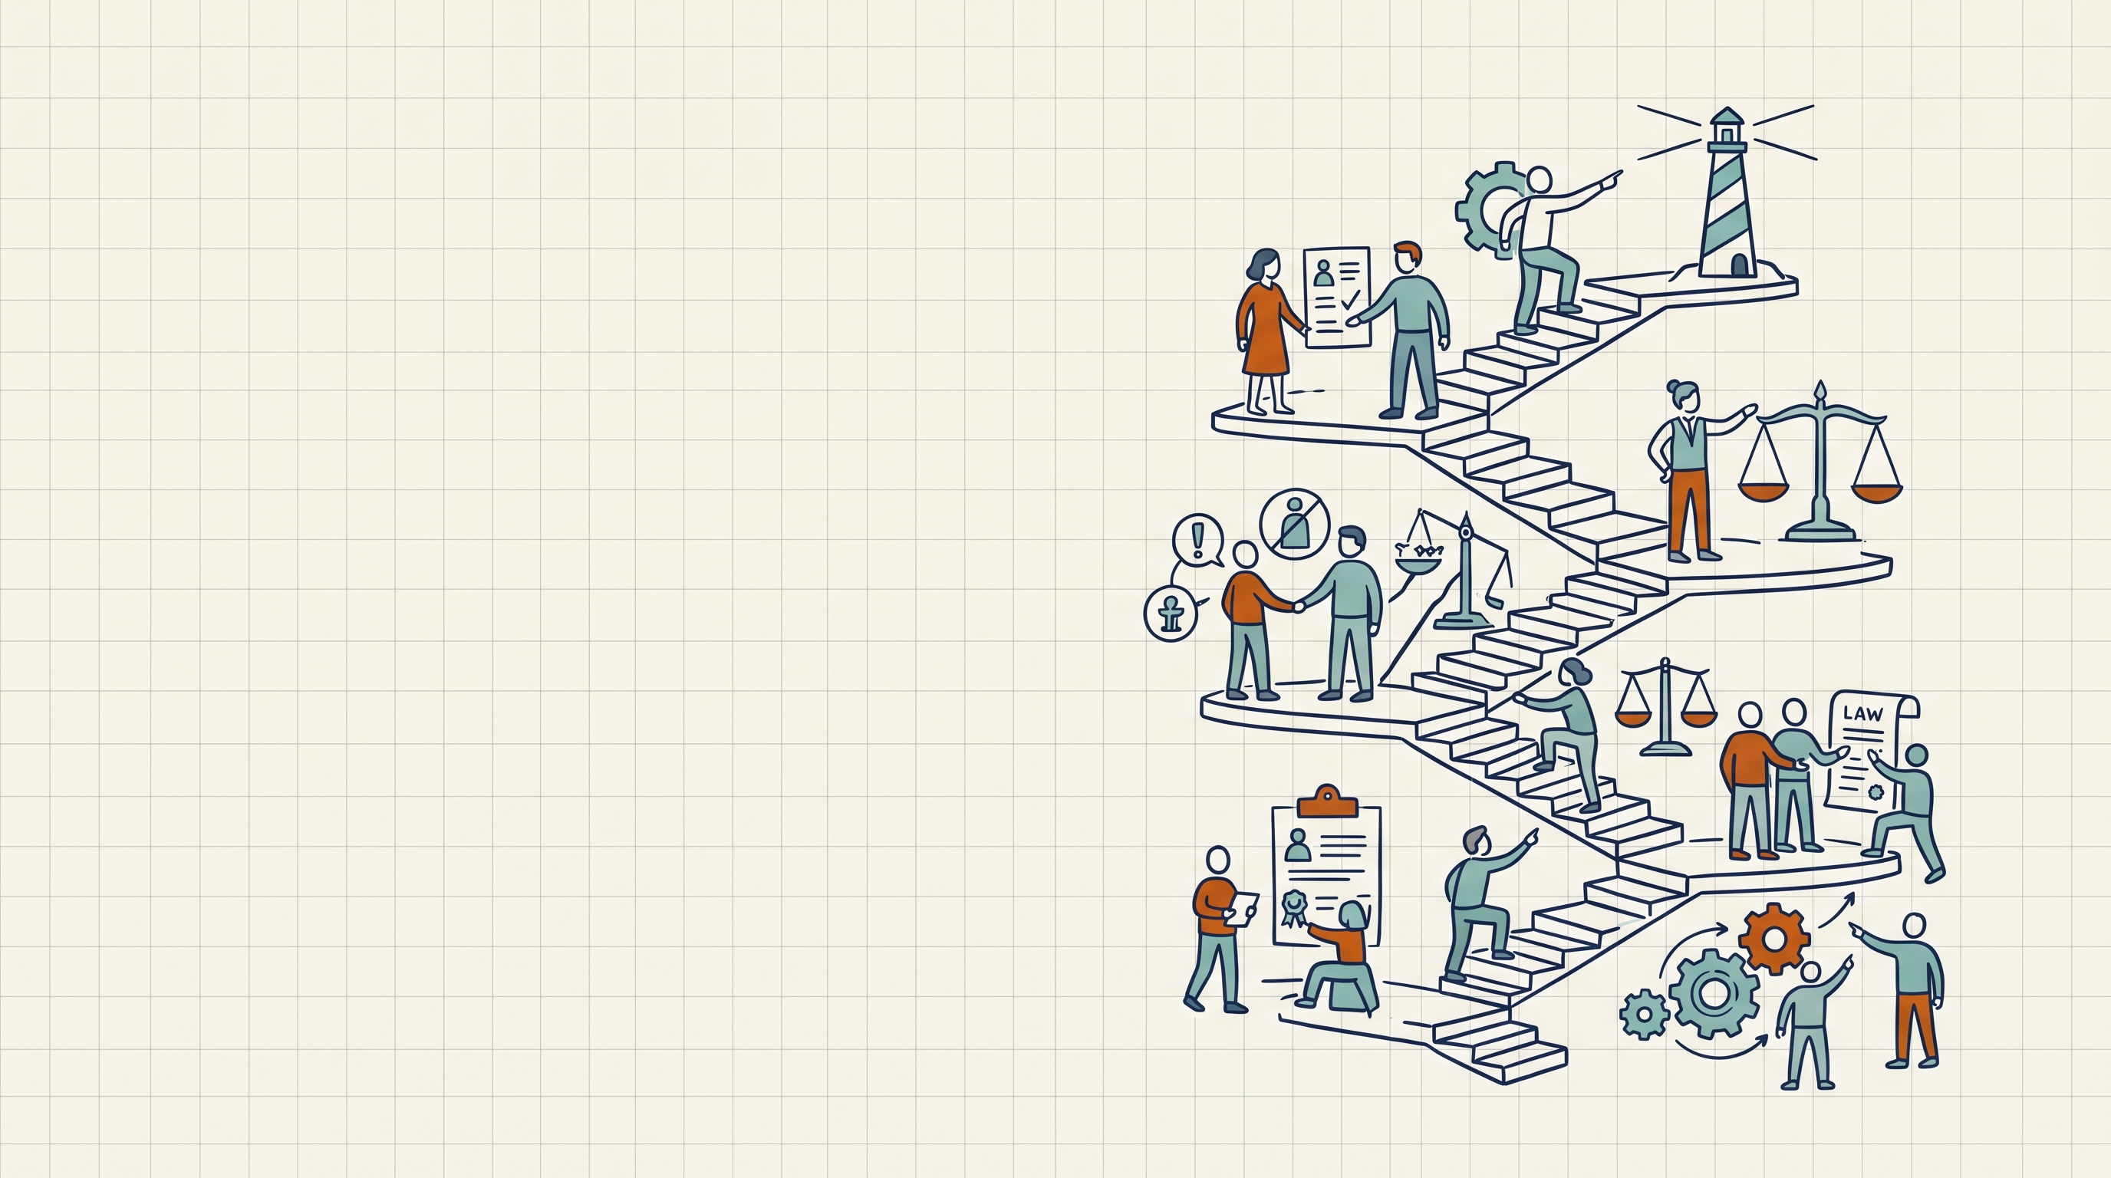
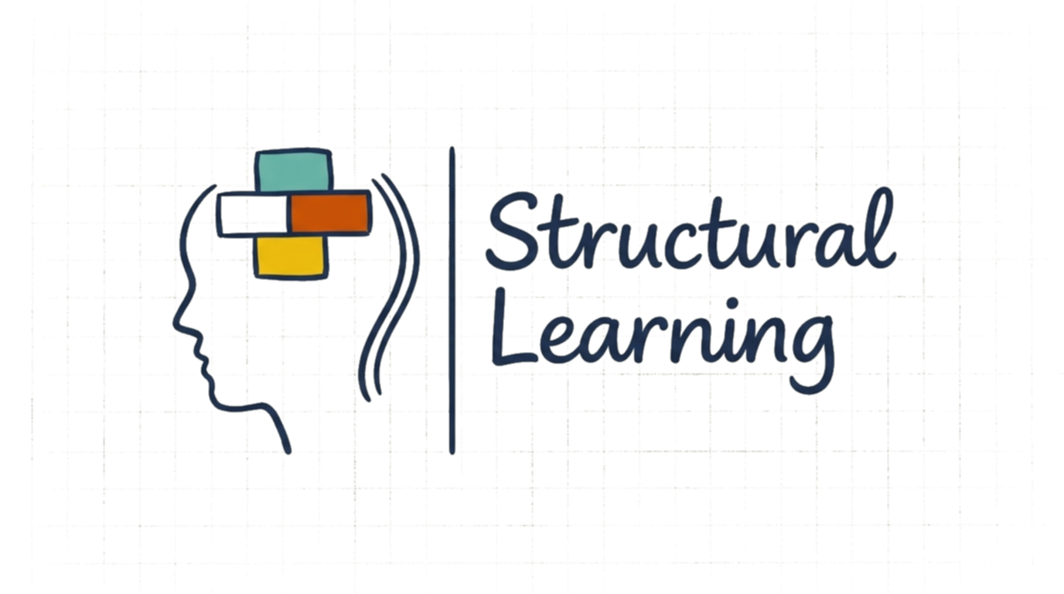
Kohlberg's 6 Stages of Moral Development for Teachers
A teacher's briefing

Slide 2
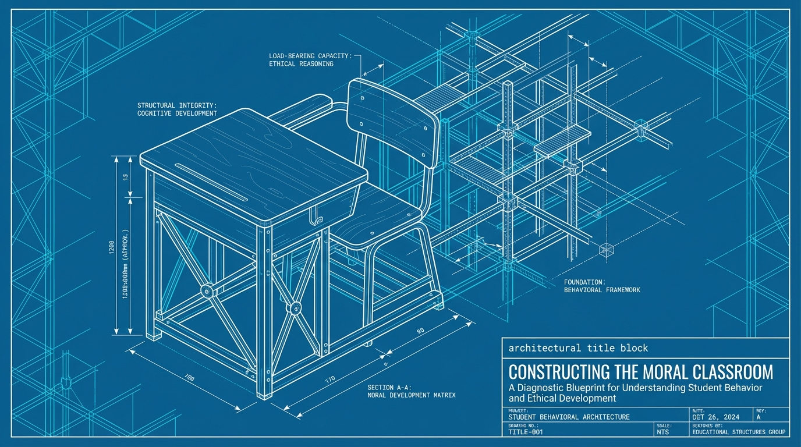
Structural Learning

Slide 3
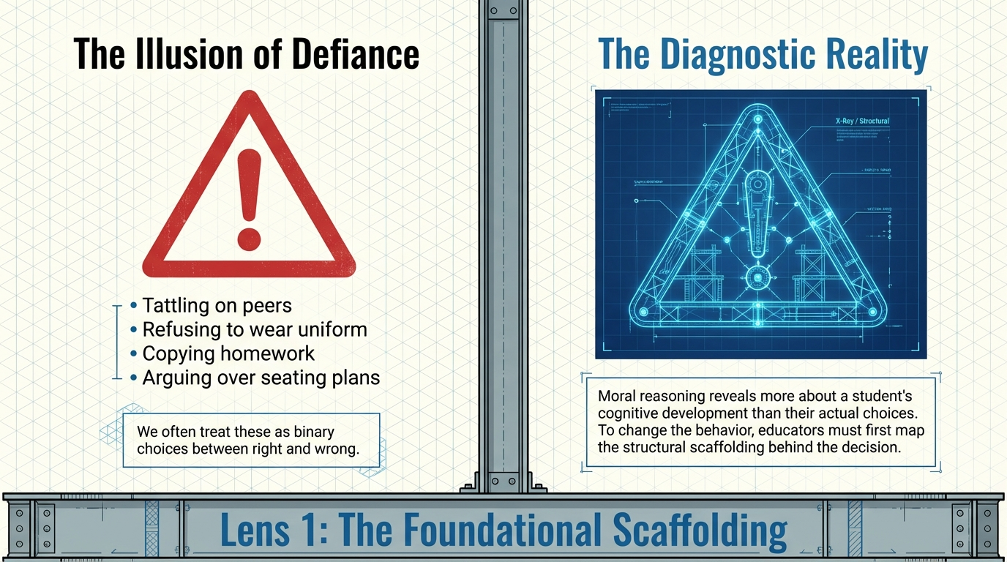
Structural Learning

Slide 4
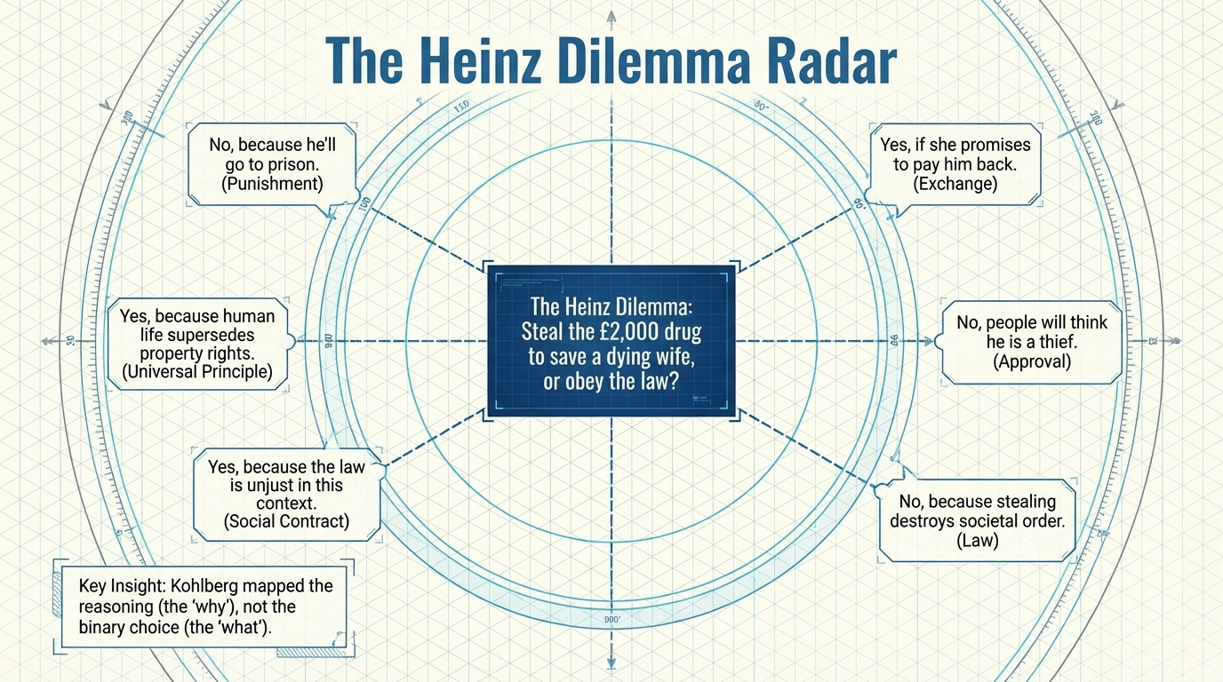
Structural Learning

Slide 5
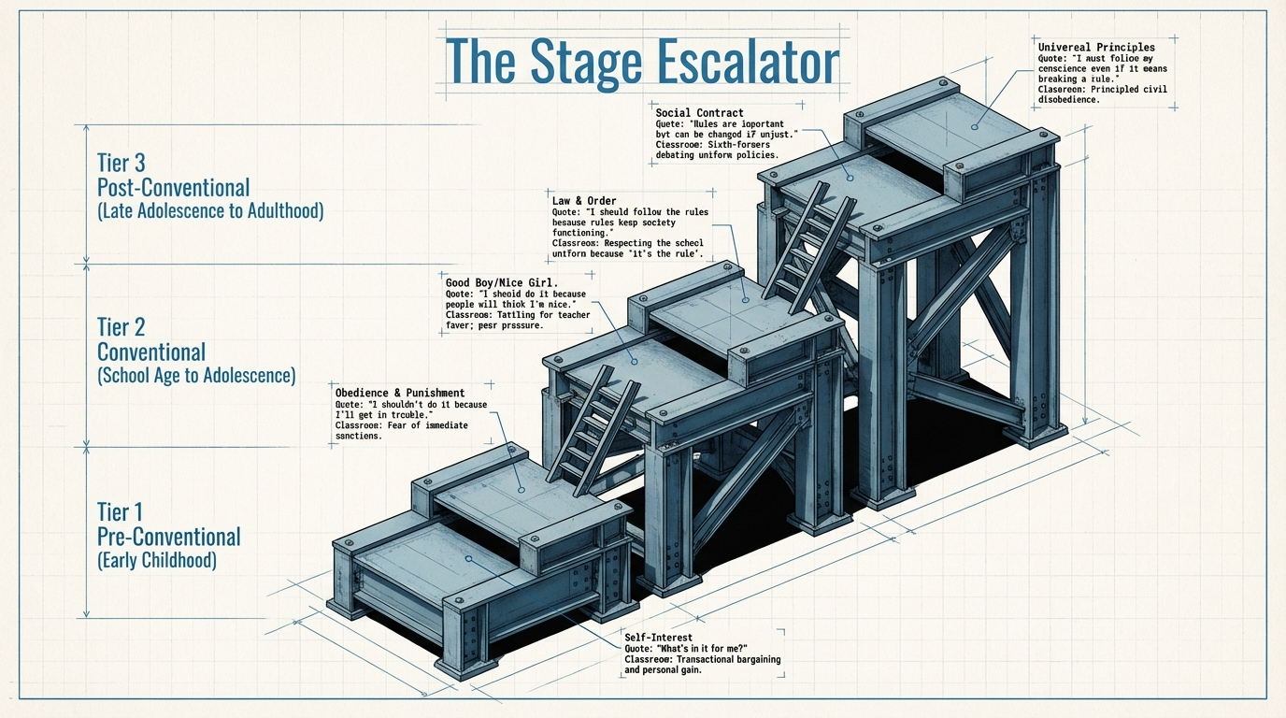
Structural Learning

Slide 6
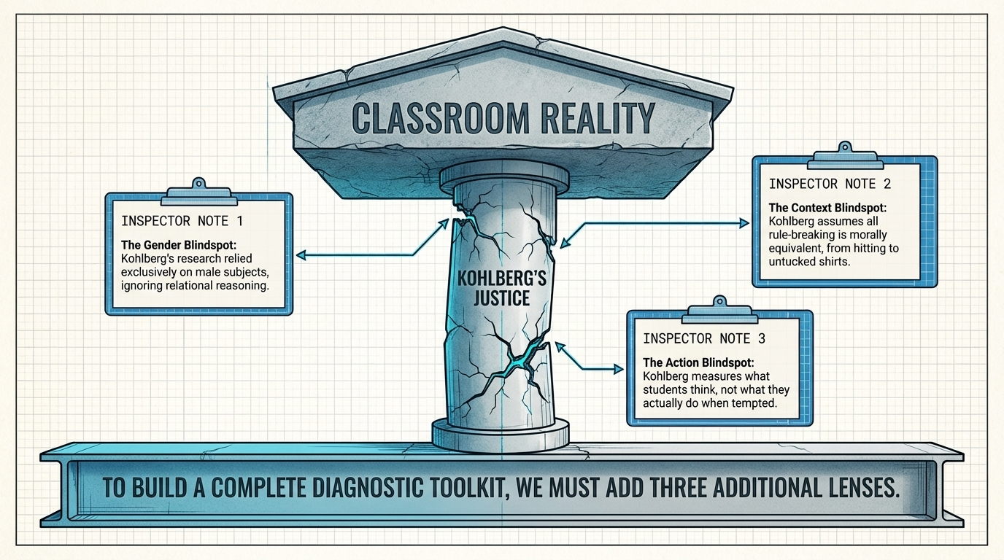
Structural Learning

Slide 7
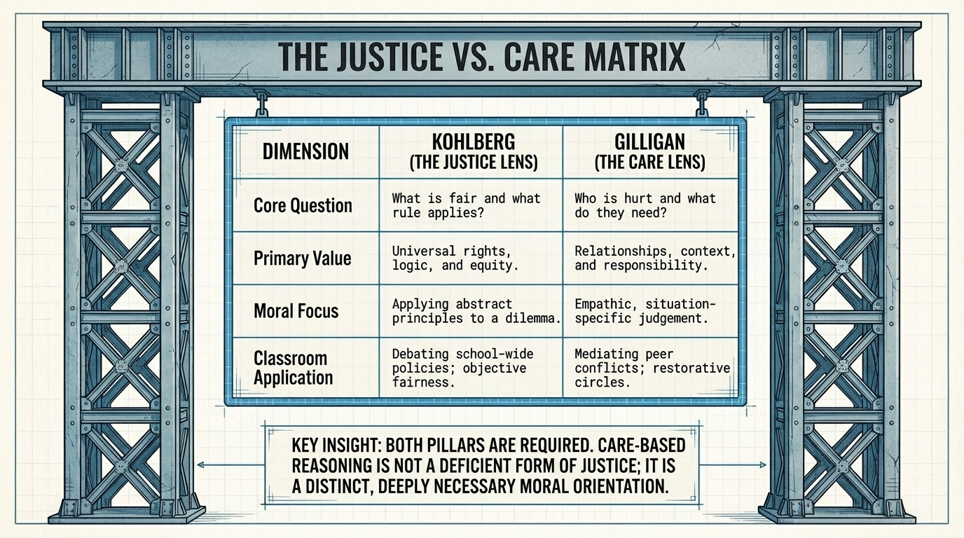
Structural Learning

Slide 8
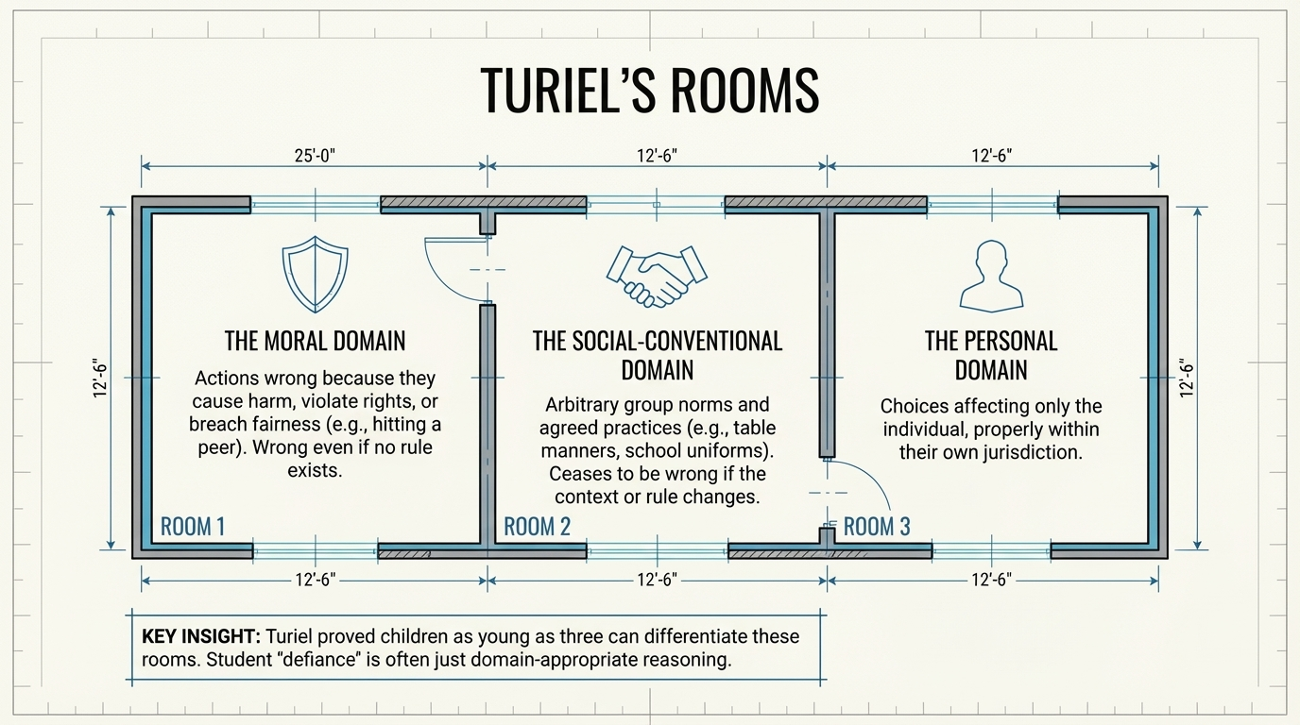
Structural Learning

Slide 9
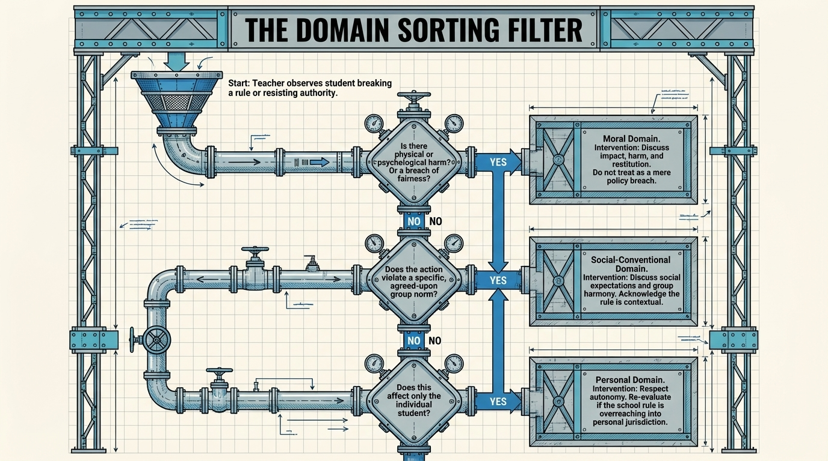
Structural Learning

Slide 10
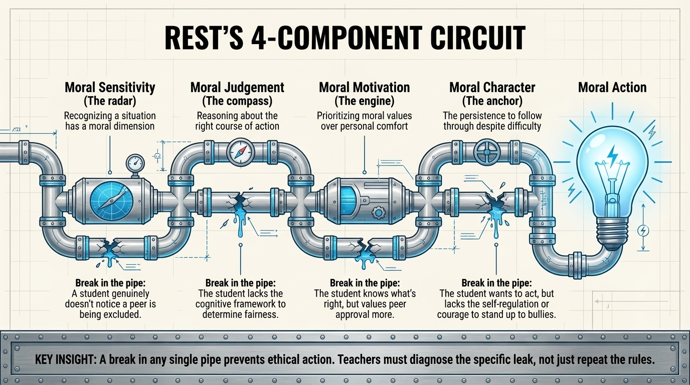
Structural Learning

Slide 11
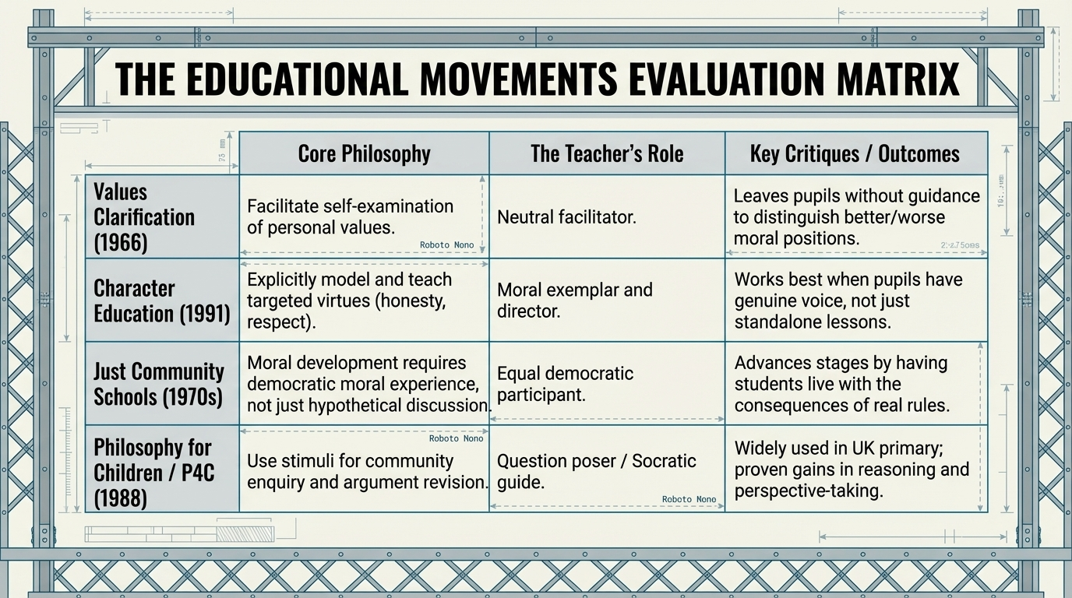
Structural Learning

Slide 12
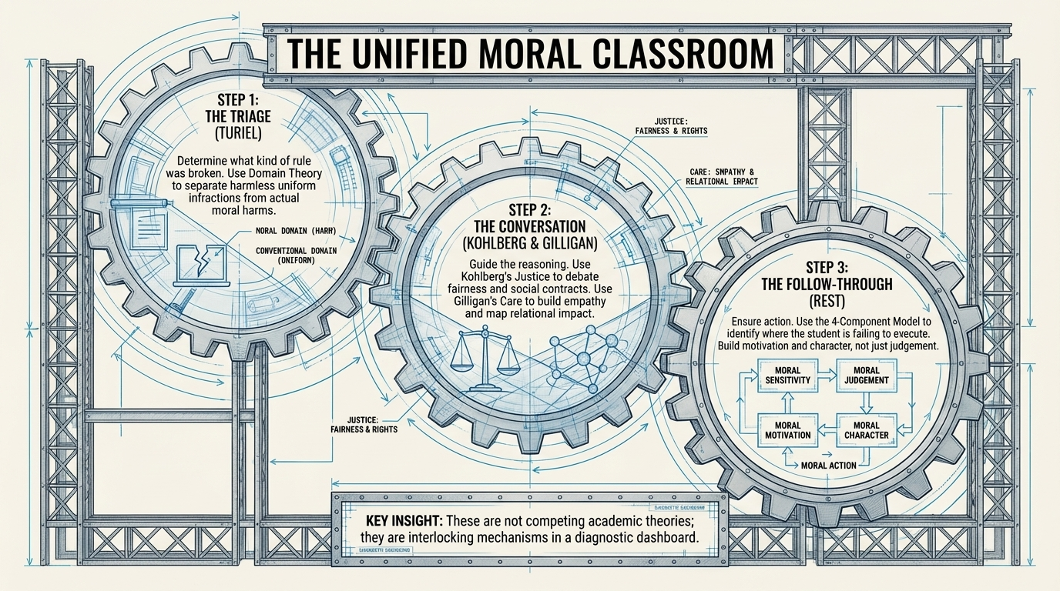
Structural Learning

Slide 13
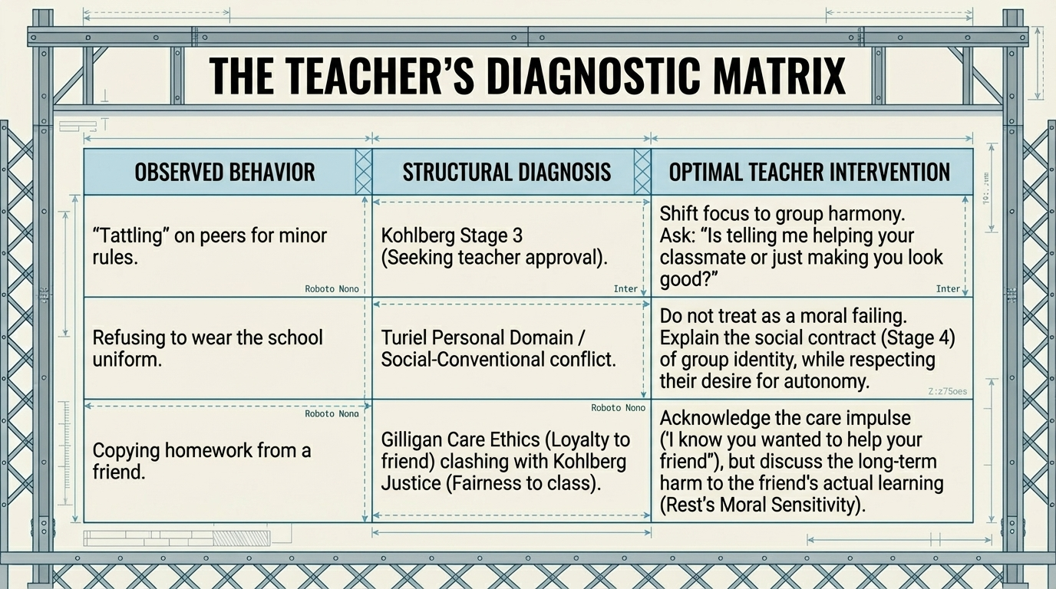
Structural Learning

Slide 14
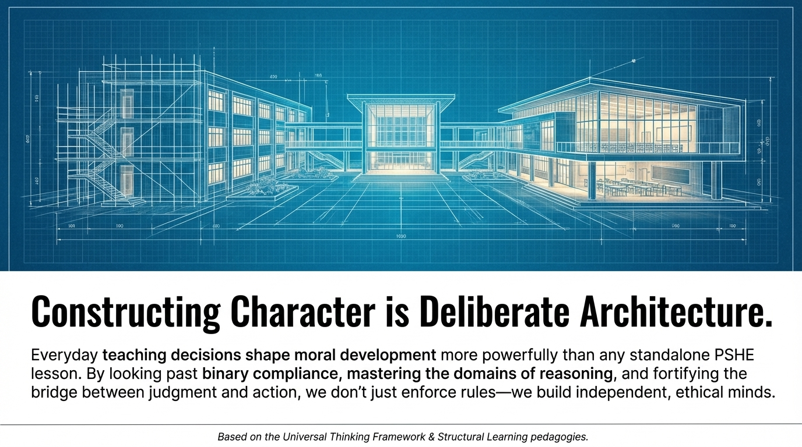
Structural Learning

Slide 15

Read the full guide
structural-learning.com/post/kohlbergs-moral-development-stages

