Slide 1

The Testing Effect: Why Retrieval Practice Works
A teacher's briefing

Slide 2
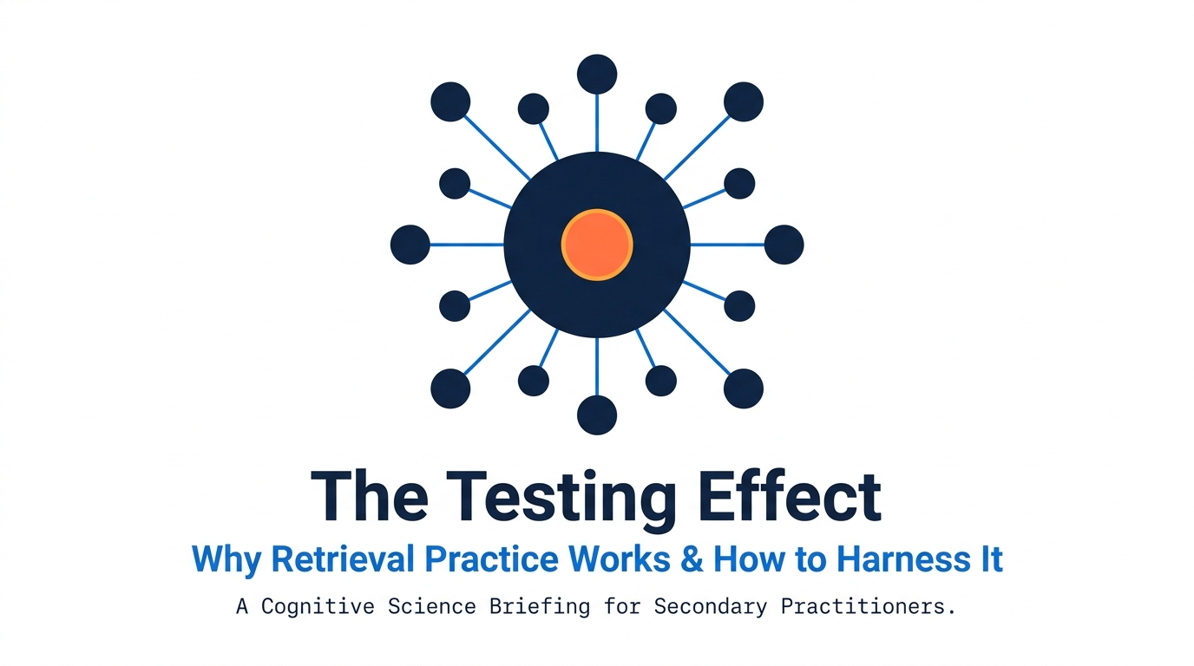
Structural Learning

Slide 3
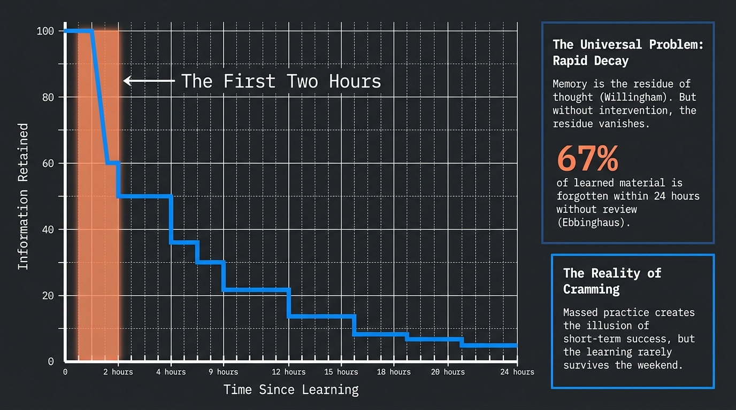
Structural Learning

Slide 4
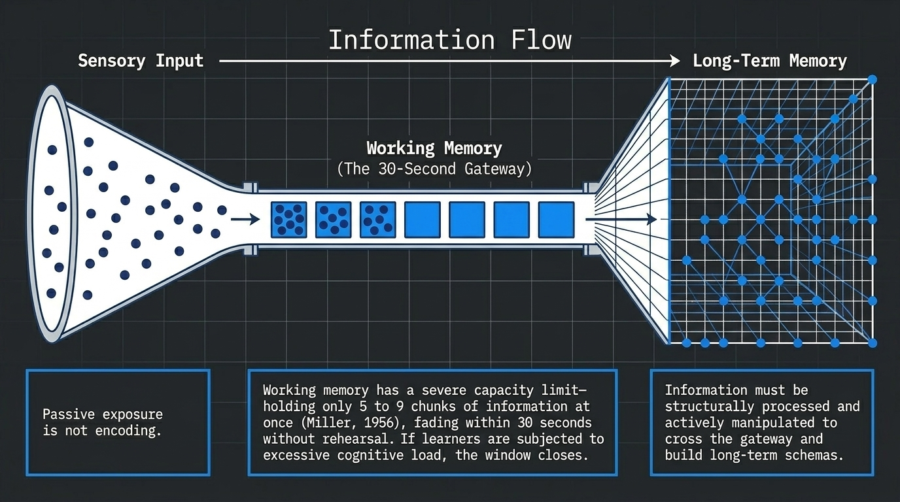
Structural Learning

Slide 5
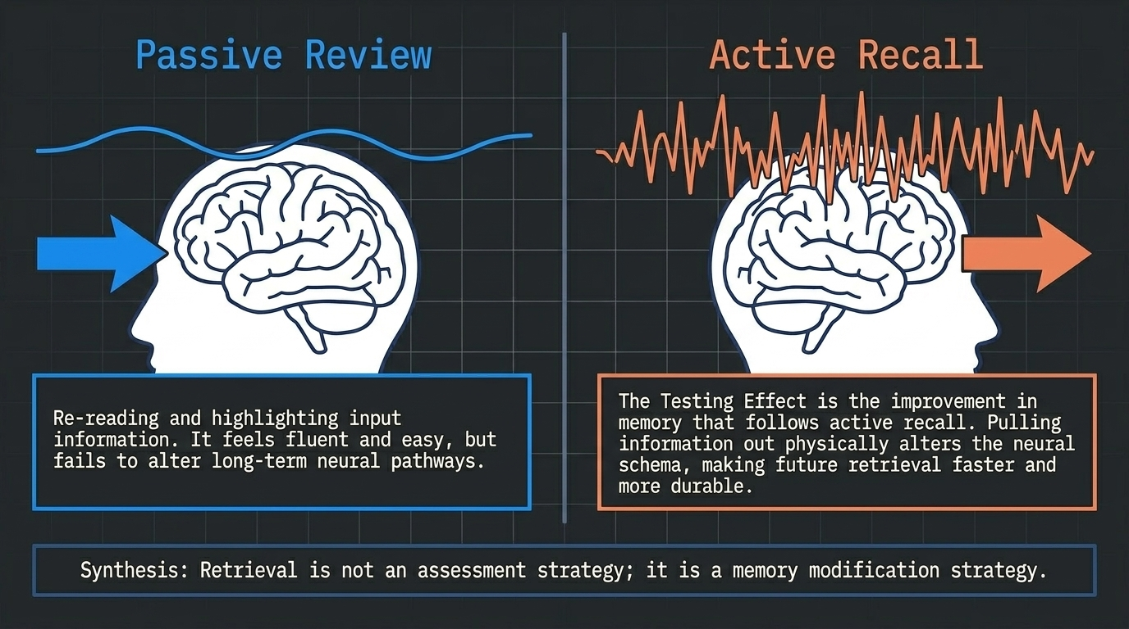
Structural Learning

Slide 6
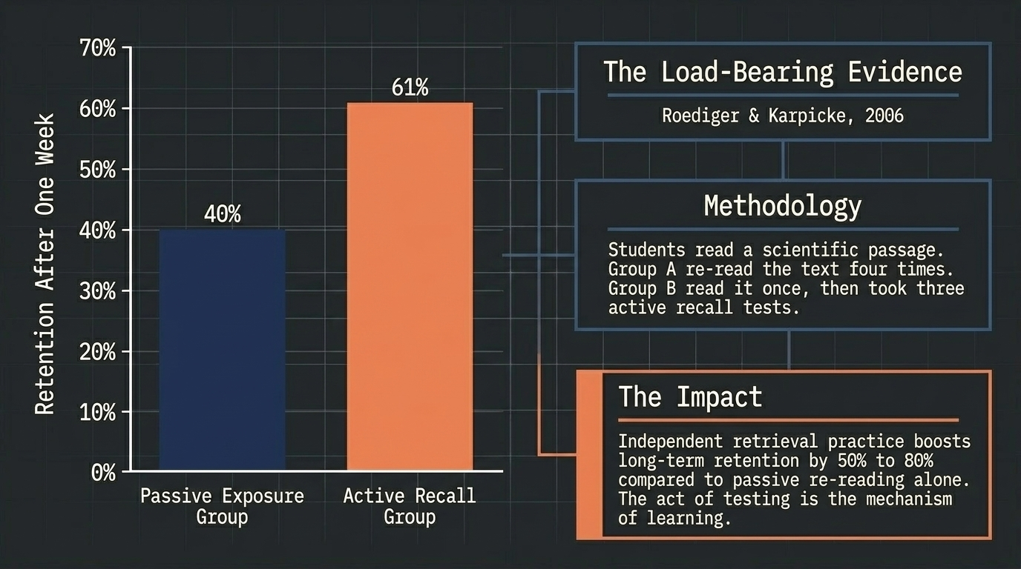
Structural Learning

Slide 7
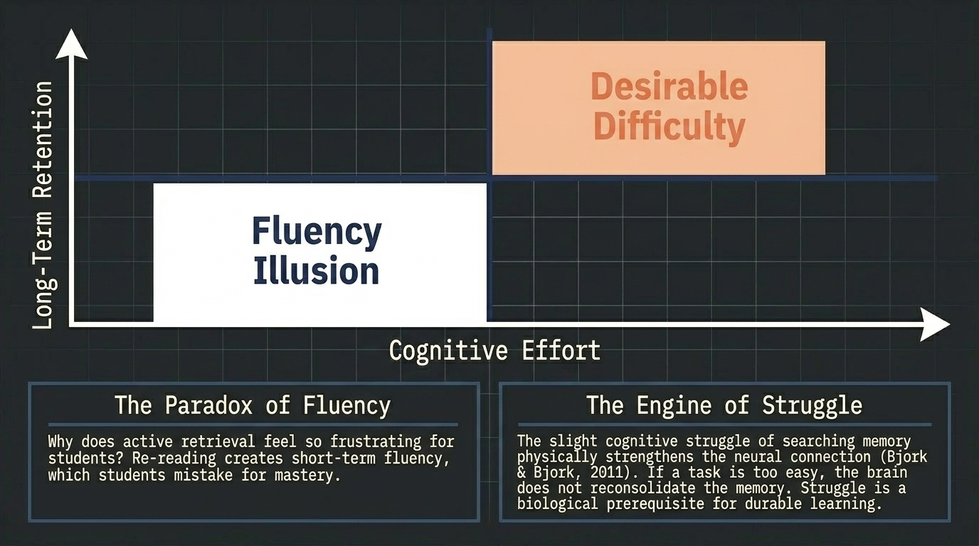
Structural Learning

Slide 8
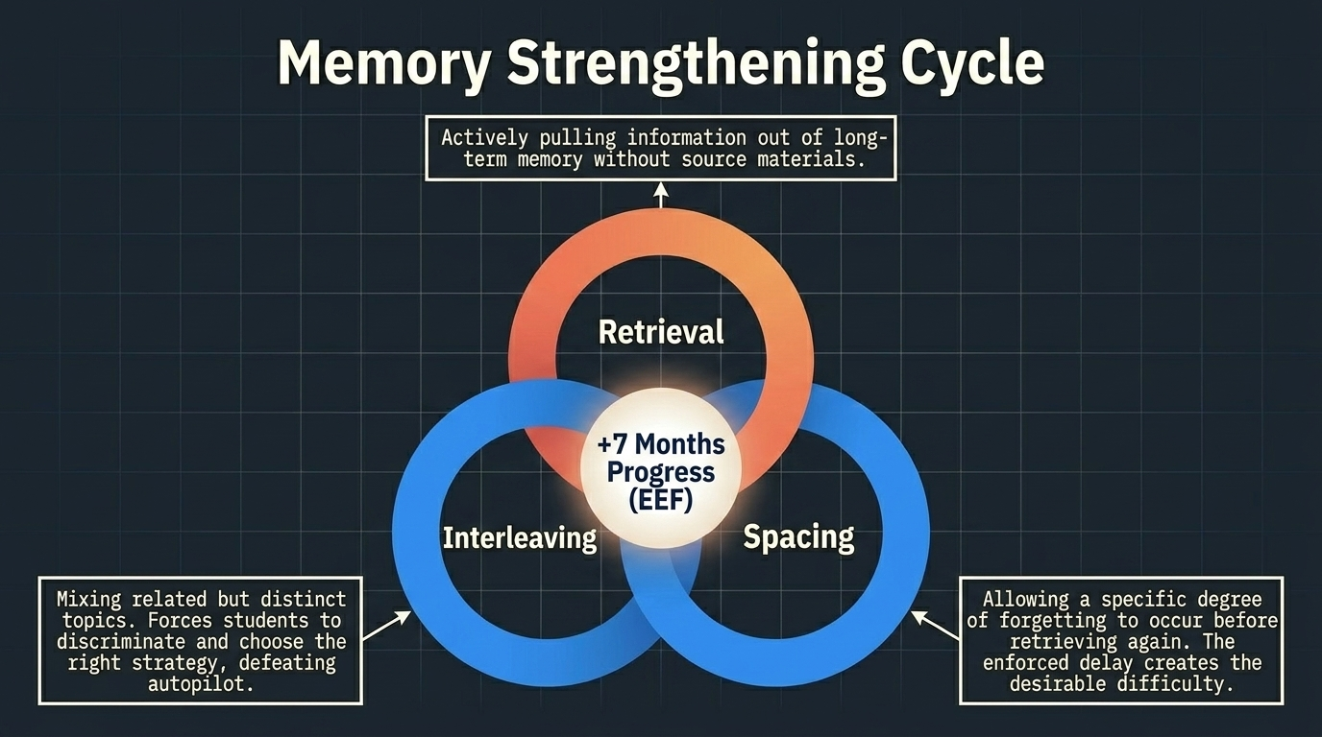
Structural Learning

Slide 9
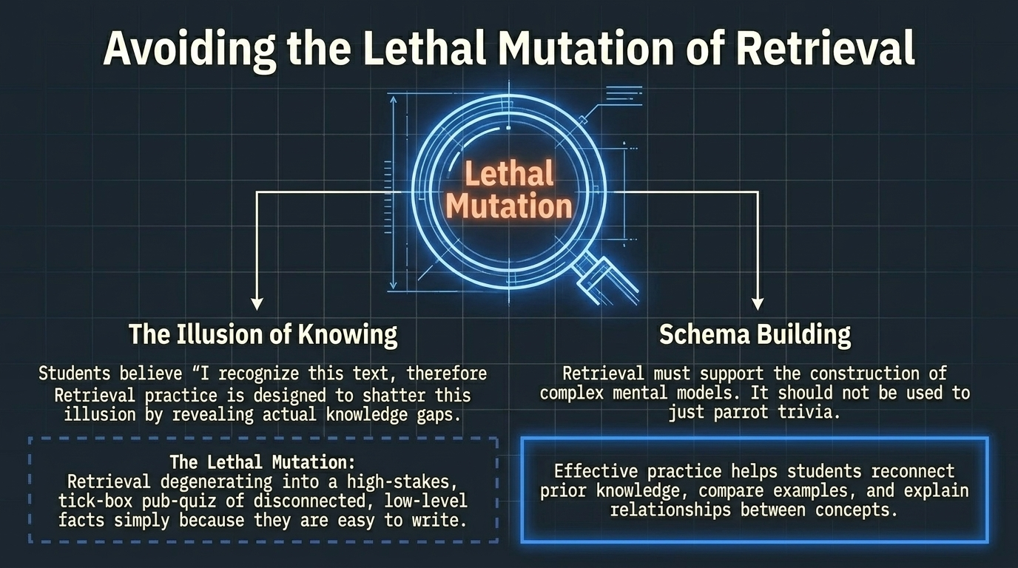
Structural Learning

Slide 10
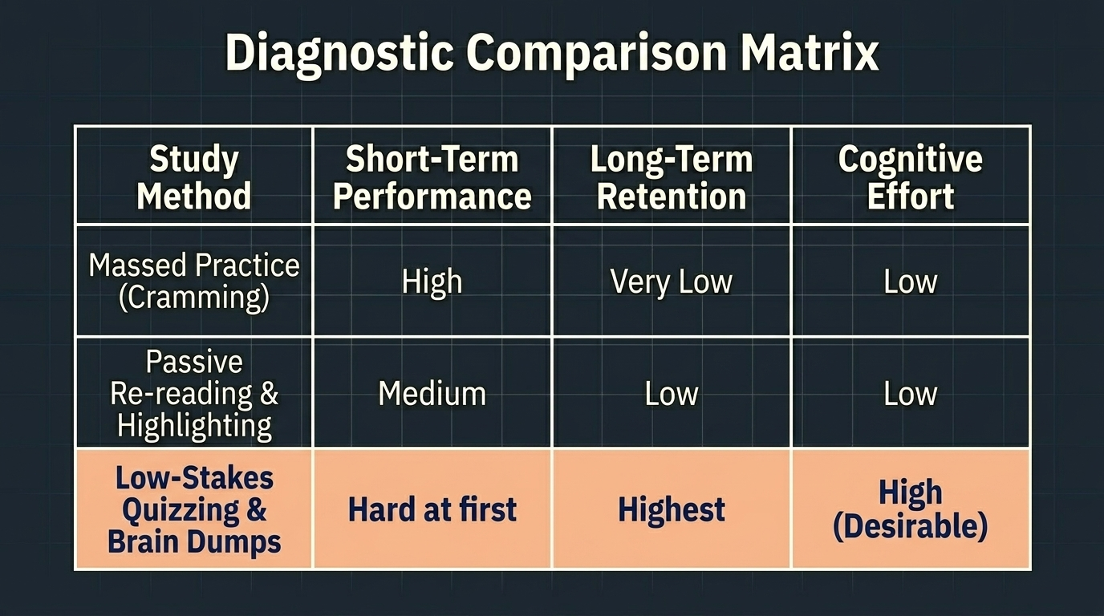
Structural Learning

Slide 11
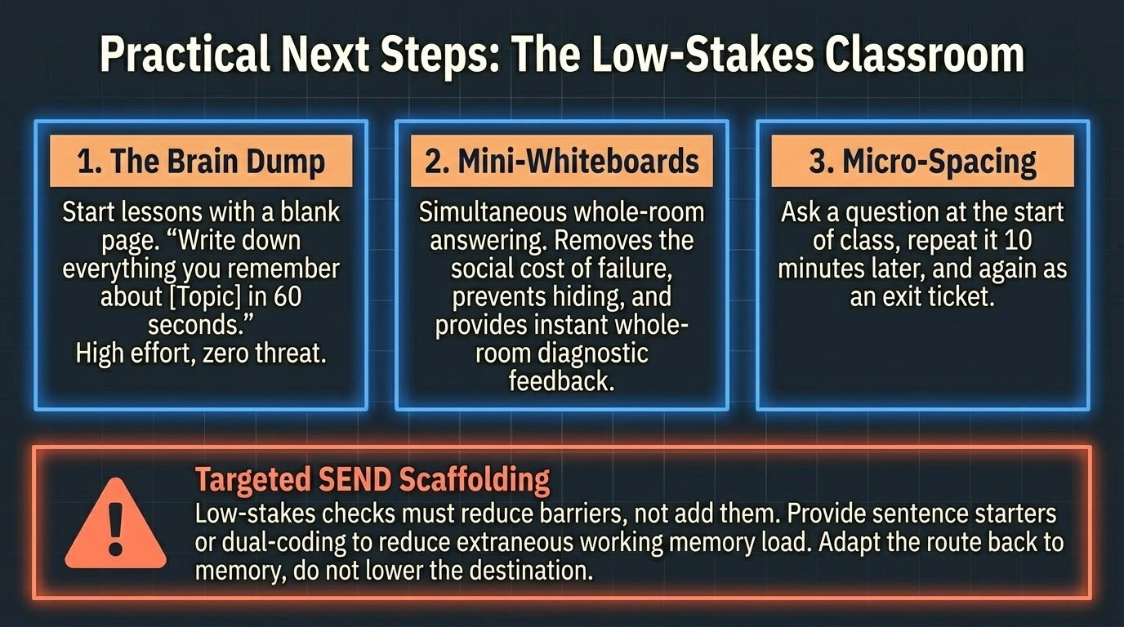
Structural Learning

Slide 12
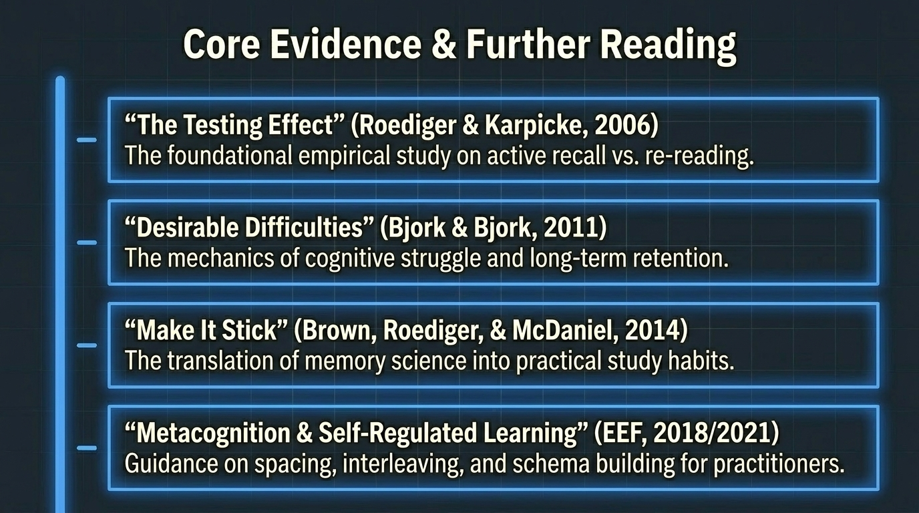
Structural Learning

Slide 13
Read the full guide
https://www.structural-learning.com/post/testing-effect-retrieval-practice

