Slide 1
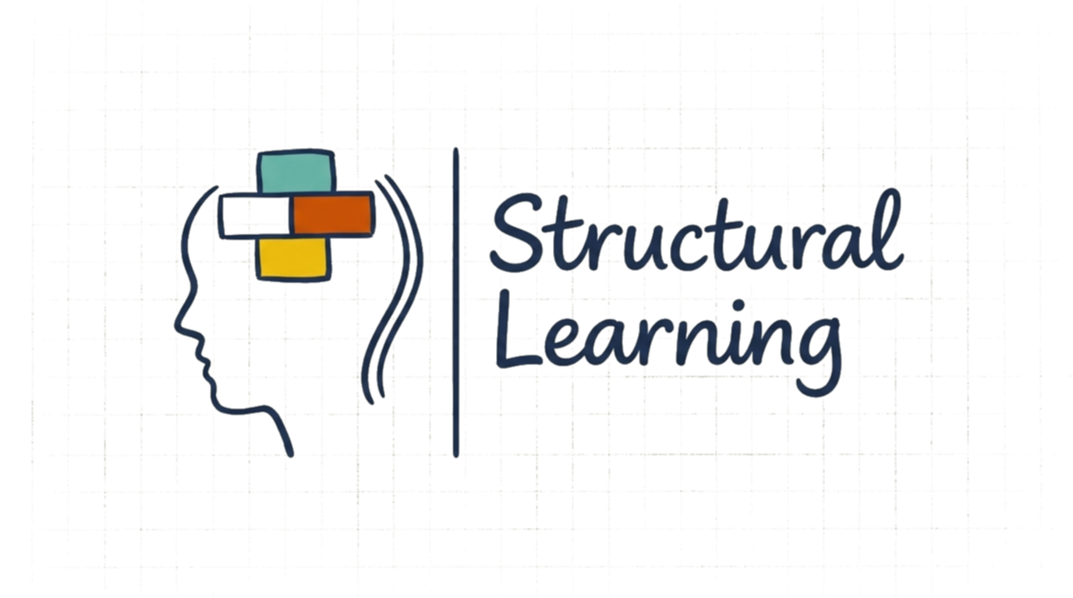
Theories of Reading: Phonics, Whole Language, and Beyond
A teacher's briefing

Slide 2
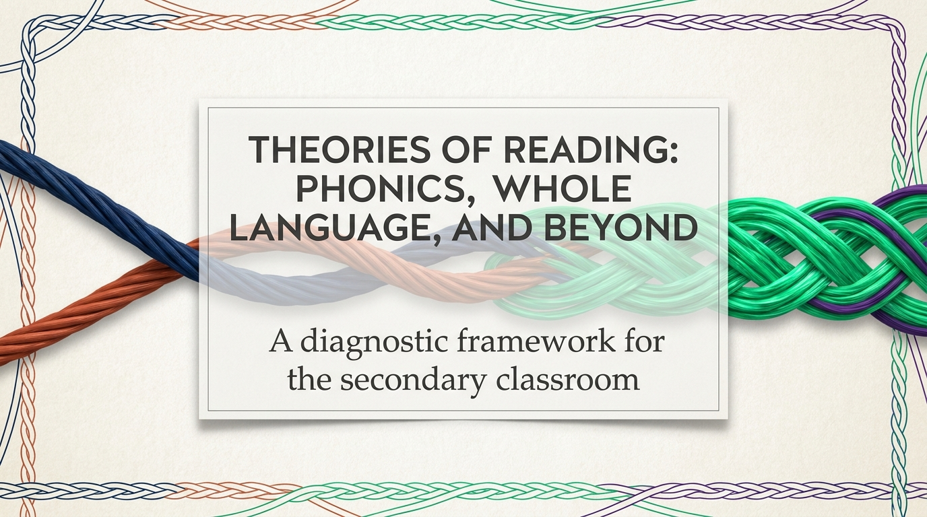
Structural Learning

Slide 3
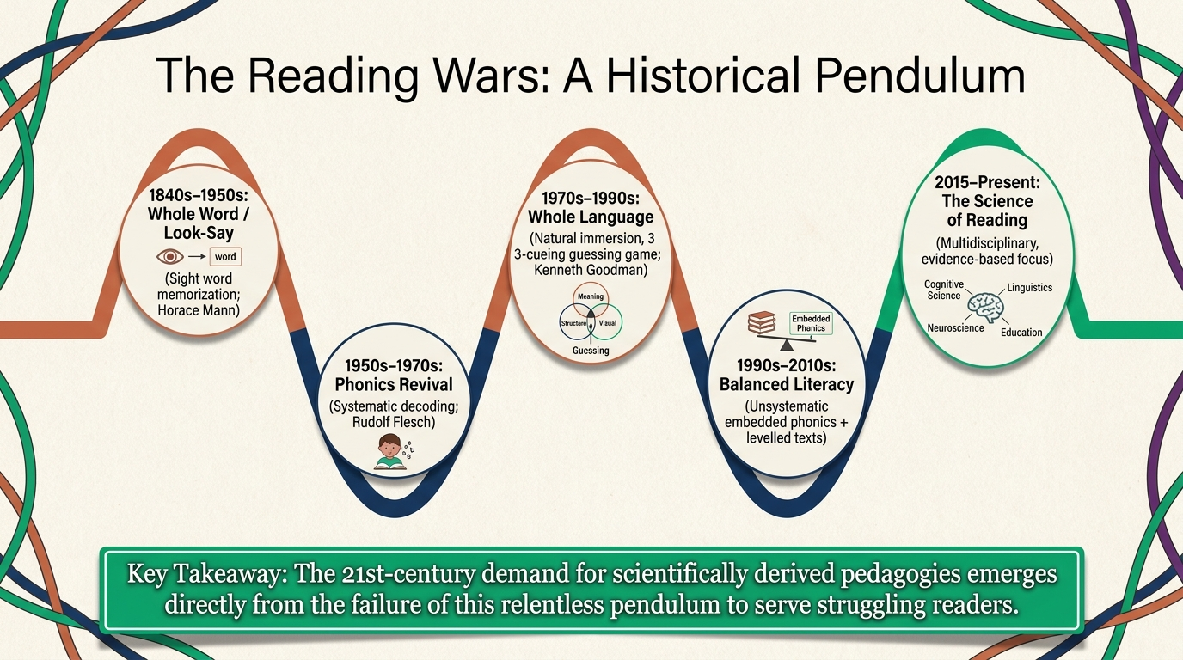
Structural Learning

Slide 4
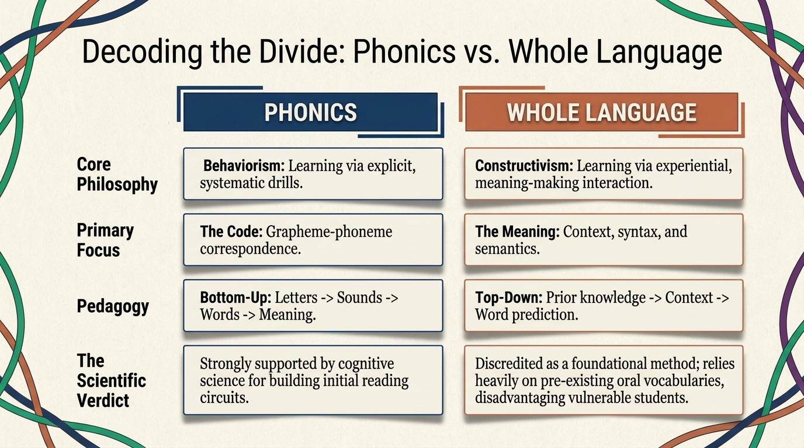
Structural Learning

Slide 5
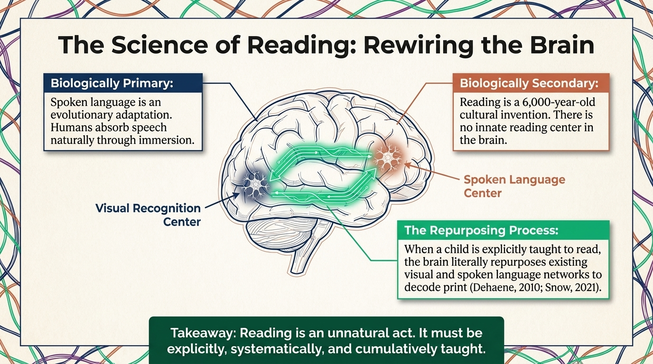
Structural Learning

Slide 6
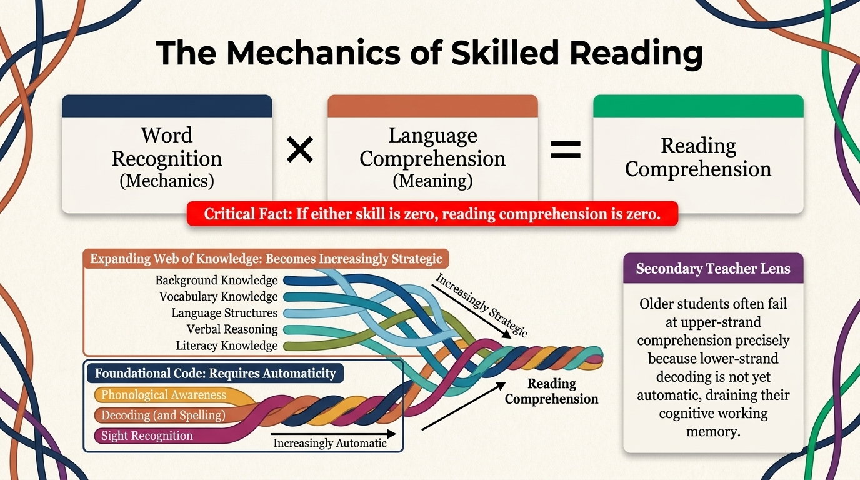
Structural Learning

Slide 7
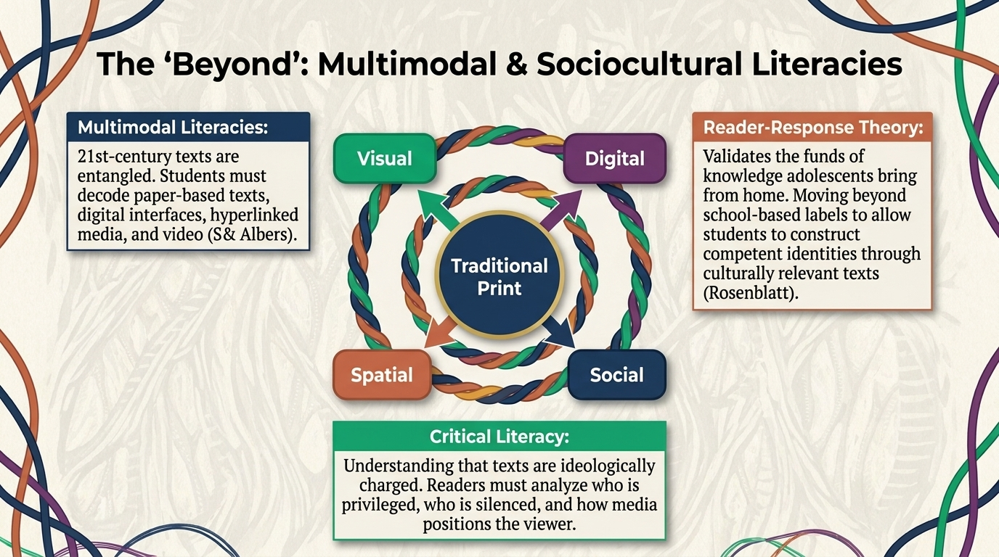
Structural Learning

Slide 8
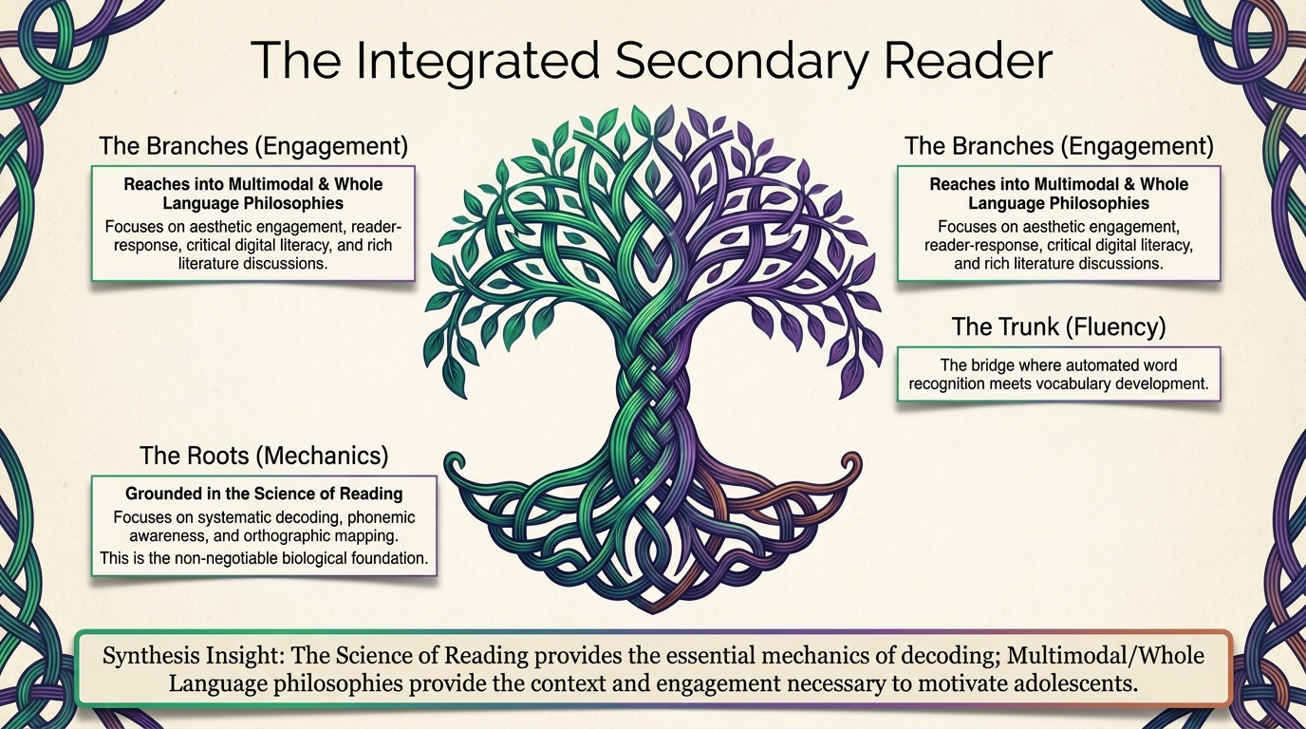
Structural Learning

Slide 9
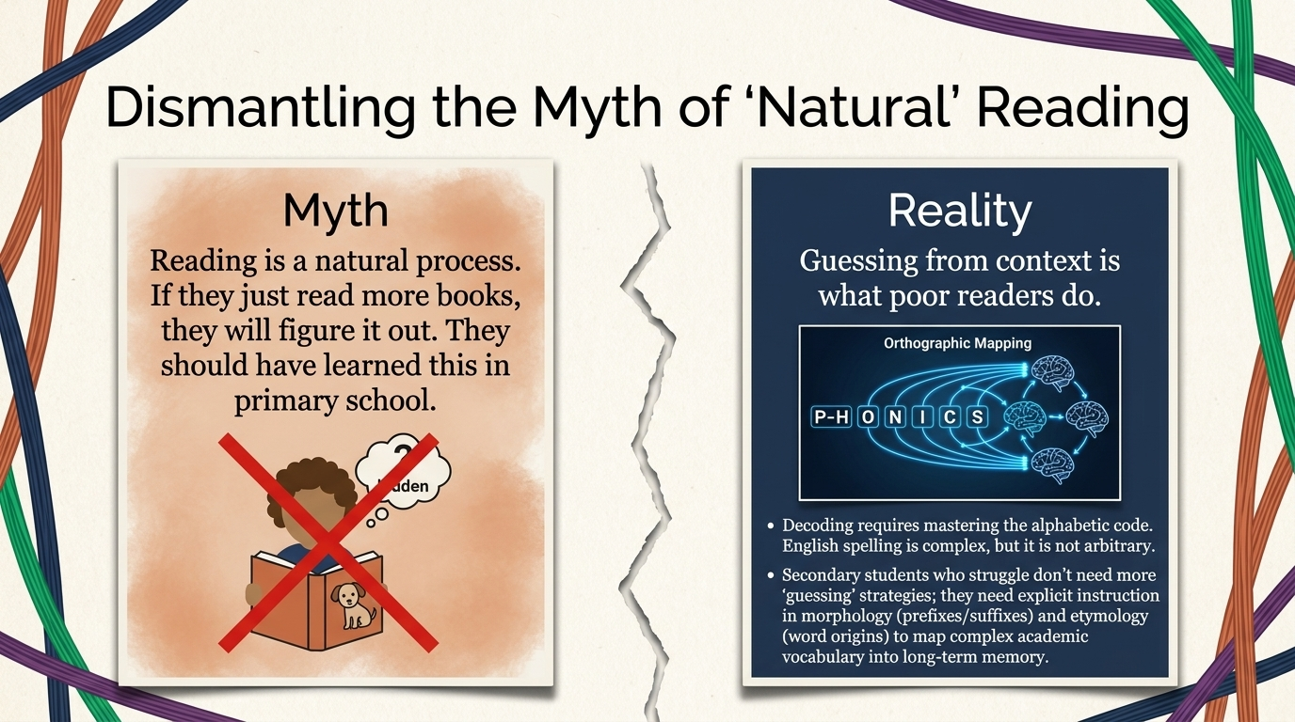
Structural Learning

Slide 10
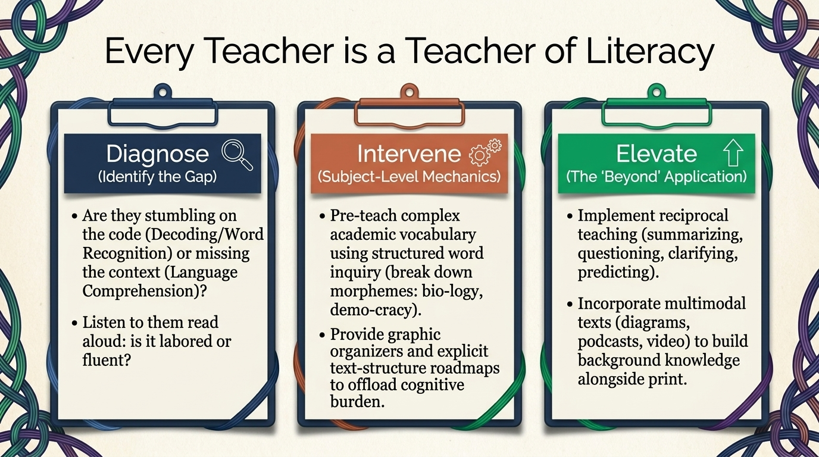
Structural Learning

Slide 11
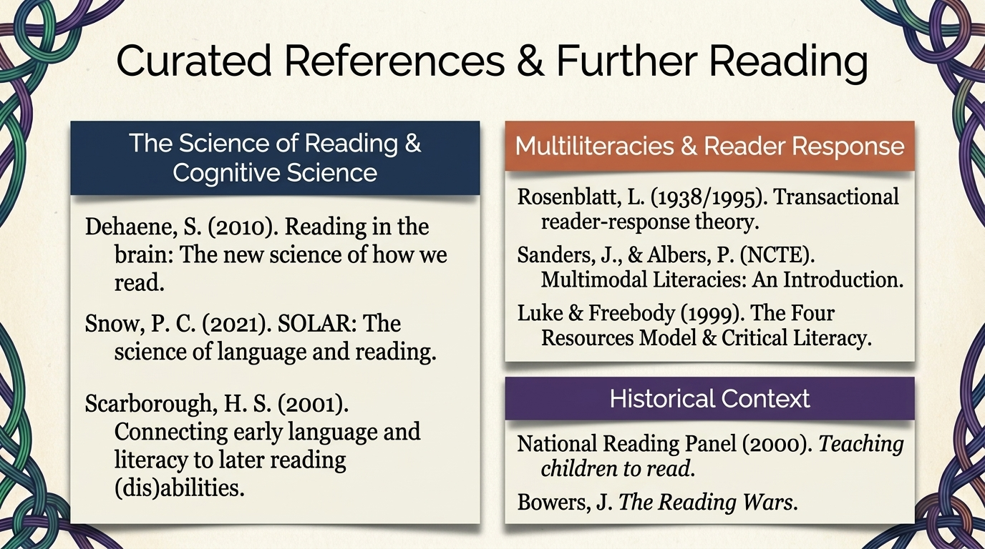
Structural Learning

Slide 12
Read the full guide
https://www.structural-learning.com/post/theories-of-reading

