Slide 1

Topmarks Games: Fluency & Engagement, Not a Replacement
A teacher's briefing

Slide 2

Structural Learning

Slide 3
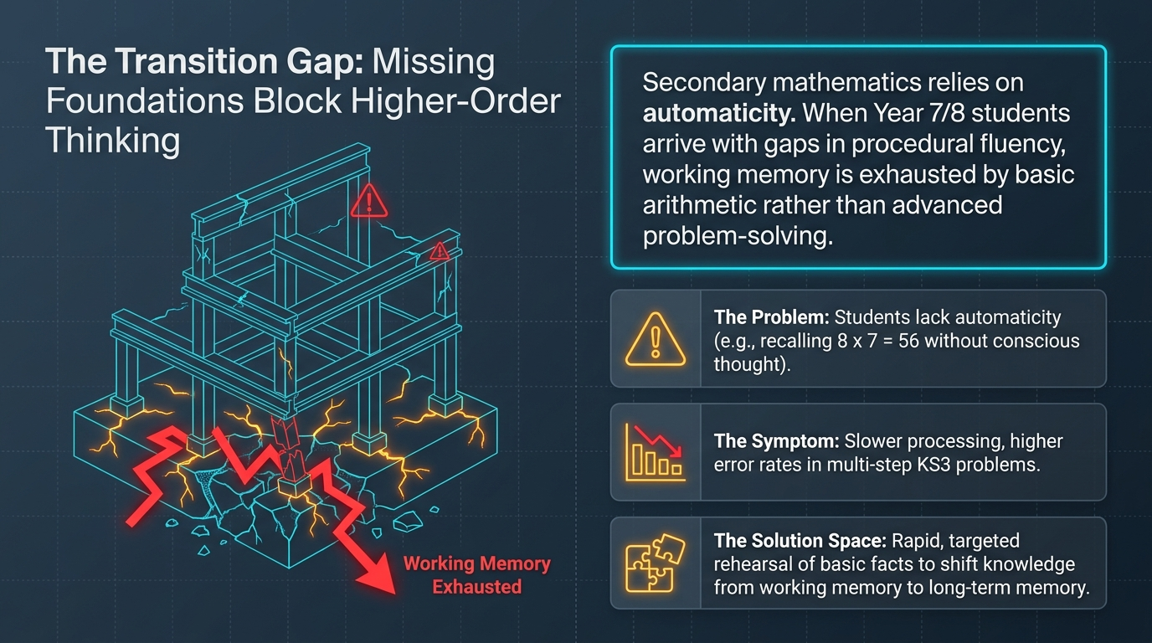
Structural Learning

Slide 4
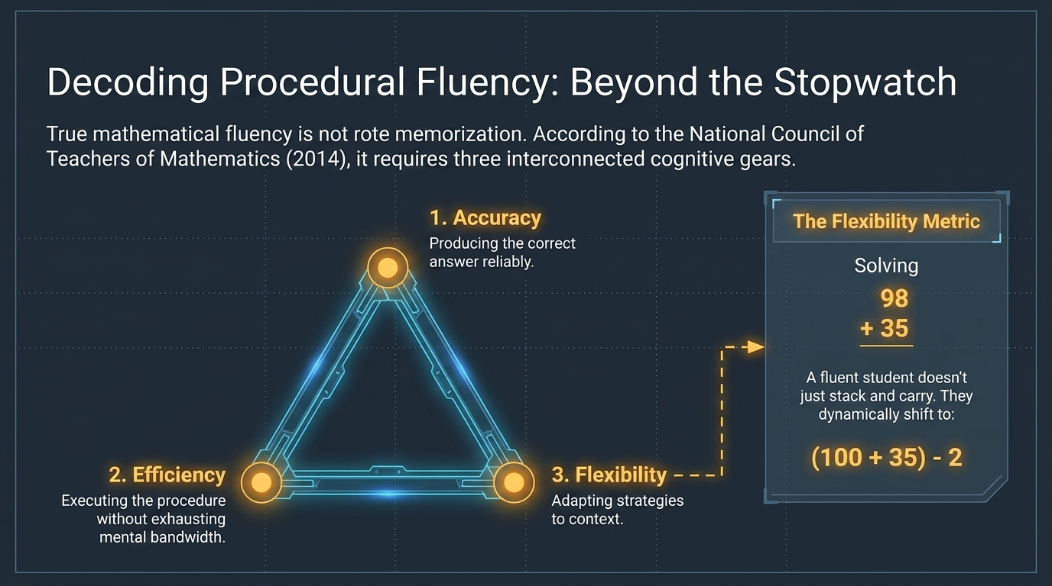
Structural Learning

Slide 5
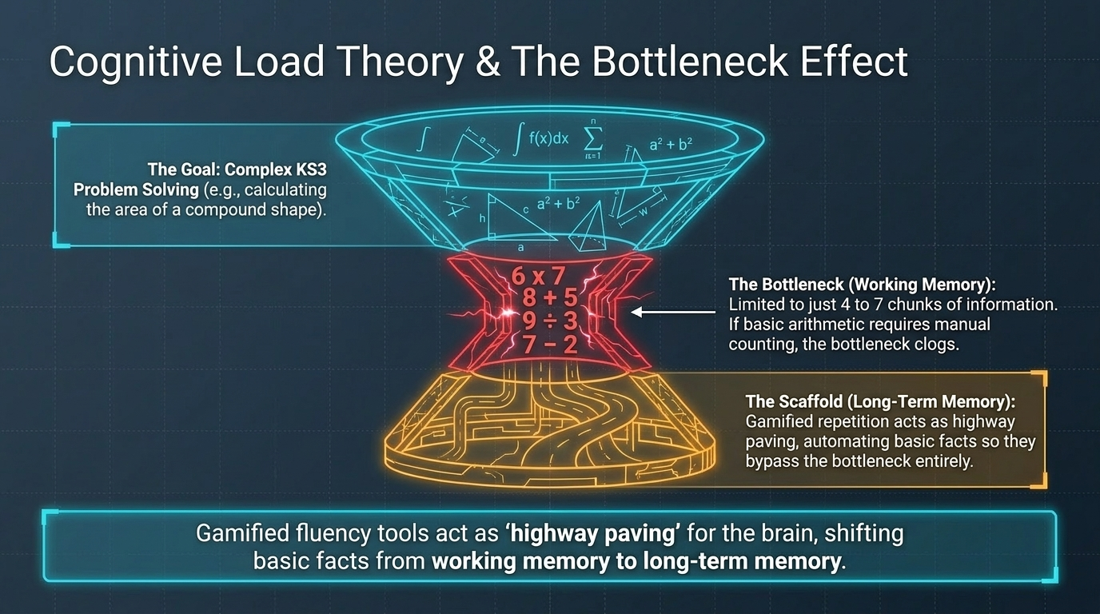
Structural Learning

Slide 6
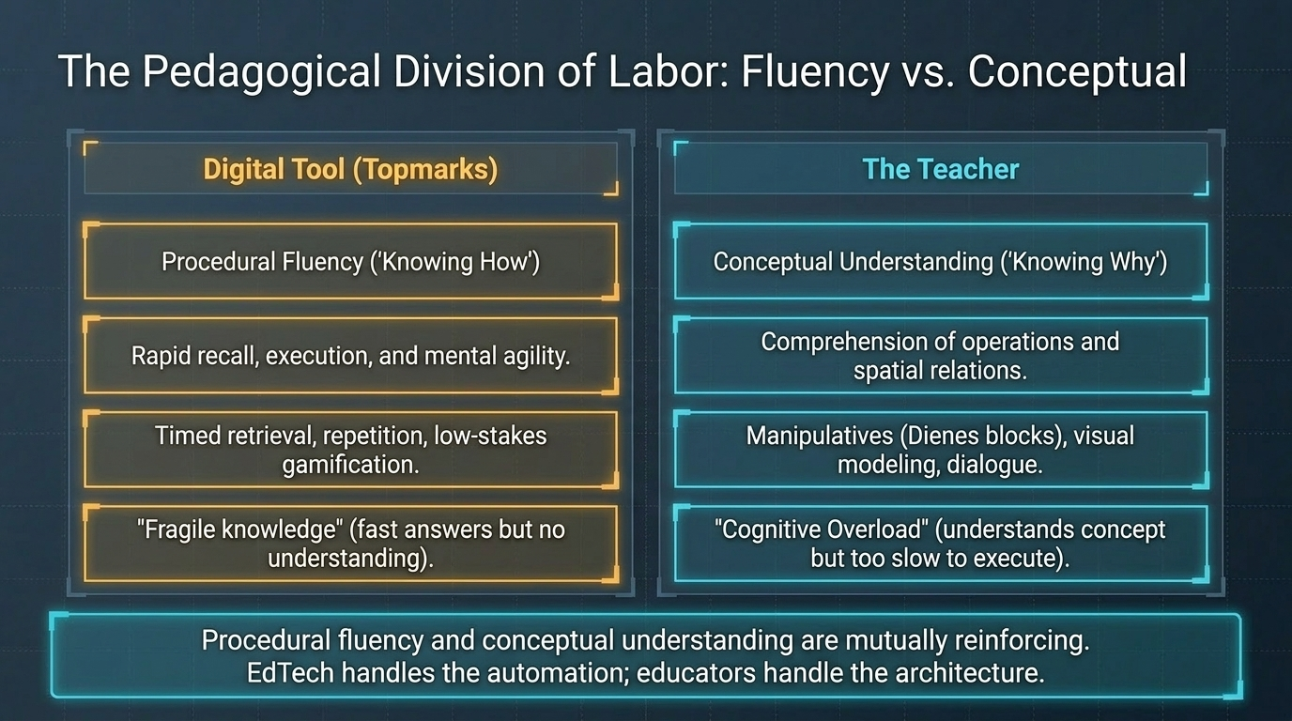
Structural Learning

Slide 7
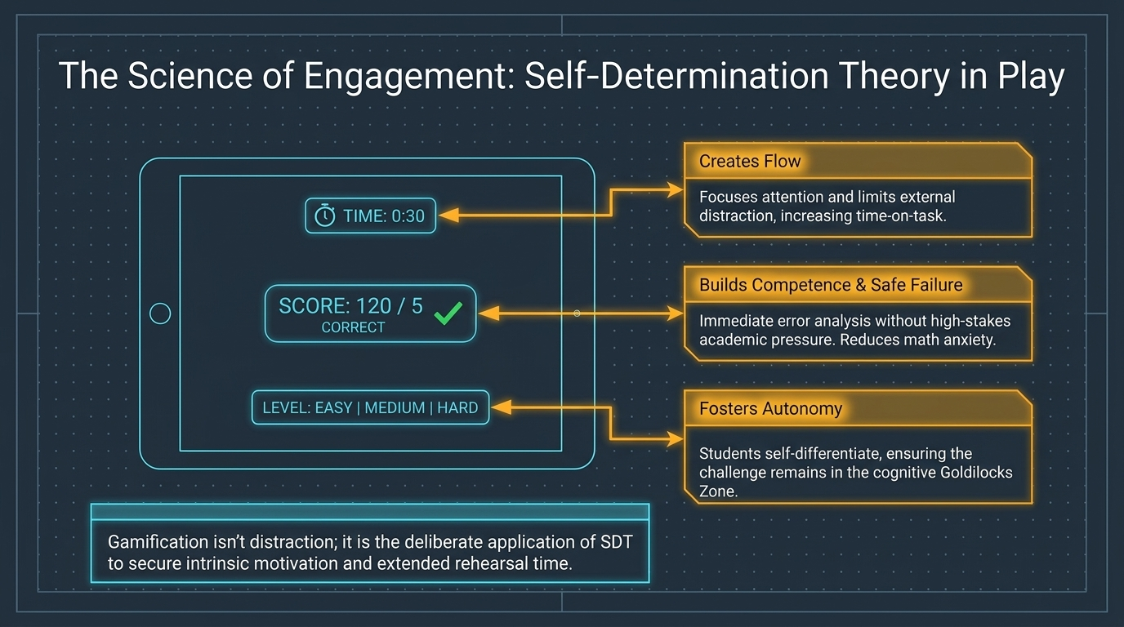
Structural Learning

Slide 8
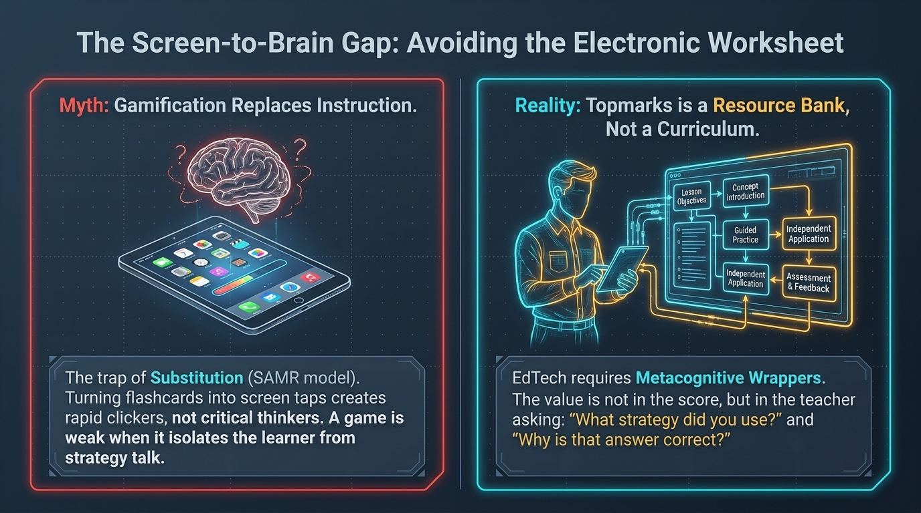
Structural Learning

Slide 9
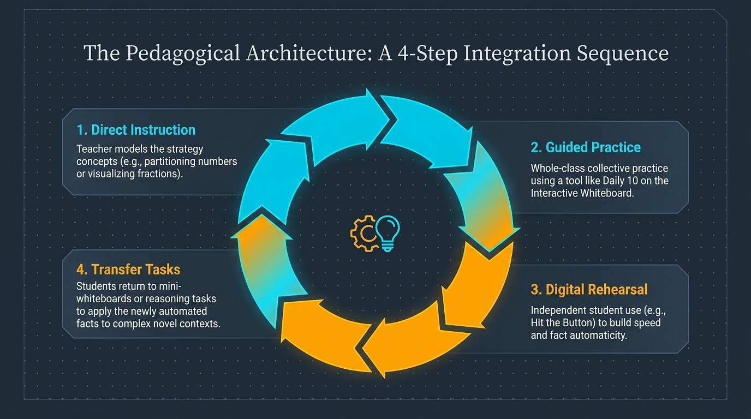
Structural Learning

Slide 10
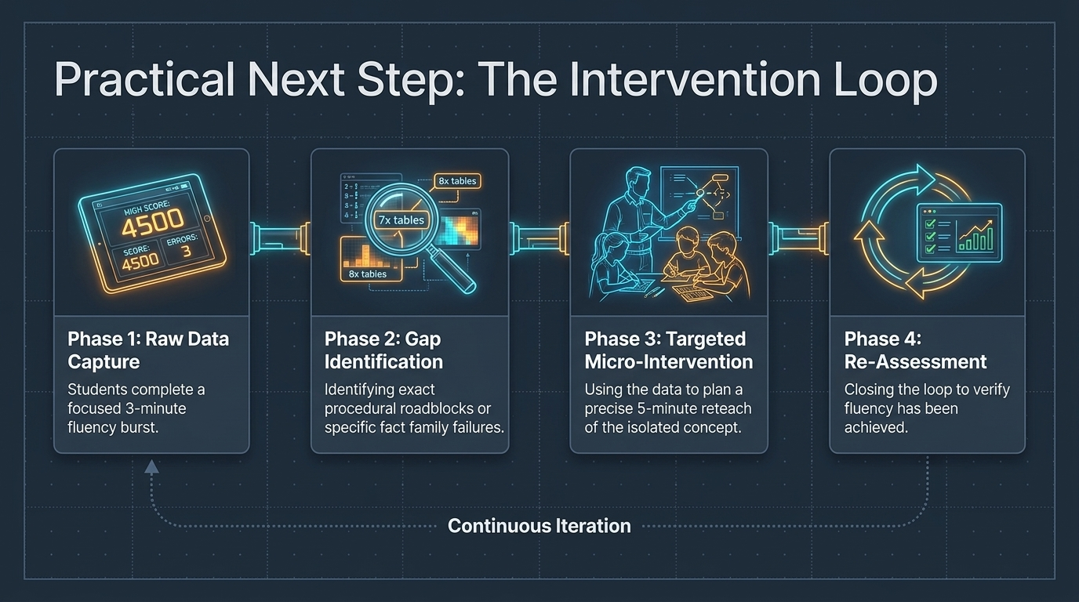
Structural Learning

Slide 11
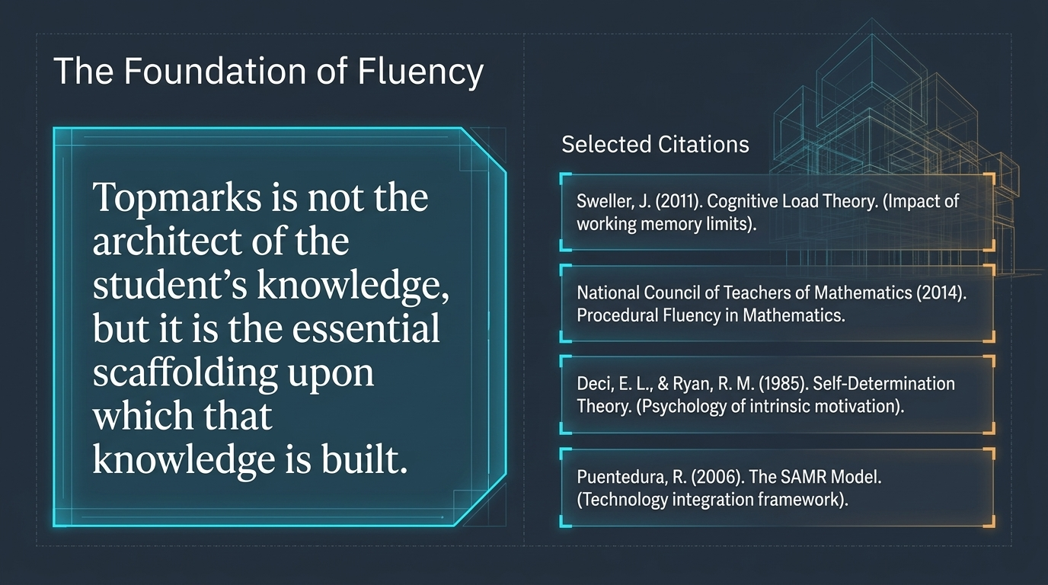
Structural Learning

Slide 12
Read the full guide
https://www.structural-learning.com/post/top-marks-a-teachers-guide

