Slide 1

The Complete IB Extended Essay Guide for Teachers: Supervising Writing & Research
A teacher's briefing

Slide 2
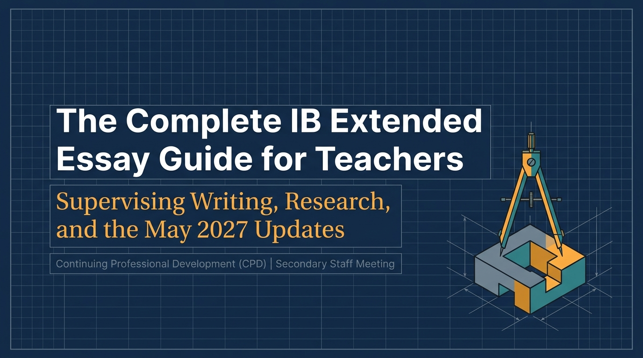
Structural Learning

Slide 3
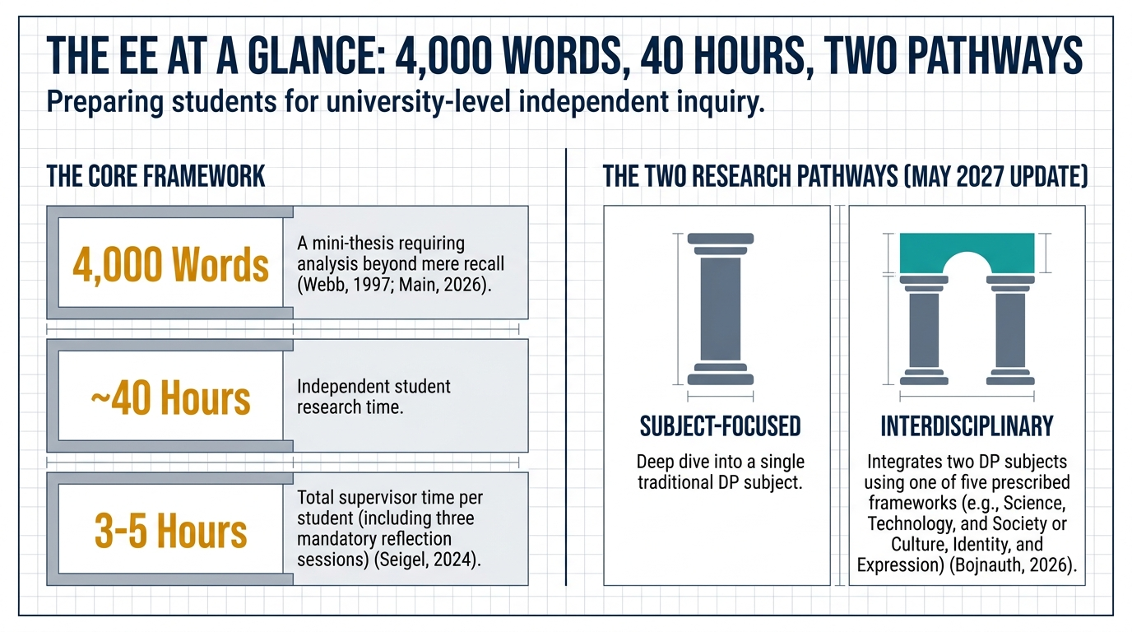
Structural Learning

Slide 4
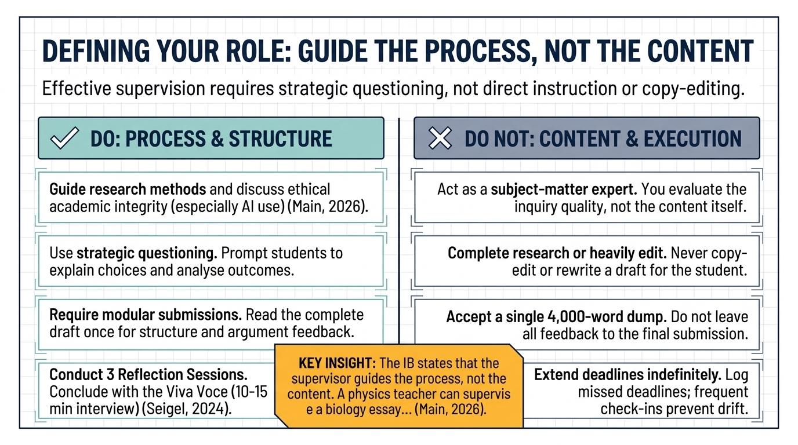
Structural Learning

Slide 5
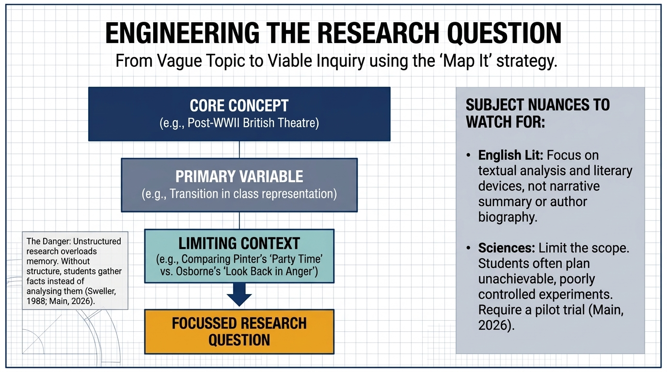
Structural Learning

Slide 6
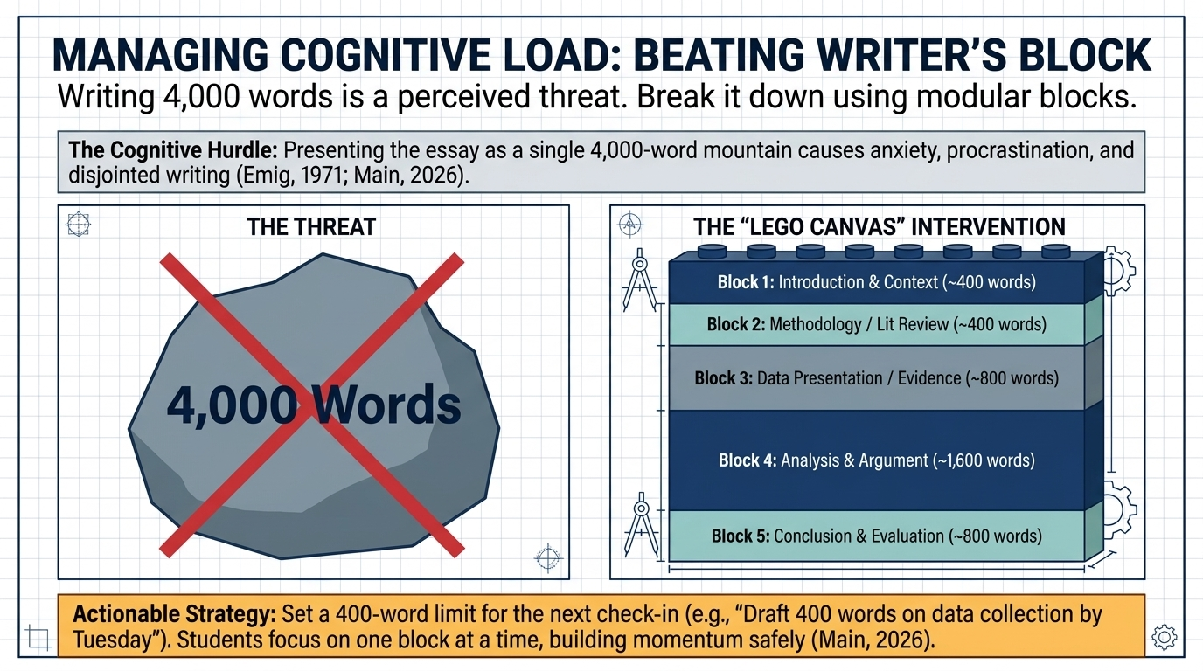
Structural Learning

Slide 7
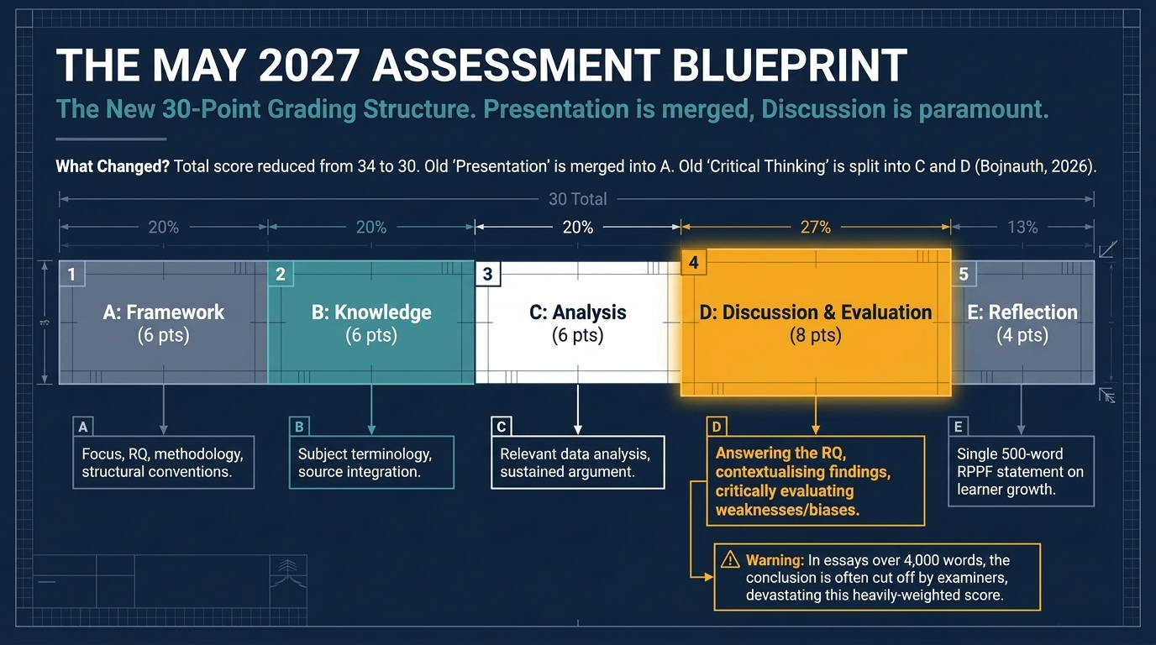
Structural Learning

Slide 8
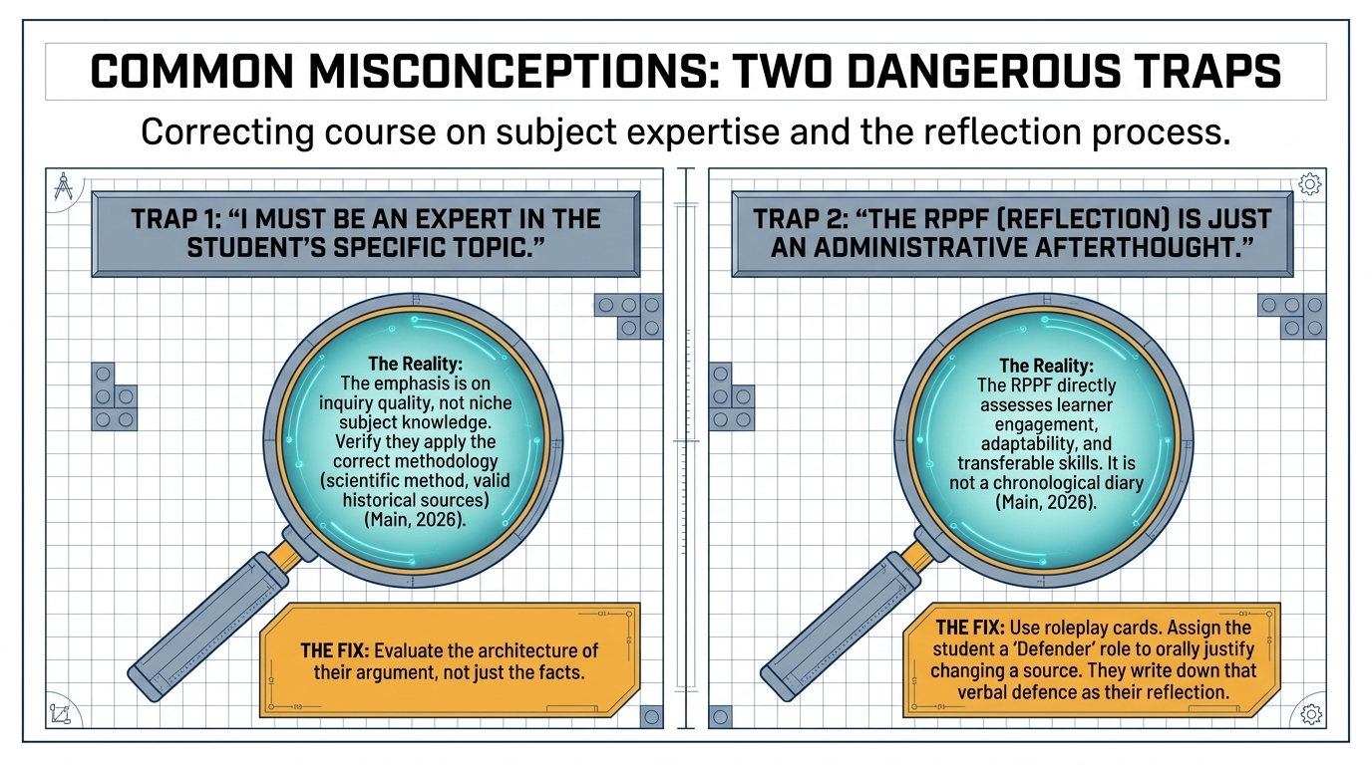
Structural Learning

Slide 9
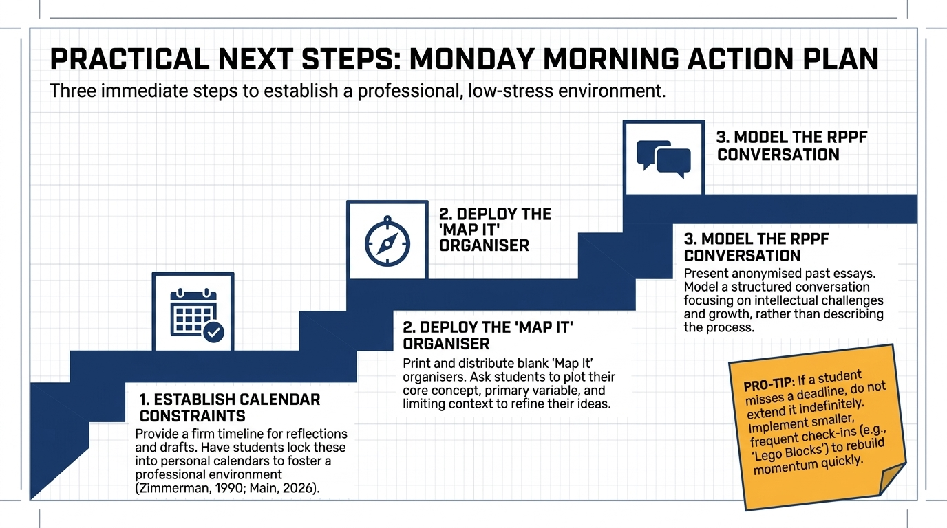
Structural Learning

Slide 10
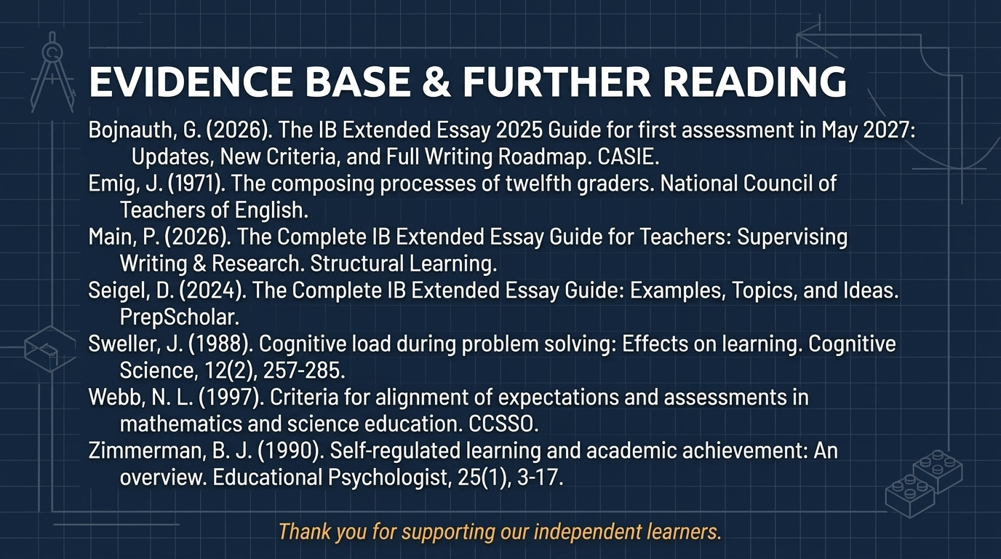
Structural Learning

Slide 11
Read the full guide
https://www.structural-learning.com/post/complete-ib-extended-essay-guide-teachers

