Slide 1

Standardised Testing: Pros, Cons, and Better Alternatives
A teacher's briefing

Slide 2

Structural Learning

Slide 3
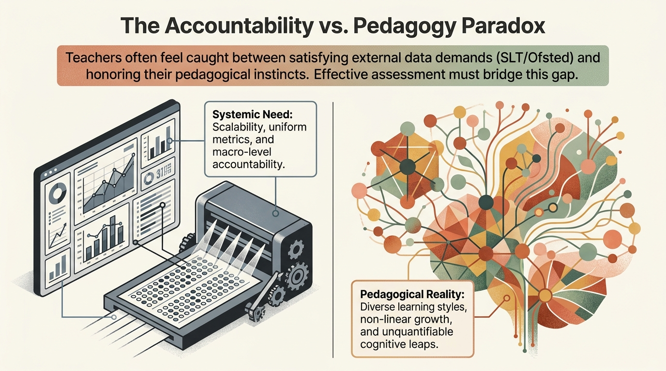
Structural Learning

Slide 4
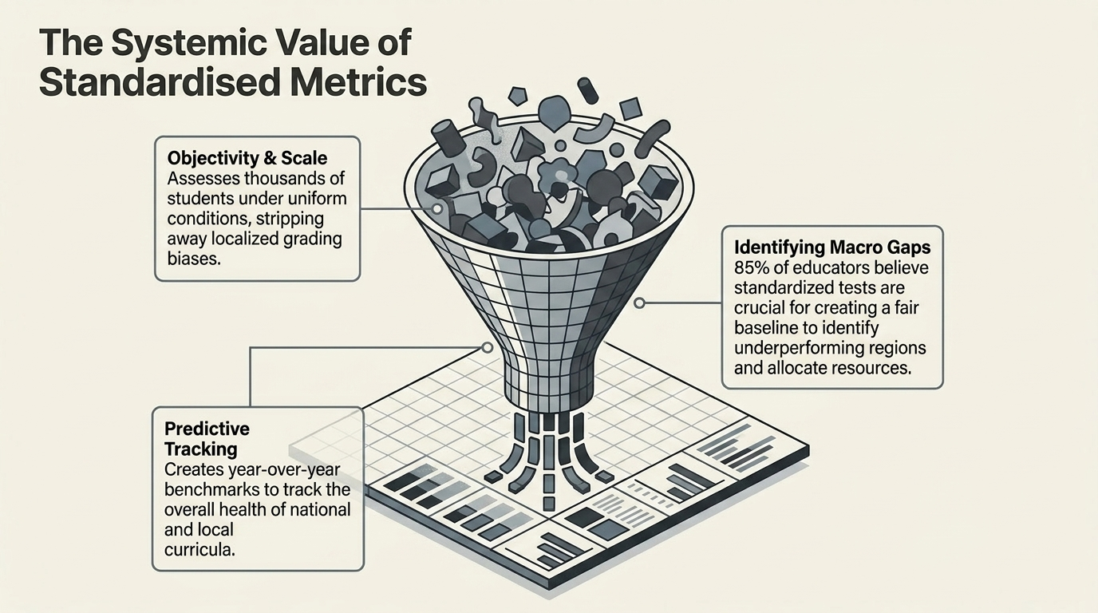
Structural Learning

Slide 5
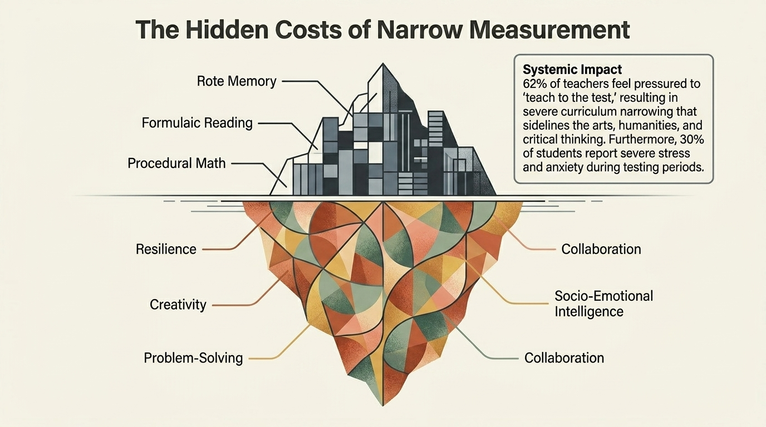
Structural Learning

Slide 6
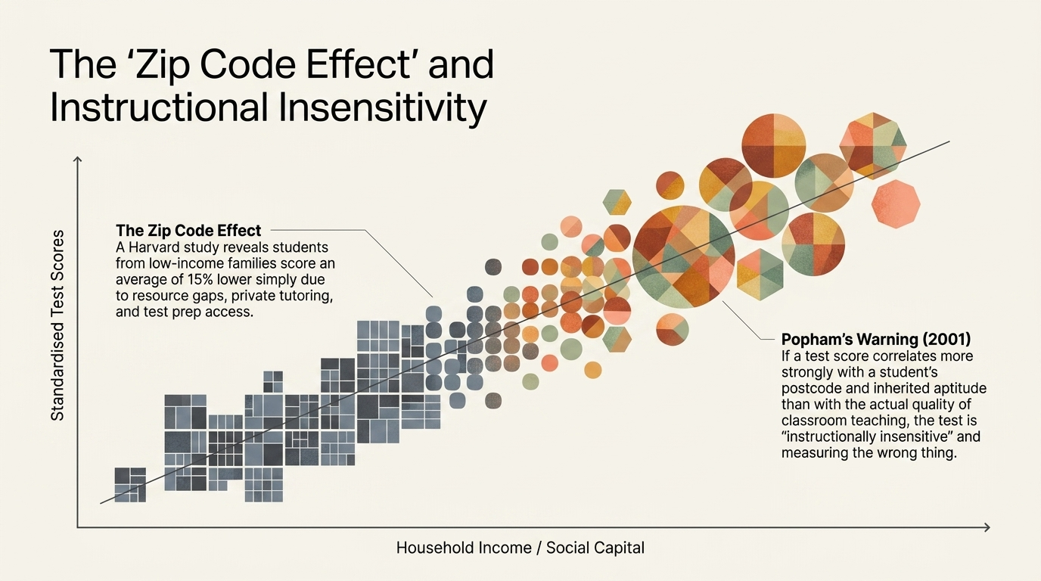
Structural Learning

Slide 7
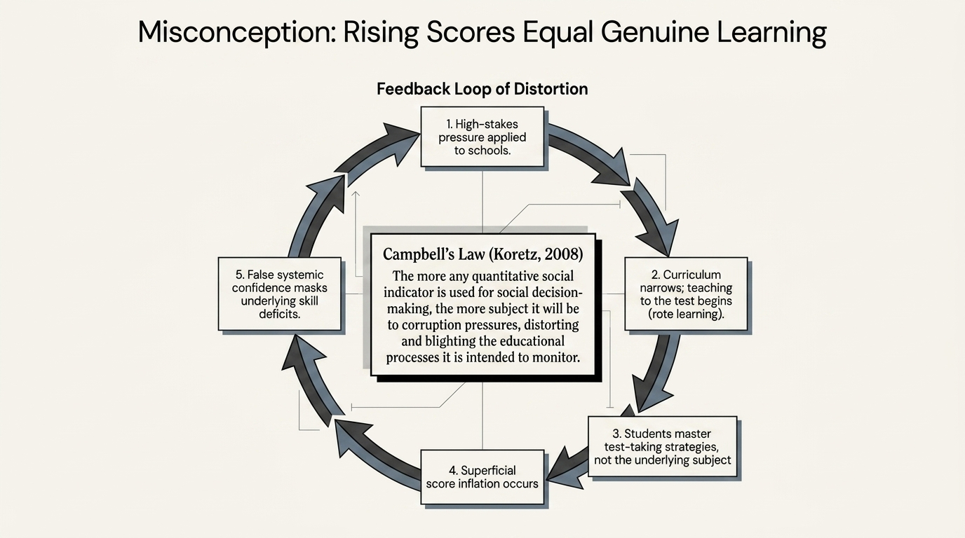
Structural Learning

Slide 8
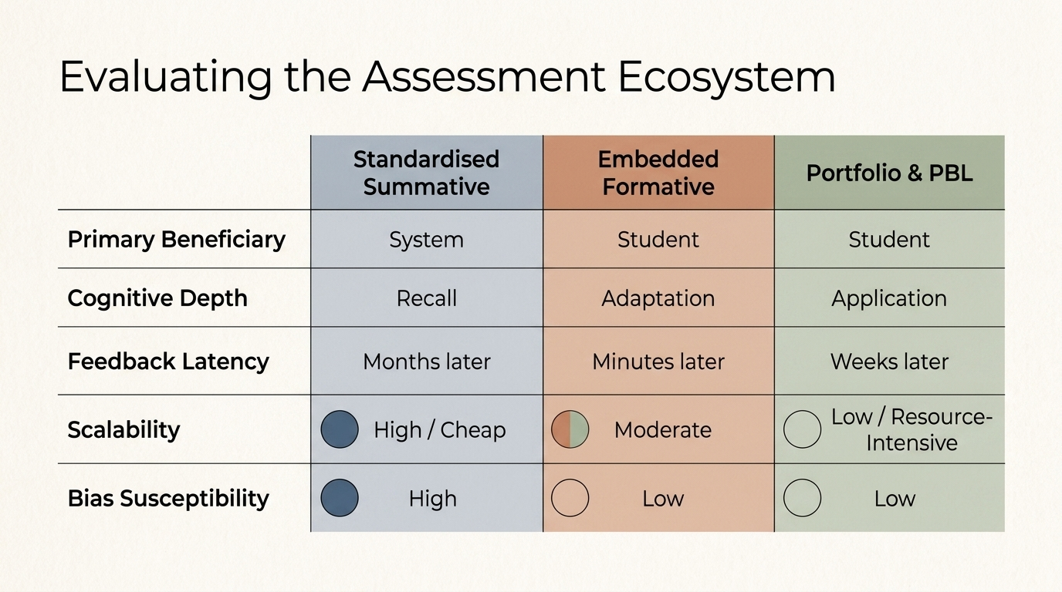
Structural Learning

Slide 9
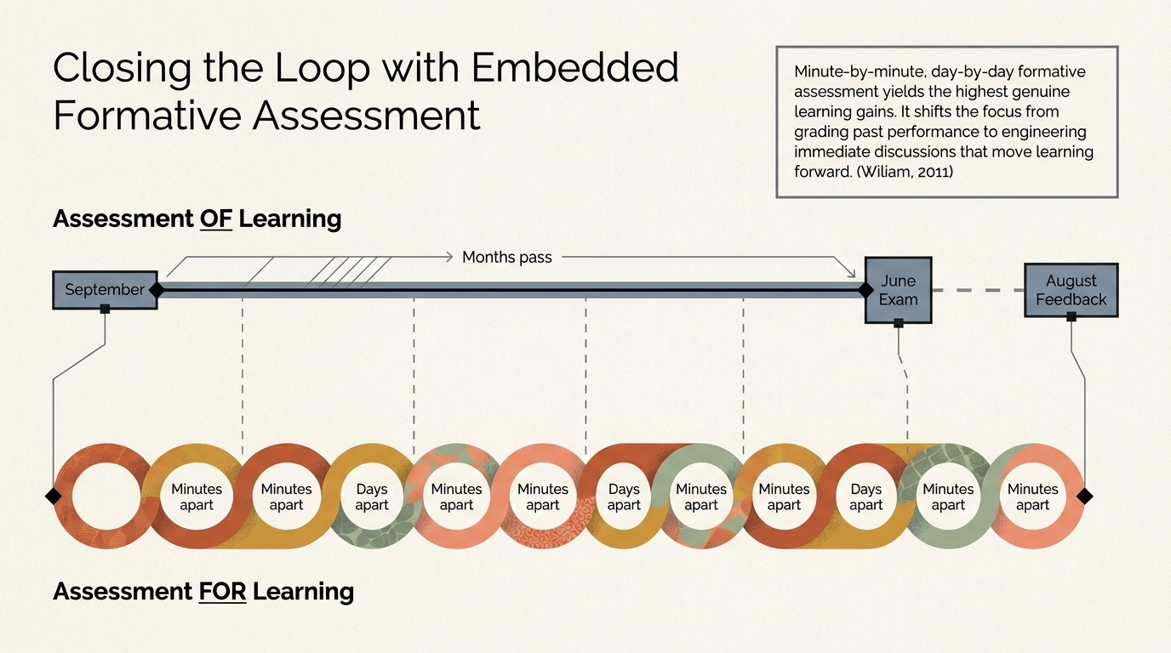
Structural Learning

Slide 10
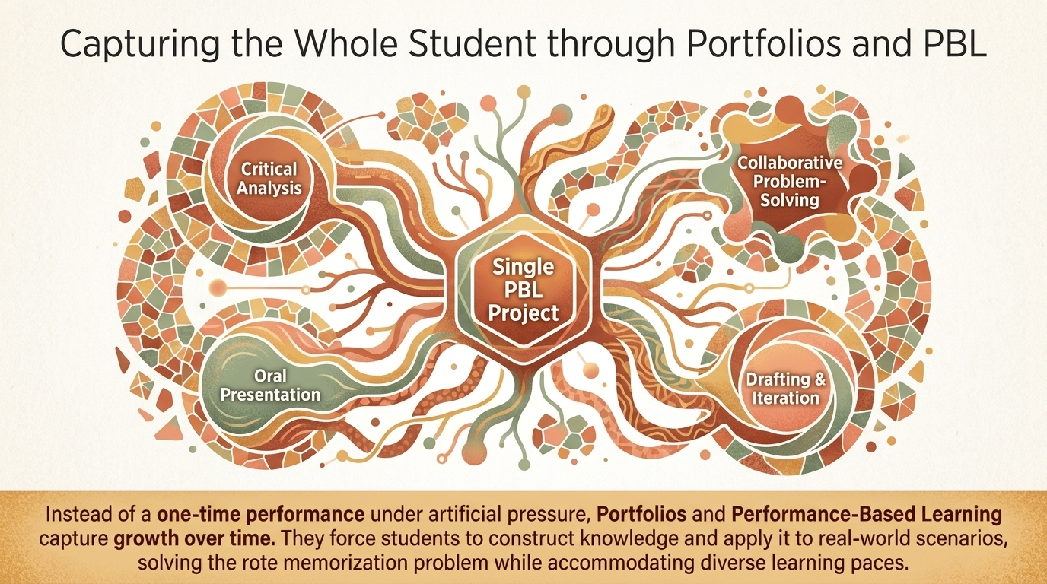
Structural Learning

Slide 11
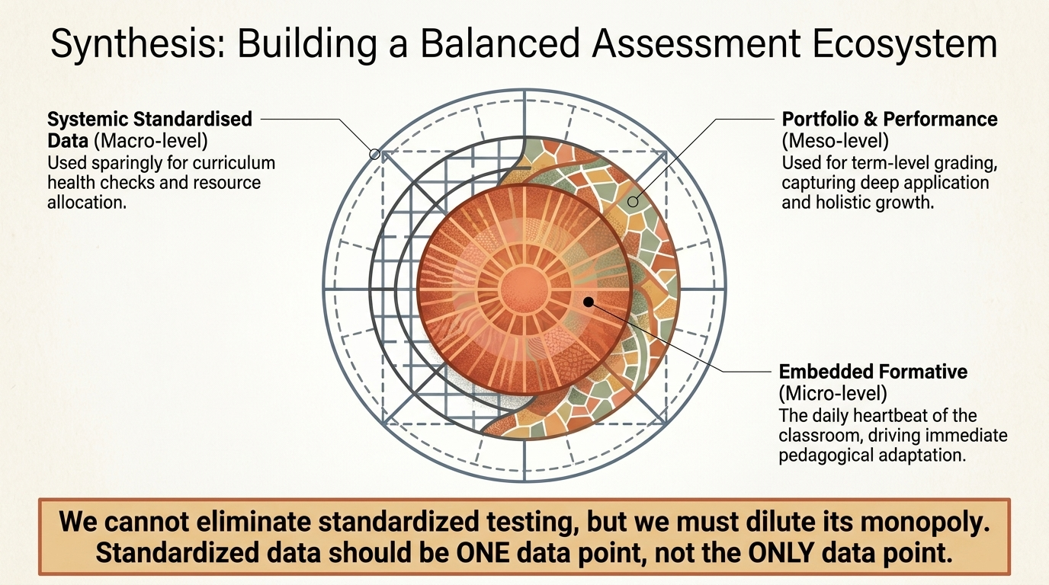
Structural Learning

Slide 12
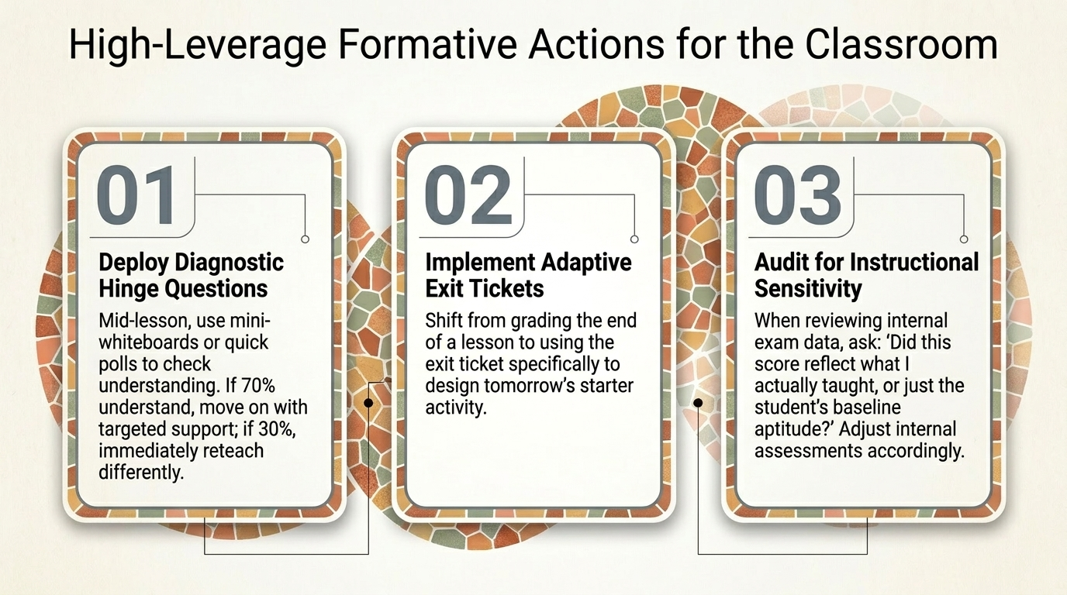
Structural Learning

Slide 13
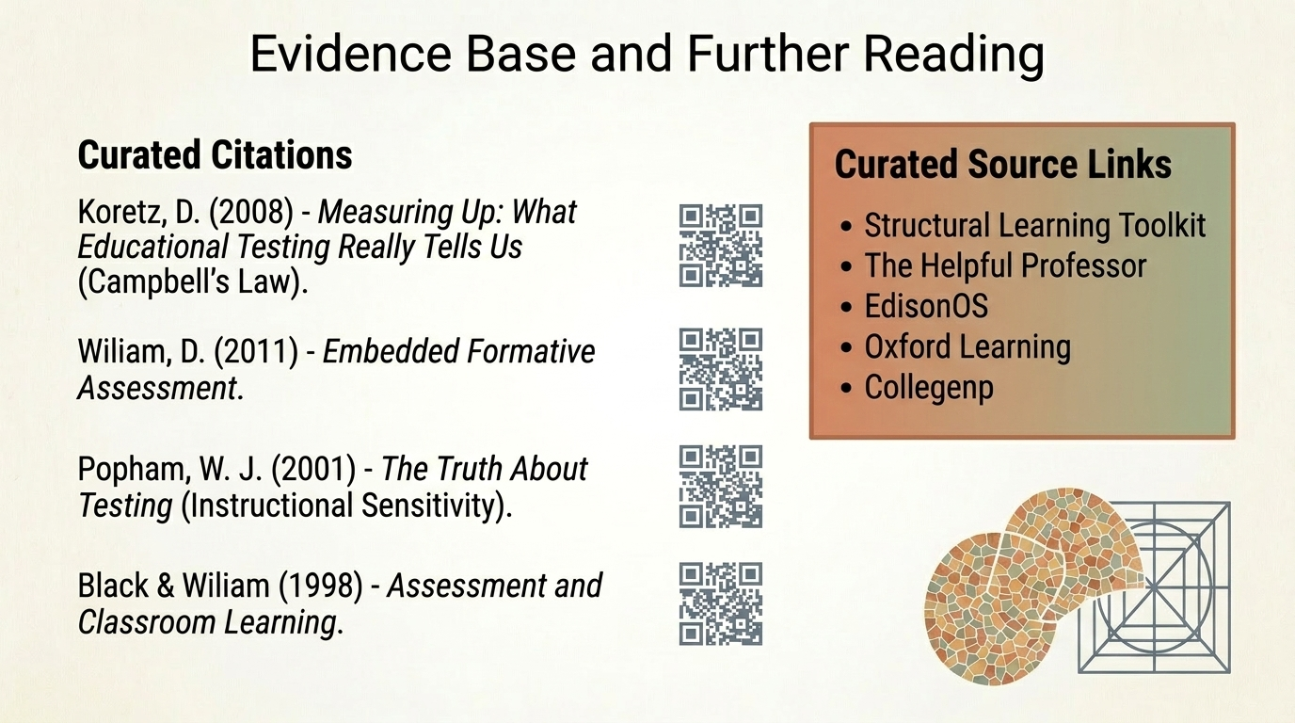
Structural Learning

Slide 14
Read the full guide
https://www.structural-learning.com/post/standardized-testing-pros-cons-and-alternatives

