Slide 1

ODD in the Classroom: Supporting Learners with Oppositional Defiant Disorder
A teacher's briefing

Slide 2
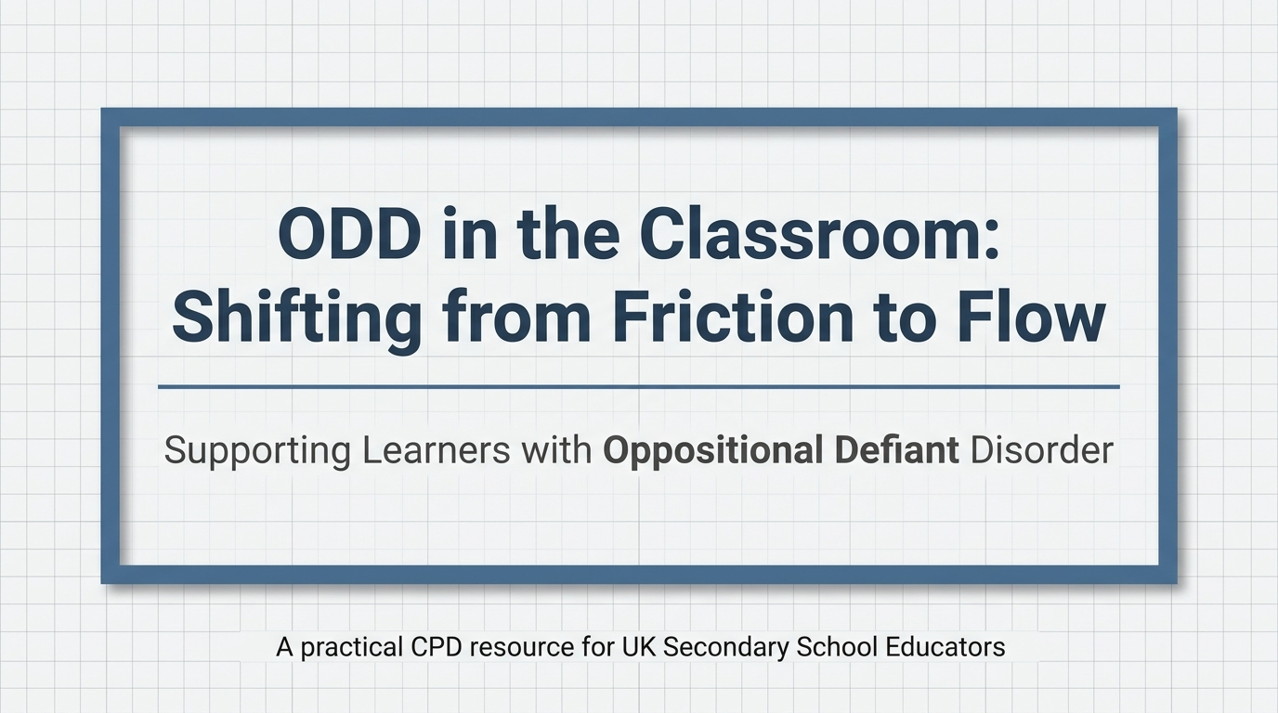
Structural Learning

Slide 3
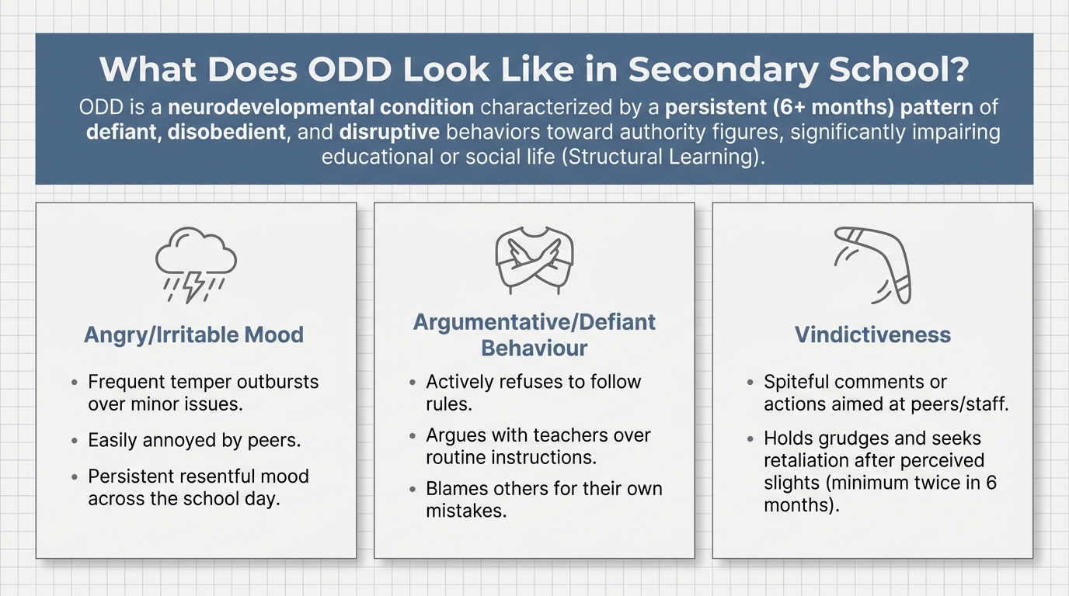
Structural Learning

Slide 4
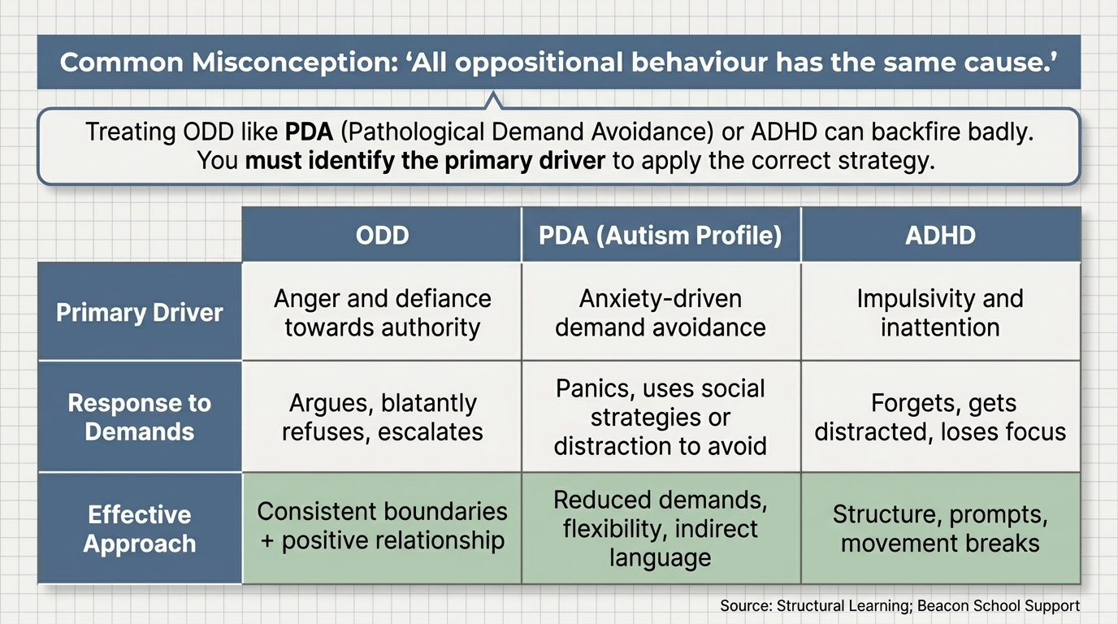
Structural Learning

Slide 5
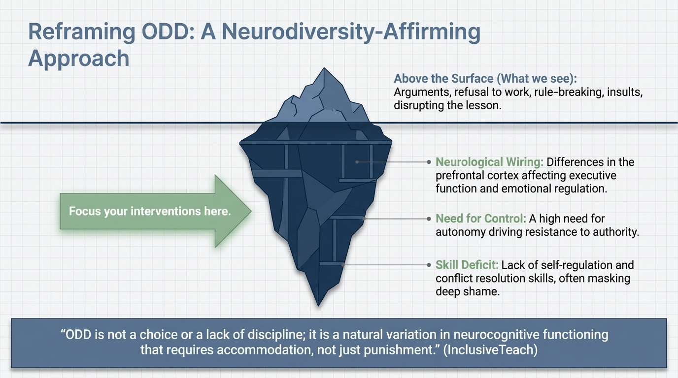
Structural Learning

Slide 6
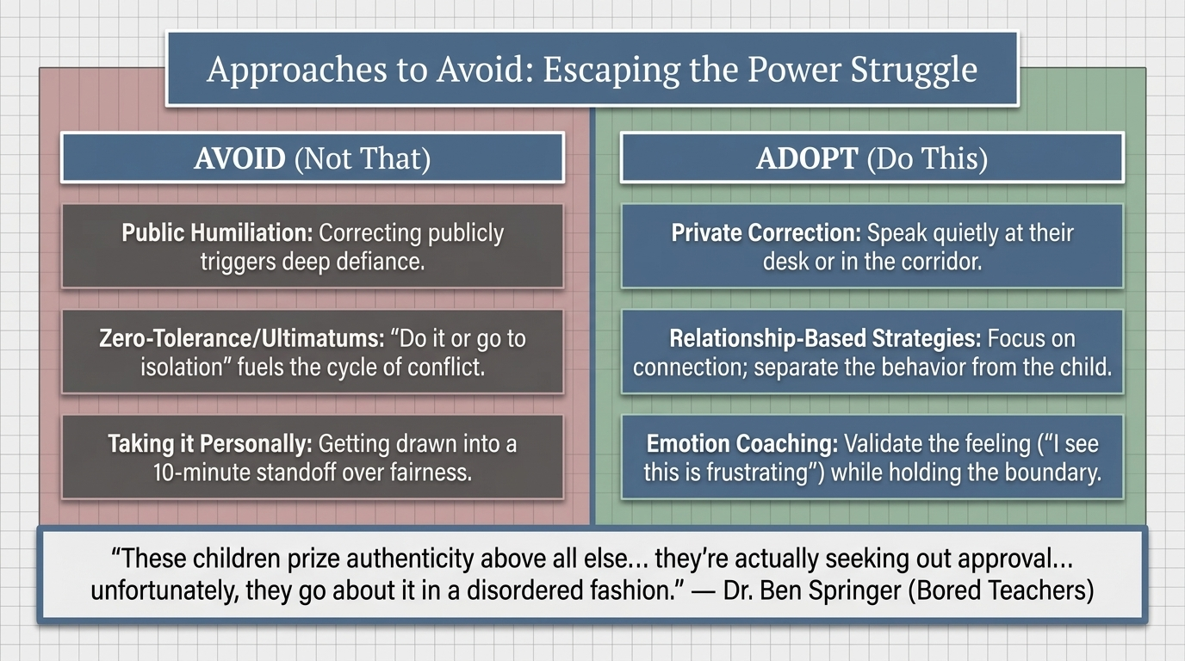
Structural Learning

Slide 7
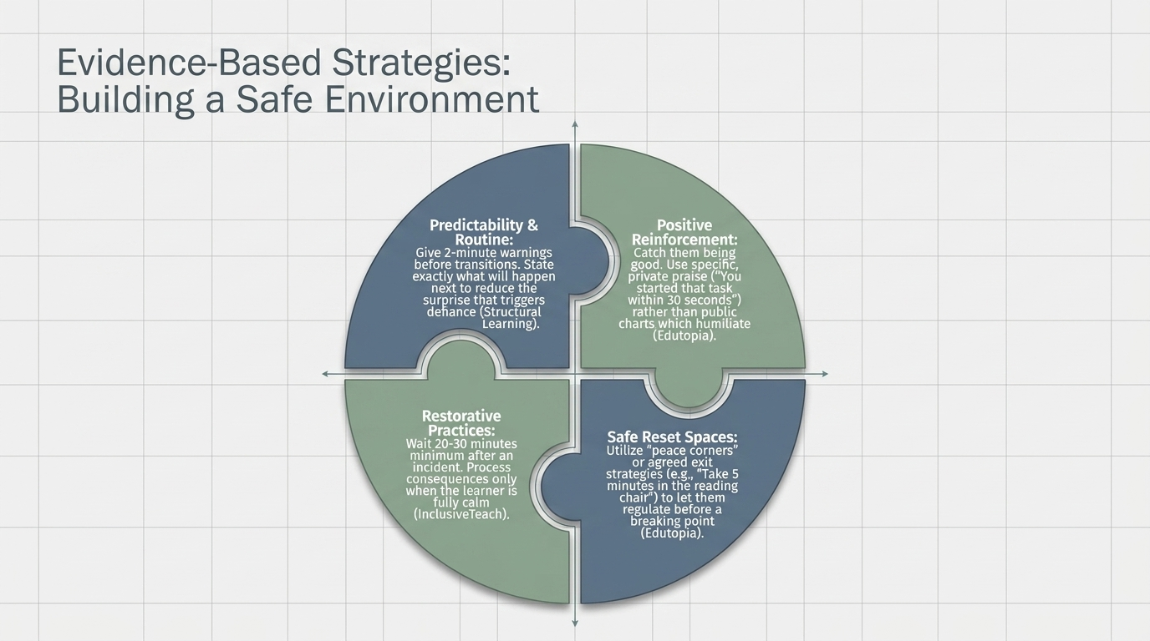
Structural Learning

Slide 8
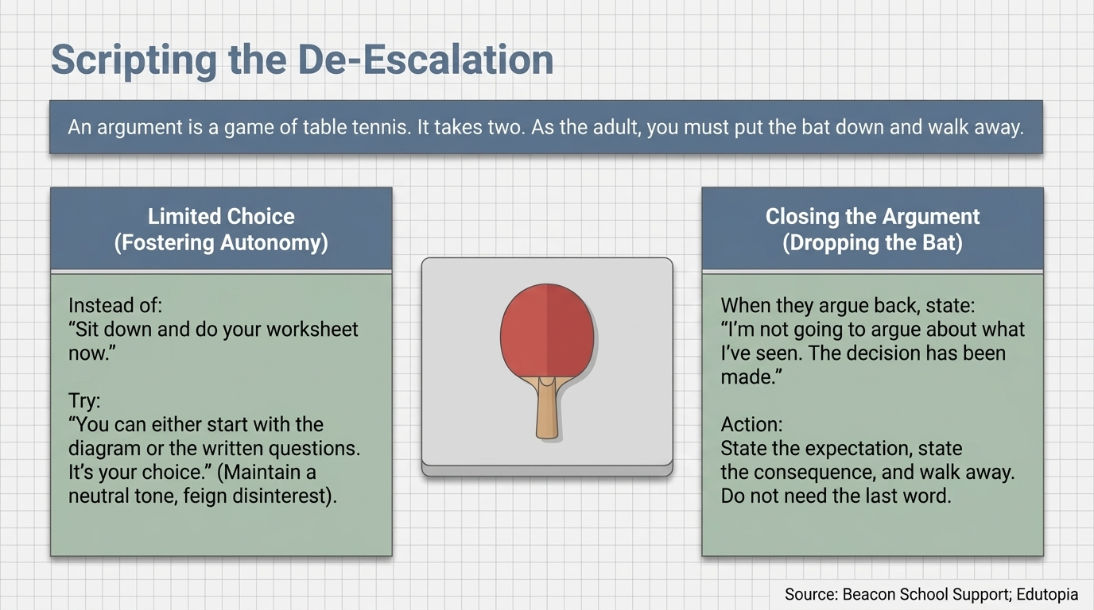
Structural Learning

Slide 9
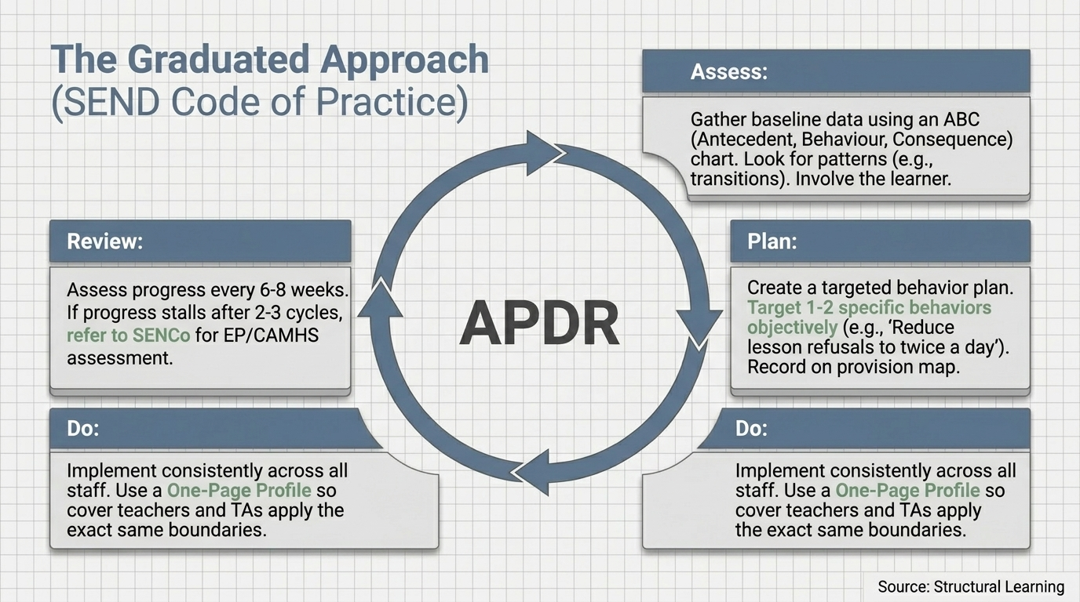
Structural Learning

Slide 10
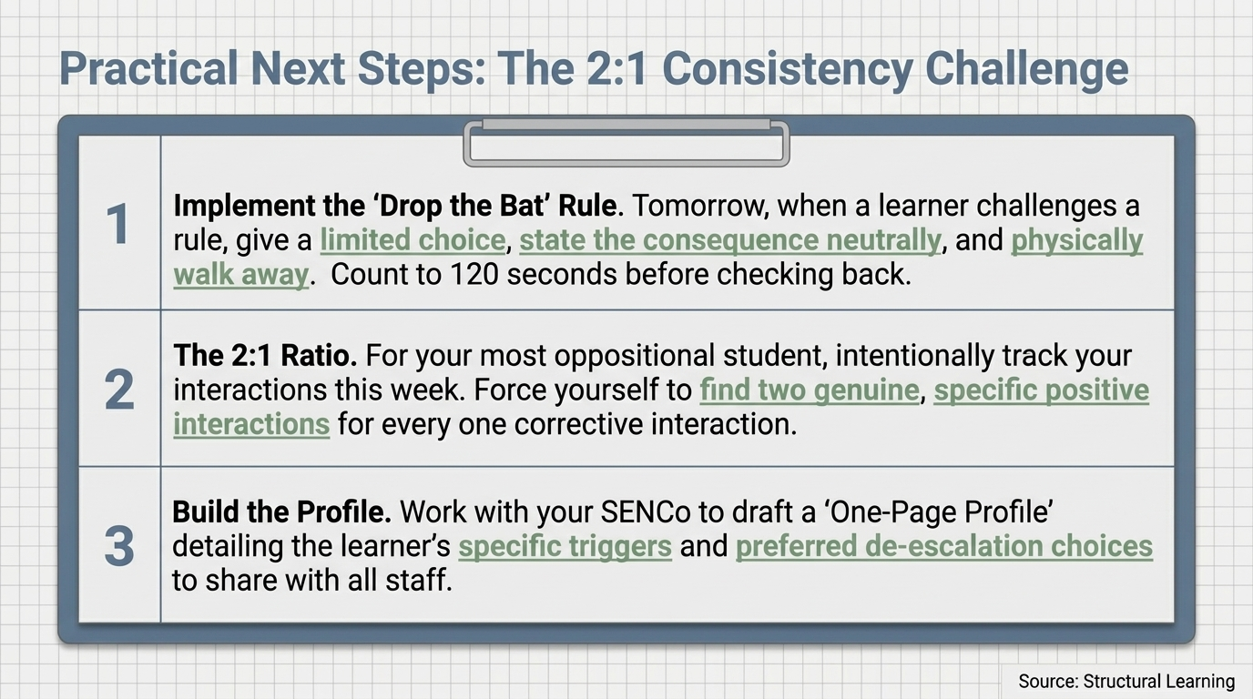
Structural Learning

Slide 11
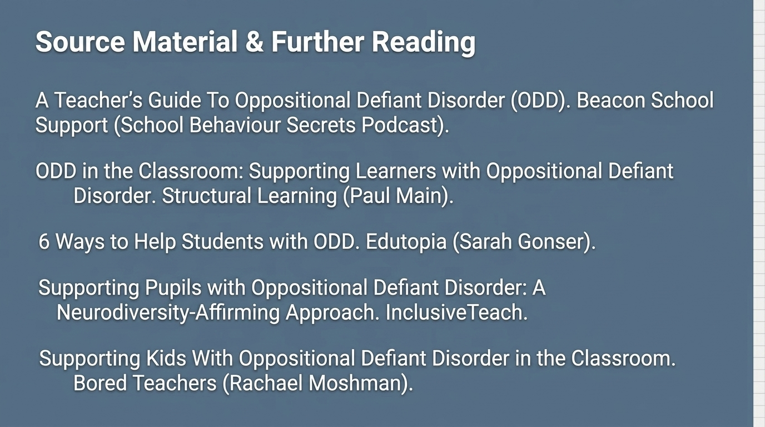
Structural Learning

Slide 12
Read the full guide
https://www.structural-learning.com/post/odd-classroom-oppositional-defiant-disorder

