Slide 1

the DP curriculum structure, six subject groups, the DP core (TOK, EE, CAS) and the 45-point scoring system
A teacher's briefing

Slide 2
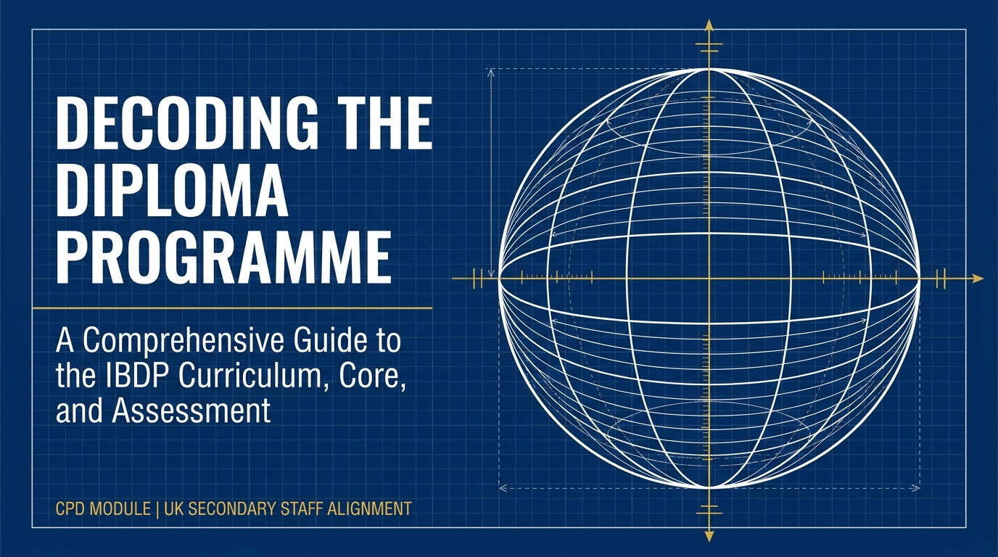
Structural Learning

Slide 3
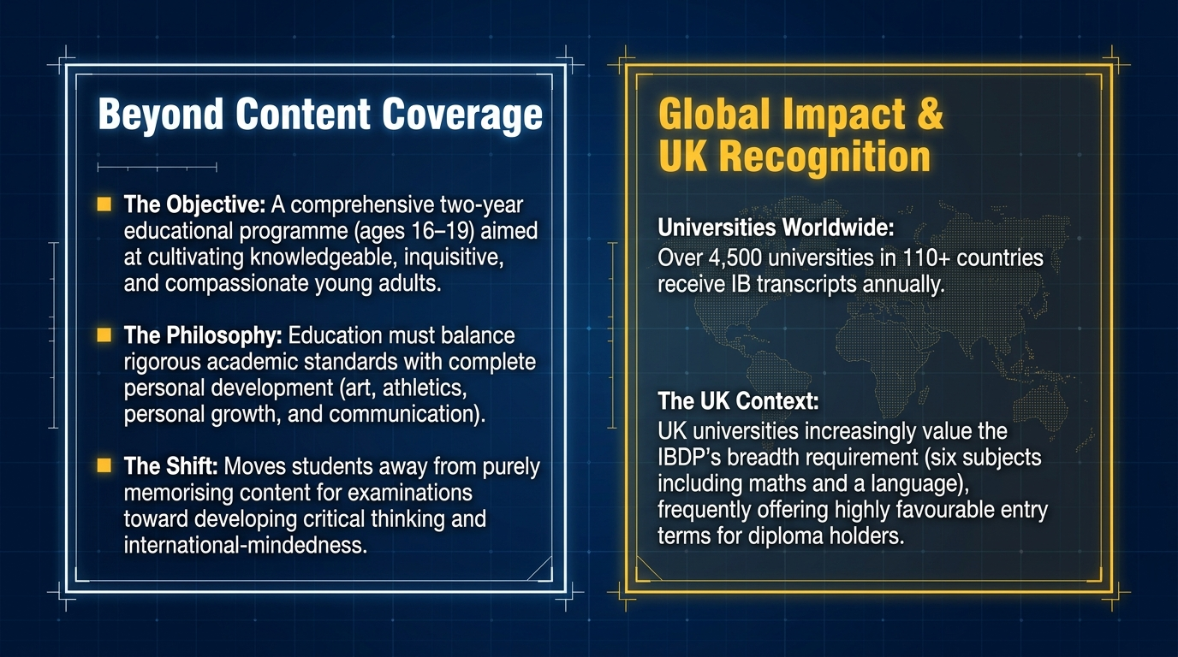
Structural Learning

Slide 4
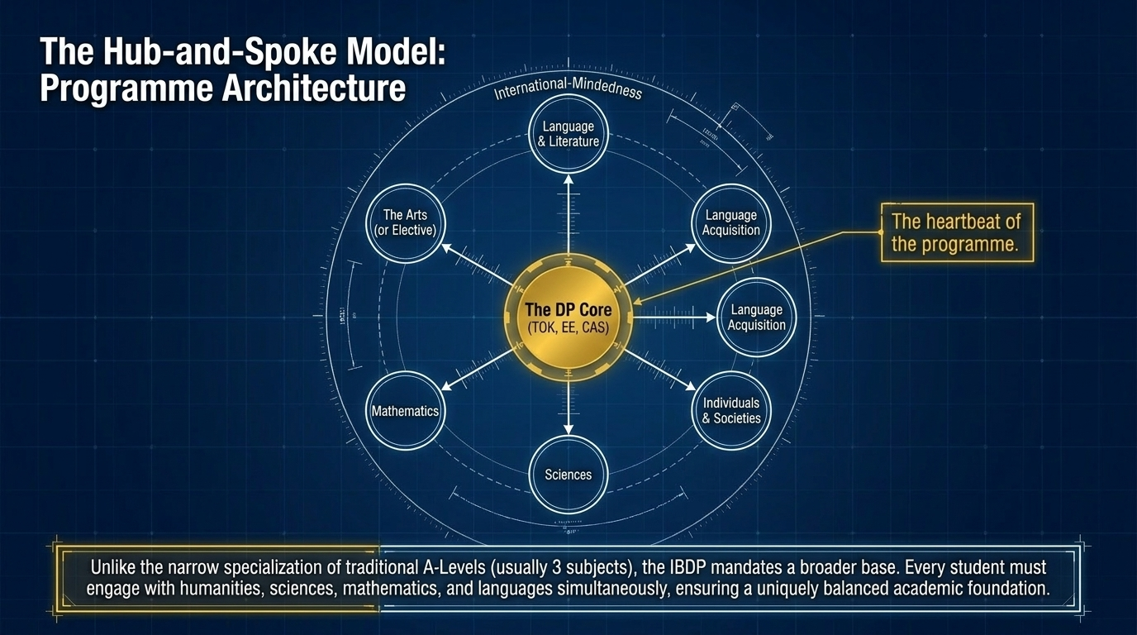
Structural Learning

Slide 5
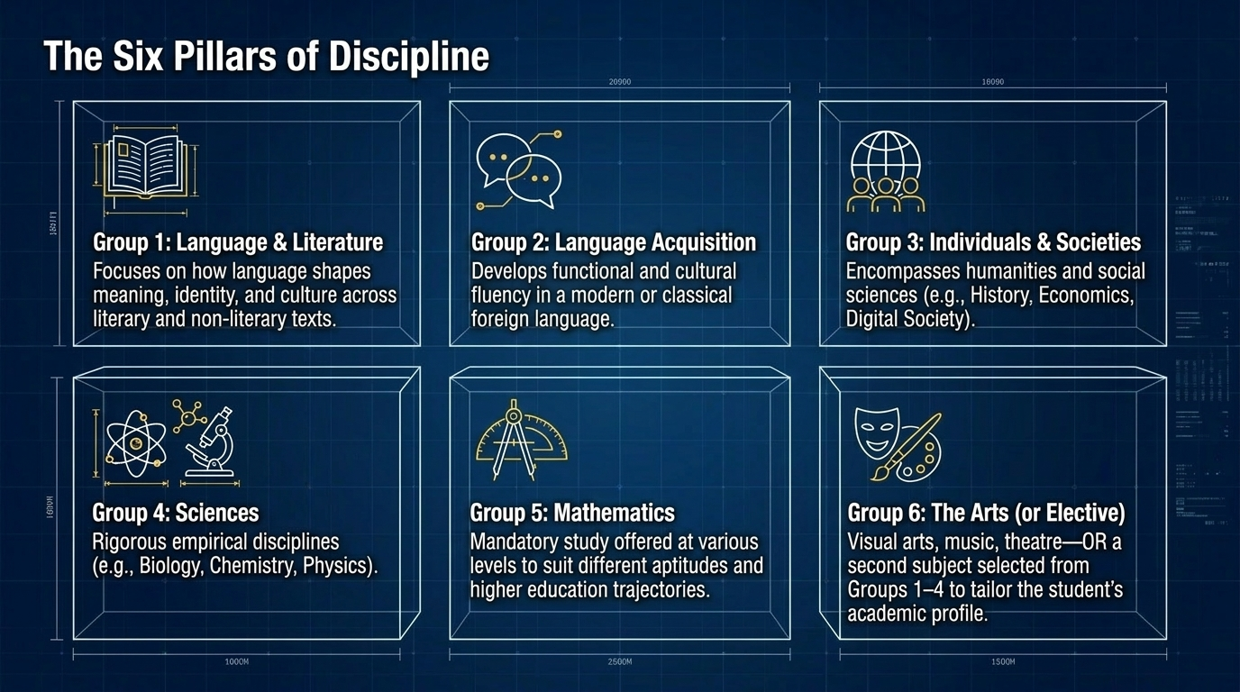
Structural Learning

Slide 6
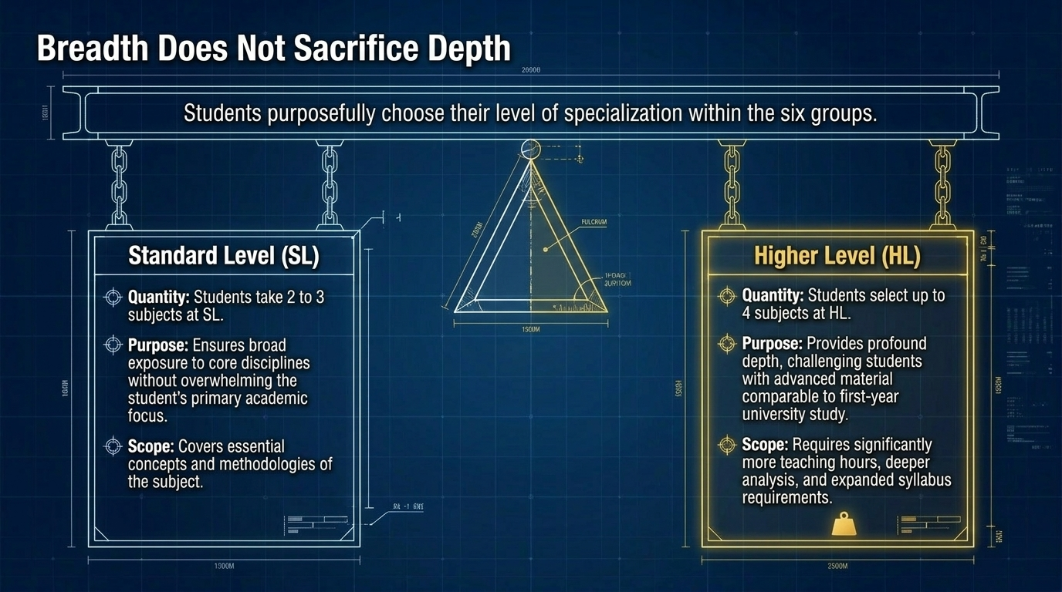
Structural Learning

Slide 7
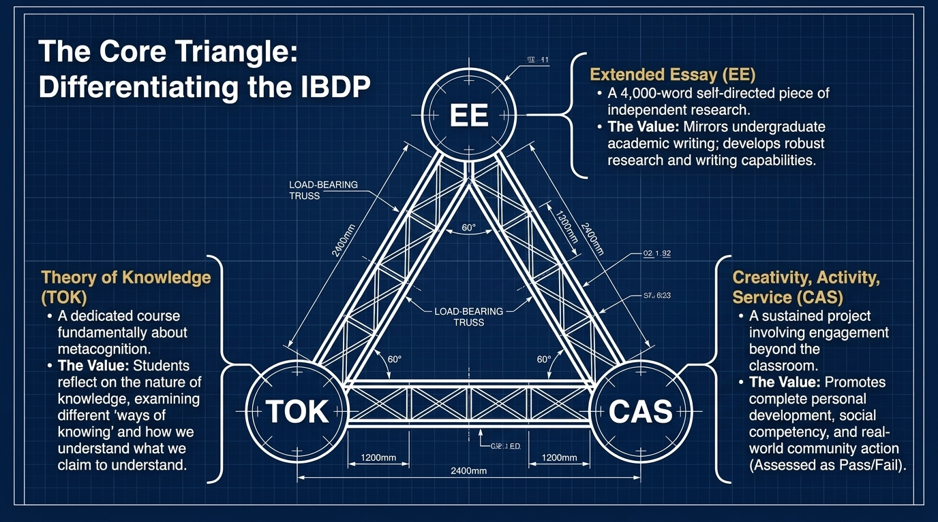
Structural Learning

Slide 8
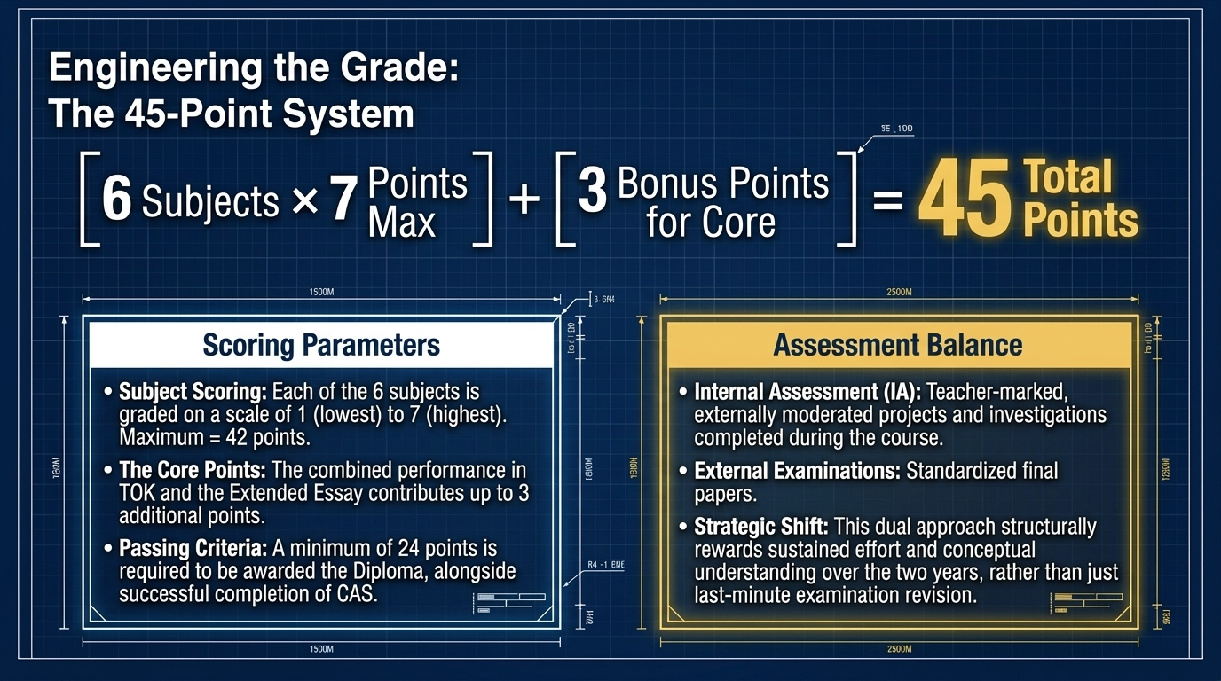
Structural Learning

Slide 9
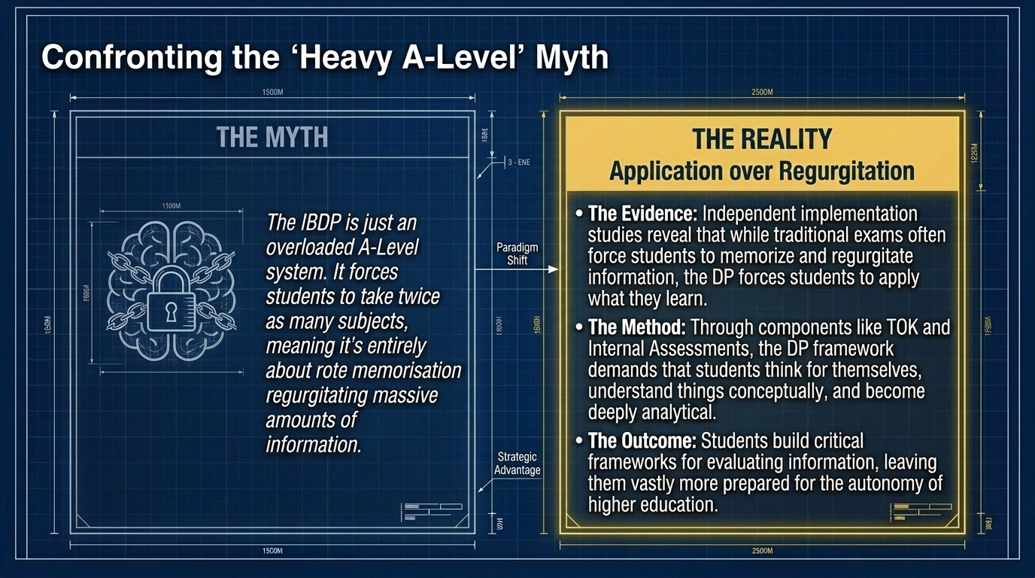
Structural Learning

Slide 10
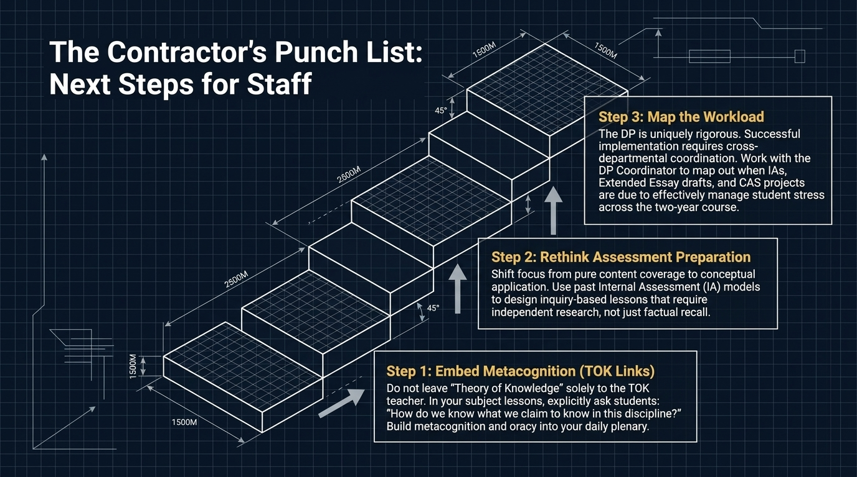
Structural Learning

Slide 11
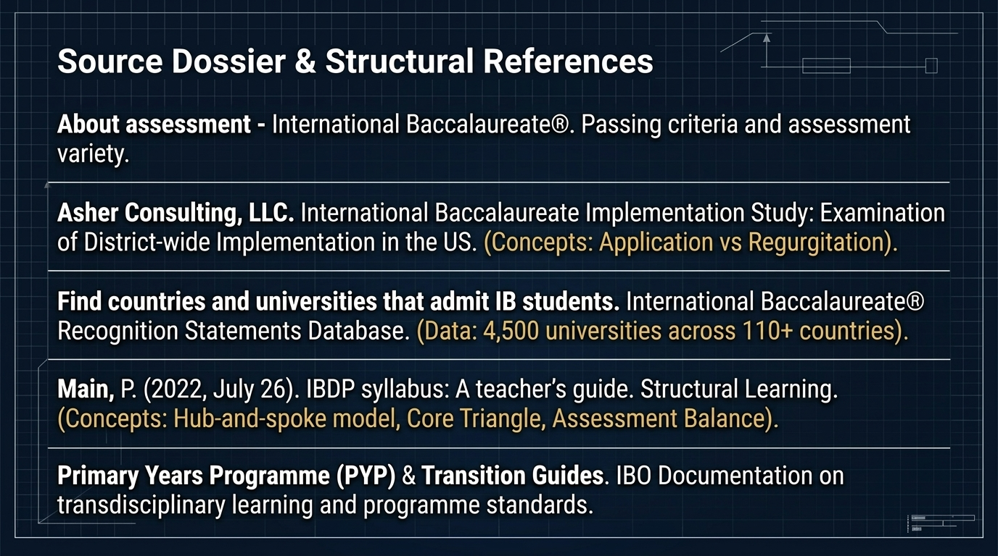
Structural Learning

Slide 12
Read the full guide
https://www.structural-learning.com/post/ibdp-syllabus

