Slide 1

10 TOK Moments for DP Maths and Science
Five-minute prompts for existing lessons
Notes:
[Sources]
- https://www.ibo.org/programmes/diploma-programme/curriculum/dp-core/theory-of-knowledge/
[/Sources]

Slide 2
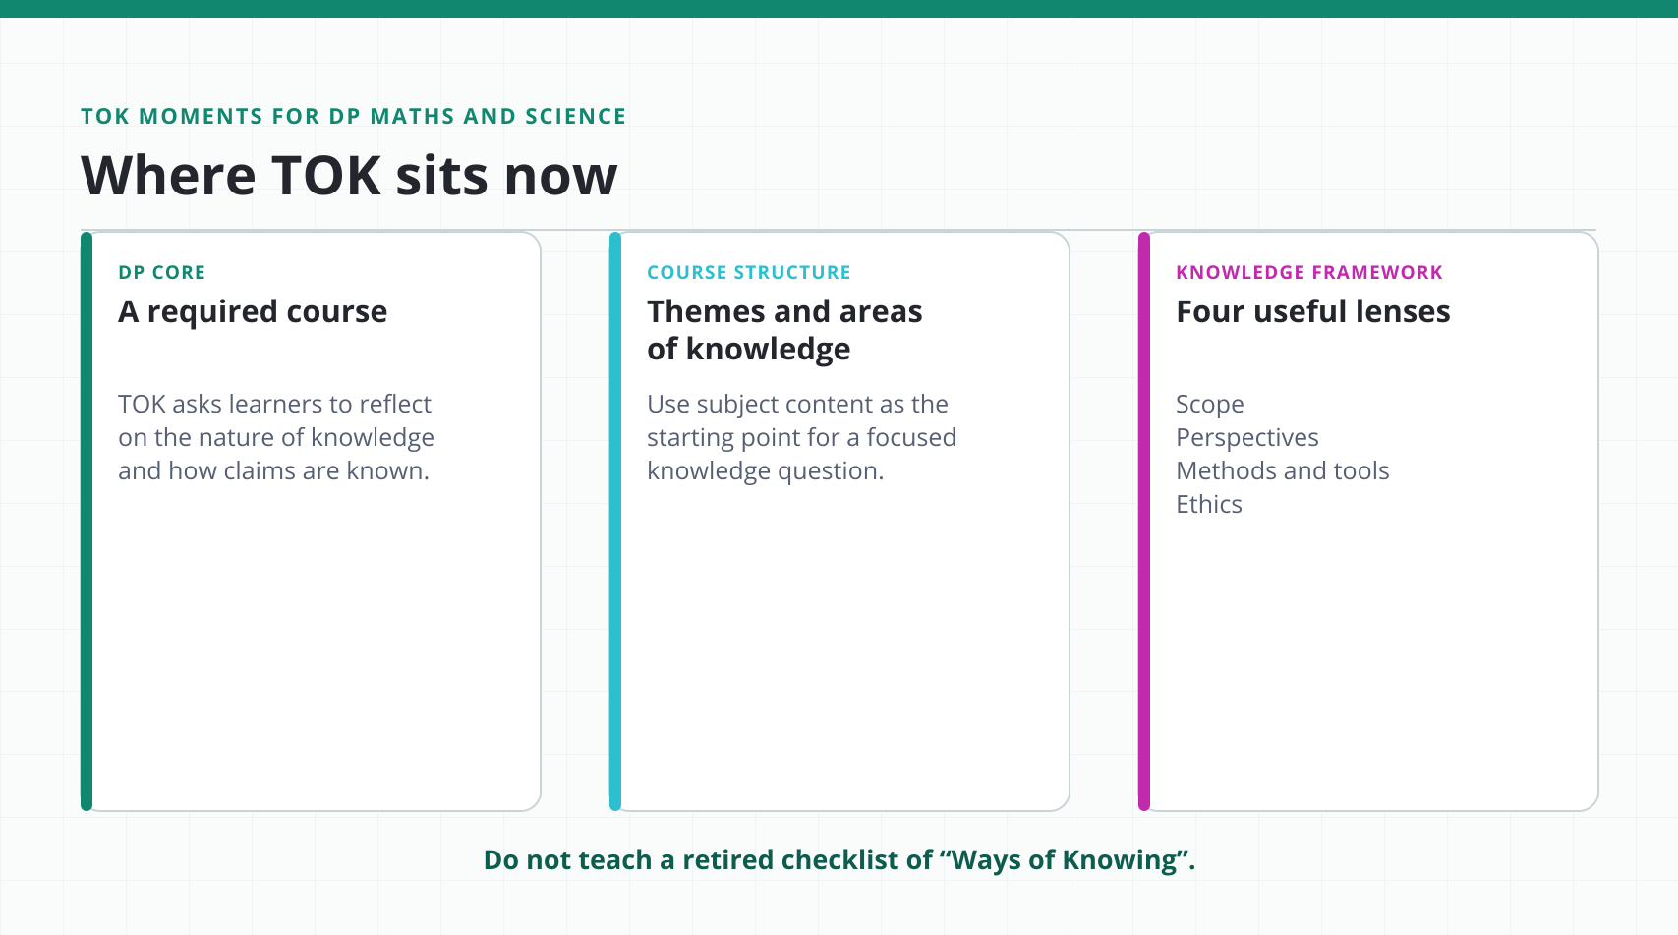
Structural Learning
Notes:
[Sources]
- https://www.ibo.org/programmes/diploma-programme/curriculum/dp-core/theory-of-knowledge/
- https://www.ibo.org/programmes/diploma-programme/curriculum/dp-core/theory-of-knowledge/what-is-tok/
[/Sources]

Slide 3
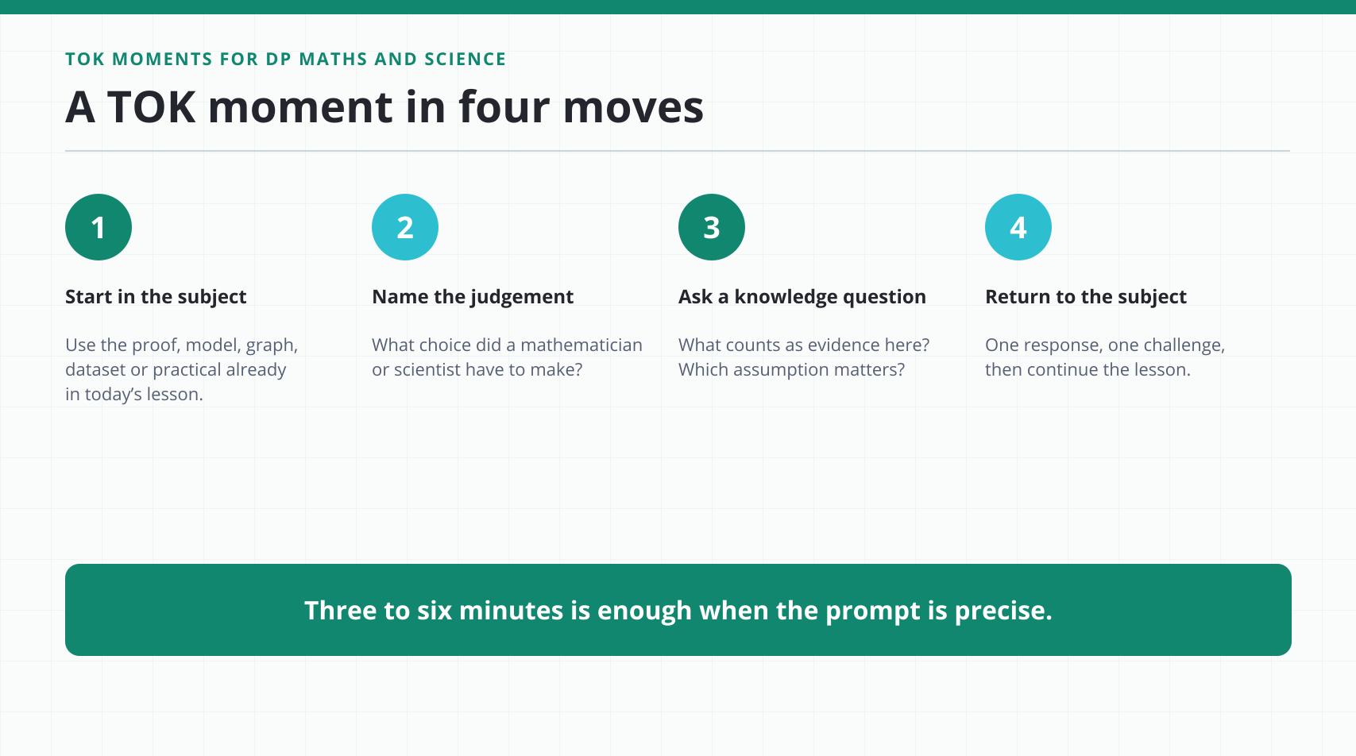
Structural Learning
Notes:
[Sources]
- https://www.ibo.org/programmes/diploma-programme/curriculum/dp-core/theory-of-knowledge/what-is-tok/
[/Sources]

Slide 4
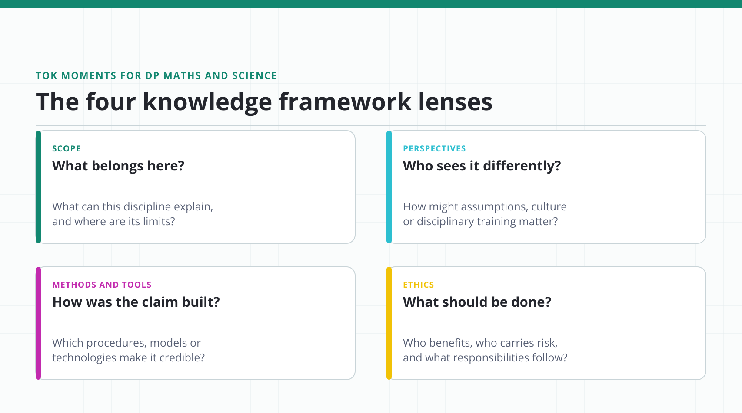
Structural Learning
Notes:
[Sources]
- https://www.ibo.org/globalassets/new-structure/university-admission/pdfs/subject-guides/theory-of-knowledge-tok-guide.pdf
[/Sources]

Slide 5
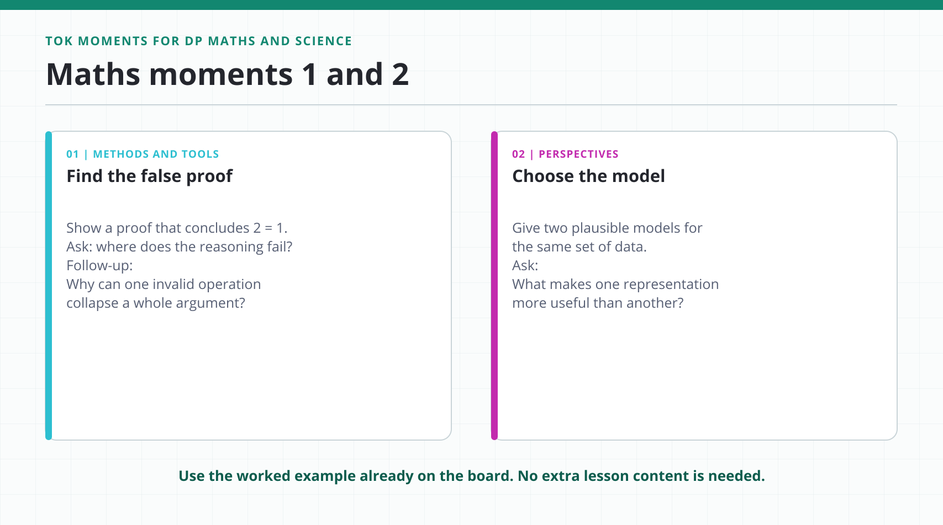
Structural Learning
Notes:
[Sources]
- https://www.ibo.org/globalassets/new-structure/university-admission/pdfs/subject-guides/theory-of-knowledge-tok-guide.pdf
[/Sources]

Slide 6
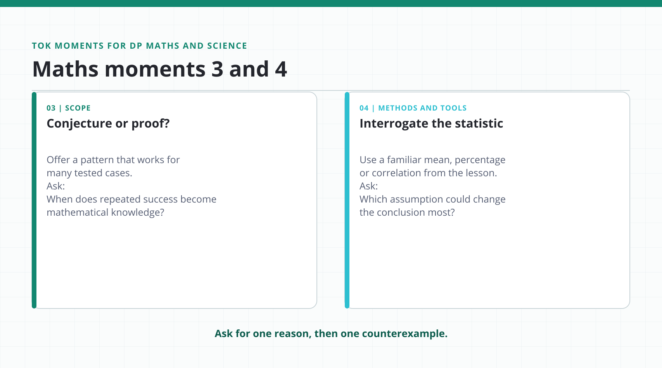
Structural Learning
Notes:
[Sources]
- https://www.ibo.org/globalassets/new-structure/university-admission/pdfs/subject-guides/theory-of-knowledge-tok-guide.pdf
[/Sources]

Slide 7
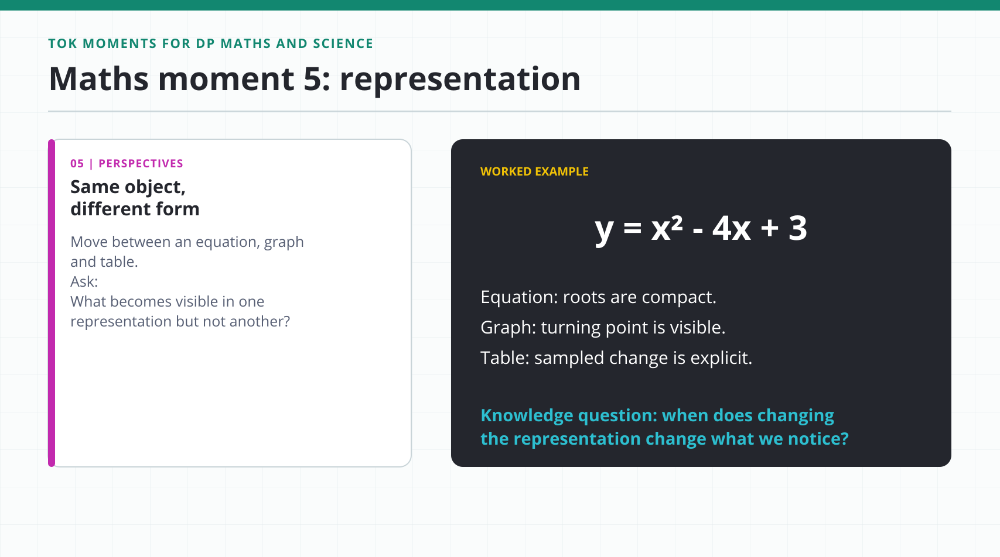
Structural Learning
Notes:
[Sources]
- https://www.ibo.org/globalassets/new-structure/university-admission/pdfs/subject-guides/theory-of-knowledge-tok-guide.pdf
[/Sources]

Slide 8
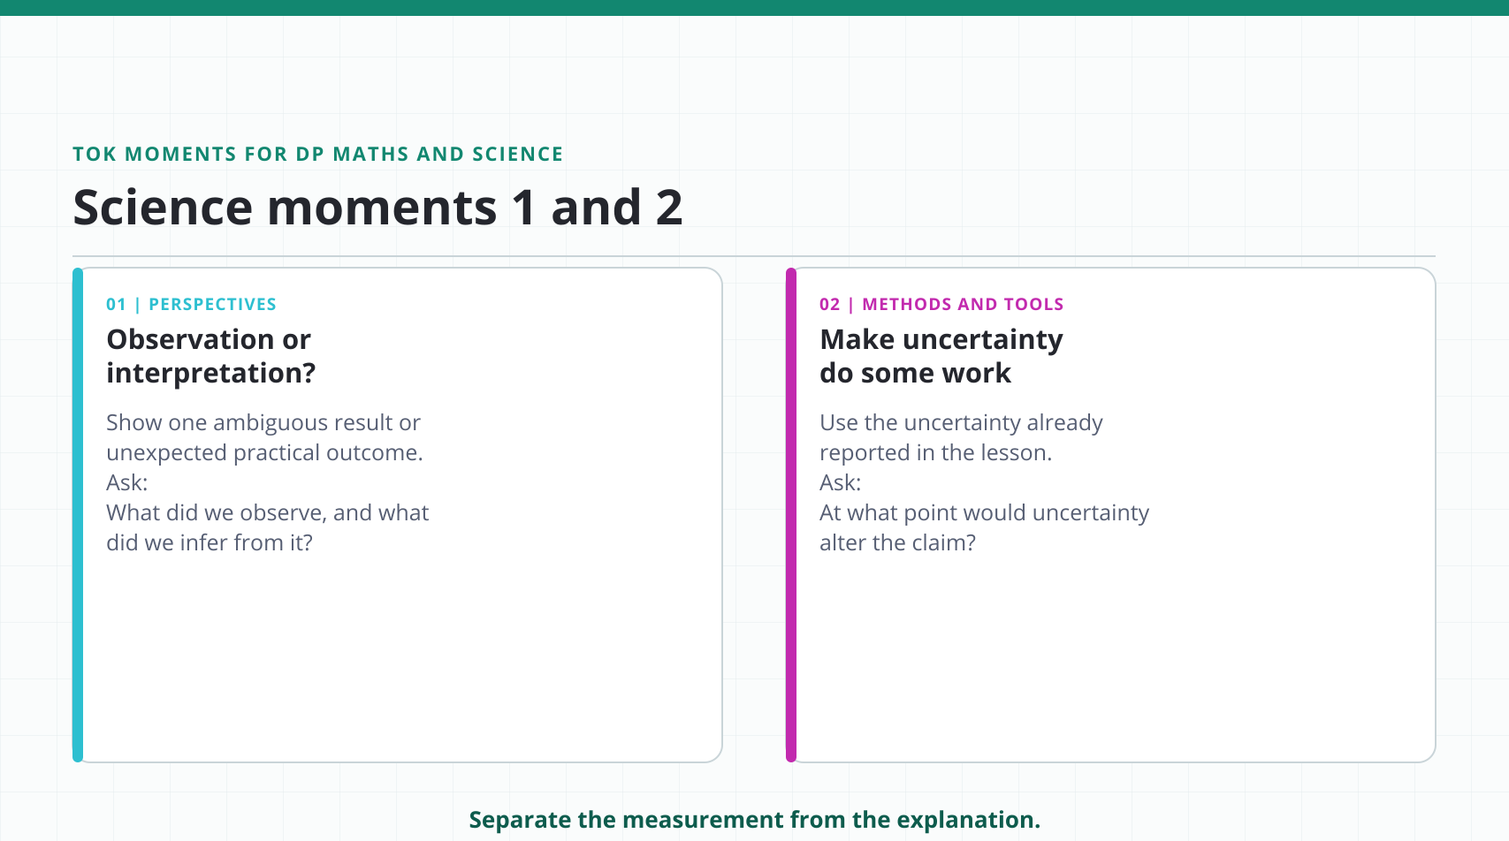
Structural Learning
Notes:
[Sources]
- https://www.ibo.org/globalassets/new-structure/university-admission/pdfs/subject-guides/theory-of-knowledge-tok-guide.pdf
[/Sources]

Slide 9
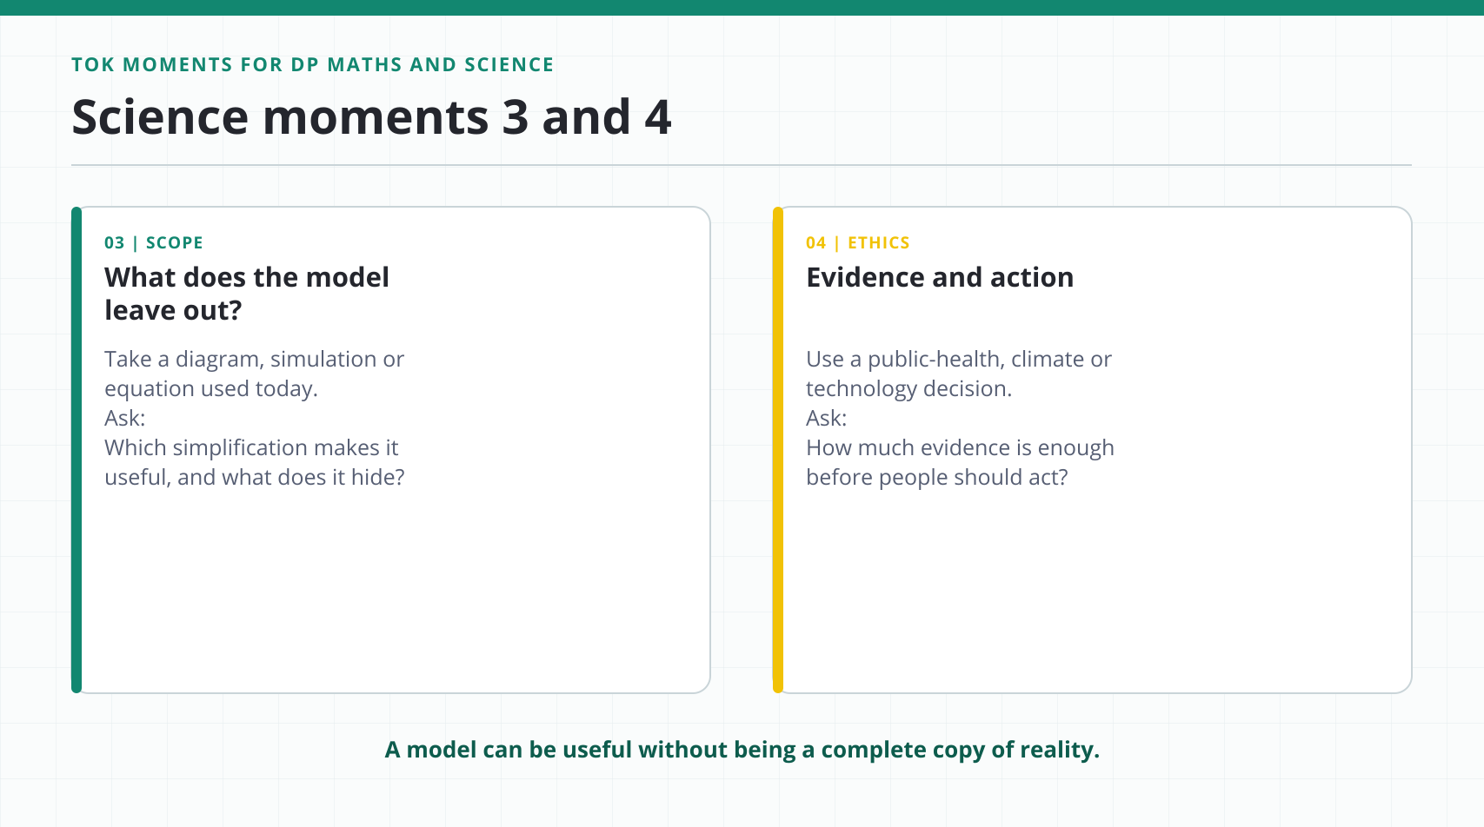
Structural Learning
Notes:
[Sources]
- https://www.ibo.org/globalassets/new-structure/university-admission/pdfs/subject-guides/theory-of-knowledge-tok-guide.pdf
[/Sources]

Slide 10
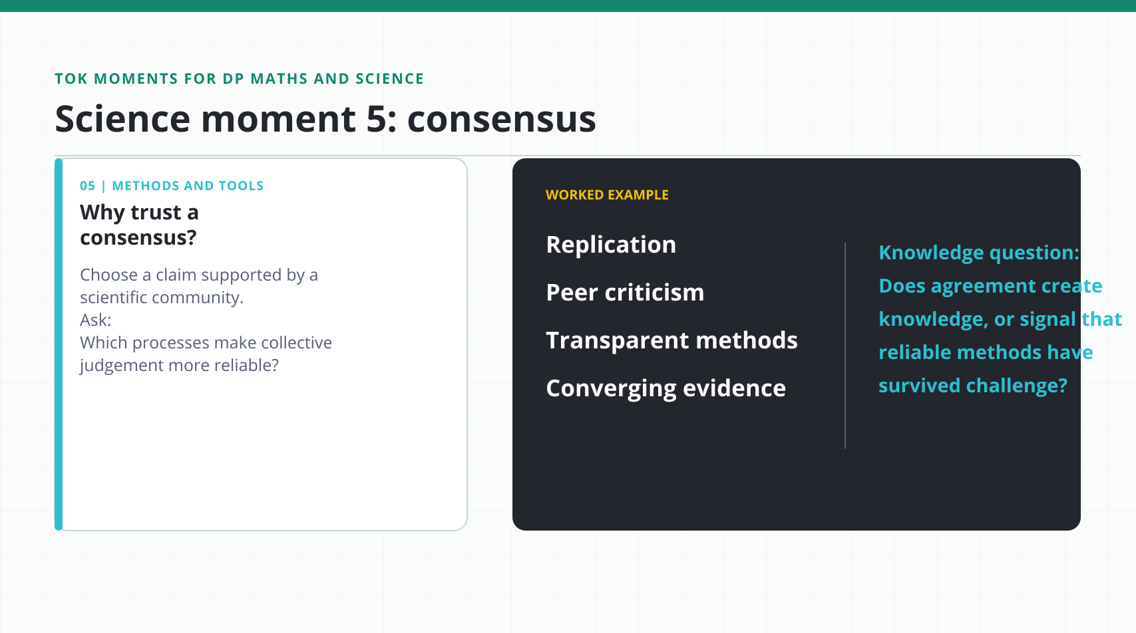
Structural Learning
Notes:
[Sources]
- https://www.ibo.org/globalassets/new-structure/university-admission/pdfs/subject-guides/theory-of-knowledge-tok-guide.pdf
[/Sources]

Slide 11
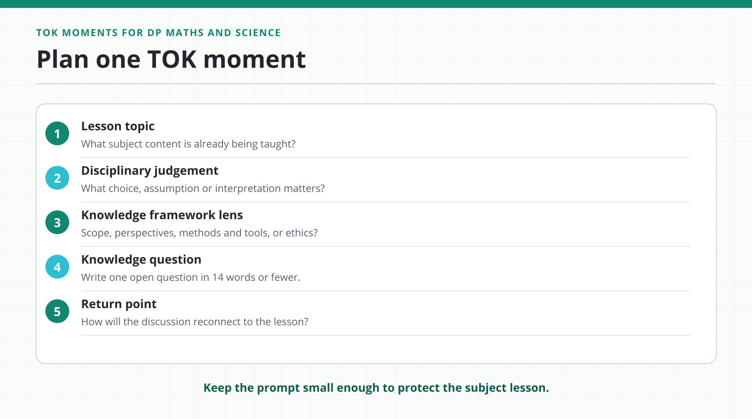
Structural Learning
Notes:
[Sources]
- https://www.ibo.org/globalassets/new-structure/university-admission/pdfs/subject-guides/theory-of-knowledge-tok-guide.pdf
[/Sources]

Slide 12
Choose one prompt for next week
structural-learning.com/post/tok-not-a-subject-embed-ways-of-knowing-stem
Notes:
[Sources]
- https://www.ibo.org/programmes/diploma-programme/curriculum/dp-core/theory-of-knowledge/
[/Sources]

