Slide 1
Unsung Hero Project
4th Grade Writing
Elise Hosmer
Oakland Christian Elementary School

Slide 2
Deep Hope:
Our Deep Hope is to recognize that we are unconditionally loved by God and that we are called to love all people, putting their needs above our own.

Slide 3

Essential Learning Targets:
I can share Christ’s love with others by acknowledging an Unsung Hero’s impact on me and the community.
I can build community by fostering a relationship with an Unsung Hero.
I can write a five paragraph biography essay about my Unsung Hero’s life and impact.

Slide 4
Curricular Outcomes:
CCSS.ELA-LITERACY.W.4.2 Write informative/explanatory texts to examine a topic and convey ideas and information clearly.
CCSS.ELA-LITERACY.W.4.4 Produce clear and coherent writing in which the development and organization are appropriate to task, purpose, and audience. (Grade-specific expectations for writing types are defined in standards 1-3 above.)
CCSS.ELA-LITERACY.W.4.5 With guidance and support from peers and adults, develop and strengthen writing as needed by planning, revising, and editing. (Editing for conventions should demonstrate command of Language standards 1-3 up to and including grade 4 here.)
CCSS.ELA-LITERACY.W.4.6 With some guidance and support from adults, use technology, including the Internet, to produce and publish writing as well as to interact and collaborate with others; demonstrate sufficient command of keyboarding skills to type a minimum of one page in a single sitting.
CCSS.ELA-LITERACY.W.4.7 Conduct short research projects that build knowledge through investigation of different aspects of a topic.
CCSS.ELA-LITERACY.SL.4.5 Add audio recordings and visual displays to presentations when appropriate to enhance the development of main ideas or themes.

Slide 5
Habit(s) of Learning:
Gracious Communicating: Students were asked to respectfully interview their Unsung Heroes. They were also asked to honor their Unsung Hero using their words and writing.
Notes:
Optional – if teachers have it, use it.

Slide 6
See God’s Story:
Creation: Everyone is valued, and has the opportunity to make an impact for God’s glory.
Fall: We are often busy and miss out on the opportunities to thank others for the impact they are making.
Redemption: When we take the time to bless others, we find that we are also blessed. Focusing on the good we see around us leads us to glorify God.
Restoration: We can support students to build community, even reaching out to people they don’t know as well, through the interview process. We then bless others through our writing and creativity.

Slide 7
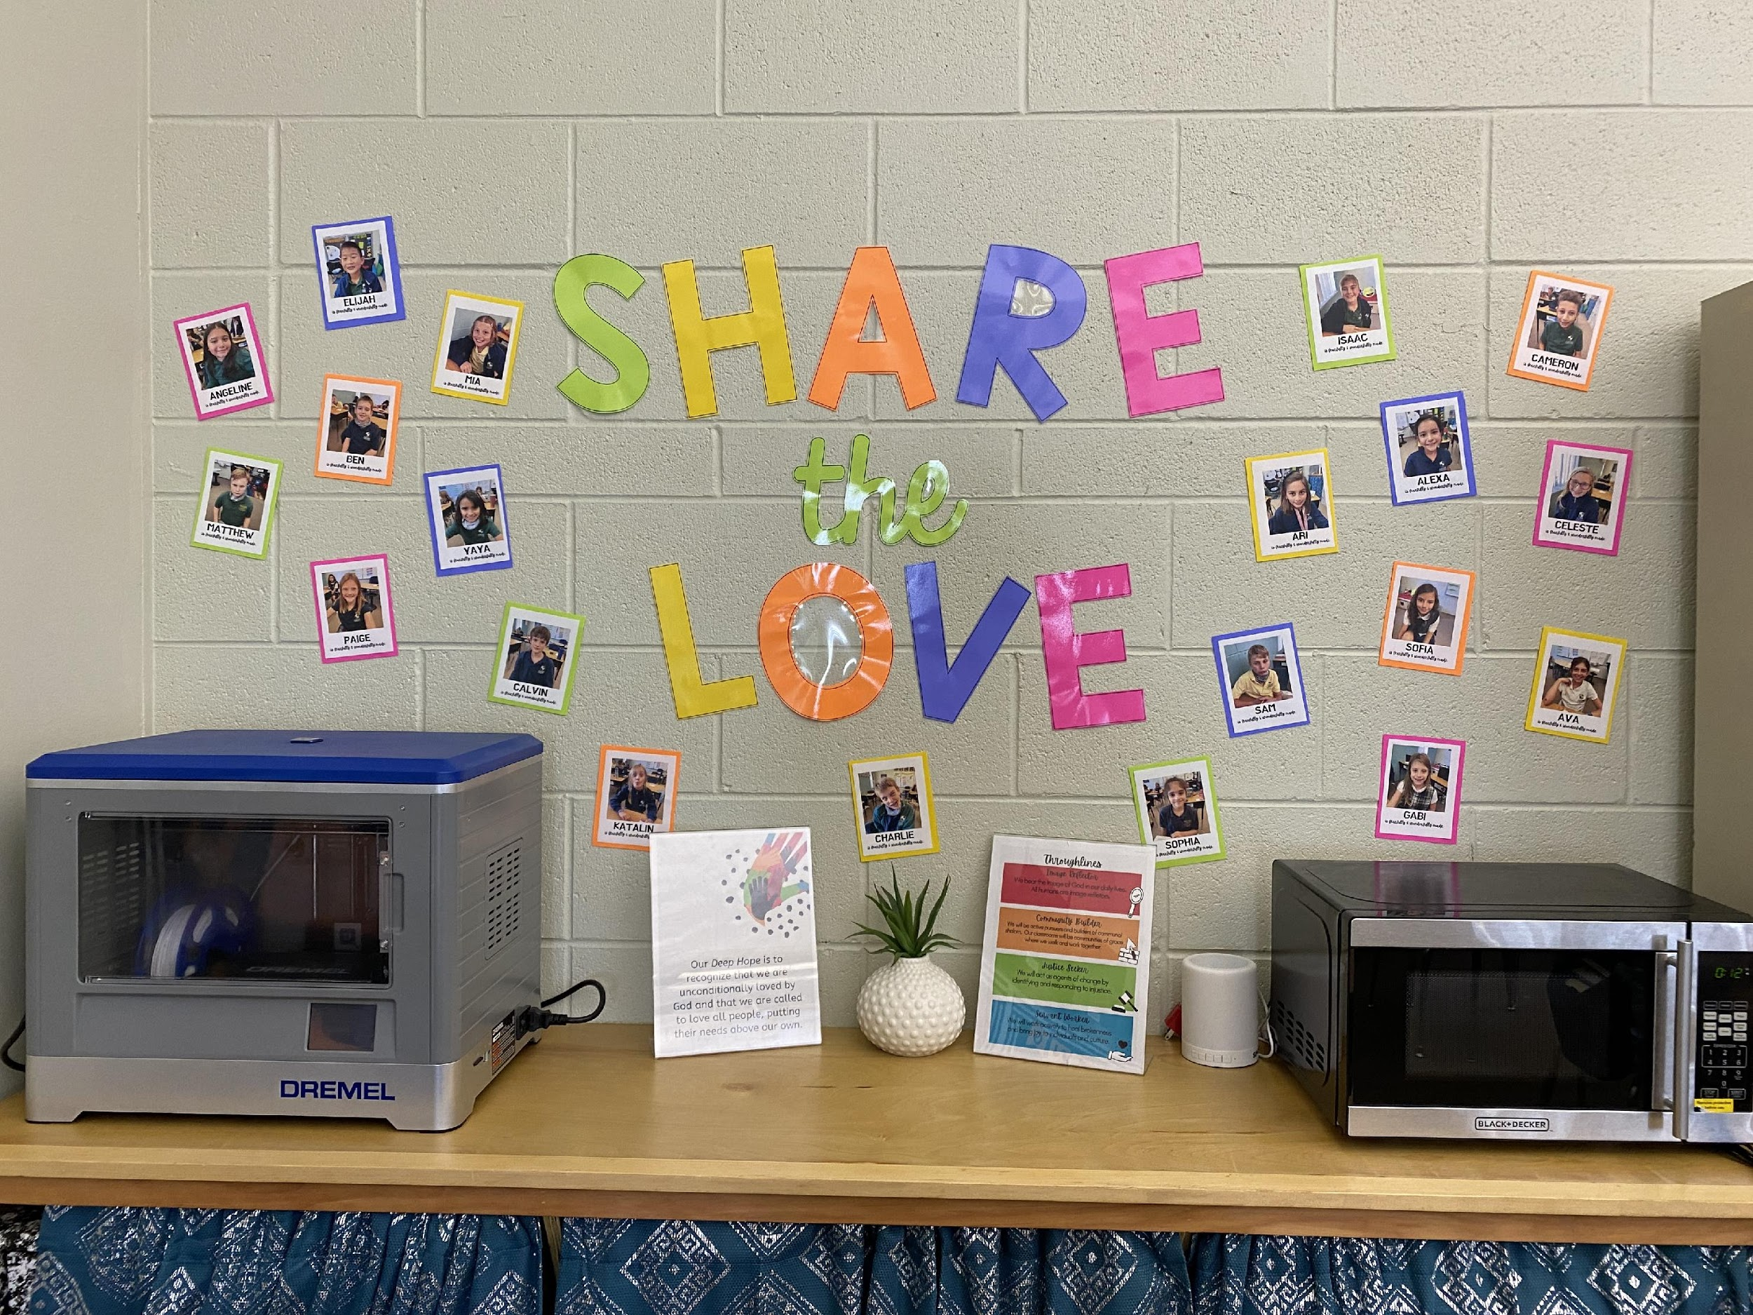
Storyline: Share the Love
The Unsung Hero FLEx fits with our Storyline to share Christ’s love with others because students acknowledged how they have been impacted by Unsung Heroes. They also honored each Unsung Hero’s story as part of God’s larger story.

Slide 8
Throughlines:
Image Reflector: All people are created in God’s image and can make an impact on the world as part of God’s story. There are no small stories to God!
Community Builder: The students are building community by fostering relationships with their Unsung Heroes.
Justice Seeker: The students are seeking people who are not often recognized by society or procedures already in place.
Servant Worker: The students are serving others by telling their stories, and by acknowledging the impact each Unsung Hero made on the kingdom.
Notes:
With some kind of explanation!

Slide 9
Formational Learning Experience:
Real needs: Community with others
Real people: Unsung Heroes from students’ personal lives
Real work: Practice writing quality interview questions, and then conducting an interview. Then, students had to write a five paragraph biography essay. Finally, students used Canva to create a graphic design as a thank you to their hero.

Slide 10
INVITE
Kindness Crew Notes: Throughout the entire school year, students have had the chance to write kind notes to others. These notes were expected to be specific and designed to encourage the recipient.
Thanksgiving Notes: At Thanksgiving, we created a list of school employees that do not receive a lot of recognition. We then divided up our list and had each student write a thankful note to them. We attached a piece of chocolate to our notes when we delivered them.
Friend Biography: Before writing a biography about our Unsung Hero, each student wrote a biography about a friend in our class. This allowed students a chance to practice conducting an interview and formatting a biography essay.

Slide 11

INVITE
Mentor Text - Sincerely, Emerson: At the start of our FLEx, we read this book to learn the power of noticing the actions of others. The book is based on a true story, so it was inspiring to see the impact one person had.

Slide 12
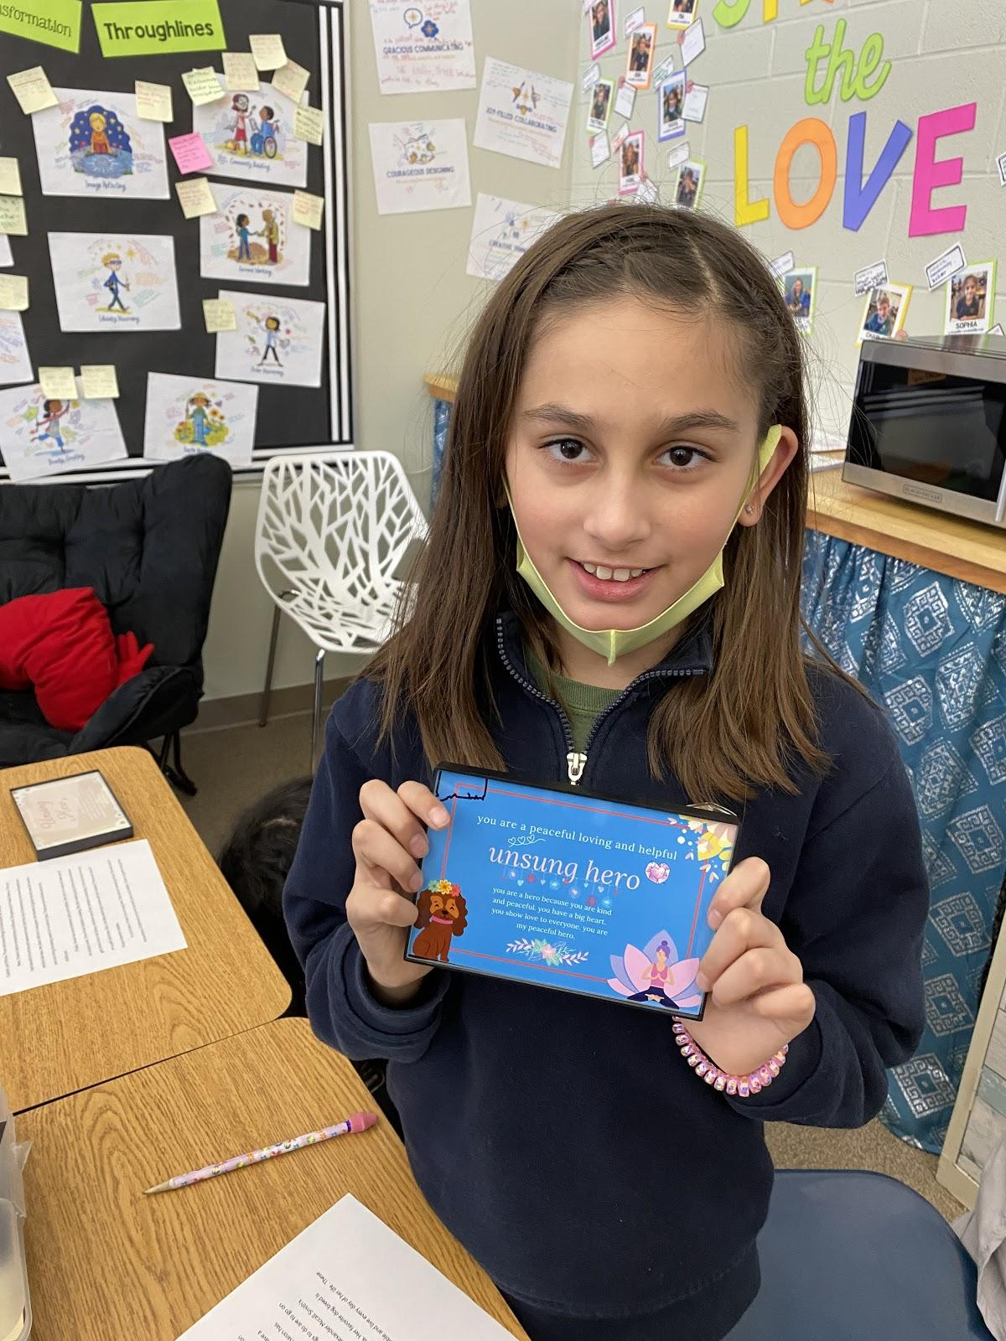
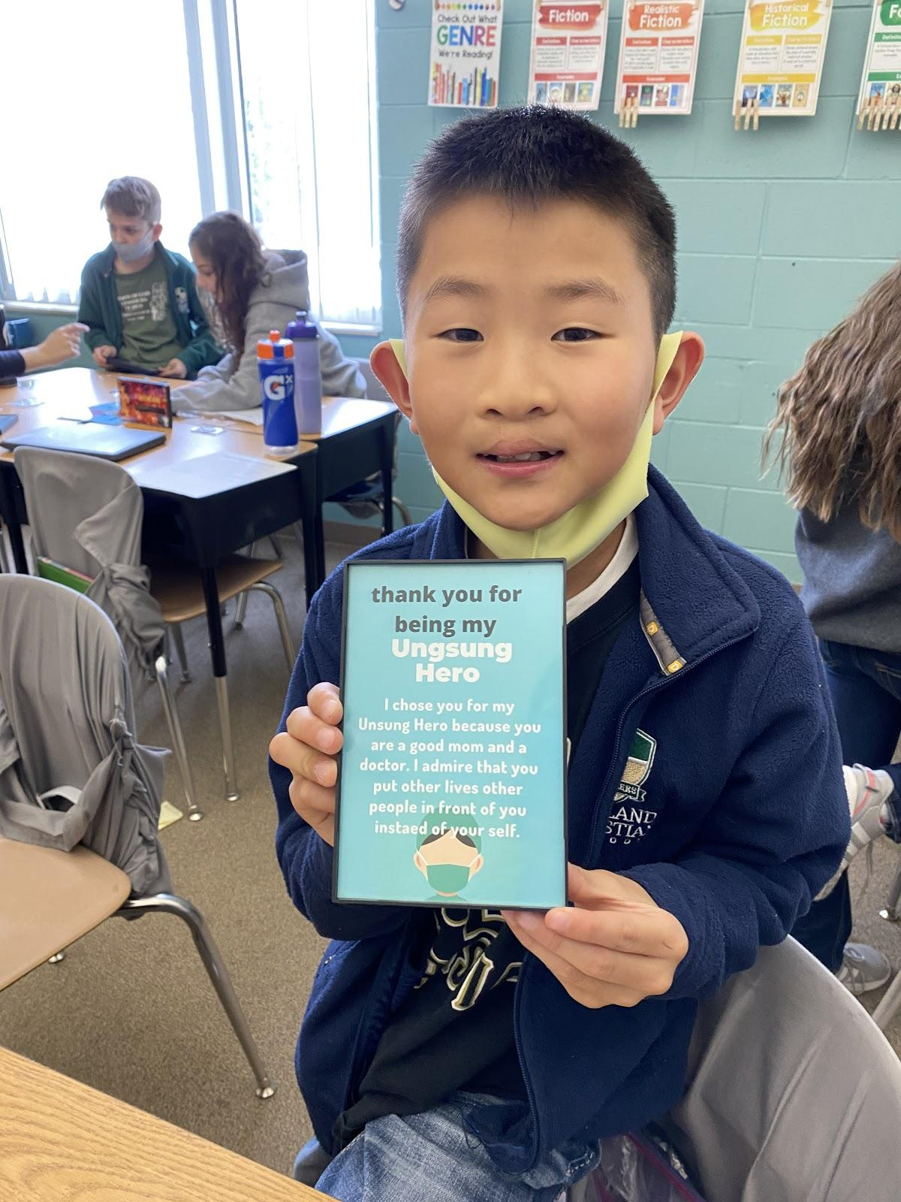
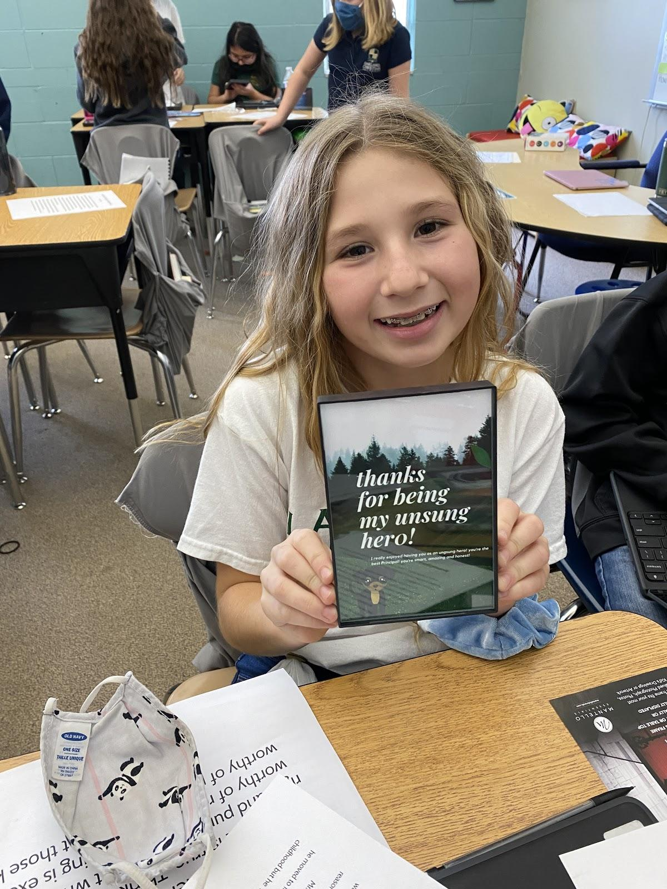
NURTURE
Students were nurtured in building community by conducting an interview with another person. This led them to foster a relationship with their Unsung Hero.

Slide 13
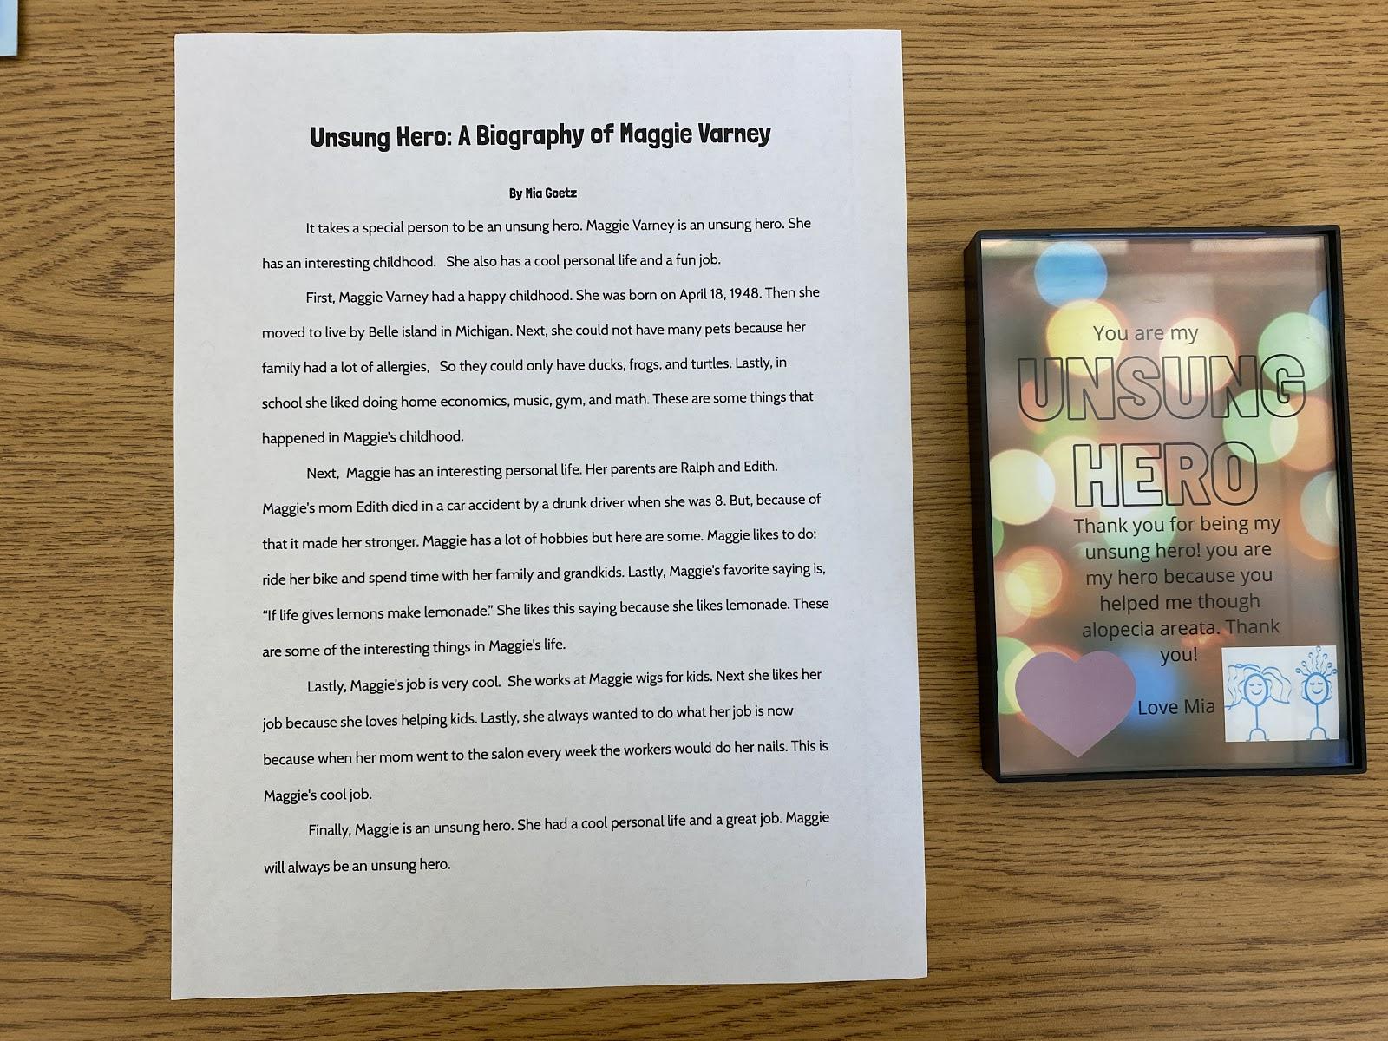
EMPOWER
Students were empowered to write a biography and create a graphic design that shows the impact their Unsung Hero has had on others.

Slide 14
Student Reflections:
“I felt awesome when my person said she was crying happy tears when I picked her and made her day. I felt great that I picked her because God really spoke to me that I should pick her. I had a great experience doing the project but one thing I wish that I could of done was interview her in person but she has a busy schedule so I could not talk to her for the interview, but overall it went pretty great.”
Notes:
Might type student work due to quality of picture.

Slide 15
Student Reflections:
. The writing part was my favorite too. I love how I put my time and knew the right words to describe my unsung hero. I also loved how I sorted everything and made it neat. I haven't given it to my unsung hero but I think she will love it.”
“ I felt overjoyed when I saw Dr. P was so happy when she got my work. I know that because she was smiling and saying thank you.”
Notes:
Might type student work due to quality of picture.

Slide 16
Teacher Reflections:
I chose this project because I wanted to give my students the chance to share the impact other people had made in God’s story. Our classroom focus is on sharing God’s love with others as humble servants. I love hearing my students’ stories about sharing with their interviewee that they selected them as an Unsung Hero, and again hearing about their reaction to their biography and framed graphic design.
One thing I wish I would have done differently is making stronger connections to the Throughlines. When I do this project again next year, I will make sure the students list which throughline(s) that their Unsung Hero shows in their biography and in their graphic design. I may also change the writing component from a biography to a persuasive essay.

