Slide 1
Digital resources for reducing parental conflict
Practitioner workshop

Slide 2

What is the programme about?
There are three digital resources available for parents that are aimed at reducing parental conflict: ​
Me, You and Baby Too (MYBT)​
Arguing better​ (AB)
Getting it right for children (GIRFC)​

Slide 3

Digital resources learning programme
Workshop agenda
SESSION 1
Programme outline – setting the scene
Welcome and introductions
Why relationships matter
Impact of conflict on children
Types of conflict
Evidence-based digital interventions
Exploring the digital resources
SESSION 2
Independently explore the digital resources
Discussion group work
Getting on Better cards
Why we talk about relationships and why we don't
A framework for working with parents
Relational skills in action
Knowing where to signpost

Slide 4
Learning programme aims and outcomes
This learning programme aims to enhance your knowledge, understanding, skills and confidence to work with parents to reduce parental conflict using a variety of digital resources.
By the end of the programme you will be able to:
Raise parents'
awareness of the issue
of parental conflict,
including impact
on children
Use digital resources
to help parents
recognise conflict
and destructive
behaviour patterns
Enable parents to develop positive communication skills and helpful conflict behaviours

Slide 5
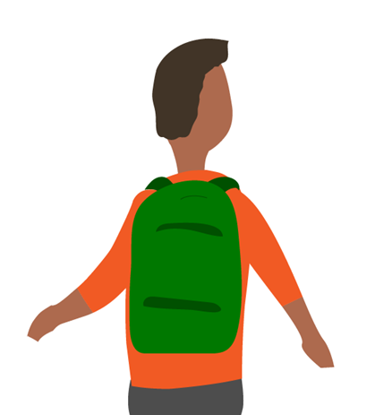
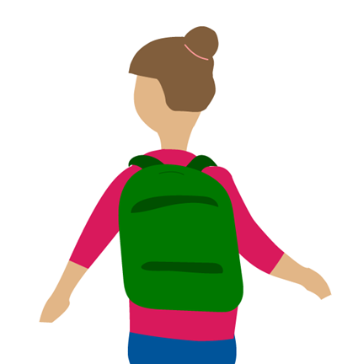
Introductions
What I do
Something about me:
I’m proud of...
or
I’m famous for…
or
a hobby…

Slide 6

SESSION 1
What do I need to know?
OPO digital resources

Slide 7
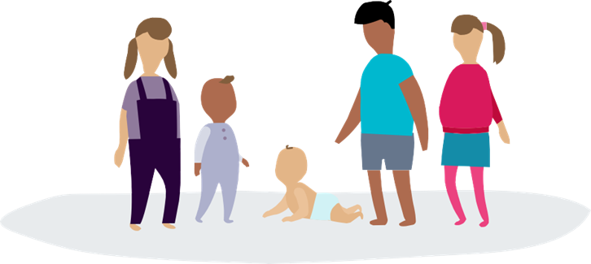
What do I need to know?
Some important definitions
Why do relationships matter
Impact of conflict on children and families
When is conflict harmful for children
Evidence base for digital interventions

Slide 8
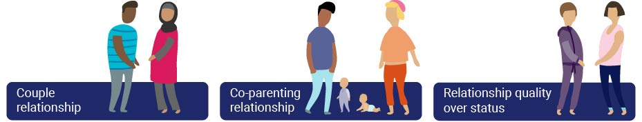
Defining parent couple relationships

Slide 9
What does the evidence show?
 |  | True | False
1. | 40-70% of parents report a decline in relationship satisfaction after the birth of a baby
2. | Conflict has an adverse effect on children of all ages
3. | By the age of 16, 47 % of children do not live with both biological parents
4. | Conflict doesn't affect children if they don't see (or hear) it happening
5. | Children living in workless families are three times more likely to experience parental conflict than families where both parents work
6. | Every child experiencing parental conflict shows signs of distress
7. | Arguing between parents indicates a level of relationship distress
8. | Children who experience relationship breakdown are five times more likely to be in trouble with the police
9. | Divorce or separation is always detrimental to the wellbeing of the child
10. | Mental health problems are more prevalent in people experiencing relationship distress

Slide 10
What does the evidence show?
 |  | True | False
1. | 40-70% of parents report a decline in relationship satisfaction after the birth of a baby | T
2. | Conflict has an adverse effect on children of all ages | T
3. | By the age of 16, 47 % of children do not live with both biological parents | T
4. | Conflict doesn't affect children if they don't see (or hear) it happening |  | F
5. | Children living in workless families are three times more likely to experience parental conflict than families where both parents work | T
6. | Every child experiencing parental conflict shows signs of distress |  | F
7. | Arguing between parents indicates a level of relationship distress | T | F
8. | Children who experience relationship breakdown are five times more likely to be in trouble with the police |  | F
9. | Divorce or separation is always detrimental to the well-being of the child |  | F
10. | Mental health problems are more prevalent in people experiencing relationship distress | T

Slide 11

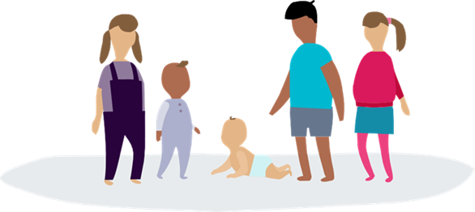
Parent relationships matter to children
Children exposed to frequent destructive
conflict are more likely to:
Experience depression or anxiety
Have physical health problems
Develop behaviour problems
Do worse at school
Struggle with peer relationship
Be prone to substance misuse, criminality,
iiiiihomelessness, self-harm and suicidality
There is a knock-on effect in later life:
Adult relationships
Psychological wellbeing
Employment
These adverse outcomes are seen whether parents are living together
or apart, and whether they are biologically related to the child or not.
Harold and Sellers (2018), Harold, Leve, and Sellers (2017), Harold, G., Acquah, D., Sellers, R. and Chowdry, H. (2016)

Slide 12
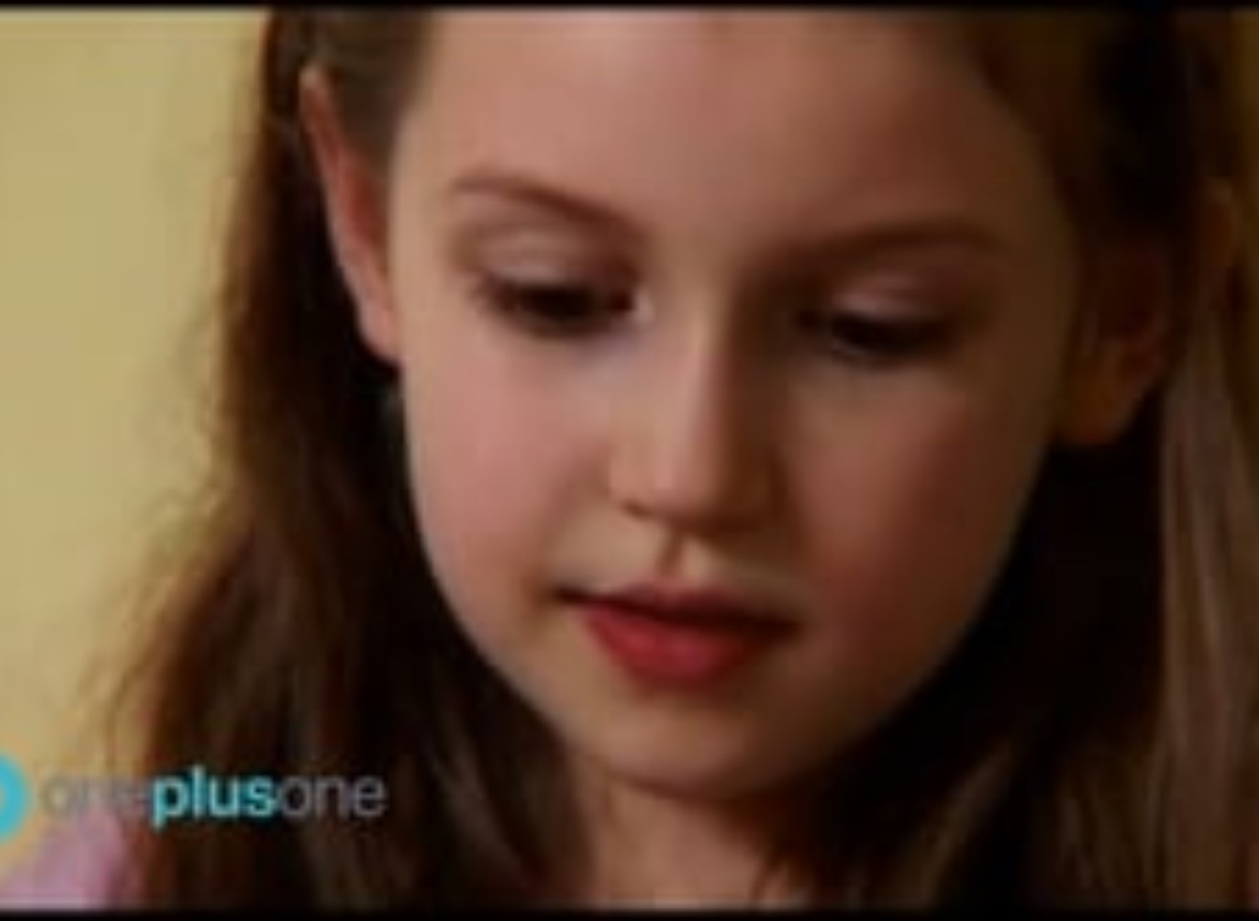
Impact of parental conflict
Film clip 1: Kids talk
How do children feel when
their parents argue?
What happens when
they make up?

Slide 13
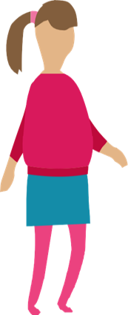
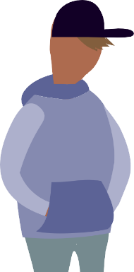

Parental conflict – effects on children
Internalising behaviour
A child withdraws and is quiet
A parent child
A child takes on the role of a parent in trying to sort out the problem. This is often a sign that they feel responsible for their
parents' conflict
Externalising behaviour
A child may become
aggressive and difficult
Sellars and Harold (2018)

Slide 14
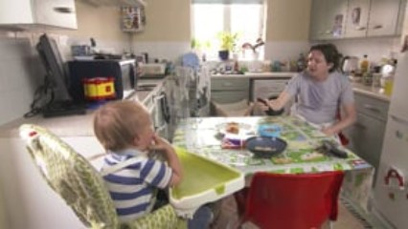
Conflict in action
What conflict behaviours do you see the mum and dad using in this film clip?

Slide 15
A note on domestic abuse
Resources are designed to be used as an early intervention before conflict is deeply entrenched.
Not appropriate to use with families where there is ongoing
domestic abuse or a history of domestic abuse.
It may only be when we start working with a couple or
co-parents that domestic abuse is identified. Follow your local authority's policy and procedures for domestic abuse.

Slide 16
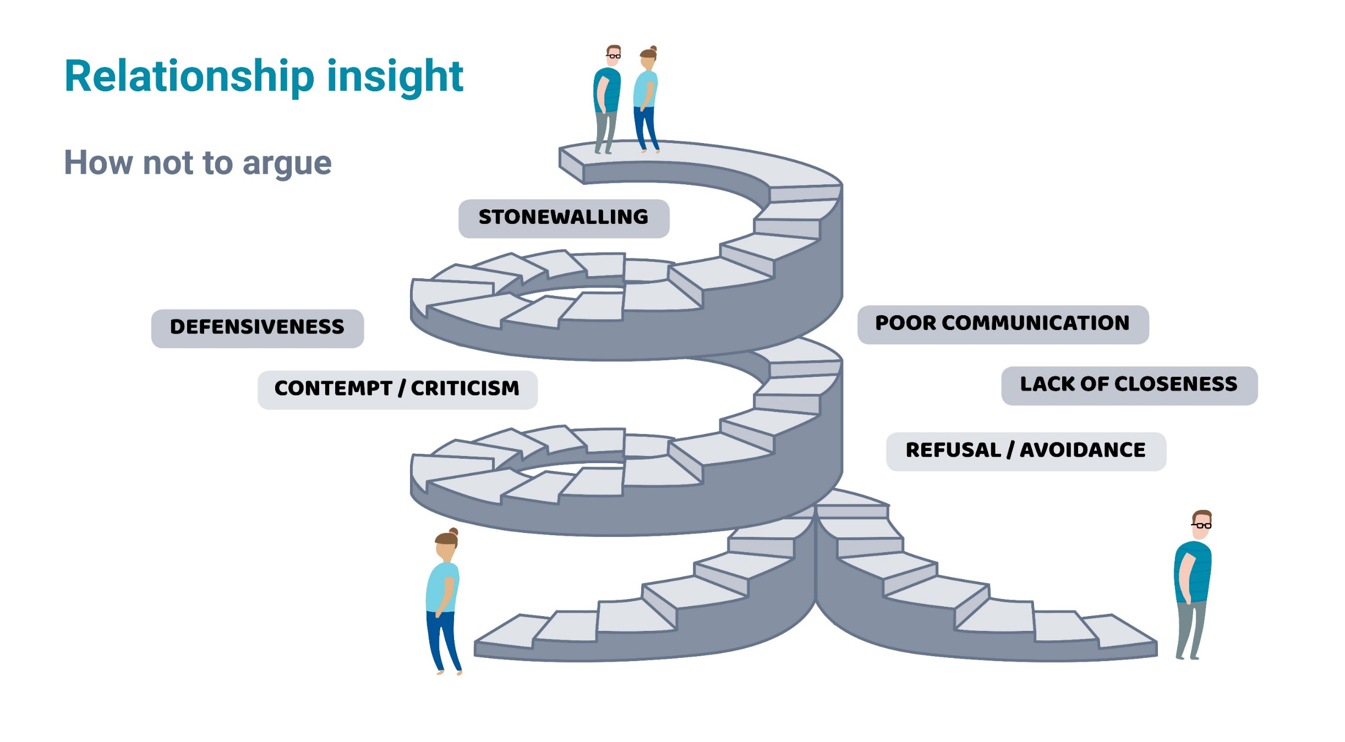
Relationship insight
How not to argue

Slide 17
Types of conflict
Destructive
(relationship damaging)
Intense arguments
Personally insulting
Verbal aggression
The silent treatment
Arguments about or
involving the children
Constructive
(relationship enhancing)
Stay calm and listen
Seek compromise
Demonstrate warmth
Use humour and negotiation
Discussion without resolution
For a child, the best ending to an argument between parents
is a meaningful resolution with apologies.

Slide 18
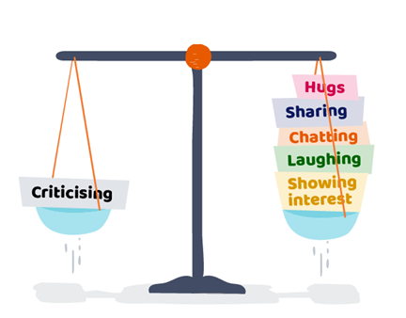
A magic ratio
Gottman (1994) found that couples have better relationships when their POSITIVE MOMENTS outweigh their NEGATIVE MOMENTS
For every NEGATIVE MOMENT between you and your partner, you need FIVE POSITIVE MOMENTS to balance it out

Slide 19

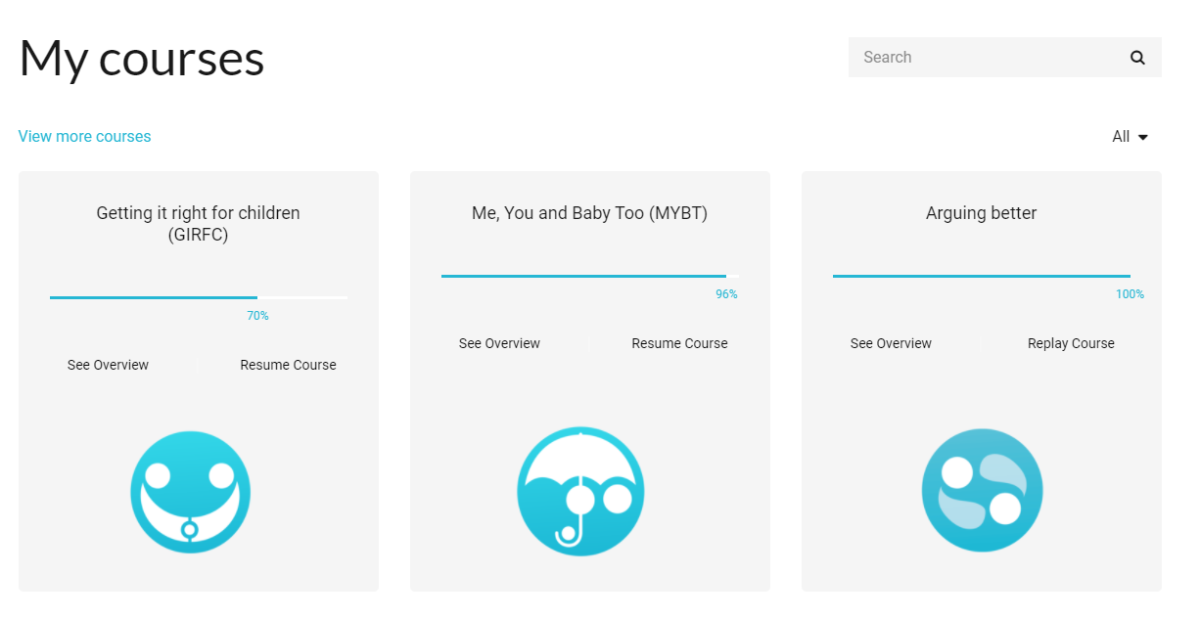
OnePlusOne digital resources
Commissioned by LA with specific number of licenses to be used with parents as part of a targeted or universal approach.
Can be self-directed or used
with full or partial support from practitioner.

Slide 20
Evidence-based digital behaviour change interventions
Literature reviews
UX
Usability testing

Slide 21
Vulnerability-stress-adaptation model
Personal strengths and vulnerabilities
Personality traits, relationship experiences, personal history
Ways of
adapting/relating
Problem solving, communication and conflict management
Relationship
Relationship
quality
stability
Stressful life events
Life transitions, work and worklessness, illness, financial pressure
(Karney and Bradbury 1995; Bradbury and Karney 2004)

Slide 22
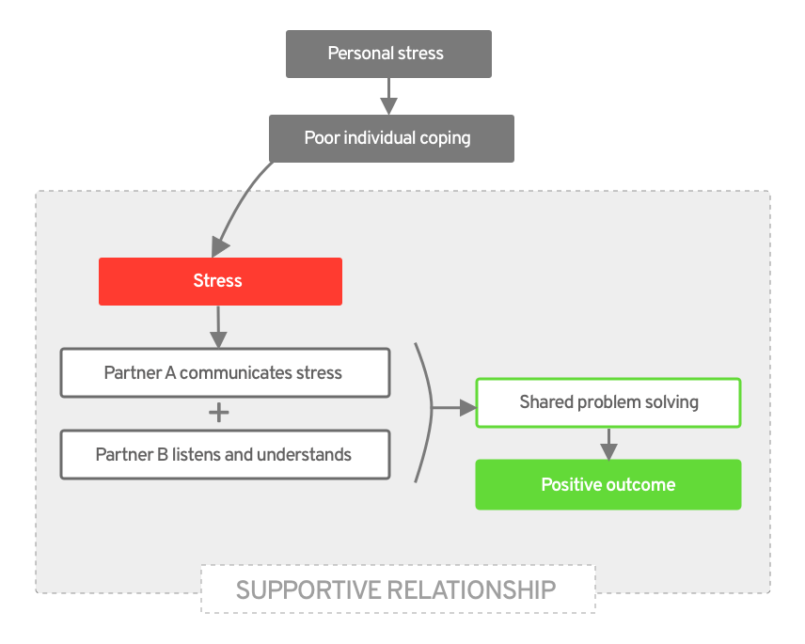
Couple coping and stress
Bodenmann (1997)

Slide 23
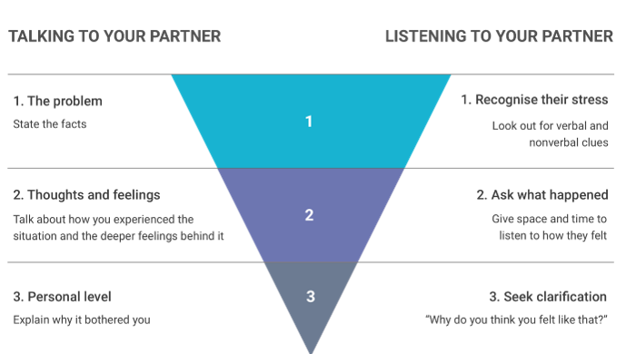
The funnel method
CCET; Bodenmann (1997)

Slide 24

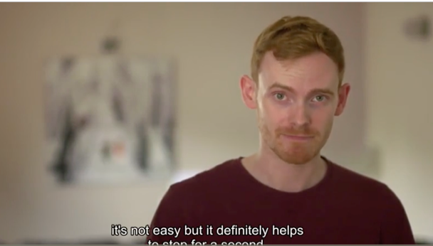
Behaviour modelling training
Attentional
  Involves observing ideal behaviours from least difficult to most difficult
Retentional
  Involves the use of symbols to memorise the new skills https://www.oneplusone.org.uk/parents
Reproduction
  Practicing the new skill
Motivational
  Positive reinforcements for demonstrating
  the newly learned skills

Slide 25
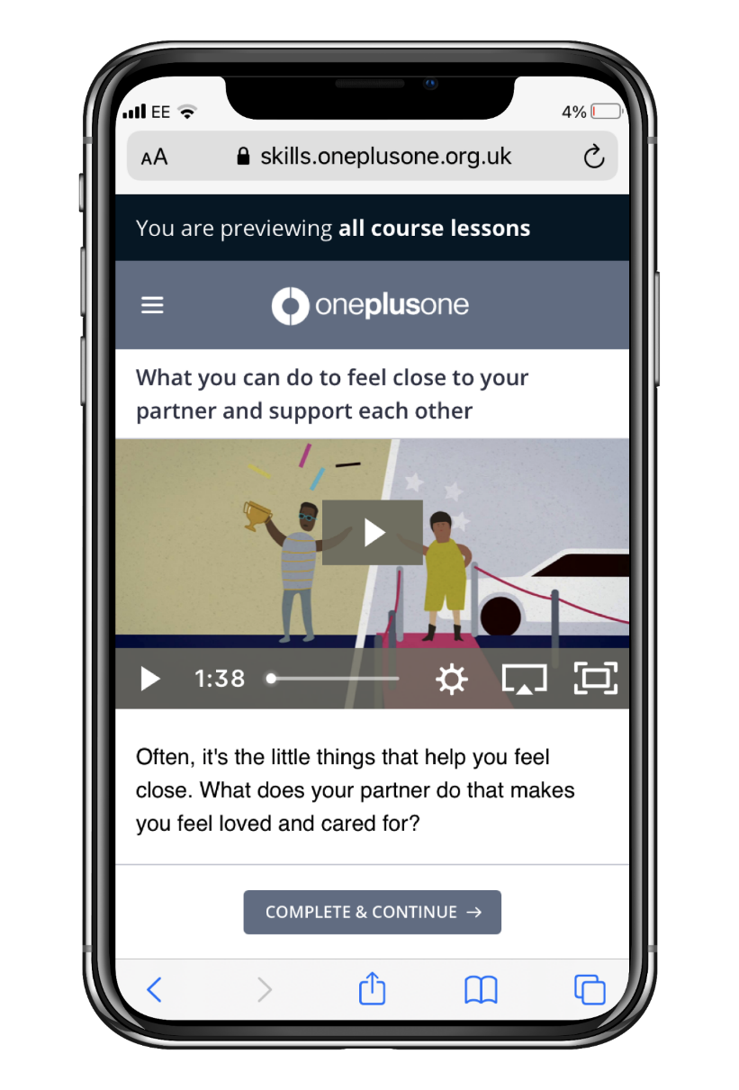
Digital resources
Accessible
readability FOG index = 9
Available
24/7 on smart phone, laptop or tablet
Adaptable
supported by practitioner

Slide 26
Outcome measures
Parent surveys consisting of demographic questions and standardised
measures are embedded in the digital resources:
  Couple coping, stress, and relationship satisfaction (MYBT)
  Couple coping and stress (AB)
  Co-parenting co-operation and emotional adaptation to relationship breakdown (GIFRC)

Slide 27
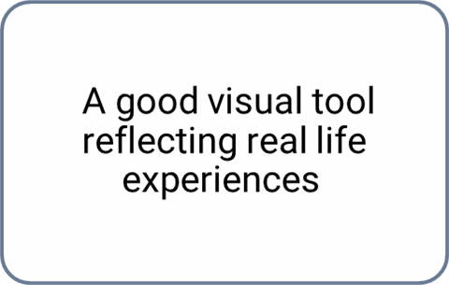
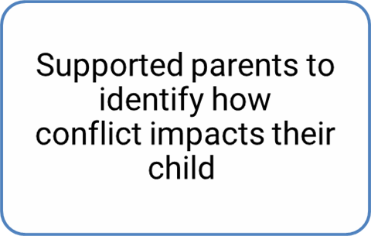
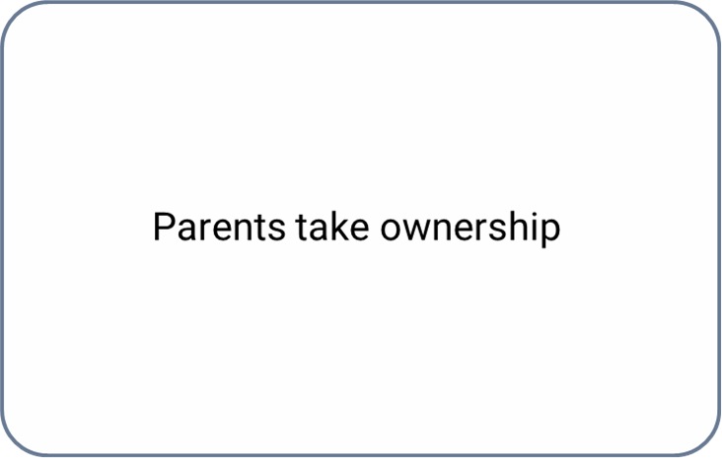
Does it work? Key findings
Statistically significant reductions in levels of conflict.
Significant improvements in relationship satisfaction amongst users.
Parents take
ownership

Slide 28
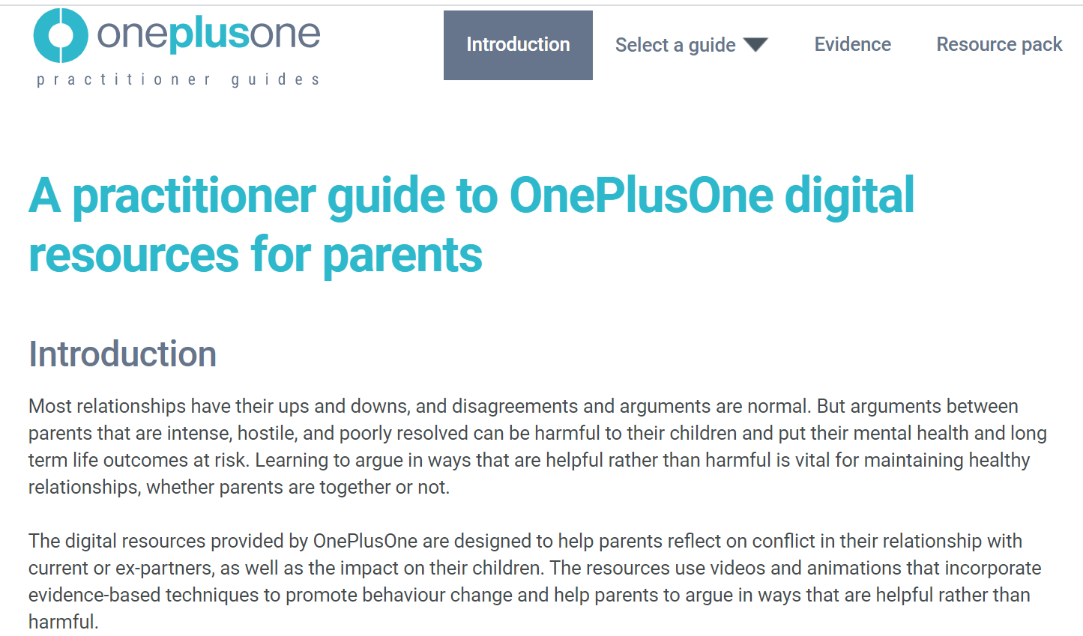
Practitioner guide
Each digital resource has an online
practitioner guide to help you to
work alongside parents.
The guide includes evidence-base, tips and guidance
for practitioners and key messages for parents.
This is only for use within your local authority.
Create account:
https://www.oneplusone.org.uk/practitioners

Slide 29
SESSION 2
How do I use digital resources with parents?

Slide 30
This morning…
9.30: Instructions
          Demonstrate websites – practitioner guide and parent resource
          Share link
          Answer questions
9.45: Independent study time
10.45/11.15: Discussion in two groups
11.45: Final session together – Talking about relationships
12.30: Finish

Slide 31
Practitioner guide – focus of independent work
Each digital intervention has an online
practitioner guide to help you to
work alongside parents.
The guide includes evidence base, tips and guidance
for practitioners, and key messages for parents.
This is only for use within your local authority.
Create practitioner account:
www.oneplusone.org.uk/practitioners

Slide 32
Exploring OnePlusOne digital interventions
Discussion group 1
9.45 Independently explore the digital resources
10.45 Return for Q and A
11.15 Coffee
11.45 Join whole group for final session
Discussion group 2
9.45 Independently explore the digital resources
10.45 Coffee
11.15 Return for Q and A
11.45 Join whole group for final session
Use this time to explore the Practitioner Guide: www.oneplusone.org.uk/practitioners

Slide 33
Questions and answers
?
What did you find the most useful?​
​
Was there anything in the content that didn’t make sense?​
​
What might be the challenges for you in using these resources with parents?​
​
What skills or approaches do you think might be helpful to use when working with parents in conflict?

Slide 34
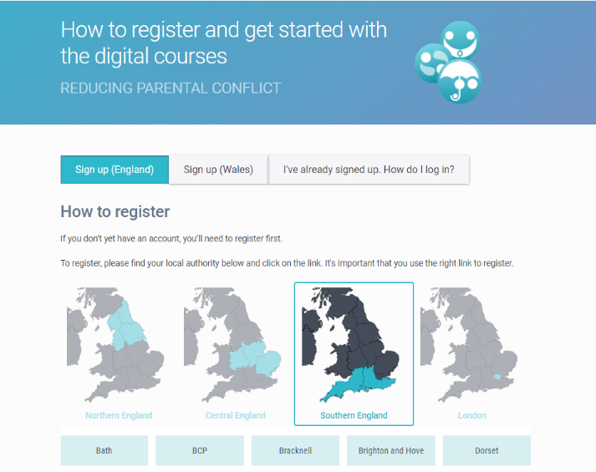
Parent resources
How parents register and get started with the digital courses.
This is where you will direct parents to access
the three digital resources.
Please choose your local authority from the map.
How parents register:
https://www.oneplusone.org.uk/parents

Slide 35
How do I engage parents with the digital resources?
Self-directed
Semi-supported
Fully-supported
Group
Discussions
Any LA practitioner can signpost and refer from a local authority in license
Delivered only by practitioners trained by OnePlusOne or inhouse TTT trainers

Slide 36
Semi-supported example – MYBT and AB
Session 1 Introduce digital intervention of choice (MYBT or AB)
Help with login, complete evaluation questions, introduce Section 1
Session 2 Recap learning from Section 1, set goals
Introduce Section 2
Session 3 Recap learning from Section 2, review goals and progress
Introduce Section 3
Session 4 Recap learning from Section 3, review goals and progress
Review key learnings and set any new goals
Session 5 Review progress

Slide 37
Semi-supported example – GIRFC
Session 1 Introduce GIRFC intervention
Help with login, complete evaluation questions
Introduce two sequences – Tom’s family and Mia’s family
Session 2 Recap Tom and Mia sequences, reflect on learning, and set goals
Introduce Emily & Jordan and Josh sequences
Session 3 Recap Emily & Jordan and Josh sequences, reflect, and set goals
Introduce Ellie & Jake sequence
Session 4 Recap Ellie & Jake sequence, reflect, and set goals
Reflect on learning from all five video sequences
Session 5 Review progress and focus on bridging behaviour change

Slide 38
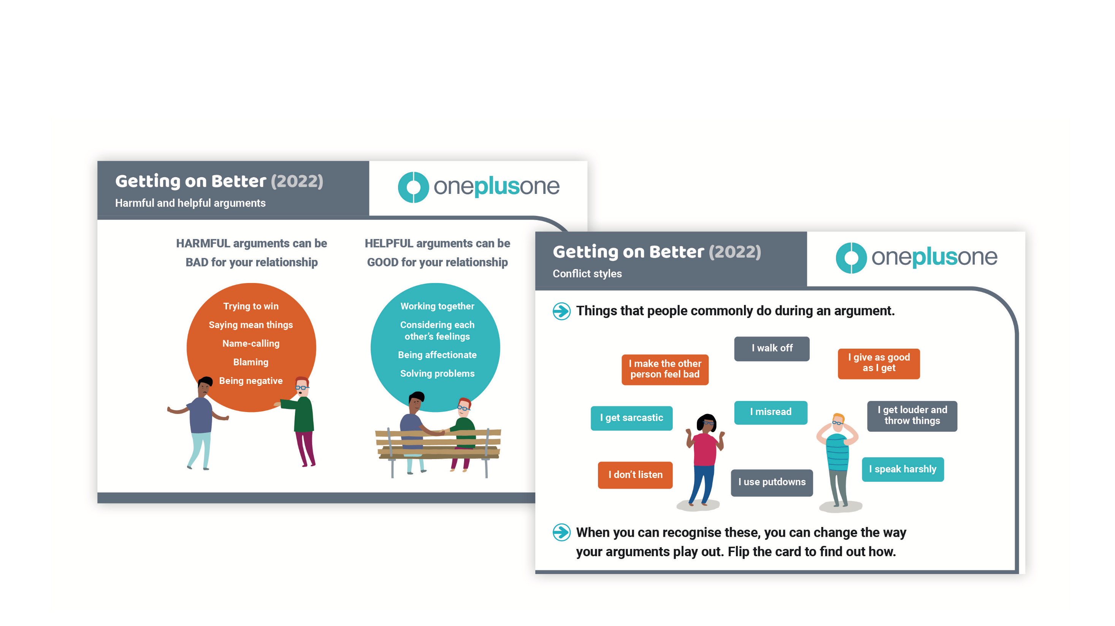
Getting on Better – cards

Slide 39
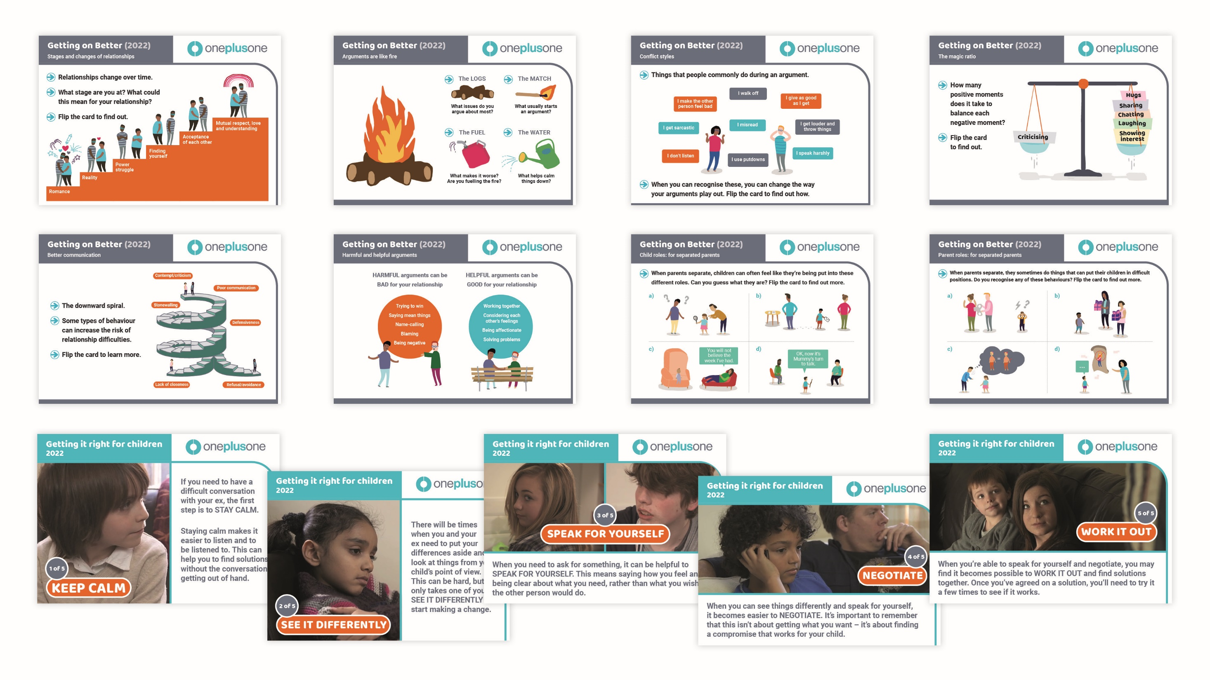

Slide 40
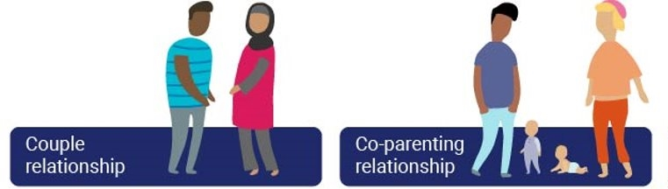
How do I talk about relationships?
Why we should and why we don’t
A framework for practice
Relational skills in action
Know where to signpost

Slide 41
Why we don't talk about relationships
It’s none of my business. I don’t have time. It might open a can of worms. I don’t have the skills. I’m not a relationship counsellor. I'm scared.

Slide 42
Why we should talk about relationships
To practice with appropriate professional curiosity and respect To reduce the effect of destructive parental conflict on child outcomes To work from an early intervention approach To acknowledge a key area of stress for many parents To effect positive change in family dynamics, helping to improve the lived experience of the child To help build healthy relational capability in parents to model to children To be part of good relational and systemic practice

Slide 43
A framework for practice
Signs of interparental conflict:
Active listening
RECOGNISE
Empathetic responding:
Open questions, clarifying, summarising
Solution-focused questions:
Reframing and identifying what needs to change
RESPOND
Action planning for change:
Collaborative based on need and shared agenda
REVIEW

Slide 44
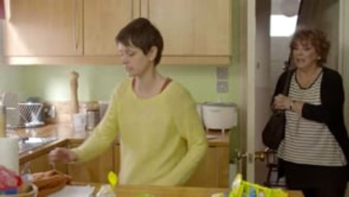
Relational skills in action
Relational skills – an approach to working with parents in conflict
Can you identify the skills being used by the practitioner?

Slide 45
TOP TIPS
Instead of | Try
Providing a solution | Normalising what is normal
Sympathising | Empathising
Assuming you know what's going on | Acknowledging what is happening
Presenting yourself as having all the answers | Offering to listen with compassion
Taking sides | Maintaining neutrality, transparency, and curiosity
Forgetting the child's perspective | Exploring the lived experience of the child
Making assumptions based on culture or ethnicity | Being sensitive to cultural differences and exploring cultural norms in relationships
Making assumptions based on your lived experience | Tuning into their lived experience
Being prescriptive | Exploring and facilitating

Slide 46

We are here to help…
Click is a unique service providing evidence-based relationship support from a mobile-friendly platform. It is available 24/7 to help parents understand more about their relationship and how they can improve it.
clickrelationships.org
See it Differently is a collection of videos and animations that helps parents see family arguments from their children’s point of view and offers alternative ways of handling disagreements.
seeitdifferently.org

Slide 47

Well done on completing the course
Please remember to complete
the post-course survey
If you have any further queries please contact
info@oneplusone.org.uk

