Slide 1
PBISApps Community
Back to school 2025-26
Why are data a key component of PBIS?
Danielle Triplett, M.Ed.
Senior Research Assistant and PBISApps Trainer
University of Oregon

Slide 2

PBISApps Community
Welcome!
In the chat tell us what filled your bucket this summer?

Slide 3
Today’s Plan
Topic: Why are data a key component of PBIS?
1. What’s new in 2025-26?
2. Data discussion: What obstacles do you face using data for decision making?
3. Share district data collection plans

Slide 4

What’s New in 2025-26
Mr. Lindsay gives us the update from middle schools this week!
Notes:
https://www.instagram.com/p/DNUAZX8yDl9/

Slide 5
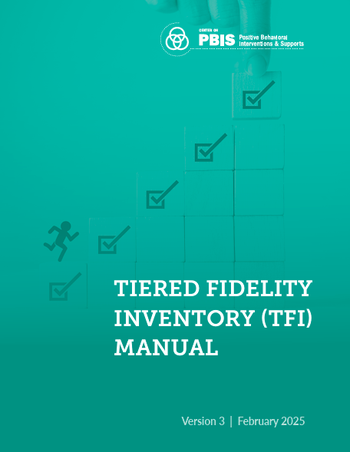
What’s New in 2025-26
Tiered Fidelity Inventory (TFI) 3.0
It measures the extent to which school teams are applying core features of school-wide PBIS (SWPBIS).
Training and support is here!

Slide 6

Intentional Language Updates
How we talk about students and the words we choose matter. The latest TFI incorporates language that is person-first, inclusive, and specific. Some of the notable changes include:
  Contextually appropriate behavior
  Equity
  Marginalized groups
  Partner
  Social emotional behavior (SEB) support

Slide 7
Intentional Language Updates
Contextually Appropriate Behavior
Behaviors or actions that are inappropriate in a given context but may be appropriate in another context. For example, yelling may be inappropriate in a classroom context, but appropriate on the playground. We intentionally use the term contextually inappropriate behavior rather than unwanted inappropriate behavior to emphasize the role of context in judgments about what behaviors are and are not accepted.

Slide 8
Intentional Language Updates
Equity
In education, equity is when “educational policies, practices, interactions, and resources are representative of, constructed by, and responsive to all people such that each person has access too, meaningfully participates in, and experiences success through high-quality learning environments that recognize and honor individual characteristics and group identities.”
(Fraser, 2008)
(Great Lakes Equity Center, 2012)

Slide 9
Intentional Language Updates
Marginalized Groups
Specific student groups that receive disparate rates of exclusionary discipline (e.g., discipline referrals, suspensions), bullying, or access to resources based on their group membership (e.g., race/ethnicity, IEP/504 status, gender, sexual orientation). Groups are identified based on school data and may change from year to year.

Slide 10
Intentional Language Updates
Partner
The broad term used throughout this tool when referring to many groups (i.e., interested/related/affected parties, consumers, or stakeholders) such as the students, families, educators, and staff in the respective organization or communities. However, it is recommended that leadership teams be specific and identify the actual group(s) they intend to engage or impact.
Notes:
The term "stakeholder" can be offensive due to its historical association with colonialism and land grabbing, particularly among Indigenous communities. The term's origins are linked to the practice of staking claims on land, which often involved displacing or harming Indigenous peoples. While "stakeholder" is widely used, particularly in business and project management, some find its connotations problematic and prefer alternative terms like "interested parties," "rights holders," or "partners".
While "stakeholder" is widely used and generally understood, it's crucial to be aware of the potential for offense, especially when working with Indigenous communities or in contexts where historical injustices are relevant. Using more specific and inclusive language can help avoid misunderstandings and demonstrate a commitment to respectful engagement.

Slide 11
Why is Data a Key Component of PBIS?
Data are an integral part of PBIS implementation, woven throughout every practice and system across every tier. School teams who use data to make decisions about student challenges are more effective and efficient than teams who don’t include data in their process. In PBIS, the data used most frequently fall into three categories: implementation fidelity, student outcomes, and screening. The first step to using data to make decisions is to figure out which questions teams want to answer. Once they have these questions, they can figure out which data to collect.

Slide 12

Talk Data to Me!
When do kids get a clean slate vs using their data to set them up with the support they need for the new school year?
What obstacles do you face when getting teams to use their data regularly?

Slide 13
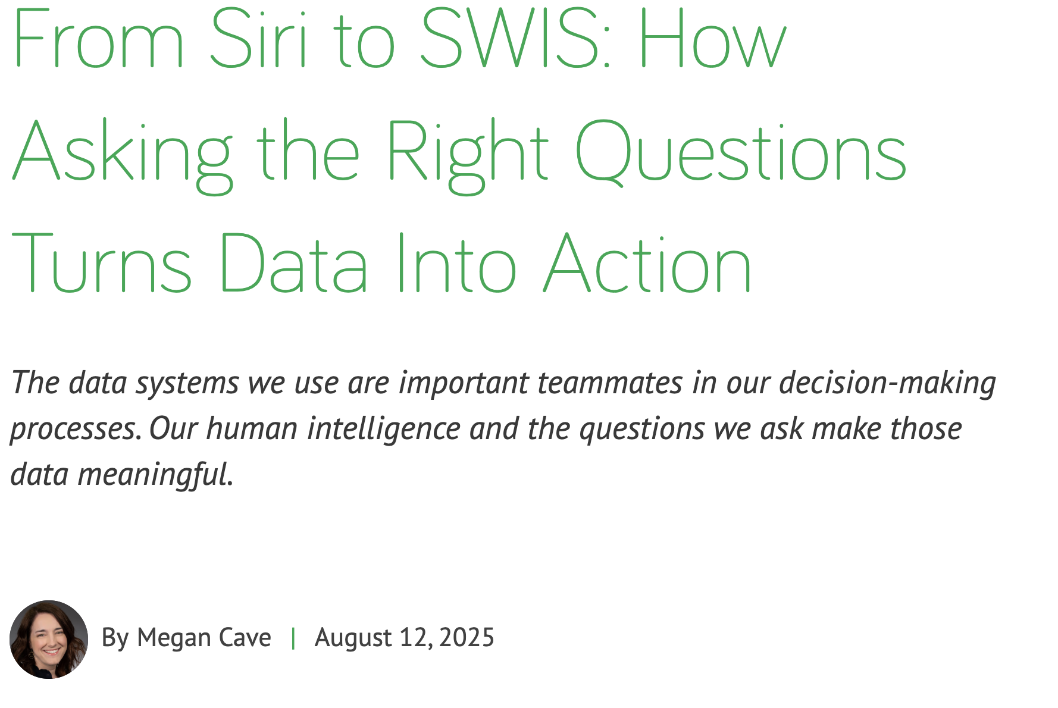
Data Resources

Slide 14
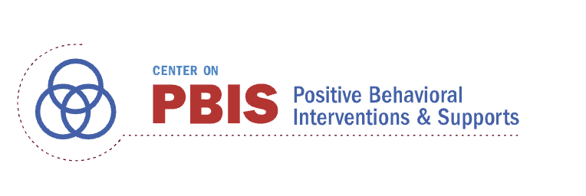
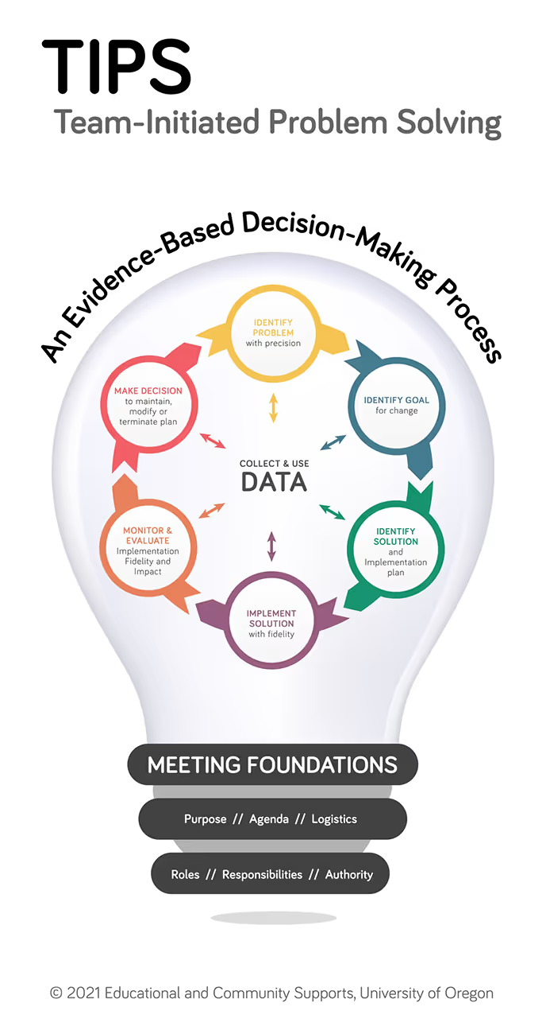

Data Resources

Slide 15
District A: Scenario & Questions
Scenario
Newly implementing SWPBIS
Grant requires specific reporting metrics in addition to standard fidelity monitoring
Evaluation Questions
What is our baseline and progress through the year?
Are we improving on our implementation of PBIS?
How do individual staff members rate implementation?
Are we on track with our overall implementation plan?

Slide 16
District A: Evaluation Plan
Measure | Exploration and Installation (TFI Data below 70%) |  |  | Initial Implementation (TFI Data 70%; only 1 data cycle) |  |  | Full Implementation (TFI Data ≥70%; 2 or more data cycles)
 | Fall | Winter | Spring | Fall | Winter | Spring | Fall | Winter | Spring
TFI T1 | X | X | X |  | X |  |  | X
TFI WT | X |  | X |  | X |  |  | X
SAS | X |  | X |  |  | X |  |  | X
Climate |  | X |  |  | X |  |  | X
DSFI |  |  | X |  |  | X |  |  | X
School-based Measures
District Measure

Slide 17
District B: Scenario & Questions
Scenario
Implementing SWPBIS for three years
Have sites at various levels of implementation for Tier 1 and want to move onto Tiers 2 and 3
Evaluation Questions
In what specific areas in PBIS are we strong, and in which areas do we need more training?
Are we improving on our implementation of PBIS?
How do staff members rate our PBIS implementation?
How is our implementation of
Tiers 2 & 3?

Slide 18
District B: Evaluation Plan
Measure | Exploration & Installation |  |  | Initial Implementation |  |  | Full Implementation
 | Fall | Winter | Spring | Fall | Winter | Spring | Fall | Winter | Spring
TFI (T1) |  | X |  |  | X |  |  | X
TFI (T2) | X | X | X | X |  | X |  | X
TFI (T3) | X | X | X | X |  | X |  | X
SAS |  | X |  |  | X |  | X
Climate |  | X |  |  |  |  |  |  | X
DSFI |  |  | X |  |  | X |  |  | X
School-based Measures
District Measure

Slide 19
District C: Scenario & Questions
Scenario
District wants to bring Social Behavior and Academics together to create one evaluation plan
Evaluation Questions
In what specific PBIS areas are we strong, and in which areas do we need more training?
In what specific academic areas are we strong, and in which areas do we need more training?
How can we tailor our training/evaluation to meet the needs of various schools?
How can we schedule our evaluations so that we are not overwhelming schools?

Slide 20
District C: Evaluation Plan (Adapted from Nieves, 2012)
Measure | Installation |  |  | Initial Implementation/ Full Implementation |  |  | Purpose
 | Fall | Winter | Spring | Fall | Winter | Spring
TFI | X | X | X |  | X |  | Fidelity
SAS | X |  |  | X |  |  | Fidelity
School Climate |  |  | X |  |  | X | Perception
AimsWeb | X | X | X | X | X | X | Screening/ Progress Monitoring
SAT 10 |  |  | X |  |  | X | Summative Evaluation
DIBELS | X | X | X | X | X | X | Screening/ Progress Monitoring
DSFI |  |  | X |  |  | X
School-based Measures
District Measure
Notes:
What is the Aimsweb assessment?
aimsweb is a benchmark and progress monitoring system based on direct, frequent. and continuous student assessment using brief, accurate measures of reading, math, spelling, and writing. aimsweb is the most comprehensive K-12 assessment system. that supports Response to Intervention (RTI) and tiered instruction.
What does SAT 10 stand for?
The Stanford Achievement Test Series, the most recent version of which is usually referred to simply as the "Stanford 10" or SAT-10, is a set of standardized achievement tests used by school districts in the United States and in American schools abroad for assessing children from kindergarten through high school.

Slide 21

Wrap up with Intention
What was most helpful about this community session today?
Contact info:
training@pbisapps.org

Slide 22

Bonus Time!
11:00-11:15 open for questions, problem solving, resource sharing, etc.

