Slide 1


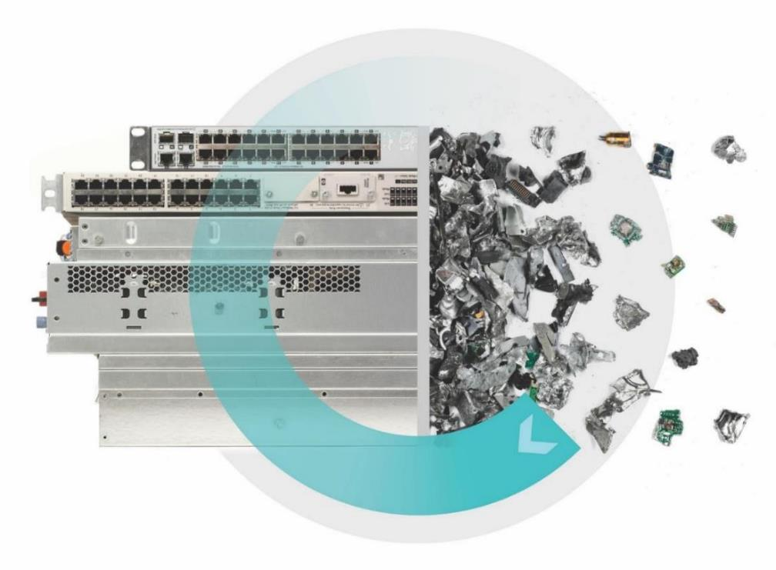









CEDaCI
Transnational Workshop
17th May 2022, online
14.00 – 17.00 CEST / 13.00– 16.00 BST
23 participants
Documentation

Slide 2
Schedule
Welcome and introduction // Nil Atmaca / Justus von Geibler
Overall Project summary // Deborah Andrews
Session I: Discussing CEDaCI Outputs (60 min)
Pilot A - Design and Manufacture // Kristina Kerwin
Pilot B - Product life extension, 2nd Life // Rich Kenny
Pilot C - EoL, Recycling & Reclamation // Deborah Andrews
SME trainings // Deborah Andrews
Session II: Co-Creation: What’s next? Barriers and Opportunities for SMEs (80 min)
Input on Policy Context // Jan Hoogstrate
Barriers and Opportunities for SMEs // Justus von Geibler / Paul Suski
Wrap up // Deborah Andrews / Nil Atmaca
Break

Slide 3
Session I: Discussing CEDaCI Outputs
Pilot A - Design and Manufacture // Kristina Kerwin
Pilot B - Product life extension, 2nd Life // Rich Kenny
Pilot C - EoL, Recycling & Reclamation // Deborah Andrews
SME trainings // Deborah Andrews

Slide 4
Session II: Co-Creation: What’s next? Barriers and Opportunities for SME
Input on Policy Context // Jan Hoogstrate
Barriers and Opportunities for SMEs // Justus von Geibler / Paul Suski
Q1: What are the barriers for SMEs to increase Circularity in the Data Centre Industry?
Q2: Which measures could support SMEs to increase Circularity in the Data Centre Industry?

Slide 5
Co-creation process: questions and instructions
The participants (20, including team members that did not run the session) were assorted into two breakout rooms at random.
The groups had 50 minutes to collect answers for two questions, and discuss and vote on the answers. Answers were recorded in text boxes in a shared document with each group working on individual slides. The amount of answers per person was not limited.
For Q1 the colour of the text boxes indicated the type of participant industry or non-industry. The participants were also asked assign each answer to one of three categories: (1) Supply side barriers for SMEs in the DCI, (2) Demand side barriers for SMEs using DC services, (3) Other issues.
For Q2 the colour of the text boxes indicated the type of measure: regulatory, technical, economical, research, or information/other. The participants were also asked to assign each answer to one of two categories: (1) Supply side measures for SMEs in the DCI, (2) Demand side measures for SMEs using DC services.
Votes were cast by placing orange dots on the respective text boxes. Each participant had three votes per question.
The results of the discussion and the voting process were later presented to all participants.
Question 1
What are the barriers for SMEs to increase Circularity in the Data Centre Industry?
Instructions:
Please brainstorm and write down barriers in the boxes, place them on the slide. (5 min)
Discuss your most important barriers in the group. (15 min)
Please vote for most important barriers by using the orange dots (max. 3 votes per person) (2 min)
Question 2
Which measures could support SMEs to increase Circularity in the Data Centre Industry?
Instructions:
Please brainstorm and write down measures in the boxes, place them on the slide. (5 min)
Discuss your most important measures in the group. (15 min)
Please vote for most important measures by using the orange dots (max. 3 votes per person) (2 min)

Slide 6
Co-creation process: Key Findings
Question 1: What are the barriers for SMEs to increase Circularity in the Data Centre Industry?
The main barriers that were identified based on votes are:
Supply side barriers
Lack of trust in used equipment (5)
Lack of recycling and reclamation infrastructure (3)
Few manufacturers adopt real sustainable practices, lots of Greenwashing (2)
High costs and long lead time on used equipment (2)
Other issues
Need to extend scope of assessment and impact modelling to reflect physical resources not just energy! (beyond carbon!) (2)
Demand side barriers
Lack of clear standards for quality around circular products (main standards support processes not goods - eg. ISO, ADISA, R2) (6)
Scope 3 emissions need to become mandatory - need full reporting which will solve many of the circular challenges (5)
Awareness of the issues at top of organisations. How many CEO/Leaders have done their carbon footprint and realised that IT is 5-20% of it? Cloud/DC often seen as offsite or other person’s problem. (4)
Lack of official support for hardware – eg. firmware, OEM maintenance, security. Impacts trust for end users. (3)
Lack of trust in used equipment,
lack of infrastructure to process it,
lack of hardware support
Lack of standards for circular products (e.g. mandatory reporting on Scope 3 emissions)
Organisations lack awareness of impact of IT on carbon footprint
Main themes of discussion

Slide 7
Co-creation process: Key Findings
Question 2: Which measures could support SMEs to increase Circularity in the Data Centre Industry?
The main measures that were identified based on votes are:
Supply side measures
Introduce global guidelines / legislation or encourage compliance with highest standards in national legislation - critical in a global market to encourage positive practice (4)
Regulation of refurbished market (2)
All manufacturers to have to either enable others to refurbish or refurbish their own tech. (2)
Introduce a Levy structure that favours the use of recycled components / materials (2)
Improve supply chain transparency to ensure accurate reporting / improved selection of components (2)
Economic incentives for materials conservation (similar to those in place for carbon)
Demand side measures
Standardized Methodology for quicker LCAs (4)
Agree on an LCA method, scope, assumptions and boundaries which is fair to all economic operators to inform policy making (2)
Carbon credit for sustainable practices in the DC (2)
Main themes of discussion
Introduction of global guidelines and regulation of the refurbished market
Improve supply chain transparency, favour recycled components / materials
Standardise and simplify LCAs

Slide 8
Results
Q1: What are the barriers for SMEs to increase Circularity in the Data Centre Industry?
Supply Side Barriers
(for SMEs in the Data Centre Industry)
Demand Side Barriers
(for SMEs using Data Centre Services)
Maintaining equipment costs more than replacing it with new one
Knowledge of environmental impacts of their technical or technological choice on products and subsystems
Lack of recycling and reclamation infrastructure - we can’t increase reuse of materials / resources until this improves!
Awareness of the issues at top of organisations. How many CEO/Leaders have done their carbon footprint and realised that IT is 5-20% of it? Cloud/DC often seen as offsite or other person’s problem.
“Toothless” GPP for circular Data Centre products and services: voluntary
Few manufactures really adopting sustainable practices (mostly greenwashing at best) -
HP better than most.
Vendors and OEMs trying to limit credibility of second use. Unless through them
3
4
Import restriction on USED goods, by some Manufacturers
Lack of trust in ‘used’ equipment
No clear standards for quality around circular products. Main standards support processes not goods - eg ISO, ADISA, R2
Tenders are written for new equipment or for recycled equipment, not refurbished
SMEs already working with suppliers on the development server (etc) solutions
2
5
Inability to buy products made from recycled materials
Cost and lead time of products
Knowledge of BOM inside components
2
Lack of knowledge- no fully aware of the process: Economic aspect, whether it’s feasible and profitable. What would be the consequences?
Respect of COP 26 requirements
Practices of REACh & Rohs rules are leading their choice of development
The contracts are set up to deal with parts and maintenance in one so self refurb is hard
There are no refurbishment standards for servers
6
1
1
Scope 3 emissions need to become mandatory - need full reporting which will solve many of the circular challenges
Lack of official support for hardware - eg firmware, OEM maintenance, security. Impacts trust for end users.
Ability to provide warranty for used equipment
Alignment with Open Compute Protocol (OCP)
End User policies not aimed at LC extension.
5
3
Other issues
Industry participants
Non-industry participants
No one really talking about transportation - massive impact and a broader than DC industry problem.
Need to extend scope of assessment and impact modelling to reflect physical resources not just energy! (beyond carbon!)
Ensure that information provided to SMEs is consistent and accurate
2
aggregated results for Q1 from group 1 and 2;
sorted by participant group;
Including votes on most important barriers
Outsourcers have limited attention for CE (Not SME..)
1
LOT 9: Scope is a puzzle, review needed
Transfer of licenses?
x

Slide 9
Results
Q2: Which measures could support SMEs to increase Circularity in the Data Centre Industry?
Supply Side Measures
(for SMEs in the Data Centre Industry)
Demand Side Measures
(for SMEs using Data Centre Services)
Improve supply chain transparency to ensure accurate reporting / improved selection of components
Regulation of refurbished market
Have a clear standard on reporting LCA
Mandatory reports on the CO2e of the server & OEM equipment of all devices - to include mechanical equipment, cooling & power. DC’s still only reporting on the buildings, which can be 1% of the CO2e of the data centre. A PUE equivalent factor but in the total carbon picture.
2
Raw Material Input Tax / Pricing
Carbon Tax / Pricing
2
Mandatory disclosures of returns rates
Introduce a Levy structure that favours the use of recycled components / materials
All manufacturers to have to either enable others to refurbish or refurbish their own tech.
2
2
1
Introduce global guidelines / legislation or encourage compliance with highest standards in national legislation - critical in a global market to encourage positive practice
Modular design to encourage component upgrade and recycling rather than complete equipment refresh
Taskforce on Nature Related Financial Disclosures built into company reporting
Targets for re-use
Reporting about IT; % refurb of purchases, extended life, Disposed, re-cycled.
Carbon credit for sustainable practices in the DC
4
More independent studies on reliability of non-new tech
1
1
2
Incentives to encourage purchase of recycled rather than virgin materials
Standard methodology for LCAs for comparison OR develop a quicker method to allow comparisons of the most important aspects
Lifecycle cost analysis for materials conservation
Suppliers required to report equipment characteristics in a consistent and comparable way
Regulatory Measures
Technical Measures
Economical Measures
Research Measures
Information / Other
1
Standardized Methodology for quicker LCAs
1
4
Economic incentives for materials conservation (similar to those in place for carbon)
Fines on use of virgin materials
Comparing LCAs must be easy to understand and functional over many products
Agree on an LCA method, scope, assumptions and boundaries which is fair to all economic operators to inform policy making
2
1
Highlight economic benefits of circular behaviour and practice in short medium and longer term to drive change
Incentives to encourage reuse / extend product life etc.
2
1
Keep producing academic evidence for circular solutions and products around key barriers, eg reliability, performance, cost, impact
Gather and publish Carbon Footprint assessments of DCs as a % of an organisations footprint.
aggregated results for Q2 from groups 1 and 2;
sorted by type of measure;
including votes on most important measures
Highest impact components for circular design (eg fans)
1
Awareness of the decline of Moore’s Law
Develop training session
First fully recycled server
1
X

Slide 10
Co-creation results: next steps
The CEDaCI team will use the results of the co-creation workshop to establish
which key barriers and measures are already taken into account regarding the project work so far.
based on current work plans which key barriers and measures can be addressed by the CEDaCI project in the future and to what extent.
which additional key barriers and measures should be addressed by the CEDaCI project and how they can be included in the work plan.

