Slide 1
4J - Data-based Decisions at Tier 3: Optimizing PBIS with the Right Information
Presenters: Katie Conley, Boise State University (ID)
Bob Putnam, The May Institute (MA)
Lauren Evanovich, University of South Florida (FL)
Strand: Tier 3, Part 3 of 3
Topic: Data-Based Decision Making
Keywords: Tier 3, Evaluation, Assessment
Notes:
“Good morning, everyone! Welcome to 4J: Data-Based Decisions at Tier 3 — Optimizing PBIS with the Right Information.
I’m Katie Conley from Boise State University in Idaho, and I’m thrilled to be here with my co-presenters Bob Putnam from the May Institute in Massachusetts and Lauren Evanovich from the University of South Florida.
Between the three of us, we’ve spent a lot of time in schools and districts supporting PBIS implementation, and what we’ve learned is that when it comes to Tier 3 — data can either feel like your best friend… or your biggest headache.” (pause for laughter)
“Our goal this morning is to help you move from data-dumping to data-driven action in other words, making Tier 3 data practical, meaningful, and actually doable.”
Optional quick audience engagement:
“Just to get a sense of who’s in the room — raise your hand if you’re primarily working at the district level… how about school level? … and student-level supports?”
“Perfect. You’re in the right place, because everything we’re sharing today connects across all of those levels.”
Thursday, October 23rd
9:30am – 10:45am CT
Part 1: Setting the Stage
Presenter: Bob Putnam
https://www.pbisforum.org/event-info/detailed-agenda

Slide 2
Learning Objectives
Discuss the roles of student-focused, school, and district leadership Tier 3 teams
01
Describe critical sources of data needed for effective and efficient decision making to support students with individualized support needs
02
Provide examples of specific questions team members can ask when engaging in data-based decision making at Tier 3
03
Notes:
“So, what do we hope you’ll take away from our session?
First, we want to highlight how teams at all levels — student, school, and district — can collect and use the right information to make better decisions.
Second, we’ll share how PBIS teams can build data systems that are sustainable — what we like to call doable, durable, and available.
And third, we’ll show how those systems help align Tier 3 supports with the broader PBIS framework — so Tier 3 isn’t something extra, it’s just part of the way you ‘do business’ in your school.”
This session will focus on the teaming structures and data sources necessary for making effective decisions within a Tier 3 PBIS framework. The goal is to help attendees understand how to use data to support students who need individualized support.
Learning Objective 1: Discuss the specific roles of student-focused, school, and district leadership teams within a Tier 3 system.
Learning Objective 2: Describe the essential data sources needed for efficient and effective decision-making.
Learning Objective 3: Provide concrete examples of questions that team members can ask to guide data-based decision-making at Tier 3.

Slide 3
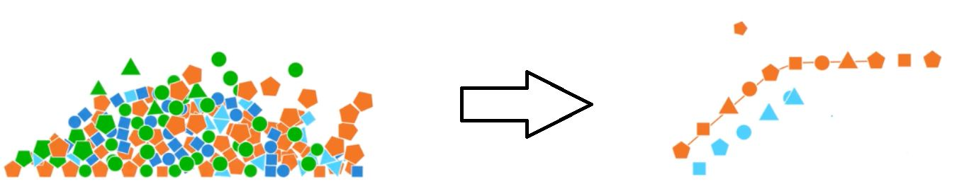
From Data-Dumping to Data-Driven Action
Notes:
Part 1: Setting the Stage
Presenter: Katie
Key Message 1: We've all been in a team meeting where we have a lot of data, but we're left asking, 'What do we do now?' Our goal today is to give you the tools and the questions you need to move from data to action at Tier 3.
Key Message 2: This presentation focuses on improving systems and adult practices, not on "fixing" students. This is a core construct of the Center on PBIS and aligns with the event's equity guidelines.

Slide 4
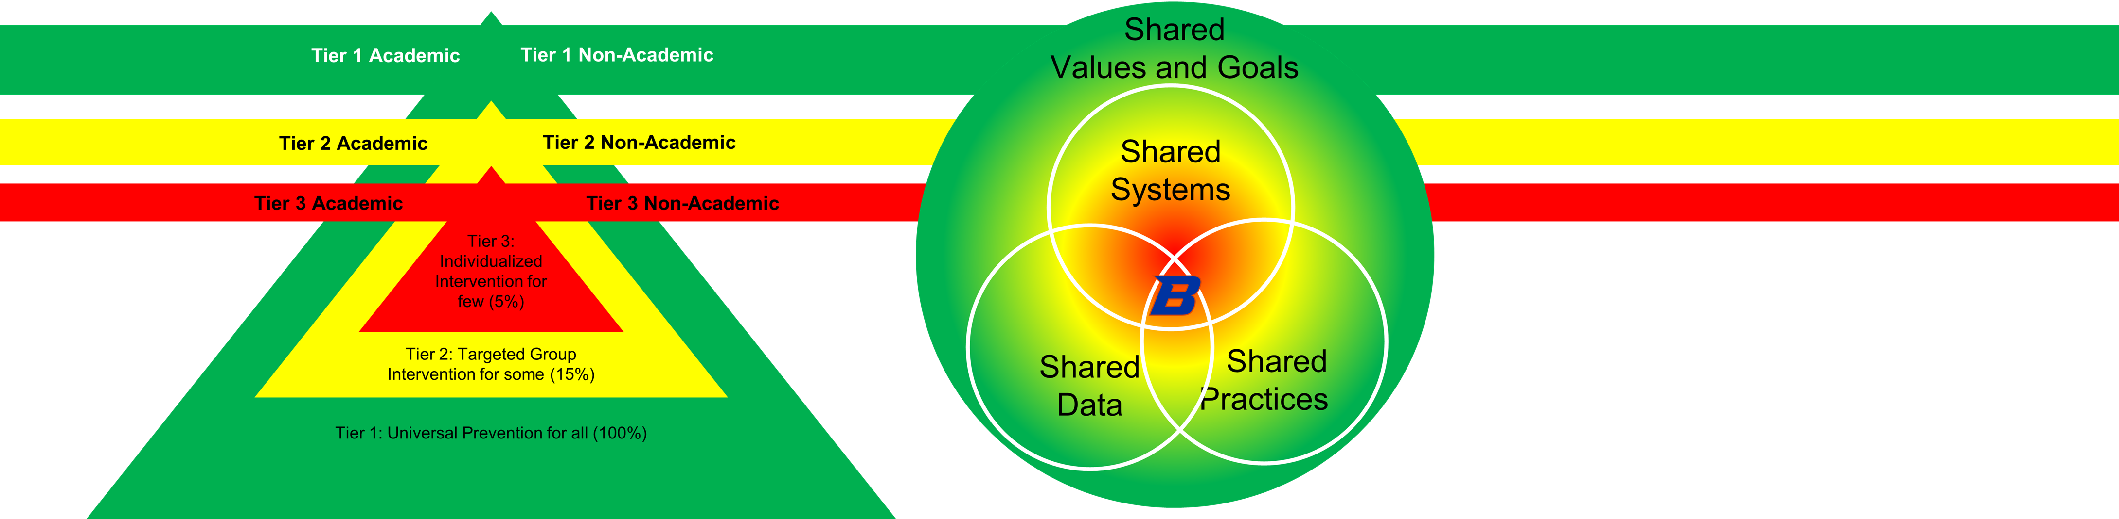
Tier 3 PBIS
Notes:
Lauren (lead) You can briefly affirm from your systems lens:
“And that distinction — between an individual student’s support plan and the broader Tier 3 system — is where data plays such a powerful role. We want to build systems that make individualized supports possible and sustainable.”

Slide 5
Tier Within the Tier
Individualized “tweaks” to Tier 2 interventions
Brief FBA/BIP
Comprehensive FBA/BIP
Wraparound
Practices are doable, durable, and available
Notes:
Lauren

Slide 6
Key Data Practices (General)
Efficient
Collected easily
Socially Valid
Acceptable
Others
Responsive
Entered quickly
Presented visually
Completeness
Easy to disaggregate in meaningful subcategories
Feasible
Useful
Notes:
Part 1: Setting the Stage
Presenter: Katie
Slide 3: The Problem
Slide Title: From Data-Dumping to Data-Driven Action
Key Message: The key to data-driven action is building shared values and goals, selecting shared practices and systems that will get us there, and then select and organize the data that will efficiently and effectively drive our decisions.
This Photo by Unknown Author is licensed under CC BY-SA

Slide 7
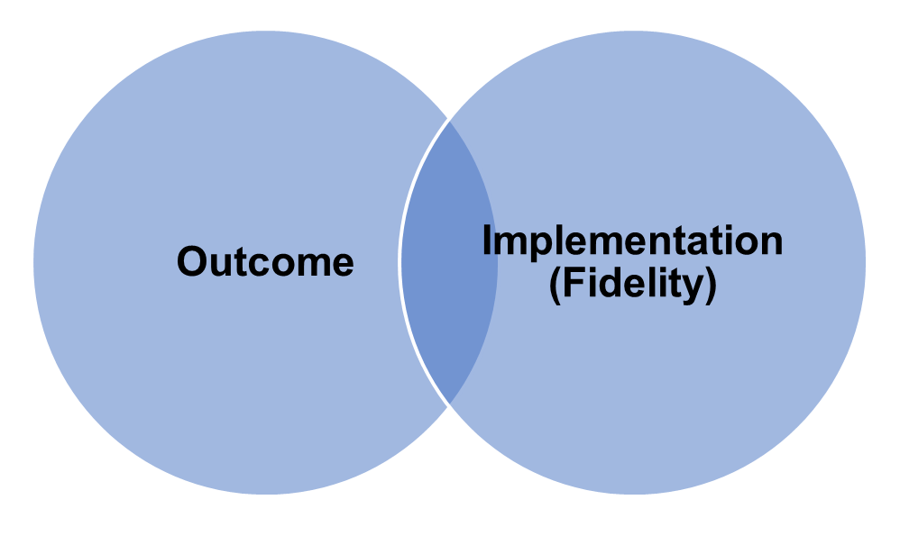
Key Data Practices (by Type)
Outcome Data
Aligned with goals
Measures target behaviors
Sensitive to small changes
Fidelity Data
Aligned with plan
Measures critical components
Sensitive to small changes
Notes:
Part 1: Setting the Stage
Presenter: Katie
Slide 3: The Problem
Slide Title: From Data-Dumping to Data-Driven Action
Key Message: The key to data-driven action is building shared values and goals, selecting shared practices and systems that will get us there, and then select and organize the data that will efficiently and effectively drive our decisions.
This Photo by Unknown Author is licensed under CC BY-SA

Slide 8
Teaming for Tier 3 Success
Lauren
Notes:
Part 2: Core Content & Activities
Presenter: Lauren Evanovich (20 minutes)
Slide 4: Teaming for Tier 3 Success
Slide Title: Who's on Your Team?
Key Content:
Student-Level Teams: Focus on individual student behavior support plans.
School-Level Teams: Focus on identifying students in need and monitoring overall Tier 3 systems.
District-Level Teams: Focus on allocating resources and providing coaching and technical assistance.
Activity Prompt: Turn and Talk: "What is one challenge your current Tier 3 team faces, and what is one small thing you could change to improve it?"

Slide 9
Tier 3 Teaming Structure
Multi-disciplinary team includes:
Administrator
Behavior specialist or coach
Mental health professionals
Staff providing Tier 3 supports
Teams meet regularly to:
Review student data
Problem-solve interventions
Monitor fidelity and outcomes
Collaboration across roles ensures comprehensive and coordinated support

Slide 10

Student-Level Tier 3 Teams
Focus: Individual Student Behavior Support Plans
Conduct Functional Behavior Assessments (FBA)
Develop and implement Behavior Intervention Plans (BIP)
Monitor progress and adjust plans based on data
Include family and student voice when possible

Slide 11

School-Level Tier 3 Teams
Focus: Identifying Students & Monitoring Systems
Use data to identify students needing Tier 3 supports
Ensure systems are in place for referral, assessment, and intervention
Monitor fidelity of implementation and student outcomes
Coordinate with Tier 1 and Tier 2 teams for alignment

Slide 12

District-Level Tier 3 Teams
Focus: Resources, Coaching & Technical Assistance
Provide training and coaching to school-based Tier 3 teams
Allocate resources (staff, time, tools) to support implementation
Monitor district-wide fidelity and outcomes
Facilitate cross-school collaboration and problem-solving

Slide 13
Turn & Talk Activity
What is one challenge your current Tier 3 team faces, and what is one small thing you could change to improve it?
Team Structure?
Data Use?
Communication?
Student Outcomes?

Slide 14
School-Wide Tiered Fidelity Inventory (SWTFI) – Evaluation tool
SWTFI helps schools assess if they have:
SWTFI Tier 3 Overview
A multi-disciplinary team in place
Function-based assessments guiding support plans
Data systems for monitoring fidelity and outcomes
Access to behavior expertise and wraparound supports
Identify gaps in Tier 3 implementation
Guiding action planning and resource allocation
Ensure equitable access to intensive supports

Slide 15
Data in Action
Bob and Lauren
Notes:
Presenter: Bob and Lauren (10 minutes)
Slide 5: Data in Action
Slide Title: An Exemplar of Effective Data Use
Key Content: Present a visual example of a student's progress monitoring data (e.g., a line graph showing a decrease in problem behavior following an intervention).
Activity: Bob and Lauren will walk through a specific case, highlighting how the data was used to inform a decision and showcase what effective data collection and display looks like.

Slide 16
Case Study 1– Improving the Effectiveness of Tier 3
www.pbis.org/resource/improving-tier-3-implementation-and-outcomes-in-a-high-needs-school

Slide 17
Case Study
1000 student high needs elementary school in Massachusetts
Focused on improving fidelity as measured by the Tiered Fidelity Inventory and the TATE across all tiers

Slide 20
Focused Tier 3 Support
Used the TATE to assess and action plan to improve individual behavior support
Ensured a Behavior Support Plan informed by a Functional Behavior Assessment implemented with fidelity
Made sure the Tier 3 system and individual teams had updated timely data for data-based decision-making

Slide 23
Florida Data
TFI data
Notes:
Lauren to include a few slides with exemplar data
Key Message: Brief storytelling about the school, data, and an example of how the data drove a key decision
This image should be simple, legible, and appropriately labeled to meet accessibility standards. Use photos and graphics judiciously, only to emphasize a point.

Slide 24
Case Study 2: Strengthening Tier 3 Systems
https://www.pbis.org/resource/tfi

Slide 25
School Context
K-8 school with 850 students in the Southeast United States
Focused on teaming and data-driven decision making

Slide 26
Fall 2022
SWTFI Score 42%
45% of students receiving Tier 3 supports had FBA-informed BSPs
30% of those had monthly plan reviews
Identified foundational gaps in Tier 3 Implementation in the areas of:
teaming structures
data-driven decision-making

Slide 27
Focused Tier 3 Support (2 year)
School enhanced Tier 3 systems by forming leadership teams, increasing staff training, and conducting consistent data reviews.​
A dedicated Tier 3 Leadership Team was formed, including behavior specialists, counselors, and administrators.
Established regular and consistent meeting schedules ensured effective coordination among the team members.
Clear referral pathways were developed and training on Functional Behavior Assessment and Behavior Support Plans was provided.
Monthly data review protocols guided decision-making to ensure student needs were proactively addressed.

Slide 28
Fall 2024
SWTFI Score 89%
82% of students receiving Tier 3 supports had FBA-informed BSPs
78% of those had monthly plan reviews
Drivers of Improvement​
Clear team roles, consistent data use, and professional development fueled progress and informed action planning.

Slide 29
Tier 3 Data Collection Systems
Katie
Notes:
Presenter: Katie Conley (20 minutes)
Slide 6: Asking the Right Questions
Slide Title: The Tier 3 Data Collection System Brief
Key Content: Introduce the new PBIS Center practitioner guide and its purpose: to help teams ask the right questions to move from data to action.
Activity: Interactive Q&A: Katie will present a case study and walk the audience through a systematic problem-solving process. For each step, she will pose a question from the practitioner guide for the audience to consider, such as: "Based on this data, what are the student's measurable goals for behavior support?"

Slide 30
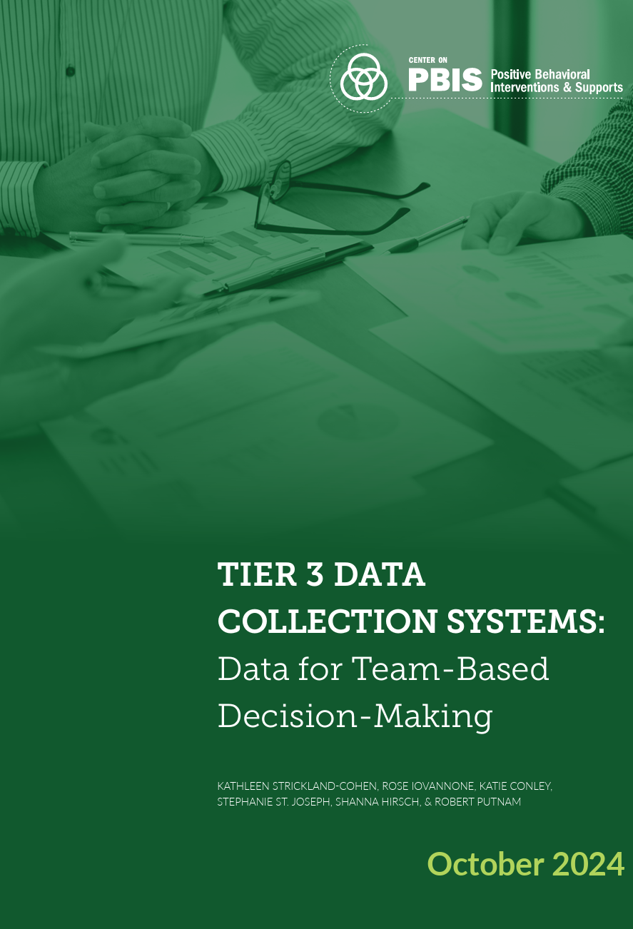
Practice Brief: Tier 3 Data Collection
This guide identifies key questions and considerations for decision-making, including:
Student-Focused teams
School Leadership teams
District Leadership teams
Notes:
https://www.pbis.org/resource/tier-3-data-collections-systems-brief-data-for-team-based-decision-making

Slide 31
Questions for Student-Focused Teams
Level | Outcome | Implementation
Student-Focused Teams (Tables 1 & 2) | Data Practices Plan Duration & Progress Decision Rules & Social Validity | Data Practices Patterns and Relation to Outcomes Decision Rules
School Leadership Teams (Tables 3 & 4) | Data Practices Student/Group Patterns (e.g., progress, duration) Decision Rules | Data Practices Student/Group Patterns and Relation to Outcomes
District Leadership Teams (Tables 5 & 6) | Data Practices School/Group Patterns (e.g., progress, duration) | Data Practices School/Group Patterns and Relation to Outcomes Capacity
Notes:
https://www.pbis.org/resource/tier-3-data-collections-systems-brief-data-for-team-based-decision-making
Explore the document and highlight a few key questions and considerations with consideration for the data show by Bob and Lauren

Slide 32



Tier 3 Practice Guides
Tier 3 Student-Level Systems Guide
Tier 3 School-Level Systems Guide
Tier 3 District-Level Systems Guide
Notes:
https://www.pbis.org/resource/tier-3-student-level-systems-guide
https://www.pbis.org/resource/tier-3-school-level-systems-guide
https://www.pbis.org/resource/tier-3-district-level-systems-guide

Slide 33
Moving from Learning to Doing
Notes:
Part 3: Action Planning & Conclusion
Presenter: Katie Conley (5 minutes)
Slide 7: Your "One Thing"
Slide Title: Moving from Learning to Doing

Slide 34

Let’s Practice!
Question and considerations
Describe your current data
Identify one Action Plan item
Notes:
Part 3: Action Planning & Conclusion
Presenter: Katie Conley (5 minutes)
Slide 7: Your "One Thing"
Slide Title: Moving from Learning to Doing
Key Content: Present a simplified action planning form inspired by the Tiered Fidelity Inventory (TFI).
Activity: "One Thing" Commitment: Ask attendees to write down "one small but meaningful improvement" they will commit to making in their Tier 3 system, using the TFI or the provided guides as a resource.

Slide 35

Your “One Thing”
Write one small but meaningful improvement you can make in the next few months.
Notes:
Part 3: Action Planning & Conclusion
Presenter: Katie Conley (5 minutes)
Slide 7: Your "One Thing"
Slide Title: Moving from Learning to Doing
Key Content: Present a simplified action planning form inspired by the Tiered Fidelity Inventory (TFI).
Activity: "One Thing" Commitment: Ask attendees to write down "one small but meaningful improvement" they will commit to making in their Tier 3 system, using the TFI or the provided guides as a resource.

Slide 36
A Call to Action
Bob
Notes:
Presenter: Bob Putnam (3 minutes)
Slide 8: Closing Message
Slide Title: A Call to Action
Key Content: A final, motivating message that summarizes the session's key takeaways.
Closing Quote: "The session ends here, but your work continues. Use these resources to make a real difference in your schools and districts.“

Slide 37
Next Steps
Establish your teams. Make sure every student, school, and district team knows its role in the Tier 3 data system.
1
Optimize your data. Start collecting multiple sources of data—including both student outcomes and implementation fidelity—to get a complete picture.
2
Use your tools. Take the provided Tier 3 Data Collection Systems guide back to your team and use its questions to drive your decision-making.
3

Slide 38
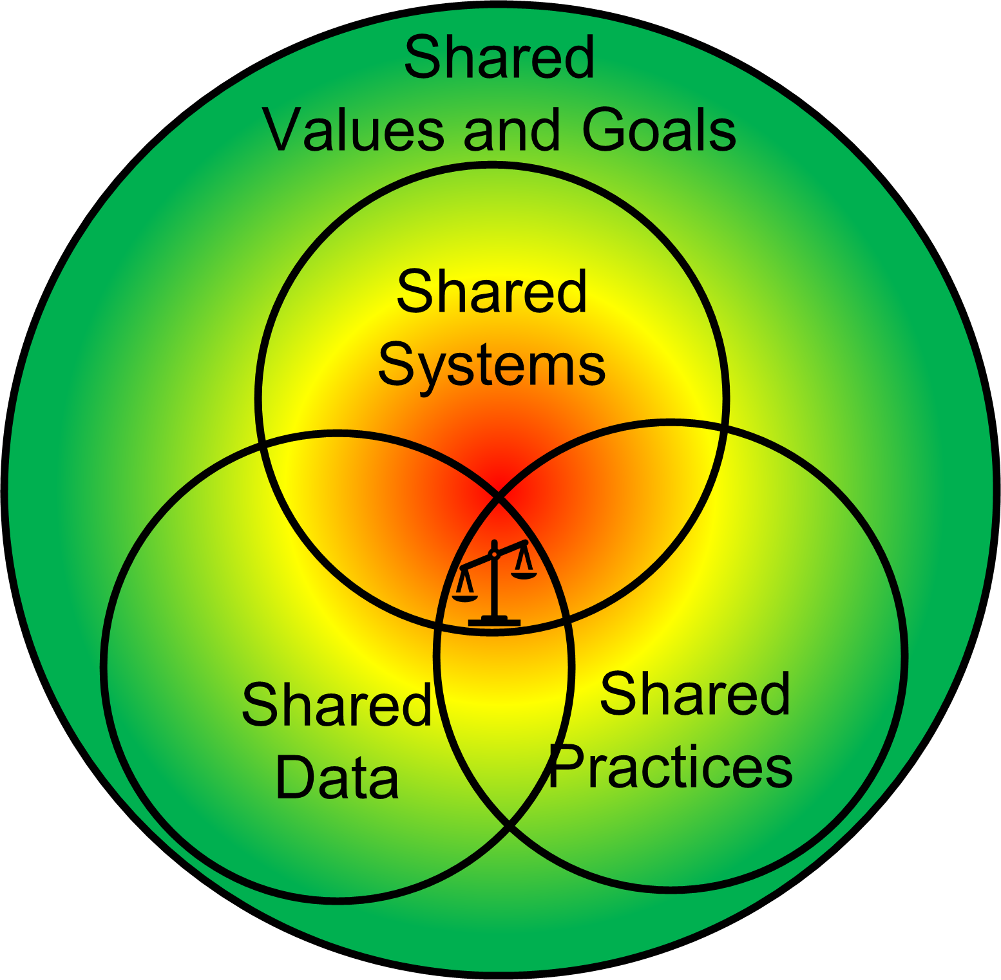
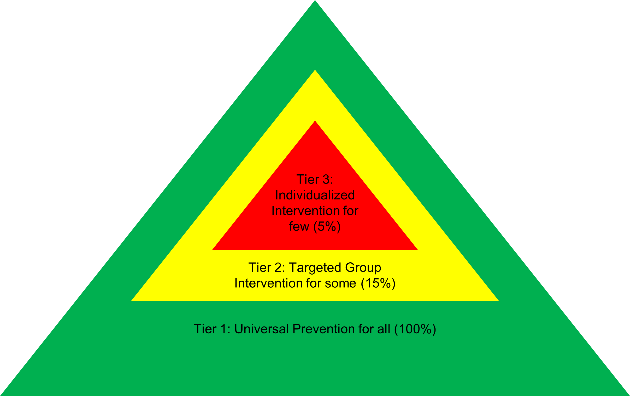
Alignment Across Tiers
PBIS is a comprehensive framework with integrated tiers, goals, practices, systems, and data.
Integrate Tier 3 naturally into the way we “do business”.

Slide 39
References
Center on PBIS. (2022). Tier 3 Student-level Systems Guide. Center on PBIS, University of Oregon. www.pbis.org.
Center on PBIS. (2022). Tier 3 School-level Systems Guide. Center on PBIS, University of Oregon. www.pbis.org.
Center on PBIS. (2022). Tier 3 District-Level Systems Guide. Center on PBIS, University of Oregon. www.pbis.org.
Strickland-Cohen, M. K., Iovannone, R., Conley, K., St. Joseph, S., Hirsch, S. E., & Putnam, R. (2024). Tier 3 data collection systems: Data for team-based decision-making [Practice Brief]. Center on PBIS. www.pbis.org.

Slide 40
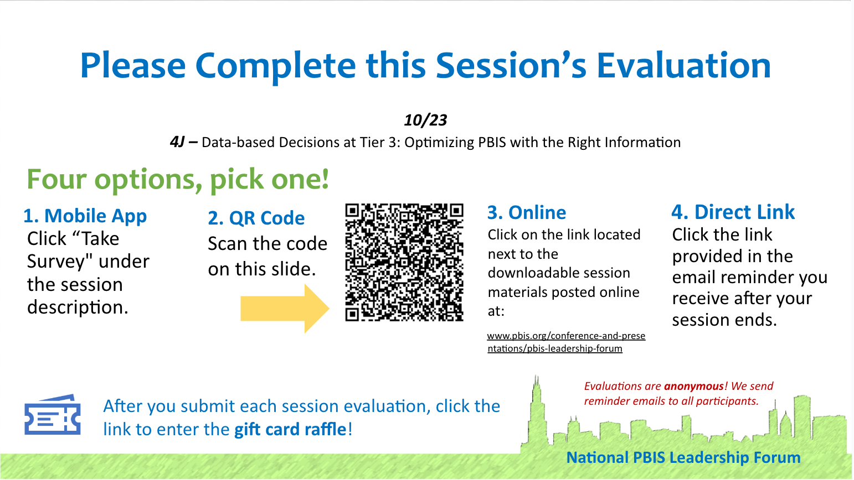
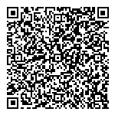

Please Complete this Session’s Evaluation
10/23
4J – Data-based Decisions at Tier 3: Optimizing PBIS with the Right Information
Four options, pick one!
1. Mobile App Click “Take Survey" under the session description.
2. QR Code Scan the code on this slide.
3. Online Click on the link located next to the downloadable session materials posted online at:
www.pbis.org/conference-and-presentations/pbis-leadership-forum
4. Direct Link Click the link provided in the email reminder you receive after your session ends.
SAMPLE
Evaluations are anonymous! We send reminder emails to all participants.
After you submit each session evaluation, click the link to enter the gift card raffle!

