Slide 1

3A – How to Engage Families in Planning Tier 3 Support: Student-Level Focus
Presenters:
Shanna Hirsch, University of Maryland
Katie Conley, Boise State University
Notes:
Tiers 2 & 3
12:00 PM - 12:40 PM
3C
How to Engage Families in Planning Tier 3 Support: Student-Level Focus
Shanna Hirsch, University of Maryland; Katie Conley, Boise State University

Slide 2

Shanna Hirsch, PhD., BCBA-D
Notes:
My name is Shanna Hirsch
Former Teacher and district behavior coordinator
I am currently an Associate Professor at University of Maryland
My Interests: Classroom level, Tier 3 Systems

Slide 3
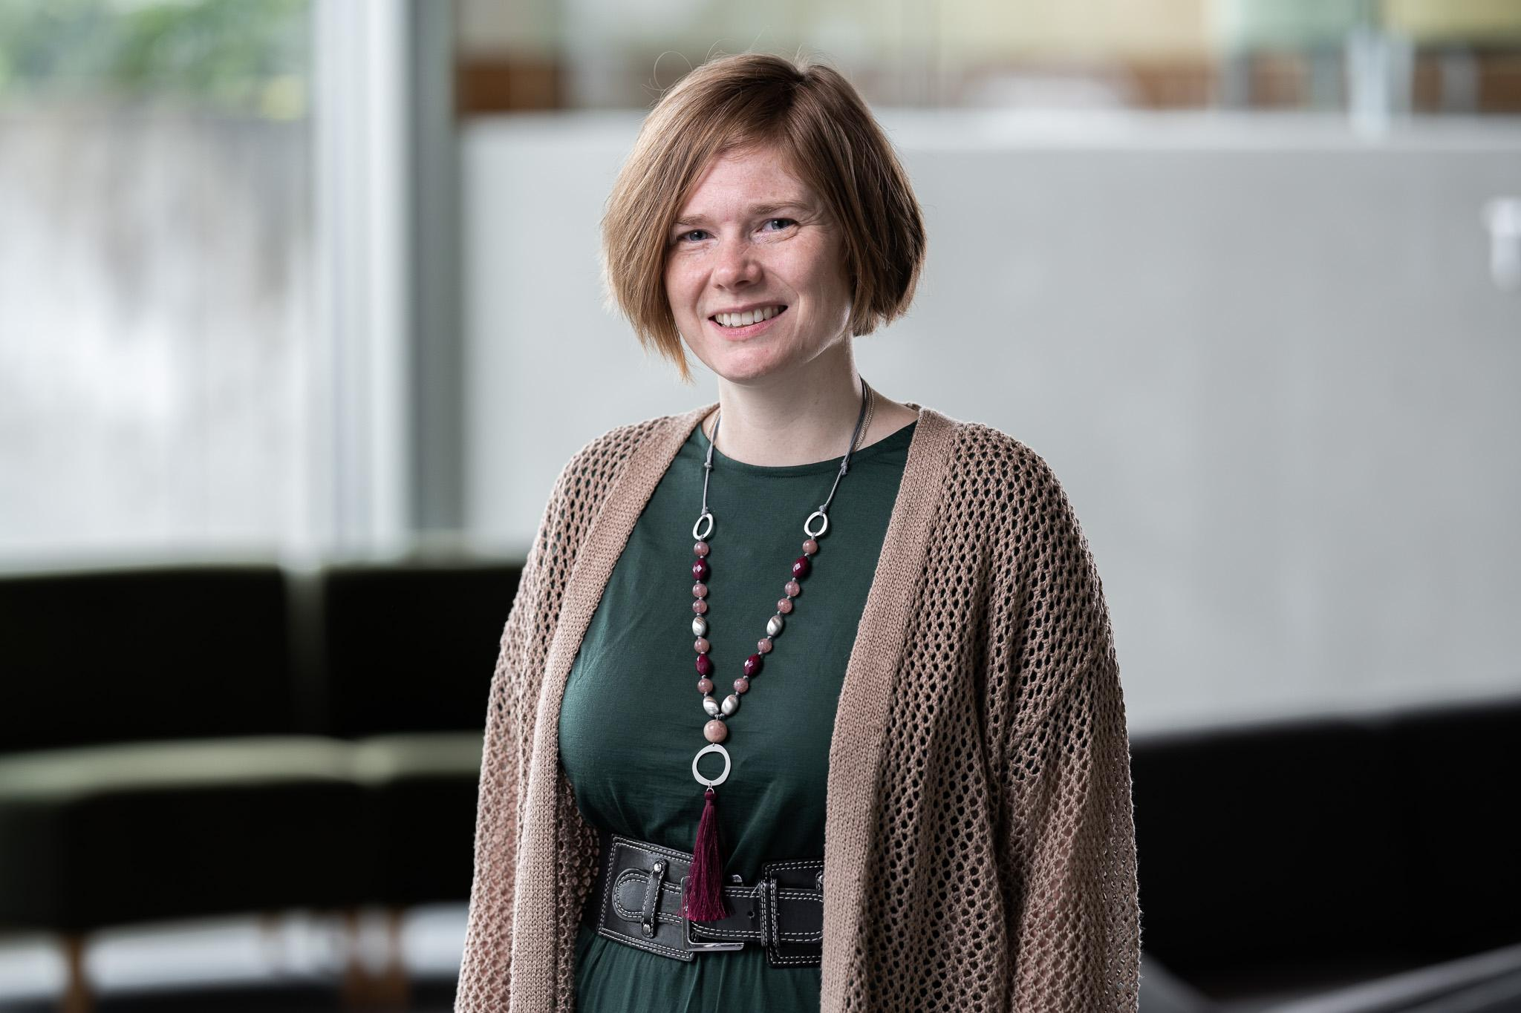
Katie Conley, PhD
Notes:
Katie Conley
Assistant Professor at Boise State University
My PBIS interests: Advanced Tiers of support, especially Tier 3, and data-based decision making

Slide 4
Learning Objectives
1. Understand practices related to family involvement and collaboration in Tier 3 processes; and
2. Identify resources to support collaborative partnerships in Tier 3 processes and action plan.
Notes:
This session will focus on building and strengthening partnerships with families related to the implementation of Tier 3 supports.
1. Understand practices related to family involvement and collaboration in Tier 3 processes; and
2. Identify resources to support collaborative partnerships in Tier 3 processes and action plan

Slide 5
Common Terms
Caregiver
Family Member
Grandparent Caregiver
Guardian
Home
Kinship Caregiver
Parent
Notes:
Throughout the presentation, we will use a variety of terms to reflect adults who care for students (Caregivers). Here are some examples of commonly used terms.

Slide 6
Tier 3 Student-Level Planning

Slide 7
Parental Involvement
Parental involvement refers to actions or activities that parents do to support their child’s learning.
It is often seen as a more passive role, where parents are involved in their child’s education but may not be actively seeking to improve it beyond these traditional activities.
Attending parent-teacher conferences or
Volunteering at school events.
https://parents4publicschools.org/
Notes:
Here is a definition of parent involvement from the Parents for Public Schools website:
Parental involvement refers to actions or activities that parents do to support their child’s learning, such as attending parent-teacher conferences or volunteering at school events. It is often seen as a more passive role,

Slide 8
Parental Engagement
Parental engagement goes beyond involvement to include activities that are more proactive and collaborative with educators.
Parent engagement is a more active, ongoing partnership between parents and educators that promotes student success.
School decision-making committees,
Advocating for school improvement initiatives,
Co-planning curriculum and instruction with teachers.
https://parents4publicschools.org/
Notes:
Parental engagement, on the other hand, goes beyond involvement to include activities that are more proactive and collaborative with educators.
Parent engagement is seen as a more active and ongoing partnership between parents and educators to promote student success.
This could include participating in school decision-making committees, advocating for school improvement initiatives, or co-planning curriculum and instruction with teachers.
Schools with family engagement as a central goal clearly set the stage for getting many families to take an interest in the school.

Slide 9

Using FBAs to Create Supportive Learning Environments
Notes:
We are going to briefly unpack The U.S. Department of Education - November 2024 guidance
This guidance is rooted in evidence-based practices to support students and allowable activities under both the Elementary and Secondary Education Act of 1965 (ESEA) and the Individuals with Disabilities Education Act (IDEA) — both of which emphasize a collaborative approach to support our Nation’s students

Slide 10
FBAs and Parent Engagement
Data collection for an FBA should be conducted by professionals who have the necessary skills, training, and knowledge to identify, analyze, and address the interfering behaviors of students and collaborate and actively engage parents and students in the process.
Page 6
Notes:
The following text is from Page 6 of the guide

Slide 11
Read the Guidance
Center on PBIS
https://www.pbis.org/current/function-based-support-throughout-the-continuum
IDEA Policy Guidance
https://sites.ed.gov/idea/idea-files/using-functional-behavioral-assessments-to-create-supportive-learning-environments/
Notes:
You can access the guide online by going to The Center on PBIS’ website or going to directly to the department of ed’s website.

Slide 12
Collaborate and actively engage families…

Slide 13
Number of Times - “Family” appears
11
Notes:
The word family appears in the guidance document 11

Slide 14
Number of Times - “Parent” appears
43
Notes:
The word parent appears in the guidance document 43
11 + 43 = 54x

Slide 15
Centering Families
“…collaborate and actively engage parents and students in the process” (p. 6).

Slide 16


What are the results of collaborating with families and students?
Improved behavior
Higher academic outcomes
Positive social-emotional development
All of the above
(Dearing et al., 2006; Delgado-Gaitan, 2004; Dotterer & Wehrspann, 2016; Fernandez-Alonso et al., 2017; Hill & Craft, 2003; Hill & Tyson, 2009; Sheldon & Epstein, 2002)
Notes:
Think to yourself… What are results of collaborating with students and their families

Slide 17
What are the results of collaborating with families and students? Answer
Improved behavior
Higher academic outcomes
Positive social-emotional development
All of the above
(Dearing et al., 2006; Delgado-Gaitan, 2004; Dotterer & Wehrspann, 2016; Fernandez-Alonso et al., 2017; Hill & Craft, 2003; Hill & Tyson, 2009; Sheldon & Epstein, 2002)

Slide 18
Student-Level Team Membership
Type of Team | Who is Included
Consultation-based approaches | teacher and classroom consultant
Comprehensive team | school personnel, family, student etc.
Wraparound teams | school personnel, family, student and members of the community/outside agencies
Center on PBIS. (2022). Tier 3 Student-level Systems Guide. Center on PBIS, University of Oregon. www.pbis.org.
Notes:
Teaming might occur through all of the tiers. Tier 3 teams, however, focus on the individual needs of one student instead of a group of students. Because those needs might be more intense, complex, and specific to that student, Tier 3 teams include members with different types of expertise. This may include administrators, teachers, social workers, school psychologists, behavior analysts, etc. Tier 3 Student Teams are also encouraged to invite the student,

Slide 19
Involving Families in the FBA-BIP Process

Slide 20
Culturally & Contextually Appropriate Behaviors
Functional behavior interventions should lead to interventions that produce culturally and contextually appropriate behaviors.

Slide 21
Comprehensive Understanding
To obtain info necessary to provide a rich, comprehensive understanding of the student(s)
history of interventions
strengths/preferences
communication skills
medical concerns
daily routines

Slide 22
Consistency
Families/caregivers are students’ most consistent and committed resource
Across settings
Across developmental stages

Slide 23
Think about a colleague who is skilled and successful at collaborating with families…
How do they do it?
Notes:
Think about a colleague who is skilled and successful at collaborating with families…
How do they do it?

Slide 24



Effective Partnerships
1-3
Communicate
Respect
Commitment
( A. P. Turnbull et al., 2015)
Notes:
Collaborate with families to support student learning and secure needed services
Communication: Teachers and families communicate openly and honestly in a medium that is comfortable for the family.
Effective on-going communication is critical to establishing good
relationships between families and schools
• Respect. Teachers treat families with dignity, honor cultural diversity, and affirm strengths.
• Commitment: Teachers are available, consistent, and go above and beyond what is expected of them.

Slide 25



Effective Partnerships
4-6
Equality
Advocacy
Trust
( A. P. Turnbull et al., 2015)
Notes:
• Equality; Teachers recognize the strengths of every member of a team, share power with families, and focus on working together with families.
• Advocacy: Teachers focus on getting to the best solution for the student in partnership with the family.
• Trust: Teachers are reliable and act in the best interest of the student, sharing their vision and actions with the family.

Slide 26
Tips for Strengthening Family Engagement in the FBA-BIP Process

Slide 27
Family Engagement:
Prior to the FBA Process
Proactive Communication
Building Trust
Notes:
Proactive Communication
Building Trust

Slide 28
Opening the Doors to Families
Back to School Nights
Family/Community Breakfast
Big Reads
Principal Office Hours
Virtual Communication (e.g., GroupMe, WhatsApp)
Open House
Notes:
Set meeting times to accommodate parent schedules

Slide 29
Open House Expectations
While visiting our classrooms, please remember that our teachers' primary responsibility is to teach their students. You are welcome to visit any room; however, if a room has a guest teacher today, it will be marked with a red paper, and we ask that you not visit that room.
We ask that you DO... | We ask that you DO NOT...
Sit only in the seats placed at the rear of each classroom Stay in the room until the announcement to switch classes Silence your phones Laugh at the teachers' jokes Learn something! | Visit classrooms with substitutes. Ask the teacher any questions during the class Talk to each other or to students Use any electronic devices inside the room
Notes:
Quick example
Big idea: provide open house orientation packets (e.g., expectations) ahead of time and at the beginning of events…. feel free to revisit

Slide 30
Open House
B | I | N | G | O
Student answers a question | Student helping students | Relationship Building | Students work in small groups | Calling sticks
Student transitions smoothly | Calming Corner | Students coming to the board | Student asks "why?" | Summarizer at the end
Using Chromebooks | Teacher helping students | FREE SPACE | Group Project | Students are reading aloud
Writing Essays | Whole Class Discussion | Student gives a thoughtful answer | Attention Getting System | Objective on the board
Discussing learning objective | Checking for Understanding | Direct Instruction | Teacher gives positive praise | Student is called by name

Slide 31

Proactive Regular Communication: Self-Management
Proactive Communication Log
Phone Call
Handwritten note
Email
Postcard
Teacher Conferences
Middle/High School - Speed Conferences
*Provide Student & Family Choice*
Name | Aug. | Sep. | Oct
CA | Phone 8/12 | Email - 9/11 | Conf. TBD
DC | Phone 8/12 | Email - 9/9 | Conf. TBD
MD | Phone 8/13 | Email - 9/11 | Conf. TBD
Notes:
TALK ABOUT THE POSITIVES
you don’t have to wait for problem behavior to occur to develop relationships and get to know your students and their families/caregivers better! ”
Intention Student Check-ins
Conferences
1:1
Intentional Communication Home
Phone Call
Handwritten note
Email
Postcard
Conferences
*Provide Student & Family Choice*

Slide 32
Family Engagement:
During the FBA Process
Respect
Equality
Trust
Notes:
Builds respect, trust, equality

Slide 33

What to expect during a functional behavior assessment
Purpose & overview of the FBA process
Who leads the FBA process
Timeline
Invite them to have a seat at the table
Notes:
Clear and open communication between school professionals and parents is crucial throughout the process. This includes starting with a “an overview of what to expect”
Regular updates, collaborative meetings, and shared decision-making help create an intervention plan that reflects shared insights.
Invite them to have a seat at the table -- Participation often involves attending interviews with a school-based team members.
Parents may also contribute by participating in direct observations or sharing insights through questionnaires and reports such as the Motivation Assessment Scale (MAS) or the Functional Assessment Screening Tool (FAST).

Slide 34
Family Engagement
Develop a Team
Providing Insight
Collect Direct and Indirect Data
Analyze the Data & Develop a Hypothesis
  Engage family
  Involve student (as appropriate)
  Provides input on goals, concerns, strengths
  Collaborate to define the contextually inappropriate behavior
  Interviews
    Student
    Family Member
  Develop a hypothesis statement
Notes:
This is a typical process - varies by student need/provider/district/state
Family involvement varies - we dont want involvement to become a burden
Solicit input throughout - Express preferences, expectations, strengths, and needs
Interviews-Interviews or questionnaires are vital to the functional
assessment process. These range from screening questionnaires to
in-depth research-based interviews
• Direct Observation Recording –family members briefly record
incidents of behavior in writing through checklists or rating scales
(brief descriptions, frequency checks, etc....) or use forms similar to
those employed by the school (ABC, scatter plot, etc.)
When family members are partners in the hypothesis
development phase, they can validate the summary of
events associated with their child’s behavior at home and in the community.

Slide 35
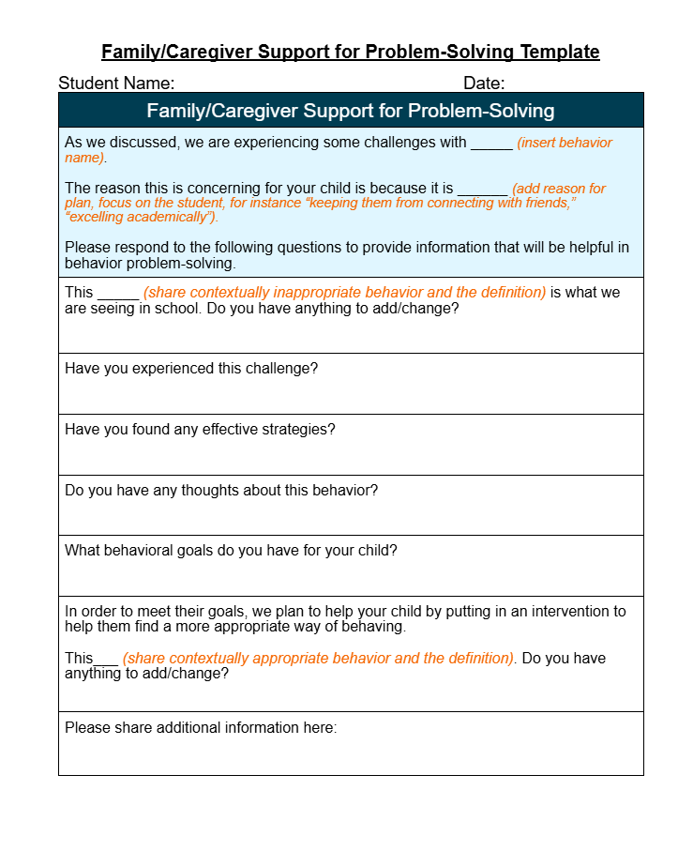
Sample Problem Solving Template
Solicit Input: Face to Face or Remote
Notes:
: Identify what matters to the student and how to partner with them

Slide 36
Family Engagement:
During the BIP Process
Commitment
Respect
Notes:
Engaging with families during the process shows your commitment to engagement and respect

Slide 37
BIP Process
Following the completion of an FBA, often a BIP is created to support the student and assist educators in developing a learning environment that addresses the student’s behavior.
Typically the BIP is a collaborative effort which may include the student’s teachers, specialized instructional support personnel, …parents, and if appropriate the student
Page 10
Notes:
Communication logs

Slide 38
BIP Process: Proactive Planning
Co-Developing Goals
Generalization & Fading
Materials
Notes:
Early involvement is especially crucial when behaviors are not consistently observed at school, as it promotes consistency and skill generalization across environments.

Slide 39




Family Communication Plan
WHO Family member(s) Caregiver(s)
WHAT Information shared (data snapshots, goals, strategies, celebrations)
HOW Mode (e.g., text, email, phone, video, in-person),
WHEN Frequency (e.g., daily, weekly)
Notes:
Write up the strategies/plan in a simple format.
This is a typical process - varies by student need/provider/district/state
Family involvement varies - we dont want involvement to become a burden
Solicit input throughout
Planned Communication
Check-ins
Meetings

Slide 40
Application Activity
Engage Families in Planning Tier 3 Support:
A Small Group Simulation

Slide 41
Application Activity Instructions
Quick Introductions (if working in groups)
Choose ONE scenario
(EC / Elem / MS / HS / Transition)
Complete, in order:
  Student & Family/Caregiver Considerations
  Student Engagement: Problem-Solving Template
  About My Child
  Family/Caregiver Support for Problem-Solving
If time: Draft a Family Communication Plan
(mode, frequency, who, what/how you’ll share)

Slide 42

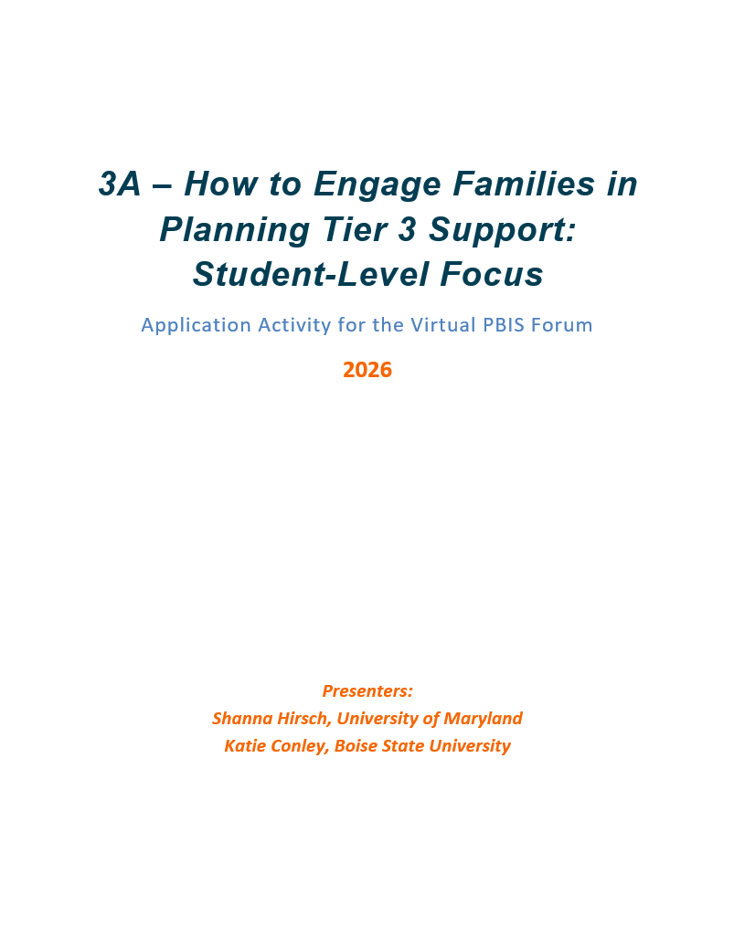
Application Activity Materials
Notes:
Links here

Slide 43

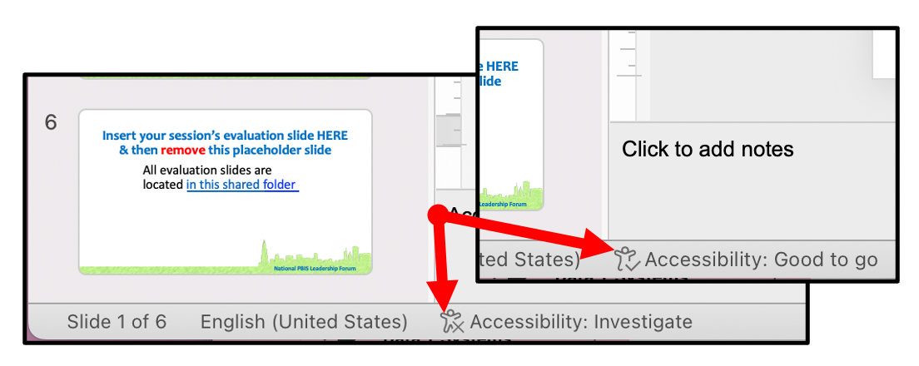
Quick Guidance on Accessibility
This slide acts as a reminder about accessibility.
This slide is to be removed before you submit or present your presentation.
It's not a PPT itself that makes a PPT accessible—it's the choices presenters make in the PPT that make the PPT accessible (or not).
Slides included in this file are accessible. Additional slides you add to this file will need to be checked for accessibility standards.
Watch our Accessibility Guidance for Presenters video
Download the Center on PBIS Tips for Making Accessible PPT Presentations
How to open PowerPoint’s Accessibility Checker:
  On both mac and PC, on the bottom of your PPT window, find the Accessibility status. Click once and it will open on the right.
  If Accessibility status is not showing, refer to the Presenter Guide for instructions on how to add it.
Notes:
Katie checked Accessibility with the built-in PPT checker on 2/2/26. Made small revisions to alt text, tables, slide titles, and contract/text size.

