Slide 1



Check-In/Check-Out: Setting Students Up for Success Using a Targeted and Efficient Behavior Program
Angus Kittelman & Lisa Powers
University of Missouri

Slide 2
Key Messages
Describe how Tier 1 practices support Tier 2 practices
Describe the core components of CICO
Identify systems to support CICO implementation

Slide 3

Acknowledgements
  5-year IES-funded project (R324A190046) focused on evaluating the efficacy of CICO for elementary school students
  3-year IES-funded project (R305A180015) focused on adapting CICO for high schools
  5-year IES-funded project (R324A230091) focused on scaling up CICO for high schools

Slide 4
Key Messages
Describe how Tier 1 practices support Tier 2 practices
Describe the core components of CICO
Identify systems to support CICO implementation

Slide 5

Tertiary Prevention:
Specialized
Individualized
Systems for Students with High-Risk Behavior
PBIS for all, some, and few
~5%
Secondary Prevention:
Specialized Group
Systems for Students with At-Risk Behavior
~15%
Primary Prevention:
School-/Classroom-
Wide Systems for
All Students,
Staff, & Settings
~80% of Students

Slide 6
How Core Tier 1 Practices Support Tier 2 Interventions
  Classroom expectations are defined and taught
  Classroom routines are predictable, prompted, practiced
  Regular recognition for positive behaviors
  Discourage problem behavior
1. Expectations Defined, Taught
2. Precorrection
3. Opportunities to Respond
4. Behavior Specific Praise
5. Consequences

Slide 7
Tertiary Prevention:
Specialized
Individualized
Systems for Students with High-Risk Behavior
PBIS for all, some, and few
~5%
Secondary Prevention:
Specialized Group
Systems for Students with At-Risk Behavior
~15%
Primary Prevention:
School-/Classroom-
Wide Systems for
All Students,
Staff, & Settings
~80% of Students

Slide 8
Tier 3 Practices:
Function-Based Behavior Support Plans
Wraparound Supports
Individual Counseling
Etc.
PBIS Practices
~5%
Tier 1 Practices:
Teaching School-wide Expectations
Acknowledging Expected Behavior
Responding to Behavior Errors
Requesting Assistance
Etc.
Tier 2 Practices:
Check-In/Check-Out (CICO)
Social Skills Groups
Self-monitoring
Behavior Contracting
Mentoring
Etc.
~15%
~80% of Students

Slide 9



Core Features of Tier 2 Practices
  Continuously available
  Function-based
  Explicit instruction
  Repeated Feedback
  Corrective consequences
  School-family communication
  Fading strategies

Slide 10
Goals of Tier 2 Interventions
  More time and instruction for skill development
  More structure and predictability
  Structured performance feedback
  Self-management skills
  (self-monitoring, self-instruction, self-correction)

Slide 11
Who Benefit From Tier 2 Supports?
  Frequently late
  Homework incomplete
  Regularly “talk-out”
  Have few friends
  Lack of connection to adults
  Students who teachers “can handle” but who are a challenge

Slide 12
Key Messages
Describe how Tier 1 practices support Tier 2 practices
Describe the core components of CICO
Identify systems to support CICO implementation
Notes:
, implementation, sustainability)

Slide 13
CICO Improves….
Academic Engagement
  Cambell & Anderson, 2011; Kilgus et al., 2016; March & Horner, 2002; Park et al., 2020; Wolfe et al., 2016
Prosocial Behaviors
  Cheney et al., 2009; Park et al., 2020; Ross & Sabey, 2005
Disruption/Off-Task
  Drevon et al., 2018; Hawken et al., 2014; Simonsen et al., 2011; Turtura et al., 2014; Wolfe et al., 2015

Slide 14
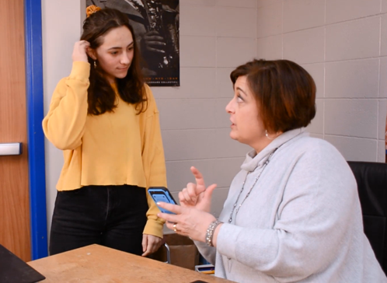
Check-In/Check-Out (CICO)
  Provides a daily “check-in” and “check-out” with an adult with student support and problem solving as needed
  Prompts & promotes positive adult-student interaction
  Increases the frequency of contingent positive & constructive feedback from adults
  Increases recognition for expected behavior

Slide 15
CICO Adult and Student Cycles
Daily Student/Coordinator Cycle
Daily Student/Teacher Cycle
Team Cycle
CICO Plan
Morning Check-In
Team Meeting
Class Check out
Progress Report
Teacher Checks
Home Check-In
Program Update
Class Check in
Afternoon Check-out
EXIT

Slide 16
CICO Mentor and Student Cycles
Daily Student/Mentor Cycle
Daily Student/Teacher Cycle
Team Cycle
CICO Plan
Morning Check-In
Team Meeting
Class Check out
Progress Report
Teacher Checks
Home Check-In
Program Update
Class Check in
Afternoon Check-out
EXIT

Slide 17
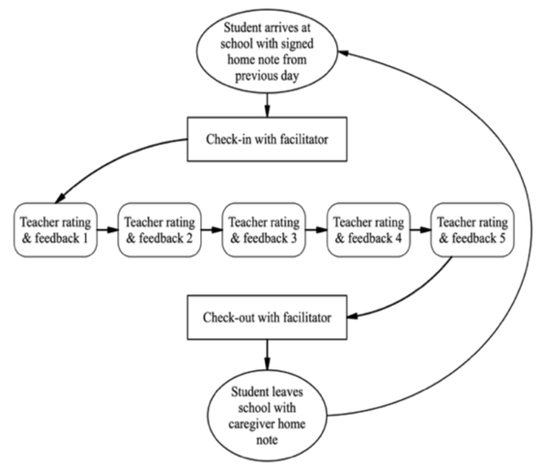
CICO Roles
Facilitator
  The person who the student checks in and out with
  Should NOT BE THE student’s CLASSROOM TEACHER
  Should be someone who is friendly, positive, and can give exceptionally good positive specific feedback
Classroom Teacher
  Elementary: Provides feedback on DPR behaviors after each lesson/ content area/ learning activity (e.g., at least 5 times per day)
Students
  Elementary: might be responsible for soliciting feedback
At-home caregivers
  Reviews student data, signs home report, sends back to school with student

Slide 18
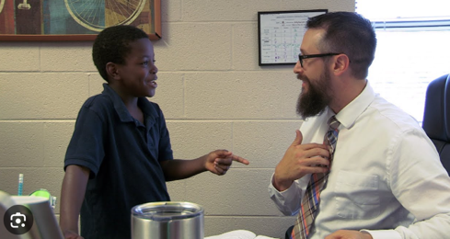
Mentor and Student “Check In”
WHAT?
  2-3 minutes at start of day
  Takes place with CICO mentor
  Gives student point card
WHY?
Increases positive adult-student interactions
First contact of each day is positive
Opportunity to intervene early if needed

Slide 19
Teacher and Student Cycles
Daily Student/Coordinator Cycle
Daily Student/Teacher Cycle
Team Cycle
CICO Plan
Morning Check-In
Team Meeting
Class Check out
Progress Report
Teacher Checks
Home Check-In
Program Update
Class Check in
Afternoon Check-out
EXIT

Slide 20
Teacher and Student “Greeting” Each Class (Beginning)
WHAT?
  Can be verbal or non-verbal
  Acknowledge each other; lets teacher know they are here
WHY?
  Increases positive adult-student interactions
  First contact of each period is positive student staff interaction; sets tone

Slide 21

Teacher Feedback
WHAT?
  Teacher provides behavior rating AND verbal feedback
  Feedback tied to student behavior
WHY?
  Consistent and predictable routine for student
  Increases positive adult-student interactions
  Delivers adult positive attention

Slide 22
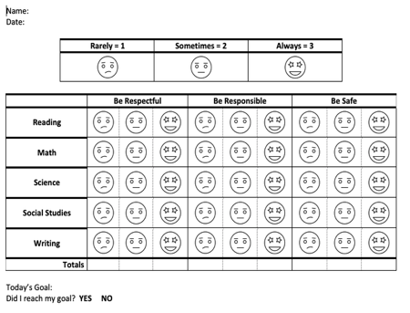
Teacher Feedback
  Increasing positive recognition for expected behavior
  All feedback linked to schoolwide expectations (values)
    Respect
    Responsibility
    Resourcefulness

Slide 23
Start of the day…
“Thanks for giving me your Daily Progress Report.
Looks like you are all set to go.
Remember to work on being a safe, responsible, learner today.”
…pre-correct about meeting expectations

Slide 24

End of Each Time Block…
…meet with the student, show scores & give specific feedback

Slide 25
Scoring the Daily Progress Report
Highest rating (e.g., 2 =
  Met expectations with few or no reminders
Middle rating (e.g., 1) =
  Required some corrections, BUT behavior changed as a result
  Lowest rating (e.g., 0) =
  Repeated instances of problem behavior that required multiple corrections
  Behavior did NOT change or behavior escalated

Slide 26
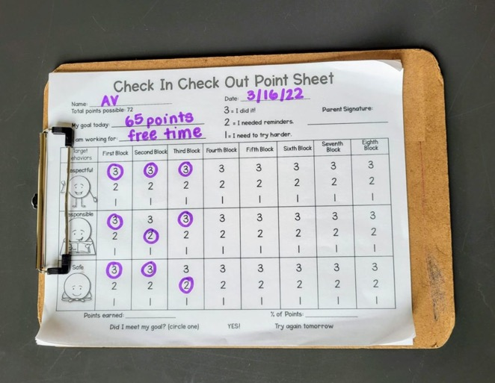
Point Card for Student Feedback

Slide 27
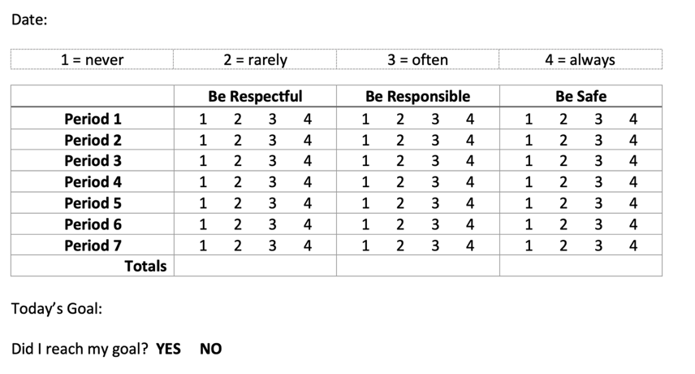
Daily Progress Report (DPR)
Behaviors often aligned with schoolwide expectations
Might be defined with the student’s specific behavioral needs

Slide 28

Daily Progress Report (DPR)
Students must be taught EXACTLY what these behaviors look like and what types of behaviors earn different ratings

Slide 29
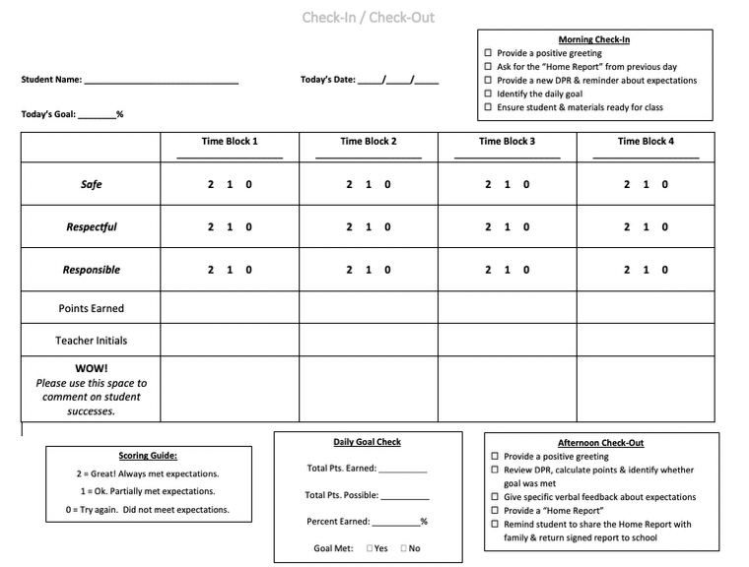

Standardize DPRs Link to PBIS

Slide 30
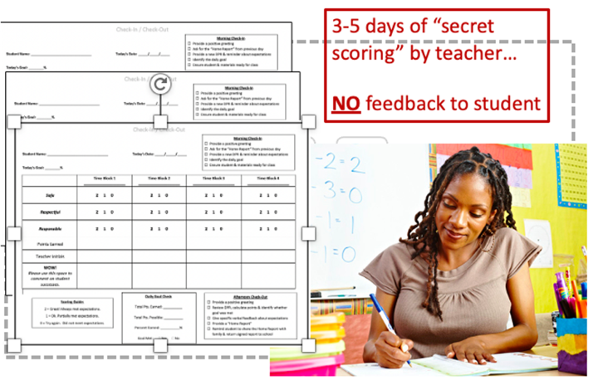
Identify Student Goals
classroom teacher(s) collects baseline data
3 to 5 days teacher ratings with NO feedback to student(s)
average percentage of points earned during baseline is used to determine student daily goal

Slide 31

Regular Home Connection
WHAT?
  Brief update on student progress
WHY?
  Provides parent with information of student meeting goals
  Provides format for positive student/parent contact

Slide 32
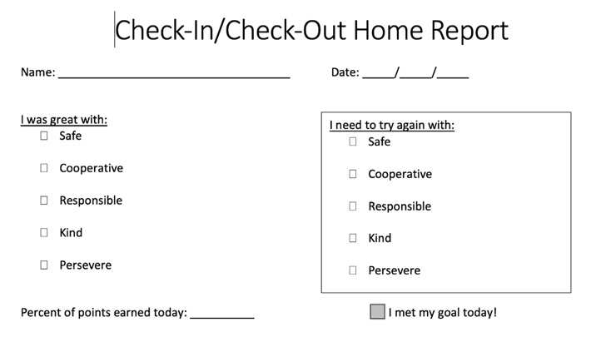
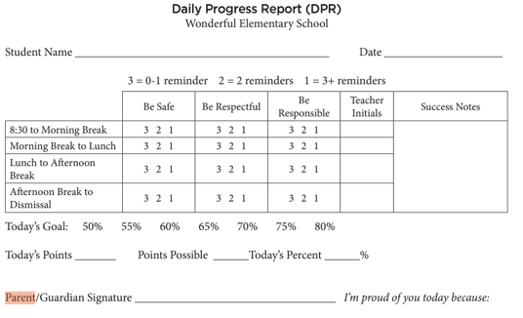
Home To School Communication

Slide 33
CICO Mentor and Student Cycles
Daily Student/Mentor Cycle
Daily Student/Teacher Cycle
Team Cycle
CICO Plan
Morning Check-In
Team Meeting
Class Check out
Progress Report
Teacher Checks
Home Check-In
Program Update
Class Check in
Afternoon Check-out
EXIT

Slide 34

Mentor and Student “Check Out”
WHAT?
  2-3 minutes at end of day
  Takes place in a designated location
WHY?
  Totals points
  Provides positive feedback
  Provides recognition for success or encouragement
  Provides home report

Slide 35
Daily and Weekly Acknowledgements
  WHAT?
  Tangible or privileges are delivered to student for meeting goals
    Building fidelity
    Meeting % goals
  WHY?
  Behavior change is effective when reinforced consistently and positively

Slide 36
CICO Acknowledgement System
  Aligns with Tier 1 System
  Uses goal setting to acknowledge achievements
  Include daily and weekly reinforcement
CICO Acknowledgements
Frequent (Daily Goals) | Intermittent (Weekly Goals)
High Five Verbal Praise Schoolwide System (Hawk Ticket) Positive phone call Small Snack | School Supplies Tickets to sports event Sports gear Quick trip coupon Helping in the Office

Slide 37
Example Student Acknowledgements
Money for school store (tangible)
Granola bars, cup o soups..
Special parking privileges (privilege)
Fast pass at lunch (privilege)
Extended lunch period (privilege)
Special access to schoolwide events (privilege)

Slide 38
Key Messages
Describe the difference between Tier 1 and Tier 2 practices
Describe the core components of CICO
Identify systems to support CICO implementation

Slide 39
CICO Teaming Cycle
Daily Student/Coordinator Cycle
Daily Student/Teacher Cycle
Team Cycle
CICO Plan
Morning Check-In
Team Meeting
Class Check out
Progress Report
Home Check-In
Teacher Checks
Program Update
Class Check in
Afternoon Check-out
EXIT

Slide 40

Core Features of Tier 2 Systems
  Tier 2 team with behavioral expertise
  Student screening and identification
  Use of data-based decision making (fidelity and outcome)
  Professional development

Slide 41

Teaming

Slide 42
Student Screening and Identification
  Schools need strategies for identifying students
  May collect additional data to determine if student would benefit from:
    Tier 2 supports
    Which Tier 2 practice (e.g., CICO)
Data for Identifying Students
Office Referrals (ODRs)
Classroom minors
Absences
Tardies
Grade point average
Achievement scores in math, reading..
Frequent counselor visits

Slide 43
Example of Student Identification for CICO
Data Source | Examples | Non-Examples
Existing School Data | Overall attendance 85% or above Failing no more than 2 classes Tardy 2-4 times per week Struggles to complete work on time | Overall attendance less than 85% Failing more than 2 classes Tardy 5+ times per week Completes very little or no work
Reason for Behavior | Get attention from adult and/or peers | Avoid attention from adult and/or peers
Types of Behavior | Minor disruptions Sitting in an unassigned seat Off-task | Physical Aggression (e.g., fights) Property Destruction Self-injurious behavior
Other Data Sources | Teacher nomination Student self-nomination

Slide 44
Teaming Cycle
  Team meets weekly or bi-weekly
  CICO coordinator uses student data to prioritize which students to discuss
  Using graphs of student data, the Tier 2 Team makes decisions about students
    Fade
    Continue
    Modify

Slide 45
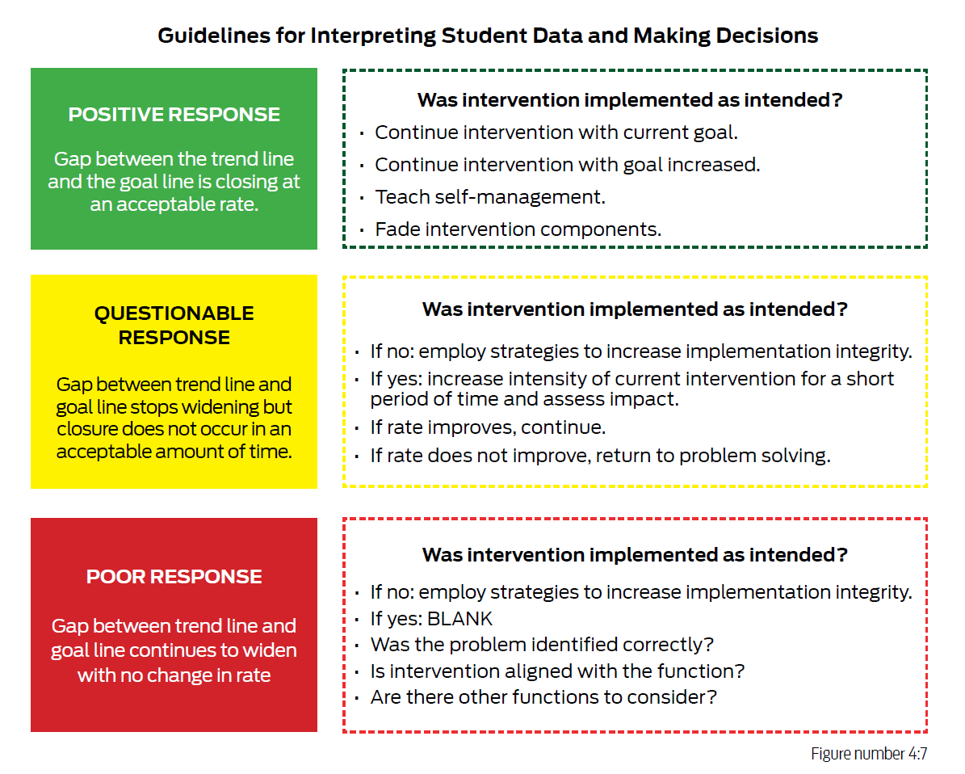

Slide 46
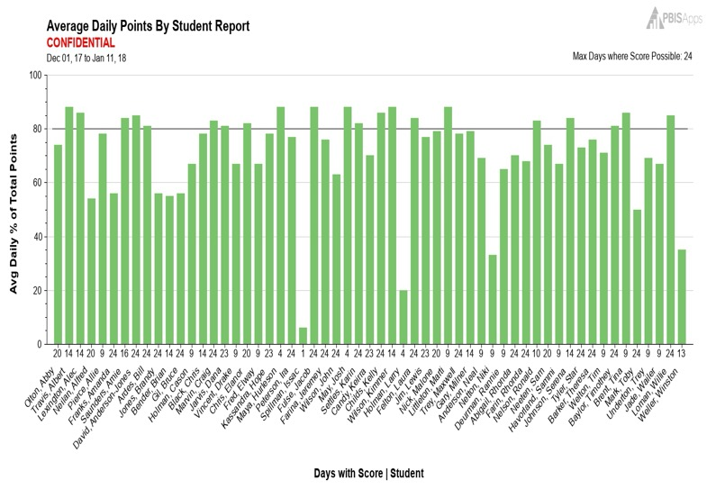
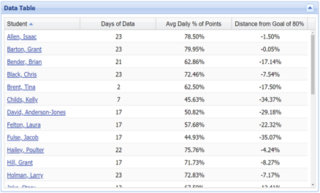
Example: Average Daily Points By Student
Kiera is Not Meeting Her Goals
Shows Progress on Student Goals

Slide 47
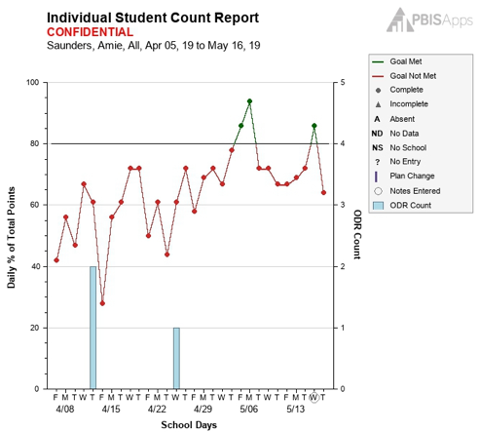
Individual Student Report (Kiera)

Slide 48
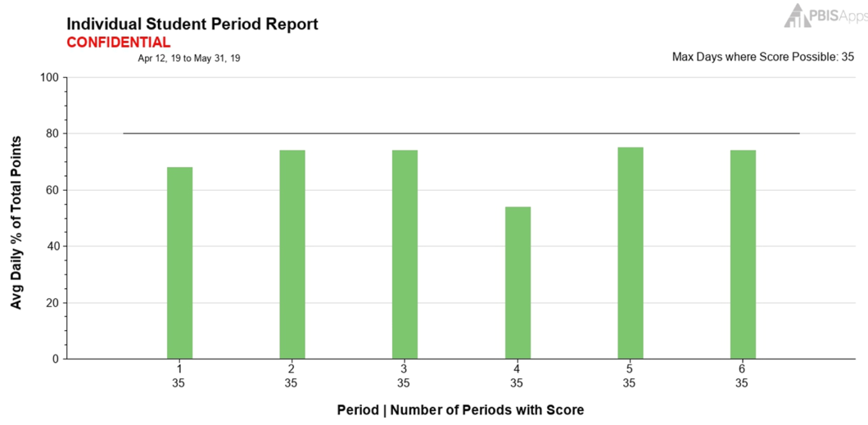
Period Report - Kiera
Kiera's Performance in Period 4 (Language Arts)

Slide 49
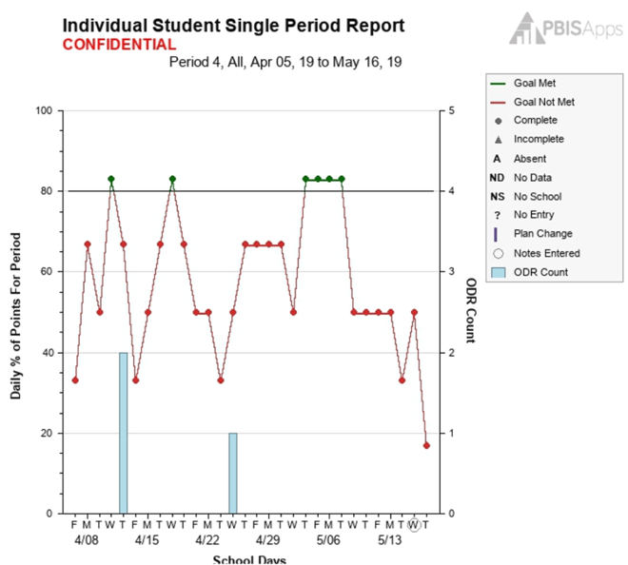
Individual Period Report (Kiera)
Period 4 (Language Arts) Performance Over Time

Slide 50
Example Decision Rules
CICO Decision Rules | Criteria
Stay as is | Last two weeks successful or improving
Make modifications | Last two weeks flat(stagnant) or downward trend
Move to fading or self-management | At least 6 weeks with 4 days per week of success
Move to more intensive supports | 2 weeks without improvement after fidelity has been monitored and modifications have been made

Slide 51
Solution Modification (Kiera)
Solution Component | Action Step(s)
Prevention | Change Kiera’s seating to be away from students with whom she is having difficulty
Teaching | Provide extra support for her in Period 4 Language Arts
Recognition | Give Kiera a ticket each day she is on time for Language Arts

Slide 52



Fading Strategies
  CICO is intended to be implemented over a short time period (6-8 weeks)
  Include criteria gradually reducing CICO support
  Effective fading strategies is seldom a linear process, and both increases and decreases in supports may be needed

Slide 53
Professional Development
  Critical that all school personnel are trained on how to participate in CICO (include fidelity checks and coaching)
      Teachers
      All Staff
      CICO Facilitators
      Students and Families
  Common to receive initial training at the beginning of the school year
      Booster Trainings throughout the year

Slide 54
Key Messages
Describe how Tier 1 practices support Tier 2 practices
Describe the core components of CICO
Identify systems to support CICO implementation

Slide 55

Additional Considerations
Standardize DPRs Linked to PBIS
Establish Clear Entry and Exit Criteria – Plan for Graduation at the start!
Student voice increases success
Feedback quality matters more than scores
Systems matter more than an individual
CICO is skill building and connection not behavior control
Layer in supports
Ensure special education is included versus a separate system

Slide 56

Join The Educator’s Blueprint
Learn from friends in the field…
Episode 10: Can we Just Start Tier 2 with Dr. Kelsey Morris
Episode 11: Student Identification with Dr. Stephen Kilgus
Episode 81: Tier 2 Systems Getting you Down? with Ms. Hannaha Wright
Episode 103: Check-In, Check-Out (CICO) Simplified, Standardized, Formalized.
Click me

