Slide 1
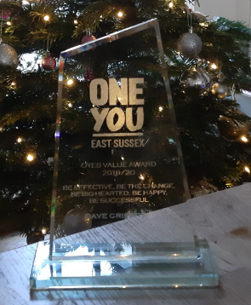

OYES TT VALUE AWARD WINNER; BE BIG HEARTED

Slide 2
OYES TT VALUE AWARD; BE BIG HEARTED (we have a draw…again!)
she is kind and caring, always makes time for everyone and always thinks of others within the team. in and out of work she is so thoughtful and never fails to remember important dates for one and all. SHE is the vision of being big hearted, with a smile on her face and a great person to go to0 at any time.
she is the nicest person ever, she never has anything negative to say. always looking on the positive SIDE and is FOREVER willing to help other's, both at work and outside OF IT. she is a pleasure to work with and is always thinking of other peoples needs above her own. SHE IS 100% BIG HEARTED!
she always puts others before herself, remembers every special day and has helped people through difficult personal situations… I just love her xxX
WHETHER IT’S BEING A MIDWIFE, HEALTH COACH OR CARING FRIEND…THIS PERSON DELIVERS EVERYTIME

Slide 3
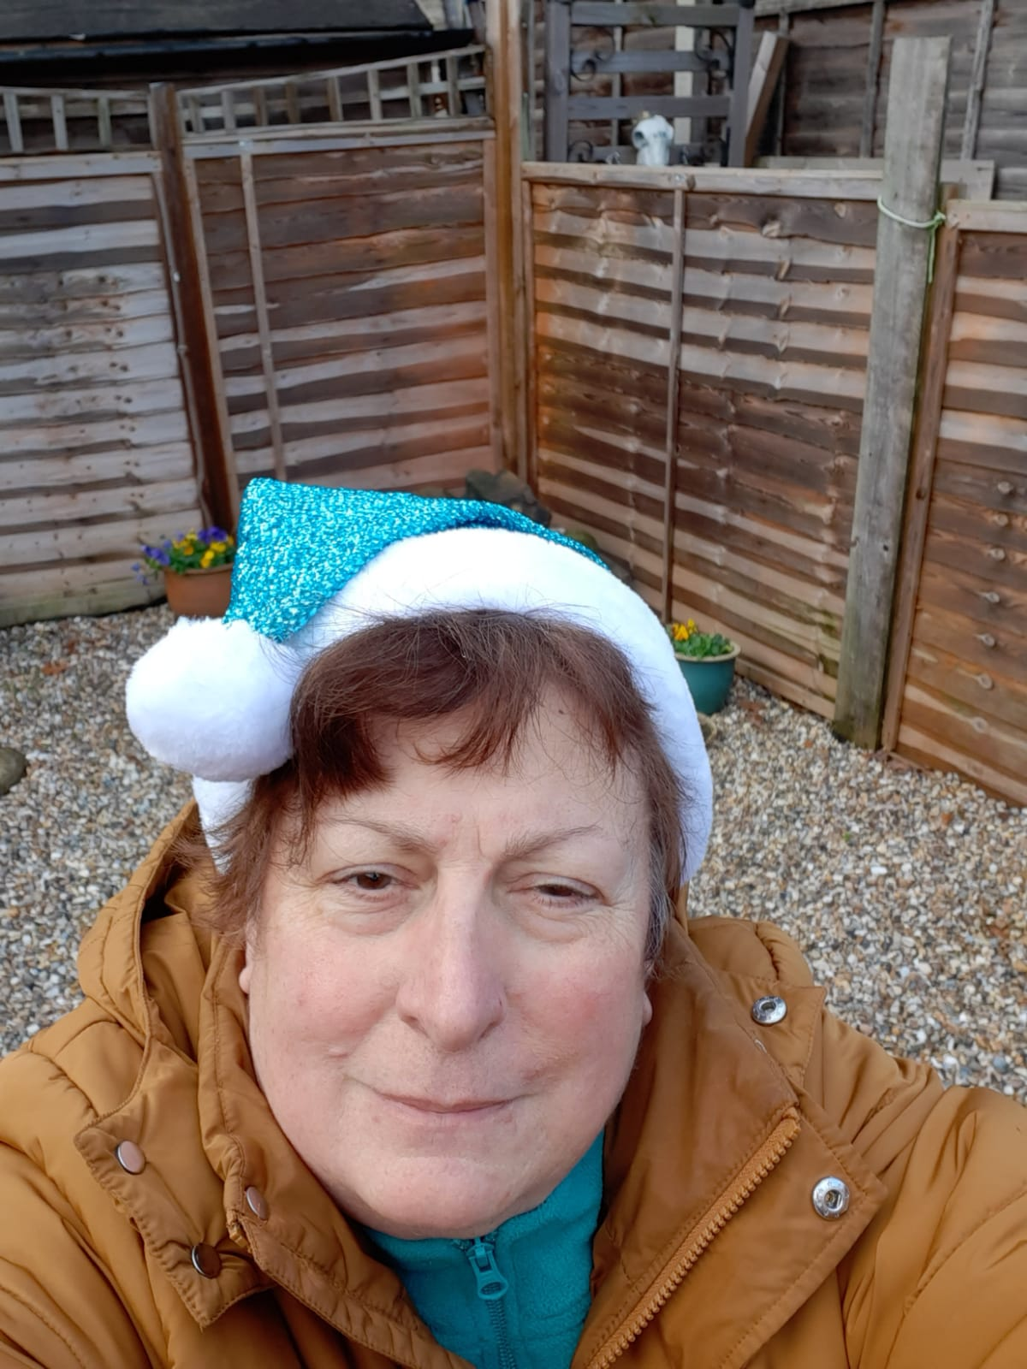
OYES TT VALUE AWARD WINNER; BE BIG HEARTED
Congratulations CAROLYN!

Slide 4
OYES TT VALUE AWARD; BE BIG HEARTED (our second winner…)
THIS PERSON has made sure she has checked on all our team and myself during the year WE have had. IT’S ALWAYS LOVELY to know that she is just a call/zoom away if needed even though she is SUPER busy!
Always happy to give her time. A WARM, friendly smile and always so supportive, positive, generous and kind
Throughout lockdown, she has been a little star - if she noticed I was a little down in our Leads meeting, she would straight away email me to see how I was and kept me stocked in homemade honey and body butters! Just so caring and thoughtful, and always willing to go out of her way to make others smile ❤️
She has just continued to continuously go out of her way to make sure we are all ok. She checks in as a team and individually and when we’ve had tough times she has made it a priority to ensure she is doing all she can to alleviate any stress, even though at times she has had stuff going on too

Slide 5
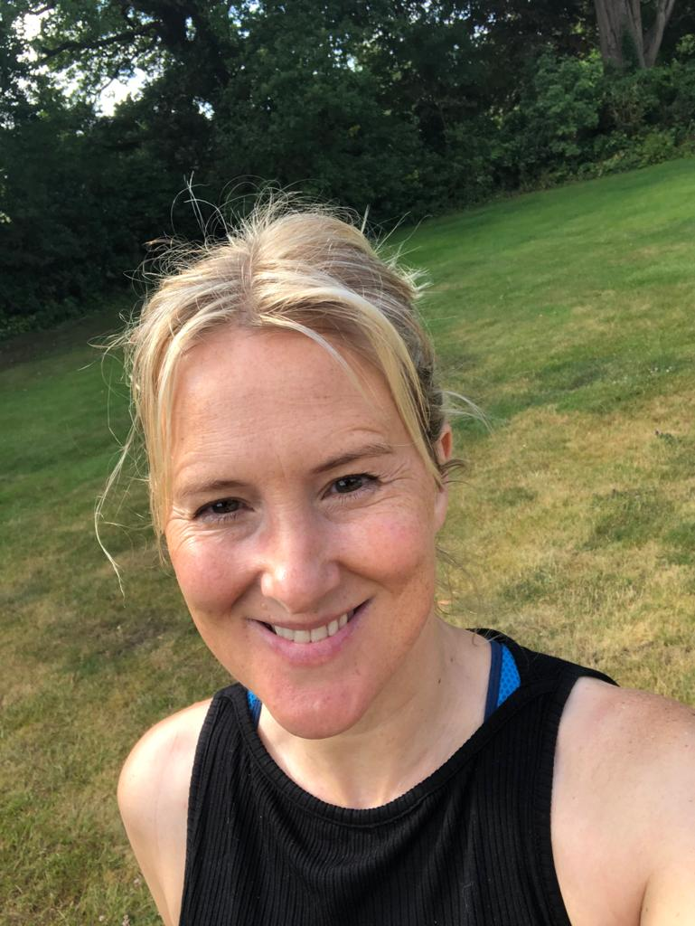
OYES TT VALUE AWARD WINNER; BE BIG HEARTED
Congratulations TANYA!

