Slide 1
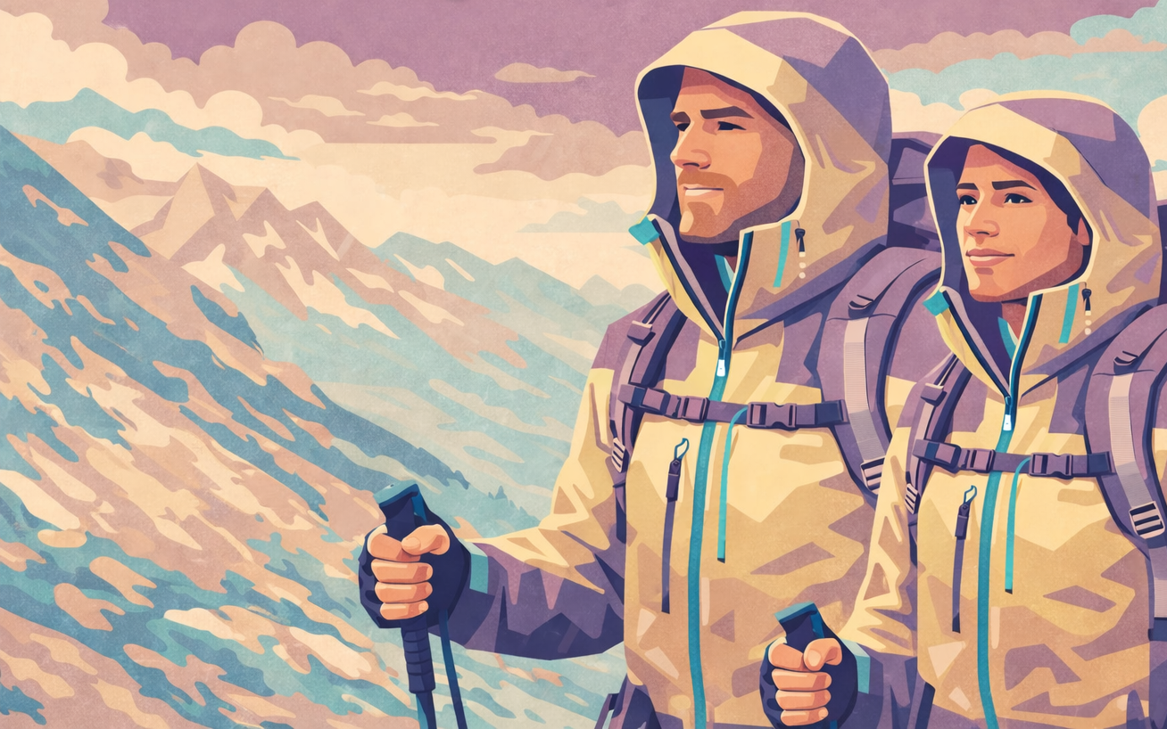
Join TRUSTex in Demonstrating Ecodesign Through a Trekking Jacket Pilot
We aim to co‑create and manufacture a batch of ±50 high‑performance trekking jackets to demonstrate ecodesign strategies that will inform upcoming ESPR textile standards.
These jackets will also validate TRUSTex developments, including:
  Sorting, disassembly & recycling technologies
  Digital Product Passport (DPP) integration
  Eco‑modulation approaches for EPR schemes
Let’s build a jacket that proves circularity
works
We have…
A research partner with testing capabilities
A supplier of recycled polyester fibres
A partner offering heat‑dissolvable yarns for disassembly
We are looking for…
A subcontracted design & manufacturing partner to co-develop and produce a batch of ±50 functional, durable, and highly recyclable jackets.

Slide 2




TRUSTex Project Introduction
Advancing Sustainable Textiles in the Circular Economy through Innovative EPR Schemes
TRUSTEX aims to enable circular textile systems in Europe through Extended Producer Responsibility (EPR)
36 months | 19 partners | 11 countries | industry & research collaboration
  Our Approach
  Propose & test strategies for circular, sustainable textiles​
  Develop recommendations to shape future EU EPR frameworks & guidelines​
  Best practices for EPR governance​
  Design eco-modulated fees
  Ecodesign, material traceability throughout the value chain​
  Optimised sorting, reuse & innovative recycling​
  Engage stakeholders & raise consumer awareness
https://trustexproject.eu/
  Key Benefits of EPR
  Encourages sustainable design
  Stipulates business models based on a prolonged textile use​
  Improves waste collection and management​
  Improves textile recycling and reuse
  Tackles fast fashion: overproduction, overconsumption, massive waste​
  Ultimate Project Goals
  Reduce resource use, textile waste & environmental impact​
  Support EU Textile Strategy & Green Deal objectives​
  Promote fair, inclusive and sustainable transitions across the value chain and society

Slide 3


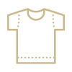


TRUSTex Circularity Strategies
Circularity strategies – Scope, objectives & pilots
WP3 “Circularity strategies” aims to
Enhance the circularity and sustainability of the textile value chain
Generate insights on scale-up levers and barriers
Providing lessons learned for the entire industry
By
Developing and implementing innovative approaches that address EPR viability and circularity hotspots
Demonstrating specific innovations that address technical aspects of circularity
Exploring collection systems, sorting technologies, and disassembly processes to improve reuse and recycling
Pilots
Ecodesigned fibres > fabrics > garments
Semi-automated sorting for reuse
Disassembly of ecodesigned products
Next-gen sorting technologies
Proof of circularity

Slide 4
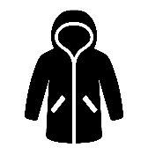
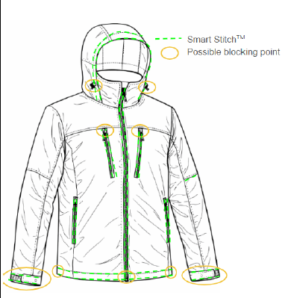







Concept Proposal – Trekking Jacket
Style & functionality
3-in-1 unisex trekking jacket
Waterproof, breathable, windproof, and thermally insulating
Modular construction
Materials
100% polyester fabrics using rPET from textile waste (RE&UP), % TBD
Polyester zippers & velcro
Other trims sewn with Resortecs® thread to allow disassembly & removal
OEKO-TEX® compliant chemistry
Key considerations
Functional, with minimal material diversity and maximum recyclability
Integration of DPP developments from WP2 (CETIM & Scantrust)
Data collection for LCA & eco-modulation work in WP4 (CETIM & Neovili)
Validation of sorting, disassembly & recycling developments in WP3
Estimated quantity requirement: 250kg/50 jackets

