Slide 1


Slide 2
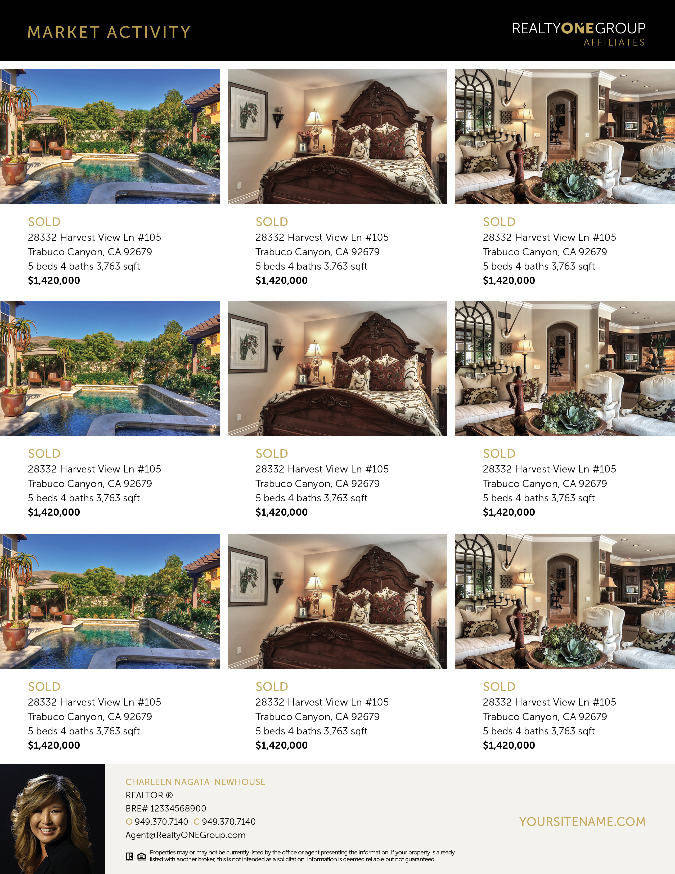
EXAMPLE
EXAMPLE

