Slide 1

Mary Kirwan BL
September 14th, 2026
GDPR & AI IN HEALTHCARE- CMG TRAINING

Slide 2
OVERVIEW
INTRODUCTION TO EUROPEAN DATA PROTECTION LAW
GDPR DOES NOT EXIST IN A VACUUM….
GDPR & HEALTH SECTOR- CONCERNS AND RECOMMENDTIONS
DEFINING HEALTH DATA - USES IN HEALTHCARE- PRIMARY AND SECONDARY USES
PROCESSING HEALTH DATA-GDPR REQUIREMENTS
CONDUCTING RESEARCH-HEALTH RESEARCH REGULATIONS -REQUIREMENTS
DPIA
SECURITY
PRIVACY NOTICE
AI
RECENT CASES

Slide 3
“The right to be let alone.”
Warren & Brandeis 1890

Slide 4
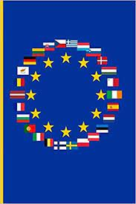
INTRODUCTION TO EUROPEAN DATA PROTECTION LAW

Slide 5
INTRODUCTION TO EUROPEAN DATA PROTECTION LAW
Roots of European Data Protection law are found in international Human Rights law forged in the aftermath of World War II;
The right to privacy emerged as a response to some of the abuses perpetrated during World War II;

Slide 6
INTRODUCTION TO EUROPEAN DATA PROTECTION LAW
Employing Article 48- State of Emergency- of the Weimar Constitution, Adolf Hitler persuaded the parliament to pass the Enabling Act which allowed him to rule by decree indefinitely;
In 1933 individuals lost the right to privacy – officials could read people’s mail, listen in on telephone calls and search private homes without a warrant;
Courts attempted to maintain privacy norms….”married couples should be able to trust each other within their four walls without fear of being denounced by their spouse for subversive talk.”
Catastrophic example in history of the utilisation of law to control, oppress and commit atrocities on humanity;

Slide 7
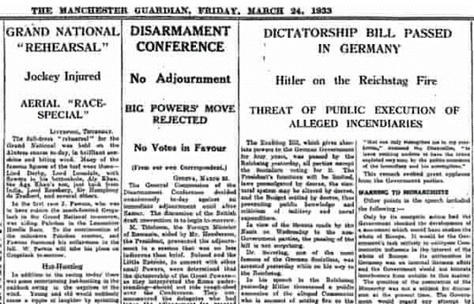
INTRODUCTION TO EUROPEAN DATA PROTECTION LAW

Slide 8

INTRODUCTION TO EUROPEAN DATA PROTECTION LAW
War correspondent Martha Gellhorn reporting on the Nuremberg trials, tasked with trying 24 of the most important political and military leaders of the Third Reich which was held in the aftermath of World War II in 1946, said:
“…What these men were able to do, no famine, no plague, no acts of God ever did: they produced destruction as the world has never seen destruction.”

Slide 9
INTRODUCTION TO EUROPEAN DATA PROTECTION LAW
UN Declaration on Human Rights 1948;
European Convention for the Protection of Human Rights and Fundamental Freedoms 1950- ratified by Ireland in 1953;

Slide 10
INTRODUCTION TO EUROPEAN DATA PROTECTION LAW
1995-European Data Protection Directive (Directive 95/46/EC);
2016- General Data Protection Regulation Regulation(EU)2016/679.

Slide 11
INTRODUCTION TO EUROPEAN DATA PROTECTION LAW
GDPR aims to preserve the fundamental rights and freedoms of individuals in compliance with the Charter of Fundamental Rights of the European Union(2007/C/303/01);
In particular Article 8(1) - Protection of Personal Data : “Everyone has a right to the protection of personal data concerning him or her.”
Other rights and freedoms mentioned are the respect for private and family life, home and communication etc.

Slide 12
INTRODUCTION TO EUROPEAN DATA PROTECTION LAW
The objectives of the General Data Protection Regulation (GDPR) are twofold:
  To facilitate the free movement of personal data, including cross-border exchange;
  2. To protect the fundamental rights and freedoms of natural persons with regard to privacy and protection of personal data.

Slide 13
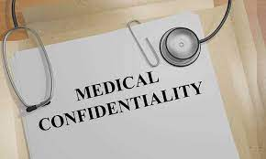
GDPR DOES NOT EXIST IN A VACUUM…

Slide 14
GDPR DOES NOT EXIST IN A VACUUM
Different laws protect different aspects of privacy;
Privacy is the individuals right to self-determination- to their home, body and information;
GDPR exists within a complex landscape of law and privacy;
GDPR acts as a set of rules for handling data that serve to protect privacy;

Slide 15
Legal Landscape… overview
The Constitution-Article 40 - “personal rights”;
UN Universal Declaration of Human Rights (Article 12);
The European Convention for the Protection of Human Rights and Fundamental Freedoms Union (Article 8);
Charter of Fundamental Rights of the European Union(Article 7 & 8);
Common law;
Professional regulation;
GDPR;
Data Protection Act 2018.

Slide 16
Right to privacy is not absolute and may be tempered by the rights of others, public order and the common good;
Must be legitimate, proportionate and fair & balanced.

Slide 17

GDPR & HEALTH SECTOR- CONCERNS AND RECOMMENDTIONS

Slide 18
DPC HOSPITALS SECTOR INVESTIGATION
“Data Protection Investigation in the Hospitals Sector”;
20 hospitals;
DPC’s Special Investigation Unit between January and December 2017;
First large-scale investigation of this kind ever undertaken in Ireland.

Slide 19
DATA PROTECTION CONCERNS
The 14 areas of concern were:
controls in medical records libraries;
security;
storage of patient observation charts in hospital ward settings;
storage of patient charts in trolley bins in ward settings;
storage of confidential waste paper within the hospital setting;
disposal of handover lists and patient lists;

Slide 20
DATA PROTECTION CONCERNS
use of fax machines;
lack of speech privacy;
absence of audit trails;
raising awareness of data protection in hospitals;
consent for research;
the processing of private health insurance information in hospitals;
maternity service users &
data retention.

Slide 21
RECOMMENDATIONS
Over 70 recommendations:
-restriction of staff access to medical records libraries as well as general swipe card access throughout the campus to ensure no unauthorised access;
-implementing automatic locking and logging off of computers in periods of inactivity;
-maintaining of more secure environments with respect to the filing of personal data and storage of charts;
-changing the standard practice of hanging patient observation charts on the end of the patient’s bed without any security, and covering of charts in transport (such as on hospital trolleys) to prevent third party access;

Slide 22
RECOMMENDATIONS
-the implementation of protocols (and training of staff) to handle a personal data breach to ensure compliance with the GDPR in this respect;
-the replacement of unsecure bins, bags and trays with secure, confidential waste bins;
-providing patients with the opportunity to move to a private space to discuss their health;

Slide 23
RECOMMENDATIONS
-making comprehensive information available to patients about the processing of their personal data;
-staff training and refresher programmes to inform and remind staff of their obligations with respect to the data protection rights of patients, particularly for reception staff;
-the implementation of procedures to safely destroy patient information once the applicable data retention period has been reached.

Slide 24
RESEARCH
Report focused particularly on chart reviews as part of medical studies;
Inspectors noted consent not sought;
Risk identified: patient information being used beyond the purpose of care and treatment;
Recommended : consent sought; information kept within hospital at all times

Slide 25
AUDIT
Lack of audit trail- who has accessed a computer system and what have they done during that time?
Consent for Audit – recommended.

Slide 26

DEFINING HEALTH DATA - USES IN HEALTHCARE- PRIMARY AND SECONDARY USES

Slide 27
USES IN HEALTHCARE
Three broad functions can be distinguished involving processing of health data:
Function 1: Data processing for the purposes of provision of health and social care by health and care providers to the patient concerned;
This includes both in-person care and telecare using eHealth or mHealth tools.

Slide 28
USES IN HEALTHCARE
Function 2: Data processing for wider public health purposes including planning, management, administration and improvement of health and care systems; prevention or control of communicable diseases; protection against serious threats to health and ensuring high standards of quality and safety of healthcare and of medical products and medical devices.

Slide 29
USES IN HEALTHCARE
Function 3: Data processing for scientific or historical research by both public and private sector organisations (third parties, not being the original data controller), including the pharmaceutical and medical technology industries and insurance providers

Slide 30
PRIMARY AND SECONDARY USE
Function 1 is considered primary use;
Functions 2& 3 are considered secondary use;
Article 5 (1)- purpose limitation- data shall not be processed further in a manner that is incompatible with the specified, explicit and legitimate purpose- must provide details of purposes when gathering .

Slide 31

      PROCESSING HEALTH DATA
      -GDPR REQUIREMENTS

Slide 32
DEFINITION OF DATA PROCESSING
GDPR sets out a definition of data processing:
“……means any operation or set of operations performed on personal data or sets of personal data, whether or not by automated means, such as collection, recording, organising, structuring, storage, adaption or alteration, retrieval, consultation, use, disclosure by transmission, dissemination or otherwise making available, alignment or combination, restriction, erasure or destruction.”
Article 4

Slide 33
It also defines personal data as any information relating to an identified or identifiable natural person known as the data subject;
Anonymous data falls outside of the scope of the Regulation;
GDPR does not apply to the deceased.

Slide 34
THE SEVEN PRINCIPLES OF LAWFUL DATA PROCESSING
LAWFUL, FAIR AND TRANSPARENT
FOR SPECIFIED PURPOSE
RELEVANT AND LIMITED
ACCURATE
STORED FOR ONLY AS LONG AS IS NECESSARY
PROCESSED SECURELY
ACCOUNTABILITY

Slide 35
WHEN PROCESSING THE DATA CONTROLLER MUST….
Identify the data controller/ data processor;
Identify DPO- input where necessary;
Classify the data – identifiable or anonymous, personal or sensitive;
Identify lawful basis for processing Article 6 & 9;
Be transparent;
Inform and fulfil data subject rights;
Handel access requests within timescales;
Transfers outside the EU- appropriately;
Data breach reporting and security;

Slide 36
1. IDENTIFYING DATA CONTROLLER
A data controller determines the purposes, conditions, and means of the processing of personal data.
There may be joint controllers or more than one controller.
The controller is responsible for ensuring compliance with the principles of GDPR.
In practice, to identify the data controller ask the following questions:
Who is deciding WHY(purpose) personal information is going to be processed? e.g. a study to investigate medication compliance.
Who is deciding HOW(means and conditions) the personal information is to be processed? e.g. the manner in which the research is going to be conducted. Project design.

Slide 37
IDENTIFYING DATA PROCESSOR
A data processor processes personal data on behalf of the data controller.
Examples of data processors include:
payroll companies or accountants or similar who hold and process personal information on behalf of someone else;
"cloud" providers are also generally data processors;
if you hire a 3rd party to process data for your research (e.g. a transcription service to transcribe audio tapes of interviews) - the third party will be a data processor.

Slide 38
IDENTIFYING DATA PROCESSOR
A data processor does not include the employees of a Data Controller (e.g. researchers employed on research projects in which personal data is collected, processed and stored)
If you are a researcher, you might be a data processor if you are employed on a service contract that collects, stores or processes personal data on behalf of a Data Controller.

Slide 39
IDENTIFYING DATA PROCESSOR
A data processor/controller agreement should be in place.
The agreement should set out:
  The terms of the agreement;
  Regulatory compliance;
  Obligations of the data controller/processor;
  Right of audit;
  Data subject rights;
  Liability and indemnity;
  Law applicable to the agreement;
  Resolution dispute with Data subject or DPC;
  Termination and variation of the agreement.

Slide 40
CASE STUDY 1-DATA CONTROLLER OR PROCESSOR?
A hospital is gathering patient data in the form of medical charts as part of direct care.
The treating consultant would like to use the data previously collected as part of the medical record to do research on ED admissions in conjunction with another academic partner.
Who is the controller/processor?

Slide 41
2. DATA PROTECTION OFFICER
The controller & processor shall ensure the DPO is involved properly and in a timely manner, in all issues relating to data protection;
The DPO shall inform and advise the controller or processor of their legal obligations;
The DPO shall monitor compliance;
The DPO shall provide training and policies;
The DPO shall provide advice regarding Data Protection Impact Assessments. – SECTION 4 GDPR

Slide 42
3.TYPE OF DATA
  PERSONAL DATA- is any information that relates to an identified or identifiable living individual.
  Examples of personal data – NOT LIMTED TO THIS LIST:
  - a name and surname;
  a home address;
  an email address;
  an identification number;
  a location number;
  IP address;
  data held by a hospital or doctor, which could be a symbol that could uniquely identify someone

Slide 43
  SENSITIVE PERSONAL DATA– data revealing:
  racial or ethnic origin;
  religious or philosophical beliefs;
  trade union membership;
  genetic data;
  health data;
  biometric data;
  data concerning sex life;
  sexual orientation.

Slide 44
4. LEGAL BASIS FOR LAWFUL DATA PROCESSING- ART 6
LEGAL GROUNDS FOR PROCESSING DATA
LEGITIMITE INTEREST
CONTRACT
LEGAL OBLIGATION
PROTECTING VITAL INTERESTS
PUBLIC INTEREST
CONSENT

Slide 45
LEGAL BASIS FOR PROCESSING SENSITIVE DATA-ART 9
RESEARCH
PUBLIC HEALTH
PROTECT VITAL INTEREST
HEALTHCARE
PUBLIC INTEREST
EXPLICIT CONSENT

Slide 46
ARTICLE 9- 10 LEGAL BASIS FOR LAWFUL PROCESSING SENSITIVE DATA
EXPLICIT CONSENT-ART 9(2)(a);
EMPLOYMENT , SOCIAL SECURITY,SOCIAL PROTECTION-ART 9(2)(b);
PROTECT VITAL INTEREST –ART 9(2)(c);
LEGITIMATE ACITVITY- NOT-FOR PROFIT,FUNDATION, ASSOCIATION -ART 9(2)(d);
DATA MADE PUBLIC BY THE DATA SUBJECT-ART 9(2)(e);
LEGAL DEFENCE OR CLAIM –ART 9(2)(f);
SUBSTANTIAL PUBLIC INTEREST-ART(9)(2)(g);
HEALTHCARE- ART(9)(2)(h);
CROSS BOARDER THREAT, SAFETY OF MEDICINAL PRODUCTS OR DEVICES-ART 9(2)(i);
RESEARCH- ART 9(2)(j)

Slide 47
Article 9-Lawful Basis
Most health research will require the processing of sensitive personal data i.e. health data. both article 6& 9 basis needed.
The most relevant legal basis for research is Article 9(2)(j).
Processing is necessary for scientific research purposes.
If using -must have -safeguards to ensure data minimisation (pseudonymisation).

Slide 48
EXPLICIT CONSENT ALSO REQUIRED – HEALTH RESEARCH REGULATIONS

Slide 49
5. BE TRANSPARENT
GDPR is all about being open with data subjects and informing them of how their data is to be used.
The controller inform/provide notice data subjects of what is being done with their data.
PIL(research) or privacy notice.
You must use clear, understandable language :concise, easily accessible, easy to understand, intelligible, age appropriate, clear and plain.

Slide 50
  the controller’s identity and contact information;
  contact details of the data protection officer;
  your legal basis for processing;
  if processing under legitimate interest –state what that is;
  the intended purposes of the processing activities;
  where applicable, that the data will be transferred to another entity or to a third country;

Slide 51
  information about any profiling (automated processing to evaluate aspects of that person such as work performance, behaviour, preferences) individuals will be subject to;
  inform data subjects of the nature of the processing activities and the rights available to them;
  recipients or categories of recipients of the data;
  how long will data be stored for?

Slide 52
Further processing/ secondary processing requires an updated notice or information if processing data for a different purpose.
A researcher may be exempt from the notice requirement if they received the personal data from someone other than the data subject (e.g. BioBank).

Slide 53
A researcher may be exempt - notice “likely to render impossible or seriously impair the achievement of the research objectives”.
Provided there are appropriate safeguards in place-minimisation of data such as pseudonymisation.

Slide 54
6. RIGHTS OF INDIVIDUALS
ACCESS
RECTIFICATION
ERASURE
RESTRICT PROCESSING
DATA PORTABILITY
OBJECT TO PROCESSING
LODGE A COMPLAINT

Slide 55
CASE STUDY 2
A young man is admitted to the emergency department with breathing difficulties. He is subsequently diagnosed with COVID-19. He makes a full recovery but now wants his medical record relating to the admission and diagnosis of COVID-19 deleted under GDPR. How should you proceed?

Slide 56
7. HANDLE ACCESS REQUESTS
The time period for dealing with requests is one month.
No fee.
The controller may charge a reasonable fee for further copies requested, or where access requests are manifestly unfounded or excessive.;
In very limited circumstances can limit data that could adversely affect others.

Slide 57
8.TRANSFER PERSONAL DATA OUTSIDE EU
The GDPR allows transfer to non EU countries with “adequate level of protection” as determined by the European Commission.
Specific safeguards, including standard contractual clauses, or if the data subject has provided explicit consent.

Slide 58
9. DATA BREACH REPORTING & SECURITY
Mandatory obligation to report data breaches to the Office of the Data Protection Commissioner.
Within 72 hours where there is a risk to the rights of data subjects.
Controllers have to notify data subjects where the breach is likely to result in a ‘high risk’ to them.

Slide 59
CASE STUDY 3
A GP is referring a patient to hospital for further investigations. What steps should be taken to ensure compliance with GDPR? Are there any other considerations? Can a patient object?

Slide 60
CASE STUDY 4
Gardai are conducting a murder investigation. They have contacted your practice and under Section 41b of the Data Protection Act 2018 are requesting the name and contact details of anyone in your practice linked to the murder suspect.

Slide 61
FINES
Non-compliance subject to fines of up to €20 million or 4% of the total worldwide annual turnover of the preceding financial year.
Fines can be imposed in addition to, or instead of, any corrective measures -such as warnings or reprimands.

Slide 62
FINES
There is a two-tier system of fines. Up to €10 million or 2% worldwide annual turnover for infringement of e.g.:
Conditions of obtaining child’s consent;
Data protection by design and default;
Joint controller arrangements;
Obligations of processors;
Security measures;
Notifications;
Conducting DPIA.

Slide 63
FINES
Fines up to €20 million or 4% total worldwide annual turnover for infringement of e.g.:
Core data protection principles;
Conditions for consent;
Sensitive personal data processing;
Data subject rights;
Transfers outside EU;
Obligations under Member State law – Health Research Regulations.
Data Protection Act 2018 section 141 (4): Public body fines have been limited to €1million

Slide 64
FINES
Since the commencement of GDPR significant regulatory fines across the EU;
In January 2019 Google France were fined €50 million because consent did not meet GDPR standard consent – “specific” and “unambiguous”;
They also failed to provide users with transparent and usable information.

Slide 65
UL- DATA BREACH
University of Limerick (UL) fined €98,000 by the Data Protection Commission (DPC) following an investigation into a series of personal data breaches.
UL notified the DPC of 12 breaches that occurred between November 2018 and January 2020.
In six of the cases, phishing attacks gained access to the employee email accounts of UL staff members.

Slide 66
UL- DATA BREACH
The compromised email accounts contained personal data including identity information, contact details, PPS numbers, bank information, medical or legal documentation, staff disciplinary and HR records, and data belonging to students, staff, and external parties;
The DPC found that UL did not implement appropriate technical and organisational measures to ensure the security of personal data as required by the General Data Protection Regulation (GDPR);
The DPC also found that the university failed in three cases to inform the people affected by a high-risk breach without undue delay.

Slide 67
HSE- RECORD STORAGE
The DPC fined the HSE a total of €645,000, and imposed a reprimand and a number of corrective orders following an inquiry into the HSE’s processing of personal data contained in paper records, stored and retained in the HSE’s external storage facilities;
Breach notified to the DPC in October 2023, when individuals gained unauthorised access to paper records stored and retained in St. Loman’s Hospital, Mullingar, County Westmeath;
In November 2023, a further breach notification was filed by the HSE with the DPC, when individuals gained unauthorised access to paper records stored and retained in the New Building in St. Conal’s Hospital, Letterkenny, County Donegal.

Slide 68
HSE- RECORD STORAGE
DPC carried out 12 site inspections nationwide;
The DPC’s decision, found that the HSE:
1. Infringed the principle of integrity and confidentiality of Article 5(1)(f) GDPR and infringed Article 32(1) GDPR by:
a. Failing to ensure appropriate security of the personal data contained in paper records stored and retained by the HSE in its external facilities;
b. Failing to implement appropriate technical and organisational measures, including proper records management processes, mechanisms and controls, to ensure a level of security appropriate to the risk.
2. Infringed the principle of storage limitation of Article 5(1)(e) GDPR by failing to retain personal data contained in paper records in a form which permits identification of data subjects for no longer than is necessary.

Slide 69
HSE- RECORD STORAGE
3. Infringed Article 33(1) GDPR by:
a. Failing to notify a breach to the DPC without undue delay, and within 72 hours of becoming aware of it, in respect of St. Loman’s Hospital;
b. Failing to notify a breach to the DPC without undue delay, and within 72 hours of becoming aware of it, in respect of the personal data contained in paper records stored and retained in the basement of St. Loman’s Hospital.
4. Infringed Article 34(1) GDPR by failing to communicate to the data subjects, the personal data breaches which occurred at St. Loman’s Hospital and St. Conal’s Hospital.

Slide 70
Portuguese Hospital- Centro Hospitalar Barrerio
Portuguese Hospital- Centro Hospitalar Barrerio- fined €400,000 under GDPR- November 2018
Non-clinical staff using “medical” profiles to access computer system.
985 users registered as physicians but there were only 296 physicians working there.
9 users were given unrestricted access to confidential patient information.

Slide 71
DUTCH –HAGA HOSPITAL
Today, the Dutch Data Protection Authority issued its first GDPR-fine of €460,000-insufficient internal security of patient records;
The Dutch DPA initiated an investigation after it appeared that a large amount of hospital staff had accessed the medical records of a Dutch celebrity (197 employees!)
The Dutch DPA concluded that the Haga Hospital had taken insufficient security measures with respect to authentication and the control of logging, which constitutes a breach of Article 32 of the GDPR.

Slide 72
RIGHT TO COMPENSATION –CIVIL ACTION
Data subjects can sue both controllers and processors for compensation for damage as a result of a breach of GDPR;
It introduces joint and several liability between parties engaged in the same data processing;
Material and non-material damages;
Class actions.

Slide 73
RIGHT TO COMPENSATION –CIVIL ACTION
Various Claimants v Wm Morrisons Supermarket PLC . The case involved a data breach of the nearly 100,000 employees of Morrisons whereby personal information from a payroll database appeared on a file sharing website in early 2014;

Slide 74
RIGHT TO COMPENSATION –CIVIL ACTION
Wrongful acts were found to be sufficiently connected to his employment resulting in Morrisons being vicariously liable for those acts;
His motives were irrelevant to the vicarious liablity. 5,518 employees brought group litigation against Morrisons claiming that Morrisons.

Slide 75
OFFENCES
Knowingly or recklessly disclosing personal data without prior authority of controller/processor;
Obtaining and disclosing personal data without prior authority of controller/processor;
Selling personal data obtained and disclosed without prior authority controller/processor.

Slide 76
OFFENCES
Under the previous Data Protection Acts 1988-2003–M.C.K. Rentals Limited 2014 two directors were convicted following prosecution for offences for which the company had been convicted. MCK found to have unlawfully obtained access to personal information and disclosing it in contravention of the Data Protection Acts -€1,500 fine each.

Slide 77

CONDUCTING RESEARCH-HEALTH RESEARCH REGULATIONS -REQUIREMENTS

Slide 78
Specification clauses permitted Member States scope when applying of certain aspects of GDPR;
Further mandatory obligations for research in Ireland.
S.I. No. 314 of 2018 -Data Protection Act 2018 (Section 36(2)) (Health Research) Regulations 2018.
Came into effect August 8th, 2018.

Slide 79
HRR -Governance
REC approval;
Specify the controller, joint controllers, any data processors;
Specify funding or others supporting the project;
Specify any person with whom it is intended to share any of the personal data collected and the purpose of such sharing;
Provide training in data protection law and practice to those carrying out the health research;

Slide 80
HRR-Processes & Procedures
Carry out of an assessment of the data protection implications of the health research;
Where high risk to the rights and freedoms of individuals, carry out of a data protection impact assessment;

Slide 81
HRR-Processes & Procedures
Data minimisation;
Controls to limit access to the personal data to prevent unauthorised consultation, alteration, disclosure or erasure of personal data;
Controls to log whether and by whom personal data have been consulted, altered, disclosed or erased;
Protect the security of the personal data concerned;

Slide 82
HRR-Processes & Procedures
Arrangements to anonymise, archive or destroy personal data once the health research has been completed;
Other technical and organisational measures;

Slide 83
HRR-Processes & Procedures
Process in a transparent manner ;
EXPLICIT CONSENT must be obtained from the data subject, prior to the commencement of the health research.

Slide 84
HRR-Processes & Procedures
Health Research Consent Declaration Committee (HRCDC) can grant consent declarations in certain circumstances;
Must have REC approval in place before application;
“Consent declaration” only applies to data processing;
Does not provide exemption for legal and ethical requirement of informed consent for participation in research.

Slide 85
May apply to the Consent Declaration Committee if Researcher of the view:
the public interest in carrying out the research SIGNIFICANTLY outweighs the public interest in requiring the explicit consent of the data subject.
statement setting out the reasons why it is not proposed to seek the consent of the data subject for the purposes of the health research.

Slide 86
Data Protection Act 2018 (Section 36(2))
(Health Research) (Amendment)
Regulations 2021 (the “2021 Regulations”)

Slide 87
21st January 2021, the Minister for Health adopted regulations which amend the data protection framework established by the Data Protection Act 2018 (Section 36(2)) (Health Research) Regulations 2018 (the “Health Research Regulations”) in relation to processing of personal data for health research purposes.

Slide 88
AREAS OF AMENDMENT
EXPLICIT CONSENT;
DEFERRED CONSENT;
CONSENT- PURSUANT TO DATA PROTECTION DIRECTIVE;
PRE-SCREENING;
RETROSPECTIVE CHART REVIEW;
HRCDC APPEALS.

Slide 89
KEY AMENDMENTS
“EXPLICT CONSENT” –within the meaning of GDPR remains the default rule;
New requirement to give participants a copy of the “explicit consent”-expanded consent requirements in line with international standards of informed consent and transparency;
The amendment introduces exemptions to the “explicit consent” rule so long as conditions are met;

Slide 90
Retrospective chart review conditions- REC approval- low risk- carried out by certain groups- HCP-students-other employees- transparency – prescriptive posters & notifications;
Pre-screening conditions- no REC approval required- limited to certain groups- HCPs- students-employees- “authorised persons”- contracts in place and additional transparency measures in place if “authorised persons” pre-screen ;

Slide 91
Deferred consent conditions- lacking physical or mental capacity-“life or death” situations- consent is deferred- data must be erased if patient objects once notified- limited in application;
Consent obtained under the 95 Directive conditions- consent hasn’t been withdrawn- have lawful basis under Articles 6&9 for processing;
Remember all other aspects of HRRs and GDPR still apply.

Slide 92
CASE STUDY 5
A researcher wishes to conduct a retrospective chart review of identifiable patient data. What are the issues?

Slide 93
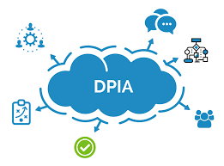
DPIA

Slide 94
GDPR- DPIA
Article 35 of the GDPR introduces the concept of a Data Protection Impact Assessment (DPIA);
Its meaning and role is set out in Recital 84 as follows:
“In order to enhance compliance with this Regulation where processing operations are likely to result in a high risk to the rights and freedoms of natural persons, the controller should be responsible for the carrying-out of a data protection impact assessment to evaluate, in particular, the origin, nature, particularity and severity of that risk”.

Slide 95
GDPR – MINIMAL CONTENT- DPIA
Minimal content is specified by Article 35(7):
(a) a systematic description of the envisaged processing operations and the purposes of the processing, including, where applicable, the legitimate interest pursued by the controller;
(b) an assessment of the necessity and proportionality of the processing operations in relation to the purposes;
(c) an assessment of the risks to the rights and freedoms of data subjects referred to in paragraph 1; and
(d) the measures envisaged to address the risks, including safeguards, security measures and mechanisms to ensure the protection of personal data and to demonstrate compliance with this Regulation taking into account the rights and legitimate interests of data subjects and other persons concerned”

Slide 96
DATA PROTECTION ACT 2018
(2) A data protection impact assessment carried out in accordance with subsection (1) shall include:
(a) a general description of the proposed processing operations to which it relates,
(b) an assessment of the potential risks to the rights and freedoms of data subjects as a result of the proposed processing, and
(c) a description of any safeguards, security measures or mechanisms proposed to be implemented by the controller to mitigate any risk referred to in paragraph (b) and to ensure the protection of the personal data in compliance with this Part.

Slide 97
WHAT IS “HIGH RISK”
WP 248 guidelines on “high risk” A DPIA is required if at least two of these 10 criteria are reached. Meeting one may also be sufficient for a DPIA:
Evaluation or scoring- especially to do with someone's work performance or health e.g. a biotechnology firm offering genetic testing to customers in order to predict disease/health risks;
Automated-decision making with legal or similar effect - the processing may lead to discrimination or exclusion;
Systematic monitoring - e.g. cctv in a public space;
Sensitive Data- e.g. health data, genetic data and all article 9 special categories of data;
Data Processing on a large scale;

Slide 98
Datasets that have been matched or combined;
Data concerning vulnerable data subjects -power imbalance between data controller and data subject e.g. patients, children, the elderly, employees, persons with disabilities;
Innovative use or applying technological or organisational solutions - e.g. fingerprint or facial recognition;
Data transfer outside the EU;
Where the processing itself prevents a data subject from accessing a service- e.g. credit screening by banks to decide whether to give someone a loan.
In terms of health research, criteria 4 & 7 nearly always apply, and sometimes 1,5 &9 also.

Slide 99
WHY DO A DPIA?
It is a legal requirement- GDPR, Data Protection Act 2018;
It is good practice & demonstrates high level compliance with GDPR;
It protects the data subject;
In some cases it is a local policy requirement;

Slide 100
EDPB- DPIA template
Recent consultation;
DPIA template;
Possible single template across EU;
https://www.edpb.europa.eu/public-consultations/template-for-data-protection-impact-assessment_en

Slide 101

SECURITY

Slide 102
a)Appropriate encryption is used - particularly for laptops, tablets, portable storage devices and cloud storage folders;
b)Appropriate security is used on smartphones, for example, finger print recognition;
c)Special categories of data is sent by encrypted email only;

Slide 103
d) Password-protect access to devices employing the use of strong passwords and password managers;
e)Work related devices are separated from those used for personal use; i.e. tablets, computers and other such devices;
f)Work related devices are not used by any family members or other third party;

Slide 104
g)Data is appropriately backed-up and any devices used for back-ups are appropriately secure;
h)No personal data is contained on old devices when they are being retired;
i)Documents are not saved or left open on open-access computers;
j)Electronic files are destroyed in accordance with a data retention and destruction policy;

Slide 105
k)All support staff receives appropriate training in relation to data protection and-communications policies are put in place for staff;
l)Up-to-date anti-virus software and firewalls are used and operating system updates are applied;
m)When making back-ups of data, using facilities which would not be at risk in the event of a ransomware attack

Slide 106

ANONYMISATION

Slide 107
Anonymised datasets can present a residual risk to the data subject;
Identifiability is a continuum;
Should be reviewed regularly;
Robust anonymisation techniques should protect against : singling out, linkability & inference

Slide 108
SRB- JUDGMENT
In 2025 CJEU confirmed the existence of the concept of relative personal data — meaning, in practice, that the same data may constitute personal data in the hands of one party, but not in the hands of another;
Court clarified that pseudonymised data does not automatically constitute personal data to the recipient. The key factor is whether the recipient has “means reasonably likely” to identify the data subject. If such means are unavailable or impractical, the data may not be considered personal from the recipient’s perspective.
Requirement for transparency & contractual clauses to prevent reidentification.

Slide 109
TRANSFERS OUTSIDE THE EU

Slide 110
ADEQUACY DECISION-Article 45
Transfer under Article 45.1 GDPR
Countries deemed by the EU to provide adequate level of data protection;
E.g. Andorra, Argentina, Canada(commercial organisations), Faroe Islands, Guernsey, Israel, Isle of Man, Japan(under review), Jersey,New Zealand, Korea, Switzerland, UK(sunset clause), Uruguay, US.

Slide 111
Article 46 & 49
Article 46 transfers subject to appropriate safeguards- SCC
Article 49 derogations- consent, contract, public interest( COVID), compelling legitimate interests for one-off transfers.

Slide 112
EU-US
EC adopted a new adequacy decision for safe and trusted EU-US data flows.
The new EU-US DPF/Adequacy Decision means that transfers of personal data to US companies registered on a Data Privacy Framework List can take place without any further measures in place-SCC's & TIAs.
No change for all other transfers to companies not on the DPF list -SCC's & TIA's will still apply
Adequacy decision is likely to be challenged by Max Schrems but stands for the moment.

Slide 113
TRANSFER IMPACT ASSESSMENT
Know your transfer- map transfers;
Verify the transfer tool-e.g Article 46, 49 transfer tool;
Assess any law in the 3rd country that might impinge on your safeguards;
Identify and adopt supplementary measures that are necessary to bring the level of protection of the data transferred up to the EU standard of essential equivalence. Only necessary if your assessment reveals that the third country legislation and/or practices impinge on the effectiveness of the Article 46 GDPR transfer tool;
Take any formal procedural steps the adoption of your supplementary measure may require, depending on the Article 46 GDPR transfer tool you are relying on;
Re-evaluate at appropriate intervals the level of protection afforded to the personal data you transfer to third countries.

Slide 114
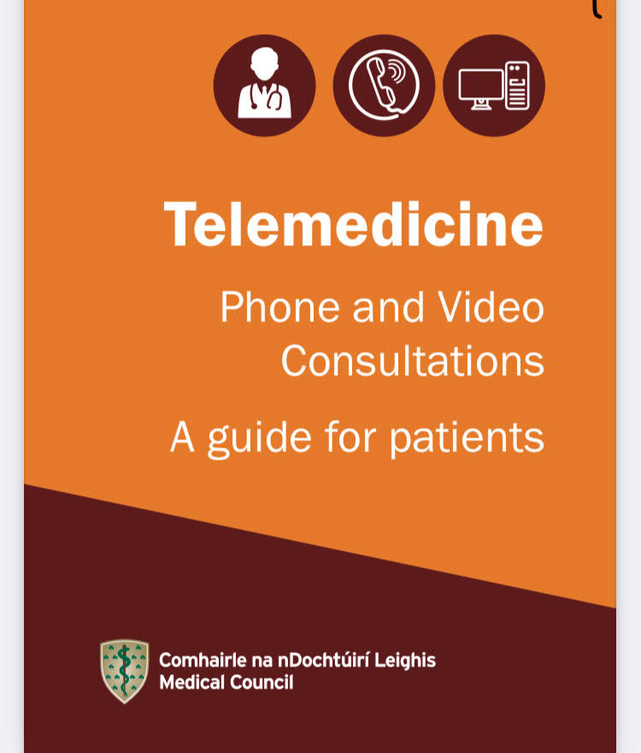
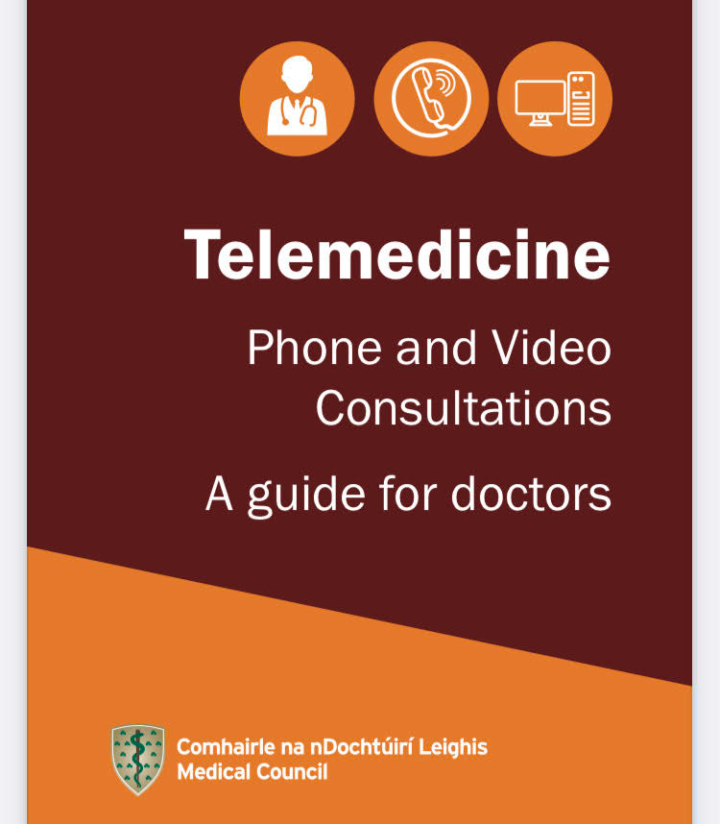
MODERN CARE PATHWAYS

Slide 115
TELEMEDICINE
Telemedicine has played a central role in caring for patients during the COVID-19 emergency- in many ways it has accelerated out of necessity rather than patient preference or demand;
5 fold increase in the population engaging with telemedicine services- 4% in March 2020 to 21% in March 2021;

Slide 116
DATA PROTECTION
GDPR- obligations and rights-update privacy notices to include telemedicine;
Antivirus, firewall, secure portals;
Inform patient of privacy risks- ensure safe mechanisms for communication for both the healthcare provider and the patient.

Slide 117
Images should be sent to work devices only;
Images, recordings etc. all form part of the medical record;
Consent to the telemedicine consultation in advance- advise of risks;
Increase in use of remote monitoring wearable device, apps etc. ensure security and GDPR compliance.

Slide 118
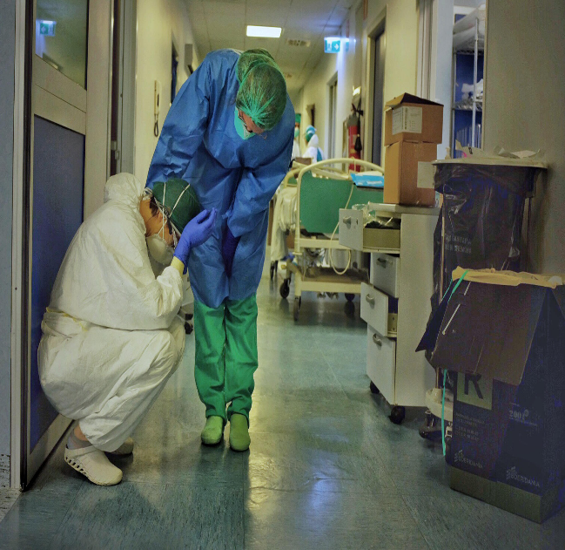
CHECKLIST
Telemedicine code of conduct recommended;
Maintain standard of care;
Data protection issues- make sure platform is secure & GDPR compliant
Ensure recordings, images are kept as part of the medical record ;
Ensure privacy notice is updated to include rights & obligations regarding telemedicine;
Make sure you obtain & record consent;
Confidentiality:
Discuss risks and document;
Non-documentation can lead to a risk that the consent or discussion did not happen;
If in doubt conduct a face to face –safety-net the consultation.

Slide 119
TELEMEDICINE – DESIGN GUIDELINES
Space requirement- adequate space for diagnosis and treatment;
Privacy- ensure confidentiality- visual and acoustic;
Acoustics- sound isolation –essential to protect patient information;
Lighting –enhances communication;
Camera angle & distance- natural eye-contact to put patient at ease;
Site identification- facility identification;
Equipment support- technical support, power and wifi.

Slide 120

ARTIFICIAL INTELLEGENCE

Slide 121
AI IN HEALTHCARE
A key challenge in medicine will be ensuring that AI is developed and used in a way that is transparent and compatible with the public interest, while stimulating and driving innovation in the sector;
AI in medicine raises the issues of patient autonomy and privacy;

Slide 122
NUFFIELD COUNCIL ON BIOETHICS
The potential for AI to make erroneous decisions;
The question of who is responsible when AI is used to support decision-making;
Difficulties in validating the outputs of AI systems;
Inherent biases in the data used to train AI systems;
Ensuring the protection of potentially sensitive data;
Securing public trust in the development and use of AI technologies;
Effects on people’s sense of dignity and social isolation in care situations;
Effects on the roles and skill-requirements of healthcare professionals;
The potential for AI to be used for malicious purposes.

Slide 123
WORLD HEALTH ORGANISATION
WHO guidance on the ethics and governance of AI for health;
6 core principles:
  1)protect autonomy;
  2)promote human well-being, safety and the public interest;
  3)ensure transparency, explainability and intelligibility;
  4)foster responsibility and accountability;
  5)ensure inclusiveness and equity;
  6)promote AI that is responsive and sustainable

Slide 124
Artificial Intelligence in Healthcare – Opportunities & Risks
The Minister for Health announced the launch of the AI for Care 2026 – 2030 Strategy which positions AI as a key enabler of change;
AI will enhance clinical care through:
  Faster, more personalised treatment
  Earlier disease detection
  Improved risk prediction, and
  More effective use of resources

Slide 125
The 6 guiding principles of Ireland’s AI for Care strategy are:
Person-centred - prioritising public needs
Transparent/trustworthy - clear communication
Human in the loop - AI supports people
Lived experience - continuous learning
Governance/safety- ethical standards, and
Proven benefit - measurable value like personalised care

Slide 126
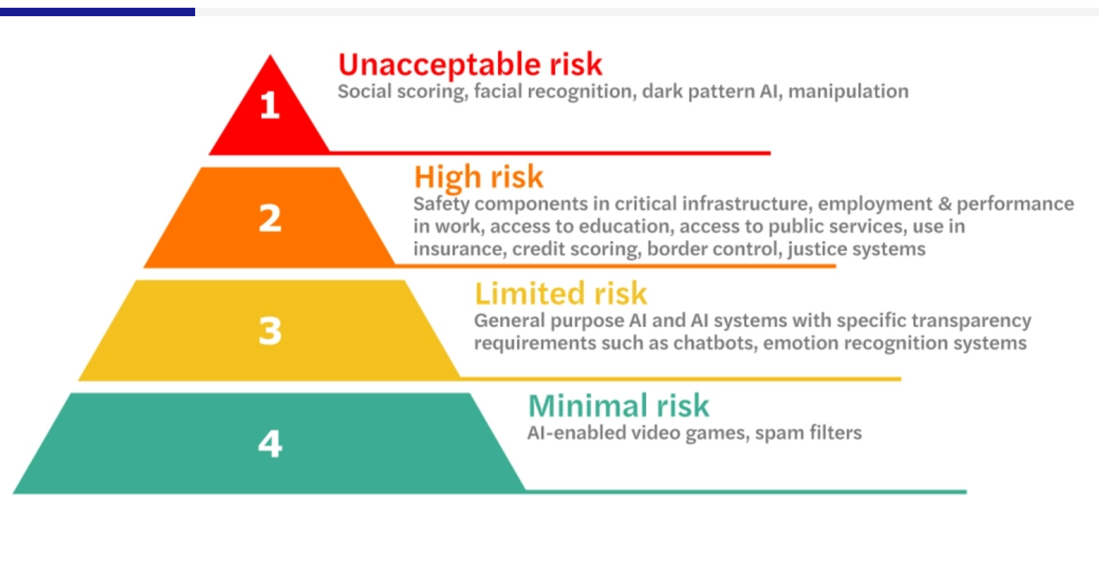
EU AI ACT

Slide 127
RISK CATEGORIES
Unacceptable Risk – Prohibited (e.g. social scoring, manipulative AI).
High Risk – Extensive obligations apply- will apply to most healthcare systems.
Limited Risk – Transparency obligations only.
Minimal Risk – No specific obligations.

Slide 128
HIGH RISK
The party (whether a provider or deployer) must comply with extensive obligations.
Provider Obligations (i.e. developer or commercialiser):
Conformity Assessment: Must conduct a conformity assessment before placing the AI system on the market
Technical Documentation: Must prepare and maintain documentation demonstrating compliance
EU Declaration of Conformity: Must issue a formal declaration that the system meets the AI Act requirements
Quality Management System: Must implement a documented system covering design, testing, compliance, and post-market monitoring
Logging: Must retain system logs for at least 6 months
Transparency & Instructions: Must provide clear instructions for use and enable human oversight

Slide 129
HIGH RISK
Deployer Obligations (i.e. user of the AI system in a professional context):
Use According to Instructions: Must follow the provider’s instructions and monitor system performance
Incident Reporting: Must report serious incidents to providers and authorities within 15 days
Human Oversight: Must assign competent individuals to oversee the system
Transparency to Individuals: Must inform affected individuals if the system is used in decisions impacting them (e.g. hiring, credit scoring)
Fundamental Rights Impact Assessment: Required for certain use cases like credit scoring or insurance
Data Quality: If controlling input data, must ensure it is relevant and representative

Slide 130
KEY POINTS
Global Reach: Even non-EU entities must comply if their AI system is used or its output affects individuals in the EU
Sector-Specific Rules: Additional or modified obligations may apply depending on the sector (e.g. healthcare, finance, transport)
Transition Periods: Some obligations phase in between 2025 and 2027 depending on the system type

Slide 131
PRIVACY AND GDPR
Article 22- Individuals have a right not to be subject to a decision based solely on automated processing which produces legal effect concerning him or her or similarly affects him or her unless;
a) it is necessary for entering into, or performance of, a contract between the data subject and a data controller;
b) is authorised by Union or Member State law;
c)is based on explicit consent.

Slide 132
PRIVACY AND GDPR
Individuals have the right to obtain human intervention;
They have a right to object to the use of AI;
Have a right to contest the decision and express their point of view;
Decisions that process special categories of data (health data) can only be processed with consent or for reasons of substantial public interest;
High level transparency is required.

Slide 133
AI – MEDICAL DEVICE?
When does AI become a medical device regulated by the Medical Devices Regulation (EU) 2017/745) (MDR) ?;
A software medical device, is generally intended to be used for the purpose of diagnosis, prevention, monitoring, treatment or alleviation of disease;
The AI software functionality is central to determining whether the it falls within the definition of medical device;
Also if the AI software makes health benefit claims it falls under the regulation.
In reality making this determination is very difficult.

Slide 134
CHECKLIST FOR THE SAFE USE OF AI
Implement an institutional AI Policy;
Training on legal and ethical constraints;
Maintain an inventory of authorised AI tools- be aware of terms of use, licensing conditions, review regularly for compliance with institutional standards and EU law;
Define minimum human intervention- what is considered meaningful input at institutional level;
Implement tools for traceability and record keeping-annotate AI generated content;
Include all use of AI in data management plans- usage, data provenance, model origin, output records;
Adapt collaborative frameworks to reflect the use of AI – ownership of AI assisted outputs, disclosure of AI contributions

Slide 135

NATIONAL GUIDELINES

Slide 136
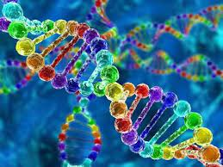
GENETIC AND GENOMIC MEDICINE

Slide 137
GENOMIC AND GENETIC MEDICINE
The unique scope and potential impact on patients of genomic/genetic medicine, raises serious questions for organisations engaged in genomic/genetic medicine in meeting the appropriate level of safeguards, transparency and rights for participants;
No other form of medical treatment aims at the systematic analysis of genome function, expression and genome-environment interaction;
No other form of medicine promises to provide the stratification of populations needed for the development of precision medicine systems;
And no other form of healthcare supports the development of genetically targeted medical interventions.

Slide 138
GENOMIC AND GENETIC MEDICINE
Concerns have also been raised around the advancements in genomic sequencing and profiling technologies and the ability of corporations to track and categorise individuals is growing, which raising the risk of commodification practices of patient health identity;
Sequencing is often done by 3rd party companies.

Slide 139
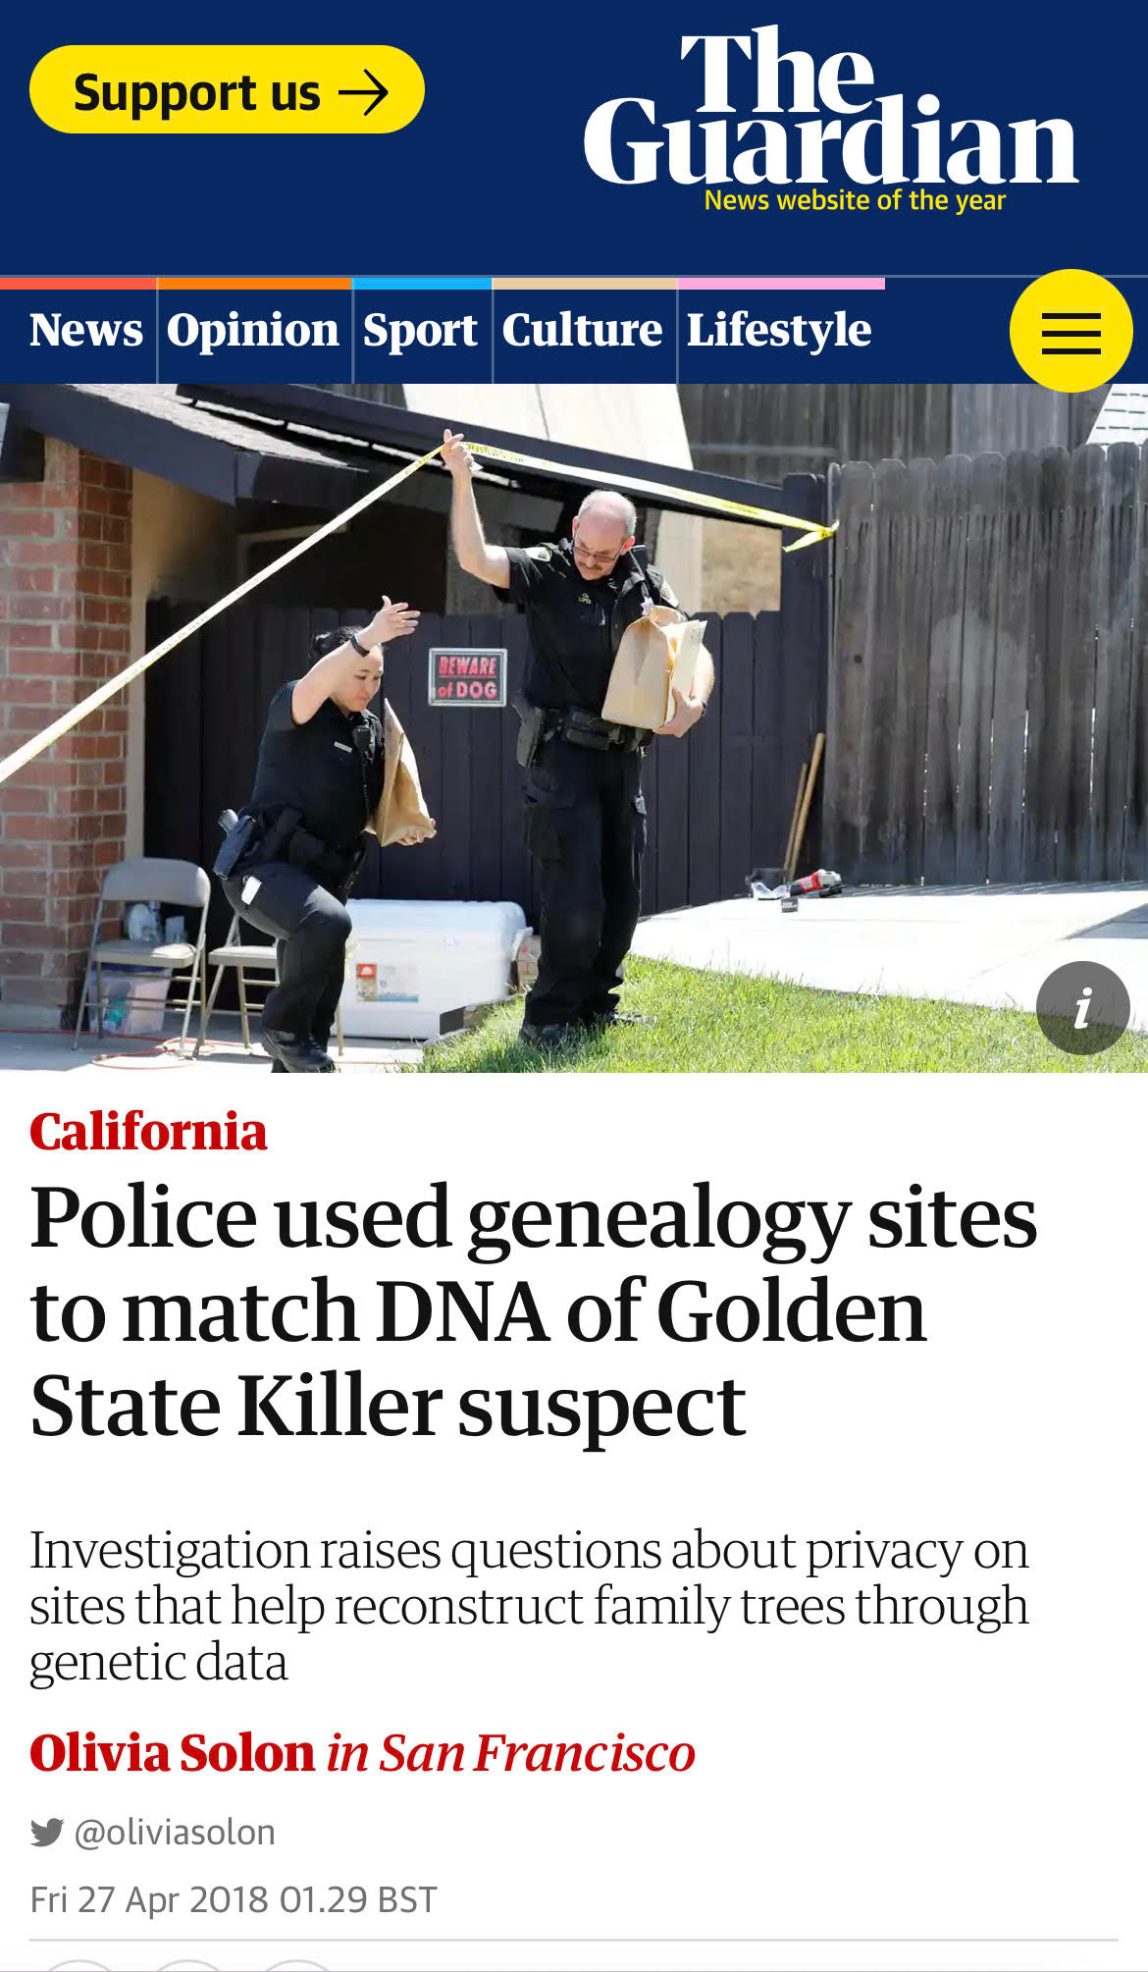
PRIVACY

Slide 140
GENETIC DISCRIMINTATION
Disability Act 2005;
Must seek consent for genetic testing;
Patients must be informed of any potential implications
Genetic information protected and may not be processed in relation to insurance, employment, pensions, mortgaging of a property;
No protection for family members.

Slide 141
EMERGING CASES

Slide 142
GENDER IDENTITY
In Case C-247/23 Deldits, the Court held that a person has the right under Article 16 GDPR to rectify an inaccurate record of their gender identity. In seeking such rectification, a person may be required to produce evidence to demonstrate that the data relating to their gender identity is inaccurate.
A medical certificate, including a psychiatric diagnosis, may be sufficient for this purpose and evidence of gender reassignment surgery cannot, under any circumstances, be required from the individual.

Slide 143
GENDER DATA
In Case C-394/23 Mousse v Commission nationale de l’informatique et des libertés (CNIL), SNCF Connect, the Court held that processing gender data of customers is not necessary in the context of purchasing a transport ticket.
A company selling train tickets claimed that it was processing personal data relating to the gender of customers for the purpose of personalising their commercial communications to those customers.
The Court held that such processing is not objectively necessary for the performance of the contract with the passenger.

Slide 144
THANK YOU!

Slide 145
References
Gellhorn M., The Face of War (1954). Atlantic Monthly Press;
"GDPR: an impediment to research?" - Irish Journal of Medical Sciences. https://link.springer.com/article/10.1007%2Fs11845-019-01980-2
“What GDPR and the Health Research Regulations (HRRs) mean for Ireland: “explicit consent”- a legal analysis. - Irish Journal of Medical Sciences.
https://link.springer.com/article/10.1007/s11845-020-02331-2
“What GDPR and the Health Research Regulations (HRRs) mean for Ireland: a research perspective- Irish Journal of Medical Sciences.
https://link.springer.com/article/10.1007/s11845-020-02330-3

Slide 146
https://www.hiqa.ie/reports-and-publications/guide/national-guidance-responsible-and-safe-use-artificial-intelligence

Slide 147
https://www.medicalcouncil.ie/public-information/telemedicine-phone-and-video-consultations-guide-for-doctors/report-of-the-telemedicine-working-group-april-2021.pdf
https://www.medicalcouncil.ie/public-information/telemedicine-phone-and-video-consultations-guide-for-patients/telemedicine-for-patients-booklet.pdf
https://www.medicalcouncil.ie/public-information/telemedicine-phone-and-video-consultations-guide-for-patients/telemedicine-for-doctors-booklet.pdf

Slide 148
This lecture or any of the information given therein is not and should not be taken to be or relied on as legal, medico -legal or medico-ethical advice.
These notes should only to be used in conjunction with this presentation.
No reproduction or distribution without prior permission.
These materials are for educational use only. While care has been taken in the preparation of these materials, no responsibility is taken by the author for any errors or omissions. Professional advice should be sought in all individual cases.
All material © Mary Kirwan BL

