Slide 1


Recurring Topics
myidea.ch 2.0
Entrepreneurial Thinking and Acting
Notes:
When developing own business ideas within the framework of myidea, certain topics, activities and corresponding tools/strategies appear repeatedly in order to support the process. Most of these were covered or developed and used in General Education classes (ABU), respectively. To ensure that all learners have the basic skills required to work with myidea, these topics, activities and corresponding tools/strategies are briefly repeated here as necessary. Basic information is also provided to indicate where and how they are relevant in myidea. To mark such recurring topics in myidea 2.0, the arrow-in-circle icon shown here is used. This enables teachers to make explicit references while recognize the icon and understand that the topic will appear again.

Slide 2

Terms of use for the myidea learning programme
We are delighted that you wish to use the myidea learning materials in your lessons. The materials are designed to teach entrepreneurial thinking and acting. Please note the following terms of use:
Open access: The documents are freely accessible and may, in principle, be used by anyone.
Who are these materials intended for? These materials have been produced for use in vocational schools. They are primarily aimed at teachers who have completed a four-day basic training course on the myidea learning programme. If you wish to use the materials without having completed this training, you are welcome to do so. In that case, we would ask you to let us know. We would also be happy to discuss this with you:
Susan Müller
Attribution: Whenever the materials are used, the «Swiss Center for Entrepreneurial Thinking and Acting scETA» must be identified as the creator of the documents. This can be done using the following wording:
«Documents created by: Swiss Center for Entrepreneurial Thinking and Acting scETA»
If you are using entire documents (e.g. PowerPoint slides or Word documents such as the mini business plan), please leave the myidea logo in the relevant places.
No commercial use: The materials must not be used for commercial purposes. They may only be used for educational purposes.
Adaptations and further developments: It is a fundamental principle that teachers using the myidea teaching materials may adapt and further develop them. However, even when making changes to the materials, please credit the Swiss Center for Entrepreneurial Thinking and Acting as the original creator. In this case, please add a note stating that changes have been made, e.g.:
«Based on material from the Swiss Center for Entrepreneurial Thinking and Acting scETA, adapted by [your name/organisation]»
Contact: If you have any questions or would like further information, please do not hesitate to contact us: Susan Müller
Thank you very much, and we wish you every success with the launch of myidea !
Swiss Center for Entrepreneurial Thinking and Acting scETA

Slide 3
Recurring Topic
Wh- & H-questions and critical thinking
Documents created by: Swiss Center for Entrepreneurial Thinking and Acting scETA
Notes:
The following six slides briefly outline the method/tool of «Wh-& H-questions». In myidea, learners are repeatedly encouraged to explore and evaluate different areas. This short learning unit helps to prepare them for this and to remind them of the importance of Wh- & H-questions. We combine this with critical thinking, i.e., asking questions and scrutinising, not accepting everything as a given, etc.
We recommend introducing or repeating the Wh- & H-questions as early as possible in the programme.

Slide 4

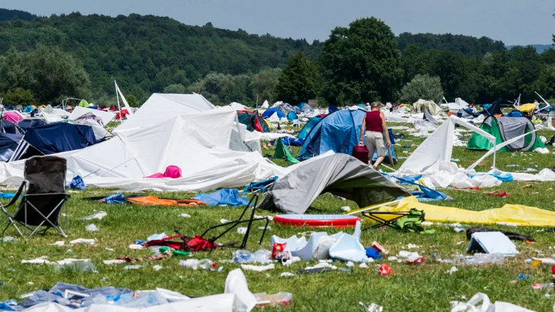
Wh- & H-questions help us explore a topic, a situation,…
For example, when thinking about the trash left behind after music festivals.
Here: Frauenfeld Open Air 2013 (Picture: Keystone)
Source: Link
Notes:
Using a simple example from learners’ lifeworld we take up an issue stimulating reflection. Trash left behind after music festivals has been a recurring topic in the media.
Learners can also be invited to formulate their own Wh- & H-questions, thereby activating their prior knowledge.

Slide 5

Why do festival-goers not take their tents with them and re-use them later?
What makes festival-goers leave their trash behind?
How did festival organisers lay down their ground rules?
When do festival-goers bring their own tents?
To what end do festival organisers provide big meadows ?
Who, what, when, where, why, how, to what end, what for?
Notes:
Here are some potential questions for the festival example. Learners should be invited at this point to formulate their own questions.

Slide 6


Wh & H-questions help us explore a topic, a situation,…
Exploring means:
Not taking things for granted
Wanting to learn more, to have more as well as more precise information
Looking at things from a fresh perspective
Showing interest and being curious
Acting like an explorer or a researcher
Reflect critically on your findings and the new information included
Source: «Nautilus» by Jakub Celstowski, Link
Notes:
We use the critical thinking icon here and on the subsequent slides. The icon is meant to establish an explicit connection to critical thinking. It can also be used as advance information / preview in case you intend to work on critical thinking tasks / elements. In that case you can refer back to this part / activity.
The picture on the journey of the Nautilus in «20,000 leagues under the sea» is used here as a metaphor for exploration and discovery.

Slide 7
Wh & H-questions are useful in myidea for…
… learning more about the problem you are interested in and understand it more fully
e
For example:
What exactly is the problem?
What makes it a real problem?
For whom is it a problem?
In what situations does the problem show itself?
… evaluating first suggestions for business ideas
e
For example:
How does our business idea match our interests and personalities?
What positive effects does our product / service have for potential customers and for society?
How are social and ecological aspects considered in our product / service?
Notes:
This is also a potential or partial preview. Depending on when in the programme you treat the Wh- & H-questions learners might not yet have developed a business idea or achieved some other milestone. In that case you can use this as a preview that helps create positive expectations: «As you see, we are going to do lot of interesting things in the next few weeks, e.g., …».

Slide 8
Wh & H-questions are useful in myidea for…
… developing a prototype representing your business idea
e
For example:
What are the main assumptions underlying our business idea?
What aspects of our product / service need to be part of a prototype?
What functions does the prototype need to fulfill?
What form / medium would help us represent our prototype to test our business idea?
… developing your business model
e
For example:
How is the product or service created?
What is the value proposition of our product or service?
Who is our target group? Who are our customers?
How are we going to make money?

Slide 9
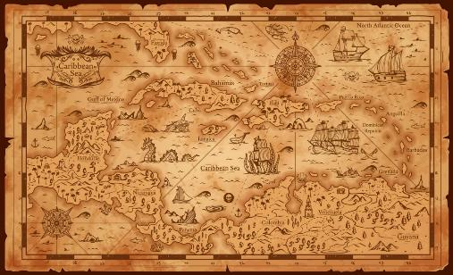
Wh & H-questions are everywhere in myidea
Throughout the myidea programme you will encounter many moments and situations where you will be asked to take a closer look and explore.
Use these opportunities to learn more about all aspects and components of your business idea and come up with your own Wh & H-questions that help you do so.
This is a journey!
Source: iStock.com/seamartini
Documents created by: Swiss Center for Entrepreneurial Thinking and Acting scETA
Notes:
We emphasise again that the myidea process is always linked to Wh- and H-questions. Learners should understand that they need to formulate and use their own Wh- & W-questions, since all business ideas and their development have unique features.

