Slide 1


Recurring Topics
myidea.ch 2.0
Entrepreneurial Thinking and Acting
Notes:
When developing own business ideas within the framework of myidea, certain topics, activities and corresponding tools/strategies appear repeatedly in order to support the process. Most of these were covered or developed and used in General Education classes (ABU), respectively. To ensure that all learners have the basic skills required to work with myidea, these topics, activities and corresponding tools/strategies are briefly repeated here as necessary. Basic information is also provided to indicate where and how they are relevant in myidea. To mark such recurring topics in myidea 2.0, the arrow-in-circle icon shown here is used. This enables teachers to make explicit references while recognize the icon and understand that the topic will appear again.

Slide 2

Terms of use for the myidea learning programme
We are delighted that you wish to use the myidea learning materials in your lessons. The materials are designed to teach entrepreneurial thinking and acting. Please note the following terms of use:
Open access: The documents are freely accessible and may, in principle, be used by anyone.
Who are these materials intended for? These materials have been produced for use in vocational schools. They are primarily aimed at teachers who have completed a four-day basic training course on the myidea learning programme. If you wish to use the materials without having completed this training, you are welcome to do so. In that case, we would ask you to let us know. We would also be happy to discuss this with you:
Susan Müller
Attribution: Whenever the materials are used, the «Swiss Center for Entrepreneurial Thinking and Acting scETA» must be identified as the creator of the documents. This can be done using the following wording:
«Documents created by: Swiss Center for Entrepreneurial Thinking and Acting scETA»
If you are using entire documents (e.g. PowerPoint slides or Word documents such as the mini business plan), please leave the myidea logo in the relevant places.
No commercial use: The materials must not be used for commercial purposes. They may only be used for educational purposes.
Adaptations and further developments: It is a fundamental principle that teachers using the myidea teaching materials may adapt and further develop them. However, even when making changes to the materials, please credit the Swiss Center for Entrepreneurial Thinking and Acting as the original creator. In this case, please add a note stating that changes have been made, e.g.:
«Based on material from the Swiss Center for Entrepreneurial Thinking and Acting scETA, adapted by [your name/organisation]»
Contact: If you have any questions or would like further information, please do not hesitate to contact us: Susan Müller
Thank you very much, and we wish you every success with the launch of myidea !
Swiss Center for Entrepreneurial Thinking and Acting scETA

Slide 3
Recurring Topic
Conducting interviews
Documents created by: Swiss Center for Entrepreneurial Thinking and Acting scETA
Notes:
When working with myidea, there are always moments in the process where interviewing relevant people provides important information – also in the form of feedback. This could be a more informal street interview or a more formal interview with an entrepreneur, an expert, etc. To ensure that learners can apply the necessary basic skills, this section covers three fundamental aspects of interviewing: planning and conducting interviews successfully; recruiting interviewees; and conducting qualitative interviews to validate business ideas.

Slide 4
How can I plan and conduct interviews successfully?
How can I find interview partners?
How can I successfully conduct qualitative interviews to validate ideas?
Notes:
This is a good moment to halt briefly and activate learners’ previous knowledge regarding interviews. This facilitates taking first steps into the topic and offers potential linking points.

Slide 5
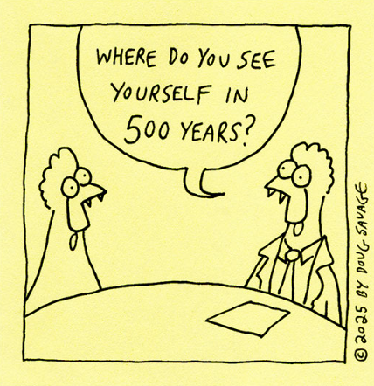
Interviews help gather information
Interviews can be used to gather personal information:
  Experiences
  Opinions
  Wishes and needs
  Ideas and concepts
  Goals
  etc.
This kind of information cannot be found in other sources (e.g., books, newspapers).
The personal information is delivered directly by the persons we are interested in, e.g., experts in a field or potential customers. These persons are important in myidea.
Source: Link
Notes:
The purpose of interviews is to gather information from relevant individuals. Learners are made aware that interviews provide information that cannot (simply) be found in other sources. At the same time, we emphasise that experts and potential customers are key individuals to interview in the context of myidea.

Slide 6
Planning an interview
Interviews require thorough preparation:
Find experts for the subject at hand
Get in touch and explain what you need
  Act politely and professionally
  Accept if someone says no
When interviewing experts: fix a place and time → avoid interruptions or disturbances (e.g., noisy locations)
When interviewing potential customers: go to a suitable location (taking the time of day into account) → e.g., street interview
Compile questions
Provide media and materials
  If necessary: recording device (e.g., cell phone)
  In any case: paper and pencil
Notes:
The steps listed here can also be compiled into a checklist for use. Learners are reminded that a professional demeanour is important. At this point, they can also discuss what «professional» means in a brief discussion in pairs.

Slide 7
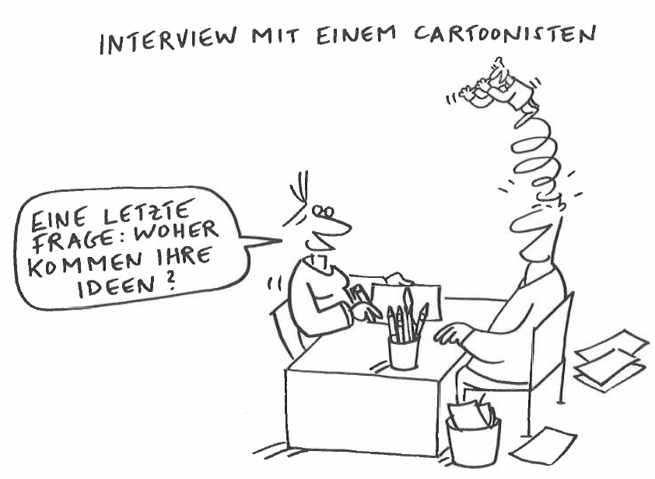
Structure of your interview
INTERVIEW WITH A CARTOONIST
The interviewee should know what the interview is about and what to expect.
This is especially relevant when interviewing experts.
Introduction
  Introduce yourself briefly (again)
  Explain purpose and goal of the interview
  Mention interview duration
Main part
  Ask simple ice-breaker questions, e.g., «How did you go to work today?»
  Ask questions on the topic of interest
  Probe for details / in case of unclear points
Winding up
  Thanks and leave-taking
LAST QUESTION: WHERE DOYOU GET YOUR IDEAS ?
Source: Spiegel et al. (2016). Sprache und Kommunikation. hep-Verlag.
Notes:
Structuring the interview in three steps is particularly important for interviews with experts, entrepreneurs, etc. These interviews tend to be longer, more formal, and the interviewee sets aside extra time for them. It is possible that the same expert may be interviewed or asked for feedback on more than one occasion. This makes it all the more important that learners conduct themselves professionally and make a good impression. In a plenary discussion, you can ask learners to briefly summarise why a clear structure is particularly important for interviews with experts.

Slide 8
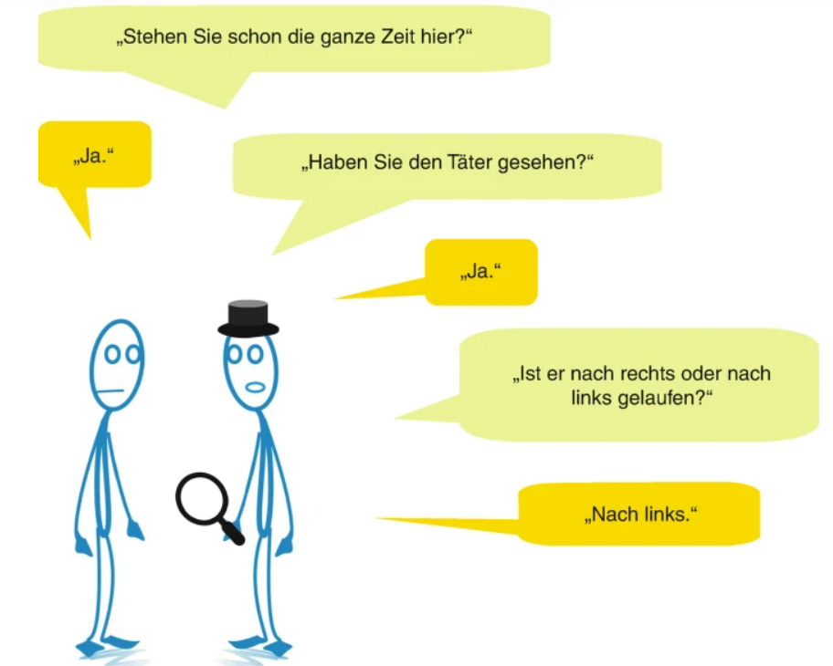
Good questions must be developed beforehand
Link to Wh- & H-Questions and critical thinking
When formulating questions some basic principles need to be considered:
e
Ask open questions (→ Wh- & H-Questions)
  «How comes…? »
  «What is…? »
  «How do we/you know…? »
  etc.
No leading questions
Avoid wordings such as
  «Don’t you agree that…? »
  «I am sure you also think that…? »
No yes/no questions
  Questions that have only yes or no as an answer do not elicit a lot of information.
  Yes/no questions offer no opportunity to interviewees to tell something.
Closed questions do not yield a lot of information.
Been here the whole time?
Yes
Seen the perpetrator?
Yes
Did he turn left or right?
Left
Source: Böhner und Schütz (2020). Psychologie der Kommunikation. Springer.
Notes:
The key principles of designing interview questions are revisited. Learners should recognise that the aim is not simply to work through a list of questions and «grill» the interviewee. The aim is to encourage the interviewee to tell their story and explain things in more detail.

Slide 9
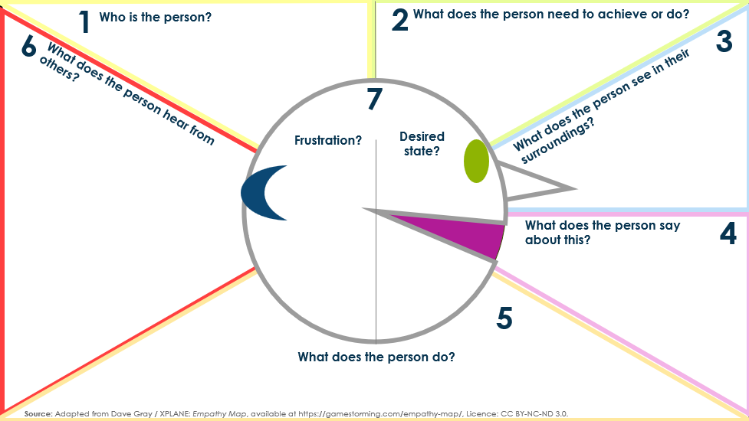
Link to Design Thinking
The Empathy Map offers additional suggestions for open Wh- & W-Questions.
These questions can also serve as inspiration for ice-breaker questions.
Notes:
During Inspiration Day, participants will explore the topic of «design thinking» in a series of steps to learn how to find out more about another person and better understand their perspective, experiences and so on. Learners should not assume they know what makes the other person tick, but should actively and directly seek out this information.

Slide 10
How can I plan and conduct interviews successfully?
How can I find interview partners?
How can I successfully conduct qualitative interviews to validate ideas?
Notes:
Some learners find it difficult to find interview partners and to contact them in an appropriate manner. However, this is not a general rule: learners who have a lot of contact with customers in their line of work are often more experienced in this area. Learners who do not have this experience very often may sometimes lack this knowledge. We therefore offer some tips on the next page.

Slide 11
How to find interview partners?
Experts: Consider which organisations could put you in touch with experts, such as industry associations, start-up organisations, universities or other research institutions, as well as government bodies.
Potential customers: Think about where you can find people who are relevant to your product or service, e.g., within your own company, in other companies, amongst your friends and acquaintances, in clubs, networks or online communities.
General tips:
  Think about anyone you know personally whom you could interview yourself, or who has contacts with other potential interviewees in this field.
  When conducting an interview, always ask at the end: «Can you recommend further interview partners to me?»

Slide 12
How to approach interview partners in a good way? 1/2
How to reach out to interview partners
Usually contact them via email or LinkedIn.
Include the recipient’s name in your opening salutation (only use «Dear Sir or Madam» as a last resort if you cannot identify a specific contact person).
Ensure your spelling and grammar are correct.
State briefly and clearly what the matter is and ask for an appointment.

Slide 13
How to approach interview partners in a good way? 2/2
How to reach out to interview partners
Suggest some dates, but at the same time make it clear that you are happy to work around the other person’s availability.
Use a polite closing, e.g., «Kind regards».
Include a signature stating your full name and the organisation you are writing from, e.g., your vocational college.
If you have not received a reply, follow up politely after about a week.
Bear in mind that not everyone will get back to you. Therefore, always contact more potential interviewers than you actually need.

Slide 14
How can I plan and conduct interviews successfully?
How can I find interview partners?
How can I successfully conduct qualitative interviews to validate ideas?
Notes:
To gather feedback on their product or service ideas, learners often conduct online surveys, which are then usually answered by friends and acquaintances. Such surveys can certainly be useful. However, qualitative interviews, in which potential customers respond directly to the idea itself, are usually better suited to truly understanding how good a product or service idea is and in which direction it should be developed further.
Within the context of myidea, learners usually do not have that much time. When setting up a real business, however, it is advisable to conduct enough qualitative interviews to be able to draw overarching observations and well-founded conclusions. This usually requires at least ten interviews.
Below, learners will find important and practical information and tips on conducting qualitative interviews.

Slide 15

Validating ideas for new products and services
Core idea:
Try to talk to potential customers early on to gather feedback on your idea.
This will help you understand better who your customers are and prevent you from going down the wrong path for too long.
This and the subsequent slides were created based on a slide set from Dom Zuend. He specialises in validating product ideas through qualitative interviews and is the founder of headbits.
Quelle: In Anlehnung an: Zuend (2003). Validating product ideas. How to rund customer interviews. headbits.
Notes:
Learners, as well as other aspiring entrepreneurs, often make the mistake of waiting too long to talk to potential customers. There is a common belief that you must first have an almost finished product or service before seeking feedback. However, this is a misconception: the sooner you take your idea out into the world, the better. The only important thing is that the person you are talking to can clearly understand what it is all about. This can also be achieved using a simple prototype or mock-up, as recommended in Design Thinking.

Slide 16
Early mistakes you should definitely avoid:
Keeping your idea to yourself.
Working on your business plan without ever «going out» to get feedback.
Believing: «I've developed a product or service that everyone really needs!»
Seeing conflicting opinions as a reason to abandon your idea. Instead, ask yourself: «How can I adapt my idea so that enough people really like it?»
You will learn the most by showing your idea to potential customers and talking to them. This will give you a clear picture of who your target customers really are.
Source: Based on: Zuend (2003) Validating product ideas. How to conduct customer interviews. headbits.
Notes:
The slides highlight some common mistakes that are frequently made. Regarding the first point («Keeping your idea to yourself»), it is worth noting that learners often worry that their idea might be stolen. Of course, that can happen. However, as a general rule, an idea on its own is usually not worth very much, and it is unlikely that anyone will use that exact idea to set up their own business or found a company. If the idea does indeed involve technical aspects that could be protected by a patent, the rule is that you do not normally need to share these when it comes to validating the idea with potential customers for the first time.

Slide 17
Validating your idea is key to your success!
The following can happen if you do not validate your idea:
You run the risk of failure
You waste resources unnecessarily
No one really, really likes your idea
«Better to have 100 users love you than 1 million that kinda
like you. The true seed of scale is love, and you can't buy
it, hack it, or game it» Y-Combinator
Source: Based on: Zuend (2003) Validating product ideas. How to conduct customer interviews. headbits.

Slide 18
Possible structure of a qualitative interview for validating your product or service ideas
1
2
3
4
Introduction
5 min
Context
10 min
Conclusion
10 min
Show prototypes & test ideas
30 min
Source: Based on: Zuend (2003) Validating product ideas. How to conduct customer interviews. headbits.
Notes:
The following section provides a step-by-step guide to how a qualitative interview might be conducted. This is intended to assist learners and give them confidence. However, it may still be a good idea to practise conducting such an interview in advance in the safe environment of the classroom.
At myidea, people usually work in pairs. In this case, it makes sense for both people to actually take part in the interview, if time permits. It is important, however, to be clear about who will lead the interview and what role each person will play.

Slide 19
1. Introduction: Topics for a
good start
Introduction
Context
Show prototypes &
test ideas
Conclusion
Thank you!: Thank your interview partner for their time
Clarify expectations: Briefly explain what the interview is about and what you hope to gain from it.
Reassuring: Show that all information shared will be treated confidentially and that there is no «right» or «wrong».
Take notes: Write down important points. This will help you guide the conversation. It also shows that you value your interview partner’s feedback.
Audio recordings: Ask for permission to record the interview. This will ensure that no information is lost.
100%: Give your interview partner 100% of your attention. Avoid distractions.
Limit the number of participants: There should not be too many people in the room (3 or 4 persons is usually a good number). This ensures a pleasant atmosphere for the conversation.
Source: Based on: Zuend (2003) Validating product ideas. How to conduct customer interviews. headbits.
Notes:
If conducting interviews is assessed or forms a compulsory part of the myidea project, teachers may sometimes require learners to provide the audio files. In this case, it may be advisable for the interview partners to sign a consent form (privacy notice) to confirm that they agree to this. At the same time, the interviewees should be assured that these files will only be shared within the school context.

Slide 20
2. Context: Give your interview partner the chance to get into the topic!
Introduction
Context
Show prototypes &
test ideas
Conclusion
Link to
«Jobs to be Done» (M 1.3)
Question
Idea behind
«Can you tell us something about yourself / your company / your position?»
This is familiar territory and easy for everyone.
«Can you tell me about a situation in which you performed [the task you want to support or simplify with your product]?»
This gives you valuable insights into your interview partner's previous experiences and approaches. It allows you to better understand the « job to be done».
«Can you give me an overview of how you use [a competing product]?»
«What tools or approaches do you currently use to complete [tasks you want to cover with your product]?»
Source: Based on: Zuend (2003) Validating product ideas. How to conduct customer interviews. headbits.

Slide 21
3. Show prototypes or mock-ups: Ask open-ended and task-oriented questions
Introduction
Context
Show prototypes &
test ideas
Conclusion
Question
Idea behind it
« What is your first impression of this?»
Important: Be sure to ask an open-ended introductory question so as not to push your interview partner in a certain direction.
« Can you describe what you see on the screen?» [in case it is an app]
Your product is probably completely self-explanatory to you because you have been working on it for a long time. Is it the same for your interview partner?
« What do you think this prototype is intended for?»
« Imagine you had to complete [task]. How would you use the prototype to do that?»
This will help you learn more about how your product could be used in a real-world context.
Source: Based on: Zuend (2003) Validating product ideas. How to conduct customer interviews. headbits.
Notes:
To ensure that your interview partner can respond effectively and provide information, it is important that they understand your product or service idea as clearly as possible. It is therefore advisable to illustrate the idea and bring along something «tangible». This could be, for example, a simple prototype or some mock-up screens.

Slide 22
3. Show prototypes or mock-ups: Here are a few tips
Introduction
Context
Show prototypes &
test ideas
Conclusion
Ask one question at a time
Avoid leading or closed questions
Pause during conversations and give your conversation partner time to respond
Pay attention to non-verbal cues
Do not defend your prototype
Go deeper: ask questions to find out more
Source: Based on: Zuend (2003) Validating product ideas. How to conduct customer interviews. headbits.

Slide 23
3. Show prototypes or mock-ups: In-depth and comparative questions
Introduction
Context
Show prototypes &
test ideas
Conclusion
Question
Idea behind
Important: Be sure to ask an open-ended introductory question so as not to push your interview partner in a certain direction.
«Why did you decide to solve the task in this way?»
«How does the approach of my product differ from the way you currently carry out [the task in question]?»
If you want your idea to be successful, you need to be able to offer a better solution than what is currently available.
«When you compare these options with the status quo, which do you prefer and why?»
It is easier for us to compare specific solutions. And ultimately, you want to know: Does it offer a benefit compared to the previous solution or not?
Source: Based on: Zuend (2003) Validating product ideas. How to conduct customer interviews. headbits.

Slide 24
4. Conclusion: Possible concluding questions
Introduction
Context
Show prototypes &
test ideas
Conclusion
Question
Idea behind
«What do you like most about it?»
It makes sense to ask about the two extremes. Important: ask the question in an open-ended way so that you do not push your interview partner in a certain direction.
«What do you like least or find confusing?»
«If you could change one thing about this prototype, what would it be?»
«Based on what you've seen today, would you use it? If yes, why? If no, how would I have to change it for you to use it?»
If your interview partner would not use your product (at least in its current form), you can learn a great deal from them. Take advantage of this opportunity!
Source: Based on: Zuend (2003) Validating product ideas. How to conduct customer interviews. headbits.

Slide 25
Summarise your notes
Type up your notes so that everything is neatly recorded
Mark the feedback by type, e.g. praise, criticism or questions
Look across all interviews: do you recognise any patterns?
Don't take everything at face value; question what is really important
Don't rush to change your product based on a single piece of feedback. Carefully analyse the results to identify clear patterns that will help you develop your product in the right direction.
Source: Based on: Zuend (2003) Validating product ideas. How to conduct customer interviews. headbits.

Slide 26

Synthesis and next steps
Review the findings and feedback together with your team.
Prioritise the feedback according to feasibility and importance.
Make adjustments to your prototype based on the feedback.
Test new assumptions in a targeted manner.
Source: iStock.com/Natalia Shabasheva
Source: Based on: Zuend (2003) Validating product ideas. How to conduct customer interviews. headbits.
Documents created by: Swiss Center for Entrepreneurial Thinking and Acting scETA

