Slide 1


Entrepreneurial Thinking and Acting
myidea.ch 2.0

Slide 2

Terms of use for the myidea learning programme
We are delighted that you wish to use the myidea learning materials in your lessons. The materials are designed to teach entrepreneurial thinking and acting. Please note the following terms of use:
Open access: The documents are freely accessible and may, in principle, be used by anyone.
Who are these materials intended for? These materials have been produced for use in vocational schools. They are primarily aimed at teachers who have completed a four-day basic training course on the myidea learning programme. If you wish to use the materials without having completed this training, you are welcome to do so. In that case, we would ask you to let us know. We would also be happy to discuss this with you:
Susan Müller
Attribution: Whenever the materials are used, the «Swiss Center for Entrepreneurial Thinking and Acting scETA» must be identified as the creator of the documents. This can be done using the following wording:
«Documents created by: Swiss Center for Entrepreneurial Thinking and Acting scETA»
If you are using entire documents (e.g. PowerPoint slides or Word documents such as the mini business plan), please leave the myidea logo in the relevant places.
No commercial use: The materials must not be used for commercial purposes. They may only be used for educational purposes.
Adaptations and further developments: It is a fundamental principle that teachers using the myidea teaching materials may adapt and further develop them. However, even when making changes to the materials, please credit the Swiss Center for Entrepreneurial Thinking and Acting as the original creator. In this case, please add a note stating that changes have been made, e.g.:
«Based on material from the Swiss Center for Entrepreneurial Thinking and Acting scETA, adapted by [your name/organisation]»
Contact: If you have any questions or would like further information, please do not hesitate to contact us: Susan Müller
Thank you very much, and we wish you every success with the launch of myidea !
Swiss Center for Entrepreneurial Thinking and Acting scETA

Slide 3
Inspiration Day
Inspiration Day | Module 1: Finding a problem worth solving | Module 2: Developing a suitable solution | Module 3: Developing a viable business model | Module 4: Ensuring financial viability | Module 5: Entering the market | Module 6: Presentation and conclusion
Notes:
During Inspiration Day, learners gain their first experience with entrepreneurial thinking and acting. It can be run as either a half-day or a full-day session. If a half-day session is chosen, we recommend focusing on design thinking. The Entrepreneur Talk can also be incorporated during the implementation of the rest of the programme.
The elements and activities of Inspiration Day prepare learners for working with myidea. In the subsequent myidea modules, numerous references can be made to Inspiration Day, for example when exploring a problem area in more detail within the context of Module 1. Linking back to the Inspiration Day may also mean that individual activities in the subsequent modules can be omitted or adapted if it becomes apparent that the learners already possess basic competence in the relevant topic.

Slide 4

Entrepreneur Talk:
Meeting and learning from inspiring entrepreneurs
Inspiration Day
The learning modules for Inspiration Day were inspired by the «TechPreneurs» project, implemented by Lars Diener-Kimmich with support from Gebert Rüf Foundation.
Design Thinking:
Putting yourself in the customers’ shoes to develop better products
Thinking about problems in different ways:
Broadening your horizons
Documents created by: Swiss Center for Entrepreneurial Thinking and Acting scETA
Notes:
During Inspiration Day, three key areas relevant to entrepreneurial thinking and acting will be introduced: thinking about problems in different ways, design thinking, and the Entrepreneur Talk. The associated activities provide an initial insight into entrepreneurship with three foci: exploring a problem in greater depth rather than rashly developing one-sided solutions; starting not from one’s own perspective on a product or service, but by gaining a better understanding of what potential customers need; and gaining authentic insights through conversations with inspiring entrepreneurs: What does it mean to develop a business idea and deal with obstacles and setbacks?

Slide 5

Black Stories: Learning to think outside the box
Notes:
Many learners find it difficult to explore a problem from multiple perspectives. It is not always clear to them that their view of a problem is not the only one. Using so-called «Black Stories», they can learn that what seems obvious to them is not the only way to think about or define a problem. To achieve this, it is helpful to confront them with seemingly simple, clear problems and let them experience that sometimes there is more behind things than we initially see. This part is laced with a touch of humor.

Slide 6
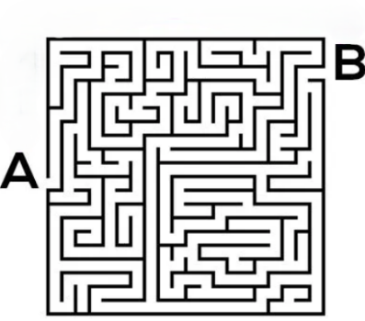
There is more than one way to think about problems
Sometimes we are faced with a problem, an obstacle, or a situation, and we don’t know how to solve it or how it came about.
When we think about a solution to the problem, we often apply logical strategies that are familiar to us.
How do you get from A to B?
Notes:
The task tends to encourage taking the traditional approach and tediously exploring and mapping out the correct route.

Slide 7
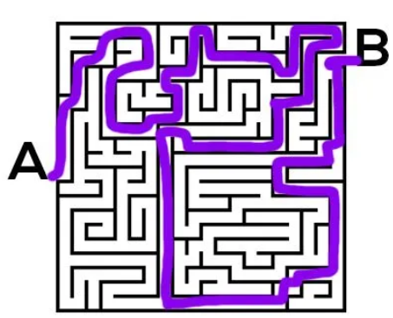
There’s more than one way to think about problems
How do you get from A to B?
That’s the way we’ve learnt to do it.
We follow the rules.
Is there another way of doing it?
Notes:
This is the path we are familiar with. We tend to stick to what we know, especially when it comes to strategies. There is nothing wrong with this, but it prevents us from considering alternatives.

Slide 8
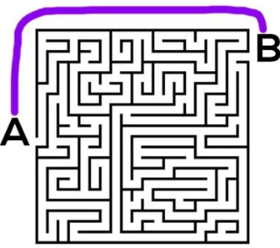
There’s more than one way to think about problems
How do you get from A to B?
Yes, exactly, very clever!
You don’t just follow the rules.
Sometimes it helps to set the rules aside and be creative.
This applies especially to your work with myidea!
Notes:
This solution demonstrates that it is indeed possible to get from A to B very easily, with minimal effort and much more quickly. Learners should be given an initial indication that working with myidea means being creative and not limiting one’s thinking from the start.

Slide 9
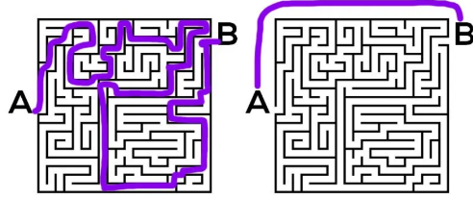
There’s more than one way to think about problems
What we’re doing here is called thinking outside the box.
The good news is: you can practise this!
And it will help you with your project
Let’s give it a go!
Source: https://www.facilistation.com/p/lateral-thinking-vs-design-thinking
Notes:
Here, the link to working with myidea is further developed. Learners discover that thinking outside the box is an important competence, and that this competence can be developed. This motivates the learners to engage with it.

Slide 10



Connect the dots with four straight lines without lifting your pencil.
Notes:
This type of problem-solving task has its origins in Gestalt psychology. In this field, thinking outside the box is described as lateral thinking. The two solutions demonstrate that it is important to move beyond established principles, in the sense that «anything is possible, as long as it leads to a solution». In this context, this means placing the sharp corners just outside the dots. The teacher can also make it clear here that many adults do not manage to solve this task straight away. This helps to maintain the learners’ motivation not to give up.

Slide 11

There is more than one way to think about problems
We can do the same with stories. Try to work out what happened in
this story and why.
Romeo and Juliet
Romeo and Juliet are lying dead in a puddle of water, the window is open and the glass is broken. What happened?
Discuss possible solutions with the person sitting next to you. You’re allowed to suggest all sorts of «crazy» explanations!
Solution: Romeo and Juliet are goldfish, and the window blew open in a gust of wind. This caused the fishbowl to fall, break, and the fish to die.
Notes:
Black Stories are also ideal for lateral thinking. Black Stories are tales that present a strange situation based on very little information. The key question is: what happened? How did this situation come about? The resolutions are surprising and sometimes seem a bit crazy. The explanations help to better understand the context, so that it becomes clear how the described events could have unfolded.
Perhaps your learners will come up with solutions that differ from those described here. If the explanation fits, that’s wonderful and will be rewarded accordingly.

Slide 12
There is more than one way to think about problems
Here’s another story:
Farmer in the field
A farmer is standing in his field. A horse comes towards him. Suddenly, the farmer has disappeared. What happened?
Solution: It’s a game of chess. The knight has captured the pawn.
Discuss in groups of three or four:
What is so special about this kind of story?
How can we find ways to reach the solution?
Notes:
To help learners grasp the principle behind Black Stories and the challenges they present, you can find here a second story. The challenge in both stories lies in realising that the initial – almost automatic – assumptions must be identified and consciously discarded. When we hear of Romeo and Juliet, we automatically think of a couple in love (humans). The farmer in his field and the horse make us think of a farming scene.
In the subsequent discussion, learners are encouraged to identify the challenge within the stories. This insight can then be used – once the initial assumptions have been discarded – to imagine more freely and to question everything. In the case of this story, such questions might include:
Where can we find farmers? What types of farmers are there?
What exactly constitutes «a field»? What types of fields do we know?
etc.

Slide 13

There is more than one way to think about problems
What we need to solve this sort of problem is called «reframing».
It’s like taking a picture out of its frame and giving it a new one.
This changes the picture too. We now see the problem differently.
Why is this important?
If we look at a problem from too narrow a perspective, it can be difficult to find multiple approaches to possible solutions.
Now let’s take the next step and apply this to lifts …
Source: Link
Notes:
The concept of «reframing» is illustrated here visually. Looking at a problem from different angles helps us to identify potential approaches to solving it. If, for example, the problem were «There is no feeding station for the winter where birds can help themselves», we would consider various solutions. Depending on the perspective we adopt, we consider factors such as proximity to the ground, thick or thin branches, and so on. If we focus on proximity to the ground, we might look for a solution involving a raised feeding station to prevent the food from being eaten by other animals. At the ends of thin branches, only something lightweight can be installed so that the branch isn’t pulled down or even breaks. Etc.

Slide 14
The problem with the slow elevator: a lesson in «reframing»
Notes:
This section explores the concept of reframing in greater depth and demonstrates how it can be used to open up new possibilities for solutions. It takes as its starting point an everyday problem: a slow elevator.

Slide 15
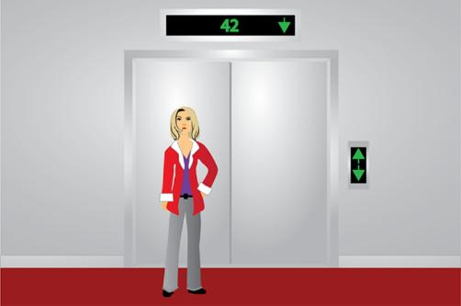
What is the problem?
Guests on the upper floors of your hotel are complaining about the slow elevators.
What is the problem?
Think of a possible solution!
Source: https://pennstatelearning.psu.edu/istudy_tutorials/problemsolving/problemsolving5.html
Notes:
We start with a short story. In the first step, learners are guided through a «familiar» problem-solving process: identifying the problem, outlining a solution.

Slide 16
What’s the problem?
Is the problem really that the elevators are slow? Or could there be another issue?
Note: What happens to the hotel guests while they wait? How do they feel about it? How do you feel when you’re waiting for the elevator?
Notes:
The group then considers whether the real problem has been addressed. Learners are encouraged to think about whether there might be another, more fundamental issue at play. Learners should try to put themselves in the hotel guests’ shoes. They can also draw on their own experiences. It is important that alternatives are generated here. This can, for example, be done simply through a brief discussion in pairs, with each pair briefly sharing their findings with the whole class.

Slide 17
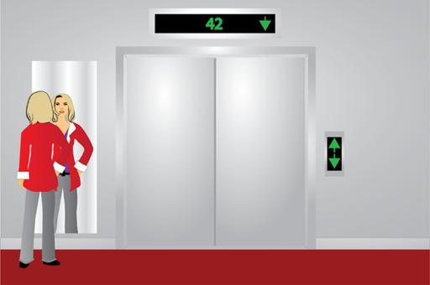
What’s the problem?
The hotel management realised that the real problem lay elsewhere: guests were focusing on how long they had to wait for the elevator.
The management decided to install mirrors next to the elevators. This distracted the guests. After the mirrors were installed, there were no more complaints.
Notes:
The story continues here. A ‘reframing’ helped the hotel management get to the root of the underlying problem. This example shows that there is no single way to interpret a situation or problem. It helps to examine the situation more closely. Thus, it is not the speed of the lift that is the problem. Even the fastest lift will cause a certain amount of waiting time in a 50-storey building. It is the waiting itself that is perceived as unpleasant.

Slide 18
Reframing a problem opens up new possibilities for solutions
Framing the problem
Scope of possible solutions
«Make the elevator faster»
Install a new elevator
Replace the motor
Improve the control system
«The elevator is too slow»
Find a solution
Reframe the problem
«Make the wait feel shorter»
Hang up mirrors
Play some music
Install a hand sanitiser stand
«Waiting is tedious »
Find a solution
Source: Wedell-Wedellsborg, T. (2017). Are You Solving the Right Problems? Harvard Business Review (Jan-Feb 2017). Link
Notes:
In this way, the apparent problem is set aside through reframing, and the real problem is identified. The examples of solutions to the actual problem given here can be supplemented or adapted as required. The important thing is to tackle the boredom, not the elevator speed. The range of solutions within the original framing of the problem is complex and costly. These solutions place a heavy financial burden on the hotel and do not guarantee that the boredom – the underlying problem – will actually be resolved.

Slide 19
The aim of reframing
Identifying the real problem is the most important step because:
It is crucial to fully grasp the problem.
Symptoms must be distinguished from causes.
In our example:
The complaints about the slow elevator are the symptom.
The boredom of waiting is the cause.
Source: https://pennstatelearning.psu.edu/istudy_tutorials/problemsolving/problemsolving5.html
«Note that the original ‘framing’ of the problem is not necessarily wrong. Installing a new elevator would probably work. The important point in reframing is not to find the ‘real’ problem, but to see if there is a better one that can be solved.»
Source: Wedell-Wedellsborg, T. (2017). Are You Solving the Right Problems? Harvard Business Review (Jan-Feb 2017). Link
Notes:
Distinguishing between symptoms and causes is key: if you only address the symptoms without tackling the cause, a new symptom may emerge, or the existing symptom may simply be alleviated. In our example, the complaints are an indicator that something is not working satisfactorily when using the lifts. Guests cite the wait as the reason, although what they are actually referring to are the negative emotions associated with waiting (impatience, frustration, etc.). If one were to take the time to speak to a few guests for a little longer and ask what exactly is so tedious about waiting for the lift, some might say things like: that I have to wait so long; I’m bored; I have no patience because I still have so much to do; I feel uncomfortable just standing there, etc.

Slide 20
In practice, too, it is often a real challenge to identify where the problems actually lie
In a survey of 106 executives from 91 private and public sector companies across 17 countries, Thomas Wedell-Wedellsborg found that a full 85% of respondents believed their companies were poor at analysing problems. 87% agreed that this shortcoming resulted in significant costs. More than nine out of ten people stated that they were affected by this problem. As it turned out, they were not struggling with solving problems, but with identifying where the problems lay.
Creative solutions almost always arise from an alternative explanation or a redefinition of a problem. The point of redefining a problem is not to find the «true» problem. Rather, it is to see whether there is a better problem that needs solving.
Source: https://hbr.org/2017/01/are-you-solving-the-right-problems
Notes:
If the content of the slide is too complex, the teacher can briefly touch on the key points. This example illustrates that it is worth investing time in analysing the problem or exploring the problem space. This analysis helps to determine the next steps in developing a solution – as a starting point for the business idea.

Slide 21
Entrepreneur Talk:
Meeting and learning from inspiring entrepreneurs
Design Thinking:
Putting yourself in your customers’ shoes to develop better products
Thinking about problems in different ways:
Broadening your horizons

Slide 22
Design Thinking
Notes:
You will need plenty of craft materials for the following activity. Have old cardboard, tape, sticky notes, thick cord, scissors, etc. ready. Where possible, a separate room can be used for prototyping; this ensures that the craft materials do not cause a distraction in the previous phases.
For the interview phase, arrange the tables so that two learners can sit opposite each other. Provide the following per table: two handouts, an envelope containing coloured question cards, two empathy maps (A3), writing materials, and the learners’ current carrying aids (backpacks, bags, etc.).

Slide 23
You will learn…
how to conduct interviews,
how to identify needs,
and how this can lead to initial ideas for a solution.
Notes:
At the outset, the setting is established: not theory, but experience. Learners work in pairs at a fast pace, conducting interviews, distilling insights, sketching out ideas and testing them immediately. The focus is on the process and a shift in perspective: moving away from one’s own opinion towards understanding the other person.
The three stages – interview, identifying needs, initial solutions – are presented as a coherent experience. It becomes evident how concrete insights for better solutions emerge from conversations. Simple sketches and a brief prototype are expected; perfection is secondary, the focus is on gaining insights.

Slide 24

«BestBag Project»
This exercise was inspired by the «Wallet Exercise» from Stanford University’s d.school and adapted for myidea 2.0. The original material is available at dschool.stanford.edu/resources.
Develop a new carrying solution for learners that is better than anything that has existed before.
Source: Link
Notes:
The exercise applies the logic of the Wallet Project (d.school) to the learners’ everyday lives: designing not for themselves, but for their partner, taking into account their specific circumstances, limitations, and preferences.

Slide 25
«BestBag Project»
Working method: randomly generated pairs
Dual role: product designer and customer
Procedure: structured, lasts approx. 3 lessons
Timekeeper: time for each development step is timed by the teacher
Materials: 2 empathy maps, 2 dossiers, one envelope containing question cards per pair, writing materials
Notes:
Pairs are formed at random; the dual role (designer ↔ client) ensures a change of perspective. The materials structure the process: empathy cards and notes help to document observations, whilst question cards provide guidance without restricting the conversation. Time is strictly managed; short, clear phases facilitate progress and keep energy levels high.

Slide 26
Design YOUR ideal solution for the BestBag Project
Sketch your idea.
3 mins
Notes:
This brief sketching exercise is deliberately carried out before the empathy phase. Learners spend 2–3 minutes sketching their own ideal carrying solution – without discussion, without justification, just quickly and roughly. The aim is to bring their own wishes and preferences to light. The sketch later serves as a basis for comparison, helping them to recognise that personal ideas often do not align with the needs of others.

Slide 27

Empathy phase – getting to know the other person
Every person is unique!
We often think we already know others. But much remains hidden until we listen more closely and ask questions differently.
In the empathy phase, we try to truly understand the person we’re talking to:
What does this person really think, feel and need?
Notes:
The uniqueness of the other person becomes the guiding principle: ask questions differently, listen more closely, gather examples rather than opinions. The conversation remains open-ended. Prepare learners for this. The aim is to understand situations, patterns, and needs. Short, specific stories («Tell me about the last time…») provide useful insights for the subsequent draft.

Slide 28
1
2
What does the person need to achieve or do?
Who is the person?
6
3
7
What does the person see in their surroundings?
What does the person hear from others?
Frustration?
Desired state?
What does the person say about this?
4
5
What does the person do?
Source: Adapted from Dave Gray / XPLANE: Empathy Map, available at https://gamestorming.com/empathy-map/, Licence: CC BY-NC-ND 3.0.
Notes:
The empathy map is provided to help learners grasp all the key aspects of the person they are interacting with during the empathy phase. It highlights how unique each person is and helps to record observations and statements in a structured way.
Suitable questions are used to systematically explore the various areas – who the person is, what they need to achieve, what they see, say, do and hear, as well as what frustrates them or what they wish for. This creates a holistic picture of the other person.
Only once this person and their needs are truly understood can we begin to consider possible solutions for a new carrying solution.

Slide 29
1
2
What does the person need to achieve or do?
Who is the person?
6
3
7
What does the person see in their surroundings?
What does the person hear from others?
Frustration?
Desired state?
What does the person say about this?
4
5
What does the person do?
Source: Adapted from Dave Gray / XPLANE: Empathy Map, available at https://gamestorming.com/empathy-map/, Licence: CC BY-NC-ND 3.0.
Notes:
The procedure for the interviews is explained here.
The learners work through the empathy map step by step, following the coloured question cards in the envelope: first yellow (1), then green (2), and so on.
The teacher decidedly guides the process: giving the starting signal, announcing the time slot, and initiating the role change.
The interviewer reads out the question on the card, listens actively, asks follow-up questions («Why? When? Where? Tell me about the last time …») and notes down the answers directly in the relevant field – ideally word for word and with examples. The interviewee speaks from their own experience; the focus is on observations and needs, not on solutions.
After this introduction, the procedure is clear to everyone, and the next slides can be worked through step by step.

Slide 30
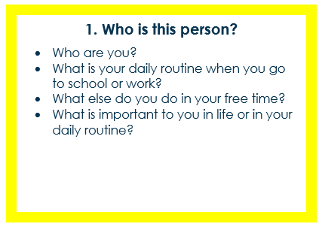
Empathy phase – getting to know the other person
1
2 mins each

Slide 31
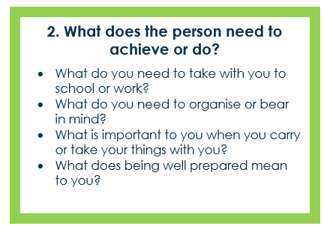
Empathy phase – getting to know the other person
2
2 mins
each

Slide 32
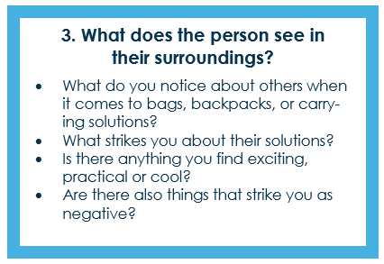
Empathy phase – getting to know the other person
3
2 mins
each

Slide 33
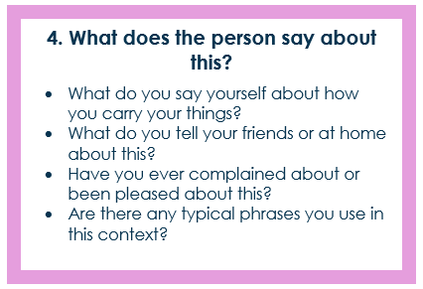
Empathy phase – getting to know the other person
4
2 mins
each

Slide 34
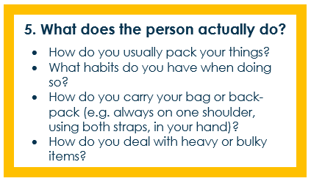
Empathy phase – getting to know the other person
5
2 mins
each
Notes:
The orange questions focus on what the person actually does. Learners are encouraged to show and explain their current carrying solutions. They should describe how they use these in everyday life, what works well and what is bothering them. Actually demonstrating it makes it easier to identify real usage patterns and habits rather than just talking about them.

Slide 35
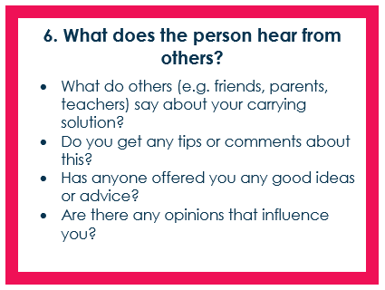
Empathy phase – getting to know the other person
6
2 mins
each

Slide 36
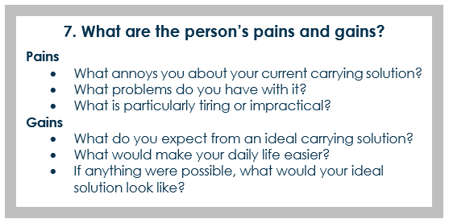
Empathy phase – getting to know the other person
7
2 mins
each

Slide 37
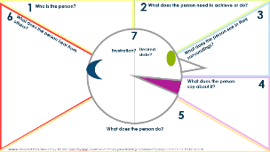
Organising and consolidating findings
8
Each person to look at their own empathy map
and answer the questions in the handout.
5 mins
What is the core need or problem?
What are noticeable patterns or surprises?
My partner needs a carrying solution that…
Notes:
We now move from the interview to the summary: the learners take the handout and work with the empathy map they have just completed for their partner.
Procedure: Look through the card quietly, marking recurring points; then fill in the fields in the handout regarding patterns, surprises and 1–2 supporting quotes, and use these to formulate a precise sentence regarding the central need or problem (without a specific solution). The teacher gives the starting signal, sets the time limit and gives the signal for the change of roles.
The following slides show the rest of the process and describe the learners’ next activities step by step.

Slide 38
9
Developing ideas: Developing options
Each person now comes up with 3 ideas for solutions. Even crazy ideas are allowed.
5 mins

Slide 39
10
Developing ideas: Developing options
Present all three ideas and record the feedback here.
2 min
each

Slide 40
11
Reflecting and generating new solutions
Revise THE BEST of your three solutions and sketch it out here.
2 mins

Slide 41

12
Create and Test
Create a prototype for your solution.
15 mins

Slide 42
13
Feedback
Present your prototype to each other and gather feedback once again.
per
2 mins
+ worked …
- could be improved…
? Questions…
! Ideas…

Slide 43

Design Thinking Method
≠
Source: iStock.com/CasarsaGuru
Notes:
At the end, the initial sketch and the final prototype are placed side by side. The learners indicate specifically what has changed and why: which insights from the interviews and empathy map influenced the design, which assumptions were discarded, and which features were added or simplified? The aim is to highlight the learning gains achieved through empathy and iteration.

Slide 44
What is design thinking?
The design thinking approach is characterised by the following features:
Human-centred approach: solutions are focused on users’ needs
Deep understanding: innovations are based on a thorough understanding of user needs
Rapid prototyping: ideas are tested at an early stage to obtain timely, practical feedback
Practical impact: products, services, processes, and organisations are creative, practical, and effective
Derived from the following definition: «Design thinking is a human-centered problem-solving approach that drives innovation by deeply understanding customer needs, rapidly prototyping ideas, and iterating based on real-world feedback. This design thinking methodology helps teams develop products, services, processes, and organizations that are not only creative but also practical and impactful.» Source: Design Thinking, Link

Slide 45

Design Thinking combines four perspectives: desirability, feasibility, viability, and responsibility
Key idea: When defining the problem you wish to tackle, consider the key perspectives of design thinking right from the start:
Desirability: Do users actually want a solution to this problem?
Feasibility: Is it technically possible to solve this problem?
Viability: Does developing a solution make sense from a business perspective?
Responsibility: Is it ethically justifiable and sustainable (in terms of social and ecological considerations) to offer this solution?
Desirability
Feasibility
Viability
Responsibility
Source: The Design Thinking Process Broken Down Step-by-Step. Link
Notes:
A key principle of the Design Thinking method is that four perspectives – desirability, feasibility, viability, and responsibility – are brought together and considered from the very beginning.

Slide 46
Entrepreneur Talk:
Meeting and learning from inspiring entrepreneurs
Design Thinking:
Putting yourself in your customers’ shoes to develop better products
Thinking about problems in different ways:
Broadening your horizons
Documents created by: Swiss Center for Entrepreneurial Thinking and Acting scETA

Slide 47
Entrepreneur Talk
Notes:
The third part of Inspiration Day consists of a guest talk by an entrepreneur.
The aim is not to deliver a formal lecture, but to share a genuine and personal story with the learners: how to start something, overcome obstacles and learn from experience.
A supporting document helps with the preparation and invitation of the entrepreneur.
Document title: «Entrepreneur Talk – Guide for Teachers»
The document explains the following points:
How to invite an entrepreneur and explain the purpose of the guest talk
Which organisations can help in finding entrepreneurs
A suggested format (20–30 minutes of storytelling + 10–15 minutes of Q&A).
A sample invitation that can be adapted and sent by email
What types of stories fit well with the myidea phases
How to prepare learners and facilitate reflection after the talk
For such a talk to be successful, it is important to create a relaxed atmosphere in which the entrepreneur can speak freely about successes, challenges, mistakes and the lessons learnt from them.

