Slide 1
The evolution of strata anti-commons
IFMOP – Tarragona, Spain, 15 May 2024

Slide 2
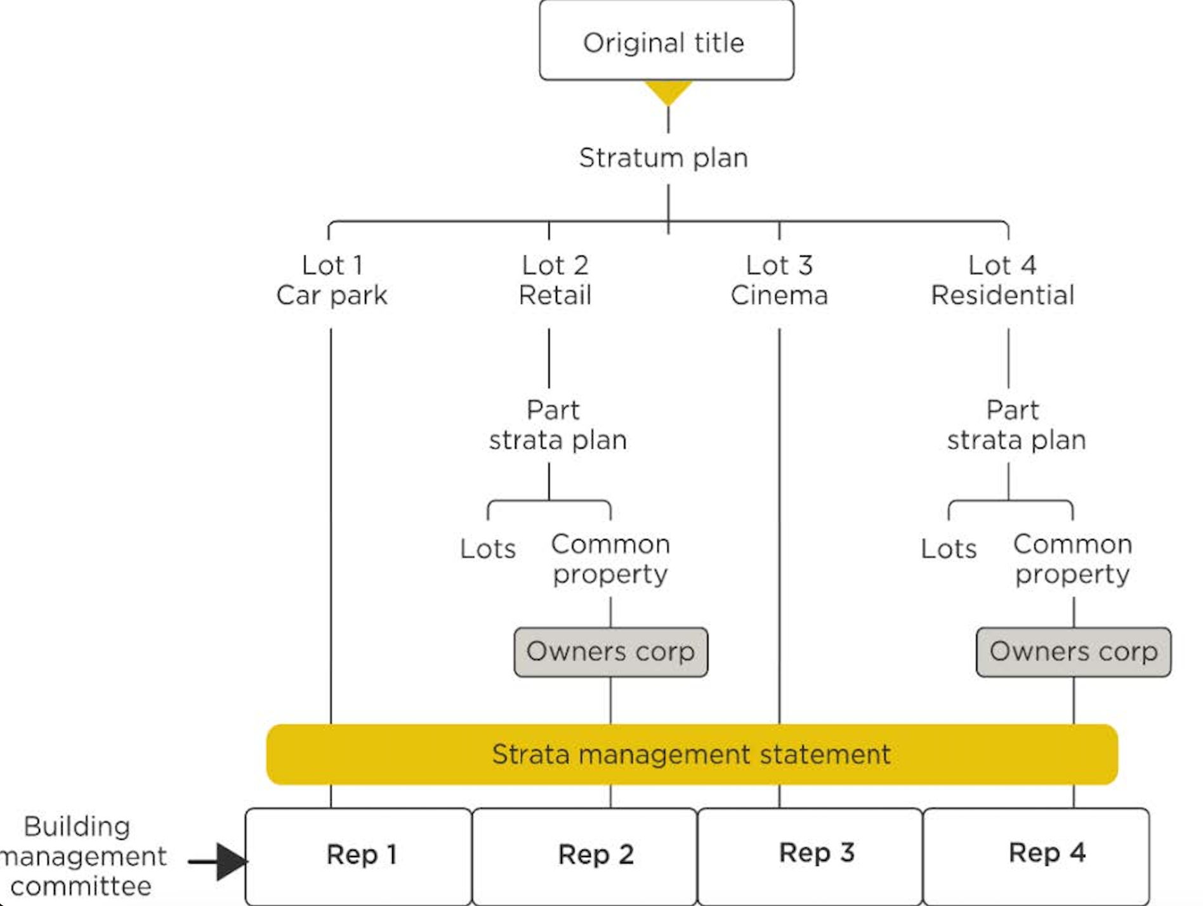
Current complexity of MUD project structuring
Mixed uses
3 property elements
Shared facilities across stratum titles
Tired decision making for strata
Power imbalance in authoring management statements

Slide 3
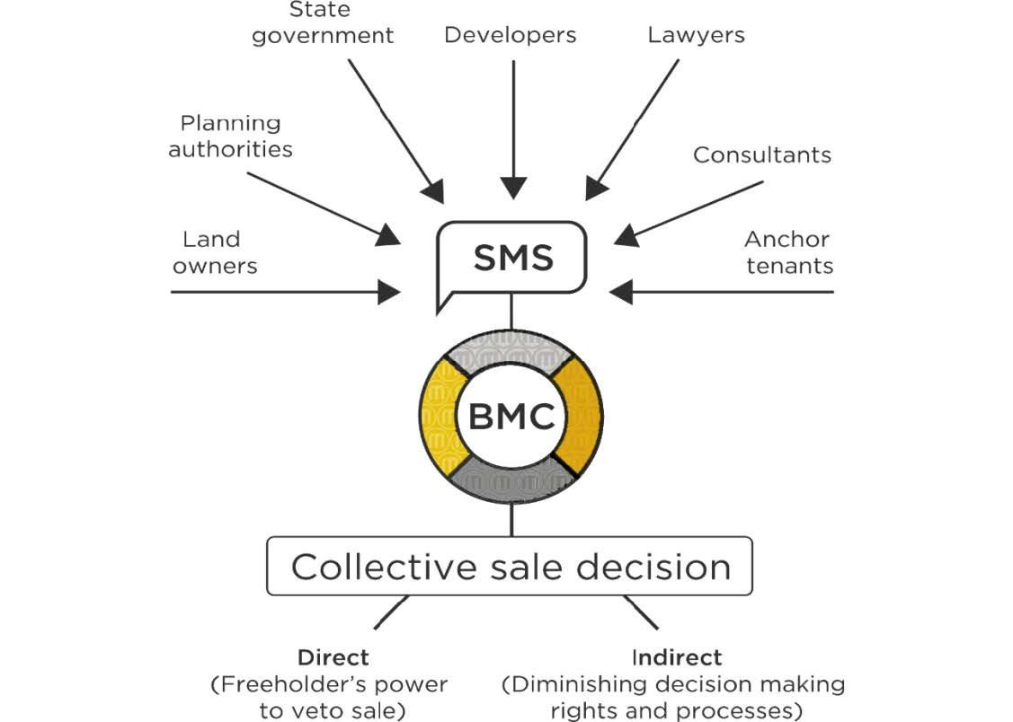
MUD laws create additional anti-commons risks
Developer/ anchor tenant unrestrained
Stratum lot owners veto
Quality decision making challenged

Slide 4
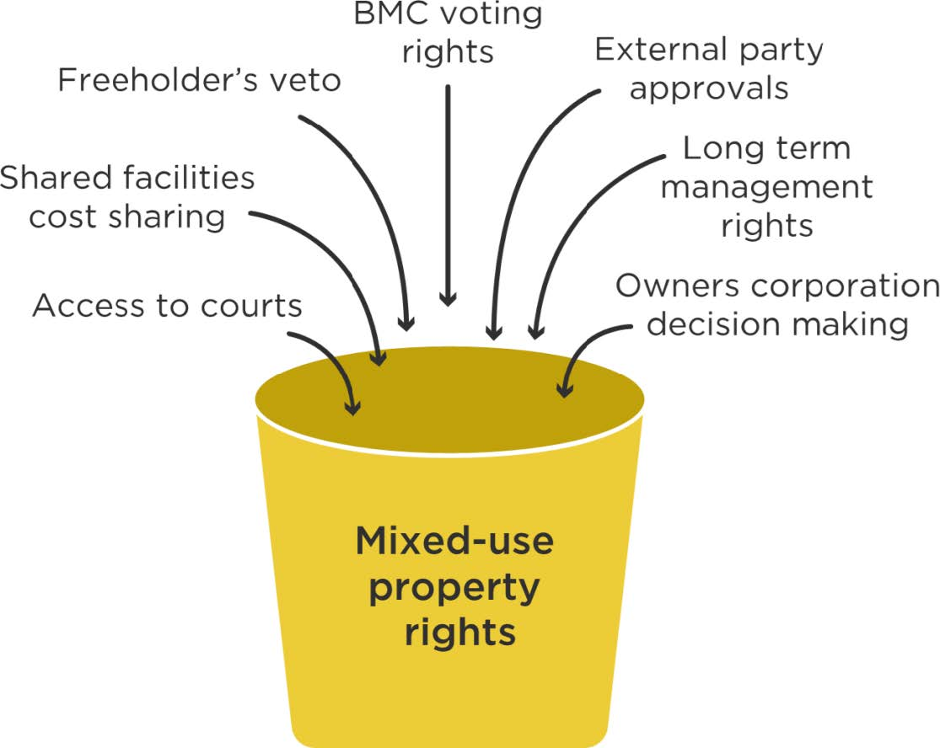
7 MUD anti-commons identified

Slide 5
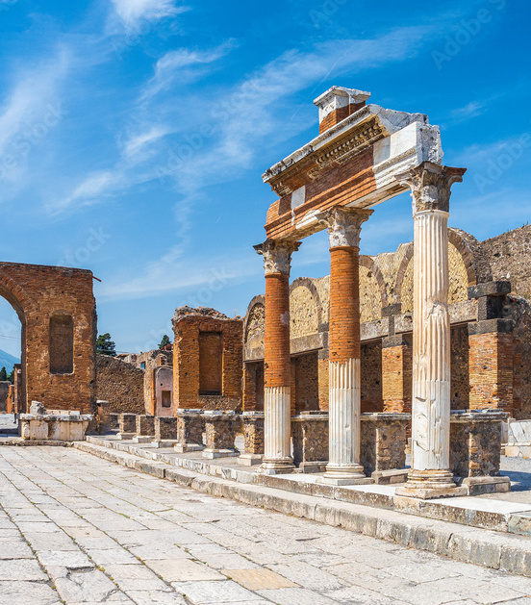
Compact city paradox
The more we seek density and diversity the more we deny this for the future city -
Owner cooperation unlikely
Legislative intrusions in commercial sector unpalatable
Brutal and uneven outcomes likely

