Slide 1
The life and death of mixed-use developments: And the quest for renewal
Michael Teys
University of New South Wales
2023 International Research Forum on Multi-owned Properties
UBC, Vancouver Canada
24 May 2023
Notes:
MUD , they have variously been described as Icons of contemporary urbanism - and minding boggling complex with implications for property owners for hundreds of years.
Both statements are of course correct - one by Bill Randolph - from a planners perspective - and one by Cathy Sherry , a lawyer . In making these statements these respected Australia academics define the disconnect in my area of research - what the planners want and what the lawyers deliver and that disconnect between the two professions is about to play out fin a new way as these monoliths decay and become ready for renewal . My thesis looks at the consequences of the built environment when it come times to pull them apart for something new and even more exciting to replace them.

Slide 2
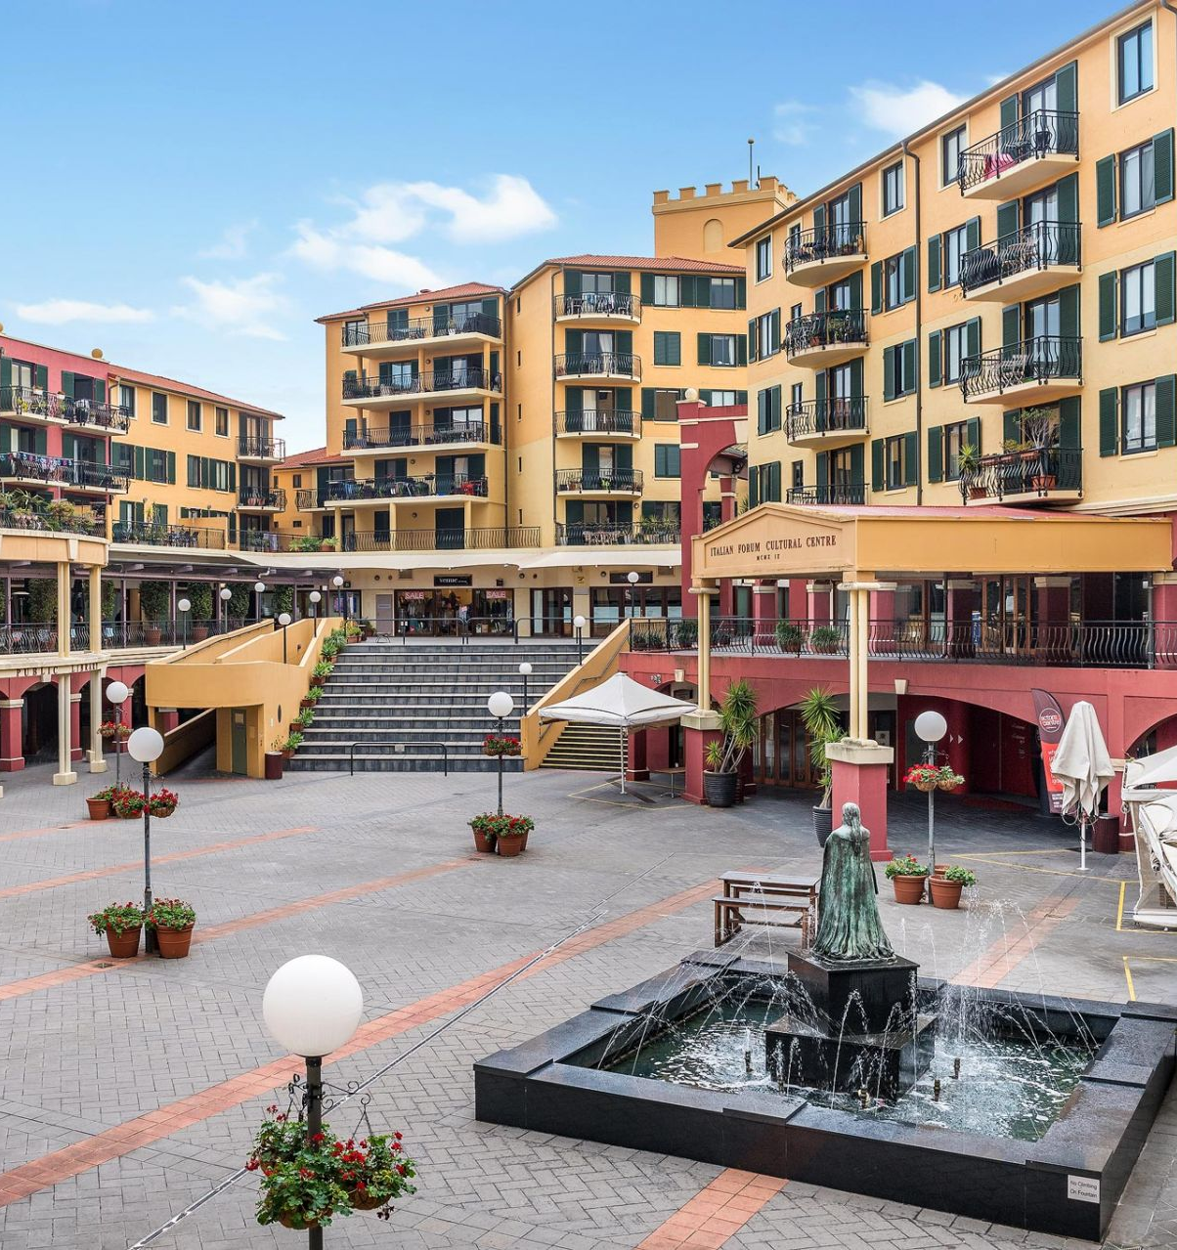
From orthodoxy to obsolescence
Jacobs 1961
Airspace subdivision 1980’s
Compact city 1990’s +
Collective sales 2000 +
Notes:
The post war history of MUDs in Australia is punctuated by 4 shifts in thinking

Slide 3
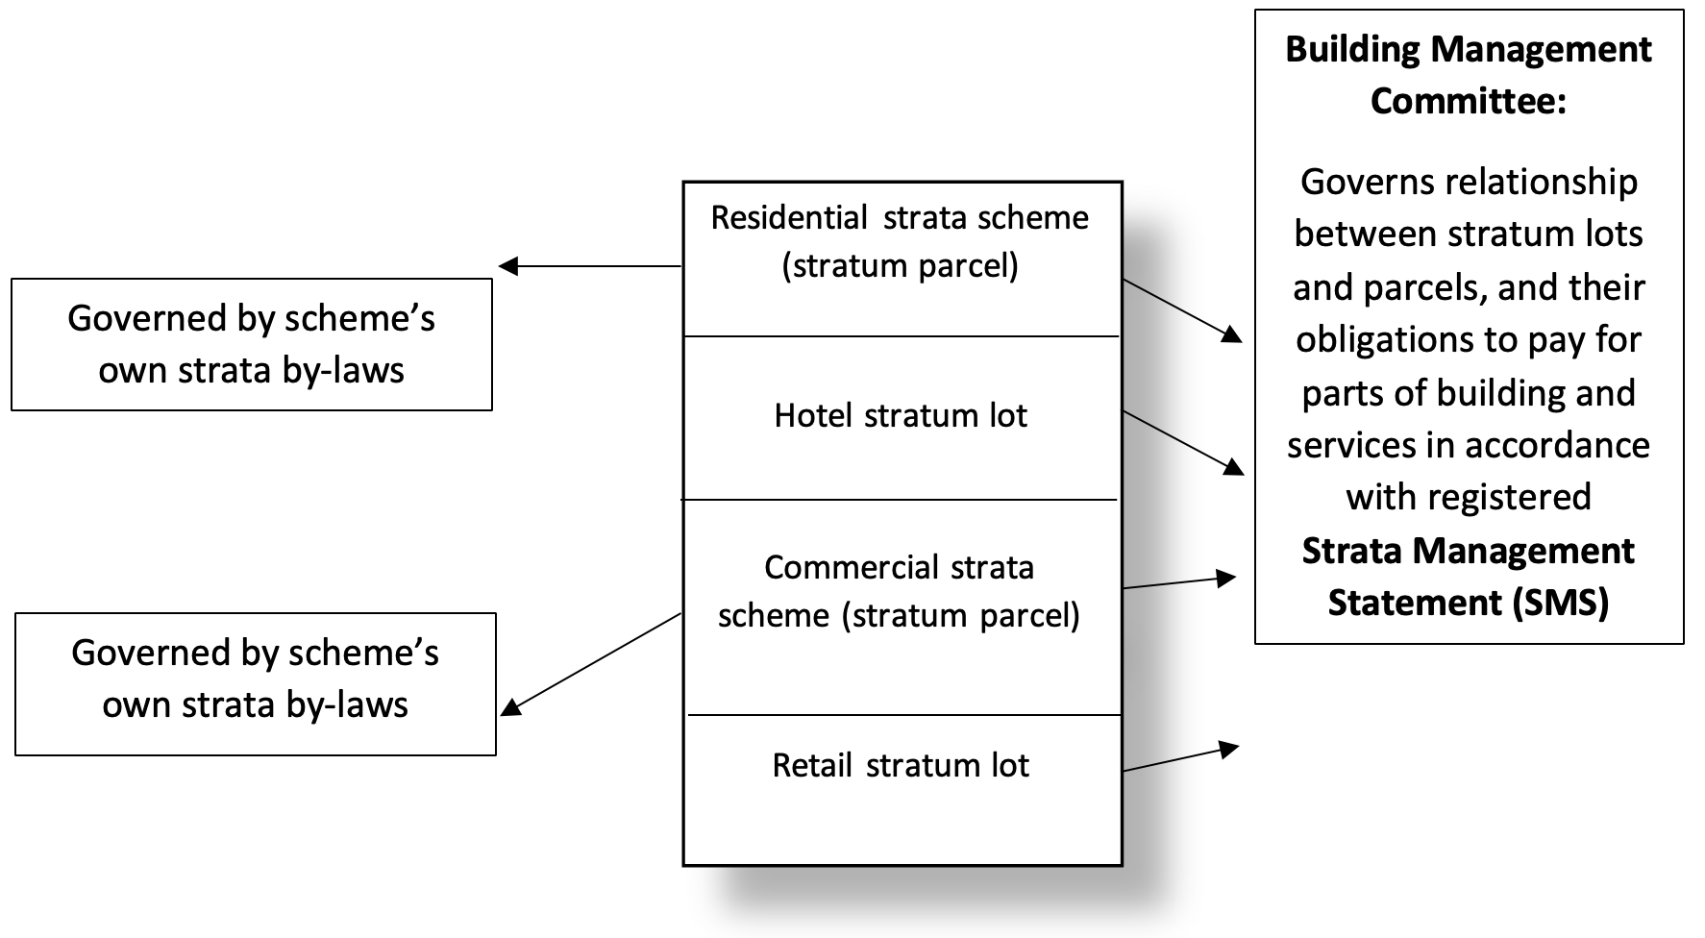
Anatomy of a mixed-use development
Sherry (2017) Fig 1.6, p. 35
Notes:
Befre we start to think about how we pull these things apart and what happens if we cant - lets examine how they are made up – hereis an example

Slide 4
Research aim and questions
Better understand the implication of mixed-use property on urban renewal by collective sales
How is MUD different to strata ?
What additional property rights are created by MUD ?
How might these rights affect decision making impeding urban renewal by collective sales ?

Slide 5
Anticommons theory as a framework
 | Tragedy of the commons Hardin (1968) | Tragedy of the anticommons Heller (1989)
Definition | Scarce resource Free access Lack of exclusionary rights | Scarce resource Less access Exclusionary rights
Resulting problem | Overuse (e.g., degradation) | Underuse (e.g., fragmentation)
Typical solution | Privatisation Regulation Cooperative /consensus-based management structure | Stakeholders cooperate Solutions legislatively imposed/ facilitated Compulsory reassembly

Slide 6
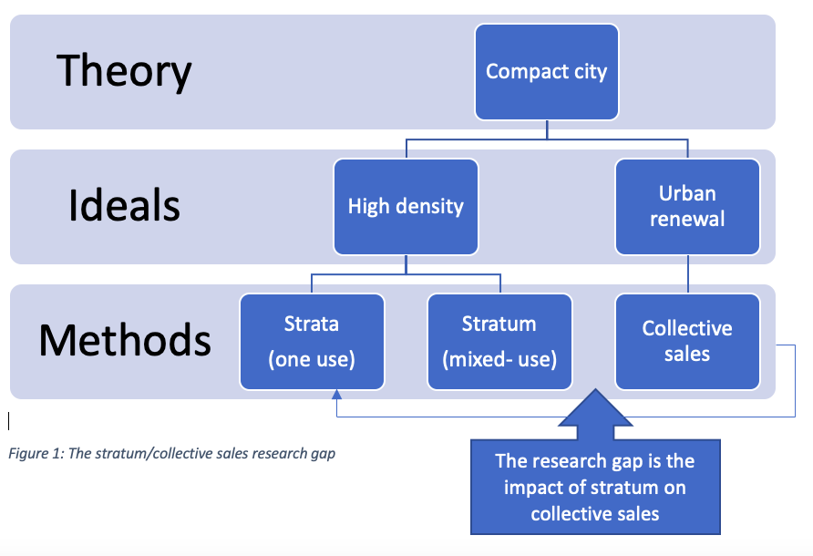
Literature review
Compact city = Complex city
MUD favoured but under researched in AU.
Developers and lawyers have great freedom on project structuring
MUD not specifically considered in AU collective sales research
Five conventional strata anticommons risks identified
Notes:
Strata anticommons include veto / by laws/ developer-imposed agreements/ bad decision making on repairs and maintenance / agglomeration of neifhghouroods

Slide 7
Research methods
Legal doctrine
Strata v stratum
Content analysis
12 SMSs
Expert interviews
Eight experts
Case study
The Italian Forum

Slide 8
Legal review
Law | Strata | Part Strata
Application | One use | Mixed-use
Legal entities | Owners + one entity | Owners + more than one entity
Types of property | Lots Common property | Lots Common property Shared facilities
Governance model | Self determination collective decision making | ‘Whole of development’ by Building Management Committee
Voting rights | Determined by law on relative values | Determined by developer preference unrelated to value
Third party rights | By lease, easement, restrictive covenant (restrained by doctrine) | By developer authored strata management statements (restrained by imagination)
Collective sales | Legislatively assisted (75%) | Unanimity - no legislative assistance

Slide 9
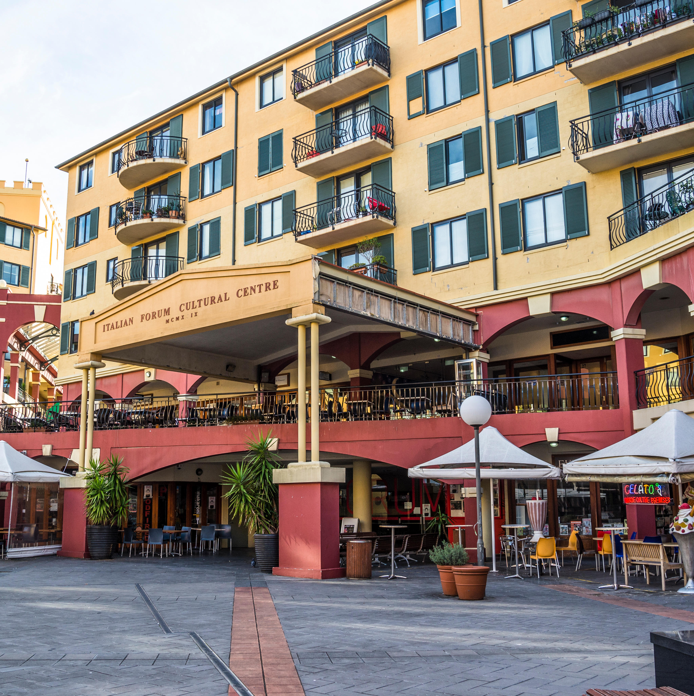
Case study – The Italian Forum
Allocating tile of the piazza inappropriately to developer has created a BMC power imbalance
Contested cost allocations of shared facilities has led to 2 supreme court cases
Covenant on title when gifted by government to use at least 10 % for cultural purposes has interfered with sale of property
Notes:
45 % vacancy of shops (27/60) - 2 of 13 restaurants – no events – disrepair

Slide 10
Content analysis findings
Data
Findings
N = 12
All Sydney locations
Registered 1999 – 2022
Came to my attention when practicing /consulting
5 by one firm and its successors
26 fields compared
5 themes
No provisions for termination
4 ways of allocating voting rights
Little evidence of developer breach of fiduciary duties (1/12)
Access to courts denied in 8/12 cases
BCM control of strata OC’s

Slide 11
Expert interview findings
Data
Findings
N = 8 (5 lawyers, 2 development managers, 1 strata manager)
10 plus years experience
All known to me when practicing
Lawyers selected for diversity of developer clientele
Termination is the elephant in the room
Developers have control but lawyers have autonomy
Lawyers feel a responsibility to the unknowns
Lawyer’s uncertain views towards allocating voting rights
Lawyer’s preference for expert's dispute determination not court

Slide 12
RQ 1 – How is MUD different to strata ?
Shared facilities
A third form of collective ownership property right (after lots and common property)
Shifts OC governance from an inward facing collective decision making to outward facing entity involving external parties

Slide 13
RQ 2 What additional property rights are created by MUD (SMS)
Inherent right to shared facilities
  Goes beyond use and surrenders proprietorial rights on repair, replacement, and sale
  Limitless as to what is shared
  Timeless
Developers right to create custom-made property rights and obligations
  Goes beyond land law limitations on title
  Enables subversion of strata title property rights
Notes:
Examples of the second include Opal Tower where the Sydney Olympic Park Authority retains power

Slide 14
RQ 3 How might MUD rights impede urban renewal by collective sales
The power of veto
External party rights
Developers abuse of promoter’s role
Inappropriate titling and structuring creating power imbalance
Subversion of strata title property rights leading to disputes, dysfunctionality, and withdrawal

Slide 15
The evolution of collective owned property rights
Unitary
Company title
Dualistic
Strata title
Tripartite
mixed-use

Slide 16
So, what would Heller say ?
Are resources scare ? | Yes
Less access ? | Yes
Exclusionary rights ? | Yes
Underuse ( fragmentation) | Yes
Solutions
Stakeholder co-operation | ?
Solutions legislatively imposed /facilitated | Worth a try
Compulsory reassembly | What are the alternatives ?

