Slide 1
Lacrosse: the fire, the fallout, the fallacy, and unresolved issues about truth and reconciliation
International Institute for the Sociology of Law
Onati, Spain 30 June 2022
Michael Teys

Slide 2
The fire
24 November 2014 (midnight – 2:23 am 1st responders 6 mins)
Cigarette stubbed in a plastic container on the balcony
Fire spread 11 floors ( 8-21st) in 11 minutes (50 sec/floor)
400 residents safely evacuated (no injury or loss of life)
$12 M property damage (fully funded by consultants PI insurers)
Unquantified/uncompensated mental heath and loss of well being

Slide 3
Effects of flammable cladding on homeowners well being (Oswald et al 2020)
Actions
Unheard
Insurance
Impacts
Denied use and amenity
Spending cuts
Emotions
Fear
Anger
Shock
Financial anxiety
Stonewalled
Unfair legal costs
Fluctuating
Phoenixing
Retirement deferred
Neighbourhood tensions
Ethical issues about disclosure

Slide 4
The fallout
Product bans
Liability determined 39% fire engineer, 33 % building surveyor, 25 % architect , 3 % smoker
Federal and state government reviews and reports on building regulation and non-conforming building products
Very different new build legislative responses by the three major states
Increased insurance premiums and less cover offered (arguably market failure)
Inconsistent remediation enforcement causing frustration and remediation delay
Subsided remediation loan in NDSW and Vic
Very slow pace of strata residential buildings remediated

Slide 5
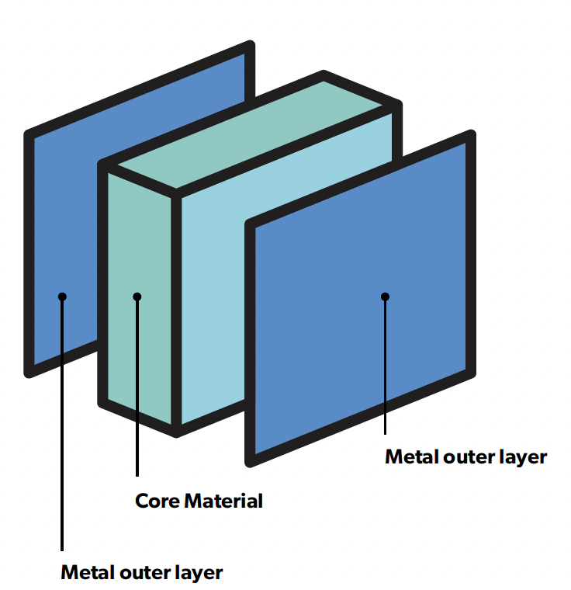
The fallacy
External high-rise walls must be non- combustible (BCA)
All ACP’s fail relevant test AS1530.1 (furnace test)
Therefore, ACPs must find a DTS concession
Bonded laminated material are a DTS concession if each laminate is non-combustible
Therefore , you only need test the metal outer layers not the PE – no problem !

Slide 6
The findings
The DTS concession argument ‘defies both logic and common sense’ [354]
That otherwise experienced and diligent practitioners were beguiled by a longstanding and widespread (but flawed) practice into giving insufficient scrutiny to the rationale for that practice [388]
There is no evidence of any of the experts, individually or collectively, subjecting the Relevant Practice to robust scrutiny of the kind discussed by Lord Browne-Wilkinson in Bolitho and, perhaps for this reason, it does not withstand logical analysis. [391]
From Owners Corporation No.1 of PS 613426T v LU Simon Builders Pty Ltd [2019] VCAT 286

Slide 7
The future
We need to understand more about how and why the fallacy came to be the collective wisdom
We need to understand more about the failings of our governments and the neo liberal approach to building regulation of the last 30 years
We need to do more to help disaffected owners – they are without voice

