Slide 1
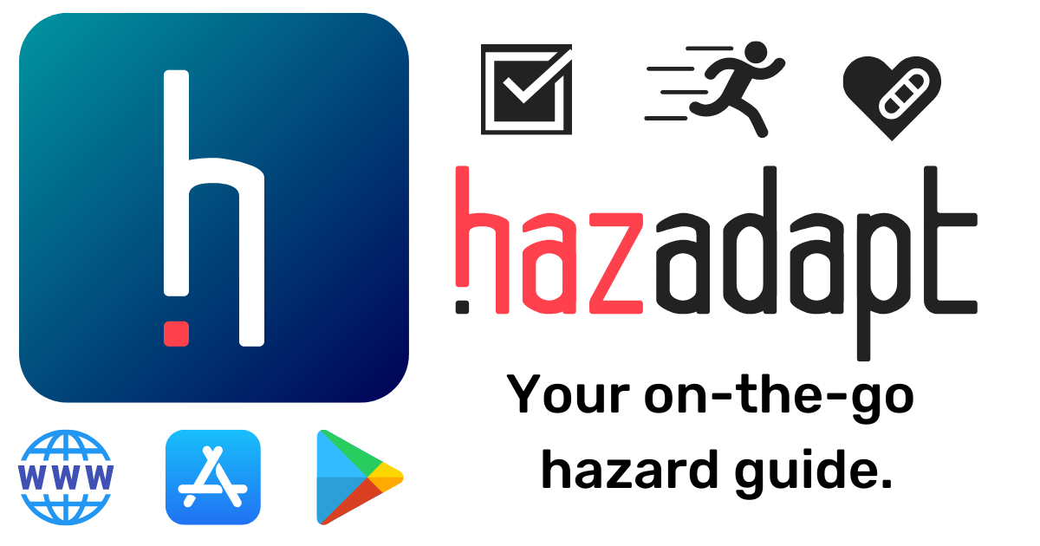

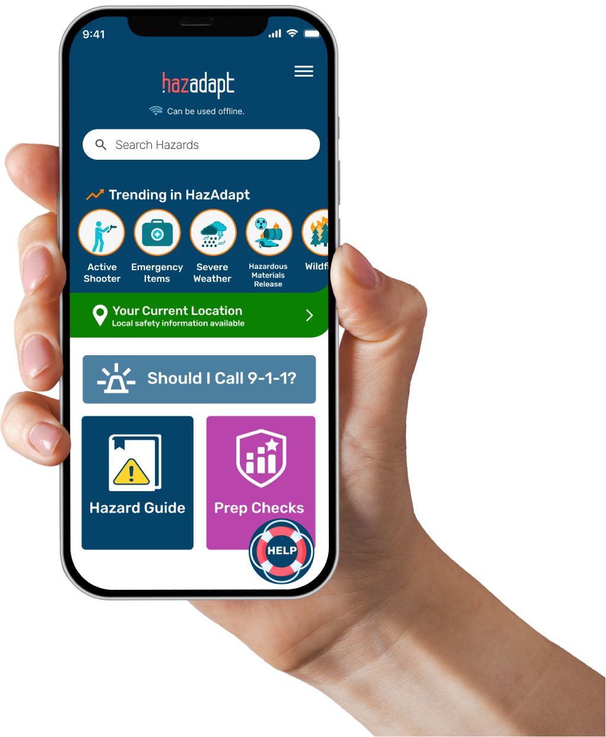
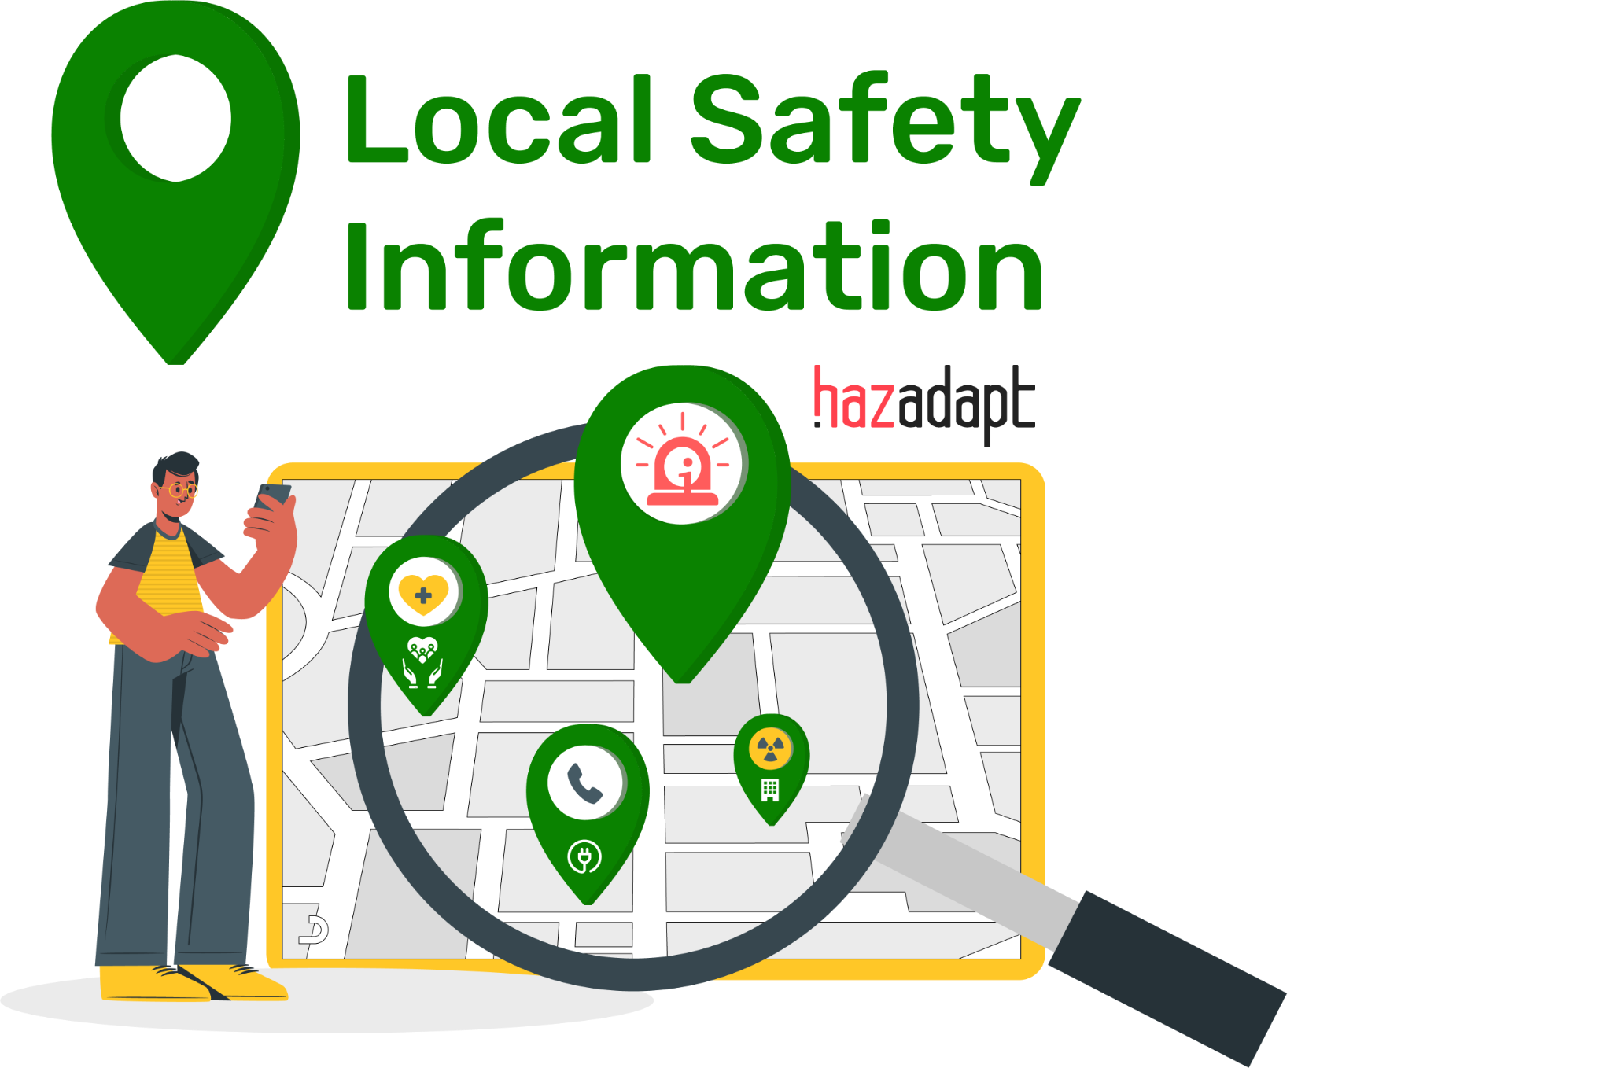

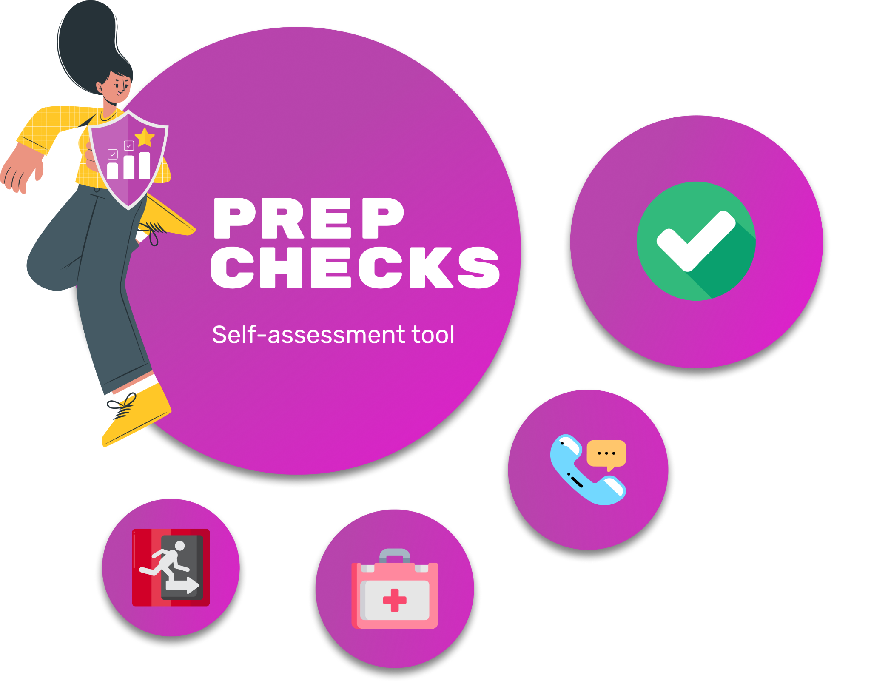
Make Disaster Preparedness Easier With HazAdapt Safety App!
Life-Saving Tools
Know what to do: Hazard Guides with step-by-step instructions how-to prepare, react, recover to 50+ emergencies.
Get help: Contact lists of local and national Crisis Support Options
Local Safety Information Get alert sign ups, and important location info boosted to you throughout the US.
How prepared are you?
Check and quickly improve your preparedness.
Notes:
HazAdapt is a safety app we recommend to help make your disaster preparedness easier and help you know what to do before, during, and after an emergency.
safety app & web tool for the public
prep, response, recovery support
customizable, just-in-time safety instructions and resources
disasters and everyday emergencies

Slide 2
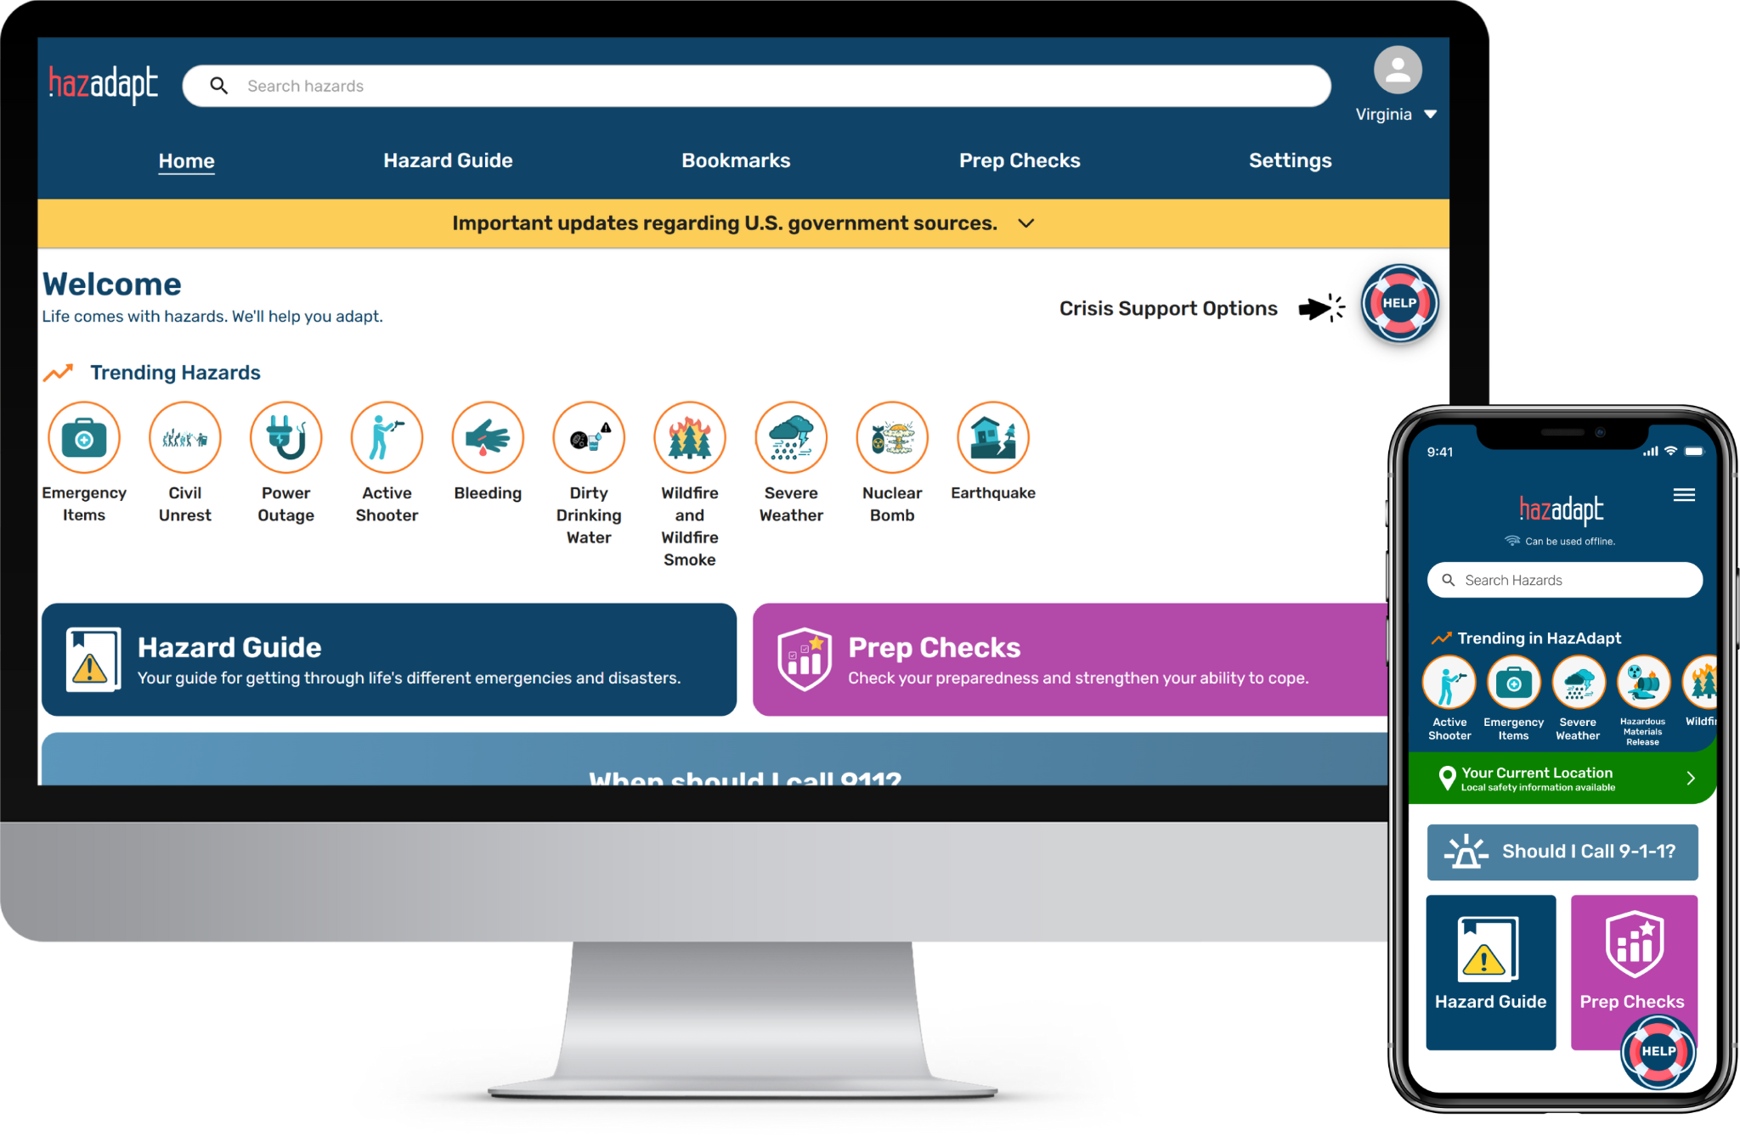

Information Accessibility and Security
100% FREE
works offline
safe to use - only you see your data
7 languages
Easy-to-read, trusted information
NO TROLLS ⬩ NO ADS ⬩ NO NOTIFICATIONS
Made in Oregon.
Trusted for emergencies in all 50 States.
Notes:
This is a free tool. you can download the app (best for offline service) or find online.
It does not send you alerts, but it will help you know what to do if your phone does not get an alert.

Slide 3
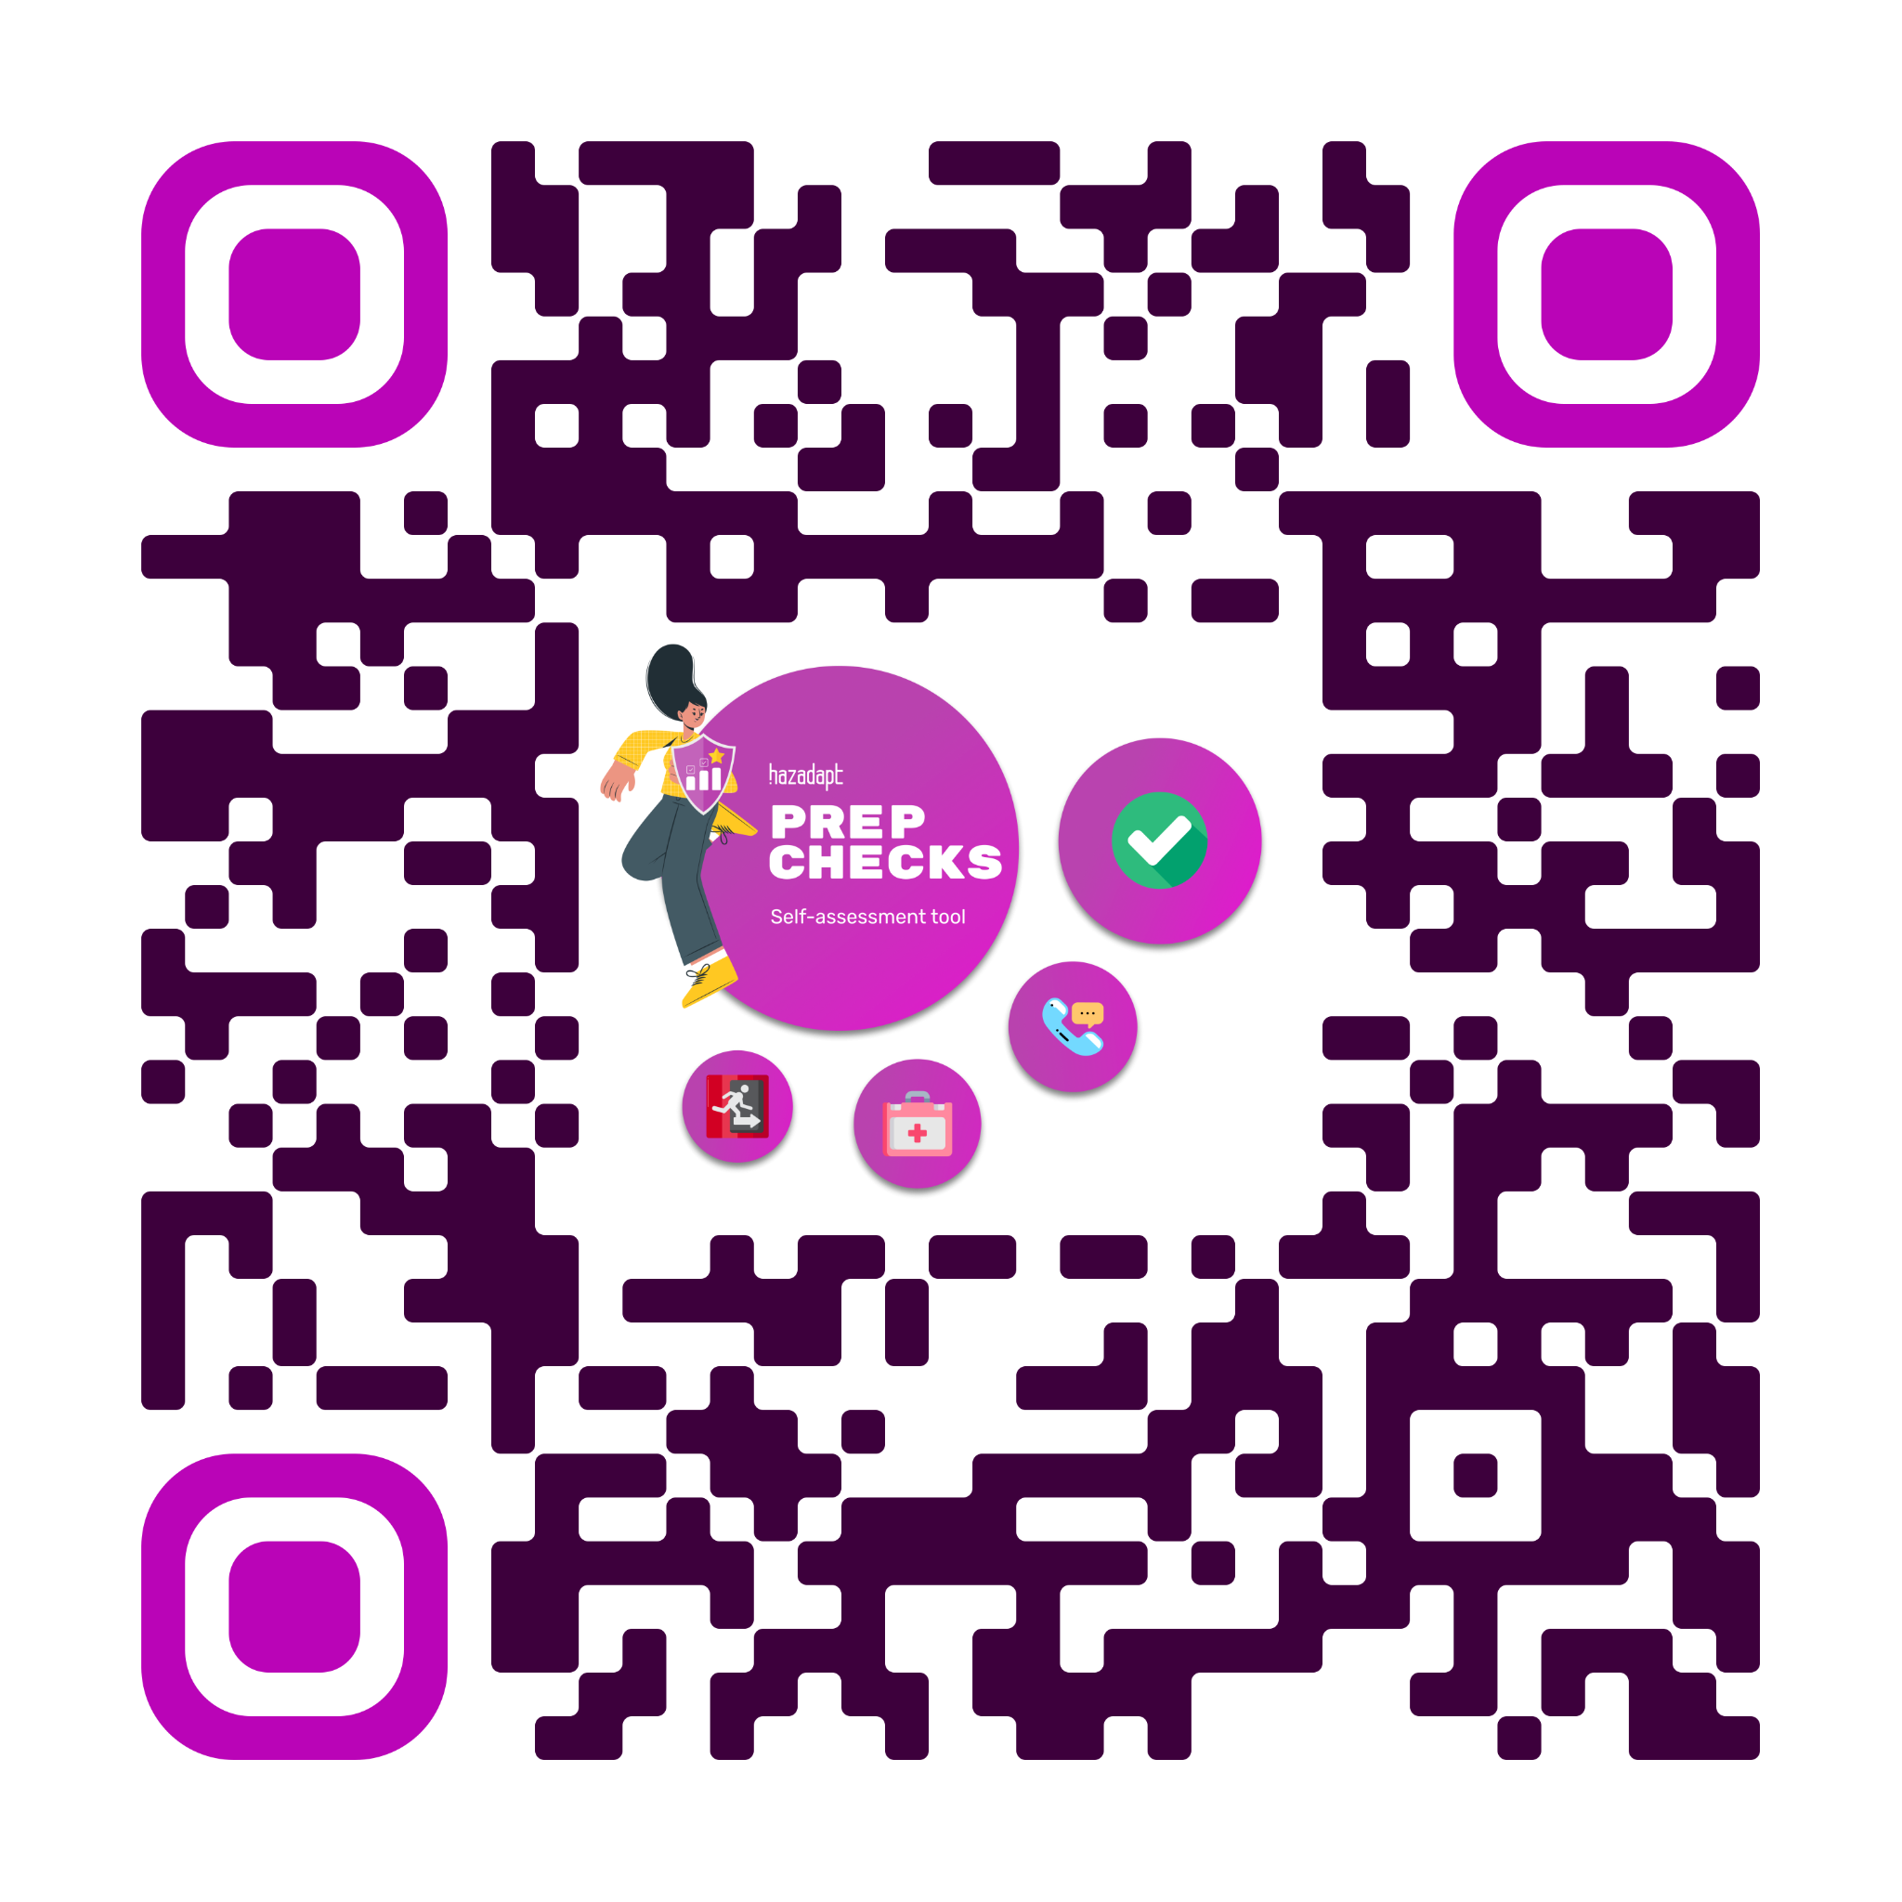
Let’s take a few minutes to check our preparedness for: a local hazard
Go to Prep Checks
Make an account (HazID)
Name, birthday, zip code, phone number, email.
Select the Prep Check and answer the three questions:
Do you know what to do?
What tools do you have now?
Who would you call for help?
🏁🏅See your preparedness score and what you can improve!
https://app.hazadapt.com/prep-checks
Notes:
Engagement Moment! (Usually less than 10 min) 1. Pick a hazard that is important to your community! 2. Open that prep check and go through the questions together: - Q1: Read the actions aloud, let the community members tell you where to put it. Offer advice, but let them be in charge. - Q2: What emergency items do you have? Let community members check off the items they have, (may take a few minutes.) “You can always go back and update your inventory any time!” - Q3: Read the question, allow people to offer suggestions for which contact they would put where, but encourage them to customize the contacts to their life and network. If in a local group setting, encourage them to add “Community members” as one of their ranked options as they are building those connections right now! 3. Submit the Prep Check! Congrats! You’ve just finished a Prep Check! Review the score and where preparedness could be strengthened, Offer an open flood for discussion - How did you do? - was there anything that surprised you?
- Where did you see opportunity to strengthen?

