Slide 1

MONTHLY REVIEW
Nordic – BUSINESS REVIEW, 2026

Slide 2

January 2026 – Department - District Org. Chart
Org. Update
Comments / Recent Changes
XX
XX
XX
INSERT DISTRICT ORG. CHART

Slide 3
January 2026 – Department – Training Dashboard
TR. Update
Comments / Recent Changes
XX
XX
XX
INSERT RELATED TRAINING DASHBORD

Slide 4
January 2026 – Denmark Department - District Pipeline & Heatmap
PIPELINE. Update
Comments / Recent Changes
XX
XX
XX
INSERT DISTRICT PIPELINE & HEATMAP

Slide 5
Update
Comments / Recent Changes
HEALTH INSPECTION
RISKPROOF
AUDITS
TRAINING
January 2026 – Foundation Operational Performance
AUDIT GO THROUGH
Monthly actuals & delta to budget
UPDATE MONTHLY
Summary
Overall summary & observations
Wins
Key successes & positive learnings
Challenges
Areas of improvement & growth opportunities

Slide 6
Update
Comments / Recent Changes
HEALTH INSPECTION
RISKPROOF
AUDITS
TRAINING
January 2026 – Foundation Operational Performance
BB DASHBOARD
Monthly actuals & delta to budget
Org. Update
Comments / Recent Changes
XX
XX
XX
UPDATE MONTHLY

Slide 7
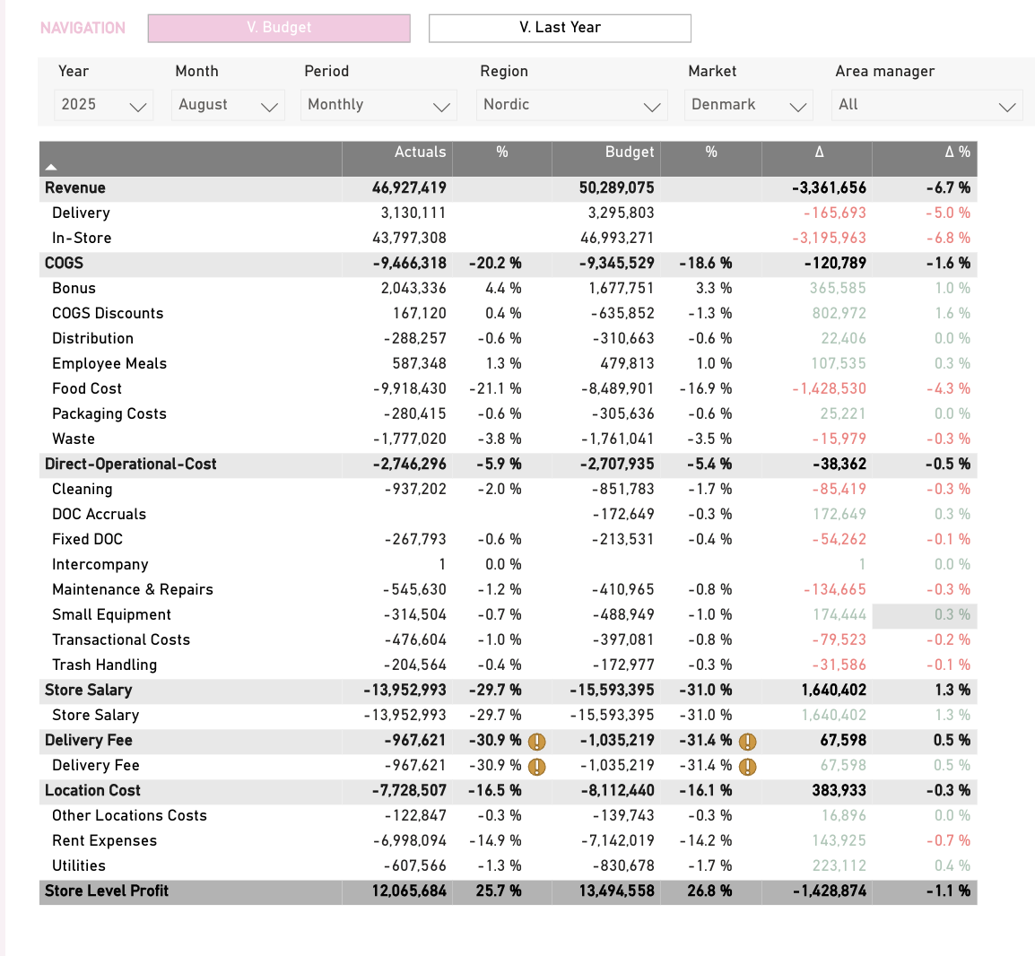
January 2026 – P&L Overview
DKK
Commentary
P&L highlights for the month
Revenue underperformance driven by closure of XX store and XX …
COGS overrun due to XXX …
Solid performance on Store Salaries due to productivity of …
UPDATE MONTHLY

Slide 8
January 2026 – Summary of the month
DKKm
Financials
Monthly actuals & delta to budget
Revenue
80,7
+10,3
SOC
20,1 (25,0%)
-3,2 (-2,5%)
SSS
+11%
WASTE%
+3,5%
UPDATE MONTHLY
Summary
Overall summary & observations
Strong heritage market performance – up 7m DKK YTD versus budget, with growth in same-store sales (+11%) and transactions (+4%)
Earnings underperforming – below budget expectations despite top-line growth
Cost pressure persists – COGS and overheads remain the primary drivers of variance
Wins
Key successes & positive learnings
Recalibrate FY forecast and budget – deliver a clear, country-by-country action plan to close the gap
Focus on essentials – avoid “wish lists” and unproven hopes; act on what delivers measurable results now
Drive impact at store level – ensure operational excellence happens where it matters most: in the stores
Challenges
Areas of improvement & growth opportunities
Deliver H2 game plan – present a clear, results-driven strategy to close the year strong
Define 2026 direction – set strategic focus and outline transformation priorities
Lead the budget process – get ahead of the curve with early, data-driven planning

Slide 9
January 2026 – Key Priorities & Monthly Action Plans
PRIORITY | ACTIONS / INITIATIVES | STATUS
INCREASE PRODUCTIVITY TO XX, ACHIVE SAL% ON XX … | Add action / initiative that will help achieve the overall goal / priority …
 | Add action / initiative that will help achieve the overall goal / priority …
 | Add action / initiative that will help achieve the overall goal / priority …
PRIORITY #2 | XXX …
PRIORITY #3

Slide 10
January 2026 – Key Priorities & Monthly Action Plans
PRIORITY | ACTIONS / INITIATIVES | STATUS
TEAM | Train every STM in ‘How to make a Juicer Training Plan’
 | Add action / initiative that will help achieve the overall goal / priority …
 | Add action / initiative that will help achieve the overall goal / priority …
EXPERIENCE | XXX …
PERFORMANCE

