Slide 1

MONTHLY REVIEW
Nordic – BUSINESS REVIEW, 2026

Slide 2
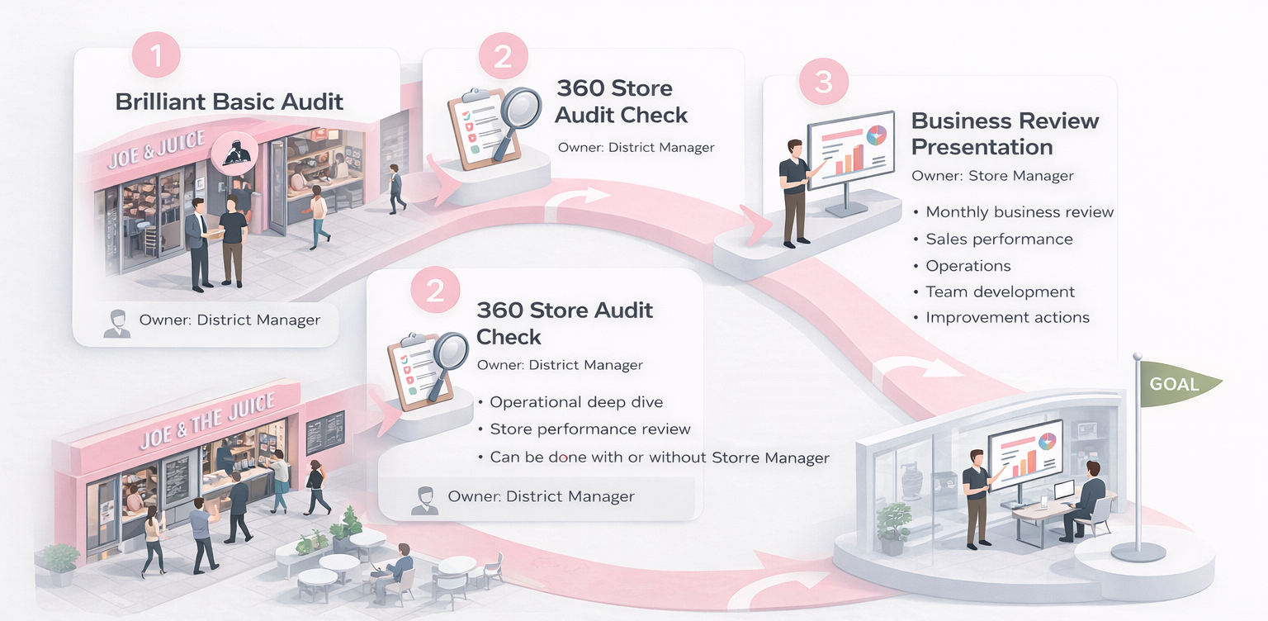
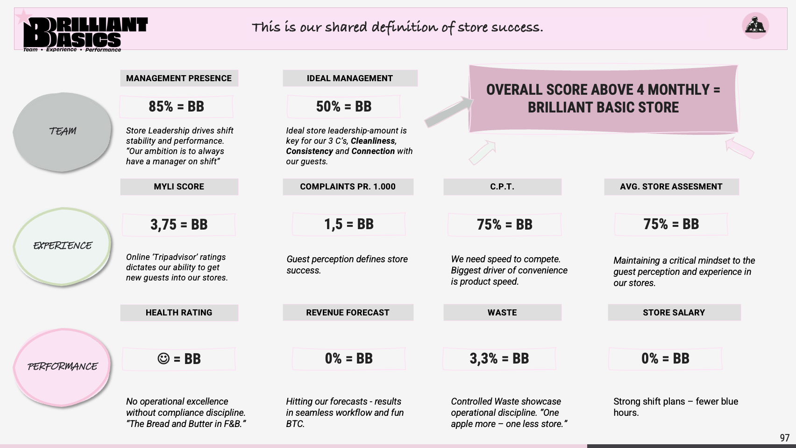
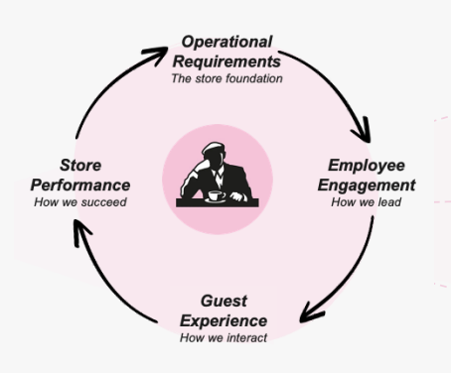
MONTHLY BUSINESS REVIEW SEQEUNCE
THE ANNOUNCED AUDIT
NORDIC BUSINESS REVIEW SEQUENCE
Quarterly
MONTHLY BUSINESS REVIEW
District - / Store Oreganisation
HeatMap and Team development
Audit Store Performance
BB Dashboard Performance
PNL and Sales Performance
Improvement actions
BB
1 UNANNOUNCED

Slide 3

January 2026 – Denmark Department - District Pipeline & Heatmap
PIPELINE. Update
Comments / Recent Changes
XX
XX
XX
INSERT STORE PIPELINE & HEATMAP (ORG)

Slide 4
Update
Comments / Recent Changes
HEALTH INSPECTION
RISKPROOF
AUDITS
TRAINING
January 2026 – Foundation Operational Performance
AUDIT GO THROUGH
Monthly actuals & delta to budget
UPDATE MONTHLY
Summary
Overall summary & observations
Wins
Key successes & positive learnings
Challenges
Areas of improvement & growth opportunities

Slide 5
Update
Comments / Recent Changes
HEALTH INSPECTION
RISKPROOF
AUDITS
TRAINING
January 2026 – Foundation Operational Performance
BB DASHBOARD
Monthly actuals & delta to budget
Org. Update
Comments / Recent Changes
XX
XX
XX
UPDATE MONTHLY

Slide 6
January 2026 – Key Priorities & Monthly Action Plans
PRIORITY | ACTIONS / INITIATIVES | STATUS
INCREASE PRODUCTIVITY TO XX, ACHIVE SAL% ON XX … | Add action / initiative that will help achieve the overall goal / priority …
 | Add action / initiative that will help achieve the overall goal / priority …
 | Add action / initiative that will help achieve the overall goal / priority …
PRIORITY #2 | XXX …
PRIORITY #3

Slide 7
January 2026 – Key Priorities & Monthly Action Plans
PRIORITY | ACTIONS / INITIATIVES | STATUS
TEAM | Train every STM in ‘How to make a Juicer Training Plan’
 | Add action / initiative that will help achieve the overall goal / priority …
 | Add action / initiative that will help achieve the overall goal / priority …
EXPERIENCE | XXX …
PERFORMANCE

