Slide 1
What is Autism?
‘Thinking Differently’

Slide 2

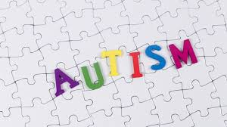
What does Autism mean?
People usually call it Autism but the official name is Autism Spectrum Disorders.
These behaviours happen when the brain develops differently and has trouble with an important job, which is making sense of the world.

Slide 3
Autism
Every day, our brains understand the things we see, smell, hear, taste, touch and experience.
But when someone's brain has difficulty understanding these things, it can make it hard to talk, listen, understand, play and learn.

Slide 4
Spectrum (Range)
Autism is a spectrum disorder, which means that it affects people in different ways, which range from mild, to moderate and through to severe.
Mild
Communication
Intelligence
Social Skills
0
Average
Good use
of speech
Gifted
1
2
Some difficulty
with speech
Average
Intelligence
Distant
3
4
Unable to speak/communicate using pointing
Severe Learning
Difficulties
Unusual
5
Severe

Slide 5
Signs of Autism
Each child will have unique abilities and challenges that they experience. For example, some children might be upset by too many noises or sounds that are very loud.
Children who have milder signs of Autism don't mind loud noises so much. Also, someone with mild signs of Autism might only need a little bit of help.
But children with severe signs of Autism might need a lot of help with learning and doing everyday things.

Slide 6
Signs of Autism
A child with severe signs of Autism might:
Be unable to start conversations, unless talking about their own interests, like planets, dinosaurs, trains, etc.
Do the same thing over and over, like saying the same word, slapping their forehead, swinging their bag, etc.
Refuse to participate in competitive games, like football, chess, ‘dobby’, or Monopoly, etc.
Move their arms or body in a certain way or kick, punch, grab and push other students.
Have trouble adjusting to changes, like moving to a different seat in the classroom, or having their belongings moved from their usual places, etc.

Slide 7
Living with Autism
Some issues — like not wanting to try new foods or not wanting to move seats — affect lots of children, not just those who have an Autism Spectrum Disorder. But children with Autism have more trouble "growing out of it" and learning to handle things that can be challenging to them.
Imagine trying to understand what your teacher was saying if you didn't know what their words really meant? And to make matters worse you can't come up with the right words to express your thoughts, or tell them what you need!
Try and imagine how you would feel if this was you?

Slide 8
Living with Autism
Doctors, therapists and SEN teachers can help children learn how to communicate better. For example a child with severe Autism might learn sign language or get a message across by pointing at pictures. Specialist workers can also help improve a child’s social skills by teaching them how to take turns, work in a group, meet new people, etc.
Children who have mild signs of Autism may choose to go to college, university and live on their own. However, some Autistic children will always need some kind of help. But all will have brighter futures when they have the support and understanding of their families, doctors, teachers, therapists, and friends at school.

Slide 9
Making Friends
Children with Autism often can't build the connections that other people make easily. For example, when people smile, you know they feel happy or friendly; when people look angry, you can tell by their face or their voice.
However, many Autistic children will struggle to understand what the different emotions look like and what another person is thinking. They might act in a way that seems unusual, and it can be hard to understand why they're doing it.

Slide 10
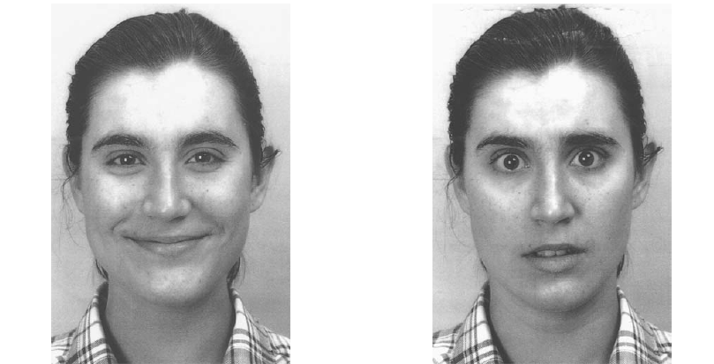
You are likely to know which emotion these faces mean.
What do you think these expressions mean?
The left one looks like the girls is happy.
But she could also be exhibiting sarcasm.
The right one looks afraid.
But she could also be feeling shocked.
For some people with ASD it is really difficult to know the difference.
Happy Afraid
Sarcastic Shocked

Slide 11

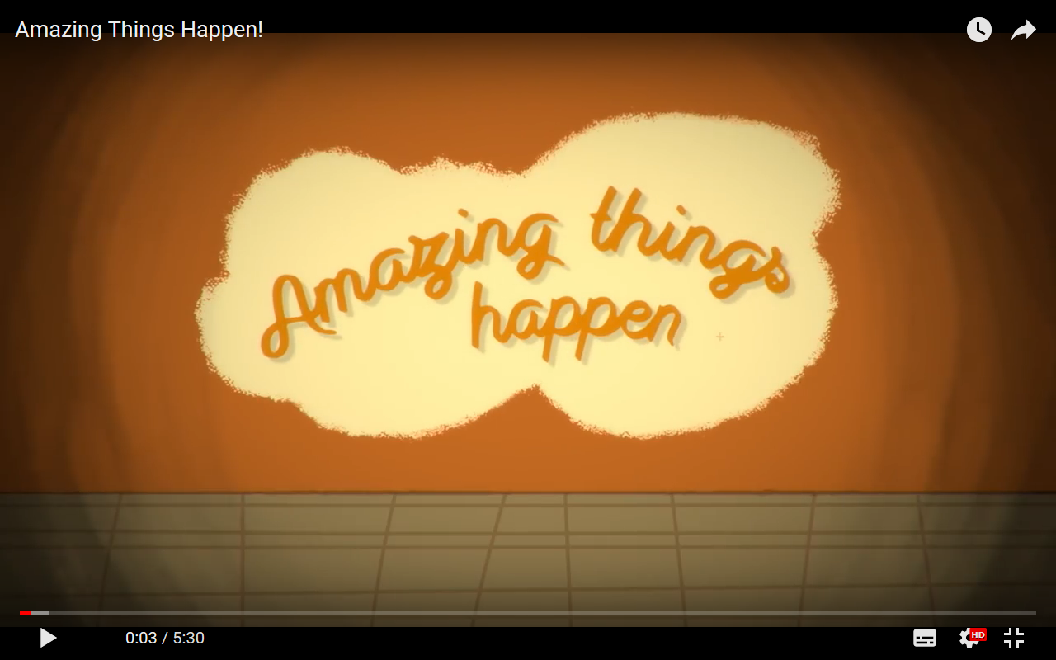
Watch this video created by children with Autism. Listen to how they perceive the world.
Make a note of any key facts and perceptions that you didn’t know or that surprise you somewhat.

Slide 12
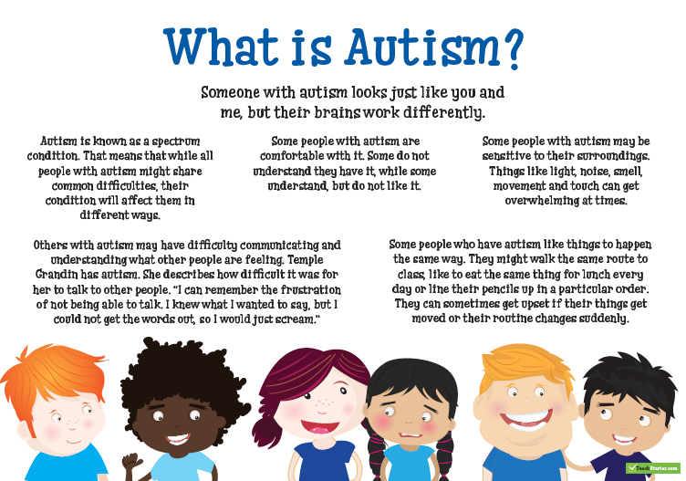
In Summary….

