Slide 1


2020 Year in Review

Slide 2
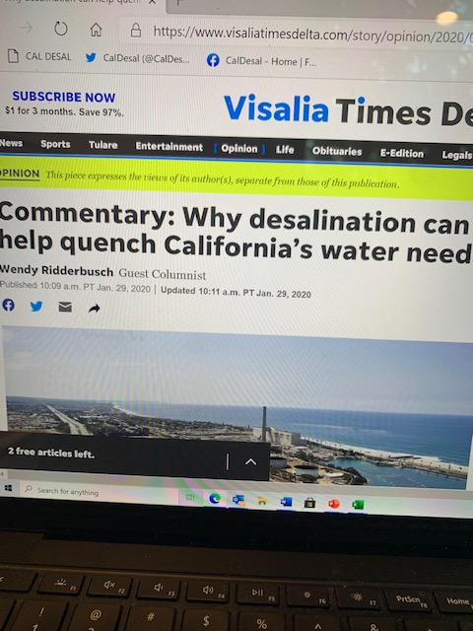
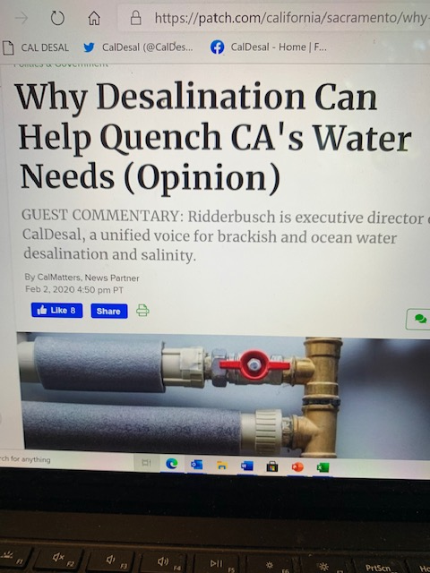
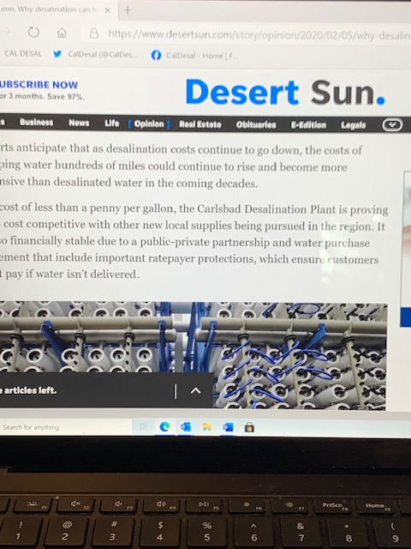
Cal Matters Publishes CalDesal Op-Ed

Slide 3
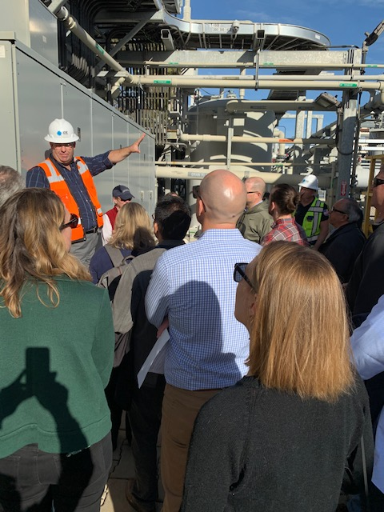
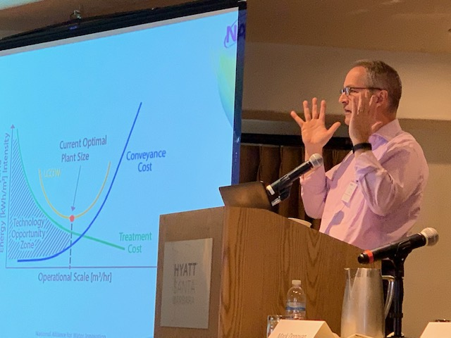
Annual CalDesal Conference
February 6 & 7, 2020 in Santa Barbara
$21,250 registrations
$19,250 sponsors and vendors
Over 100 attendees
City of Santa Barbara desal plant tour

Slide 4
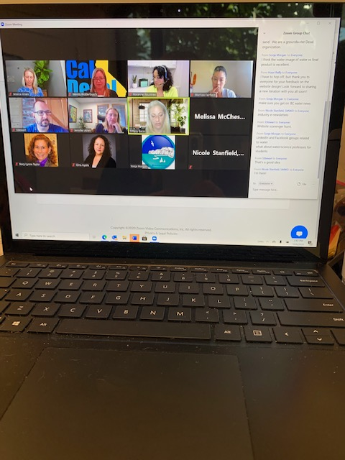
Consistent and Reliable
Policy Committee Meetings
New committees: Outreach Communications, Membership, and Technology Innovation
New Subcommittees: Website, Social Media, Ocean Plan Amendment Review, and FAQ Content Editor
Comprehensive meeting notes taken and distributed after every meeting
We held 68 committee and subcommittee meetings in 2020

Slide 5
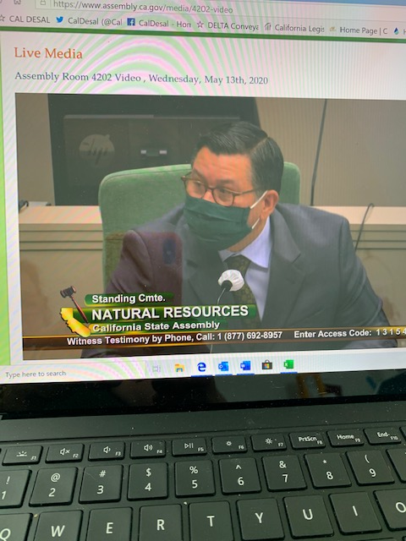
Pursued State and Federal Funding
Adopted support positions on state general obligation water bond legislation
Worked on federal bills: S. 1932 (Feinstein) and H.R. 3723 (Levin) Desalination Development Act
Collaborated with Sen. Feinstein’s office to ensure H.R. 2 (DeFazio) Moving (transportation and infrastructure) Forward Act includes desal funding

Slide 6

Voluntary Contributions
enhanced internal
enhanced internal
Southwest Strategies Outreach Communications Contract
California American Water
Mesa Water District
Poseidon Water
West Basin Municipal Water District

Slide 7
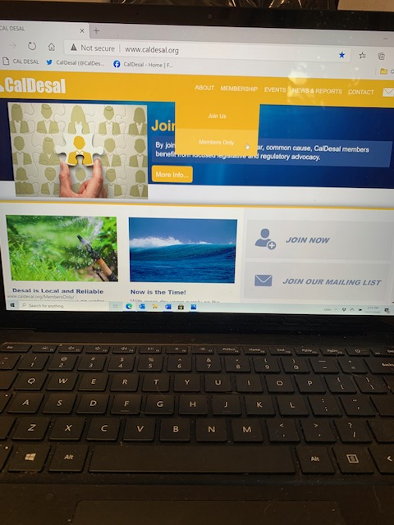
Updating Website and Social Media Experience
Created a “members’ only” page on the existing “Go Daddy” platform
Transitioning to the new CalDesal website on the “Webflow” platform for first upgrade in a decade
Updating Facebook, LinkedIn, Twitter platforms adding friends, likes, content

Slide 8

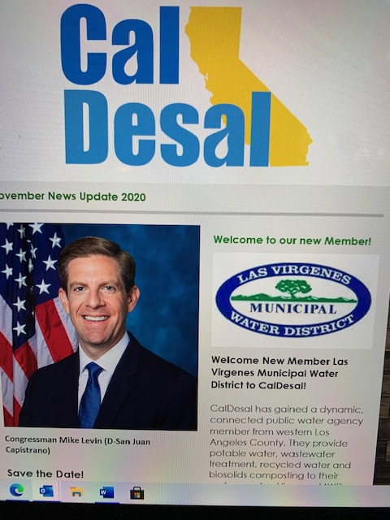
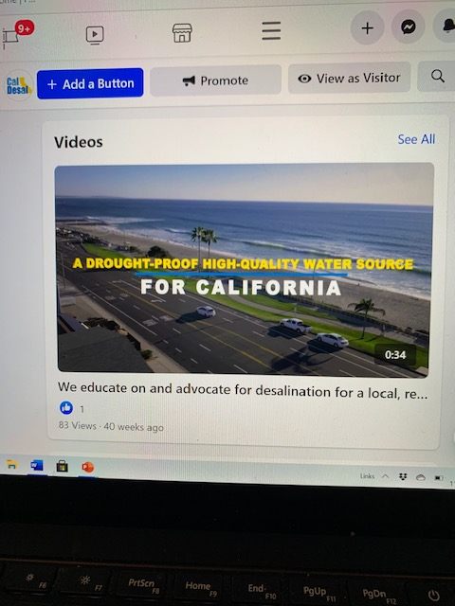

Outreach Communications Ramping Up

Slide 9



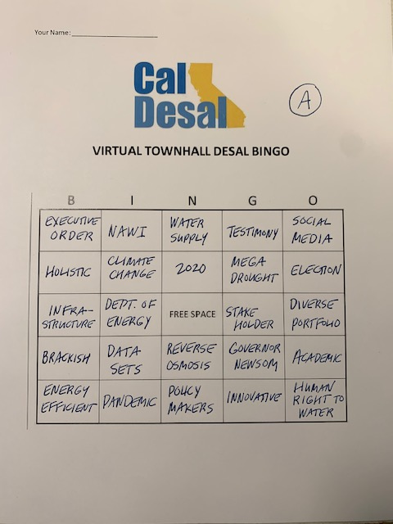

Virtual Townhall Meeting
Nancy Vogel, Governor Newsom’s Water Resilience Portfolio Director
Dr. Peter Fiske, NAWI

Slide 10
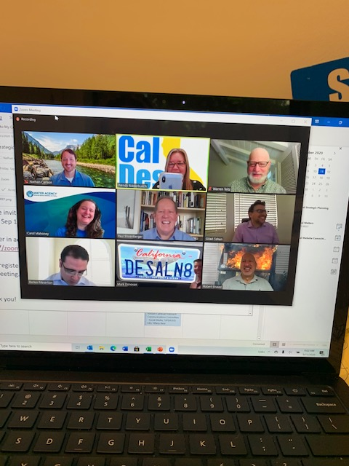
2021-22 Strategic Plan
Held a three-hour Strategic Planning meeting and worked through three drafts
Set organization’s priorities and goals to work towards in 2021 and 2022
Finished first Strategic Plan as a foundation for future more traditional longer-term plans

Slide 11
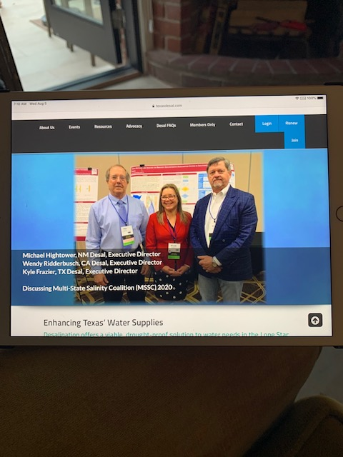


External Collaboration

Slide 12

ED Performance Evaluation
First 6-month informal check-in to ensure on right track
Annual Executive Committee formal review

Slide 13








Ongoing Recruitment and Retention

Slide 14

Looking forward to 2021
Covid-19 Vaccine
Return of In-Person Events
Bylaws Update
Continue Steady Growth
Focus on Strategic Plan Priorities

Slide 15

THANK YOU CALDESAL MEMBERS!
We appreciate and value your investment in our organization!

