Slide 1
Cultivating Belonging: Differences & Shifting the Culture
You Belong Here™
Grade 6 - Lesson 3
Notes:
TEACHER NOTES SECTION GUIDE:
Italic Text – Notes for instructors
Normal Text – Verbal Instruction (as you get familiar with the content, you are welcome to use your own voice, but feel free to use the verbal instruction notes we have included here as a guide)

Slide 2
Community Engagement
Protect the information in this space.
Share what you feel comfortable sharing.
Honor the knowledge in this space.
Stay curious. Be just uncomfortable enough.
Notes:
MS
Share what you feel comfortable sharing – Our goal is to create a safe space, so please share only what you feel comfortable, if something is too private you are welcome to talk to me one on one.
It’s also important that we don’t share the stories that belong to others. If this happens, I’ll gently remind you. We want to honor everyone’s right to tell their own story.
Protect the information in this space – Confidentiality – teachers and counselors are mandatory reporters, if you tell us about harm being done to you, harm you are doing to yourself, or harm you are doing to others we, by law, must make a report
Be kind to yourself and others, we want everyone to feel comfortable sharing and exploring and learning together. What is easy for you may be difficult for someone else and what is easy for someone else may be difficult for you.
Honor the knowledge in this space – the specifics stay here, the knowledge and lessons can be shared outside the space. I like to remember it this way: What is said here, stays here. What is learned here, leaves here.
Stay curious – listen to understand, not respond. Also- ask questions! Chances are if you have a question, someone else in the space is wondering the same thing!
Can we agree to these?

Slide 3
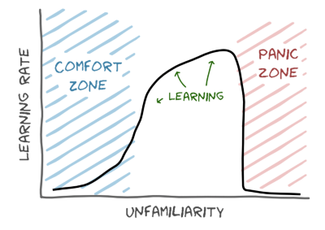
Learning to Grow
Learning about ourselves, others, our relationships, and many other topics can be a great way for us to grow. If you feel discomfort, that is normal. If you feel distress, please let yourself take a break. Learning happens when we move ourselves out of our comfort zone, while honoring our experience.
Notes:
Read the slide.

Slide 4
Discuss power and privilege
Explore the meaning and effects of dominant cultural norms
Explore how our bias causes us to notice differences
Discuss bullying and disconnection
Notes:
Read objectives, answer any questions that arise

Slide 5
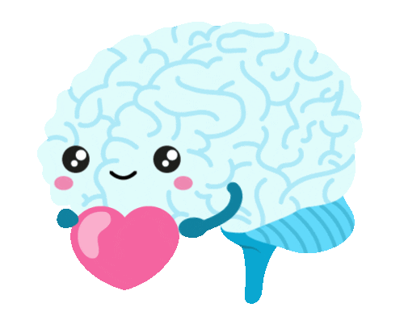
What’s up in our brains?
The Neurobiology of Identity
Notes:
Here’s a reminder of the brain science behind identity that we discussed in our last lesson. (You can choose to read this again, or paraphrase to remind)
We were born with a right to honor our whole selves- our bodies, minds, and spirits. We were born to nurture our inner voice, the one inside of us that seeks connection with other humans. This type of connection is something we as humans are hardwired to give and receive.
Interconnectedness is the way in which every human is connected to every other human, and in fact, there are special cells in our brains called mirror neurons that keep these connections throughout our lives.
Love and connection help humans to thrive. We are going to learn about the many ways we can cultivate this connection- both the messages we share and the inner voice inside of us- to create the types of lives we most want to lead.
Image source: @nerdbugs on giphy

Slide 6
The 3 M’s
Meditation
Mindfulness
Movement
Notes:
Mindfulness, meditation, and movement are 3 “M’s” that allow us to take care of our brains, hearts, and spirits. Mindfulness, meditation, and movement are all ways that humans have practiced making space for interconnection and inner peace. In fact, meditation actually changes not just the way we think and feel and our relationship to our own thoughts and feelings, but it also changes the anatomy of our brains.
We will practice one of these 3 M’s at the start of each lesson to ground ourselves in this learning space.

Slide 7
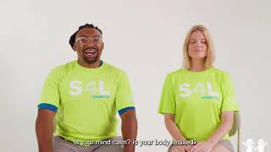
Notes:
Play Video: https://www.youtube.com/watch?v=rTvzhZxeMS4&t=3s

Slide 8
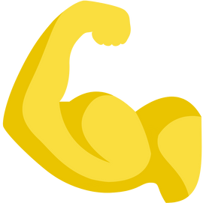
Power and the Dominant Culture
Notes:
Last lesson, we learned about culture (remind students of what culture means, if needed). In our culture, some identities and social groups hold power and privilege, and some don’t. In the dominant culture here in the United States, people who are white, middle class, Christian, able-bodied, English-speaking, heterosexual, and cisgender make up the dominant culture; and people in these social groups hold power and privilege.
Power can mean a lot of different things, and there are many ways to use and hold power. In our dominant culture, having power usually means “power over.”
Has anyone ever experienced the feeling of someone having power over them? We’re not going to share those stories, but I do want us to think about how that felt.
Have any of us ever used power over someone? Did this make you feel more connected to people, or less?

Slide 9
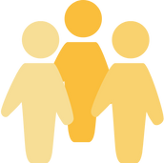
Power Over
Power With
Notes:
Having Power Over others is not the only way to think about power. We can also think about “power with.”
When people with dominant social identities start to think about power in these ways, they can share their privilege to create “power with.”
This type of power creates connections. Those connections can and have changed our culture
Can anyone think of any messages from our culture about which identities are more important than others?
(Look for: grown ups are more important than kids, hierarchies across gender, race, ability, socio-economic status, citizenship status, religion, geographic location, ethnicity, grade in school, teacher>student.).
When society gives us these messages that some identities are more important than others, a hierarchy is created.
A hierarchy is a way of thinking about people that makes some people more important than others. (Draw a pyramid on the board and write POWER OVER.)
How many people can fit at the top of this pyramid? (Students respond: not very many)
What about the bottom? (Students respond: a lot)
Hierarchies are designed for a small amount of people to have POWER OVER many others. Does this seem fair to you?
(Put an X through the pyramid, and draw a circle. Write: POWER WITH ).
How many people can fit in this circle? (Students respond: everyone). Does this seem fair to you?
Let’s examine these hierarchies and think about the ways we can replace them with circles. In a circle, everyone belongs, everyone shares power WITH one another.
So, which of these shapes gives MORE of us power? (a circle!)

Slide 10
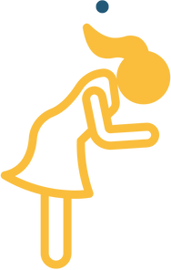
…and Privilege
Notes:
Privilege means the benefits a person gets by having identities close to the dominant culture.
Are there parts of your identity that hold privilege? Are there parts of it that do not hold privilege?
Think about the pyramid. If someone holds privilege and resides at the top of the pyramid, what is scary to them about giving up that power?
(look for- they don’t want to be at the bottom)
They have a “Scarcity mindset”- this means that they believe power, love, and resources are LIMITED. In our dominant culture, resources have been unfairly distributed so that people at the top of the pyramid have more.
Do you think this makes that person feel MORE connected to the rest of the world? (NO)
That person at the top of the pyramid is required by the dominant culture to live disconnected from others, and often from themselves.
Now, think about that circle. If that same person were to share power with others, do you think that person would feel more connected?

Slide 11
Under a system of oppression,
everyone suffers.
Notes:
Here’s the thing- systems of oppression like racism and sexism (which we can also call “patriarchy”), harm ALL OF US, even those who hold dominant identities.

Slide 12
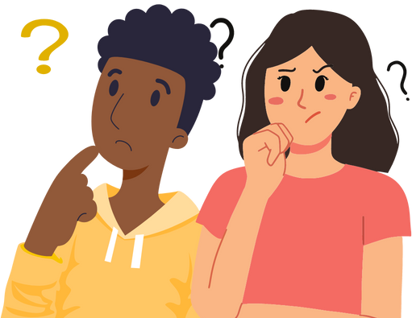
How am I noticing difference?
Notes:
Our brains are very good at noticing difference. When we notice difference based on a person’s social identity, we are making judgements based on our prejudices. This judgement is called “bias.” Some of our prejudice and bias is conscious - meaning that we are aware of it. And some of our bias is created so quickly by our brains that we’re not aware of it. This is called unconscious bias.
Prejudice is a judgement we hold about a social group or social identity. When we combine prejudice and power, we get harmful systems of oppression. Racism is one shameful example of this type of system. Anti-Black racism is a founding piece of our dominant culture. Racism is the way that prejudice is combined with abuse of power by people who hold dominant identities. Racism is such a big part of our dominant culture that it can be found in all of our institutions and systems. Everywhere.
When we are noticing difference, we have to be critical thinkers about the harmful messages our dominant culture is giving us about the way we and others are “supposed to be.”
We need to ask ourselves: how am I noticing difference?
When we notice difference as a way to connect, learn, and celebrate others, we can maintain interconnectedness in our culture.
When we use difference as a weapon, we are creating disconnection. This type of disconnection is REQUIRED by our dominant culture. Think back to the top of that pyramid.

Slide 13
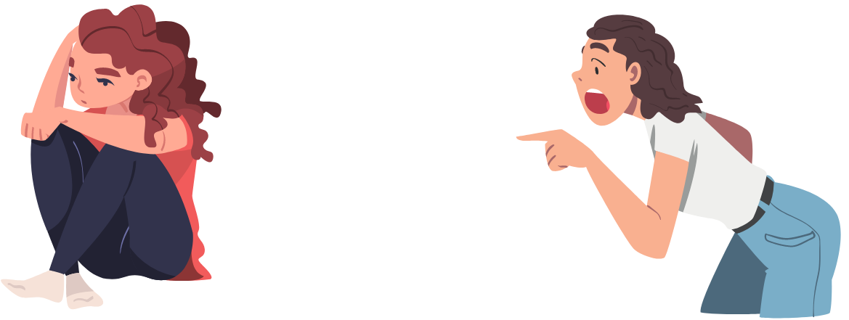
When difference is used as a weapon:
Harassment
Bullying
Notes:
Harassment is behavior that is designed to make a person feel bad about themselves and/or embarrassed.
When people use difference as a weapon, they disconnect themselves from the people around them.
Sometimes, they may be trying to fill an emptiness inside of themselves, or they want to use their power, or both.
Bullying is the term we use to describe repeated harassment.
Bullying and harassment can take place in real life, and they can take place online. Neither are okay.

Slide 14
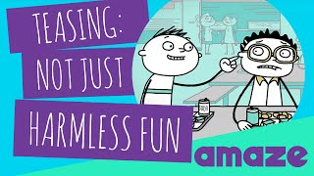
Notes:
Play video - https://youtu.be/nKKDsIuMaKU
Ask: How can we know if teasing crosses the line? (It’s not fun unless we’re both having fun)

Slide 15
Bullying = Disconnection
Notes:
Bullying behavior of someone who holds a scarcity mindset - they might not even be aware of it.
Bullying occurs when a person feels that their power is threatened, or because they are worried about not aligning with the rules set by our dominant culture.
Female-to-female bullying is one way that girls can experience bullying in this way. Often this is because of harmful messages we receive from media and society that tells girls that they have to compete with each other. It is one way that the message of girls not being good enough shows up inside of us - when girls bully other girls, it is one way that the dominant culture’s desire for us to be disconnected plays out.
I’ll give you a moment for reflection: Have you ever been the victim of teasing or harassment? Have you ever bullied someone? Have you ever witnessed bullying?
Remember, when we enact violence against each other, we threaten our hard-wired human need for connection. We are letting the dominant culture dictate how we live our lives.

Slide 16
Shifting the Culture
Notes:
We learned about a lot of important ideas today, and the ways in which the dominant culture can cause us harm.
As we continue to learn together, we’ll talk about the ways we can shift this culture. Each one of us has the power to confront those messages, think hard about the ways we are socialized, and decide for ourselves what kind of relationships we want to have with other people, what types of relationships we want to have with ourselves, and the communities we want to build together.
Culture was created by humans, and it can be changed by humans!

Slide 17
What is one thing you’re thinking about differently as
a result of this lesson?
Do you have a question?
Notes:
Have students stand (if they can) and ask for volunteers to answer the question or asking one…make sure they listen to others since duplicates are not allowed!

Slide 18
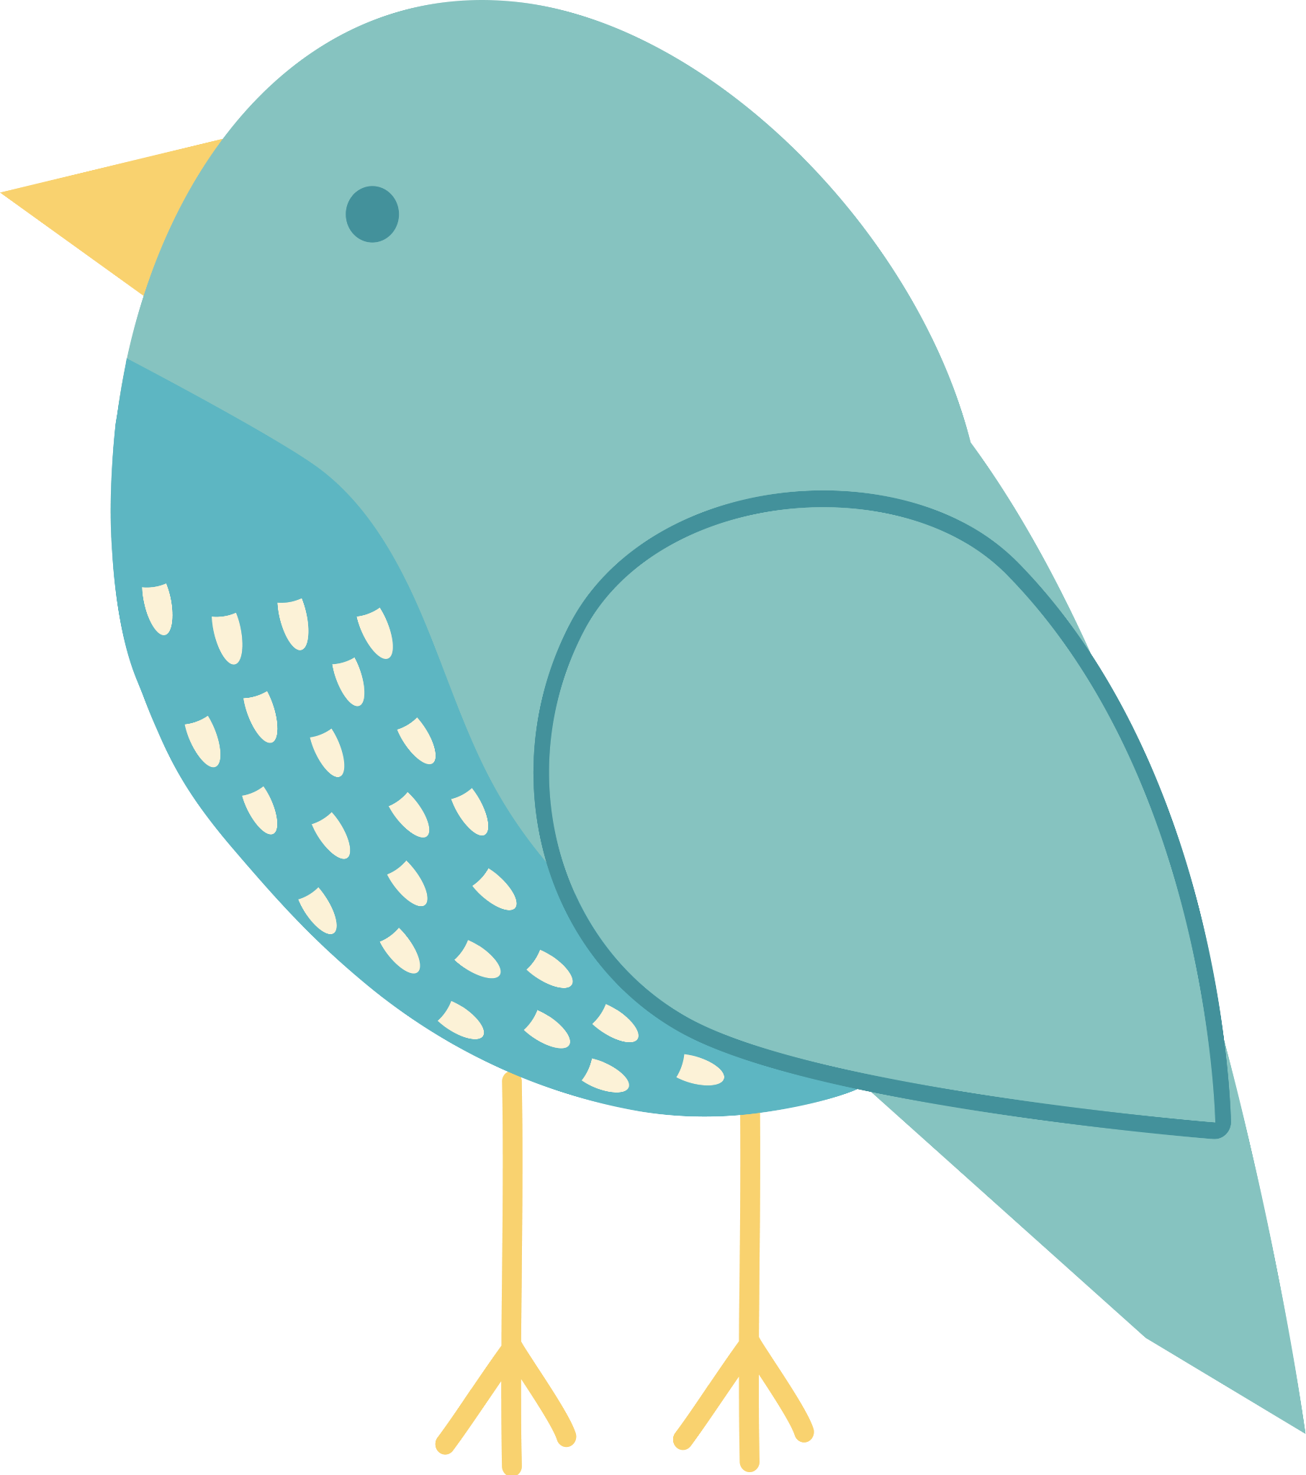
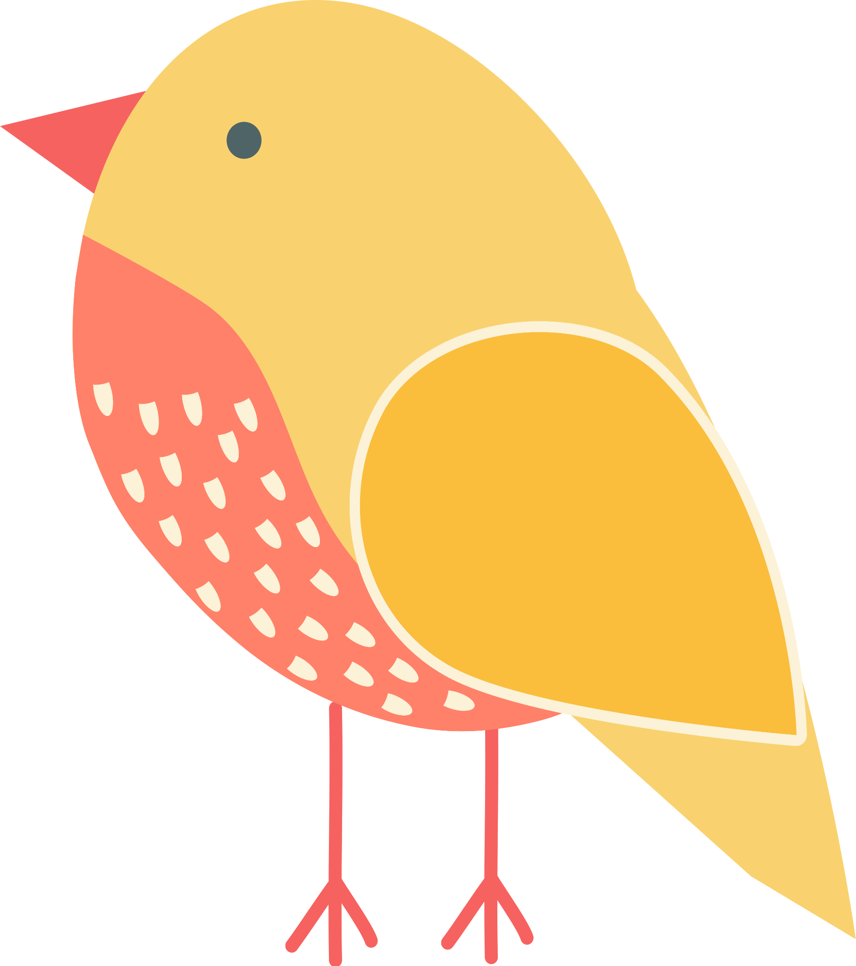
Thank You!
You Belong Here™

