Slide 1
You Belong Here™
Mental Health Advocacy Projects
Grade 5 - Lesson 4
Notes:
NOTES SECTION GUIDE:
Italic Text – Notes for instructors
Normal Text – Verbal Instruction (as you get familiar with the content, you are welcome to use your own voice, but feel free to use the verbal instruction notes we have included here as a guide)

Slide 2
Community Agreements
Share what you feel comfortable sharing.
Accept mistakes will happen
Be kind to yourself and others
Listen and be curious with others
Notes:
If students contributed additional community agreements in Lesson 0, display and refer to that list from the chart paper.
Before we begin our work today, can someone please read through our community agreements for the class?
Share what you feel comfortable sharing – we want to hear your stories. If a story is really private, I will ask you to wait and share it with me later. We’re also going to let others tell their own stories, so if I hear a story that belongs to someone else, I will remind you to share about your own experience and let that person own and share their own story.
Mistakes will happen, it is ok for us to make mistakes as we learn new information.
Be kind to yourself and others, we want everyone to feel comfortable sharing and exploring and learning together. What is easy for you may be difficult for someone else, and what is easy for someone else may be difficult for you. We are all different.
Listen when others speak, ask questions about their ideas - be curious!
Can we agree to these? Thumbs up if we can agree to use these agreements to build our solid foundation!

Slide 3
Mental Health
Stigma
Notes:
Let’s do a quick refresher from our last lesson. Who remembers what the term “Mental Health” means?
Look for: Like our physical health but for our minds and emotions, “Mental health includes our emotional, psychological, and social well-being”
CLICK
Our advocacy projects from last class are aimed at breaking down stigmas surrounding mental health. Can someone explain to me what “stigma” is?
Look for: unfair and negative beliefs about something, fear, lack of understanding, uncomfortable about mental health
Display the chart paper list from the previous lesson.
As a reminder, here are our ideas as a class (column 1) that promote mental wellness, (column 2) are examples of stigmas around mental health, (column 3) and advocacy ideas for how we can educate our school community. You can now get together in your project groups from the last lesson.

Slide 4
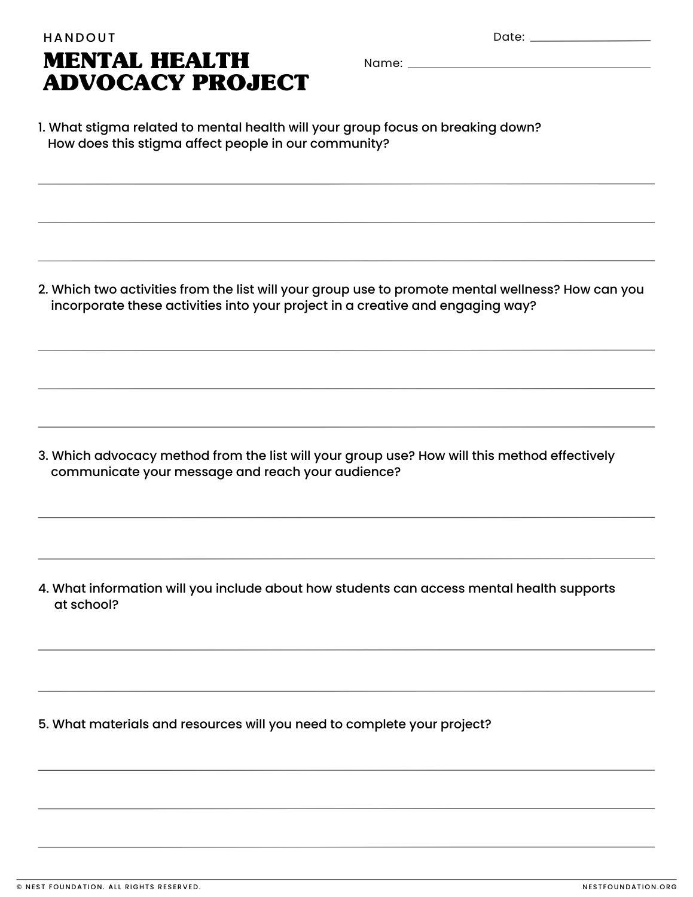
Notes:
As a reminder: Each group must pick one of the advocacy methods from the third column (or come up with another one), a stigma from the second column, and at least two activities to promote mental wellness from the first column. Their advocacy projects will need to work to break down their chosen stigma and promote mental wellness activities. Lastly, each advocacy project should include information on how students can access mental health supports at school. Provide this information on the following slide while students are working in their groups. Allow students the remainder of class time to brainstorm with their groups.
Have students arrange themselves in their groups from last class and take out their Mental Health Advocacy Project Handouts.
Have necessary materials available for students based on the last lesson. For example: poster paper, markers, etc. for groups creating posters. Have a visual timer available to keep students on track. Have the following slide available for students to reference if necessary.
Today we are going to continue on our Mental Health Advocacy Projects. You should all already have chosen your ideas and have your handouts filled out. You will have 25 minutes today to finish up your projects before presenting to the class.

Slide 5
School Counselor
Insert the information for the school counselor, social worker, or other mental health support staff on your campus here.
Include a photo, room number, and how to access support and encourage students to utilize this resource.
Notes:
Insert the information for the school counselor, social worker, or other mental health support staff on your campus on this slide. Include a photo, room number, and how to access support and encourage students to utilize this resource. Include how students can access this support, i.e. have the teacher connect you, create an appointment, etc.
Leave this slide up for students to reference during their work time.

Slide 6
Presentations
Notes:
Have students present their advocacy projects.
If possible, display student projects either in the classroom or around the school.

Slide 7
Mindfulness
Meditation
Movement
3M’
s
Notes:
Can someone name all of our 3 “M’s”?
Look for: Mindfulness, Meditation, and Movement
CLICK Very good, thank you. To end our time together today, we will do a meditation that supports our mental health but by helping us handle stress and anxiety.
Invite students to get comfortable with their sitting posture.

Slide 8
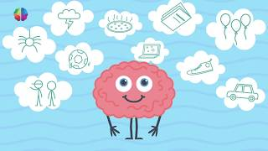
Notes:
Play video-https://www.youtube.com/watch?v=70j3xyu7OGw
Following the exercise, ask students to look at their Feelings Wheel handouts, and share one emotion they feel with a shoulder partner (allow about 2 minutes).

Slide 9
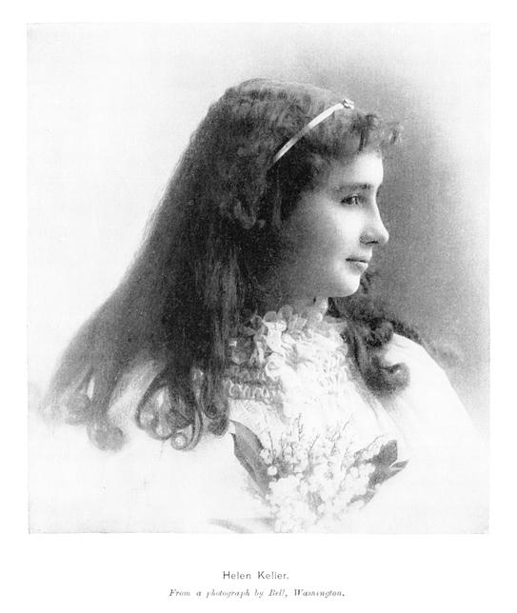
Alone , we can do so little;
Together, we can do so much
Notes:
Once again, thank you everyone for contributing your advocacy ideas today. I look forward to seeing them around our classroom/school and hope that they will help make our school community a stronger and healthier place.
To end our You Belong Here lesson today, let’s recite our closing quote all together.
Repeat after me:
Alone, we can do so little;
Together, we can do so much.

