Slide 1
Your Journey: Self-Kindness & Connections
You Belong Here™
Grade 5 - Lesson 1
Notes:
NOTES SECTION GUIDE:
Italic Text – Notes for instructors
Normal Text – Verbal Instruction (as you get familiar with the content, you are welcome to use your own voice, but feel free to use the verbal instruction notes we have included here as a guide)

Slide 2
Identify and categorize different types of self-care
Learn how kindness to ourselves, increases connection to others
Develop a self-care plan for ourselves
Notes:
As 5th graders, it’s easy to be more focused on your friends, than on yourself. Today we are going to explore why when you prioritize being kind to yourself and intentionally caring for your well-being, you make better connections with others.
Read the objectives or have a student volunteer read them outloud.
Today we are going to:
Identify and categorize different areas of self-care
Learn how kindness to ourselves increases our connection to others
Develop a self-care plan for ourselves

Slide 3
Community Agreements
Share what you feel comfortable sharing.
Accept mistakes will happen
Be kind to yourself and others
Listen and be curious with others
Notes:
If students contributed additional community agreements in Lesson 0, display and refer to that list from the chart paper.
Because we are doing this very special type of learning together, we’re going to take a minute to review and remind ourselves of the community agreements we created together in our last lesson.
Share what you feel comfortable sharing – we want to hear your stories. If a story is really private, I will ask you to wait and share it with me later. We’re also going to let others tell their own stories, so if I hear a story that belongs to someone else, I will remind you to share about your own experience and let that person own and share their own story.
Mistakes will happen, it is ok for us to make mistakes as we learn new information.
Be kind to yourself and others, we want everyone to feel comfortable sharing and exploring and learning together. What is easy for you may be difficult for someone else, and what is easy for someone else may be difficult for you. We are all different.
Listen when others speak, ask questions about their ideas - be curious!
Can we agree to these? Thumbs up if we can agree to use these agreements to build our solid foundation!

Slide 4
Mindfulness
Meditation
Movement
3M’
s
Notes:
Invite students to stand up next to their seats.
Right now, we’re going to get our brains ready for our learning today by doing a mindful movement activity. Remember, mindfulness, meditation, and movement are the 3 “M’s” that allow us to take care of our brains, hearts, and spirits. When we are better aligned, we are more prepared for learning.

Slide 5
Notes:
Play video-https://youtu.be/0vuaCHEAs-4
Following the exercise, ask students to look at their Feelings Wheel handouts, and share one emotion they feel with a shoulder partner (allow about 2 minutes).

Slide 6
“Speak to yourself with compassion on the inside and you will radiate peace on the outside.”
Amy Leigh Mercree
Notes:
Ask for a volunteer to read the quote on the slide.
“Speak to yourself with compassion on the inside and you will radiate peace on the outside.”
How would you interpret this quote?
Allow students to share and respond.
Self-kindness is an important quality that means being kind and gentle towards yourself. Just like we show kindness to others, it's also essential to be kind to ourselves. When we prioritize our own physical, emotional, social and spiritual health, we are better prepared to be a good friend, student, child, and a better person overall.
Self-kindness involves recognizing our limits, setting boundaries, and engaging in activities that promote our overall well-being. One important way to be kind to ourselves is to care for ourselves.
Source: Torres-Soto, N. Y., Corral-Verdugo, V., & Corral-Frías, N. S. (2022). The relationship between self-care, positive family environment, and human wellbeing. Wellbeing, Space and Society, 3, 100076. https://doi.org/10.1016/j.wss.2022.100076.

Slide 7
Self-Care
Notes:
Self-care. Raise your hand if you have ever heard of this term?
See if anyone raises their hand.
How would you explain it to someone who has never heard of it?
Invite a few students to respond.
Self-care means taking the time to do things that help you live well and improve your physical, emotional, social and spiritual health. Self-care can help you manage stress, lower your risk of getting sick, and increase your energy.
On the journey to becoming a middle school student, you are going to notice that your focus will shift to many different areas of your life like, school, relationships (dating, friends, etc.), sports, social media, gaming, and many other important things. However, in order to be your best self, it is important to take care of yourself. Even small acts of self-care in your daily life can have a big impact.
Source: National Institute of Mental Health. (2022). Caring for Your Mental Health. https://www.nimh.nih.gov/health/topics/caring-for-your-mental-health

Slide 8
Emotional
Physical
Social
Spiritual
Notes:
Split students up into groups of four. Direct students’ attention to the four labeled corners (Emotional, Physical, Social, Spiritual) around the room. Use the Self-Care Strategies Printouts or your own pieces of paper.
We are going to focus on “Self-Care” for today’s activity. When you look around the room you see 4 different posters. Each poster is labeled Emotional, Physical, Social, and Spiritual.
In your assigned groups, you will need to brainstorm 4-5 activities that can be done to increase self care for EACH of the four areas posted around the room. There can be NO duplicate activities. Once your team is done brainstorming, choose one person to add one activity to each sheet. IF the activity is ALREADY listed, another activity from your team list will need to be added. You have about 5 minutes to come up with possibilities before we add to the posters. And remember, NO DUPLICATES!

Slide 9
Self-Care
Physical
Dance party
Emotional
Journal writing
Social
Going to a movie with friends
Spiritual
Meditate in the park
Notes:
Here are a few examples to get us started:
CLICK
Physical: Is about taking care of your body and staying healthy. CLICK Dance party
CLICK
Emotional: Is about your feelings and understanding how they affect you and others. CLICK Journal writing
CLICK
Social: How you interact with others and build relationships CLICK Going to a movie with friends
CLICK
Spiritual: Is about your beliefs, values, and finding meaning in life. CLICK Meditate in the park
Allow students 5 minutes to work in their groups. When the five minutes are finished, the designated scribes can add their group’s self-care ideas to the 4 lists in the classroom.
Read through each list to the class. Feel free to leave the posters hanging in your classroom.
Have students remain seated with their groups. They will do another group activity together.

Slide 10
Benefits of Self-Care
Notes:
When you practice self-care and you are kind to yourself, you develop a positive attitude towards others. You learn to be understanding and empathetic towards their feelings and needs. This helps you build strong and healthy relationships with your friends, family, and classmates.
Now that we have a good list of self-care ideas, let’s learn more about the benefits.
Source: National Institute of Mental Health. (2022). Caring for Your Mental Health. https://www.nimh.nih.gov/health/topics/caring-for-your-mental-health

Slide 11
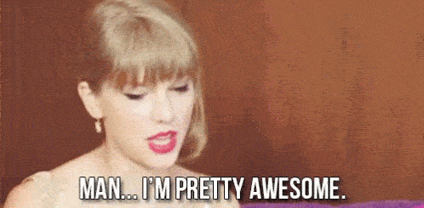
It boosts your confidence!
When you are kind to yourself, you start to believe in yourself more.
Notes:
Have a volunteer read the slide.
It boosts your confidence!
When you are kind to yourself, you start to believe in yourself more.
Image Credit: Tenor

Slide 12
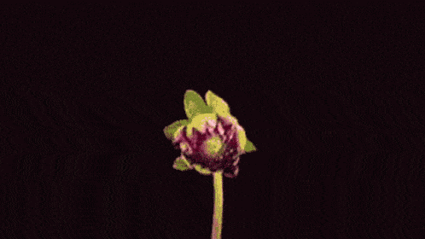
It helps you learn and grow.
When you're kind to yourself, you understand that making mistakes is a part of learning.
Notes:
Have a volunteer read the slide.
It helps you learn and grow.
When you're kind to yourself, you understand that making mistakes is a part of learning.
Image Credit: Tenor

Slide 13
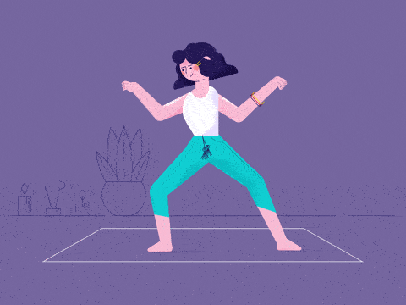
It improves your well-being.
Being kind to yourself means taking care of your physical and emotional needs.
Notes:
Have a volunteer read the slide.
It improves your well-being.
Being kind to yourself means taking care of your physical and emotional needs.
Image Credit: Anchor Point on Giphy

Slide 14
It creates a positive mindset.
When you're kind to yourself, you focus on the good things about yourself and your life.
Notes:
Have a volunteer read the slide.
It creates a positive mindset.
When you're kind to yourself, you focus on the good things about yourself and your life.
Image Credit: Tenor

Slide 15
C L A S S D I S C U S S I O N
Self-Care Scenarios
Erik the Gamer
Erik doesn’t have many friends. The kids at school think he’s mean but he’s actually really nervous. He spends his nights and weekends playing video games because he feels like no one likes him. His parents try to encourage him with family game nights, but Erik isn’t interested.
Notes:
Meet our new classmates, Erik, Diego, and Lela. We are going to read through a scenario for each one of them. A “scenario” is an example event or situation. We will then recommend an area of self-care they could practice to help them with their situation.
Whole class activity. Invite a student to read Erik’s scenario aloud.
Erik the Gamer
Erik doesn’t have many friends. The kids at school think he’s mean but he’s actually really nervous. He spends his nights and weekends playing video games because he feels like no one likes him. His parents try to encourage him with family game nights, but Erik isn’t interested.
Based on Erik’s story, what area of self care does he need to work on?
Wait for response: Social
I need three volunteers to find an activity on the Social poster that might help Erik.
Have the three volunteers walk to the Social poster and read their choice out loud.

Slide 16
C L A S S D I S C U S S I O N
Self-Care Scenarios
Diego’s School Stress
Diego is a straight “A” student. He wants to get into a STEM middle school, so he is always studying and has disconnected from all his friends. He’s now experiencing stomach aches and headaches from the extra stress.
Notes:
Invite a student to read Diego’s scenario aloud.
Diego’s School Stress
Diego is a straight “A” student. He wants to get into a STEM middle school, so he is always studying and has disconnected from all his friends. He’s now experiencing stomach aches and headaches from the extra stress.
In your groups, I want you to discuss which of the areas of self-care Diego could benefit from: Physical, emotional, social or spiritual. You will also need to choose a corresponding activity from that list for Diego to try. I will give you a few minutes to discuss. Please also choose a spokesperson for your group.
When students are finished discussing, instruct their spokesperson to get up and stand in the corner of self-care their group chooses. If groups choose different areas of self-care, have their spokesperson explain their reasoning.
Did any groups struggle to pick only one area?
Allow for responses.
It is common for more than one area of self-care to be lacking. Creating a balance between all four areas is important.
Ask each spokesperson to read one of the self-care activities from the list that their group chose.

Slide 17
C L A S S D I S C U S S I O N
Self-Care Scenarios
Lela’s Volleyball Pressure
Lela just made the team and she has become so popular that she wants to impress the coach and all her new friends. She focuses on this so much that she begins ignoring her own needs.
Notes:
Invite a student to read Lela’s scenario aloud.
Lela’s Volleyball Pressure
Lela just made the team and she has become so popular that she wants to impress the coach and all her new friends. She focuses on this so much that she begins ignoring her own needs.
In your groups, discuss which of the areas of self-care Lela could benefit from: Physical, emotional, social or spiritual. Remember to also choose a corresponding activity from that list for Lela to try. I will give you a few minutes to discuss. Please also choose a new spokesperson for your group.
When students are finished discussing, instruct their spokesperson to get up and stand in the corner of self-care their group chooses. If groups choose different areas of self-care, have their spokesperson explain their reasoning. Ask each spokesperson to read one of the self-care activities from the list that their group chose.

Slide 18
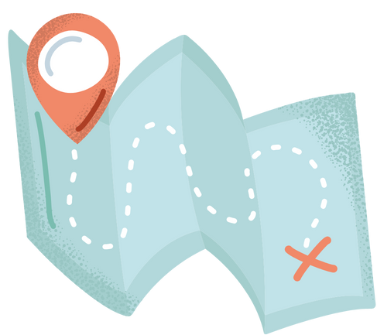
Self-Care
Roadmap
Notes:
Distribute the Self-Care Road Map Handouts to each student. After students complete their plan, they can be placed inside of a journal or posted around the classroom (whichever the student chooses). Depending on time, this can also be a homework activity
We are going to end our time today by each creating a personalized self-care “road map.” You can use ideas from our class lists, or from your own preferences. Feel free to write or draw.

Slide 19
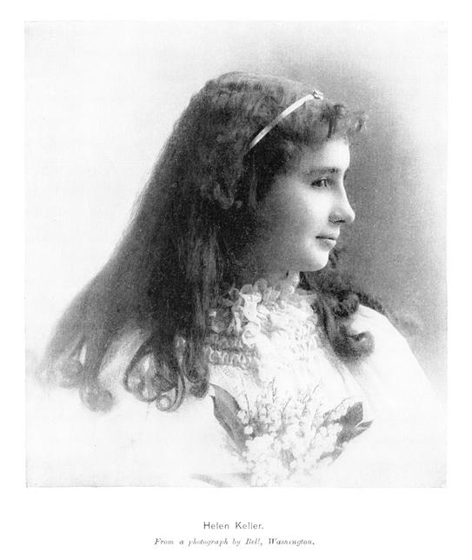
Alone , we can do so little;
Together, we can do so much
Notes:
Now that you have some ideas for your own self-care, leave it in a safe place so you can look at this when you need a reminder. You can also add more activities as we go throughout 5th grade. WE have done a great job today and continue to become better people everyday.
To end our time together today (and for all You Belong Here lessons), let’s end by reciting our closing quote all together.
Repeat after me:
Alone, we can do so little;
Together, we can do so much.

