Slide 1
Lesson 2:
Abuse Prevention
Nest© SB9 Curriculum
Grade 3
Notes:
*Compassionate response reminder* Teaching prevention education helps provide students with language and tools to define and identify abuse. Often while teaching prevention education, students will disclose experiences of harm or abuse to trusted adults. This lesson is trauma-informed and has been designed to acknowledge the varied experiences students may have. Before teaching please be sure to have viewed the Compassionate Response video and revisit as necessary to ensure you feel equipped to respond to instances of disclosure with a compassionate, trauma-informed approach. Please also confer with other school staff on how to handle student disclosures and navigate sensitive topics raised during these lessons.
Speaker notes key
Italics = notes to teacher (not to be read aloud)
Text = Language to read verbatim
Yellow highlight = special considerations or modifications

Slide 2
Self Care
We’re talking about abuse and safety. If you feel uncomfortable, it’s okay to let me know that you need a break. We will also be discussing how to get help at the end of this lesson.
Notes:
We’re talking about abuse and safety. If you feel uncomfortable, it’s okay to let me know you that you need a break. We will discuss how to get help at the end of this lesson.

Slide 3
Community Agreements
Be kind to yourself and others.
Share what you feel comfortable sharing.
Accept mistakes will happen.
Listen and be curious with others.
Notes:
Review with the class the Community Agreements with students to set a safe and welcoming tone in the classroom.
SAY: Share what you feel comfortable sharing – Our goal is to create a safe space, so please share only what you feel comfortable, if something is too private you are welcome to talk to me one on one
Protect the information in this space – Confidentiality – teachers and counselors are mandatory reporters, if you tell us about harm being done to you, harm you are doing to yourself, or harm you are doing to others we, by law, must make a report
Be kind to yourself and others, we want everyone to feel comfortable sharing and exploring and learning together. What is easy for you may be difficult for someone else and what is easy for someone else may be difficult for you.
Honor the knowledge in this space – the specifics stay here, the knowledge and lessons can be shared outside the space
Stay curious – listen to understand, not respond

Slide 4
Describe healthy and unhealthy friendships
Identify 3 trusted adults in their safety plan
Define abuse and neglect
Notes:
Read objectives

Slide 5
SAFE
UNSAFE
UNWANTED
Healthy Friendships
Trust
Fun
Kindness
Respect
Sharing
Notes:
5 min (this slide and the next)
SAY: Let’s review Safe, Unsafe, and Unwanted Touches from our last lesson, but we’ll think about our friendships.
If I have a HEALTHY friendship, what type of touch is involved between me and my friend? Safe, Unsafe, or Unwanted? Students should respond-Safe
Here are some other traits that you are in a healthy and safe friendship:
Trust
Fun
Kindness
Respect
Sharing

Slide 6
SAFE
UNSAFE
UNWANTED
Unhealthy Friendships
Yelling
Ignoring
Exclusion
Teasing
Shaming
Notes:
When it comes to Unsafe touches or Unwanted touches and our friends, both are clear signs that a friendship is unhealthy. What are some other signs that a friendship is unhealthy? Allow students to answer, then click through unhealthy responses.

Slide 7

Notes:
Say: What about friendships online? How do we know if they are Safe or Unsafe? Allow a few students to respond. Now we will watch a video to share some information that will keep us safe online.
Please end the video at 3:00 if it does not end automatically.

Slide 8
Online Safety Tip
How do they talk?
Controlling signs
Getting serious to quickly
Wants you to send photos
Never give any personal information.
If it starts getting weird get an adult that you trust.
Leave the chat, and get help
What to look for:
Don’t forget to:
Notes:
Ask: What are your thoughts on that video? Allow a few responses.
Ask: Where would you likely encounter someone pretending to be a kid in the digital world? Encourage students to share the names of games, chat rooms, apps etc.
Say: As you grow up, you will have more opportunities for independence. With that freedom you will be challenged to make decisions, that can be challenging and sometimes they may even cause you to feel uncomfortable. Let’s review the tips to remember to keep your friendships safe online. Review the tips on the screen

Slide 9

Trusted Adults
1.
2.
3.
Notes:
3 min
SAY: When it comes to adults that make you feel safe, usually you have a healthy/good relationship with them. Remember the last lesson we did? Take out the list of your 3 trusted adults. Quietly read their names to yourself. SHARE OUT: If you feel comfortable, let’s share. Who are they? If you would like, everyone can share out the name of one of their trusted adults, if you would like to.
Quick share (move through student share outs quickly without adding commentary after each one).
Think about the last time you asked them for help or asked them questions about something you needed to talk to a trusted adult about.
*Emphasize that there are lots of trusted adults in our lives who are not our parents. Give examples from your personal life.*
Model: “One of my trusted adults when I was a kid was _____, I asked them for advice about _____ regularly.”
Share out 3-4 student responses. Listening and affirming as needed.
ASK: Why do you think we put the names of our trusted adults in a heart? (because they make us feel cared for, loved, safe, etc.)
SAY: Today we will be talking more about more serious situations of physical boundaries being crossed. What to do, who to get help from, and how to start a help seeking conversation. This may make you uncomfortable. It is important that you listen to your feelings and your body. I am here for you. If you would like to talk to me or someone at school after, please let me know. If you need to take a break, you can ______.
(Remind students of the place in your classroom where they can sit for a few moments to calm down or reset.)

Slide 10
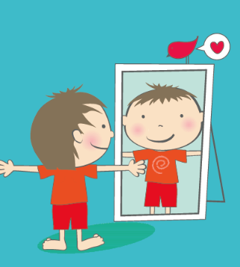
Taking Care of You!
One of the most exciting parts about being __ years old is that you are learning all about YOU!
When you need rest
What foods you like
Listening to your body
What makes you feel good
How to manage big emotions
Ask for help
Advocate for yourself
You’re the boss of your body
& so much more!
Notes:
1 min
SAY: One of the most exciting parts about being __ years old is that you are learning all about YOU! When you need rest, What foods you like, Listening to your body, What makes you feel good, How to manage big emotions, Ask for help, Advocate for yourself, and ultimately you are learning how to be the boss of your own body.
A big part of learning growing up comes with knowing what is safe and what is unsafe as it relates to your body. Now that we talked about how to keep you safe online, we are going to talk about the safety of your body.

Slide 11
Turn and Talk
With your seat partner or table, share out 2 things you have learned about yourself this year.
The person with the shortest hair shares first! Be ready to share out what your partner said.
Examples:
During recess, I run as hard as I can because I have so much extra energy.
When I need alone time, I like to go in my room and listen to music.
When I am feeling funky, I take my dog for a walk. It always changes my mood.
Notes:
5 min
ASK: What are some things you are learning about yourself right now?
SAY: Students share in pairs (on the carpet) or in small groups (at desks/tables). Offer a personal example to model for students. Example: When I was younger, I realized that I don’t like to run, but that I love riding my bike. I am still the same way!
Let students share in pairs/small groups then do a share out. Listen and affirm student responses.
SAY: Learning how to take care of you is one of the most important things you learn at this age. What hobbies you enjoy, what your hopes and dreams are, how you like to be treated, etc. This is such an exciting time in your life! Part of learning how to take care of you is always knowing that your body is yours. You are the boss of your body!
We are going to learn more today about safe and unsafe touches.

Slide 12

Bathing Suit Rule
Think about the area your bathing suit covers.
This is a private area.
ALL ADULTS KNOW THE BATHING SUIT RULE.
Notes:
1 min
SAY: We are learning a new rule today that relates to unsafe touches. It is called the bathing suit rule.
ASK: What is it called? Have students call back: the bathing suit rule.
Think about when you go swimming and what your bathing suit usually looks like. Pause. The area this covers is called your bathing suit area. It is a private area.
ALL ADULTS KNOW THE BATHING SUIT RULE.

Slide 13
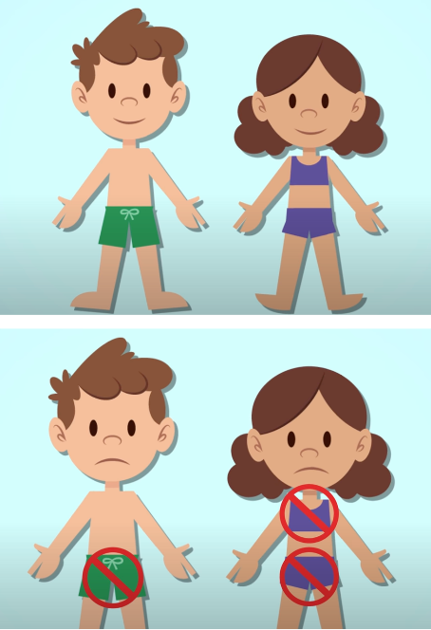
Bathing Suit Rule
It is NEVER okay for:
An adult or child to touch this area
You to touch someone’s bathing suit area
Someone to show you theirs or ask to see yours.
Notes:
1 min
SAY: Here are 3 parts of the bathing suit rule:
It is NEVER okay for:
An adult or child to touch this area. UNLESS they are a doctor and your parent or caregiver is in the room.
You to touch someone’s bathing suit area
Someone to show you theirs or ask to see yours

Slide 14
Surprises vs. Secrets
Fun! Usually make everyone feel happy
Revealed after a short period of time
Example: It is your cousin’s birthday next week, and the whole family is throwing a surprise party for them. Your family asks you to not tell about the party.
Stop someone from knowing something
Can make you feel uncomfortable, sad, mad, or confused.
Someone wants you to keep it “forever” or to “never tell anyone”
Can lead to someone getting hurt
SURPRISES
SECRETS
Notes:
2 min
SAY: Another important part about growing up, is learning the difference between surprises and secrets.
Let’s talk about surprises!
Fun! Usually make everyone feel happy
Revealed after a short period of time Example: It is your cousin’s birthday next week, and the whole family is throwing a surprise party for them. Your family asks you to not tell about the party.
ASK: What are some examples of surprises? (gifts, parties, surprise visitor, something unexpected and happy)
SAY: Now when it comes to Secrets:
Stop someone from knowing something
Can make you feel uncomfortable, sad, mad, or confused.
Someone wants you to keep it “forever” or to “never tell anyone”
Can lead to someone getting hurt
SAY: If someone wants you to keep a secret and tells you, “No one will believe you if you tell” or “Your mom or dad will be so mad at you if you say something” that is not okay. They are in the wrong. You SHOULD tell a trusted adult.
ASK: What do you think the difference between a surprise and a secret is? (secrets might hurt someone’s feelings, they never get told, someone could get hurt, etc)

Slide 15

Bathing Suit Rule
If someone breaks the bathing suit rule, it is not to be kept a secret.
Adults should never ask kids to keep secrets.
It is never too late to tell a trusted adult about a secret you know.
Notes:
1 min
SAY: If someone breaks the bathing suit rule, it is not to be kept a secret. A trusted adult wants to know so they can help! Adults should never ask kids to keep secrets.
It is never too late to tell a trusted adult about a secret you know.
**Remind students that if they know a secret that they now realize they should TELL, it’s never too late to tell a trusted adult about what happened. **
TEACHER NOTE: Grooming basics includes adults testing boundaries with keeping secrets. An adult might secret/boundary test and it may escalate from there if a child keeps a secret.)

Slide 16
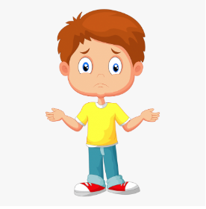
Uh-Oh Feeling
An Uh-Oh Feeling is your Intuition (your inner voice).
Your intuition:
Lets us know when we might not be safe
Tells us something is “just not right”
Notes:
3 min
Let students know that the word for that “uh-oh” feeling is “intuition.”
SAY: Our intuition is an inner voice that gives us messages. Sometimes intuition lets us know when we might not be safe. Our intuition is the part of us that can sometimes tell us ahead of time if something might not be safe, or that something is “just not right”. It’s usually a feeling, like a flutter in your gut or as if the hair was standing up on the back of your neck. The “Uh-Oh Feeling” is what we often call this feeling of our intuition telling us that something might be wrong. It’s our body saying “Uh-Oh! Something isn’t right”
Help children understand how to recognize their intuition warnings and identify in their own body where the “uh oh!” feeling shows up – it can be different for everyone!
ASK: “Where do you feel ‘Uh-Oh’ Feelings in your body? Does this feel like a lump in your throat? Or, a sinking feeling in the bottom of your stomach? A shiver along your arms? A creepy feeling on the back of your neck? A thought that keeps coming back to bother you?”
Students share out.
ASK: When was a time you listened to your intuition or uh-oh feeling? What happened? Teacher includes a personal anecdote to model.
Students share out.

Slide 17
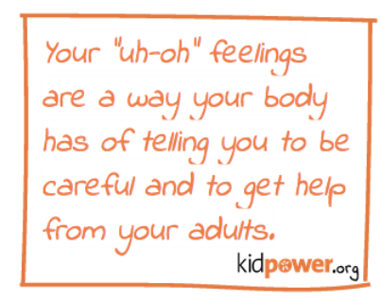
Uh-Oh Feeling
Always listen to your intuition or uh-oh feeling!
Go and tell one or more trusted adults.
Tell someone until they listen and believe you.
Notes:
1 min
ASK: Always listen to your intuition or uh-oh feeling. Read the slide
Reinforce for students that if that voice or any part of them gets an uh-oh feeling, they should go and tell one or more adult they trust. Tell someone until they listen and believe you.

Slide 18
Body Boss Toolkit
Listen to my body.
Go someplace safe.
Tell a trusted adult.
Notes:
1 min
SAY: If anyone ever breaks the bathing suit rule or has broken in it the past, you can: listen to you body, go someplace safe, and/or tell a trusted adult. It is okay for you to follow these steps even if the bathing suit rule has been broken in the past.
We have three new tools to add to your body boss toolkit. You can do all three of them if it feels right for you.

Slide 19

Listen to My Body
Everyone’s body reacts differently.
You might:
Yell
Freeze
Cry
Fight back
Feel confused or angry
Notes:
1 min
SAY: If someone breaks your bathing suit rule, your body may respond in different ways. Each person is different. Some people might yell, some might freeze, some might cry, fight back, feel confused or angry. Some might do all of these things. It is okay. Everyone’s body reacts differently.
It takes a lot of courage to tell someone NO or STOP especially if they are an adult of older kid. No matter who it is- they are not allowed to touch your bathing suit area. UNLESS they are a doctor and your parent is in the room.

Slide 20
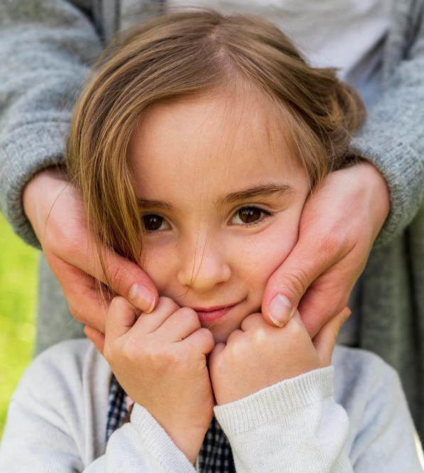
Go Someplace Safe
A place where there are people you know and trust who will listen to you.
Where would be a safe place you could go at school, home, a friend’s house, at the mall, etc.?
Notes:
1 min
SAY: Another thing you can do if someone breaks the bathing suit rule is to go away from them right away to a safe place. A safe place is somewhere there are people you know and trust and who will listen to you. A safe place is somewhere you feel safe and protected.
ASK: Where would be a safe place you could go?
Discuss safe places in a variety of environments: school, home, a friends house, at the mall, etc.)

Slide 21
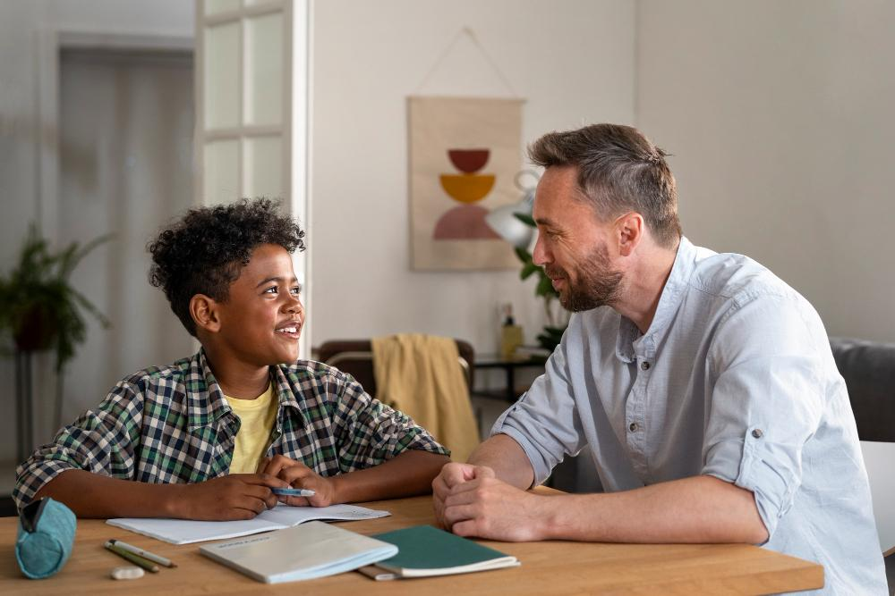
Tell A Trusted Adult
This is the most important tool!
Tell a trusted adult about what happened.
It should never ever be a secret.
A trusted adult wants to know about this so they can help you.
If you’re too scared to tell, as soon as you’re ready, tell as soon as you can. It will never be too late.
Notes:
3 min
SAY: One more thing you can do if someone breaks the bathing suit rule, is tell a trusted adult. This is the most important tool in your body boss toolkit. If someone breaks the bathing suit/private area rule, tell a trusted adult about what happened. It should never ever be a secret. A trusted adult wants to know about this so they can help you. If you’re too scared to tell, as soon as you’re ready, tell as soon as you can. It will never be too late.
Remember ALL ADULTS KNOW THE BATHING SUIT RULE.
We need to make sure that the adult we tell understands exactly what happened so they can help us and can make sure that it doesn’t happen again. If someone ever breaks the bathing suit rule, it is never your fault and you will not get in trouble for telling. Keep telling a trusted adult until someone believes you and helps you.

Slide 22

Everyone deserves to feel safe.
Adults and other children should NEVER touch your bathing suit area. That is an unsafe touch.
This is never okay and never your fault.
Notes:
1 min
SAY: Everyone deserves to feel safe at school, in public, and home. It is never okay for adults or other children to use unsafe or unwanted touches on you or someone at home. Also, when someone hurts you with physical force, pressures you to do something sexual/uncomfortable, or doesn’t take care of your needs, this is considered abuse and it is not okay. This is never your fault.
These actions are unsafe and illegal. If this is ever happening at home, it is important you tell a trusted adult. Keep telling a trusted adult until they believe you and do something.

Slide 23
Asking for Help
Find a time to talk with your trusted adult.
You can start the conversation or write a short note to get started.
Examples:
“I need to talk to you about something unsafe that happened.”
“Can I talk to you during recess about something?”
“Can I talk to you during lunch?”
Notes:
1 min
SAY: Asking for help can be very difficult. When you are going to a trusted adult for help, you can tell them in private or write them a short note if you are nervous to start the conversation. “I need to talk to you about something unsafe that happened at home.” “Can I talk to you during recess about something?” “Can I talk to you during lunch?”
ASK: When would be a good time to talk to a trusted adult? What can you use to write a note? (sticky note, index card, scrap piece of paper, etc.)
Have students share out if they have ideas to volunteer.

Slide 24

Notes:
4 min
SAY: Let’s revisit consent & boundaries from our last lesson
Play the video
SAY: We are going to watch Boss of My Body music video, feel free to dance and sing along (optional)
Source: https://youtu.be/EPgUKVAYAJc

Slide 25
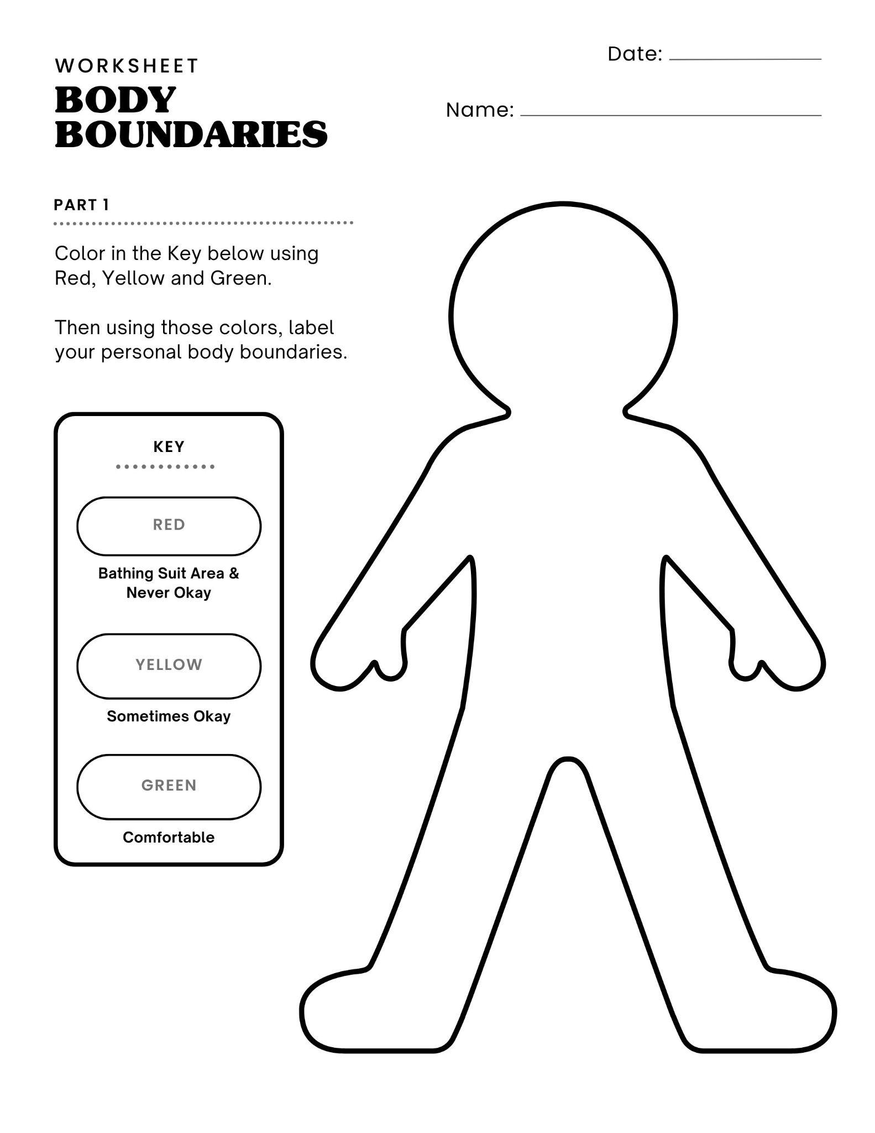
Body Boundaries Worksheet
Notes:
8 min
Remind students they are the boss of their bodies, you’re going to explore the idea of personal boundaries together.
Ask students if they know what the term “personal boundaries” means.
Let students know that personal boundaries help us understand what we need for ourselves and what other people need from us to feel safe.
Next distribute the Body Boundaries worksheets and ask students to color in their body boundaries. Note: everyone has different boundaries! Prompt students to use red to color in areas where they don’t like to be touched AND their bathing suit area, yellow can be used for areas where they are sometimes okay being touched, for example by certain people, and green are areas where they generally feel comfortable being touched. Provide example using yourself: I don’t like it when people touch my waist, so on my body worksheet, I'm going to color my middle section in red and make that a boundary. I don’t mind being hugged around my shoulders when people ask me permission, so I’m going to color my shoulders in yellow. And, I’m always down for giving people high fives, so I’m coloring in my hands green.
SAY: This worksheet is for you to reflect on your personal boundaries. I will not be collecting it when you are done.
Once you have colored in your boundaries, fill in the blanks as a way to remember the steps we covered today.

Slide 26
Notes:
1 min
Wrap up the lesson and remind students that today’s lesson may have brought up emotions. You are there as someone they can talk to if they need to. Remind them of their support system at home who they can go to for support and to ask questions.

