Slide 1
Lesson 1:
Healthy & Unhealthy Relationships
Nest© SB9 Curriculum
Grade 5
Notes:
*Compassionate response reminder* Teaching prevention education helps provide students with language and tools to define and identify abuse. Often while teaching prevention education, students will disclose experiences of harm or abuse to trusted adults. This lesson is trauma-informed and has been designed to acknowledge the varied experiences students may have. Before teaching please be sure you feel equipped to respond to instances of disclosure with a compassionate, trauma-informed approach. Please also confer with other school staff on how to handle student disclosures and navigate sensitive topics raised during these lessons.
Speaker notes key
Italics = notes to teacher (not to be read aloud)
Text = Language to read verbatim
Yellow highlight = special considerations or modifications

Slide 2
Community Agreements
Be kind to yourself and others.
Share what you feel comfortable sharing.
Accept mistakes will happen.
Listen and be curious with others.
Notes:
Review with the class the Community Agreements with students to set a safe and welcoming tone in the classroom.
SAY: Share what you feel comfortable sharing – Our goal is to create a safe space, so please share only what you feel comfortable, if something is too private you are welcome to talk to me one on one
Protect the information in this space – Confidentiality – teachers and counselors are mandatory reporters, if you tell us about harm being done to you, harm you are doing to yourself, or harm you are doing to others we, by law, must make a report
Be kind to yourself and others, we want everyone to feel comfortable sharing and exploring and learning together. What is easy for you may be difficult for someone else and what is easy for someone else may be difficult for you.
Honor the knowledge in this space – the specifics stay here, the knowledge and lessons can be shared outside the space
Stay curious – listen to understand, not respond

Slide 3
Navigate between healthy and unhealthy relationships
Identify the characteristics of healthy dating relationships
Understand the impact of unhealthy relationships
Notes:
Read objectives

Slide 4
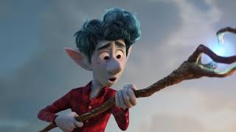
Notes:
2 min
SAY: We are going to start with a short clip. As you’re watching, think of qualities you notice about their relationship. Be ready to share out!
Play Video
Have students share out and facilitate the conversation. Ask students “WHY” they think a certain quality is present to justify their thinking.
ASK: What type of relationship do you think these two have? Answer: friendship
Source: https://youtu.be/MifkpysWjSk (stop at 0:40)

Slide 5
Relationships
Who do we have relationships with?
Self
Family
Friends
Classmates
Teachers
Teammates
Neighbors
Romantic Partners
Notes:
2 min
SAY: We are all in relationships. Here is a quick list of common relationships that many people have.
Click through responses.
SAY: Think about all of these different types of relationships we have in our lives. Some have healthy traits and others may have unhealthy traits. It is important to remember that we are humans and humans make mistakes. Relationships go through different seasons and that is okay. Whether it is a relationship with a family member or a relationship with a friend, our goal is to have a healthy relationship.

Slide 6
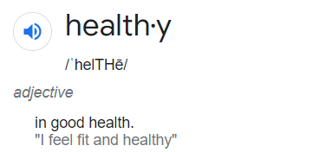
Healthy Relationships
What are important traits or signs of a healthy relationship?
Trust
Fun
Kindness
Respect
Honesty
Empathy
Forgiveness
Good Communication
Notes:
3 min
SAY: Let’s imagine we are baking a cake full of ingredients that make up a healthy relationship. Instead of mixing together eggs and flour, we need to mix items like trust and honesty; what other ingredients would you add to make this “healthy relationship cake” and why?
Feel free to use the following prompts to help them brainstorm:
Maybe it’s a friend you can always go to who listens when you need them.
Maybe it’s a parent who builds you up and supports your dreams.
A coach or teacher who you ask for advice and wants to see you do well.
Give students an opportunity to think of answers independently. Write student responses on the board and then click through the responses provided to affirm their answers or add to their list.

Slide 7

Small Group Discussion
How can we maintain healthy friendships over time?
How can we help create healthy relationships in our classrooms? At home? In our friendships?
Notes:
9 min
SAY: Before we move forward, we are going to pause and reflect. Get in small table groups, and discuss them with your group mates.
Share out as a class after about 5 minutes of group discussion time.
Image credit: freepik.com

Slide 8
Healthy Relationships
Dating and Marriage Relationships
Trust
Fun
Kindness
Respect
Patience
Honesty
Sharing
Forgiveness
Good Communication
Compatibility
Notes:
2 min
SAY: As you build friendships and interact with others, you may begin to experience strong feelings and friendships can progress into the feelings in dating relationships. It is important to understand what a healthy dating relationship looks like.
Here are some essential characteristics of a healthy dating/marriage relationship:
Click through the responses provided and add examples and explanations when needed.
Explanations that can be used when needed:
Trust- Couples who trust and believe one another
Fun- Couples who have fun together (laughter, joy, happiness)
Kindness- Couples who are kind, nice, or show compassion to each other
Respect- Couples who respect each other by listening, supporting, and valuing each other
Patience- Couples who show patience by politely waiting for each other
Honesty- Couples who do not lie to each other
Sharing- Couples who offer a portion of something with the other person
Forgiveness- Couples who offer grace to each other if mistakes are made
Communication- Couples who talk and listen to each other without interrupting
Compatibility- Couples who have several things in common

Slide 9
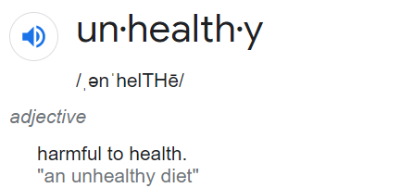
Unhealthy Relationships
What types of traits and signs exist in many unhealthy relationships?
Yelling
Ignoring
Exclusion
Physical Harm
Dishonesty
Shaming
Threats
Teasing
If you are in an unsafe situation where your are being hurt by ANYONE, get help.
Notes:
4 min
SAY: Now that we have identified the traits and signs for our healthy relationship list, let’s talk about some of the specific traits and signs that you may see in an unhealthy relationship. Please keep in mind that not all relationships are the same, so there may be differences depending on the type of relationship, the age of the people, and even the culture of the family.
Here are some of traits and signs that exist in many unhealthy relationship:
Yelling- screaming matches (not listening to each other respectfully)
Dishonesty- telling lies to one another or about one another
Ignoring- acting like they don’t see or hear you; treating you like you don’t exist
Shaming- trying to make you feel bad or embarrassing you in front of others
Exclusion- keeping other people away from you and making you feel like you are alone
Threats- telling you that your safety is in danger or that something bad will happen that will affect you
Physical Harm- someone hitting, slapping, kicking, punching or having physical contact with you in order to cause pain. This physical contact may not seem like a big deal but it is not safe, whether it’s from a friend or family member. This crosses a physical boundary and it is not okay.
Teasing- hurtful name calling and put downs
Emphasize- If a unhealthy relationship turns into physical harm, harassment, or threats (from an adult or younger person), it’s important to get help from a trusted adult (until you are safe). We will cover this more explicitly in the next lesson.
*Not a comprehensive list, there could be more.

Slide 10
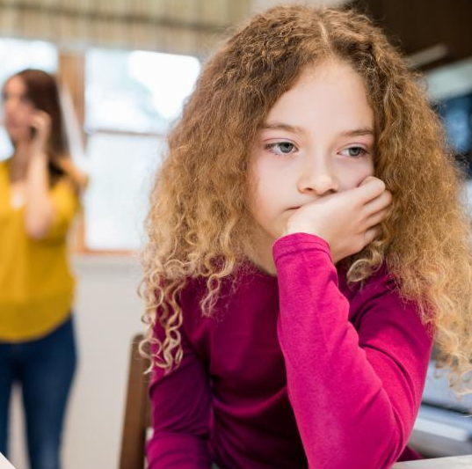
Small Group Discussion
How does being in an unhealthy relationship impact people?
When a friend starts to become negative, showing unhealthy behaviors, and they want you to join in - how would you respond?
Notes:
9 min
SAY: Before we move forward, we are going to pause and reflect again. Get back into small table groups, and discuss the questions with your group mates.
Share out as a class after about 3 minutes of group discussion time.
ASK: How does being in an unhealthy relationship impact people?
Makes people sad or upset
Causes arguments/fights
Leads to breakups or divorce (ending the relationship)
ASK: When a friends start to become negative, showing unhealthy behaviors, and they want you to join in- how would you respond?
Try to convince them to act more positively by influencing their behavior
Get help from an adult
End the friendship if they don’t change their behavior
Image credit: freepik.com

Slide 11

Relationship Movie Trivia
Notes:
1 min
SAY: We are going to play game movie trivia that highlights relationships that have both healthy and unhealthy signs. Let’s see if your team can figure it out

Slide 12
In what popular movie did the cowboy and astronaut fight over being the most loved?
Notes:
1 min
Read the question on the slide

Slide 13
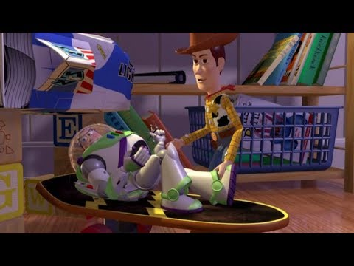
Toy Story
Notes:
5 min
SAY: The answer is: Toy Story
Play video clip - https://youtu.be/YMgoKhFEN6s
SAY: Did we see characteristics and behaviors that were HEALTHY, UNHEALTHY, or BOTH in this clip? Justify your answer.
Allow 1-2 students to respond.

Slide 14
In what popular movie did his father teach him how to reign over the entire jungle, then he started leading his own pride?
Notes:
1 min
Read the question on the slide

Slide 15
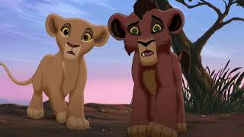
The Lion King 2
Notes:
5 min
SAY: The answer is: The Lion King 2
Play video clip - https://www.youtube.com/watch?v=paTbis5WS2Y
SAY: Did we see characteristics and behaviors that were HEALTHY, UNHEALTHY, or BOTH in this clip? Justify your answer.
Allow 1-2 students to respond.

Slide 16
In what popular movie did an ex-NFL coach relocate to small town to build a better relationship with his son by coaching his youth football team?
Notes:
1 min
Read the question on the slide

Slide 17
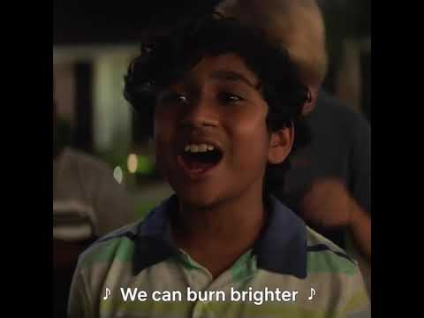
Home Team
Notes:
5 min
SAY: The answer is: Home Team
Play video clip - https://youtu.be/9fHpaizSHeE
SAY: Did we see characteristics and behaviors that were HEALTHY, UNHEALTHY, or BOTH in this clip? Justify your answer.
Allow 1-2 students to respond.

Slide 18

If you could make one of your relationships better, which one would you improve and how?
Parent
Sibling
Friend
Teacher
Coach
Other
Notes:
3 min
Distribute a copy of the Exit Ticket Handout to each student.
SAY: We are going to close our conversation with a quick Exit Ticket.
“If you could make one of your relationships better, which one would you improve and how?”
Allow students to respond on a Exit Ticket Handout.

Slide 19
Notes:
1 min
We are going to do this breathing exercise five times. On the last exhale we will let out a big sigh!

