Slide 1
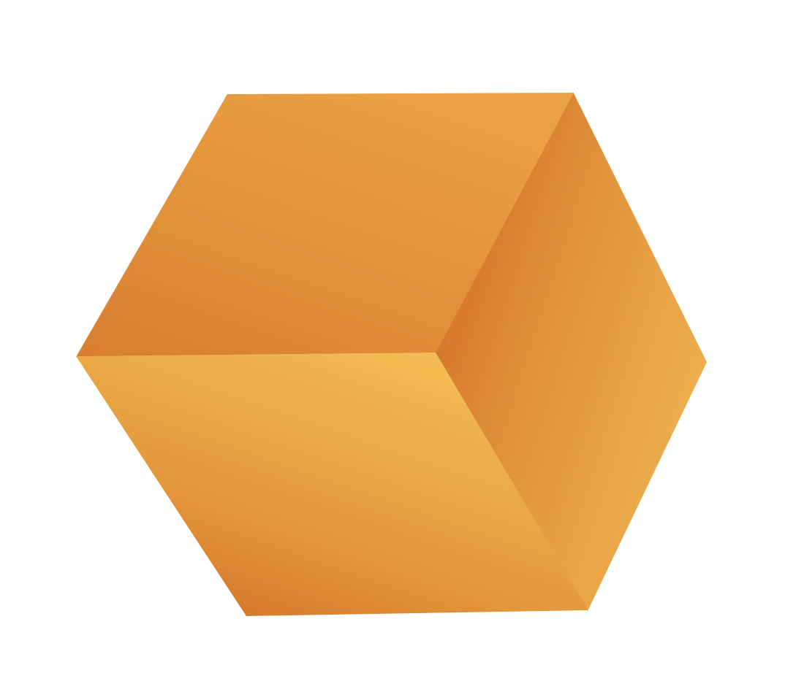


AI Execution Layer - OpenShift AI
Tools Involved:
RedHat OpenShift AI, NVIDIA, Dell AI Factory
The Modern AI Challenge: Bridging Innovation and Enterprise Execution
Delivered by:
MOBIA Platform Engineering
The Business Challenge: Stalled AI Initiatives
Enterprises are investing heavily in AI experimentation, but without a unified execution layer, initiatives often stall before reaching production. Fragmented toolchains, inconsistent infrastructure, and governance limitations restrict scalability and operational efficiency.
Accelerate Value Delivery: Move AI workloads from experimentation to production faster through a unified OpenShift AI environment.
Leverage Any Infrastructure: Enable AI across on-prem, edge, and cloud using certified integrations with Dell AI Factory and NVIDIA technologies.
Optimize Cost & Performance: Run inference and training where it makes the most sense—across GPU or Dell AI Factory-based compute environments.
Ensure Governance and Compliance: Centralize workload management and governance with Ansible Automation and policy-driven automation.
WHY THIS IS CRITICAL FOR YOUR ORGANIZATION
The Solution: A Two-Pillar Path to Operationalized AI
Our structured approach establishes a robust AI foundation and scales operational excellence across all environments
Pillar 1: AI Platform Foundation (Build & Enable)
This pillar focuses on establishing the core, flexible platform for all future AI work.
What We Do | Deploy OpenShift AI and integrate it with your existing compute, storage, and network infrastructure using NVIDIA and Dell AI Factory solutions.
Business Value | Unified AI Platform: Replace fragmented experimentation with a scalable, secure AI middleware layer
Alignment | Establish a standardized, governed, and secure AI platform foundation for your organization
Pillar 2: AI Operations & Inference (Run & Optimize)
This pillar focuses on operationalizing models for high availability and continuous delivery of insights.
What We Do | Configure OpenShift Inference Server for model deployment and lifecycle management, integrating automation with Ansible
Business Value | Faster Time-to-Production: Standardize data science workflows using Jupyter Notebooks and integrated MLOps pipelines.
Alignment | Operationalize AI workloads across hybrid environments with full visibility, compliance, and automation
AI Execution Layer – Openshift AI

