Slide 1

Annual General Meeting
19 July 2023

Slide 2
Agenda
Please note we are recording the session
Welcome
Trustees Annual Report for 2022 - Mary Peterson, chair of trustees
Annual accounts for the year to 31 December 2022 - Jo Carver, trustee
Trustee board update - Mary Peterson
MBC annual survey – key points - Richard Martin, Executive Officer
Theory of change – an overview – Richard Martin
Questions and reflections

Slide 3

Trustees’ annual report for 2022
Mary Peterson, chair of trustees

Slide 4

Annual accounts for year to 31 December 2022
Jo Carver, trustee

Slide 5
Update on your trustee board
Mary Peterson, chair of trustees

Slide 6
2023 member survey
Richard Martin – executive officer

Slide 7

2023 Member
Survey highlights

Slide 8
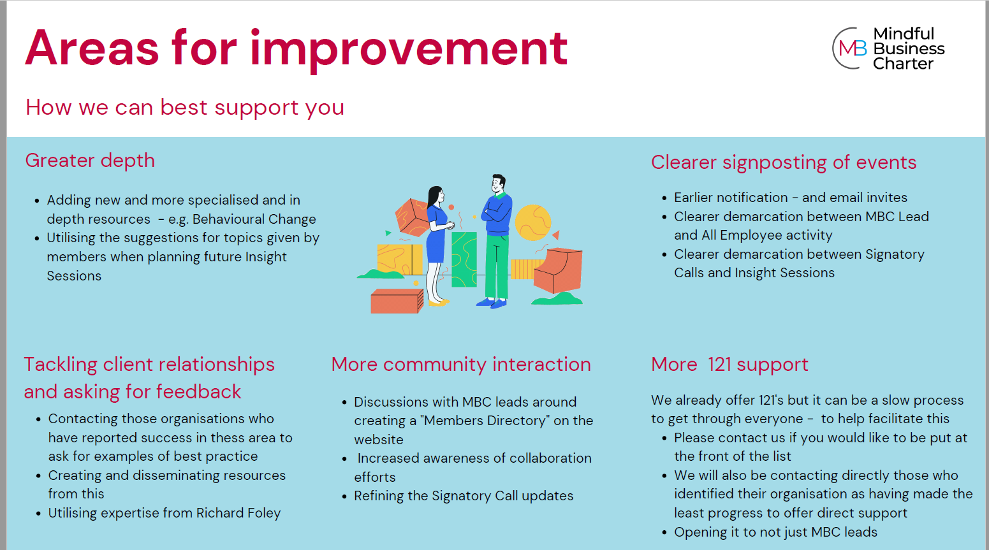

Slide 9
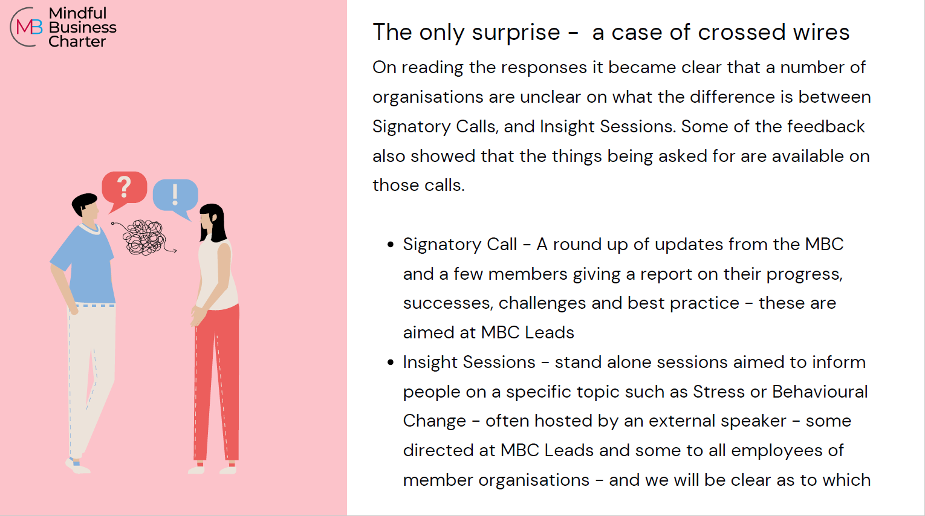

Slide 10
Our theory of change model
Richard Martin – executive officer

Slide 11
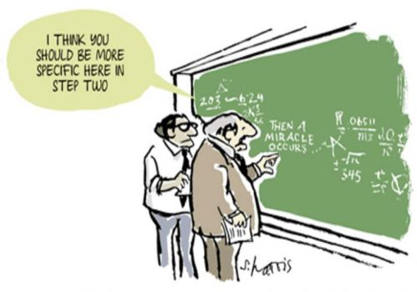
What is a Theory of Change?
A description of why a
particular way of working will be effective, showing how change happens in the short, medium and long term to achieve the intended impact.

Slide 12
Purposes of a theory of change
Creating a shared story and purpose
Guiding what to focus on in the future
Improving existing interventions / activities
Planning for evaluation

Slide 13
Key elements
Target Group
Who are our end users – the people or organisations we want to benefit from our activity?
Activities
the things we do
Outcomes
The real world changes resulting from our activities
Impact
The big long term change we want to see
Assumptions we make
Enablers and risks

Slide 14
An example
Higher youth employment in Oxfordshire
Target group – young people in Oxfordshire not in education, training or employment
Young people become more work ready
Long term
Young people understand more about appropriate behaviour at work
Young people have greater confidence
Young people have increased knowledge of job market
Medium term
Young people have improved experience of work
Note the use of change language – greater, more etc
Work placements
Peer mentoring
Short term
Young people have better basic skills
Skills workshops

Slide 15
The process
Identify the problem, who is affected, the underlying causes and key contextual factors
Agree long term intended impact – what are we trying to achieve?
Map outcomes backwards, thinking of them as necessary pre-conditions
Identify activities necessary to achieve outcomes (or review existing activities in this light)
Identify assumptions that underpin the theory of change

Slide 16
Target group - The employees of professional services providers and their clients with focus on the UK Legal sector
Healthier employees
More effective working
Reduction of unnecessary stress
More evidence of MBC impact and success
Greater accountability
Increased organisational motivation to change
Develop credible means of assessment of impact
Self benchmarking
External benchmarking
Awards
Celebration
Annual conference
Greater individual confidence in the genuineness of the organisation’s commitment
Greater individual confidence to speak up internally - calling out and promoting
Leaders and managers increasingly role model healthy behaviours
Increased living and breathing the MBC
More bilateral collaboration around MBC working
Greater individual confidence to speak up externally (members and non members) - calling out and promoting.
Member organisations will carry out;
Case Studies
Internal surveys
Measuring of relevant internal data
Member organisations will proactively empower and enable employee activity
Organisations will allocate sufficient resource to drive activity
Members will engage with MBC activity such as;
Peer support
Sharing best practice/storytelling internally
Gathering feedback
Internal workshop
Resource dissemination within organisations
Organisations (members and non-members) will engage with MBC effectively
Organisations will see the MBC as a cost effective means of achieving their aims
Greater individual confidence in the ability to make a difference
More individual awareness of the impact of our behaviour on others and also on ourselves
Behaviour change modelling
Taskforces
Focused collaborations
Members directory
MBC Community is increasingly supportive and conducive to Members change
MBC is increasingly seen as an expert on workplace wellbeing reform
Individual and group performance increases due to reduced stress
More effective education and dissemination of resources through an organisation
More effective education and dissemination of our values through an organisation
Train the trainer
Internal workshop
MBC Insight workshops
Gathering feedback
Peer support
Resources creation and sharing with members
Sharing best practice/storytelling with the community
Optimised Members Area of the website
Create opportunities for community collaboration
Member 1:1’s
More participation from existing members
New members
Newsletter
Member Survey
Signatory calls
Onboarding
Data gathering on positive impact of MBC activity
Increased organisational commitment to ongoing and iterative change
A greater awareness of the symbiotic nature of individual and organisational wellbeing
Increased acknowledgement of the benefits of collaboration and a shared solution
Greater profession wide understanding of the negative impacts of stress
Increased senior level buy in
Raising the bar for professional behaviour
Greater acknowledgment of an issue, and that it is structural/cultural
Our Website, social media and press releases communicating with potential members
Effective onboarding process
Providing evidence of the clear links between workplace stress and burnout, lack of productivity etc
Engaging with regulators, professional bodies and related organisations

Slide 17
Questions and reflections

Slide 18
Re-humanising the workplace
Website:
www.mindfulbusinesscharter.com
Email:
richard@mindfulbusinesscharter.com
charlotte@mindfulbusinesscharter.com
info@mindfulbusinesscharter.com
Follow us:
Linked In @mindfulbusinesscharter

Slide 19
Please stand by we are experiencing technical difficulties…

