Slide 1

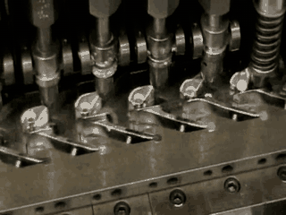
WELCOME TO
BRAXTON MANUFACTURING
A metal forming company specializing in deep drawn metal stampings.

Slide 2
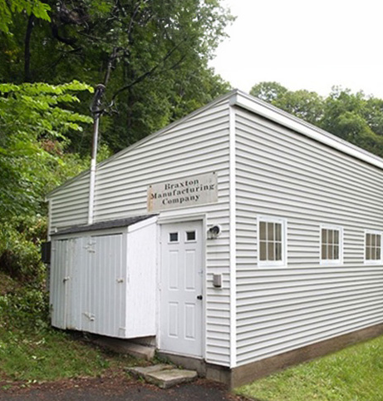
Braxton Manufacturing began in 1964 in a modest 360 sq. ft. building in Woodbury, Connecticut.
1964
Our journey started with just three dedicated people. We didn't just buy machines; we built them.
The foundation of our company was three Braxton-designed machines, two metalworking lathes, and a single heat-treating furnace.

Slide 3
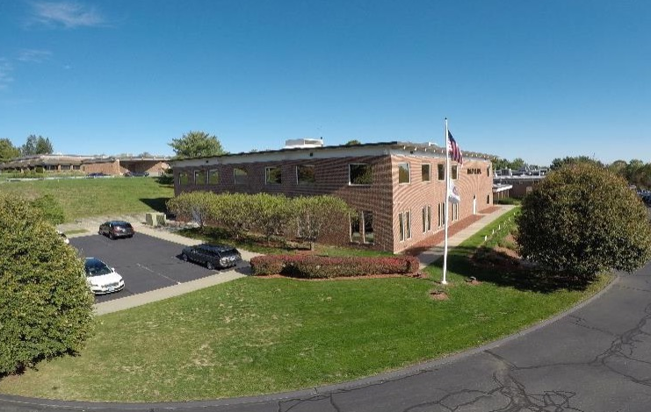
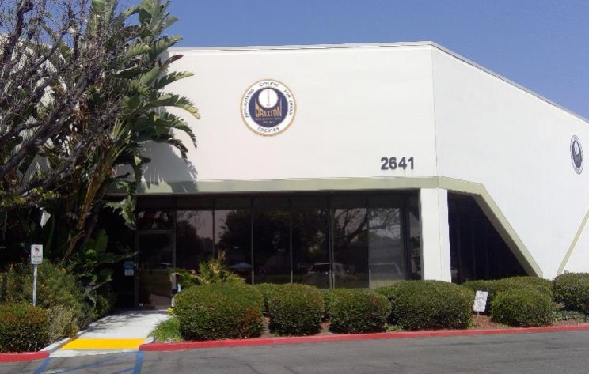
ADVANCED FACILITIES
BACKED BY WORLDWIDE ENGINEERING EXPERTISE
Current Infrastructure: Two modern, state-of-the-art production plants.
  Watertown, Connecticut: 60,000 sq. ft. facility.
  Tustin, California: 30,000 sq. ft. Facility.
Global Reach: Engineering and production capabilities on both U.S. coasts, supported by sales and engineering offices in Germany and China.

Slide 4
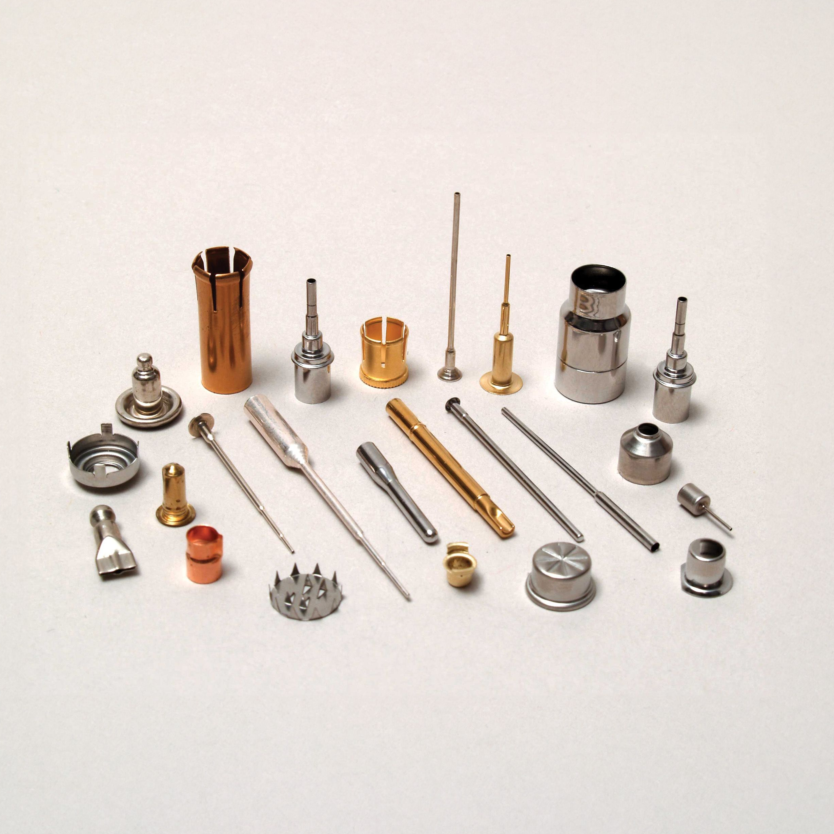
ENGINEERING EXCELLENCE
ACROSS EVERY SCALE
OF PRODUCTION
Braxton Manufacturing Company Inc. functions as a singular, powerhouse entity comprised of three specialized capabilities: we are a high-volume manufacturer producing billions of precision parts annually, a dedicated make-to-order partner capable of executing thousands of specialty runs, and a cutting-edge product development firm.
By leveraging our proprietary machine technology and modern engineering methods, we deliver exclusive, deep-drawn solutions that no other manufacturer in the world can replicate.

Slide 5
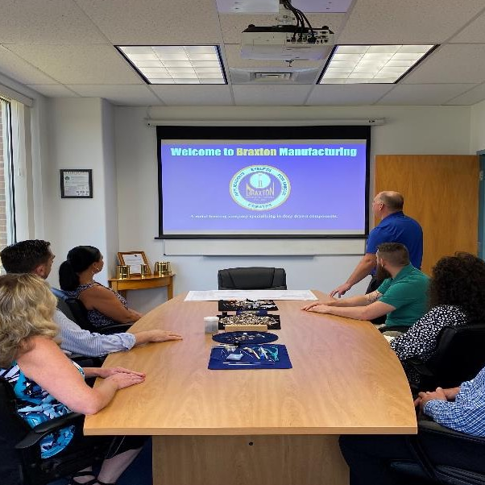
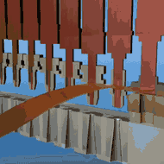
WORLD-CLASS EXPERTISE ACROSS
EVERY SCALE OF PRODUCTION
Our Authority in Deep-Draw Engineering
A Legacy of Solutions
For over 60 years, our team has operated under a single, driving motto:
"Braxton creates eyelets for unique applications".
The Elite Management Team
Our award-winning leadership is composed of specialized Quality, Mechanical, and Tooling engineers who bring a combined level of professional expertise that is unmatched in the deep-draw metal forming community.
A Drive for the Impossible
Our global reputation is built on a relentless drive to achieve "the impossible," a commitment that has made our team world-renowned among major OEMs and industry leaders.
Industry Recognition
This dedication to excellence has earned us prestigious awards and recognition from both local Chambers of Commerce and large-scale global OEMs.
The Braxton Promise
Our deep-rooted experience and technical mastery ensure that your products receive a level of precision and attention that far surpasses our competitors.

Slide 6
THE BRAXTON
ADVANTAGE
CNC Department
Specialty Machine Department
State of the art Cleaning Systems
Two EngineeringDepartment
State of the Art Quality Systems
Automated Inspection & Packaging
Custom Tooling Engineering
Research and Development
TURNKEY SERVICES
Annealing
Heat-Treating
Anodizing
Plating (Pre and Post Plate)
Cladding
Wire EDM
Custom Packaging and Labeling
Rack Plating
Edging
Stress Relieving
NADCAP, Nitric and Citric Passivation
Precision Cleaning

Slide 7
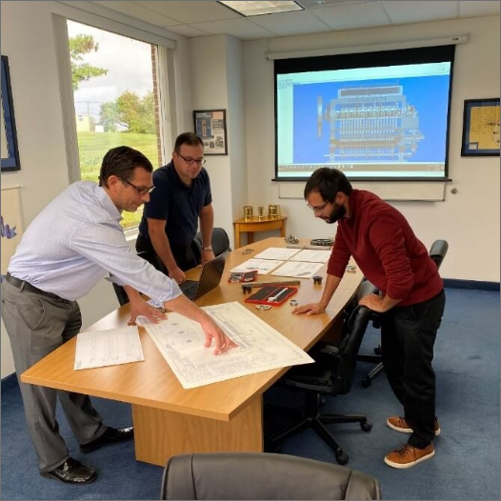
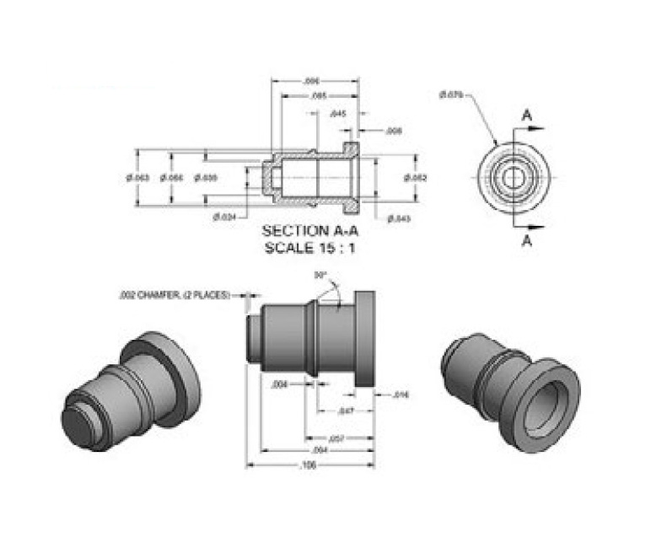
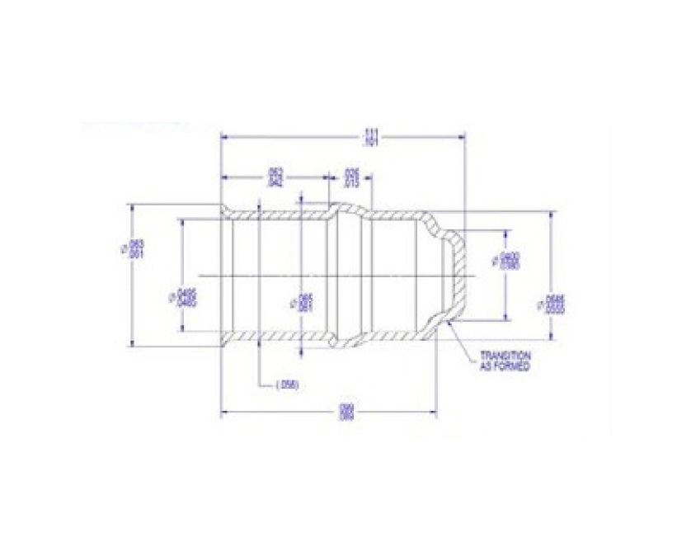
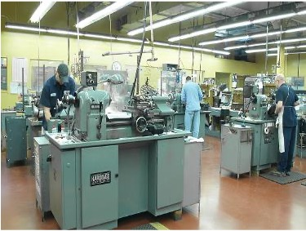
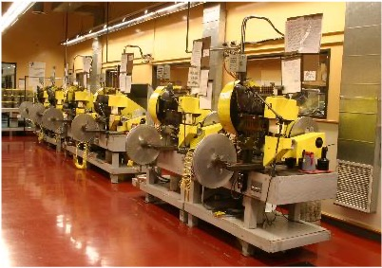
BRAXTON MFG.’s UNIQUE DESIGN PROCESS
Concept Development
Design Feasibility
Design Verification
Design Validation
Production
We initiate every partnership with strategic consultations to deeply understand your specific performance needs and align our engineering roadmap with your high-level technical objectives.
Our engineers and prototype technicians collaborate closely with your team to develop sophisticated solutions that bridge the gap between initial vision and manufacturing reality.
We perform rigorous technical analysis to establish a precision-driven manufacturing process that guarantees your exact specifications are met with absolute consistency and reliability.
Following the creation of custom tooling, our experts conduct final engineering checks to ensure the component performs flawlessly and meets every one of your unique operational requirements.
Once the component is fully validated, we transition into high-efficiency production to deliver world-class parts at scale using our exclusive, proprietary deep-drawing technology.

Slide 8
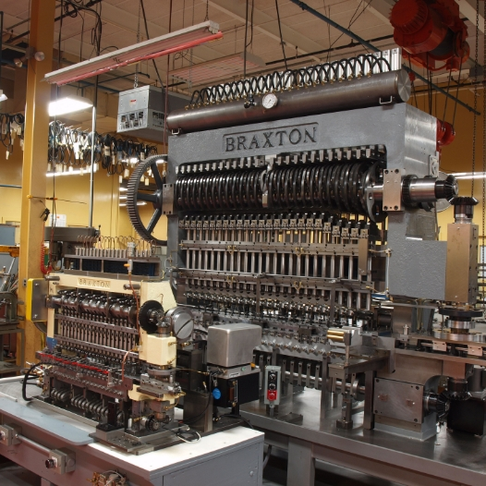
HIGH-EFFICIENCY DEEP-DRAWING WITH 25-STATION CAPABILITY
Proprietary Power
Braxton’s exclusive, proprietary deep-drawing machines are engineered with up to 25 independent stations in a single machine to provide unmatched manufacturing flexibility.
Complex Geometry
These multiple independent stations empower us to deep-draw parts with smaller diameters and longer lengths that conventional machines simply cannot achieve.
Integrated Innovation
By building optional features directly into the primary draw cycle, we eliminate the need for expensive secondary operations, significantly reducing your total cost of production.
Seamless Efficiency
Our 25-station capability ensures that even the most complex components are produced with high-speed efficiency and absolute precision in a single, streamlined process.

Slide 9
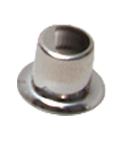
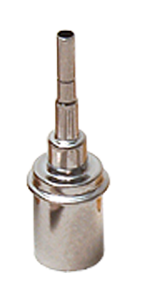
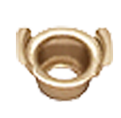
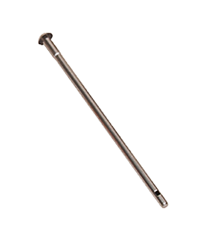
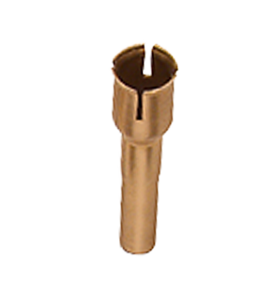
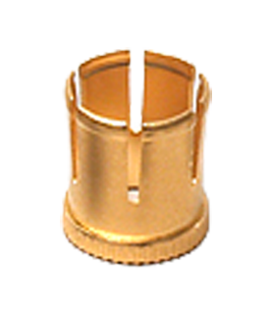
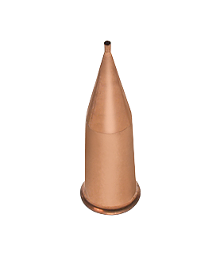
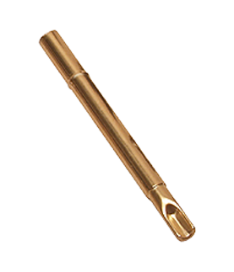
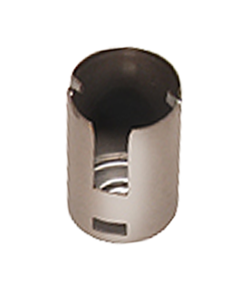
SECONDARY PROCESSES THAT ARE ACHIEVABLE
Shaped Piercing
Multiple Diameters
Shaped Flanges
BY USING BRAXTON’S PROPRIETARY MACHINES.
Side Holes
Slotting
Knurling
Bead Diameters
Crimp Forming
Tabs
Tapers
Coining

Slide 10
BRAXTON’S RANGE OF SIZES AND TOLERANCES THAT ARE POSSIBLE BY USING BRAXTON’S UNIQUE DEEP DRAWING TECHNIQUES.
RANGE
INCHES
MILLIMETERS
I.D
0.005 to 1.945
0.127 to 49.3
O.D
0.006 to 1.950
0.15 to 49.5
Wall Thickness
0.0005 to 0.022
0.0127 to 0.56
Length to diameter ratios greater than 55:1 is attainable
Length
0.013 to 2.250
0.33 to 57.2
Finished Part Tolerance
As low as ± 0.00015
0.004
ID/OD Tolerance
As low as ± .000050
0.00127
Length Tolerance
As low as ± 0.0005
0.0127
Length to Diameter Ratio exceeds
55:1
-
Surface finish to 10 microinches Ra

Slide 11
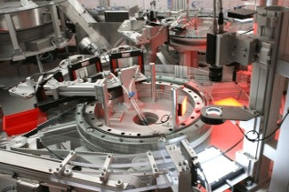
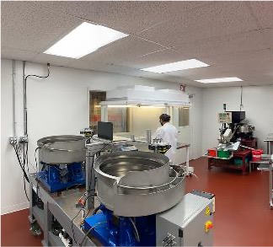
Braxton Manufacturing provides state-of-the-art automated vacuum degreasing and cleaning capacities driven by proprietary, part-specific programs designed to meet the most stringent industry cleanliness standards.
Our ISO-certified manufacturing infrastructure utilizes modern process controls and exceptional turnkey solutions, including clean room capabilities, real-time statistical analysis, and complete lot traceability,
to deliver a Certificate of Conformity with every product
we ship.

Slide 12
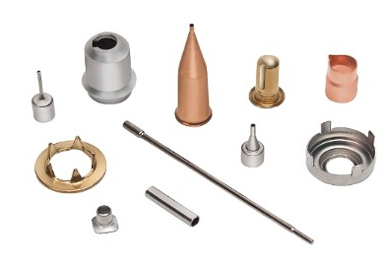
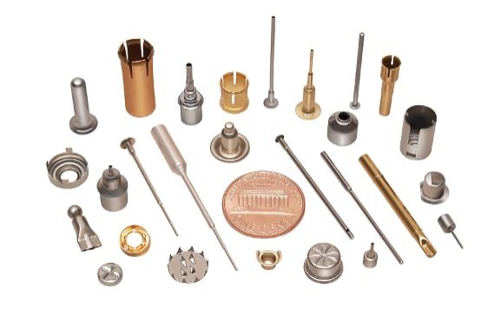
FROM SUBMINIATURE TO COMPLEX PARTS…
Compared to standard screw machines, plastic extrusion, tubing, and traditional stampings, Braxton’s unique deep-drawing techniques offer superior benefits for the most demanding applications. We don’t just manufacture components; we engineer specialized solutions that redefine what is possible in metal forming.

Slide 13

BENEFITS TO USING BRAXTON’S
UNIQUELY CREATED DEEP-DRAWN COMPONENTS.
1
2
3
4
5
Our advanced engineering guarantees superior part-to-part repeatability, ensuring your high-volume orders remain consistent from the 1st part
We specialize in producing intricate, complex designs that were previously considered impossible by conventional manufacturing standards.
Raw material is work-hardened during the deep-draw process, effectively eliminating the need for secondary heat treating on most finished components.
Raw stock can be clad or pre-plated with gold prior to the process, guaranteeing 100% even coverage on both the Outer Diameter (OD) and Inner Diameter (ID).
By starting with flat stock and ending with a finished tubular part, our process drastically minimizes material waste, allowing for a 1/3 cost
savings in most
production cases.
to the billionth

Slide 14
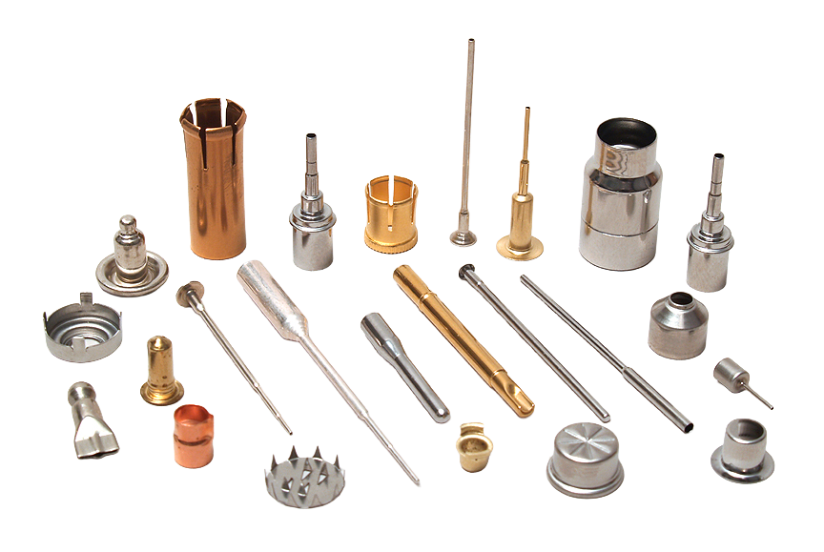
BRAXTON MANUFACTURING CAN CREATE SPECIALIZED APPLICATIONS
FOR DEEP DRAWN COMPONENTS IN A WIDE RANGE OF MATERIALS
Beryllium
Copper
Nickel Silver
Copper
Aluminum
Nichrome
Brass
Platinum
Invar
Bronze
Gilding
Glass Sealing Alloys 42, 52
Platinum Rhodium
Titanium
Gold
Silver
Monel
Kovar
Inconel
Stainless Steel
Plated Stock
Platinum Iridium
Phosphor Bronze
Nickel
Ni/Fe48

Slide 15
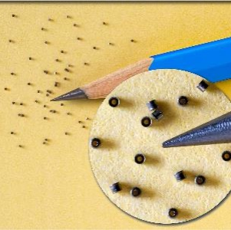
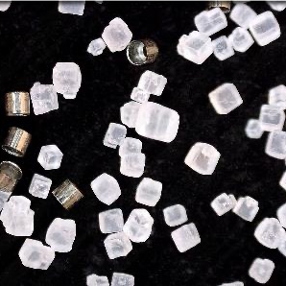
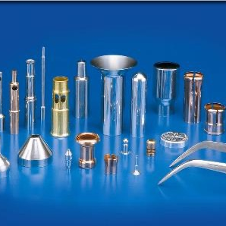
ENGINEERED FOR EVERY INDUSTRY,
BUILT FOR EVERY NEED
Braxton’s products are a global standard, serving the most critical needs of the following industries:
Medical: Precision components for life-saving technologies.
Aerospace & Automotive: Highly accurate specialized technology built for extreme environments.
Electronics: High-volume, subminiature components for modern connectivity.
We do not target a single industry; instead, we offer highly accurate technology to any customer requiring high-volume precision or extremely unique, make-to-order applications.

Slide 16




BRAXTON MANUFACTURING,
HELPING YOU BUILD A BETTER FUTURE.
ELECTRONICS
AUTOMOTIVE
AEROSPACE
MEDICAL

Slide 17

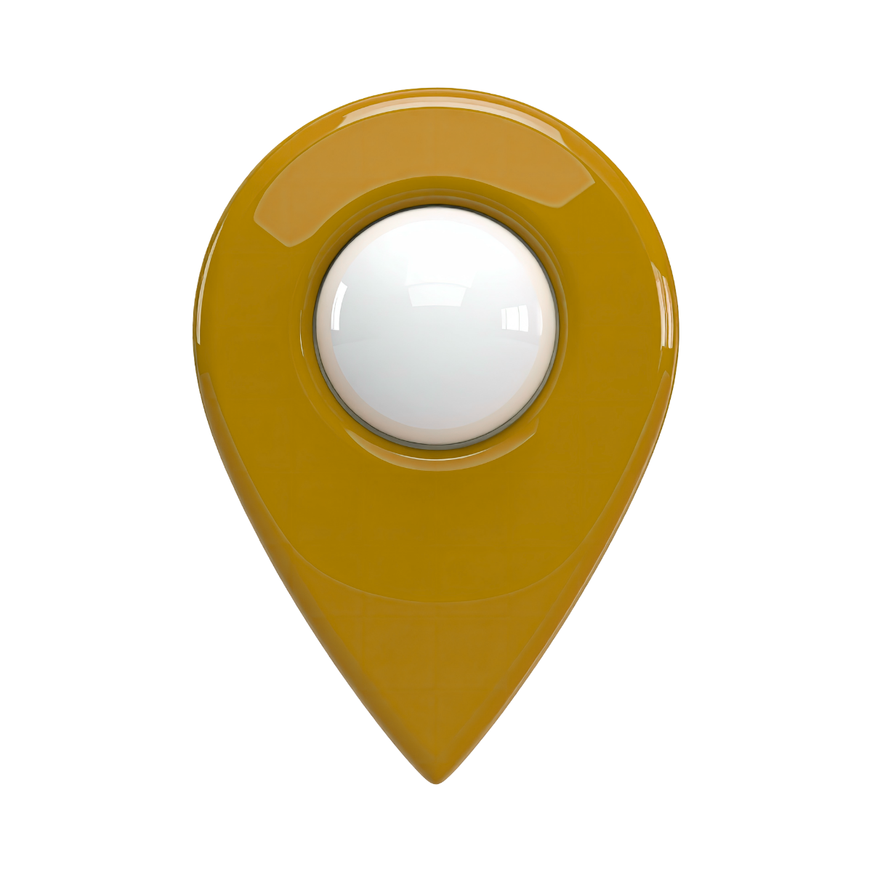
CONNECTICUT
GERMANY
Braxton Mfg. Co., Inc.
858 Echo Lake Road
Watertown CT 06795 USA
+1 860 274-6781
sales@braxtonmfg.com
M-F 8am - 4:30pm EST (UTC+4)
www.braxtonmfg.com
Braxton European Sales Offices
Aegidiusplatz 7
53604 Bad Honnef Germany
+49 2244 918 130
sales@jvs.com
M-Th 8am-17pm,
F 8am-14:30 UTC+2
www.braxtonmfg.com
CALIFORNIA
Braxton Caribbean Mfg., Co., Inc.
2641 Walnut Avenue
Tustin CA 92780 USA
+1 714 508-3570
sales@braxtonmfg.com
M-F 8am - 4:30pm PST (UTC+1)
www.braxtonmfg.com
CHINA
Shanghai Rongfeng Medical Instrument Co., Ltd.
Rm 701, No.788, West Zhijiang Rd., Jing’an District Shanghai, China 200070
86-21-66076858, 86-18616244980
liurong6@163.com
www.braxtonmfg.com
CONTACT ONE OF BRAXTON’S GLOBAL OFFICES FOR ALL YOUR MANUFACTURING NEEDS.

