Slide 1

HYDROGEN OFFTAKE AGREEMENTS
Maroof Mittha
Andrew Renton

Slide 2







Castletown Law
Specialist Law firm
Energy and Infrastructure experts
Operating internationally
Staffed by experts in their field
Advisor to a landmark Hydrogen Project in Wales
Advisor to a Hydrogen Project Developer for agricultural farms in GB and Europe
Advisor to a major industrial hub developer in England
Advisor to Hydrogen Vehicles manufacturer in the Middle East and North Africa

Slide 3
OFFTAKE AGREEMENTS
To mitigate risks faced by the producer and Offtaker.
To provide financial viability for the project.
A lender/producer may require an Offtake Agreement before committing the capital to deliver the hydrogen production asset.
To ensure compliance with the regulatory aspects of the transportation and consumption of hydrogen applies.
To ensure compliance with low carbon hydrogen standards
For details of background see- https://www.gov.uk/government/consultations/hydrogen-economic-regulatory-framework

Slide 4

Hydrogen Production Matrix
Funders
Insurers
Regulators
EPC
O&M
Supply Chain
Producer

Slide 5
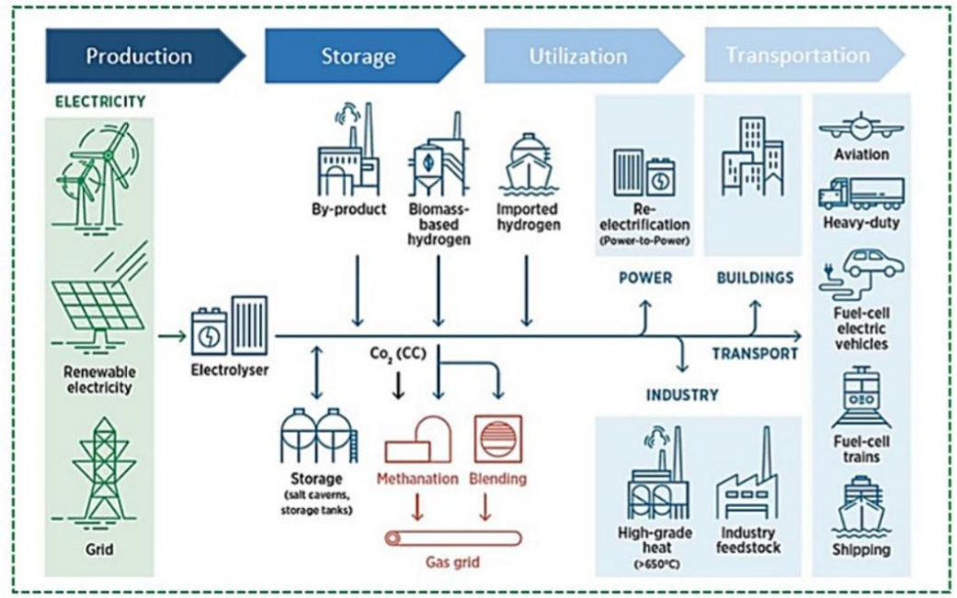
Consumption/Use Matrix
Storage
Transport
Network Transmission
Private contract
Multiple-use complex
Industrial Hard to abate sectors
Figure source
https://doi.org/10.1016/j.scitotenv.2024.173622

Slide 6

Key Contractual Points
No standard form yet, but styles follow closely on natural gas precedents.
Long-term (10+ yrs) requirement to support funding of production assets.
Producers will want take or pay included.
Certification and quality warranties will be requested.
Price certainty and minimum pricing considerations.
Carbon reduction certification and warranties
Domestic supply differs from international
In the EU, European Federation of Energy Traders (EFET) terms will likely begin to take precedence.
Contractual clarity on the point at which risk in the product transfers.

Slide 7
Clauses and Application
If in anticipation of plant development, hedging on delays and volumes
Confidentiality, security, and defence issues.
EU/UK Hydrogen classification and certification
Choice of Law and Jurisdiction
Mediation and dispute resolution
Supply volume guarantee
Take or Pay
Scottish Environmental Protection Agency (SEPA) and other regulatory compliance.

Slide 8
Commercial Structure and bankability
Long-term commitment (10–15+ years) is typically required to underpin project finance and secure supply
Offtake agreements are central to project bankability and de-risking high CAPEX hydrogen projects
Off-takers must assess: Creditworthiness of counterparties Alignment with financing structures (e.g. lenders may require a firm take-or-pay terms) In early markets like Scotland, contracts may need government support mechanisms (e.g. CfDs, subsidies) to close viability gaps

Slide 9
Pricing mechanisms and Price risk
No mature global hydrogen price benchmark, pricing is highly negotiated and uncertain
Key pricing structures:
Fixed price
Indexed (e.g. to power prices, gas, carbon)
Hybrid / floor-ceiling mechanisms
Need to address:
Green premium vs fossil alternatives
Price review clauses over long contract durations
Government-backed mechanisms (e.g. auctions, CfD’s) can bridge price gaps

Slide 10
Volume commitments or flexibility
Key negotiation: take-or-pay vs flexible offtake
Risks:
Overcommitment if hydrogen demand evolves slowly
Under-supply if production is intermittent (renewables-based)
Contracts must define:
Minimum offtake volumes
Delivery profiles (baseload vs flexible)
Curtailment and balancing provisions

Slide 11

Technical specifications and quality standards
Hydrogen purity, pressure, and composition must match end-use (e.g. industrial vs grid injection)
Contracts should specify:
Delivery conditions (gaseous, liquid, ammonia, etc.)
Testing and verification regimes
Rights to reject “off-spec” hydrogen and associated liabilities

Slide 12
Certification and “Green” credentials
Offtakers must ensure hydrogen qualifies as low-carbon:
Guarantees of Origin (GoOs) / certification schemes, i.e., UK Hydrogen Certification Schemes
Compliance with emerging EU/UK definitions (e.g. Renewable Fuels of Non-Biological Origin RFNBOs)
Certification affects:
Regulatory compliance
Ability to claim emissions reductions
Access to subsidies or carbon markets

Slide 13
Delivery, logistics and infrastructure risk
Contracts must define:
Delivery point (plant gate, pipeline, port)
Transport responsibility (producer vs offtaker)
Infrastructure risks include:
Lack of hydrogen pipelines
Reliance on trucking, shipping, or conversion (e.g. ammonia)
Interface risks between production, storage, and transport are critical.

Slide 14
Regulatory & policy risk
Hydrogen markets are policy-driven and evolving:
Subsidies, carbon pricing, and standards may change
Contracts should include:
Change-in-law provisions
Reopener clauses if regulation shifts
Regulatory uncertainty is a major barrier to firm agreements

Slide 15
Counterparty and performance risk
Key issues:
Producer’s ability to deliver (technology risk, electrolyser performance)
Force majeure (especially renewable intermittency)
Contracts define:
Liquidated damages for non-delivery
Performance guarantees
Step-in or termination rights

Slide 16
Market immaturity & strategic positioning
Hydrogen markets are still liquid and evolving, with limited buyers and standardisation
Only a small share of projects have firm offtakers → first movers take higher risk
Agreements often resemble hybrids of:
Gas supply contracts
Power purchase agreements
Off Takers must balance:
Early-mover advantage (securing supply, ESG benefits)
vs. technology, price, and policy uncertainty

Slide 17
Critical Considerations
Price uncertainty + policy support dependence
Production energy availability and reliability
Intermittent renewable-linked supply
Certification compliance for UK/EU markets
Storage and safety and security (HSE and SEPA)
Underdeveloped transport infrastructure
Need for long-term but flexible commitments
Change in Law and Regulation
Insurability of risks
Market volatility and competition from other markets

Slide 18
Papers to Consider
https://gh2.org/sites/default/files/2024-05/GH2_Considerations%20for%20Hydrogen%20Offtake%20Agreements_2024.pdf
https://www.irena.org/Innovation-landscape-for-smart-electrification/Power-to-hydrogen/15-Hydrogen-purchase-agreements
https://cms.energytraderseurope.org/storage/uploads/media/210420-lc-st-eecs-v2-and-ga-power-certficates-appendix-v2---guidance-notes.pdf#:~:text=By%20making%20the%20appropriate%20elections%20in%20the,biogas%20and%20renewable%20source%20hydrogen%20by%20means
https://www.oxfordenergy.org/wpcms/wp-content/uploads/2025/08/ET50-Hydrogen-Offtake-Agreements.pdf

Slide 19
Thank you. Invite us in.
Maroof Mittha
maroof.mittha@castletownlaw.com

