Slide 1
All of Our Voices make a Difference!
Washington, DC Public Policy Seminar 2024
Sent By the Council: Brandi Monts, Emily Rogers, Melanie Cates, Melanie Baker, Sydney KrebSBACH AND SANDI GRUBERG
Notes:
This is the first slide of the presentation

Slide 2
Some of the issues that were discussed during the Disability Policy Seminar
Voting
Autism Cares
Community Living
Criminal Legal
Social Security/SSI
Disability Funding
Education
Employment of People with Disabilities

Slide 3
What did we do on this busy day on the hill?
There were 15 of us from our State participating the Disability Policy Seminar.
We divided and conquered the appointments.
We met with Senator Cantwell and staff from Senator Patty Murray’s office, Congressman Rick Larson’s office, Congresswoman Pramila Jayapal’s office, Congresswoman Kim Schrier’s office, Congressman Rick Larson’s office and Congresswoman’s Marilyn Strickland’s office.
Everyone had really good appointments.

Slide 4
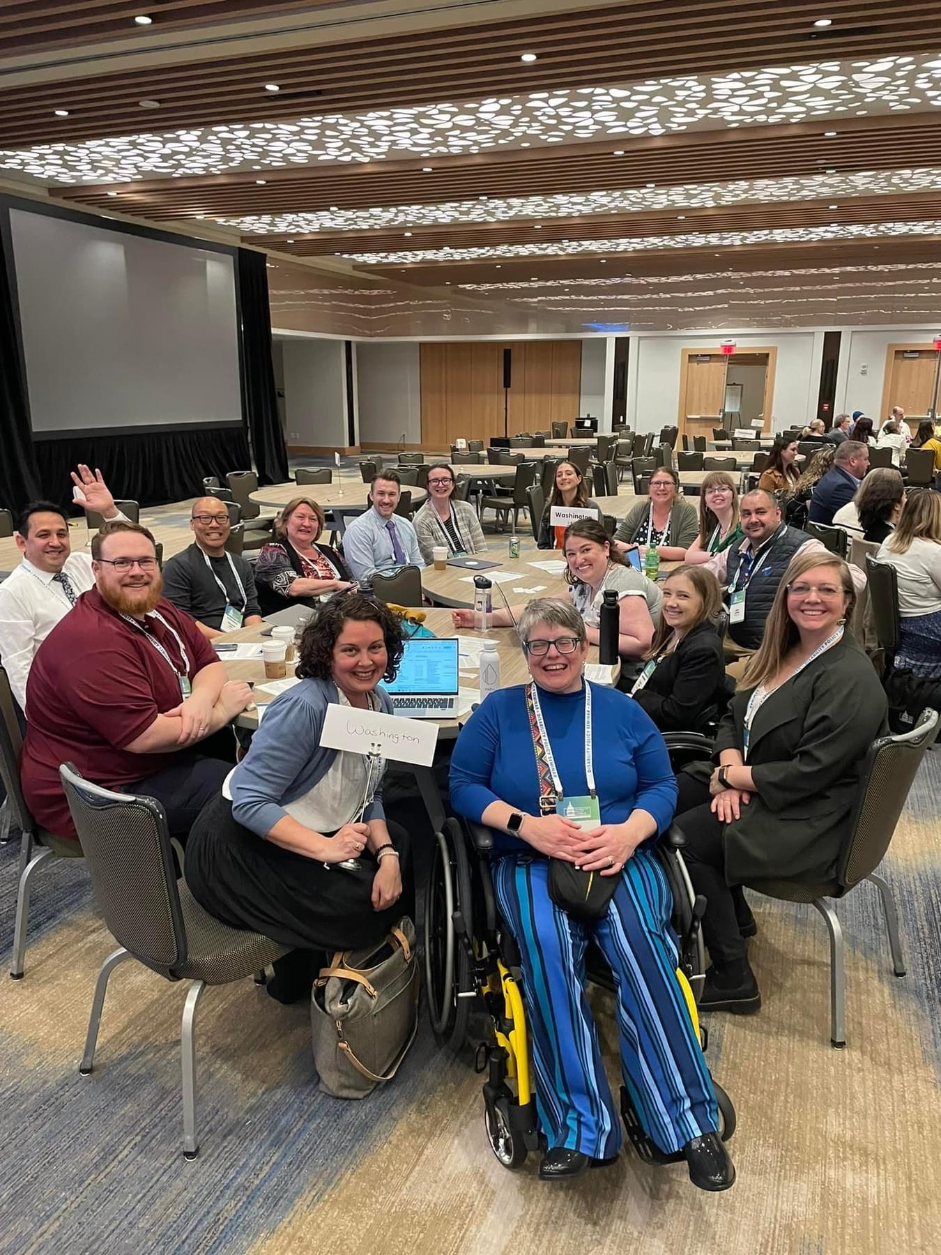
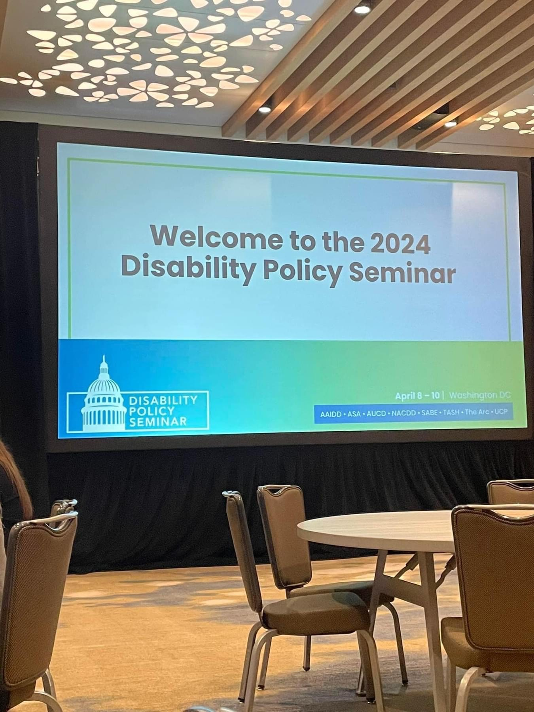

Slide 5
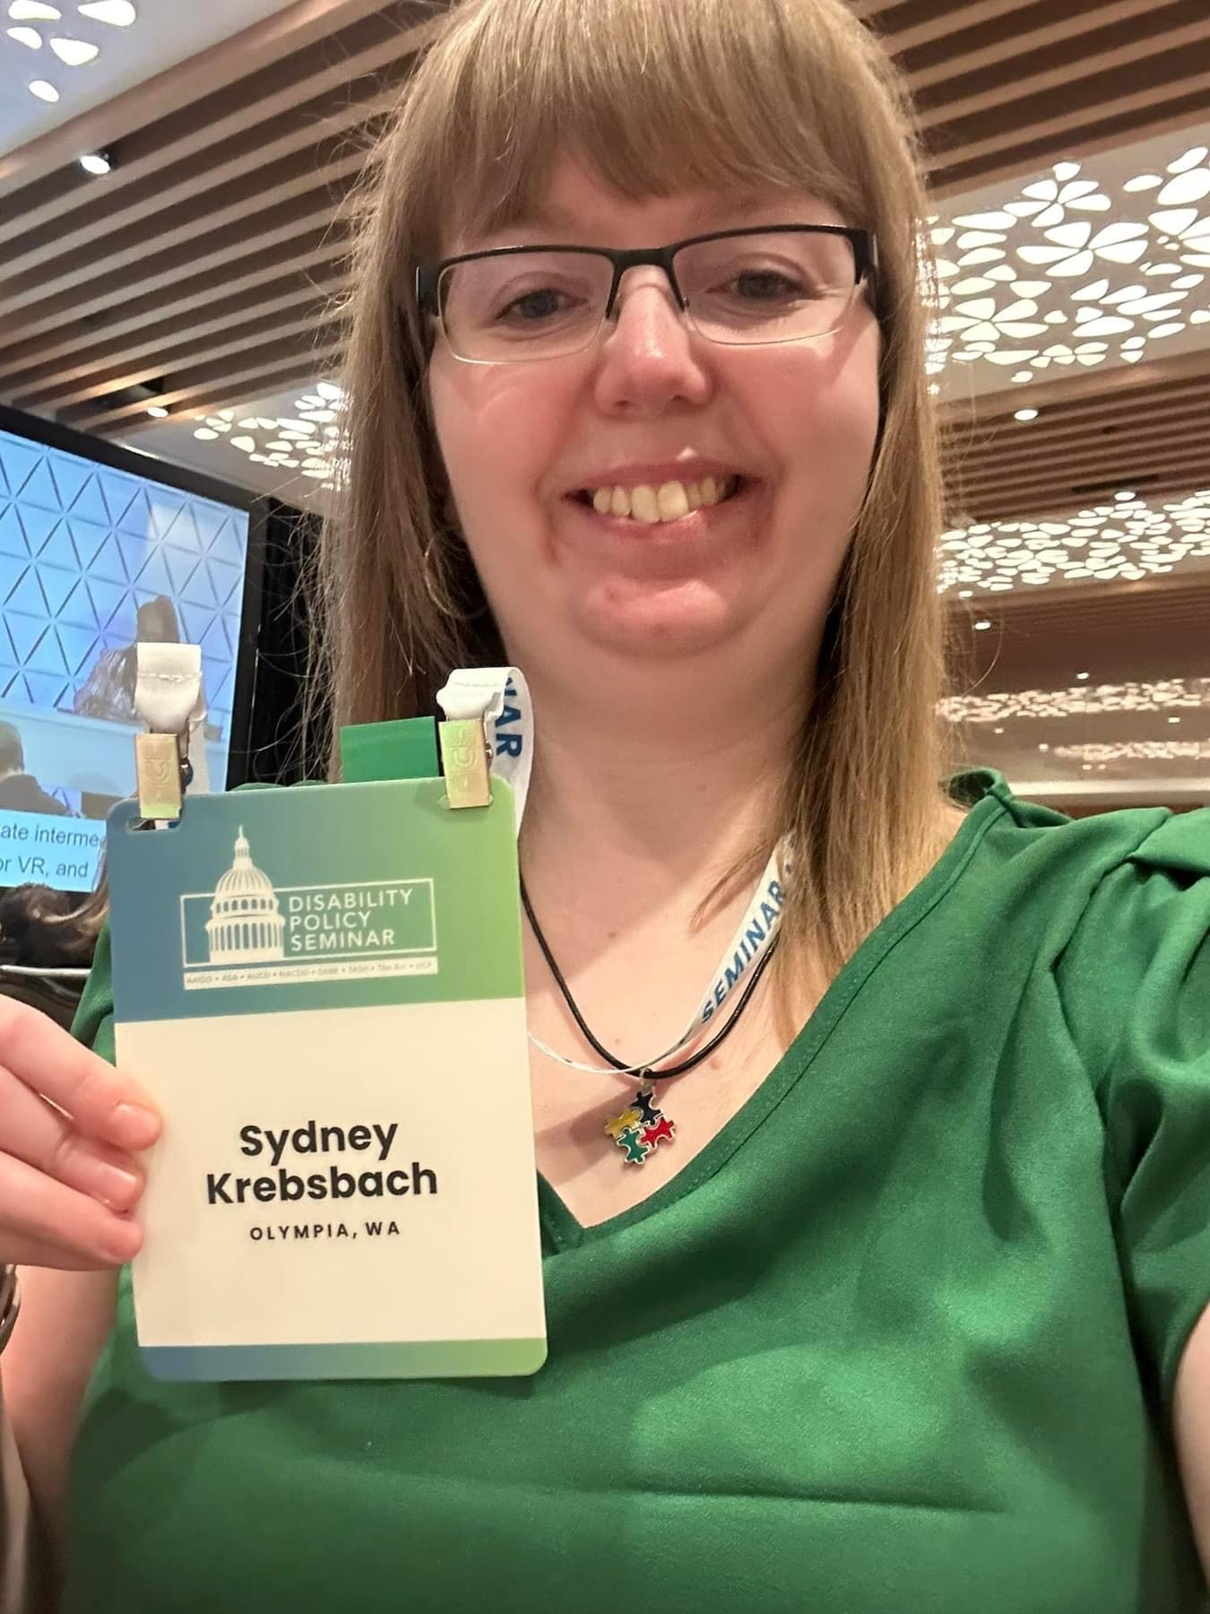
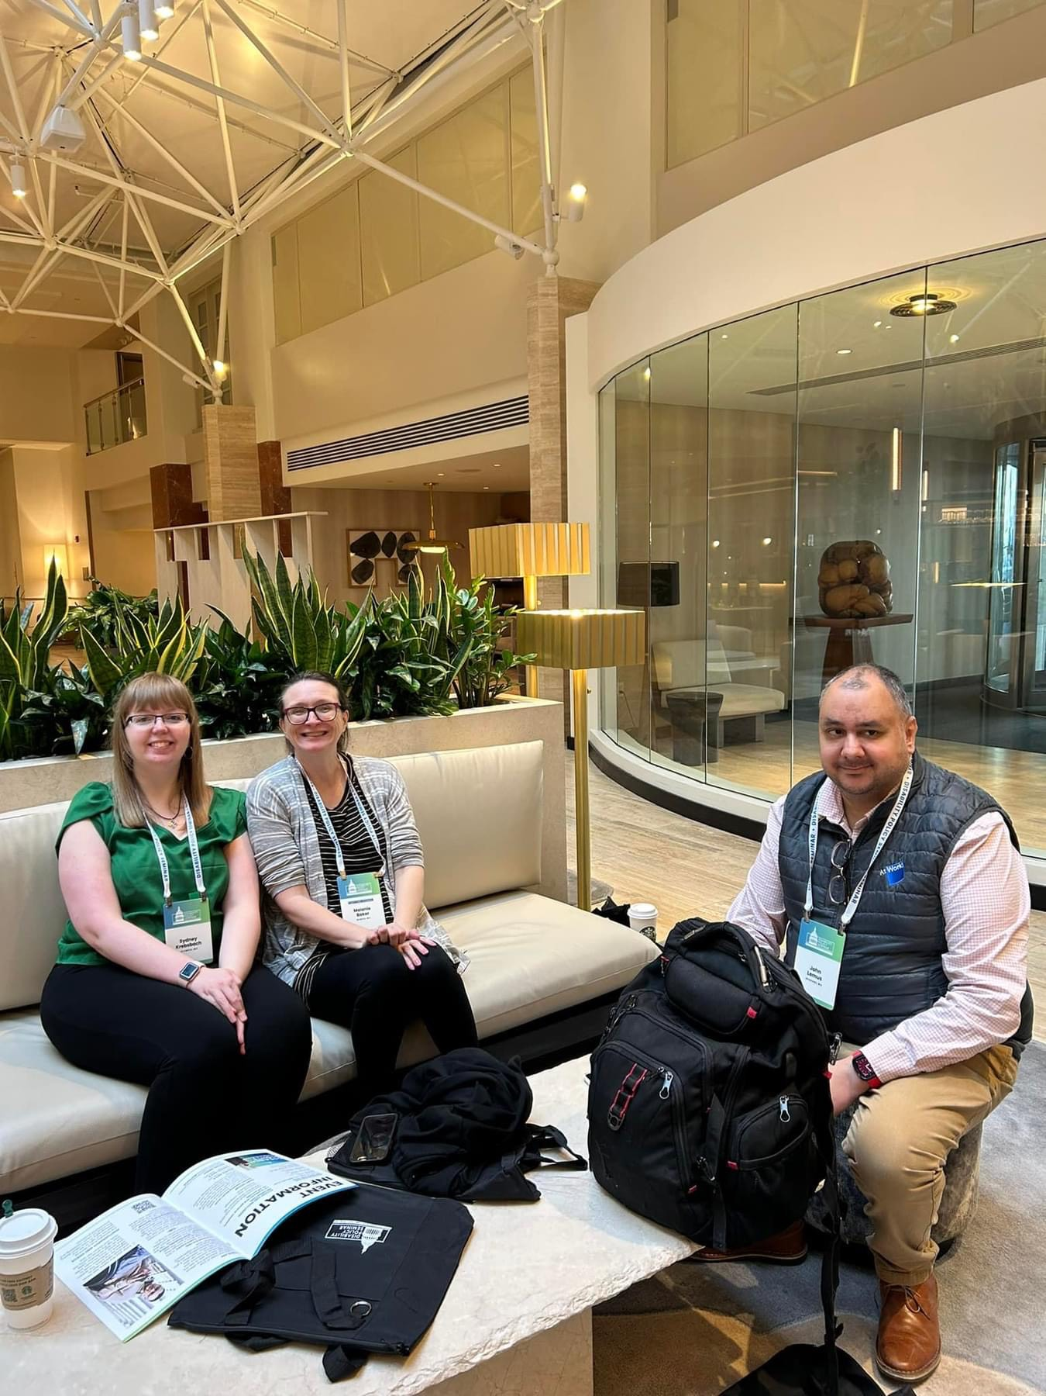

Slide 6
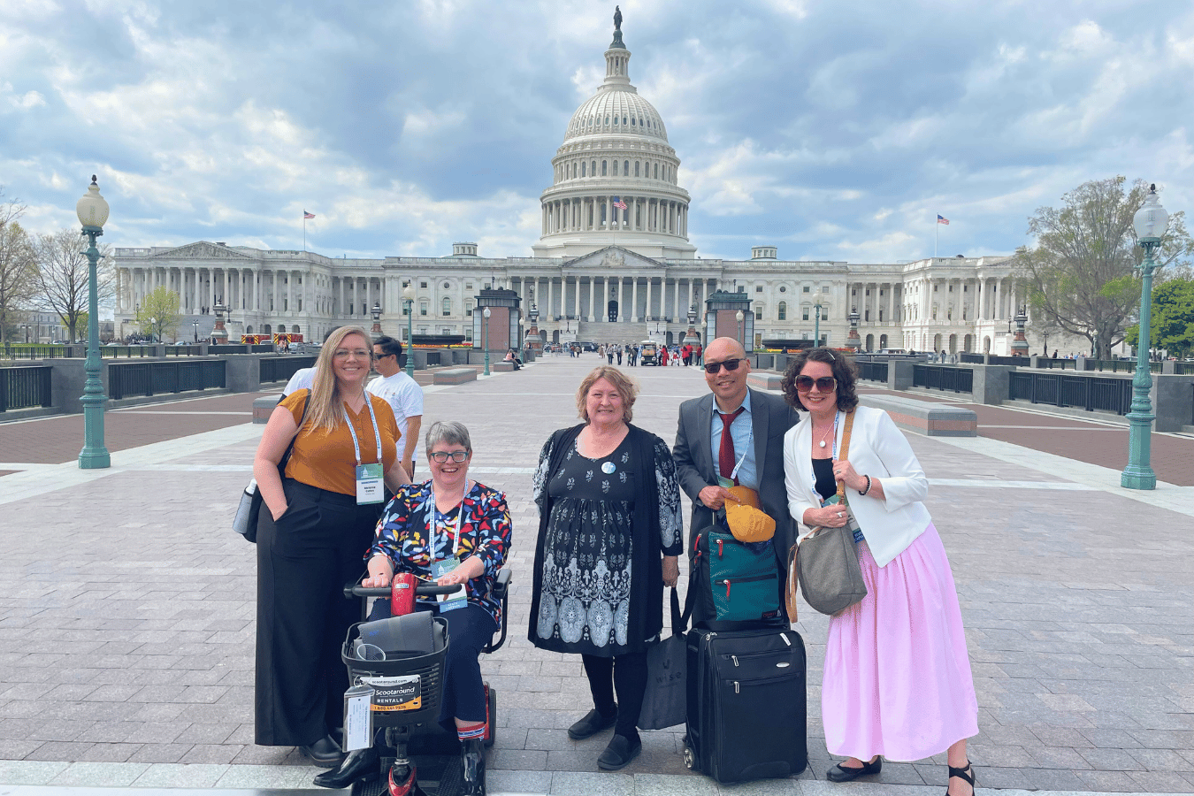
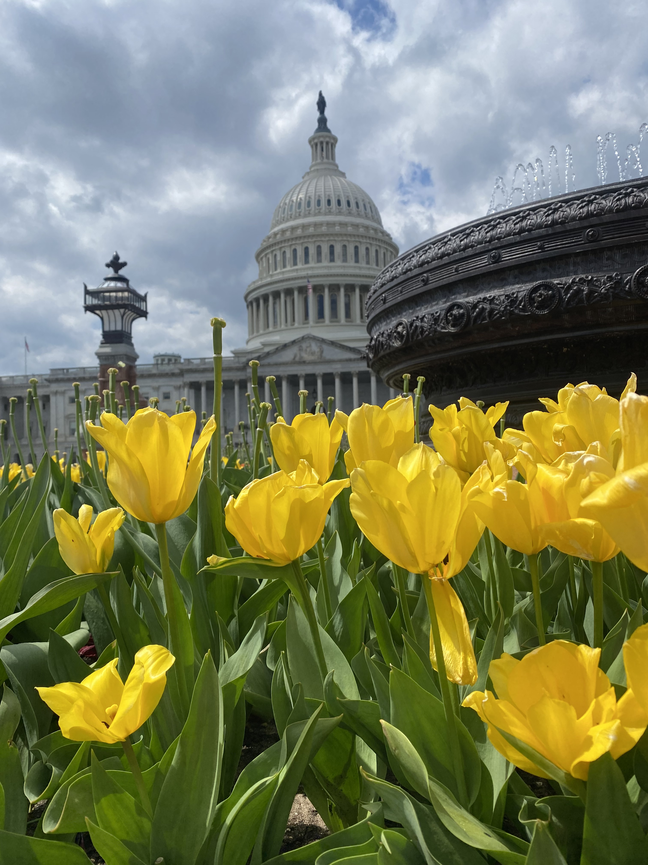

Slide 7
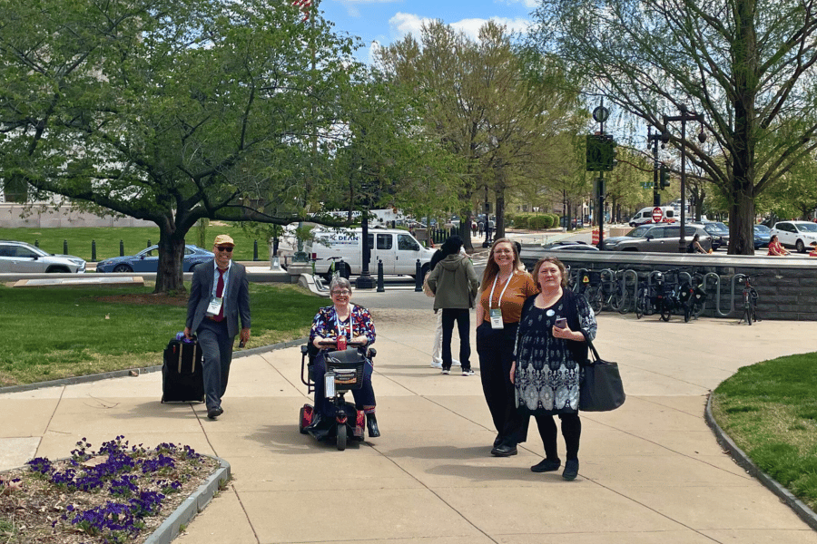
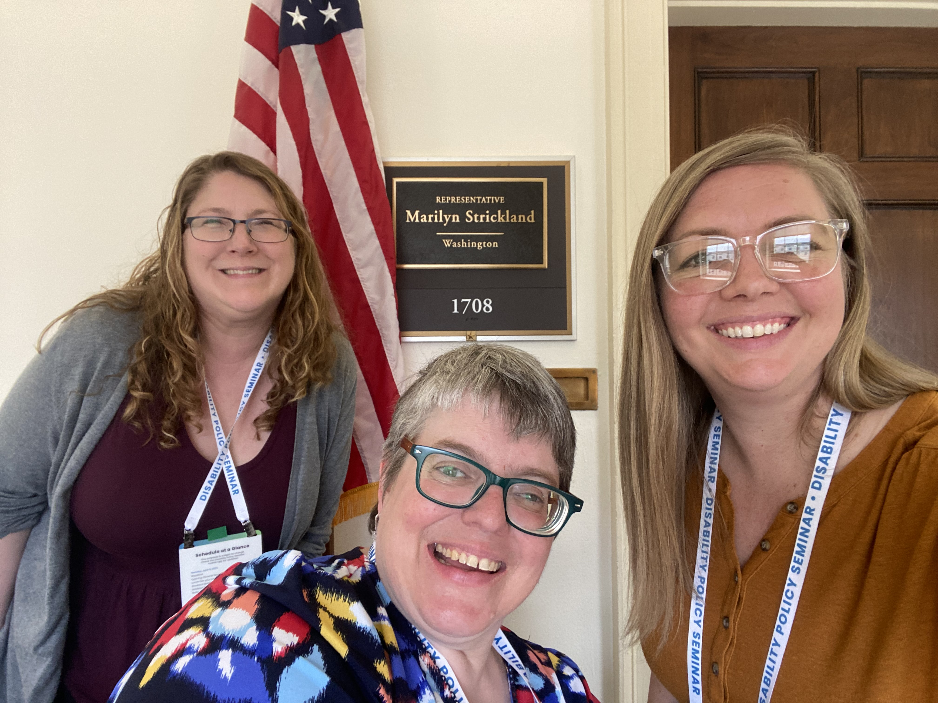

Slide 8
Federal Issues impact us!
Remember that Medicaid underpins and funds all of the medical AND many community supports including:
  Residential
  Employment
  Community Inclusion
Lawmakers on any level want to hear from you about how the service affects your life
  I need this service because. . .
  I use this service because. . .
Congress people have home state offices and staff that are willing to meet and talk with you.

Slide 9
Questions and Thoughts

