Slide 1

Waiver Redesign Project
Community Collaboration

Slide 2
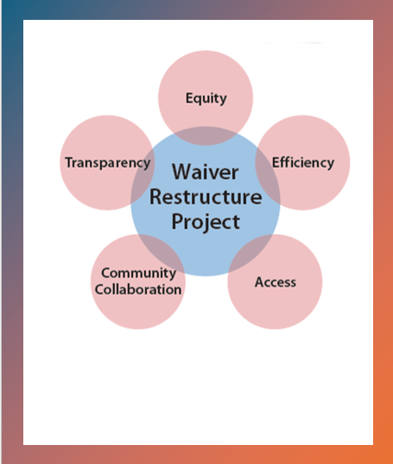
Waiver Redesign Project
1,800+ comments:
“make the waiver service system better.”
Medicaid 1915 (c) Waiver Restructure Report to the legislature

Slide 3

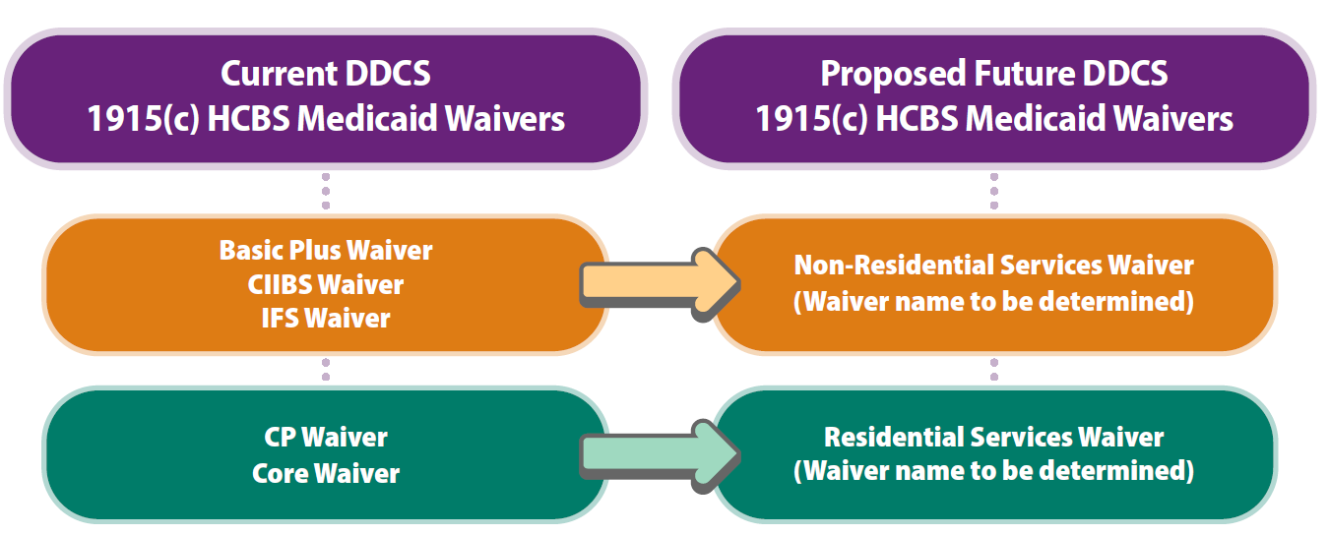
Waiver Redesign Overview

Slide 4

Workstreams Identified
  Community collaboration
  Feasibility
  Service and system design
  Rates
  Funding
  Provider needs
  IT systems
  Federal approval/roll out
  Quality monitoring

Slide 5

Timeline updates
Estimated total timeline for 2 waiver roll out: 48-66 months
Service design, rates, and service amount assessment
Research and Data Analysis Division finalize algorithms for rates and service amounts
Division of Information Technology will build the algorithms into The CARE assessment tool

Slide 6

Waiver Redesign Community Collaboration
Listening sessions
  People with lived experience
  Family advocates
  Advocacy organizations and other advocates
  Providers and counties
  DDCS staff
Waiver redesign public facing webpage
  Includes a timeline, updates and additional opportunities for feedback.

Slide 7

Questions?

Slide 8
Thank you
Bob Beckman, Waiver Requirements Program Manager bob.beckman@dshs.wa.gov
Sarah Coleman, Waiver Services Satisfaction Program Manager sarah.coleman@dshs.wa.gov

