Slide 1
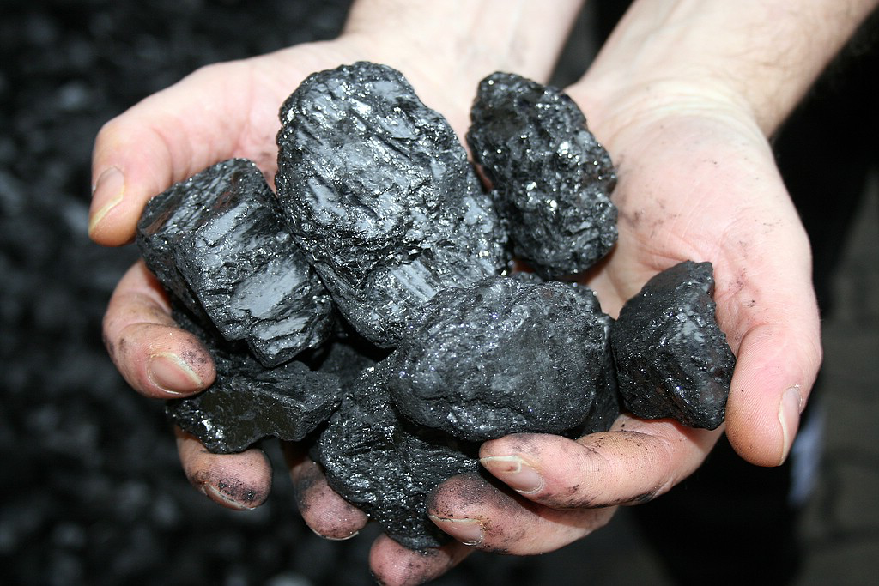

The Carbon Negatives
Bradford Cook Vice President – Sales and Marketing Sabin Metal Corporation bcook@sabinmetal.com

Slide 2
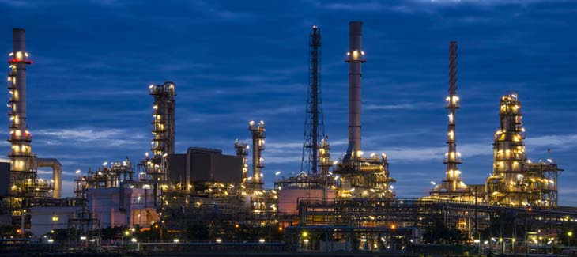
The increasing carbon trend…
Less in-situ burning?
Longer run times?
More difficult feed?
Bio-diesel?
Notes:
Even before COVID, a trend seemed to be developing in the petroleum and petrochemical refining industry as an ever-increasing percentage of carbon was being found within the PM catalysts sent in for reclaim. Some of this material was over 40% carbon, and these facts were corroborated by many PM refining companies around the world. It was unclear whether this trend was a result of less in-situ pre-reclaim burning to save time/money on turn-arounds, longer run times, more difficult feed-stocks or the increasing production of renewables. The most likely answer is that it was a combination of all these factors.
When the decision to delay maintenance and turnarounds during the COVID crisis became quite common, the high-carbon issue grew even further. Feed stocks choices and production decisions, as well as run-time analysis, are the forte of the process engineers and plant management; so let’s talk about the bottom line that we must address…the removal of the carbon.
Not that long ago, pre-reclaim kilning was SOP for just about every precious metals catalyst change out; now it appears to be much more common to dump the used cat and send it out to the PM reclaimers dirty.

Slide 3
The increasing carbon trend…
Notes:
While I do not have detailed data from our competitors, the increase in carbon-loaded lots shipped to Sabin (those that must be kilned) remained at or around 10% for at least six years prior to 2011. (For reference, if the carbon content is higher than 5% the material must be thermally reduced.) The rise through the COVID delayed-maintenance era (2020-2022) is dramatic and clear. During this time Sabin and others began delivering the “Carbon Negatives” message through presentations, publications, client meetings, etc. It appeared that a great deal of the customer base heard, understood and began to address the problem, although other factors were likely at play as well.
Unfortunately, the carbon content and coked-up shipments have clearly begun to increase again, and the worst of it is getting worse…i.e. more than one out of every ten shipment are over 10% carbon.
FYI: this data runs about 6 months to a year behind what is actually happening in the oil refineries. This is due to the time lapse between end of the run time in situ and the date that the materials arrive at Sabin and are tested for carbon. Normal life-cycles for these catalysts are three to five years, but since we are looking at almost 70 different clients, many with multiple locations, there would appear to be little chance that we are simply looking at some sort of repeating cycle or pattern: something is changing.

Slide 4
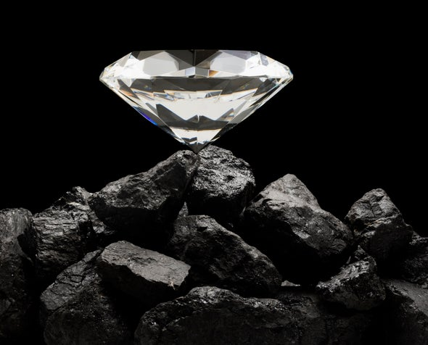
Why Kilning?
Homogeneity – remove contaminants
Wrong sampling = wrong assays
Final metal recoveries
Notes:
Why Kilning? Basic sampling theory rightly stresses homogeneity, so there is no getting around the necessity of kilning. The contamination levels within the catalyst, whether they are carbon, moisture, etc. must be eliminated or greatly reduced to make it possible to properly sample. Inaccurate sampling means erroneous precious metal content calculations…which is of course very bad for everyone. Additionally, both hydro- and pyro-metallurgical precious metals recovery methods require low carbon feed for best precious metals recoveries and overall efficiency.
Reclaimers are doing what they can to handle this growing need for excessive kilning, i.e. Sabin installing a third kiln in our North Dakota facility and a long-standing 24-7 operation. Sadly, our hopes of catching up are being crushed: the dirty stuff comes in the door faster than it can be processed.
Now let’s talk about the repercussions being felt by the catalyst owners and the PM marketplace by looking at the larger effects on the precious metals return and the market in general. This is the real financial pain behind the scenes…or what I’ve been calling…

Slide 5
In Situ Burning and the Perception of Cost Savings…
24 Hours
200K lbs. of catalyst
$550K per day reactor
In situ burn ‘cost’ = $2.75 per lb.
$945K per day reactor
In situ burn ‘cost’ = $4.73 per lb.
Average = $3.74 per lb.
Notes:
In situ pre-burn and the perception of cost savings
Here are two case studies from separate units of differing catalyst types. Both case studies used the same timeline for the in situ regen. The actual time periods known were an eight hour regen burn and a 6 hour cooling period, but I imagine that there is set up and start protocols and some time to restart afterward, so I’ve rounded it up to a total of 24 hours for discussion purposes. Each unit in the study contained 200K lbs. of catalyst, but different products were being made so the revenue per day varied…and so therefore did the cost:
$550K revenue per day reactor = in situ burn at $2.75 per lb. $945K revenue per day reactor = in situ burn at $4.73 per lb. Average: $3.74 per lb.
We could get ourselves into anti-trust thin ice if we start talking about how much all the various precious metals reclaimers charge for kilning, but suffice to say that it is way less than that. It would certainly appear from the front-end view that outsourcing the carbon removal is cost-saving, as it allows a faster refinery return to production. This has led many catalyst users to choose to forego the in situ burn, drop the dirty cat and send it off for kilning at a perceived lower rate. These high levels of coke, carbon, and other contaminants are creating significantly higher operating costs for the reclaimers, not to mention storage issues, etc.

Slide 6
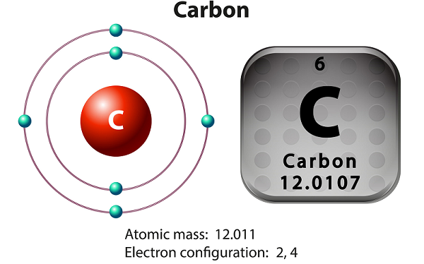
“The Carbon Negatives”
Increased wait times
‘Clean’ versus ‘Dirty’
Fewer vendors
Lease costs skyrocket
“The Real Equation”
Notes:
“The Carbon Negatives”:
Increased wait times for final precious metals return
Catalysts that are received clean, that is, with carbon, benzene, moisture, etc. all within acceptable tolerances, can proceed directly to sampling. The typical settlement time for these relatively clean materials (that is, from receipt at the reclaimer facility to final delivery of the precious metal value to the client) is approximately three months. This includes all processing, laboratory analysis of the samples, and final paperwork agreement and execution. These so-called “clean” catalysts may have come from a product line that does not generate carbon, benzene, etc., or they may have been burned in situ (the pre-reclaim burn) or sent out for burn at a specialized vendor before shipping to the precious metals reclaimer.
The settlement time when kilning is required is at least twice that long. In some extreme cases, heavily coked catalysts (over 15% or so) require second or third runs through the kilns to reduce the carbon sufficiently. This timeframe includes waiting their turn in line for kilning and the kilning time itself.

Slide 7
The Platinum Lease effect…
Notes:
“The Carbon Negatives”:
Lease costs skyrocket
The lease rates for platinum and palladium have been steady at 1 to 3% for decades, with an occasional, easily-explained blip. For example, when two nickel mines flooded in Russia years ago, palladium prices and lease rates jumped; then they returned to what was considered ‘normal’. At these low-impact rates, the users and refiners of platinum and palladium traditionally treated the lease expense as just “the cost of doing business”.
The main driver is the supply squeeze, that is, the physical availability of precious metals, lease rates have become extremely volatile of late. If we stick with our previous examples of 200,000 lbs. of Pt catalyst, there will typically be around 7300 troy ounce of platinum contained. With platinum averaging US $1300 per ounce this summer, even just a six-month lease would now cost over $800K.
Imagine if your procurement department urgently needed to renew a lease when the spike hit 55% in mid-July!

Slide 8
In Situ Burning and the Perception of Cost Savings…old thinking
24 Hours
200K lbs. of catalyst
$550K per day reactor
In situ burn ‘cost’ = $2.75 per lb.
$945K per day reactor
In situ burn ‘cost’ = $4.73 per lb.
Average = $3.74 per lb.
Notes:
In situ pre-burn and the perception of cost savings
Here are two case studies from separate units of differing functionality. Both case studies used the same timeline for the in situ regen. The actual time periods known were an eight hour regen burn and a 6 hour cooling period, but surely there are set up and start protocols and some time to restart afterward, so we’re rounding up to a total of 24 hours for discussion purposes. Each unit in the study contained 200K lbs. of catalyst, but different products were being made so the revenue per day varied…and so therefore did the cost:
$550K revenue per day reactor = in situ burn at $2.75 per lb. $945K revenue per day reactor = in situ burn at $4.73 per lb. Average: $3.74 per lb.
We could get ourselves into anti-trust thin ice if we start talking about how much all the various precious metals reclaimers charge for kilning, but suffice to say that it is way less than that. It would certainly appear from the front-end view that outsourcing the carbon removal is cost-saving, as it allows a faster refinery return to production. This has led many catalyst users to choose to forego the in situ burn, drop the dirty cat and send it off for kilning at a much lower rate. These high levels of coke, carbon, and other contaminants are creating significantly higher operating costs for the reclaimers, not to mention storage issues, etc.

Slide 9
In Situ Burning and the Perception of Cost Savings $550K/day reactor…new thinking
No in-situ burn (‘drop it dirty’)
Reclaimer kiln charges = ~$300K
Extended Lease cost ~$783K
200K lbs avg cat = ~7300 troy ounces Pt
7300 t.o. 6 months add’l lease at 16% = $783K
Total = $1.08 million*
Vs.
In-situ burn = one lost production day
No kiln charges at reclaim
No add’l lease cost
Total =$550K lost revenue
*Shutdown and restart costs not included as they should be equal in each scenario
Notes:
The Real Equation 1
Comparing the two options on the less-profitable reactor, and estimating a six-month lease extension for kiln time, we see that the client could have saved approximately $500K by conducting the in-situ burn. Obviously, these are all estimates and examples of current interest rates, but it illustrates the point.

Slide 10
In Situ Burning and the Perception of Cost Savings $945K/day reactor…new thinking
No in-situ burn (‘drop it dirty’)
Reclaimer kiln charges = ~$300K
Extended Lease cost ~$783K
200K lbs avg cat = ~7300 troy ounces Pt
7300 t.o. 6 months add’l lease at 16% = $783K
Total = $1.08 million*
Vs.
In-situ burn = one lost production day
No kiln charges at reclaim
No add’l lease cost
Total =$945K lost revenue*
*Shutdown and restart costs not included as they should be equal in each scenario
Notes:
The Real Equation 2
For the more profitable reactor, with the same six-month lease extension for kiln time, is quite different. There is only roughly $60K saved by conducting the in-situ burn, but this could easily evaporate once actual data is input instead of the estimates and examples.

Slide 11
Call to Action:
More reclaimers/more kilns
Reclaimers increase kiln charges to near level of in-situ burn costs
Compare true costs and start in-situ burning when it makes financial sense
Internal meetings to discuss clarity on overall costs of doing in-situ burn
Share this presentation
Notes:
Call to Action
There are perhaps only a limited number of possible ‘corrective actions’:
The PGM reclaimers continue to add more kiln capacity. Ongoing, but that will not achieve full correction. This will almost certainly mean higher pricing.
If the PGM reclaimers raise their kilning prices to near or the same level as the cost of in-situ preclaim burning, the catalysts users will re-evaluate shipping the cat dirty. Should have the desired effect over time, but customers who do not understand ‘the real equation’ are just going to get mad and seek services elsewhere.
The ‘middle ground’ option would be for catalyst owners to calculate the full cost of skipping the in-situ burn and start making them the norm again when feasible. The overall ‘best decision’ will only be apparent if operations, finance and any other internal department related sit down and crunch the numbers.

Slide 12
Thanks
The Carbon Negatives
Bradford Cook bcook@sabinmetal.com Sabin Metal Corporation

