Slide 1
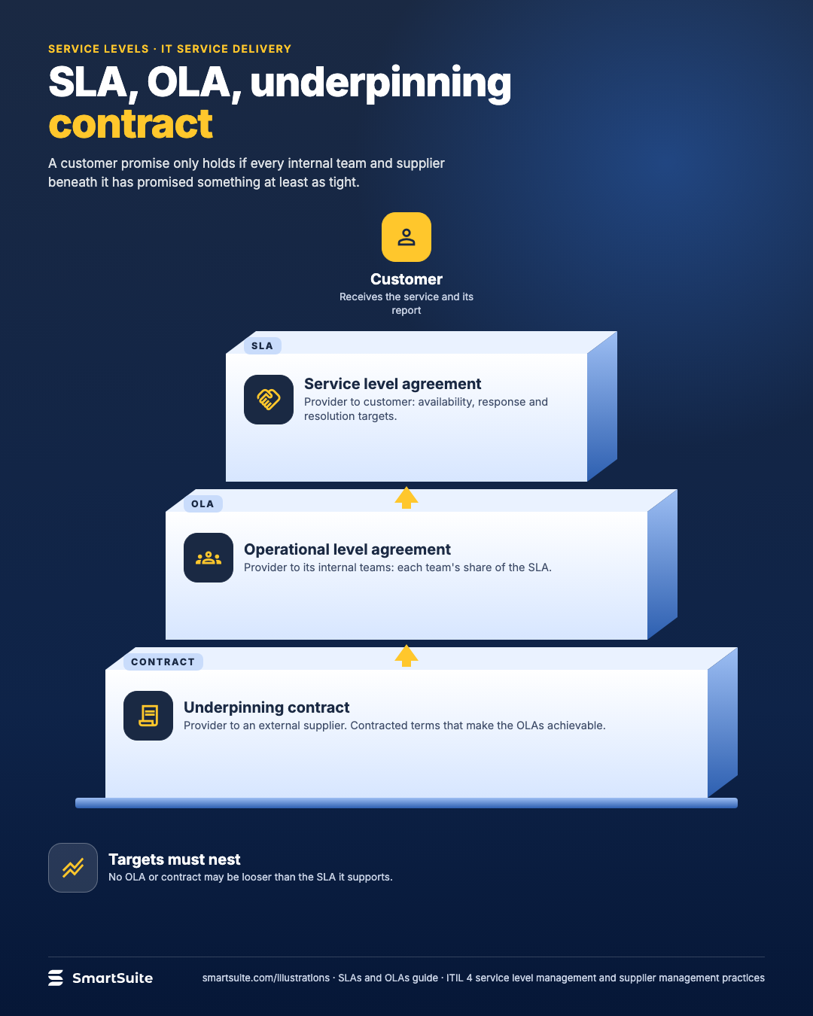
SLA, OLA, underpinning contract
How a service level agreement rests on operational level agreements and underpinning contracts.
Source: ITIL 4 service level management and supplier management practices; OLA/underpinning contract terms carried over from ITIL v3
Notes:
SLA, OLA, underpinning contract
How a service level agreement rests on operational level agreements and underpinning contracts.
Source: ITIL 4 service level management and supplier management practices; OLA/underpinning contract terms carried over from ITIL v3 · From: SLAs and OLAs
Credit: Source: SmartSuite, smartsuite.com/illustrations

Slide 2
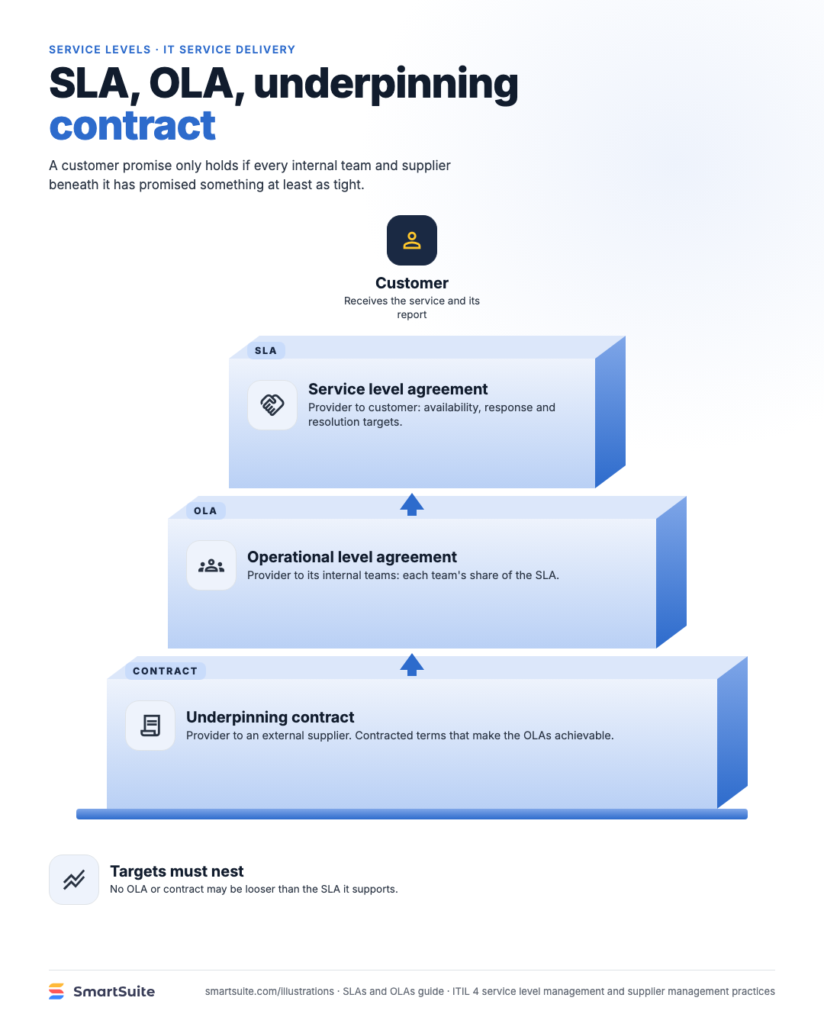
SLA, OLA, underpinning contract
How a service level agreement rests on operational level agreements and underpinning contracts.
Source: ITIL 4 service level management and supplier management practices; OLA/underpinning contract terms carried over from ITIL v3
Notes:
SLA, OLA, underpinning contract
How a service level agreement rests on operational level agreements and underpinning contracts.
Source: ITIL 4 service level management and supplier management practices; OLA/underpinning contract terms carried over from ITIL v3 · From: SLAs and OLAs
Credit: Source: SmartSuite, smartsuite.com/illustrations

